Slide 1



Intake of Phthalate-tainted Foods and Microalbuminuria in Children:
The 2011 Taiwan Food Scandal
Ming-Tsang Wu, MD, ScD, MOH
Kaohsiung Medical University,
Kaohsiung, TAIWAN

Slide 2
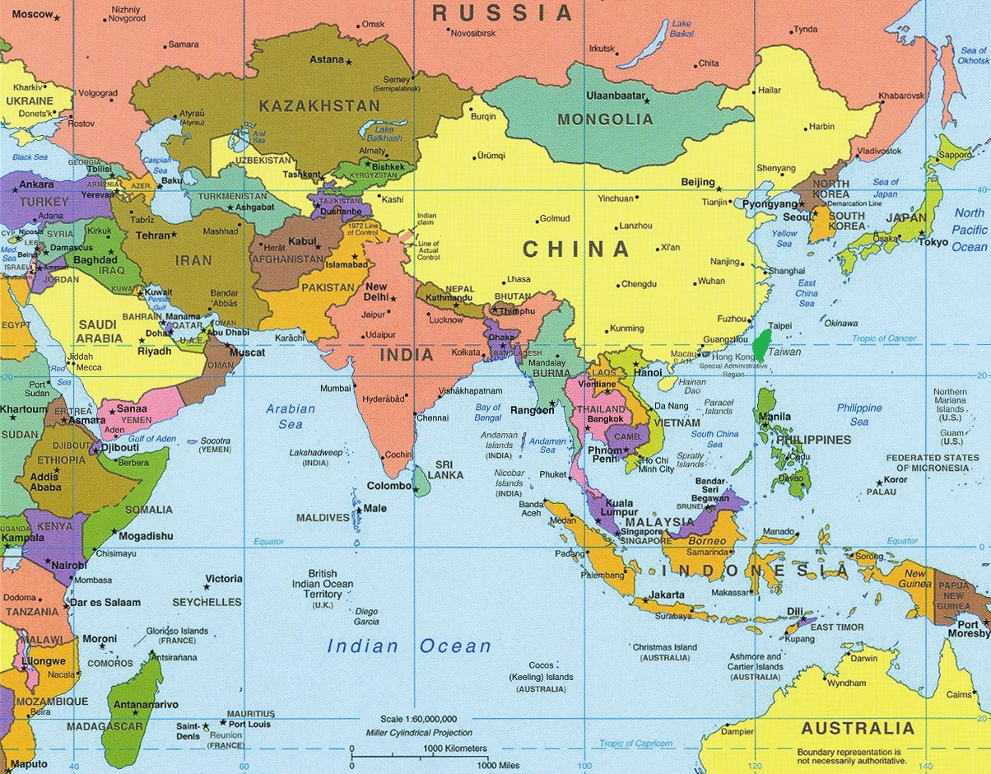
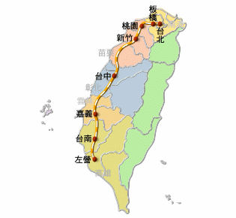
Taiwan
Taipei
Kaohsiung

Slide 3
Outline
Brief history of Taiwan food scandal in 2011
NHRI, like NIH, initiated nationwide survey
DEHP-tainted foods and renal damage
Conclusion

Slide 4
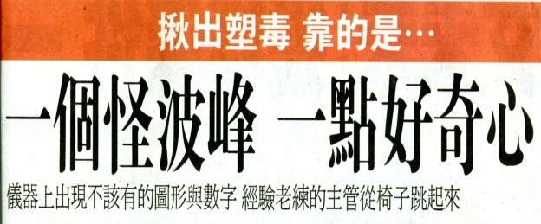
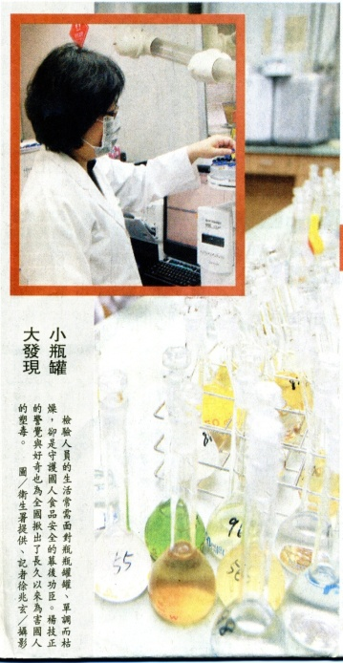
History of Taiwan Food Scandal (I)
In April 2011, a laboratory staff member from the Taiwan’s FDA, accidentally detected ~600 ppm DEHP (Di-(2-ethylhexyl)phthalate) in a probiotic supplement.
Two perfumery-chemical companies: illegally adding DEHP and DINP (Di-isononyl phthalate), as substitutes for more costly emulsifiers (clouding agents), into their downstream products for more than 10 years.
Five major food categories were contaminated: (I) sports drinks, (II) fruit beverages, (III) tea drinks, (IV) fruit jam or jelly, and (V) health food or supplements in tablet or powder form.
Some phthalate-tainted foodstuffs (34 manufacturers and 206 food products in total) had been exported to as many as 22 countries, including the USA and European Union (Germany).

Slide 5
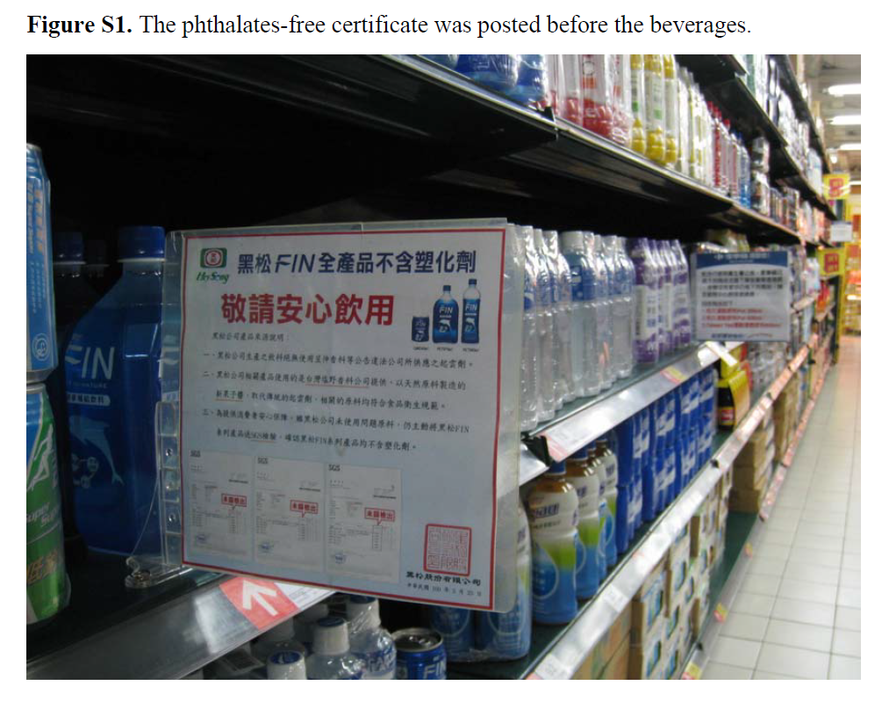
History of Taiwan Food Scandal (II)
D-day (31 May 2011): all items of those 5 categories on the shelf were needed to have certificates (DEHP, DIDP, DNOP DINP, DBP, and BBP < 1 ppm).
13 July 2011: DOH officially limited the maximum TDI (mg/kg bw/day) for DEHP to < 0.05, DBP to < 0.01, DINP to < 0.15, BBP to < 0.5, and DIDP to < 0.15.
01 August 2011: Taiwan government cancelled the need of phthalate-free certification.

Slide 6
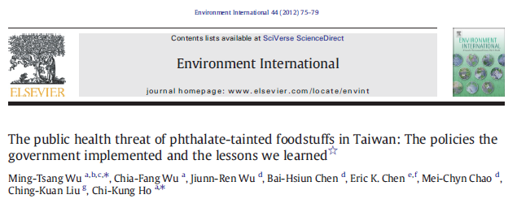
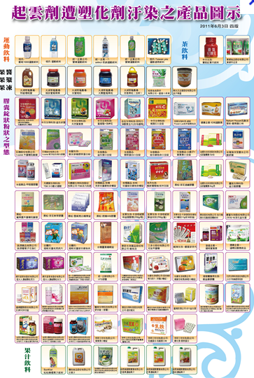
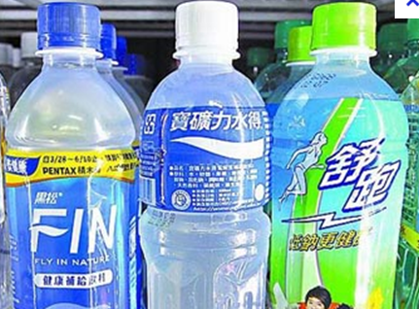
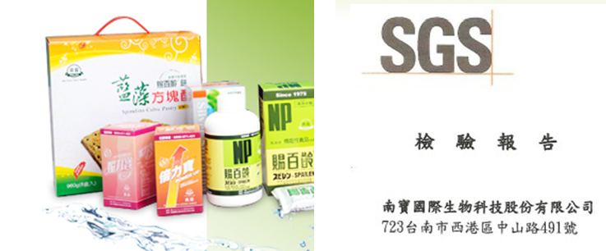

Slide 7
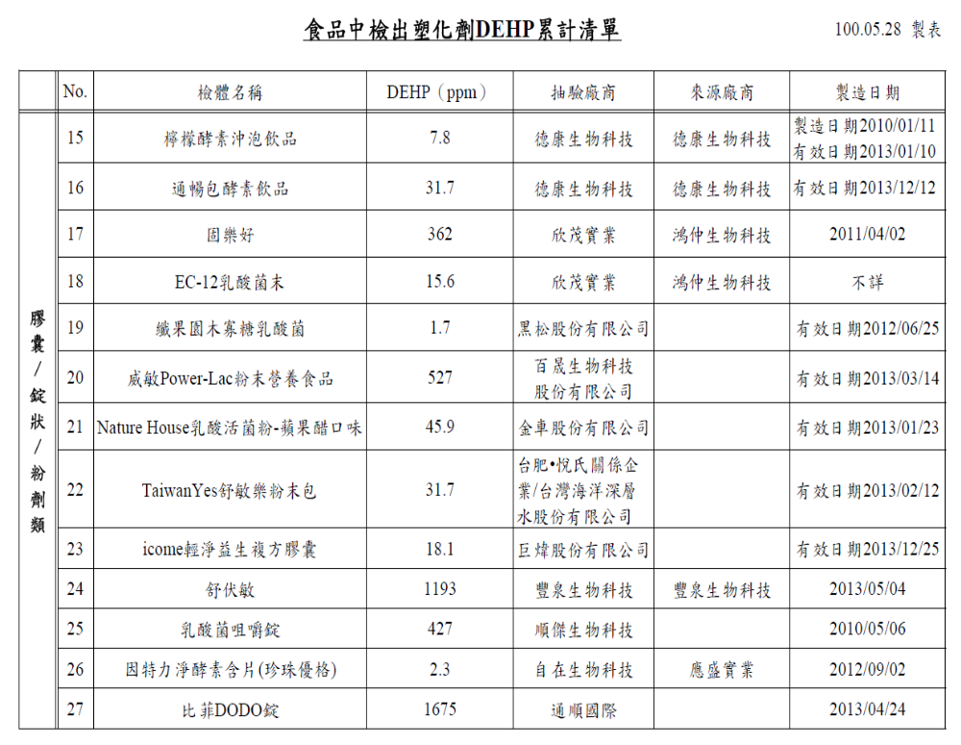
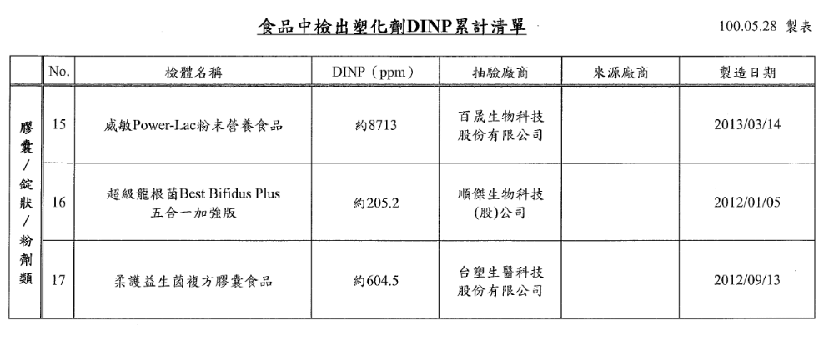
V. Probiotics

Slide 8
Wu et al., Environ Int, 2012

Slide 9
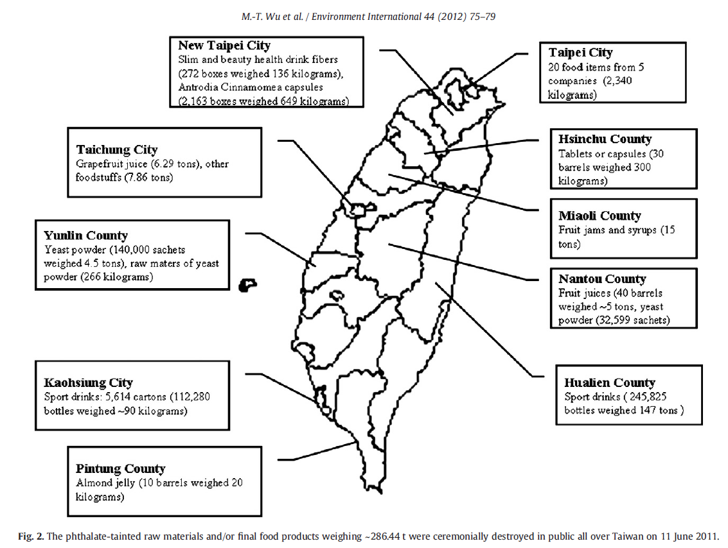

Slide 10
Outline
Brief history of Taiwan food scandal in 2011
NHRI, like NIH, initiated nationwide survey
DEHP-tainted foods and renal damage
Conclusion

Slide 11
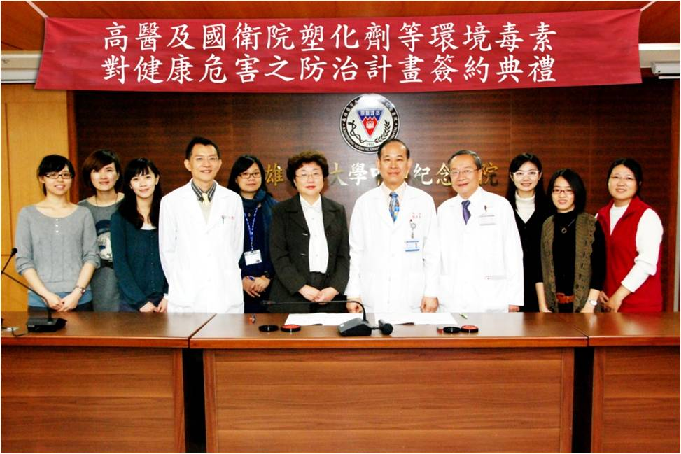

Slide 12
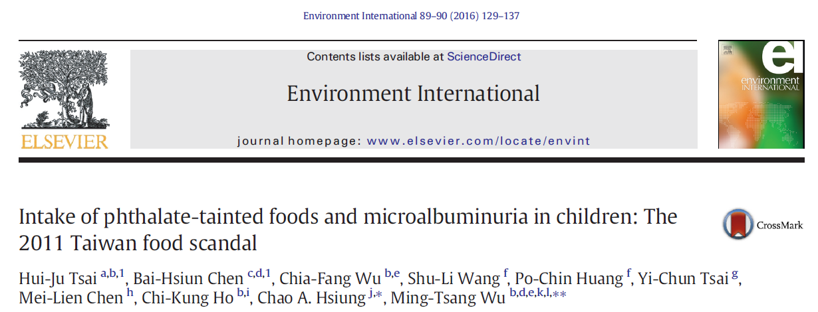
Phthalates are well known as endocrine-disrupting chemicals (Halden, 2010; Pak et al., 2011).
For renal function, animal studies suggested that some phthalates, such as DEHP and DINP, can damage kidney (Kaufmann et al., 2002; Ito et al., 2007).
One human study, the 2009-2010 National Health and Nutrition Examination Survey (NHANES), has investigated the association between exposure to phthalates and renal function in children and adolescent (Trasande et al., 2014).
  Studied 667 children aged 6-19 years old and found a positive association between metabolites of HMW phthalates and urine ACR.
Notes:
Phthalates are well known as endocrine-disrupting chemicals (EDCs) that can adversely interfere with sex and thyroid hormone, reproductive systems and neurodevelopment (Halden, 2010; Pak et al., 2011).
Animal studies have also suggested that some phthalates, such as DEHP and DINP, can affect kidney function (Crocker et al., 1988; David et al., 2000; Ganning et al., 1984; Ito et al., 2007; Kaufmann et al., 2002).
One human study, the 2009-2010 National Health and Nutrition Examination Survey (NHANES), has investigated the association between exposure to phthalates and renal function in children and adolescent (Trasande et al., 2014). That study found that certain metabolites of high-molecular-weight (HMW) phthalates such as DEHP in urine were significantly and positively associated with urine albumin/creatinine ratio (ACR).
One study measured urinary phthalate metabolites in 667 children aged 6-19 years old participating in the 2009-2010 NHANES to examine the association between phthalate exposure and low-grade albuminuria (Trasande et al., 2014). That study found a positive association between metabolites of HMW phthalates and urine ACR.

Slide 13
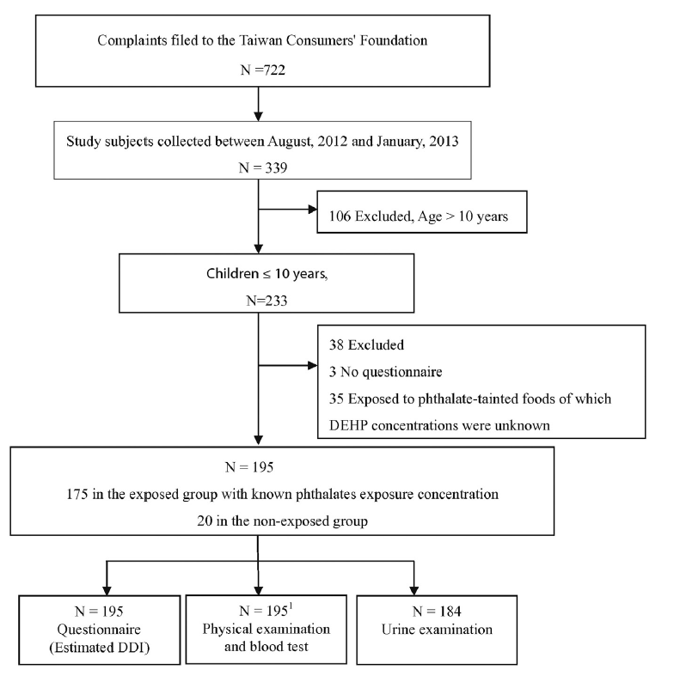

Slide 14
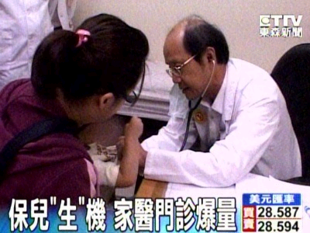
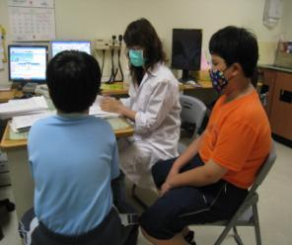
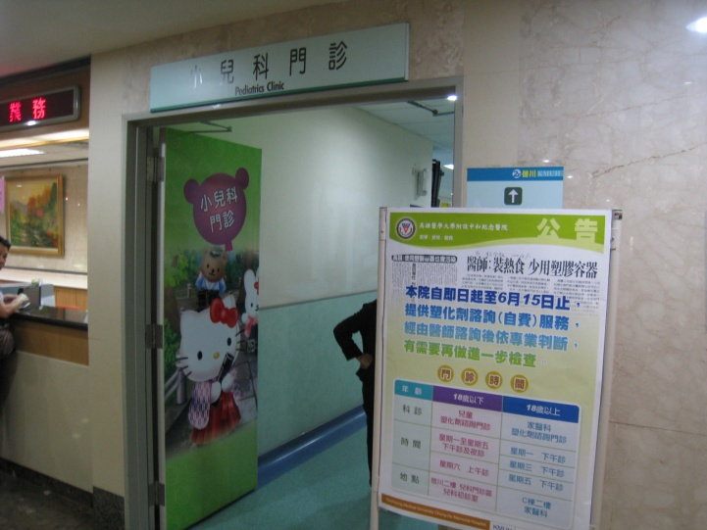
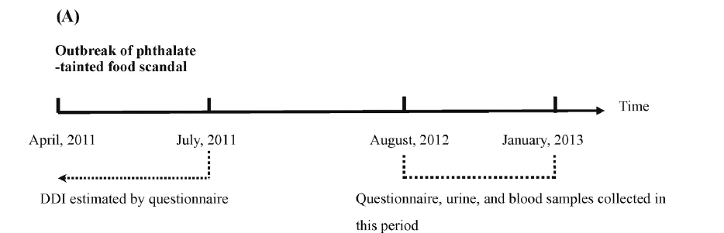
Phthalates Special Clinic for Children

Slide 15
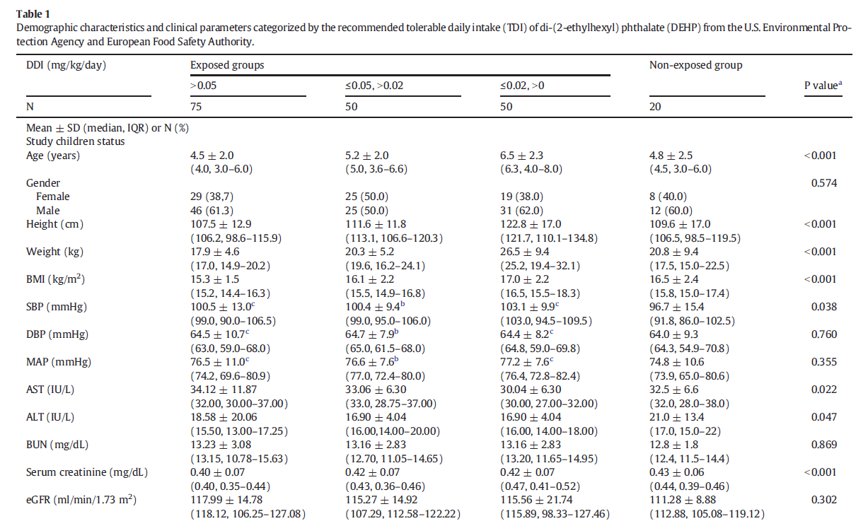
Results

Slide 16
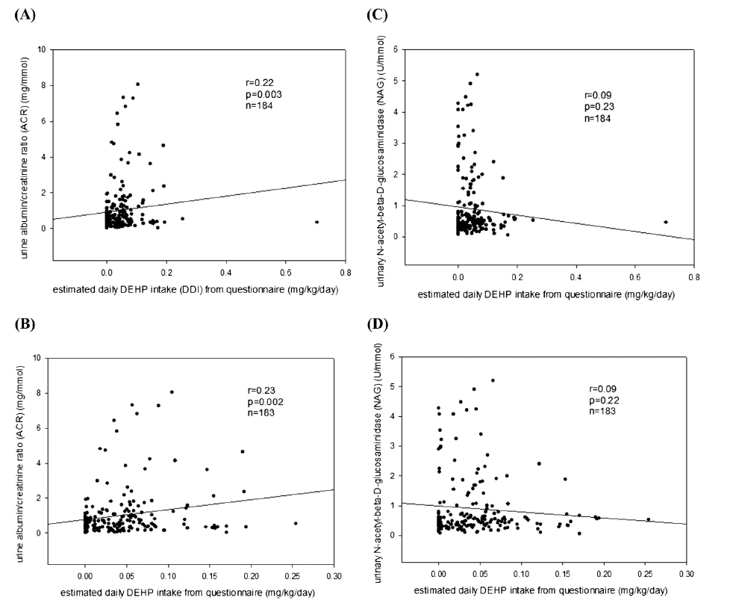

Slide 17
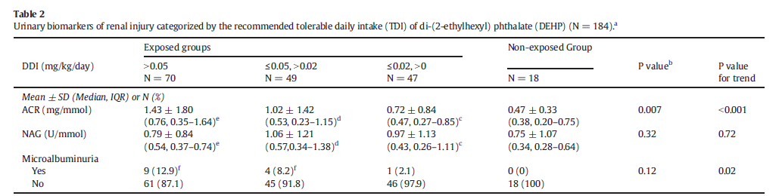

Slide 18
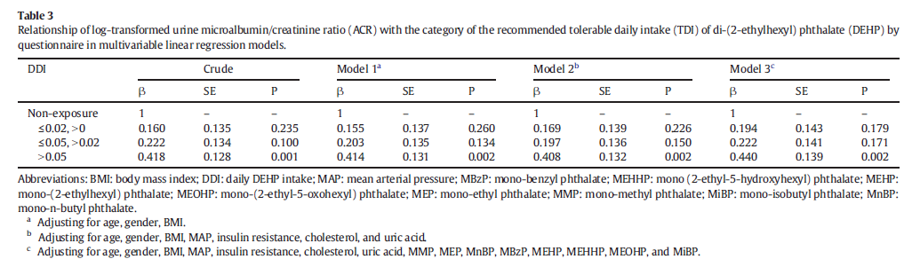

Slide 19
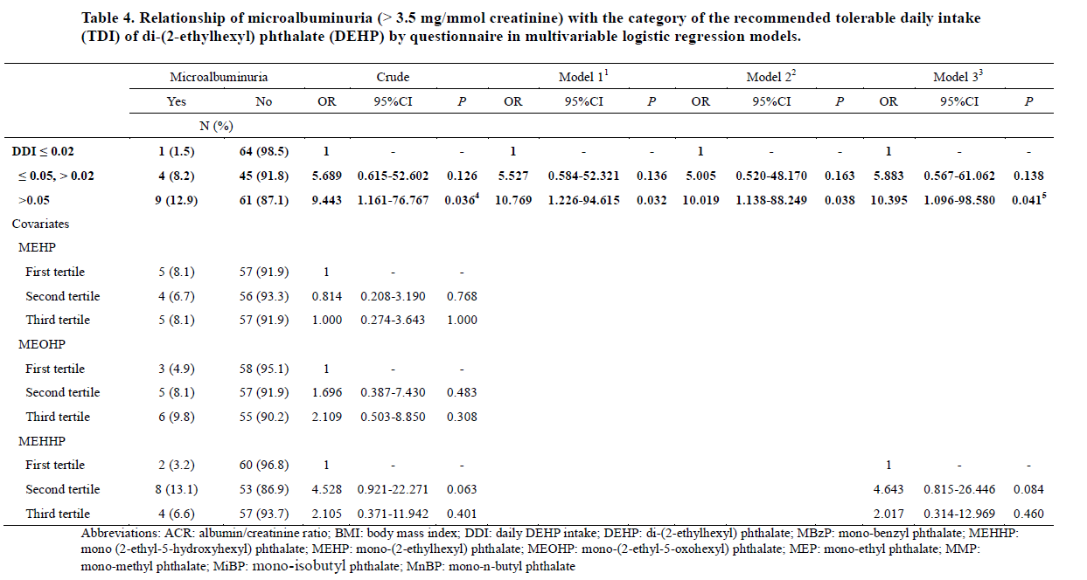

Slide 20
Summary
A major health threat from phthalate-tainted foodstuffs occurred in Taiwan in 2011.
DEHP-tainted food intake increases the excretion of urinary ACR in children.
DEHP-tainted food intake may increase the risk of microalbuminuria.

Slide 21
Mechanism
Animal studies have suggested that phthalates, such as DEHP and DINP, can induce glomerulonephritis, damage tubulointerstitial tissues, and decrease kidney function (Kamijo et al., 2007; Erkekoglu et al., 2012).
Oxidative stress induced by DEHP exposure may play a pivotal role of kidney damage in rats and mice (Dobashi et al., 1999; Karalliedde & Viberti, 2004).
Notes:
Animal studies have suggested that phthalates, such as DEHP and DINP, can induce glomerulonephritis, damage tubulointerstitial tissues, and decrease kidney function (Crocker et al., 1988; David et al., 2000; Erkekoglu et al., 2012; Kamijo et al., 2007). The mechamism through which phthalates damage the kidney is not well understood. Dobashi et al. and Kamijo et al. suggest that oxidative stress induced by DEHP exposure may play a pivotal role of kidney damage in rats and mice (Dobashi et al., 1999; Karalliedde and Viberti, 2004).

Slide 22
Acknowledgement
Supported by
Research grants from Kaohsiung Medical University (KMU-TP104A00 & KMU-TP104A27)
Taiwan National Health Research Institutes (NHRI-EX98-9708PI & NHRI-EX102-10209PI)

Slide 23
Thanks!

Slide 24
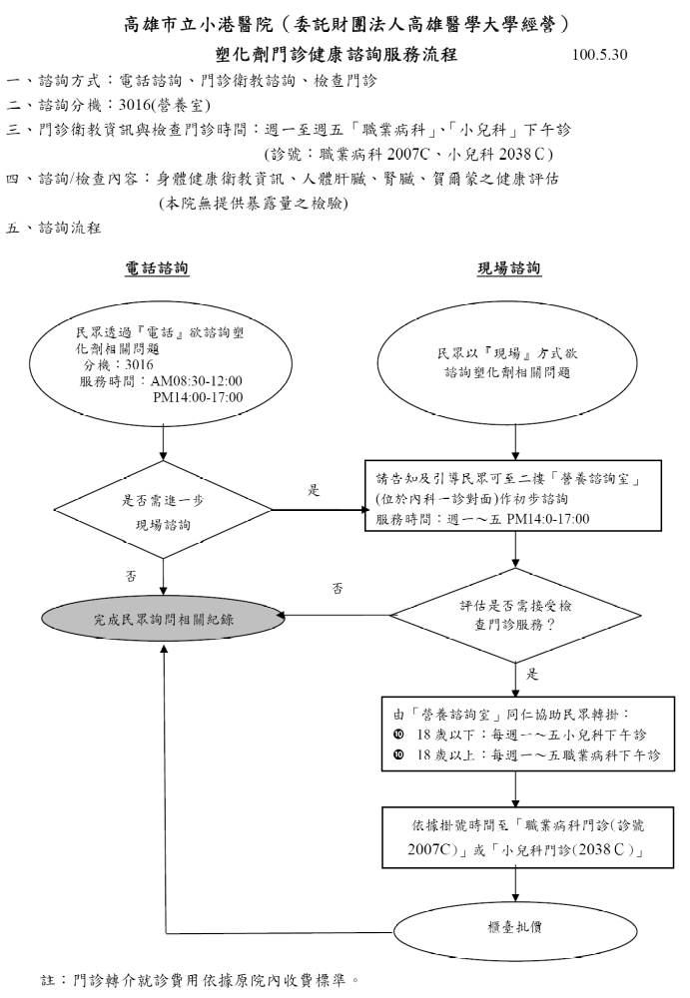
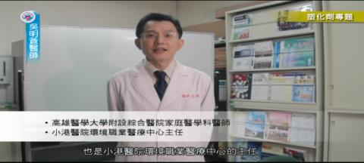
Intervention & Health Education
Protocol for Clinical Services
Education Video
Leaflet for Prevention
遠離塑化劑—健康衛教單
運動後多飲用白開水，避免運動飲料的攝取。
選擇以新鮮水果取代坊間市售濃縮果汁。
多攝取新鮮食材（蔬菜、肉類），以均衡飲食，少接觸化學合成的健康食品。
茶飲料可自行以茶葉沖泡飲用，避免選擇坊間市售茶飲料。
以保鮮膜包覆食物時，避免使用電鍋或微波爐加熱。
避免以塑膠瓶裝取食物或水，尤其更不能將塑膠容器加熱。
先暫不食用「運動飲料」、「果汁飲料」、「茶飲料」、「果醬、果漿或果凍」、「膠錠粉狀」等五大類食品，如想知道哪些食品受塑化劑污染，可上衛生署食品藥物管理局網站查詢。
(http://www.fda.gov.tw/content.aspx?site_content_sn=2451)
小港醫院關心您
Notes:
設計塑化劑衛教單張 Provide to NHRI 與衛生署之國健局
DVD在高醫體系放送及給高中以下之學校

Slide 25
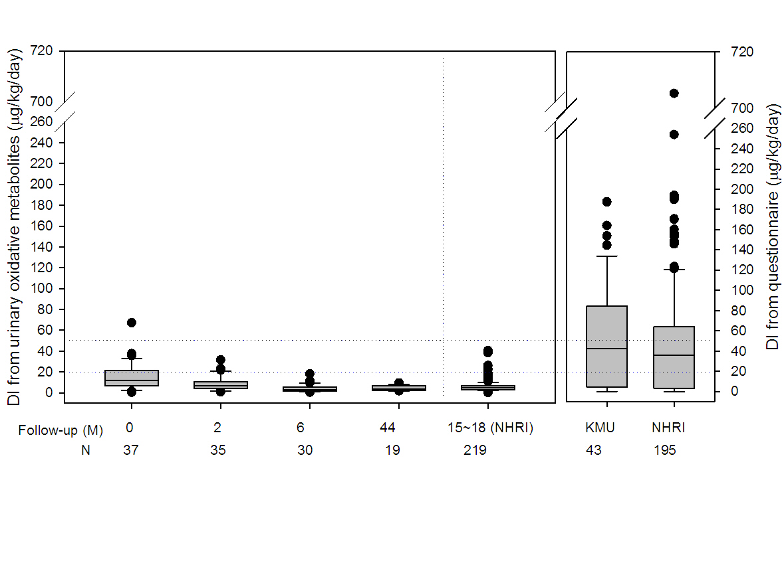

Slide 26
