Slide 1

Role of Macrophage Polarization in Tumor Metastasis
Min Yang
Beijing Anzhen Hospital, Capital Medical University, Beijing, China
Beijing Institute of Heart Lung and Blood Vessel Diseases, Beijing, China
8-31-2015

Slide 2
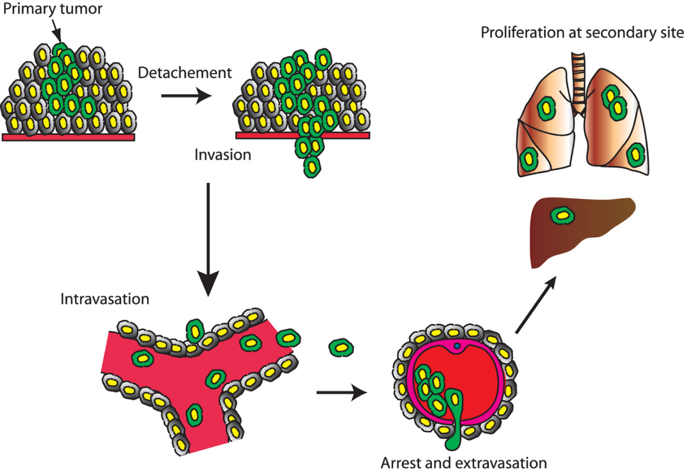
Introduction
Schematic showing tumor cell metastasis
Proliferation of the primary tumor cell
Invasion through surrounding tissues
Survival and proliferation at secondary site
Intravasation in the circulation
Extravasation through the vessel wall
Accumulating evidence suggests that invasive behavior of tumor cells depends on crosstalk between tumor cells and host cells in a complex microenvironment.
2

Slide 3
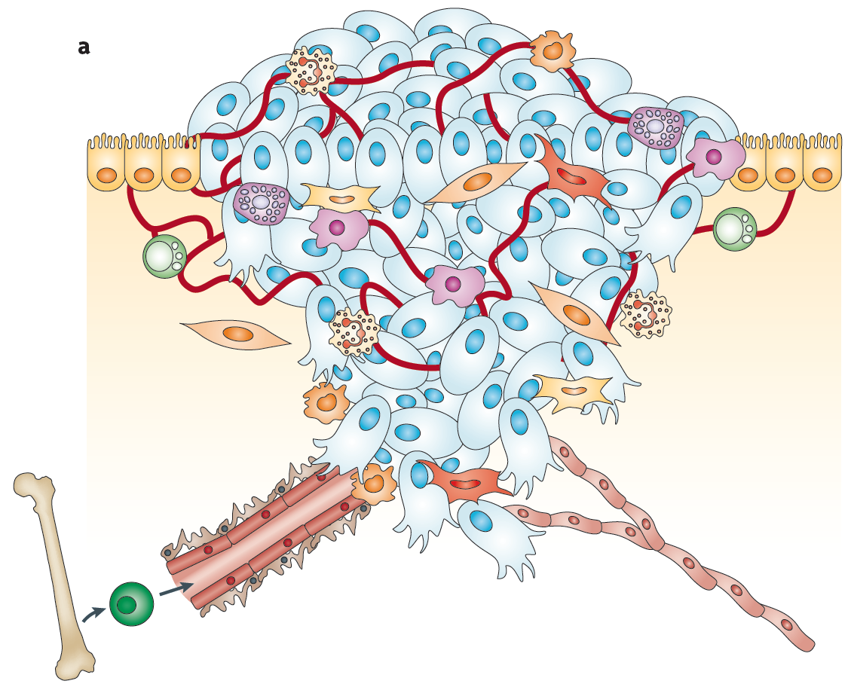
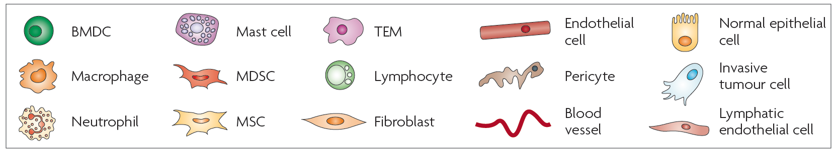
Introduction
The primary tumor microenvironment
Nature Reviews| Cancer, 2009
3

Slide 4
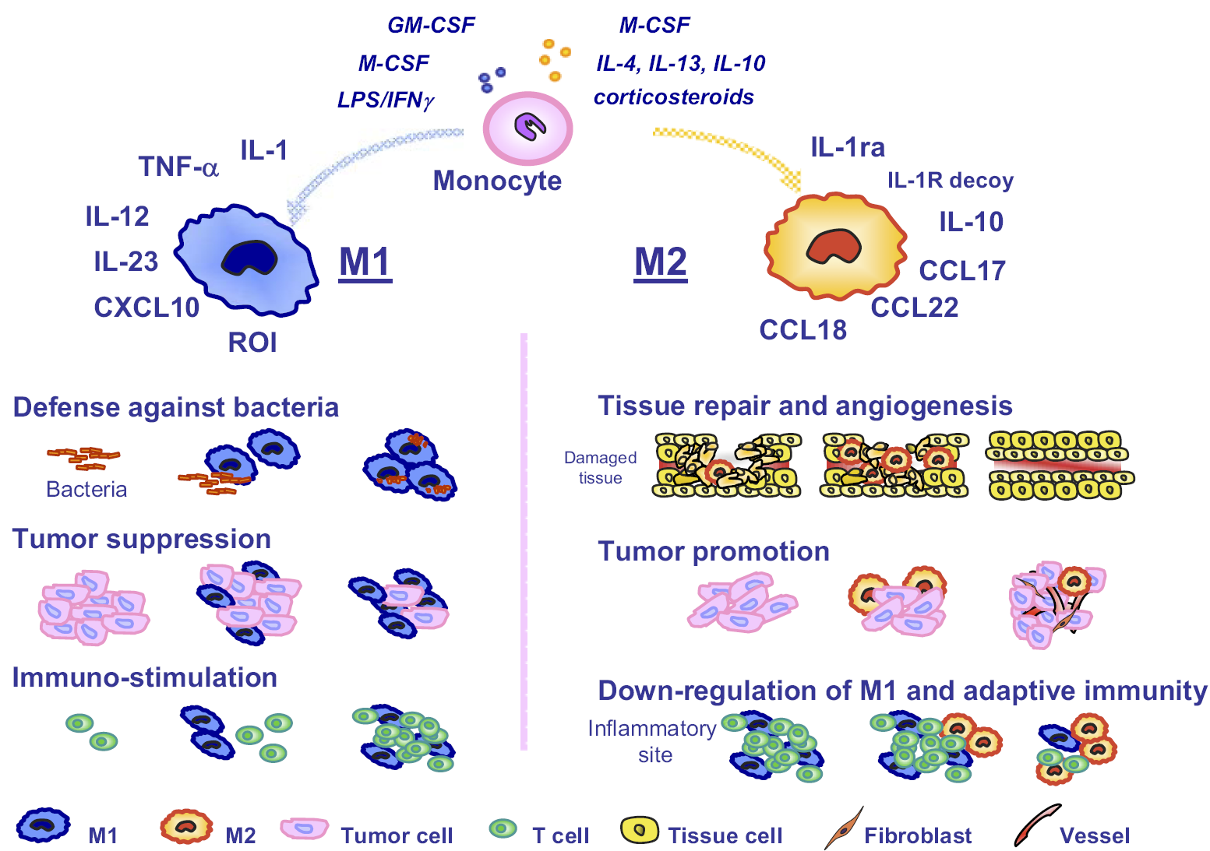
Introduction
Macrophage Polarization – M1 & M2
M1-type
Anti-tumor
activity
M2-type
Pro-tumor
activity
J Leukoc Biol. 2009

Slide 5
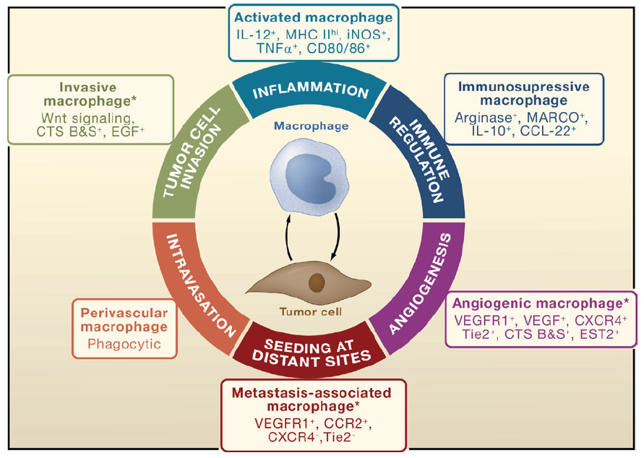
Introduction
Macrophage phenotypes and protumoral functions
?
Macrophages undergo a process of maturation or “education” within the tumor microenvironment. Whereas, how macrophages respond to tumor cells and turn on their protumoral phenotype is unknown.
Cell, 2010
5

Slide 6
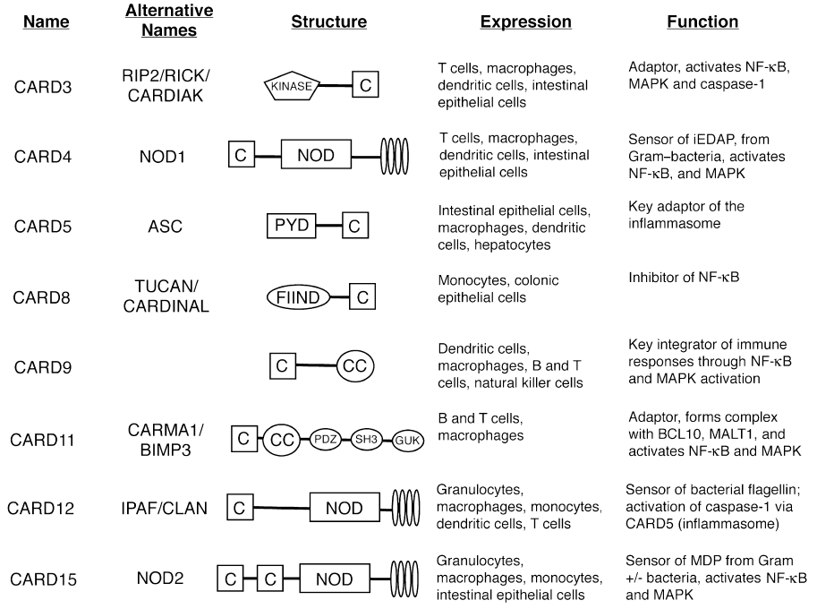
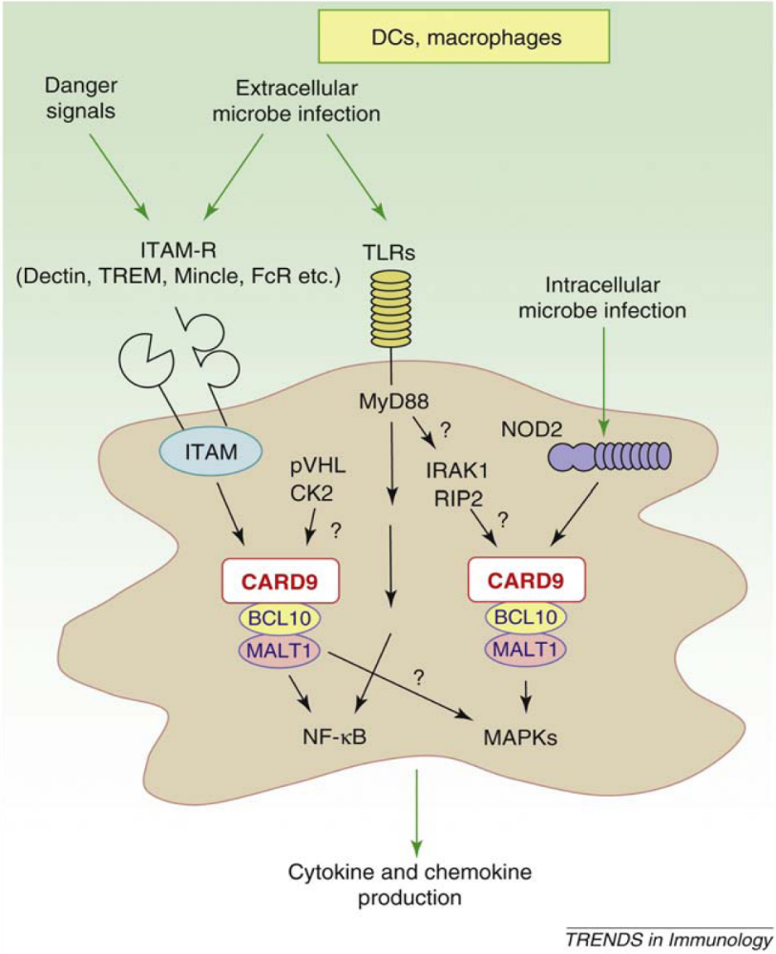
Introduction
Caspase recruitment domain-containing protein 9 (CARD9)
is a central sensor and adaptor protein
of innate immune responses
Current Opinion in Gastroenterology , 2008
6

Slide 7
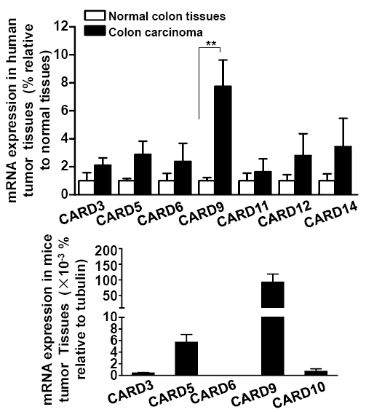
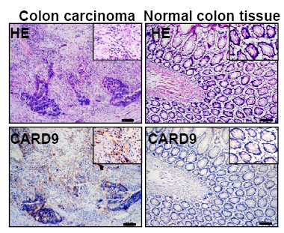
Result
CARD9 is the highest expressed one among CARD family member in human colon cancer
A
mRNA level of CARD family members
B
Protein expression of CARD9
metastatic foci in the liver
7

Slide 8
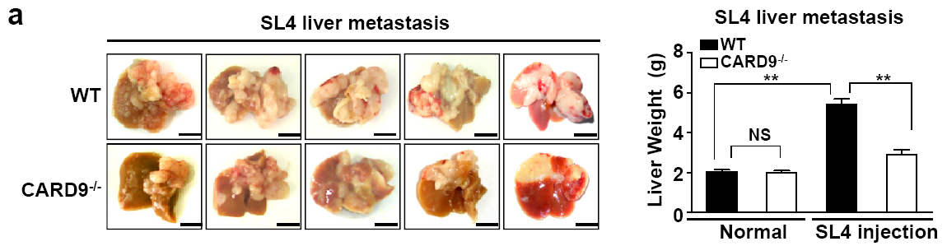
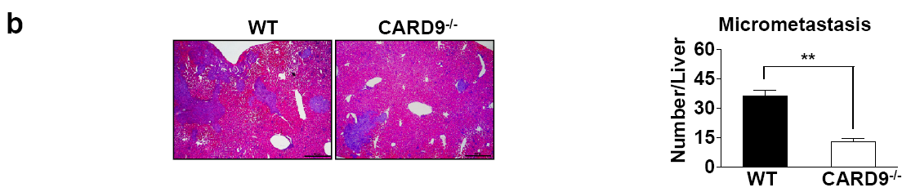
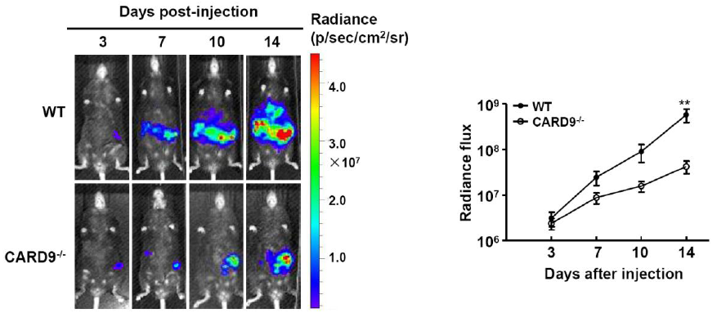
Result
CARD9 deficiency inhibits tumor metastasis
A
B
C
Gross examination of liver metastasis of colon cancer cells
The average number of liver micrometastasis
In vivo bioluminescence imaging
8

Slide 9
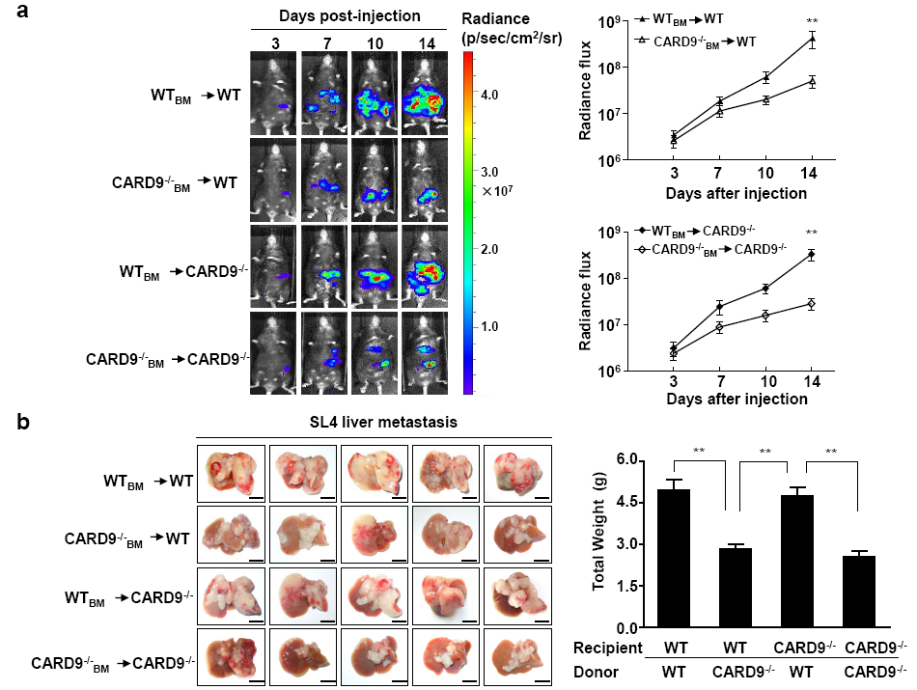
Result
CARD9 expression in bone marrow-derived
leukocytes promotes tumor metastasis
A
A
B
9

Slide 10
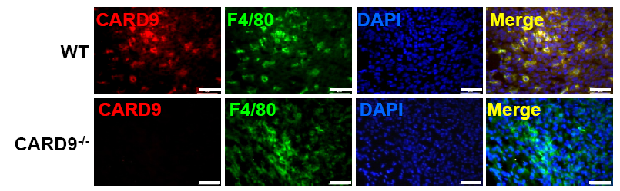
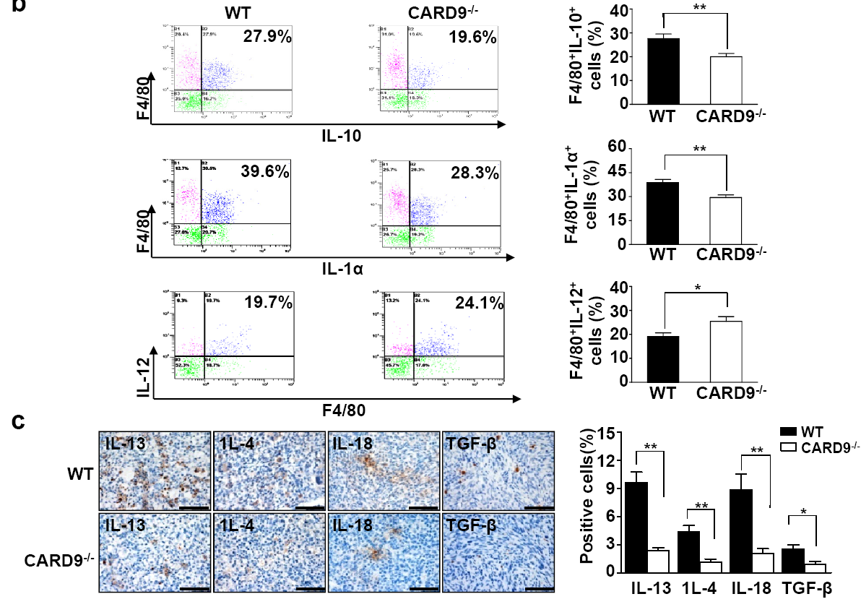
Result
CARD9 expressed in infiltrating macrophages increases tumor-promoting cytokine levels during tumor metastasis
A
B
CARD9 expressed in macrophages
Intracellular cytokines levels
10

Slide 11
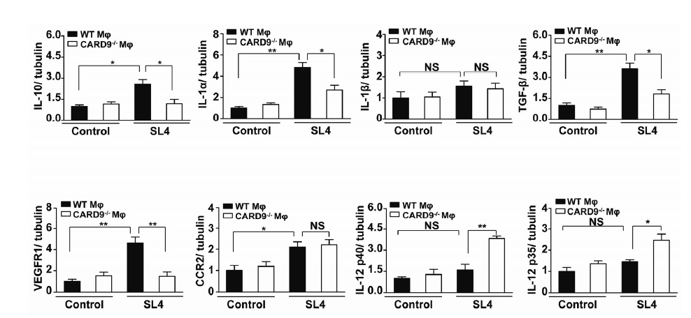
Result
CARD9 deficiency attenuates the prometastatic M2 gene profile
11

Slide 12
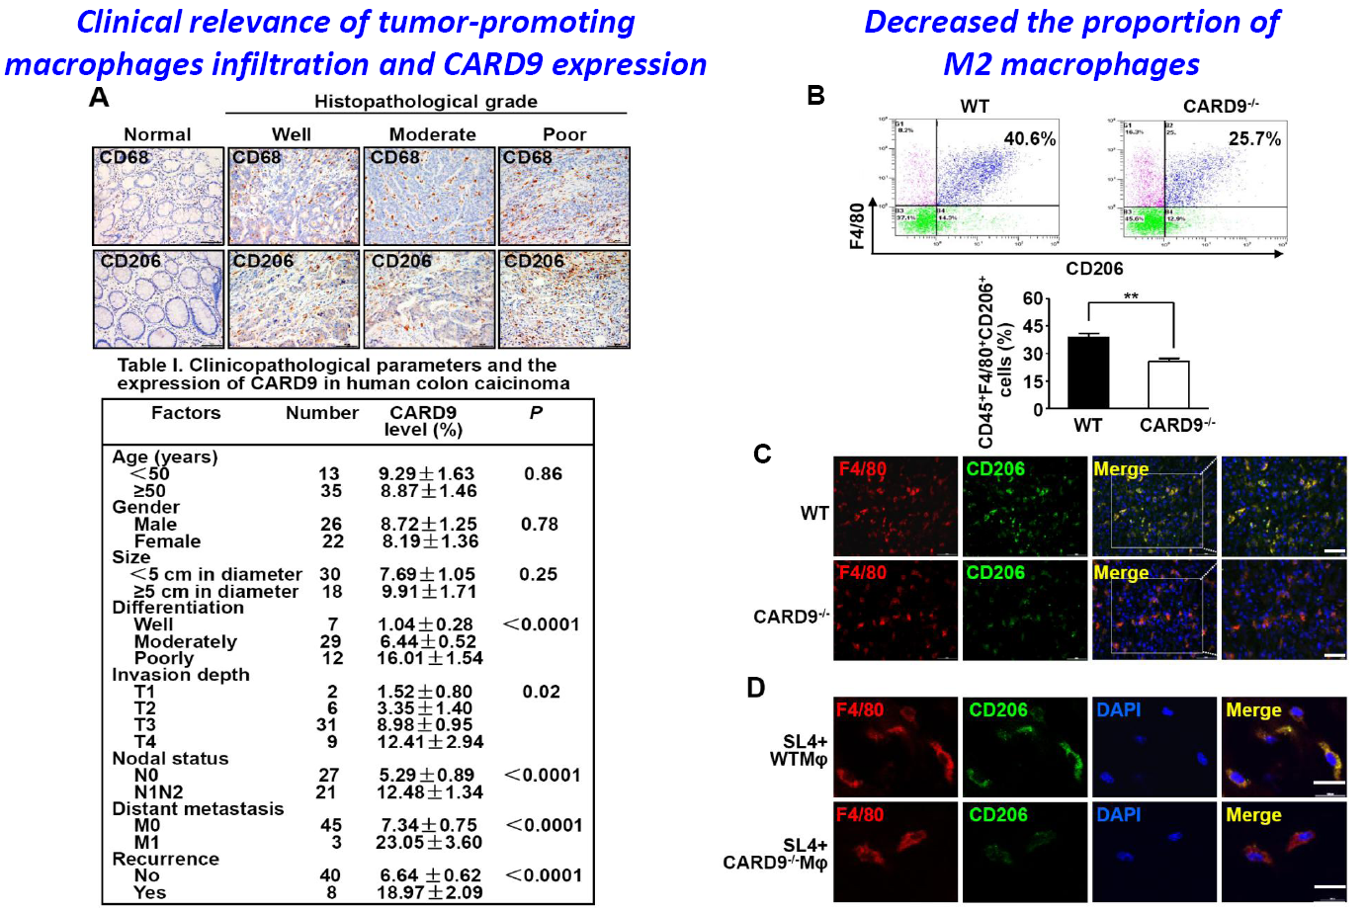
Result
Tumor cell education of macrophages toward metastasis-associated polarization is mediated by CARD9
12

Slide 13
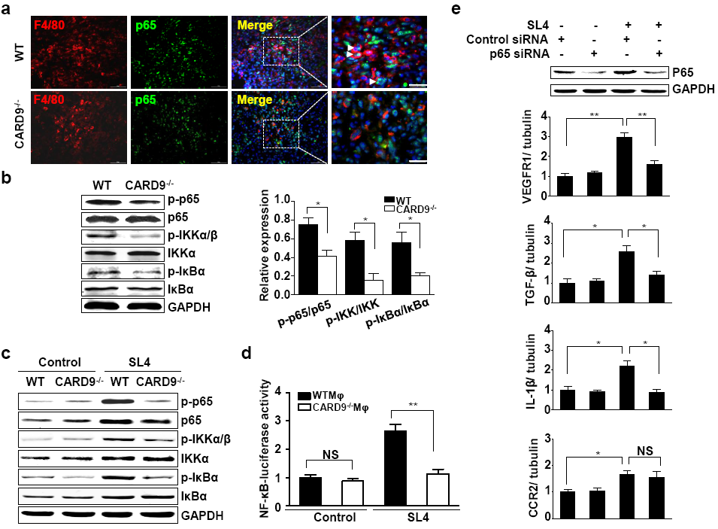
Result
CARD9 mediates macrophages toward metastasis-promoting phenotype through activation of NF-κB pathways
A E
B
C D
Suppressed prometastatic gene expression
Blocked nuclear translocation and phosphorylation of NF-κB signals
Downregulated NF-κB transcriptional activity
13

Slide 14
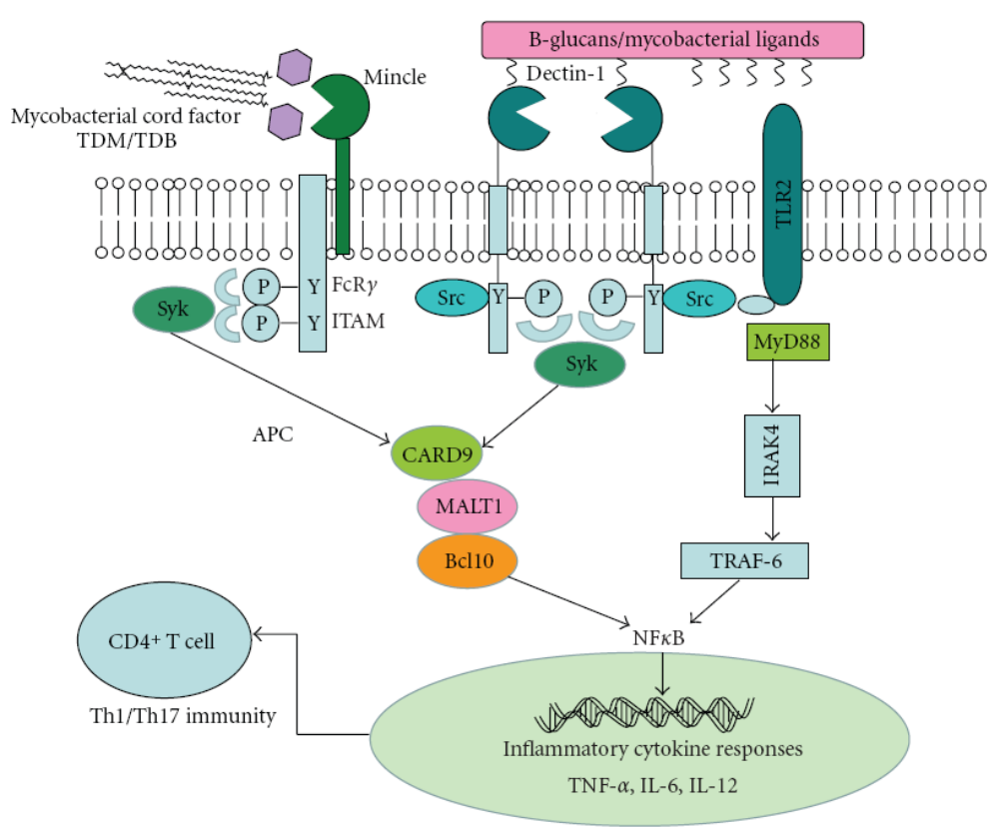
Introduction
Syk kinase plays a critical role in innate immune cell signaling pathways
Tumor cells
Cold Spring Harb Perspect Biol, 2010
14

Slide 15
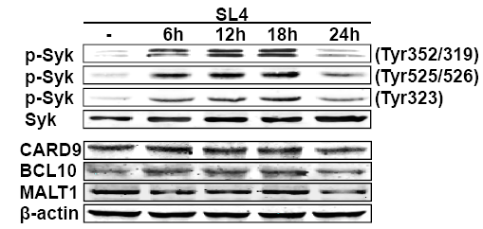
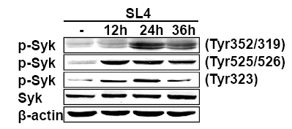
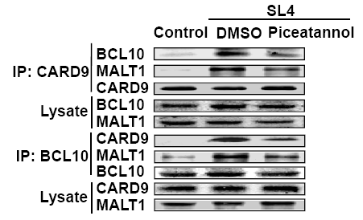
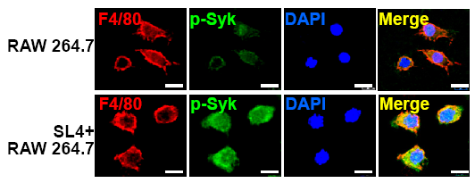
Result
Syk activation is necessary for CARD9-BCL10-MALT1 complex formation in macrophages
A C
D
B
Induced Syk phosphorylation in RAW264.7
Induced Syk phosphorylation in BMDM
Impaired SL4 cells-induced CARD9-BCL10-MALT1 association
Syk
inhibitor
15

Slide 16
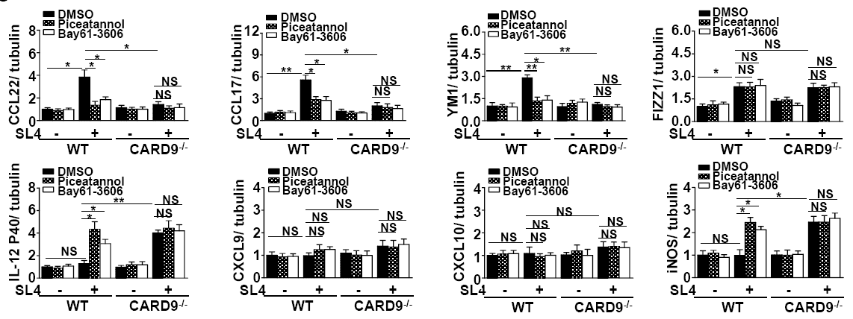
Result
Syk inhibitor prevents expression of M2-specific and prometastatic genes in macrophages
with SL4 cells coculture
Syk-CARD9-dependent signaling pathway plays an important role in driving macrophages toward the metastasis-promoting phenotype.
16

Slide 17
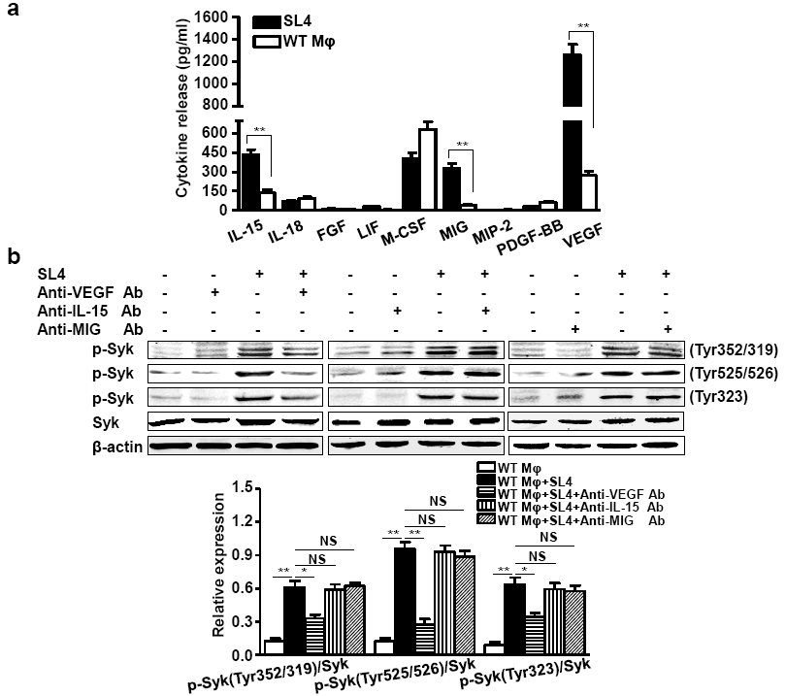
Result
VEGF is a key cytokine secreted by tumor cell that stimulates Syk activity in macrophage
A
B
Cytokine Profile
Bio-Plex array assay for secreted cytokines
Neutralizing antibodies
Against identified cytokines
17

Slide 18
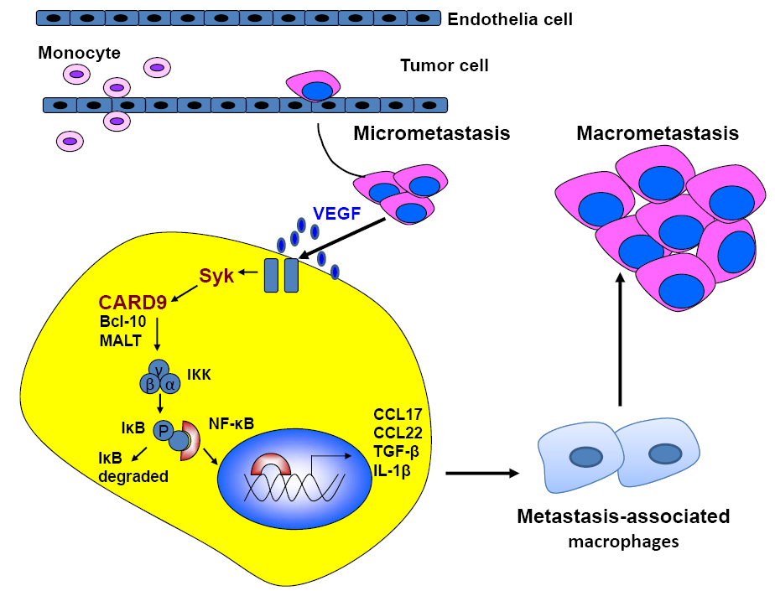
Conclusion I
Tumor cell-activated CARD9 signaling contributes to metastasis-associated macrophage polarization
Min Yang, et al. Cell Death&Differentiation (2014)
18

Slide 19
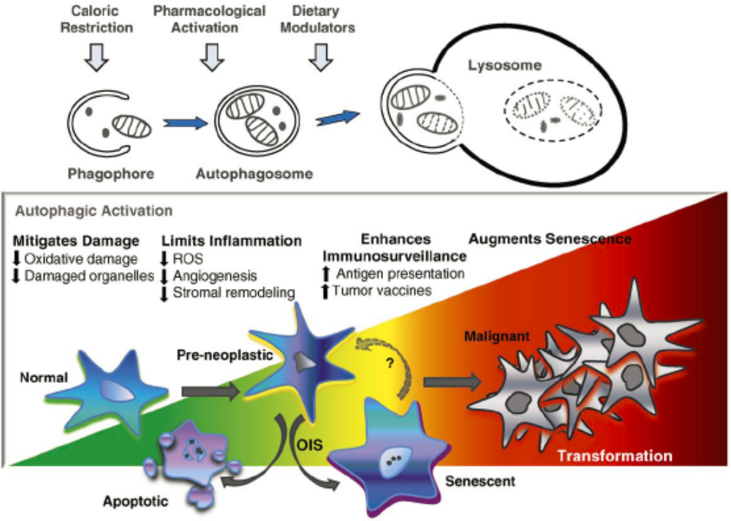
Introduction
Autophagy is essential for maintaining homeostatic processes
Autophagy is essential for maintaining homeostatic processes, such as organelle and protein turnover, but it is also crucial in responses to stress conditions such as nutrient deprivation, oxidative stress, pathogen infection and hypoxia.
Nature. 2008; 451, 1069-1075.
Nat. Rev. Drug Discov.2007; 6, 304-312.
19

Slide 20
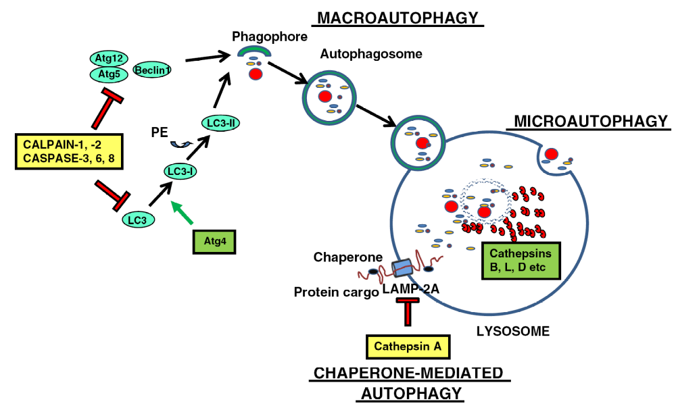
Introduction
Involvement of proteases in autophagy
Biochim Biophys Acta. 2011 May 24.
20

Slide 21
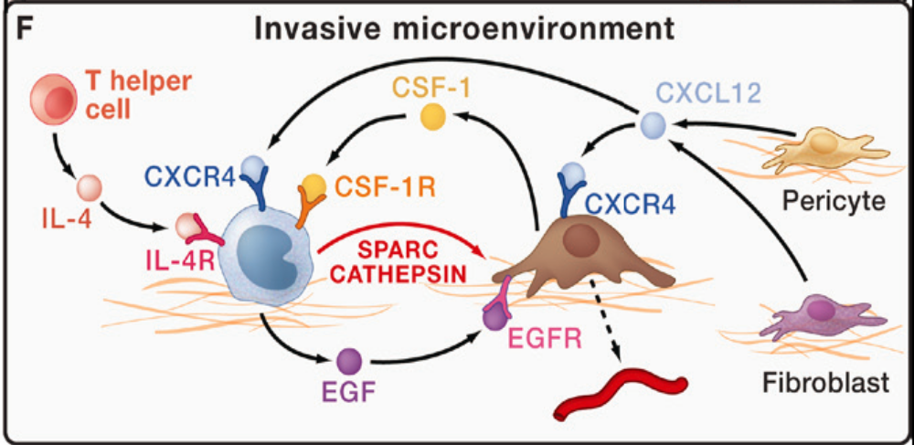
Cell 2010;141, 39-51.
Cathepsin S is highly expressed in different malignant tissue and is involved in the progression of cancer via tumor proliferation, angiogenesis, and cell migration.
JAMA. 2011;306(10):1113-1121.
It was observed that infiltrating macrophages are a source of cathepsin S in the tumor microenvironment.
Clin Cancer Res. 2009, 15(19):6042-6051.
Whether cathepsin S promotes tumor growth and metastasis through
regulating autophagy of tumor-associated-macrophages (TAMs)?
21

Slide 22
Result
Cat S expression is elevated in human cancer tissue
Clinicopathologic Analysis
22

Slide 23
Result
Cat S deficiency inhibits tumor growth and metastasis
23

Slide 24
Result
Cat S deficiency inhibits transition toward the M2 phenotype in TAMs
24

Slide 25
Result
Cat S deficiency induces autophagosome accumulation in TAMs
Autophagic vesicles
25

Slide 26
Result
Cat S is required for autophagic flux of TAMs
Block fusion of autophagosomes with lysosomes
Attenuate DQ-BSA degradation rate
26

Slide 27
Result
Cat S-mediated autophagy contributes to M2 phenotype polarization of TAMs
Autophagy inhibitor : Chloroquine (CQ)
27

Slide 28
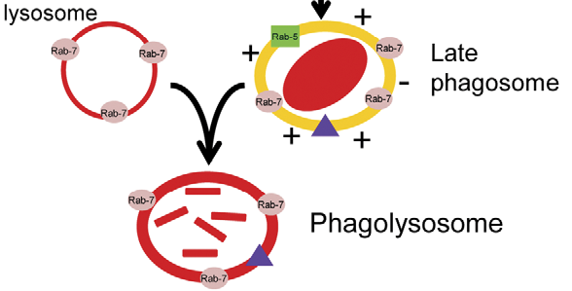
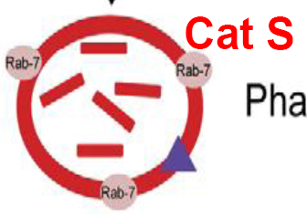
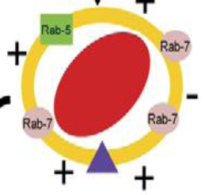
Conclusion II
Cathepsin S-mediated autophagic flux in tumor-associated macrophages accelerate tumor development
by promoting M2 polarization
Tumor cells
Tumor development
Cancer-related inflammation
Homeostatic
processes
Cat S
Autophagosome
phagocytosis
TAMs
(＋)
M2 Polarization
Autophagy
Cat S
Min Yang, et al. Molecular Cancer (2014)
28

Slide 29
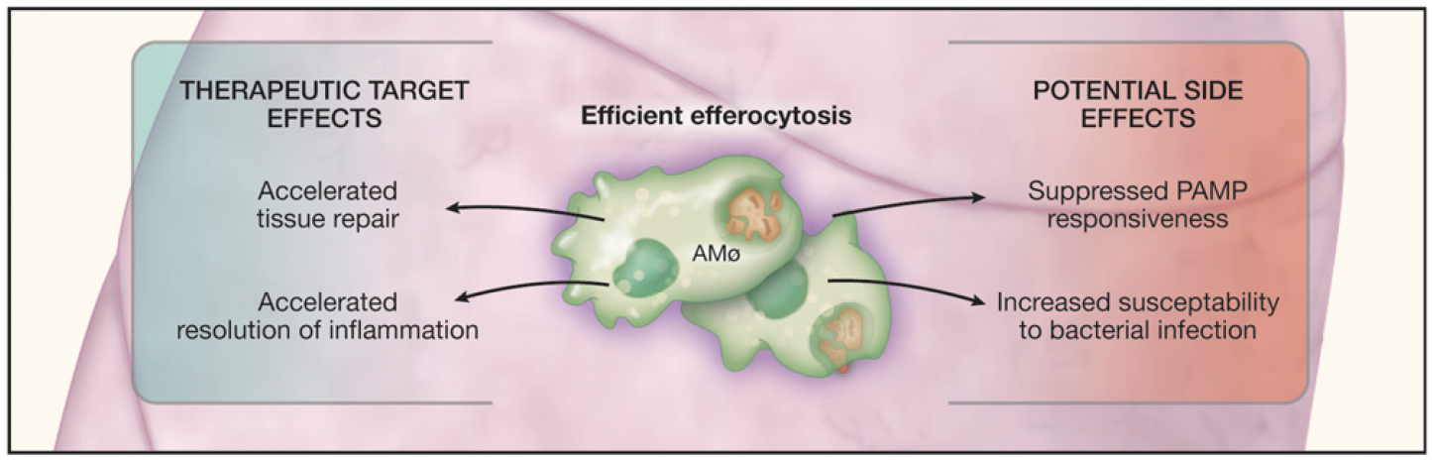
Introduction
Efferocytosis is a process by which apoptotic cells are removed by macrophages, is critical for development
and resolution of inflammation
CHEST, 2013
29

Slide 30
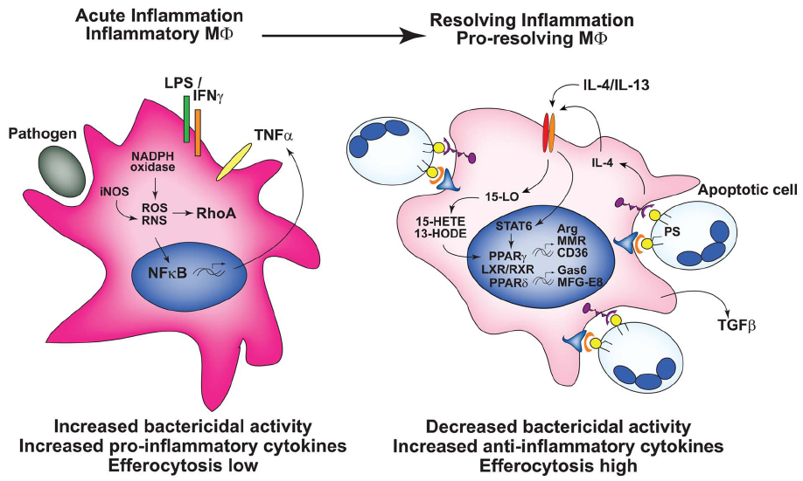
Introduction
Macrophage programming determines efferocytic capacity
M1 macrophage
(Classical activation)
M2 macrophage
(Alternative activation)
Frontiers in Immunology, 2011
30

Slide 31
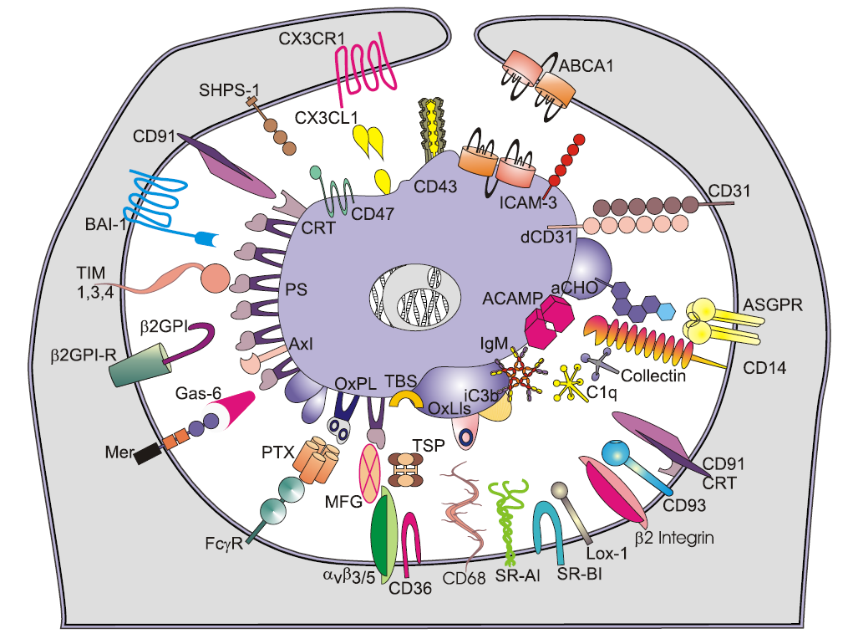
Introduction
Close encounters between macrophages and apoptotic cells
Integrin-based systems
Scavenger receptors
Immunoglobulin superfamily molecules
Complement receptors
Soluble and cell-associated pattern recognition molecules
Intercellular cell adhesion molecule-1 (ICAM-1) is the ligand for β2 integrin molecules present on leukocytes, which plays the key roles in immune responses.
Journal of Leukocyte Biology, 2011
31
Notes:
The immune system including, integrin-based systems, receptors, have been involved in the clearance of apoptotic cells by macrophages.
However, the roles of ICAM-1 in regulating macrophage phenotype and the mechanism for macrophage polarization in tumor microenvironment remain unclear.

Slide 32
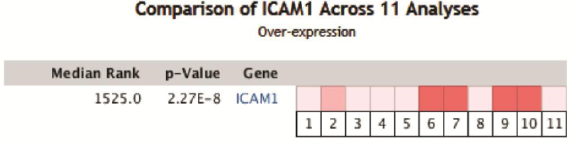

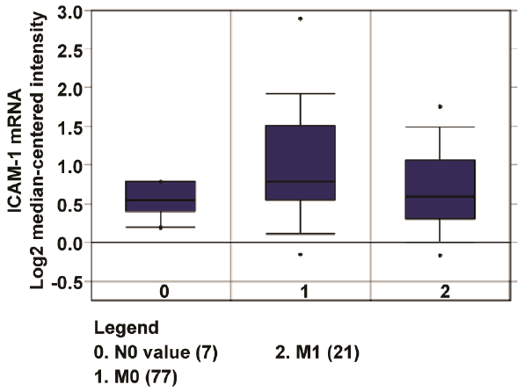
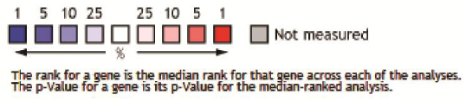
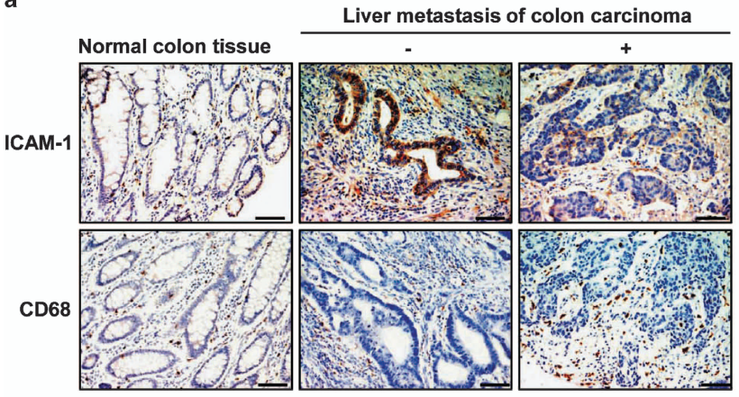
Result
Loss of ICAM-1 expression is associated with metastasis of human colon cancer
32
Notes:
We first analyzed ICAM-1 transcript by using the Oncomine database. The analysis revealed a significant upregulation of ICAM-1 mRNA expression in colon cancer.
The data from pathological phenotype showed a decreased expression of ICAM-1 m RNA in colon cancer with distant metastasis.
Importantly, IHC staining demonstrate the expression of ICAM-1 protein in primary tumors with liver metastasis was
significantly lower than those without liver metastasis.
So, these data indicate that Loss of ICAM-1 expression is associated with metastasis of human colon cancer.

Slide 33
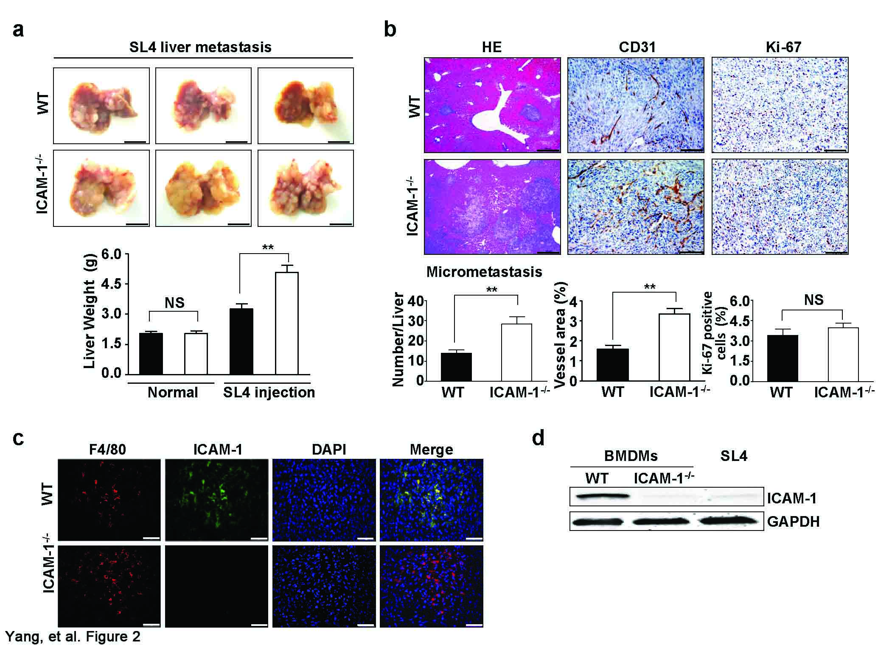
Result
ICAM-1 deficiency in the host facilitates tumor metastasis
33

Slide 34
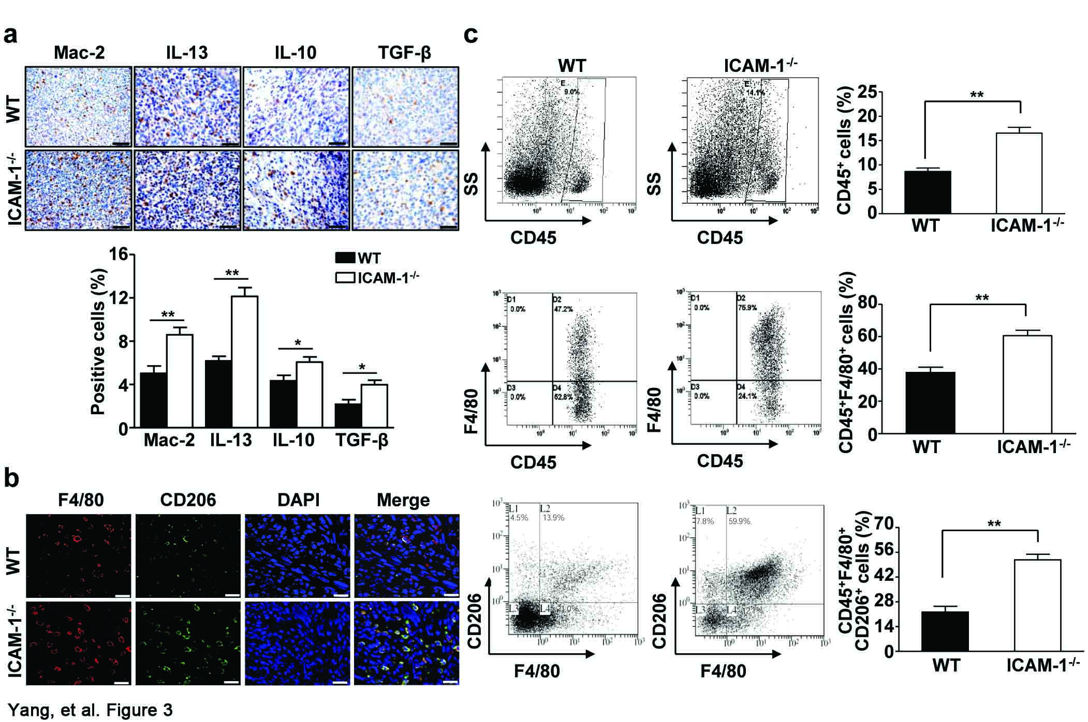
Result
ICAM-1 deficiency increases M2 macrophage infiltration into the tumor microenvironment
34
Notes:
To determine the contribution of macrophages to tumor development, we examined the expression of the macrophage marker Mac-2 and the relevant cytokines.
IHC staining combined with flow cytometry revealed ICAM-1 deficiency increases M2 macrophage infiltration into the tumor microenvironment.

Slide 35
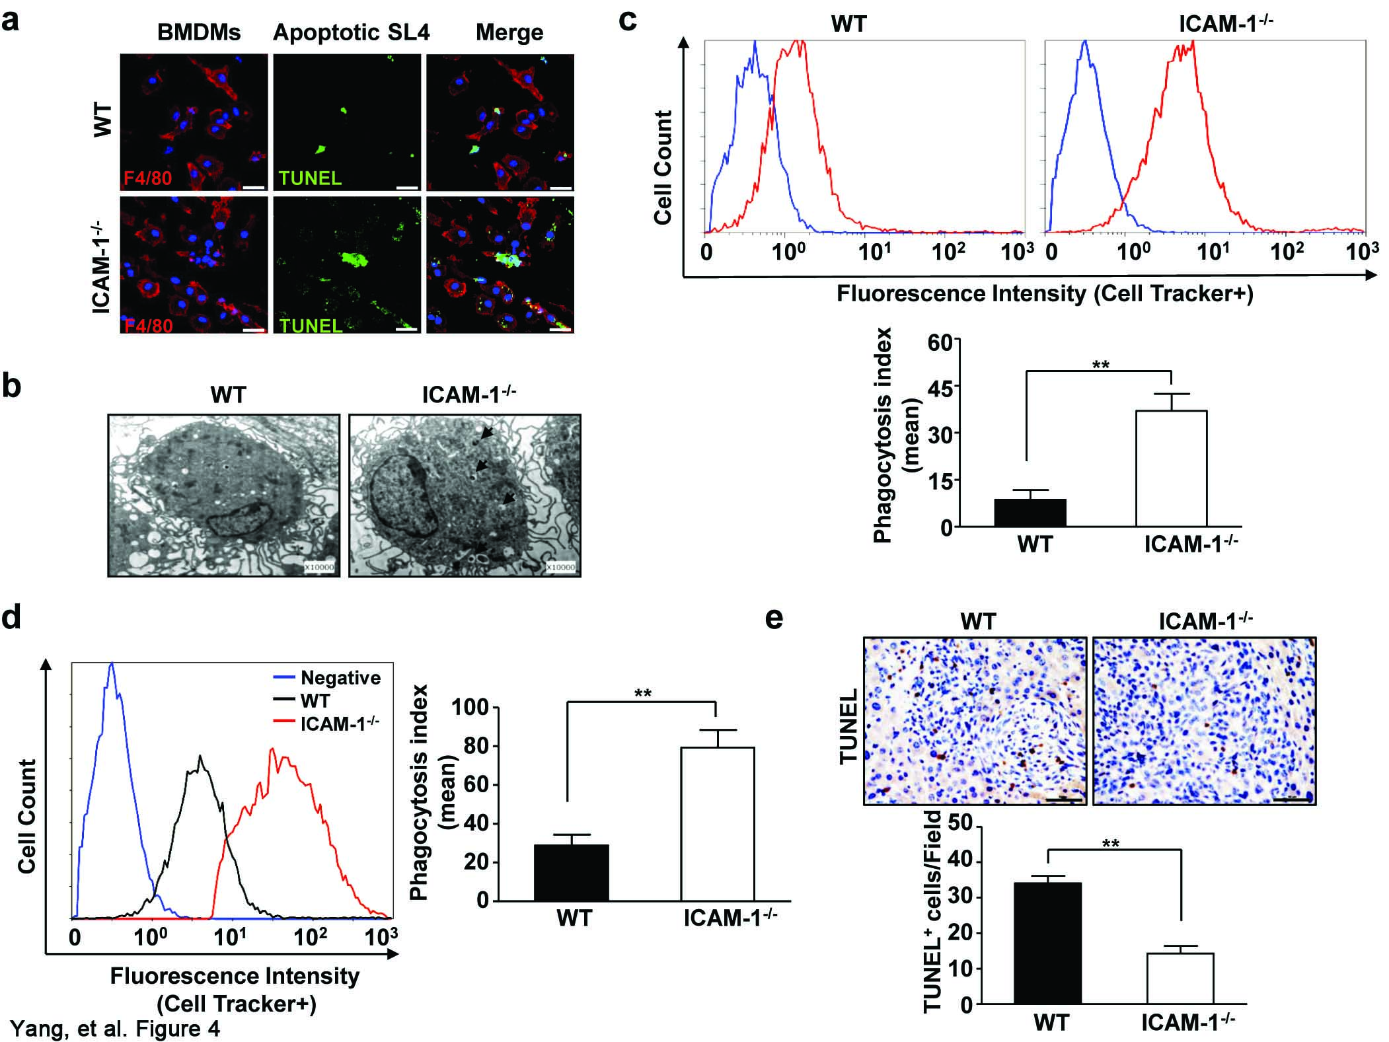
Result
ICAM-1 deficiency in macrophages leads to promotion of apoptotic tumor cell efferocytosis
TUNEL-positive SL4 cells
Efferocytosis of fluorescent apoptotic SL4 cells
Phagosomes
35

Slide 36
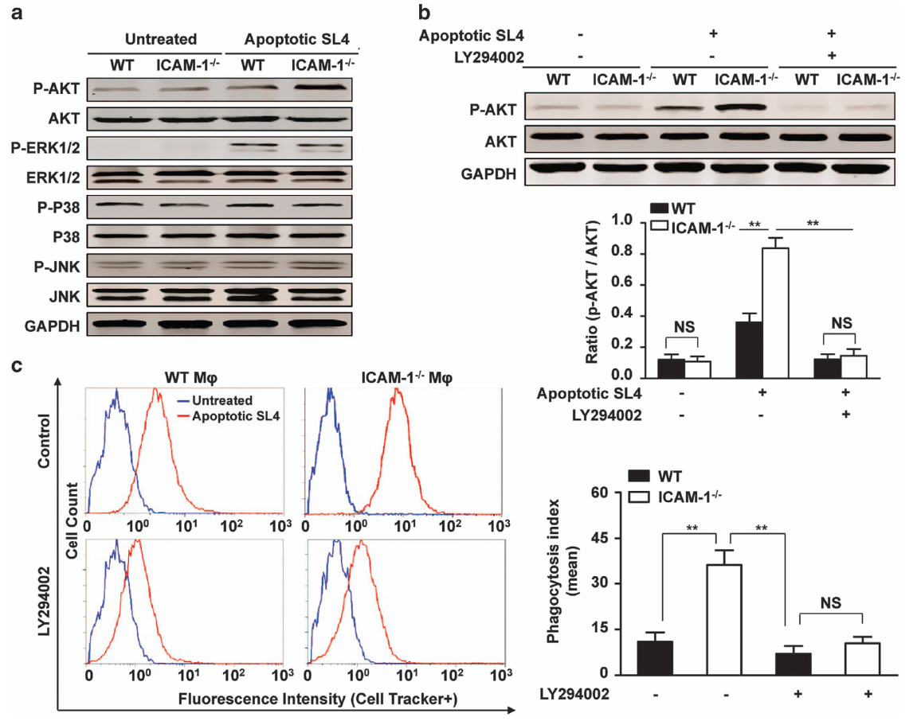
Result
The PI3K/AKT pathway mediates ICAM-1–associated modulation of apoptotic tumor cell phagocytosis
36

Slide 37
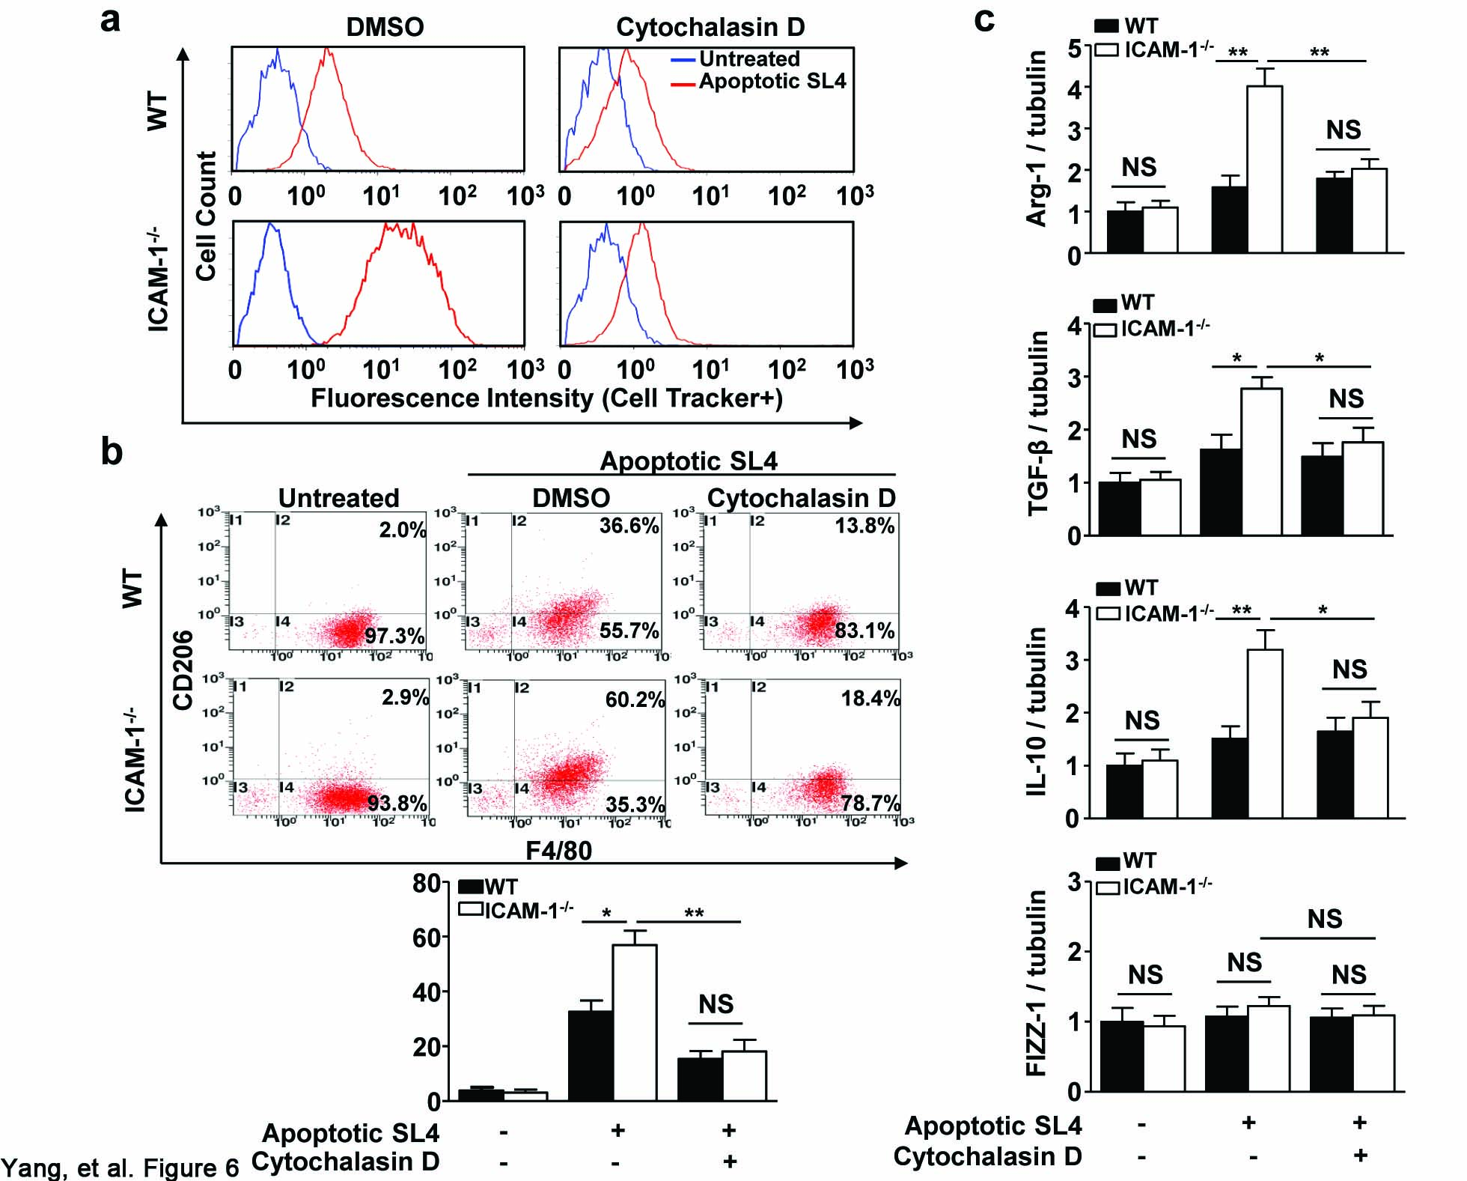
Result
ICAM-1 deficiency–mediated efferocytosis contributes to M2 macrophage polarization
Phagocytosis inhibitor
37

Slide 38


Conclusion III
ICAM-1 suppresses tumor metastasis by inhibiting macrophage M2 polarization through
blockade of efferocytosis
Tumor cells
Cancer-related inflammation
Tumor development
Apoptotic SL4 cell or dead cell debris
phagocytosis
ICAM-1 -/-
TAMs
(＋)
Min Yang, et al. Cell Death&Disease (2015)
38

Slide 39
Summary
We have identified a novel role of BM-derived CARD9 that can contribute to tumor metastasis via regulation of metastasis-associated macrophages.
Cat S-mediated autophagic flux is an important mechanism for inducing M2-type polarization of TAMs, which leads to tumor development.
Our findings demonstrate a novel role for ICAM-1 in suppressing M2 macrophage polarization via downregulation of efferocytosis in the tumor microenvironment, thereby inhibiting tumor metastasis.
39

Slide 40




ACKNOWLEDGEMENT
Jie Du, Ph.D.
Professor and Dean, Beijing Institute of Heart, Lung and Blood Vessel Diseases, Beijing Anzhen Hospital, Capital Medical University, Beijing, China
Director, the Key Laboratory of Remodeling-Related Cardiovascular Diseases, Ministry of Education, China
Jiahuai Han, Ph.D.
Professor and Dean, Faculty of Medicine and Life Sciences, Xiamen University, China
Director, State Key Laboratory of Cellular Stress Biology
Siqi Liu, Ph.D.
Professor and Director, Proteomic Analysis Center at Beijing Institute of Genomics, Chinese Academy of Sciences
Xin Lin, Ph.D.
Professor, Department of Molecular and Cellular Oncology, The University of Texas MD Anderson Cancer Center
Director, Cancer Biology Program, Graduate School of Biomedical Sciences, The University of Texas, Houston, TX
40

Slide 41




Slide 42

Thanks for Your Attention
42

