Slide 1
Extensions of Dynamic Programming for Decision Tree Study
Mikhail Moshkov
King Abdullah University of Science and Technology Saudi Arabia
Big Data Analysis and Data Mining
September 26-27, 2016, London, UK

Slide 2
Coauthors
PhD student Hassan AbouEisha, KAUST, KSA
PhD student Mohammad Azad, KAUST, KSA
Dr. Igor Chikalov, Intel, US
Dr. Shahid Hussain, Habib University, Pakistan

Slide 3
Dynamic Programming
The idea of dynamic programming is the following. For a given problem, we define the notion of a sub-problem and an ordering of sub-problems from “smallest” to “largest”
If (i) the number of sub-problems is polynomial, and (ii) the solution of a sub-problem can be easily (in polynomial time) computed from the solution of smaller sub-problems then we can design a polynomial algorithm for the initial problem

Slide 4
Dynamic Programming
The aim of usual Dynamic Programming (DP) is to find an optimal object from a finite set of objects

Slide 5
Extensions of DP
We consider extensions of dynamic programming which allow us
To describe the set of optimal objects
To count the number of these objects
To make sequential optimization relative to different criteria
To find the set of Pareto optimal points for two criteria
To describe relationships between two criteria

Slide 6
Extensions of DP
The areas of applications include
Combinatorial optimization
Finite element method
Fault diagnosis
Complexity of algorithms
Machine learning
Knowledge representation

Slide 7
Applications for Decision Trees
In the presentation, we consider applications of this new approach to the study of decision trees
As algorithms for problem solving
As a way for knowledge extraction and representation
As predictors which, for a new object given by values of conditional attributes, define a value of the decision attribute

Slide 8
Decision Trees
1
2
3
f₁ | f₂ | f₃ | d
1 | 0 | 0 | 1
0 | 1 | 0 | 2
0 | 0 | 1 | 3
f₁
f₂
f₃
f₁f₁
Decision table
f₁
0
1
f₁f₁
f₁f₁
f₂
1
Depth
Number of nodes
Total path length (average depth)
Number of terminal nodes
0
1
f₁f₁
f₁f₁
3
2
Decision tree
Cost functions

Slide 9
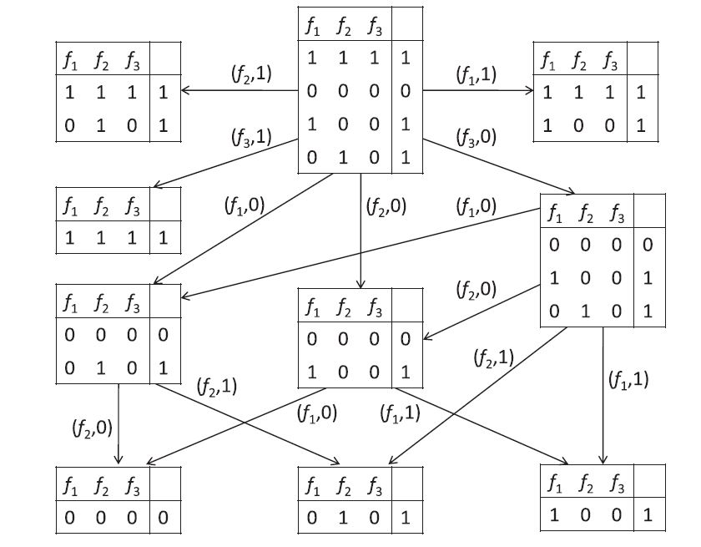
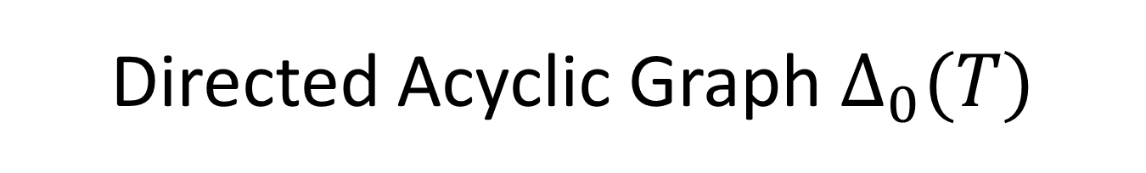
Directed Acyclic Graph $∆_{0}(T)$

Slide 10
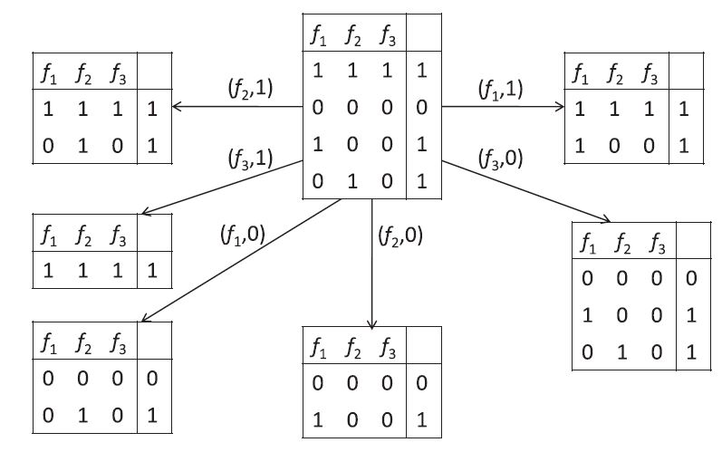
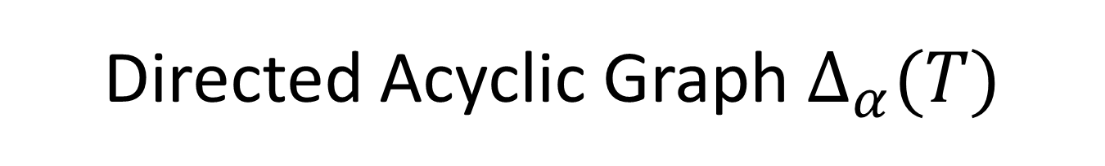
Directed Acyclic Graph $∆_{α}(T)$

Slide 11
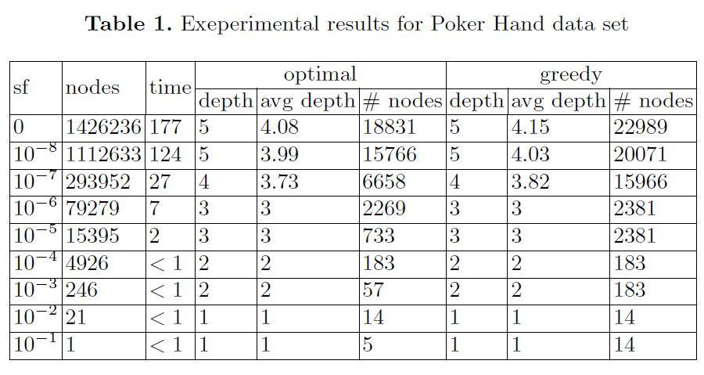
About Scalability
Training part of Poker Hand data set contains 25010 objects and 10 conditional attributes

Slide 12
Restricted Information Systems
We described classes of decision tables for which the considered algorithms have polynomial time complexity depending on the number of conditional attributes

Slide 13
Extensions of DP for Decision Trees
Sequential optimization
Evaluation of the number of optimal trees
Relationships between cost and accuracy
Relationships between two cost functions
Construction of the set of Pareto optimal points

Slide 14
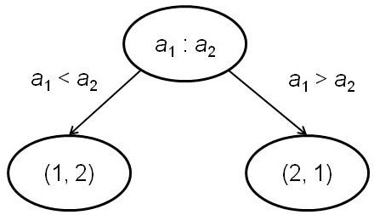
Sorting of 8 Elements
We proved that the minimum average depth of a decision tree for sorting 8 elements is equal to 620160/40320
This solved a long-standing problem (since 1968) considered by D. Knuth in his famous book The Art of Computer Programming, Volume 3, Sorting and Searching
We proved also that each decision tree for sorting 8 elements with minimum average depth has minimum depth. The number of such trees is equal to 8.548×10³²⁶³⁶⁵

Slide 15
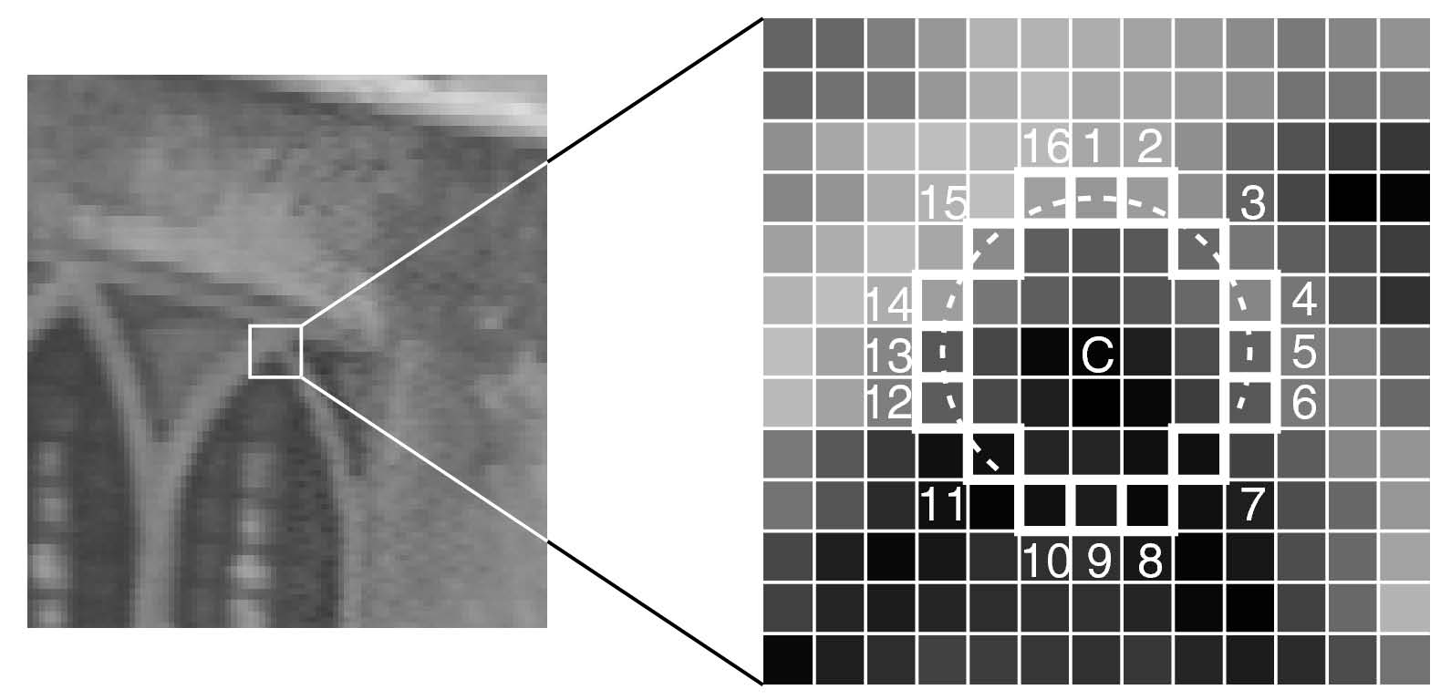
Corner Point Detection
Corner points are used in computer vision for object tracking (FAST algorithm devised by Rosten and Drummond)
A pixel is assumed to be a corner point if at least 12 contiguous pixels on the circle are all either brighter or darker than the central point by a given threshold

Slide 16
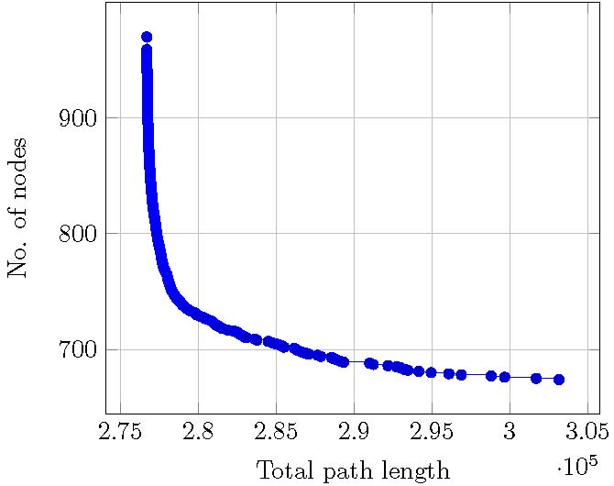
Corner Point Detection
Dynamic programming approach allows us to construct decision trees for corner point detection with average time complexity 7% less than for known ones, and analyze time-memory tradeoff for such trees

Slide 17
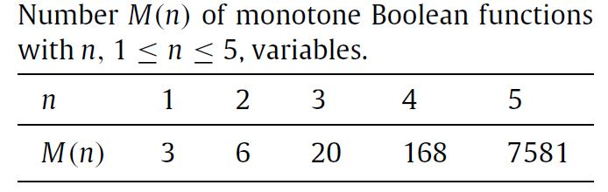
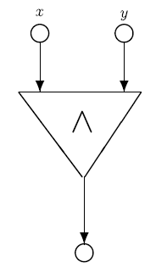
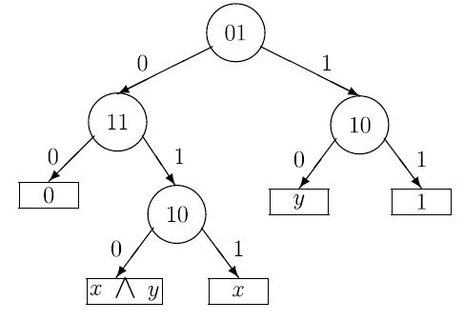
Diagnosis of 0-1 Faults

Slide 18
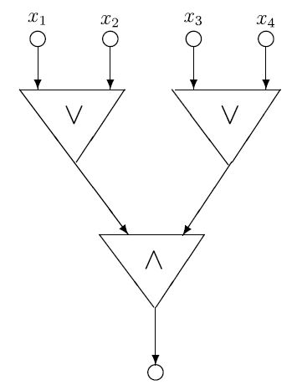
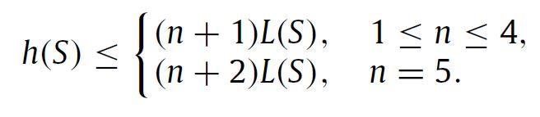
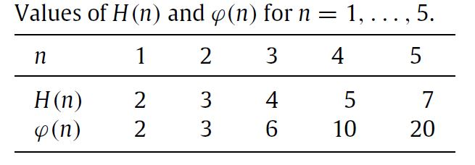
Diagnosis of 0-1 Faults

Slide 19
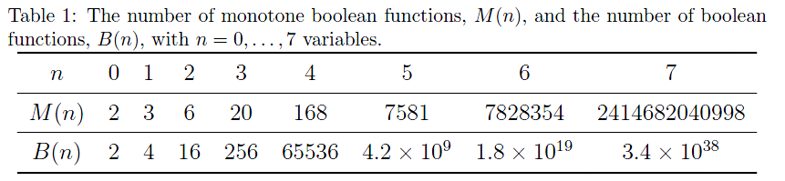
Totally Optimal Decision Trees for Boolean Functions

Slide 20
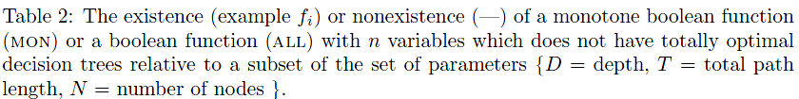
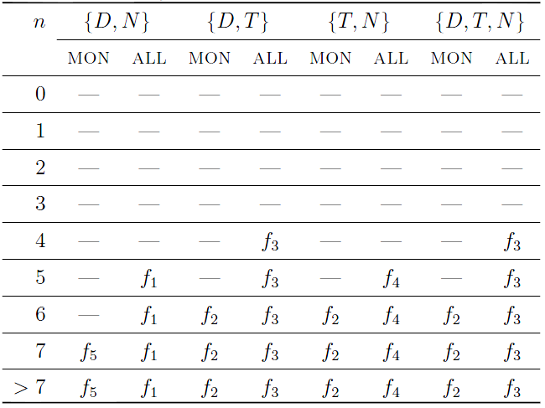
Totally Optimal Decision Trees for Boolean Functions

Slide 21
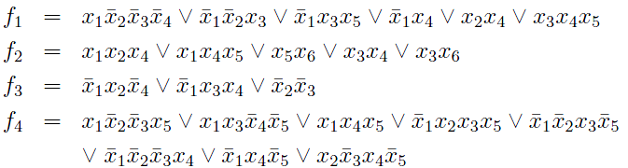

Totally Optimal Decision Trees for Boolean Functions
Two hypotheses for D, N and D, T

Slide 22
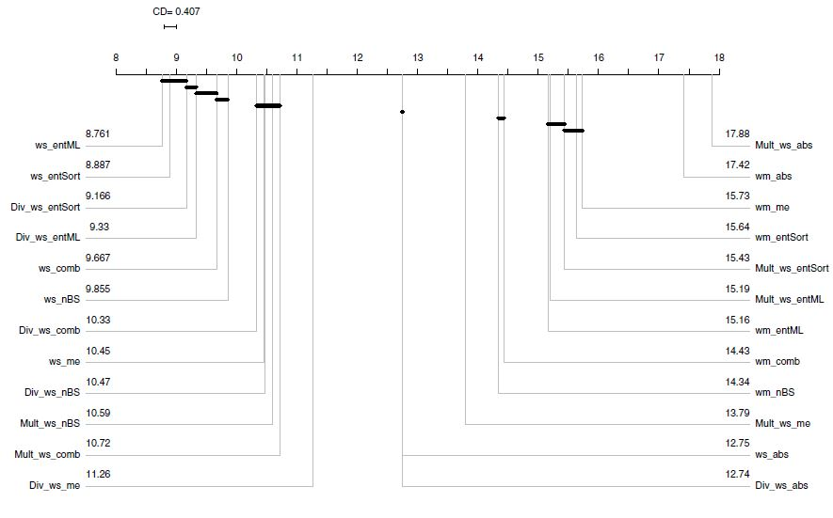
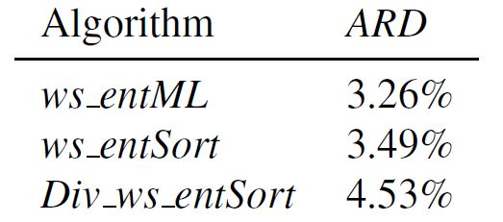
Heuristics for Decision Tree Construction
Minimization of decision tree average depth for decision
tables with many-valued decisions

Slide 23
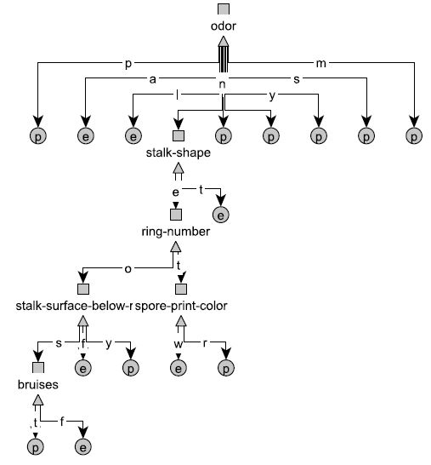
Minimization of Number of Nodes
Decision table Mushroom contains 22 conditional attributes and 8124 rows
The minimum number of nodes in a decision tree for Mushroom is equal to 21

Slide 24
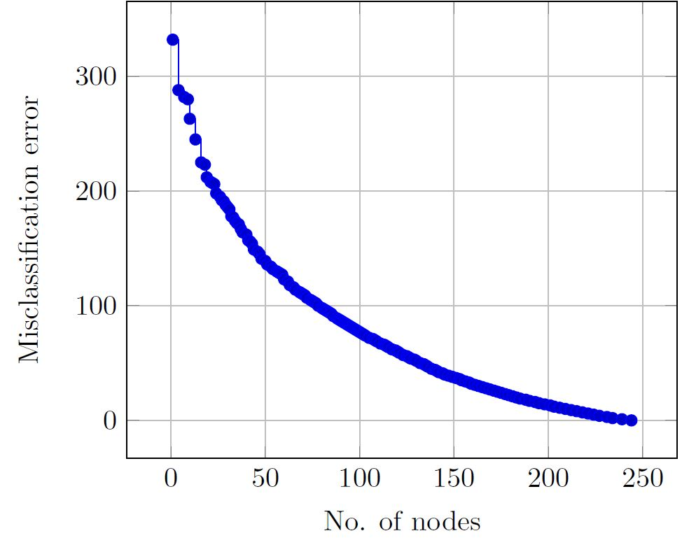
Relationships Number of Nodes vs. Misclassification Error
When the number of misclassifications is increasing, the number of nodes in decision trees can decrease
One can be interested in less accurate but more understandable decision trees
Tic Tac Toe, 9 attributes, 959 rows

Slide 25
Decision Trees and Rules
Decision rules are widely used in machine learning and for knowledge representation
One of the ways to obtain decision rules is to construct a decision tree and derive rules from this tree
f₁f₁
f₁
0
1
f₁f₁
f₁f₁
f₂
1
f₁ = 0 ∧ f₂ = 0 → d = 3
f₁ = 0 ∧ f₂ = 1 → d = 2
f₁ = 1 → d = 1
0
1
f₁f₁
f₁f₁
3
2
Set of decision rules
Decision tree

Slide 26
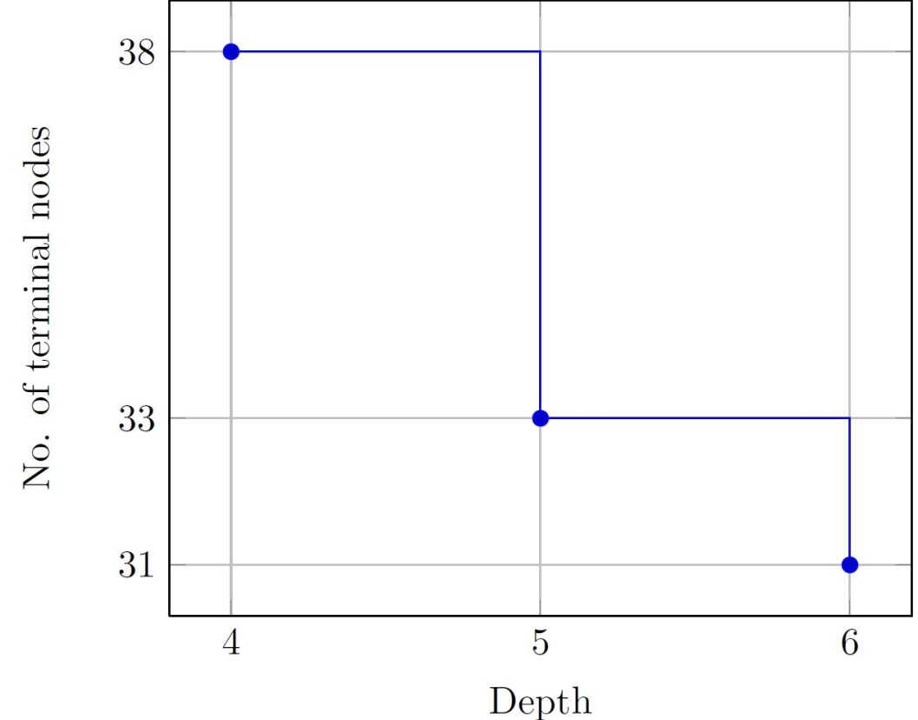
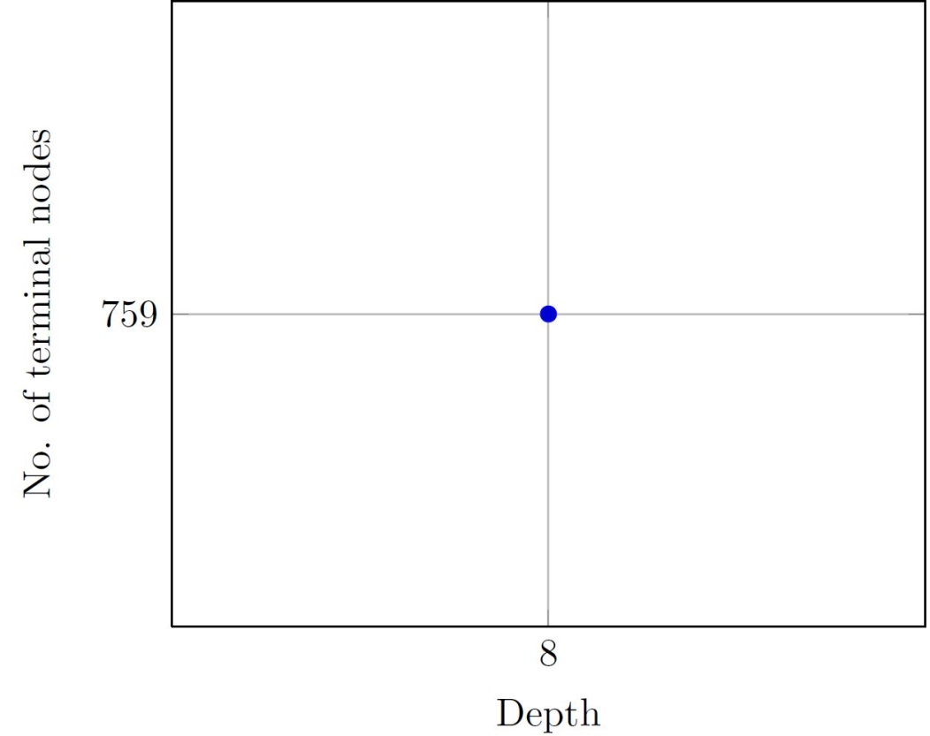
Relationships Depth vs. Number of Terminal Nodes
Lymphography, 18 attributes, 148 rows
Nursery, 8 attributes, 12960 rows

Slide 27
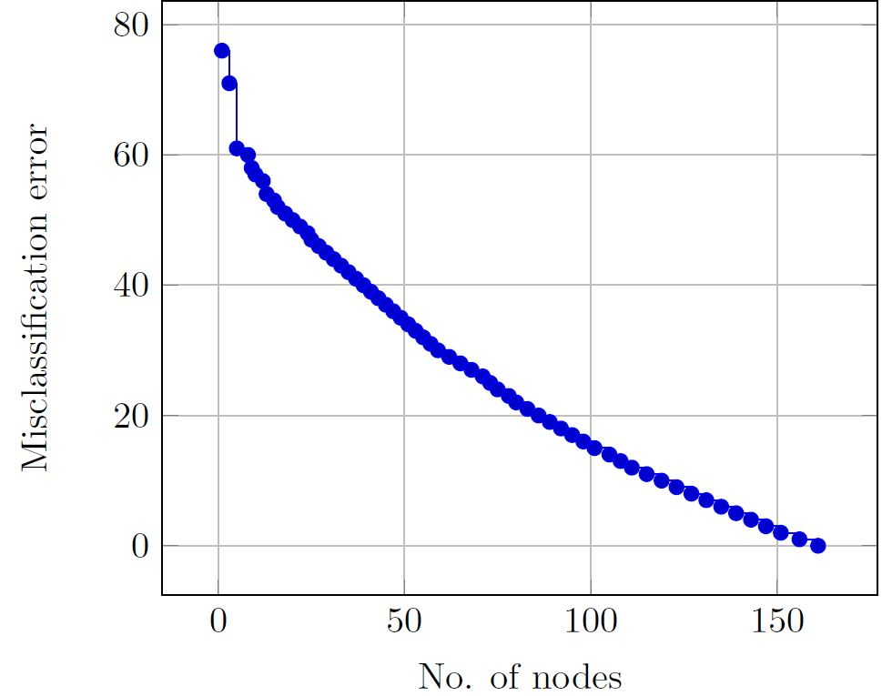
Relationships Number of Nodes vs. Misclassification Error
Relationships between the number of nodes and the number of misclassifications can be used in a special procedure of pruning – multi-pruning (MP)
Breast cancer, 9 attributes, 266 rows

Slide 28
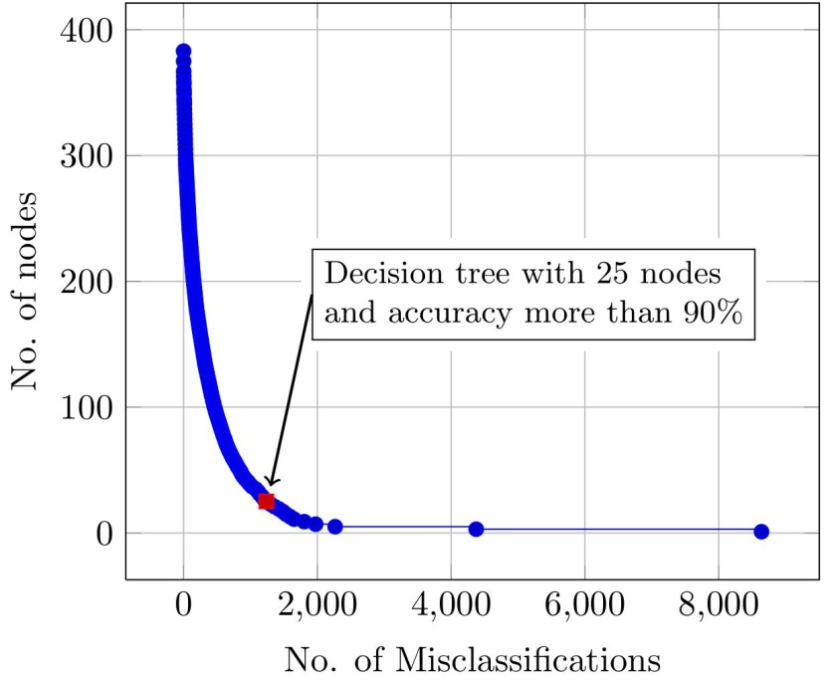
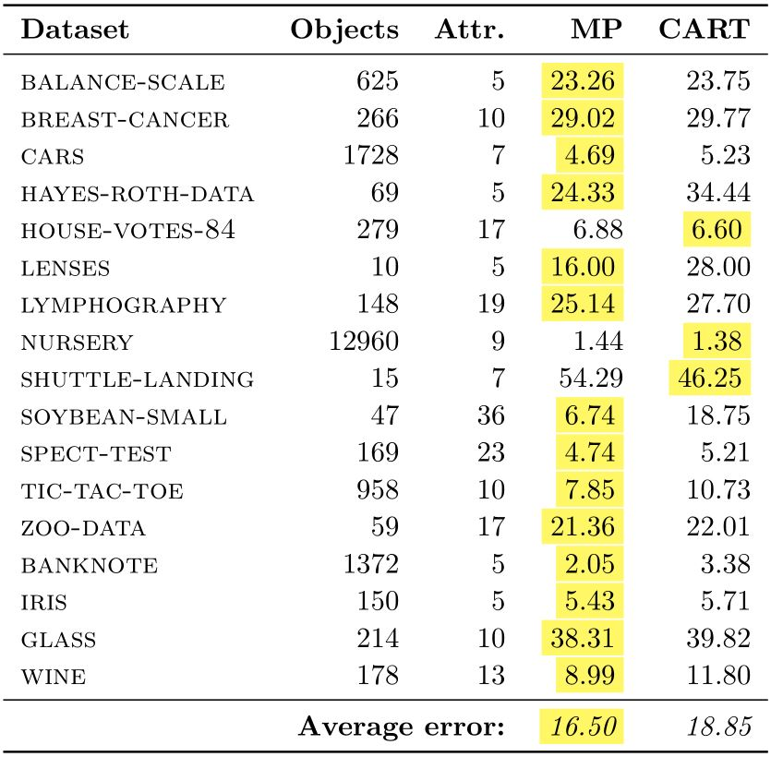
Pareto-Optimal Points (POPs) for Bi-Criteria Optimization of Decision Trees
We consider the number of nodes and number of misclassifications as two criteria for decision trees. Construction of the set of POPs allows us:
To find relatively small and accurate decision trees which represent the knowledge contained in the dataset
Dataset nursery with 9 attributes and 12960 objects
To build classifiers using new multi-pruning procedure (MP) which outperform classifiers constructed by well known CART method

Slide 29
Three Books Published by Springer
“Bridge" among three
approaches in Data
Analysis which
previously were not
connected
Textbook for the course
CS361 in KAUST
Research monograph

Slide 30
New Book and New Course
Extensions of Dynamic Programming for Combinatorial Optimization and Data Mining

Slide 31

KAUST

Slide 32
KAUST
KAUST is an international graduate-level research university located on the shores of the Red Sea in Saudi Arabia
The University’s new facilities, state-of-art library and Shaheen II Supercomputer (10th among top 500 supercomputers) offer an ideal environment and resources for graduate level study and research

Slide 33

KAUST

Slide 34
KAUST
Students receive a KAUST fellowship that includes:
full tuition
competitive monthly living allowance
private medical and dental coverage
housing
relocation support

Slide 35

KAUST

