Slide 1
Extensions of Dynamic Programming for Machine Learning and Knowledge Representation
Mikhail Moshkov
King Abdullah University of Science and Technology, Saudi Arabia
Houstone, October 2016

Slide 2
Dynamic Programming
The idea of dynamic programming is the following. For a given problem, we define the notion of a sub-problem and an ordering of sub-problems from “smallest” to “largest”
If (i) the number of sub-problems is polynomial, and (ii) the solution of a sub-problem can be easily (in polynomial time) computed from the solution of smaller sub-problems then we can design a polynomial algorithm for the initial problem

Slide 3
Dynamic Programming
The aim of usual Dynamic Programming (DP) is to find an optimal object from a finite set of objects

Slide 4
Extensions of DP
We consider extensions of dynamic programming which allow us
To describe the set of optimal objects
To count the number of these objects
To make sequential optimization relative to different criteria
To find the set of Pareto optimal points for two criteria
To describe relationships between two criteria

Slide 5
Extensions of DP
The areas of applications include
Combinatorial optimization
Finite element method
Fault diagnosis
Complexity of algorithms
Machine learning
Knowledge representation

Slide 6
1. Restricted Multi-Pruning of Decision Trees
This is a joint work with
  Mohammad Azad (KAUST, Saudi Arabia),
  Igor Chikalov (Intel, USA), and
  Shahid Hussain (Habib University, Pakistan)

Slide 7
Restricted Multi-Pruning of Decision Trees
Decision trees are widely used as classifiers or as parts of ensembles. The question how to improve the classification accuracy of decision trees continues to be important
We discuss so called multi-pruning which allows us to construct classifiers (decision trees) that outperform often classifiers constructed by CART

Slide 8
CART-Like Decision Trees
Let T be a decision table with n conditional attributes f₁, …, f_{n} which are categorical or numerical, and with a categorical decision attribute d
Let Θ be a subtable of the table T obtained from T by removal of some rows. The subtable Θ can be considered as a node of constructed decision tree

Slide 9
CART-Like Decision Trees
Instead of conditional attributes we use (as in CART) binary splits (binary attributes) each of which is based on a conditional attribute f_{i}
If f_{i} is a categorical attribute with the set of values B then we consider a partitioning of B into two nonempty subsets B₀ and B₁. The value of the corresponding binary split s is equal to 0 if the value of f_{i} belongs to B₀, and 1 otherwise
If f_{i} is a numerical attribute then we consider a real threshold α. The value of corresponding binary split s is equal to 0 if the value of f_{i} is less than α, and 1 otherwise

Slide 10
CART-Like Decision Trees
Each binary split s divides the table Θ into two subtables Θ_{s=0} and Θ_{s=1} according to the values of s on rows of Θ
We use Gini index as an uncertainty measure for the decision tables. The impurity I(Θ, s) of the split s is equal to the weighted sum of uncertainties of subtables Θ_{s=0} and Θ_{s=1}, where the weights are proportional to the number of rows in subtables Θ_{s=0} and Θ_{s=1}, respectively
A split s based on attribute f_{i} with minimum impurity I(Θ, s) is called the best split for Θ and f_{i}

Slide 11
CART-Like Decision Trees
Let m₁ and m₂ be nonnegative integers such that 0 < m₁ + m₂ ≤ n
For each nonconstant attribute for Θ, we find a best split for Θ and this attribute
Let s₁, …, s_{p} be the obtained splits in order from best to worst. We construct a set S(m₁,m₂,Θ) containing the first m₁ attributes from s₁, …, s_{p} and m₂ randomly chosen attributes from the rest

Slide 12
CART-Like Decision Trees
In a nonterminal node Θ of a decision tree, we can use any attribute from S(m₁,m₂,Θ)
If Θ is a terminal node then it is labeled with a most common decision for Θ
The obtained trees are called (m₁,m₂)-CART-like decision trees
For each such tree Γ, we denote by L(Γ) the number of nodes in Γ and by mc(T, Γ) the number of misclassifications of Γ on rows from T

Slide 13
Set of Pareto Optimal Points
Let A be a finite set of points in two-dimensional Euclidean space. A point (a, b) ∈ A is called a Pareto optimal point for A if there is no point (c, d) ∈ A such that (a, b) ≠ (c, d), c ≤ a, and d ≤ b. We denote by Par(A) the set of Pareto optimal points for A
We correspond to each (m₁,m₂)-CART-like decision tree Γ the point (mc(T, Γ),L(Γ))
Using extensions of dynamic programming we can construct, for the obtained set of points, the set of Pareto optimal points POP(m₁,m₂,T)

Slide 14
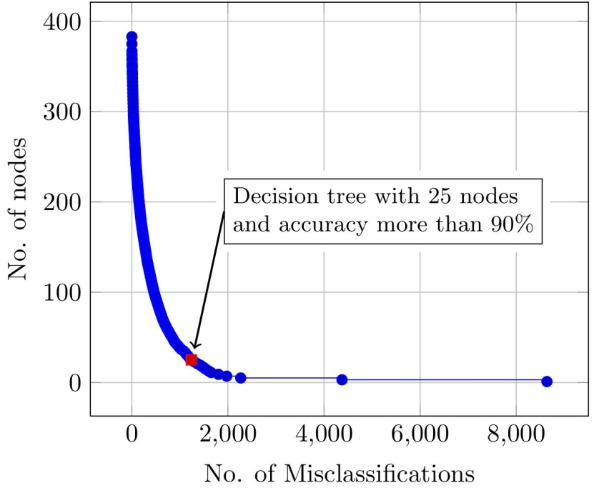
Pareto Optimal Points for Knowledge Representation
Construction of the set of POPs allows us to find relatively small and accurate decision trees which represent the knowledge contained in the dataset – example of the dataset nursery with 9 attributes and 12960 objects

Slide 15
Restricted Multi-pruning
We divide the initial decision table T into three subtables: training subtable T_{train} , validation subtable T_{val}, and testing subtable T_{test}
We construct the set of Pareto optimal points POP(m₁,m₂,T_{train})
For each point (a, b) from POP(m₁,m₂,T_{train}), we derive randomly k decision trees (in our experiments k = 5) Γ₁, …, Γ_{k} such that (a, b) = (mc(T_{train} ,Γ_{i}),L(Γ_{i})) for i = 1, …, k

Slide 16
Restricted Multi-pruning
Among decision trees derived for all Pareto optimal points, we choose a decision tree Γ which has minimum number of misclassifications on T_{val}
We evaluate the quality of this tree by counting the number of misclassifications on T_{test} and dividing it by the number of rows in T_{test}
As a result, we obtain the misclassification error rate of Γ

Slide 17
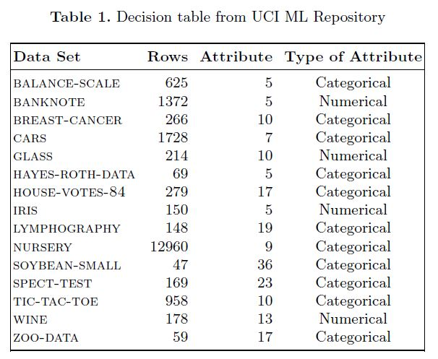
Experimental Results

Slide 18
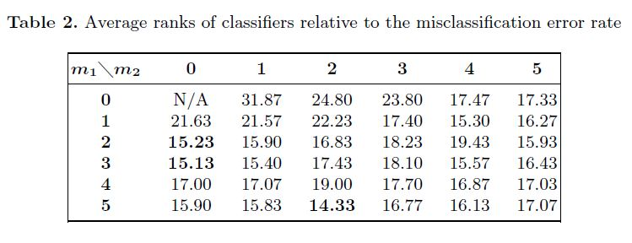
Experimental Results

Slide 19
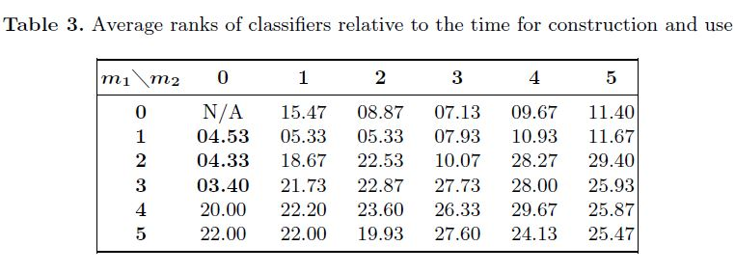
Experimental Results

Slide 20
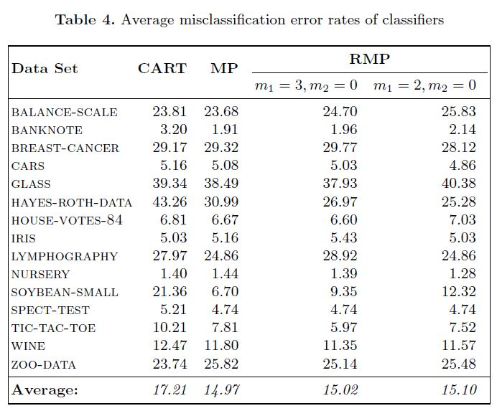
Experimental Results

Slide 21
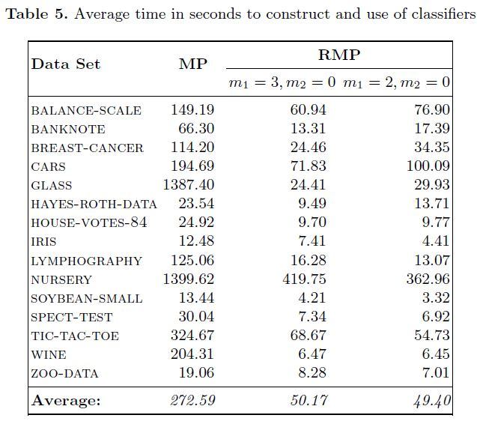
Experimental Results

Slide 22
2. Multi-stage Optimization of Decision Rules for Knowledge Discovery
This is a joint work with
  Fawaz Alsolami (KAU, Saudi Arabia),
  Talha Amin (KAUST, Saudi Arabia), and
  Igor Chikalov (Intel, USA)

Slide 23
Multi-stage Optimization of Decision Rules for Knowledge Discovery
Decision rules are widely used in machine learning to construct classifiers and in data mining to represent knowledge extracted from datasets
We created a tool which allows us, for many datasets from UCI ML Repository, to construct small systems of enough accurate decision rules that cover the most part of objects

Slide 24
Multi-stage Optimization of Decision Rules for Knowledge Discovery
We study decision tables with many-valued decisions in which each row r is labeled with a nonempty finite set D(r) of decisions
For a given row r of a decision table T, it is necessary to find a decision from D(r)
We denote by N(T) the number of rows in T, and by N_{mcd}(T) – the number of rows r for which D(r) contains the most common decision for T

Slide 25
α-Decision Rules
As an uncertainty measure for nonempty decision tables we consider relative misclassification error
rme(T) = (N(T) - N_{mcd}(T))/N(T)
Let α be a real number such that 0 ≤ α ≤ 1. We say that a decision rule is an α-decision rule for T if this rule localizes rows in a subtable Θ with uncertainty at most α
The right-hand side of this rule is the most common decision for Θ

Slide 26
β-Systems of α-Decision Rules
Let S be a nonempty finite set of α-decision rules for T (system of α-decision rules for T), and β be a real number such that 0 ≤ β ≤ 1
We say that S is a β-system of α-decision rules for T if rules from S cover at least (1 - β)N(T) rows of T

Slide 27
Algorithm α-β-Rules
Based on extensions of dynamic programming, we created Algorithm α-β-Rules for construction of a β-system of α-decision rules
During each step, we choose an α-decision rule which covers maximum number of uncovered previously rows and has minimum length among such rules
In some sense, we simulate the work of greedy algorithm for the set cover problem

Slide 28
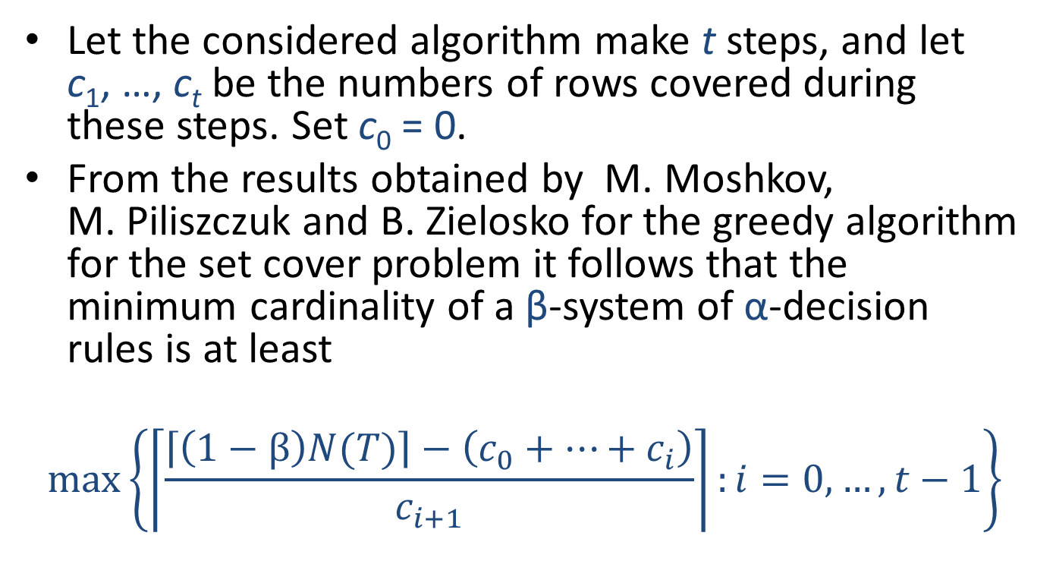
Use of Information about Algorithm α-β-Rules Work
Let the considered algorithm make t steps, and let c₁, …, c_{t} be the numbers of rows covered during these steps. Set c₀ = 0.
From the results obtained by M. Moshkov, M. Piliszczuk and B. Zielosko for the greedy algorithm for the set cover problem it follows that the minimum cardinality of a β-system of α-decision rules is at least
$$max\left\{\left\lceil \frac{\left\lceil \left(1−β\right)N(T)\right\rceil −\left(c_{0}+…+c_{i}\right)}{c_{i+1}}\right\rceil :i=0,…,t−1\right\}$$

Slide 29
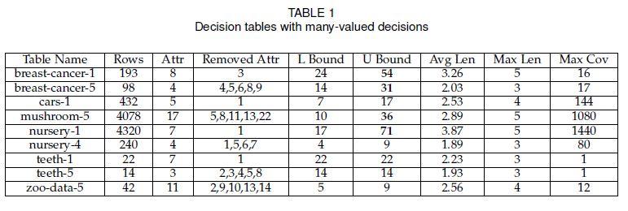
Experimental Results

Slide 30
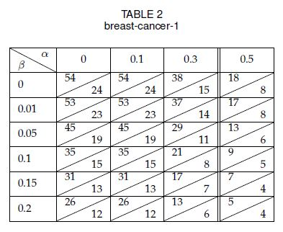
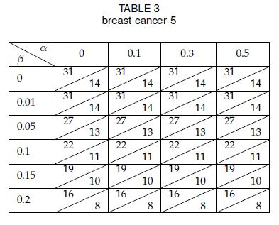
Experimental Results

Slide 31
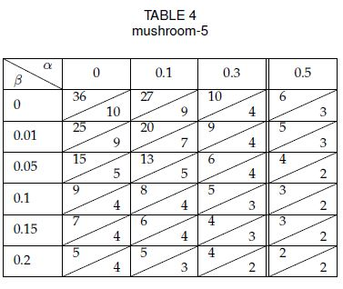
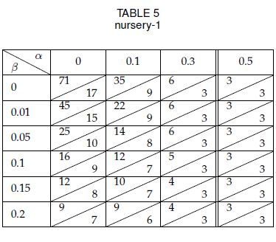
Experimental Results

Slide 32
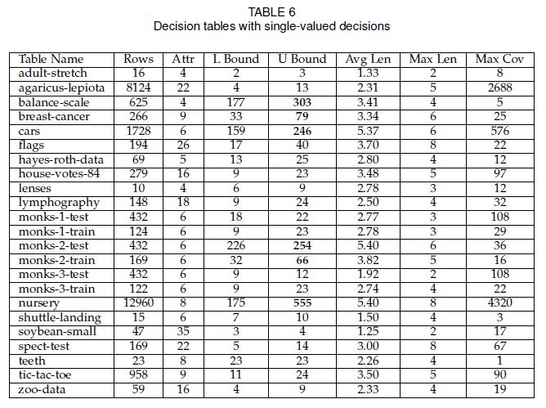
Experimental Results

Slide 33
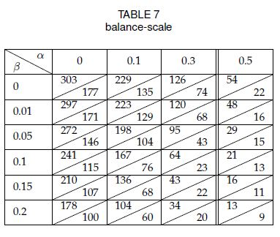
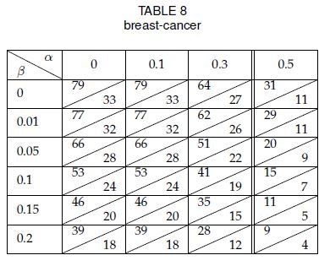
Experimental Results

Slide 34
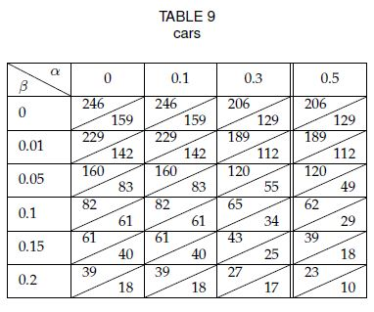
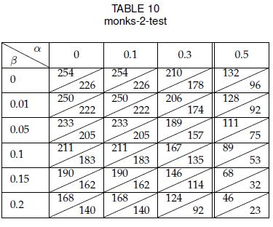
Experimental Results

Slide 35
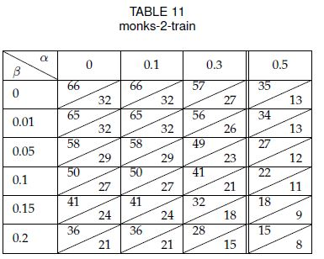
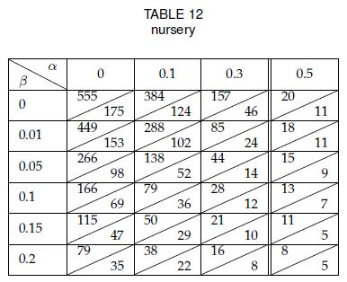
Experimental Results

Slide 36
Conclusions
We are planning to study rules based on binary splits considered in CART
We are planning to use not all possible attributes but only part as it was done for trees

Slide 37

KAUST

Slide 38
KAUST
KAUST is an international graduate-level research university located on the shores of the Red Sea in Saudi Arabia
The University’s new facilities, excellent faculty, state-of-art library, and Shaheen II Supercomputer (Cray XC40, 10th in Top500 List, June 2016) offer an ideal environment and resources for graduate level study and research

Slide 39

KAUST

Slide 40
KAUST
Students receive a KAUST fellowship that includes:
full tuition
competitive monthly living allowance
private medical and dental coverage
housing
relocation support

Slide 41

KAUST

