Slide 1

Cerebral responses to vocal attractiveness and auditory
hallucinations in schizophrenia:
An fMRI study for understanding social cognitive function
Koeda ¹, H. Takahashi ², M. Matsuura ³,
K. Asai ⁴, and Y. Okubo ¹
  Nippon Medical School, Tokyo, Japan
  Kyoto University, Kyoto, Japan
  Tokyo Medical and Dental University, Tokyo, Japan
  Asai Hospital
International conference on Brain Disorders and Therapeutics
Session on: Brain Disorders: An Over view
(24th, August, 2015, London)

Slide 2
Background
Auditory hallucinations
and thought
disorders are the
main symptoms of schizophrenia, and these symptoms profoundly affect the neural basis of social communications as well as behavior.

Slide 3
Greeting conversations are essential tools for communicating socially with family, friends, and community.
Attractiveness is one of the favorable behaviors associated with
social communication (Kampe et al., 2001; Winston et al., 2007).
The roles of the inferior frontal gyrus (IFG) and superior temporal gyrus (STG) are essential for perceiving auditory attractiveness (Bestelmeyer et al., 2012).
A recent meta-analysis:
Schizophrenia patients with auditory hallucinations had significantly increased activity in IFG-STG areas involved in speech generation and speech perception (Jardri 2011).
However, to our knowledge, no study has ever investigated the cerebral response to auditory attractiveness in schizophrenia.

Slide 4
Objective
The aim of our research is to clarify the cerebral response to auditory attractiveness when patients with schizophrenia are listening to greetings.

Slide 5
Methods
(Mean±SD) Subjects | Controls 18 | Patients 18
(M/F) | 9/9 | 8/10
Age Illness duration | 35.5±8.6 yrs | 35.7±8.4 yrs 12.3±8.0 yrs
Dose
4.7±2.2 mg
(Risperidone Eq)
13.0±1.0 yrs 13.3±1.3 yrs
Education PANSS
positive
negative
15.1±6.4
20.7±6.2
32.3±7.9
general psychopathology

Slide 6
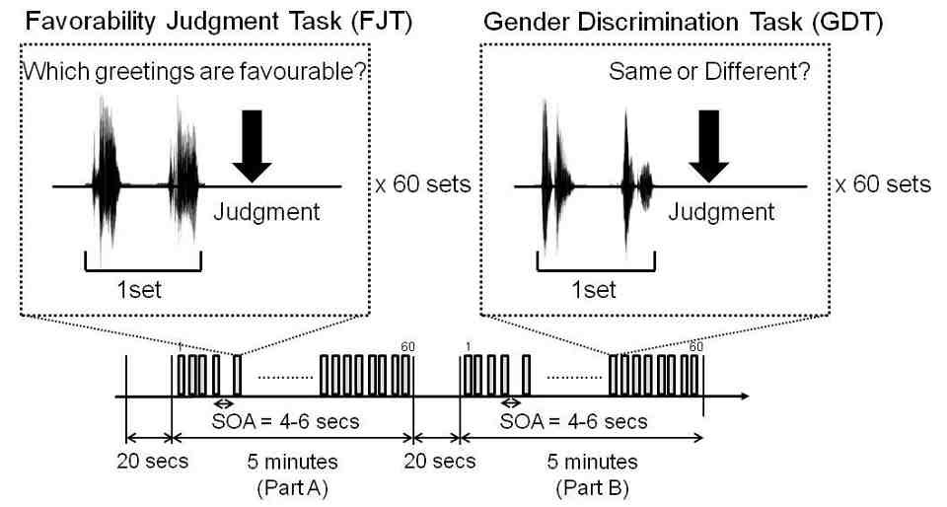
FMRI procedure
MRI acquisition: GE scanner (1.5T), TE/TR 50/2500 msec,
264 EPI sequences, slice thickness 6mm, Matrix: 64 X 64, FOV: 24 x 24 Data analysis was performed with SPM8. For cerebral activation, ANOVA was calculated using the factors of subjects’ group and fMRI task (FJT/GDT).

Slide 7
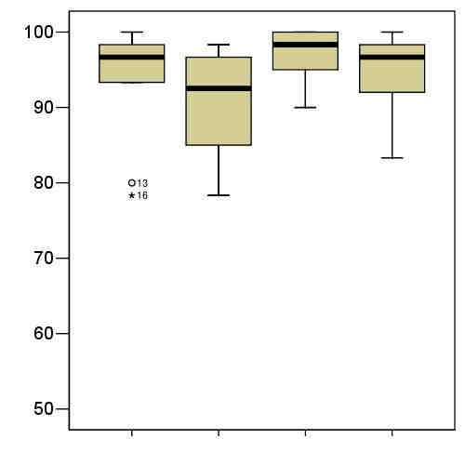
Results
Accuracy (%)
Controls
Patients FJT
Controls
Patients
GDT

Slide 8
Main Effect of Task (FJT/GDT)
Koeda et al. (2013, Frontiers in Human Neuroscience)

Slide 9
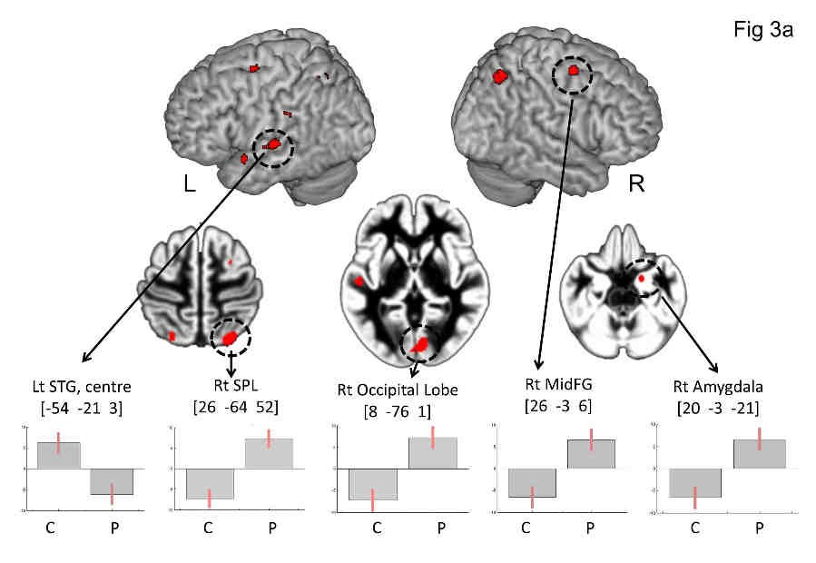
Main Effect of Group (Controls/Schizophrenia)
(P < 0.05, FDR-corrected)
Koeda et al. (2013, Frontiers in Human Neuroscience)

Slide 10
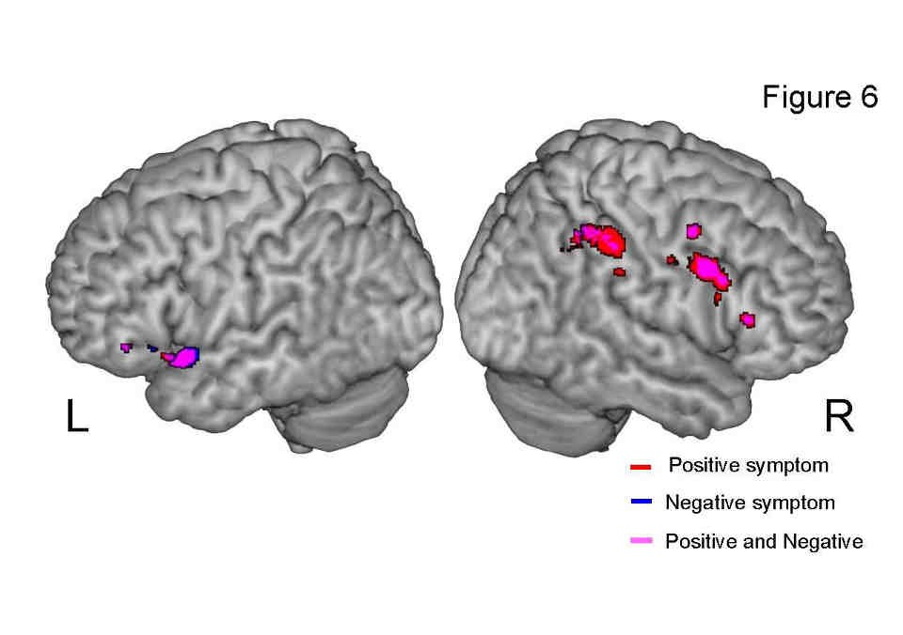
Correlation between cerebral activation under FJT>GDT contrast and psychiatric symptoms
(P < 0.05, FDR-corrected)
Koeda et al. (2013, Frontiers in Human Neuroscience)

Slide 11
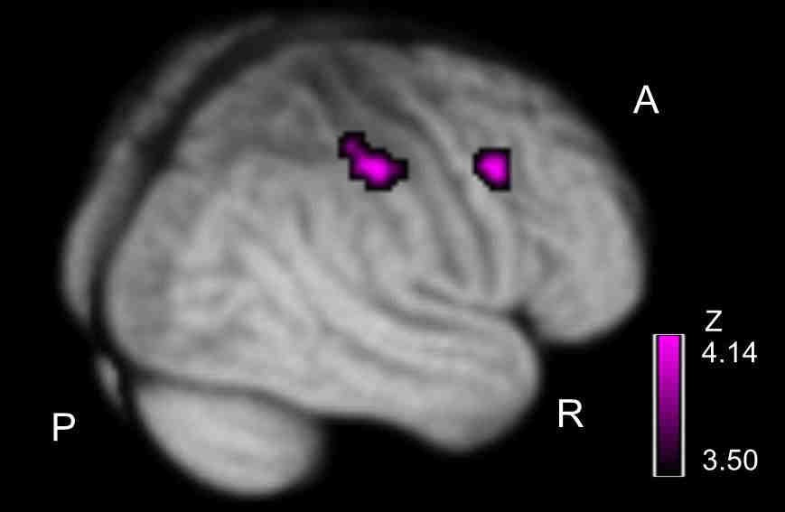
Correlation between favorable activation
and severity of auditory hallucination
Koeda et al. (2013, Frontiers in Human Neuroscience)

Slide 12
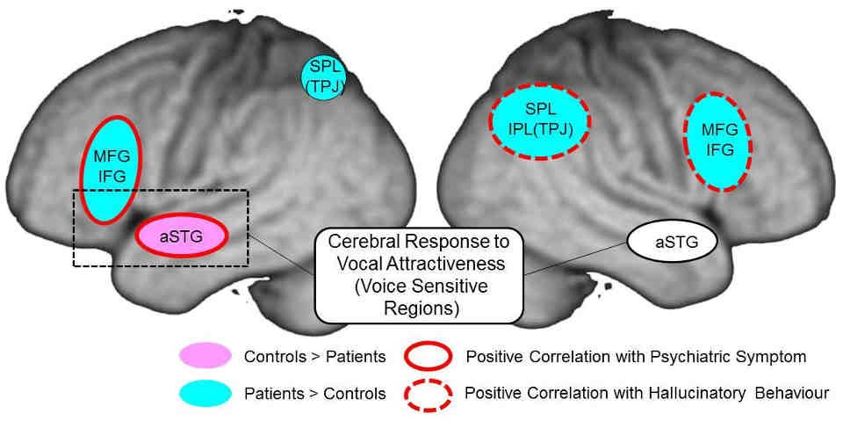
Summary of Results

Slide 13
Discussion
Left STG-IFG activation by recognition of
auditory attractiveness
Cerebral function of STS is important for grasping auditory social cues (Saarela and Hari, 2008; Scharpf et al., 2010).
Functional connection between STG and IFG is important in the recognition of auditory attractiveness (Bestelmeyer et al., 2012).
In accord with these findings, our results showed left STG-IFG activation in the recognition of auditory attractiveness including social communications.

Slide 14
In comparison with controls, schizophrenia patients showed less activation in left STG, but greater activation in MFG, amygdala, TPJ, and occipital lobe in the right hemisphere.
Paradoxical brain activation in schizophrenia patients with auditory hallucination may be caused by both 1) reduced activation due to impaired brain function in auditory processing and 2) increased activation due to disturbance of attention bias toward internally generated information (Jardri et al., 2011; Kompus et al., 2011).
In accordance with this recent study,
less activation in schizophrenia could represent impairment of favorability judgment in auditory processing,
whereas greater activation in schizophrenia may reflect disturbance of attention bias toward internally generated information by the appearance of auditory hallucination.

Slide 15
Conclusions
Cerebral function in recognition of auditory attractiveness was revealed in left IFG and left STG.
In schizophrenia, compared with controls, less activation was observed at left STG, whereas greater activation was confirmed in the right fronto-parietal region. Cerebral response in this region was positively correlated with the severity of auditory hallucinations.
These findings suggest that dysfunction in the left fronto- temporal regions is related to the ability to appropriately assess the attractiveness of vocal communications in schizophrenia.
The right fronto-parietal region could represent cerebral dysfunction to auditory attractiveness including social communications.

