Slide 1

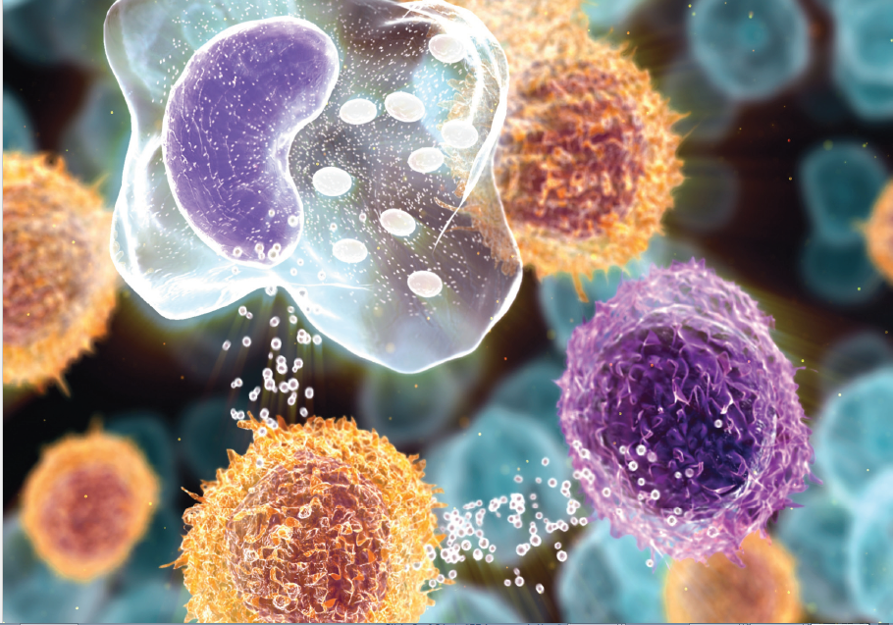
2360 Corporate Circle, Suite 400
Henderson, NV 89074-7722, USA
Innovative Diagnostic Approach
in Primary Immunodeficiency Disorders
Notes:
Good morning.
My name is Michelle Tseng and I am representing the Amerimmune immunology lab. Today I will discuss an innovative approach that is efficient and cost-effective to diagnose PIDs.
I’d like to thank the OMICS International for providing this opportunity and facilitating this conference. I hope this presentation will provide some insights and awareness in finding better approach to diagnosis PIDs.

Slide 2
2360 Corporate Circle, Suite 400
Henderson, NV 89074-7722, USA
Innovative Diagnostic Approach
in Primary Immunodeficiency Disorders
Michelle Tseng
mtseng@oandoalpan.com
Amerimmune Immunology Laboratory
Fairfax, Virginia, United States
Notes:
Good morning.
My name is Michelle Tseng and I am representing the Amerimmune immunology lab. Today I will discuss an innovative approach that is efficient and cost-effective to diagnose PIDs.
I’d like to thank the OMICS International for providing this opportunity and facilitating this conference. I hope this presentation will provide some insights and awareness in finding better approach to diagnosis PIDs.

Slide 3
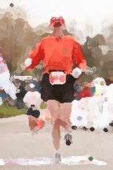

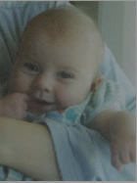
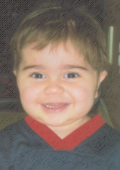
Impacts of Delayed Diagnosis
Contracted other infections with potentials to developing long-term diseases
John
Toni
Brooklyn
Ethan
Immunodeficiency Canada; retrieved from http://immunodeficiency.ca/support/patient-support-stories/
Notes:
Despite major advances in the molecular characterization of PIDs over the last 20 years, and attempts to increase awareness and detection of PID, diagnosis is delayed over 10 years in 45% of the cases.
Although newborn screening programs now help identify immunological emergencies, the vast majority of PIDs still go undiagnosed or are diagnosed too late with severe consequences
For instance,

Slide 4
Presentation Outline
Overview of Primary immunodeficiency disorders (PIDs), scope of immune workup, and diagnosis method
Discuss challenges in the current
methodology used in PIDs diagnosis
Introduce the Amerimmune Curbside Consultation approach
Summary
Notes:
The scope of today’s presentation will cover a brief overview of PIDs in context of immune variations, and their diagnosis to understand how we have progress over the last 80 years in this field.
In addition, I’d address the challenges in diagnosing PIDs and their identification. We hypothesized 3 challenges in diagnosing PIDs. With that said, we have an approach to overcome these challenges with the Amerimmune Curbside Consultation approach. I will illustrate with a study, its method, and share the study result.
Finally, I would sum up my presentation.

Slide 5
Brief Overview of PIDs
Definition of Primary immunodeficiency
disorders (PIDs):
- group of over 150 chronic immune disorders
- caused by hereditary or genetic defects
- not contagious; characterized by infections
- susceptible to opportunistic infections
Prevalence of PIDs:
- diagnose at any age
- affect ~ 1 in 1,200 persons in U.S.
Notes:
Primary immunodeficiency disorders or PIDs is a term used to describe a collective group of 150 genetic disorders which have been described of their molecular characteristics. The mutated genes impair the normal development and function of immune organs, cells, and molecules which lead to developmental arrest in immune differentiation, absent or non-functional proteins, abnormal DNA repair, altered signal transduction, impairment of cell-to-cell and intracellular communications. This causes the impairment of immune responses during opportunistic infections.
With that said, susceptibility to infections is one of the most common symptoms of PIDs. However, the symptoms can vary, and they can be mistaken for common infections. This is one of the reasons it can be difficult to diagnose PIDs. In fact, a PIDs diagnosis can take about 12.4 years from the time symptoms begin.
PIDs were once thought to be a child's disease but we now know that PIDs can be diagnosed at any age. PIDs affect approximately 1 in 1200 persons in the U.S.

Slide 6
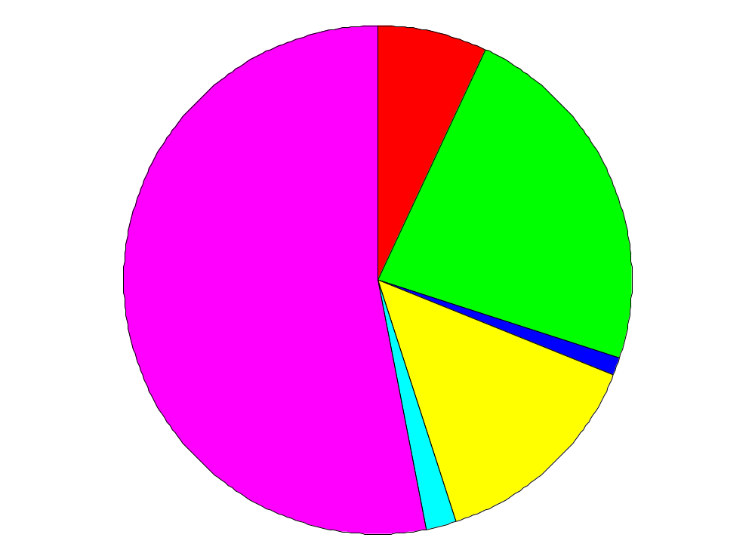
Relative Distribution of PIDs:
Categorized by Defect Type
Cellular Immunodeficiency (7%)
Combined
Immunodeficiency
(23%)
Antibody
Deficiency
(53% of
live births)
Complement
Deficiency (1%)
PMN Dysfunction
(14%)
Other (2%)
Skoda-Smith and Barrett, Contemporary Pediatrics 17:156-165
sIgA deficiency ranges from 1:300 to 1:100,000
80% of affected persons < 20 years of age
70% males (5:1 males in children; 1:1 in adults)
Notes:
This pie chart gives a whole perspective of the relative distribution of PIDs. The fact that antibody deficiency mark up over 53%, follows by combined immunodeficiency,
polymorphonuclear neutrophil dysfunction, and cellular immunodeficiency illustrates

Slide 7
Scope of Immune Workup in PIDs Diagnosis
10 warning signs of PIDs (clues)
Family medical history
- vaccination record, infections, auto-
immune disorders… etc.
Basic and advanced laboratory tests
- lymphocyte lineage enumeration by
flow cytometry
- biochemical tests for soluble molecule
- cellular functional tests
- genetic tests
Notes:
The immune work up usually involve with family history with a physical exam. The blood and skin tests are ordered to check if the blood cells, antibodies, and immune system are working properly.

Slide 8
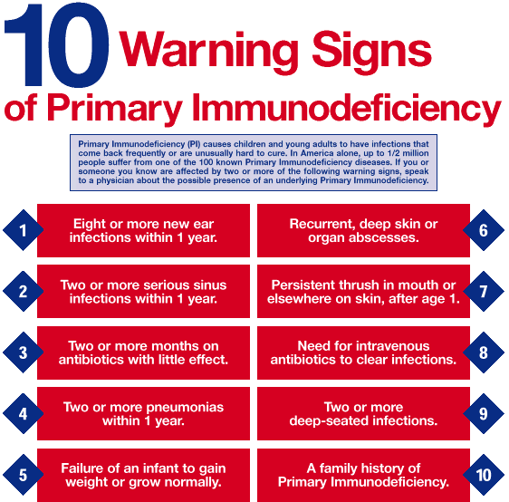
Scope of Immune Workup:
10 Warning Signs of PIDs
10 Warning Signs of Primary Immunodeficiency. Jeffrey Modell Foundation. Retrieved from info4pi.org.
Notes:
There is no good guideline on how to follow these steps.

Slide 9
Scope of Immune Workup in PIDs Diagnosis
10 warning signs of PIDs (clues)
Family medical history
- vaccination record, infections, auto-
immune disorders… etc.
Basic and advanced laboratory tests
- lymphocyte lineage enumeration by
flow cytometry
- biochemical tests for soluble molecule
- cellular functional tests
- genetic tests
Notes:
The immune work up usually involve with family history with a physical exam. The blood and skin tests are ordered to check if the blood cells, antibodies, and immune system are working properly.

Slide 10
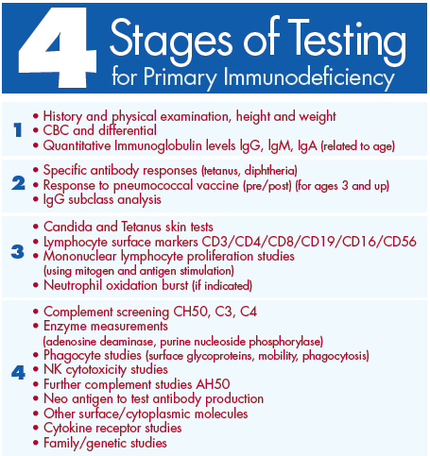
Traditional Step-wise Stages of Immune Workup Approach
4 Stages of Testing for Primary Immunodeficiency. Jeffrey Modell Foundation. Retrieved from info4pi.org.
Notes:
There is no good guideline on how to follow these steps.

Slide 11
Challenges in Diagnosis of PIDs
One major challenge contributed by
physicians
- lack of understanding in immune disorders
- inadequate components of immune
deficiency evaluations
- poor interpretation of test result
Drawbacks in utilizing the step-wise method
- insensitive
- inefficient
Sequential immune
evaluation
Notes:
We hypothesized that physicians lack understanding of immune disorders, the components of an immune deficiency evaluation, and its interpretation as being the three main obstacles in identifying PIDs.

Slide 12
A Solution: Amerimmune Curbside Consultation
Pre-set immune workup diagnostic tool
- multi-dimensional method composed of
necessary, effective immune evaluations
Advantages
- physical referrals are not necessary
- cost-effective
- not much affected by shortages of lab
facilities or immunologists
- blend in nicely with the newly emerging
specialties and health systems
Notes:
We designed a pre-set diagnostic method called “curbside consultation” and offered it to physicians in Northern Virginia, a population of approximately 3 million people. Components of Curbside:
We then calculated prevalence of PID before and after our intervention.

Slide 13
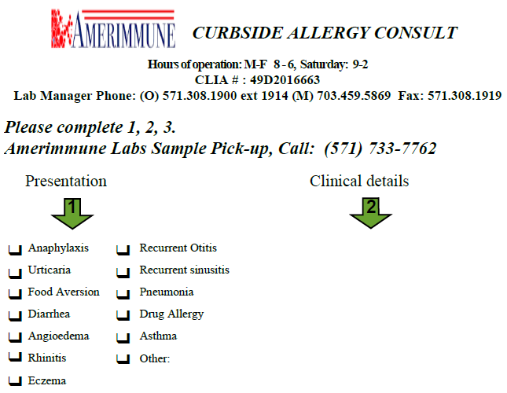
A Solution: Amerimmune Curbside Consultation = Complete Evaluation
http://www.curbsideconsultation.com/
Notes:
We designed a pre-set diagnostic method called “curbside consultation” and offered it to physicians in Northern Virginia, a population of approximately 3 million people. Components of Curbside:
We then calculated prevalence of PID before and after our intervention.

Slide 14
Curbside Consultation Approach:
Immune Profiling
Amerimmune Curbside immune work-up approach:
Immune Compartment | Tests (immune cells by numbers) | Tests (Functions)
Cellular | CBC with differential T-cell (CD3), NK-cell (CD56/16), αβTCR, γδ TCR, CD4RO, CD8RO | Non-specific: Mitogen proliferation & DHR CD25 & HLA-DR on T cells,Th17 Specific: Antigen proliferation or DTH to candida
Humoral | 1. B cell (CD20/19), 2. CD27⁺IgG⁺ B cells, 3. CD27⁺IgM⁺ B cells, 4. CD21dim cells, 5. IgG+ B cells | Specific: Antibody titers to tetanus, pneumococcal 14 serotype and HiB Non-specific: IgG, IgA, IgM, IgE & IgG subclasses
Notes:
ªEven though there is significant overlap and interdependency between the humoral and cellular immune components, the distinction has been made to simplify the immune work-up. ^{b}alpha (α), beta (β), gamma (γ) and delta (δ) ^{c}Memory T-helper (CD4⁺CD45RO) and memory T-killer (CD8⁺CD45RO) cells.^{d}Di-hydro-rhodamine (DHR) test was reserved for patients presenting with abscess.^{e}CD25 (IL-2 receptor) and HLA-DR represent T cell activation status. ^{f}Switched memory B cell (CD27+ IgG+) ^{g}Unswitched memory B cell (CD27⁺IgM⁺) ^{h}CD21 dim cells represent transitional B cells and their increase indicate the presence of auto-reactive B cells. ^{i}Response to vaccination in 4 weeks if never vaccinated or non-immune. DTH = delayed type hypersensitivity; Haemophilus influenzae type b bacteria

Slide 15
Amerimmune Curbside:
Pilot Study Method – Comparison
Surveyed 328 primary care providers from January, 2011 to September, 2012 in northern
Virginia, U.S.
Identified PIDs patients diagnosed in their practices
Offered 10 warning signs & performed Curbside Consultation
- provide patient’s clinical history, pertinent
immunological tests as indicated
Laboratory results interpretation done by immunologists
Notes:
we surveyed 328 primary care providers (PCPs) and specialists asking the number of PID patients they have diagnosed in their practices. We provided them with the 10 warning signs of immunodeficiency⁴ and offered to perform the curbside consultation (Figure 1) in patients they suspected of having an immunodeficiency. The immune evaluation was uniform for all patients. Patients’ clinical history and pertinent findings were reported to us on a “curbside consultation form” along with a blood sample to perform the immunological studies. Laboratory results were interpreted by an immunologist based on the supporting clinical data provided and reported back to the referring physician.

Slide 16
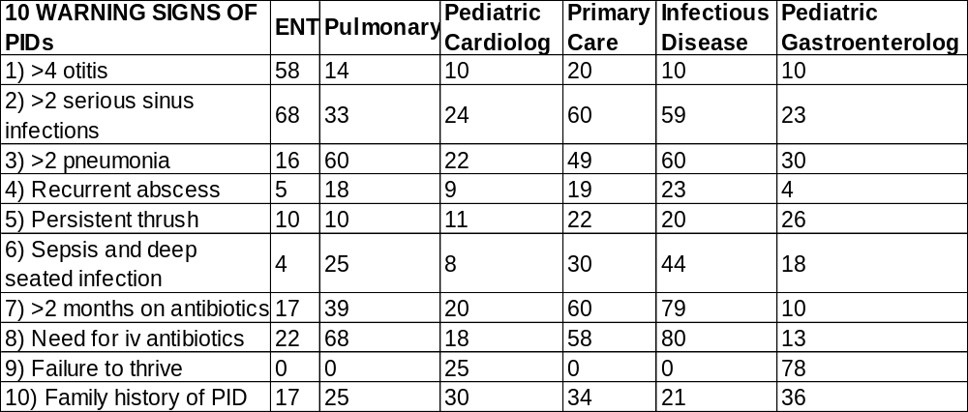
Curbside Study Result: (Pre-)
Cases Based on 10 Warning Signs
Distribution of percentage of patients within each specialty
that had immune work up based on 10 warning signs of PIDs:
Total of 9,265 patients
Notes:
6 medical practices of different specialties
Ear, Nose & Throat Care (ENT) = otolaryngology
Distribution of the10 warning signs of PID within and between specialties. Some patients had multiple warning signs.

Slide 17
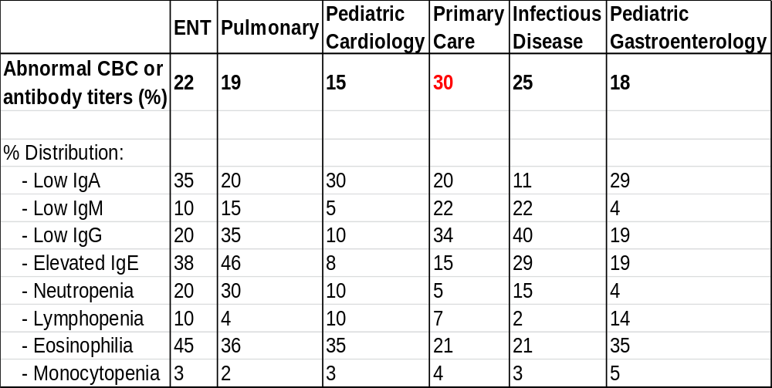
Curbside Study Result: (Pre-)
Low Diagnose Sensitivity
Contribution of immune test groups to the diagnosis of PIDs:
Notes:
: Laboratory findings based on CBC with differential and serum total antibody levels, vaccine titers to S. pneumonia serotypes and Hib, cellular immune system numbers and function and B cell numbers. The percentages in bold represent percent contribution by each laboratory component.
Basically, we utilized the necessary tests and info needed for the diagnosis. This includes complete blood count (CBC) with a differential and serum quantitative antibodies alone detected only up to 30% of the PIDs. The addition of a qualitative assay (e.g. vaccine titers) and immune profiling, each by itself had a statistically significant impact on identifying additional cases of PID
important info in the CBC: 1. Lymphopenia
- Screen for B and T cell Deficiencies
2. Lymphocytosis
- Omenn Syndrome, Leukocyte Adhesion Deficiency
3. Neutrophil Count
- Leukocyte Adhesion Deficiency
4. Platelet Size and Number
- Wiskott Aldrich
Stage 1: Immunoglobulins
1. IgG, IgM, IgA, IgE
2. IgG in young infants less reliable –largely maternal
3. Lab Variations! Age Adjusted Normals
4. Low IgG in Infant
- Hypogammaglobulinemia of Infancy
5. Undetectable IgA
- Primary Immune Deficiency
6. High Levels IgM + Absence of other Ig
- Hyper IgM
7. IgE
- Atopic Disease or Parasitic Illness, Hyper IgE

Slide 18
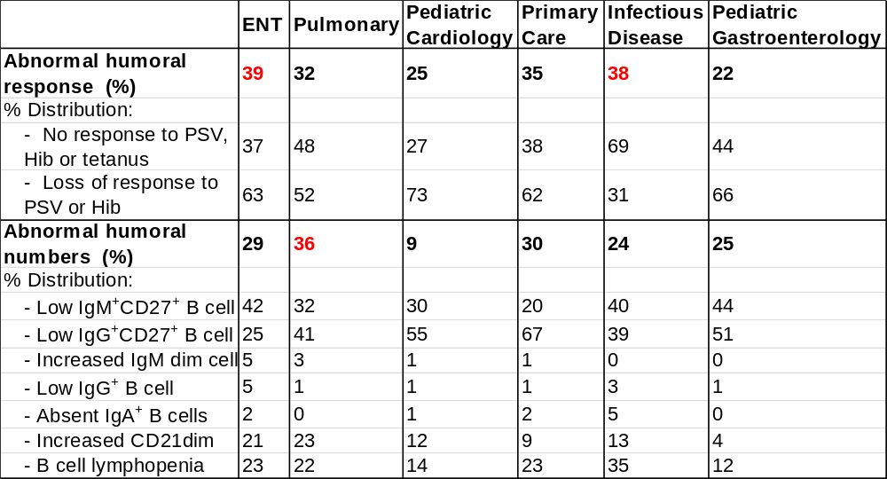
Curbside Study Result: (pre-)
Some Diagnose Sensitivity
Contribution of immune test groups to the diagnosis of PIDs:
Notes:
Furthermore, the value each one of these immune tests differed between specialties

Slide 19
Curbside Study Result: (pre-)
Varied Diagnose Sensitivity
Contribution of immune test groups to the diagnosis of PIDs:
Notes:
For example, T and NK cell abnormalities are more common in pediatric cardiology patients whereas B cell abnormalities are more predominant in pulmonary, primary care, and otolaryngology referrals

Slide 20
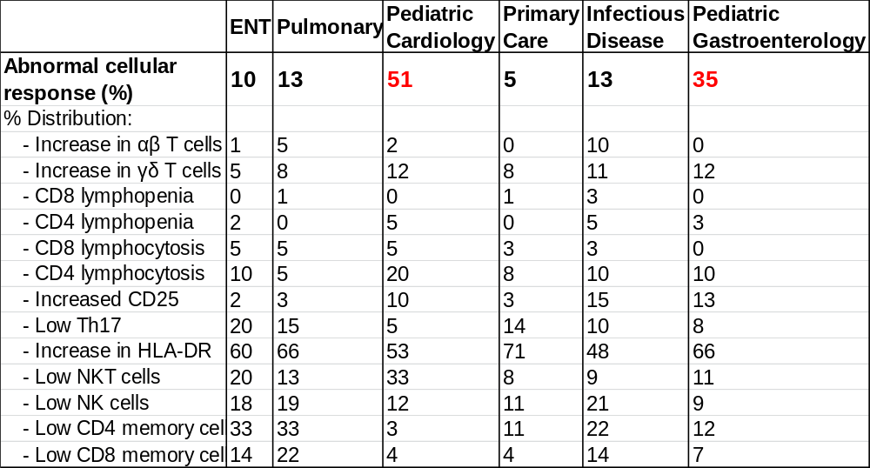
Curbside Study Result: (Pre-)
Better Diagnose Sensitivity
Contribution of immune test groups to the diagnosis of PIDs (%):
Notes:
For example, T and NK cell abnormalities are more common in pediatric cardiology patients whereas B cell abnormalities are more predominant in pulmonary, primary care, and otolaryngology referrals

Slide 21
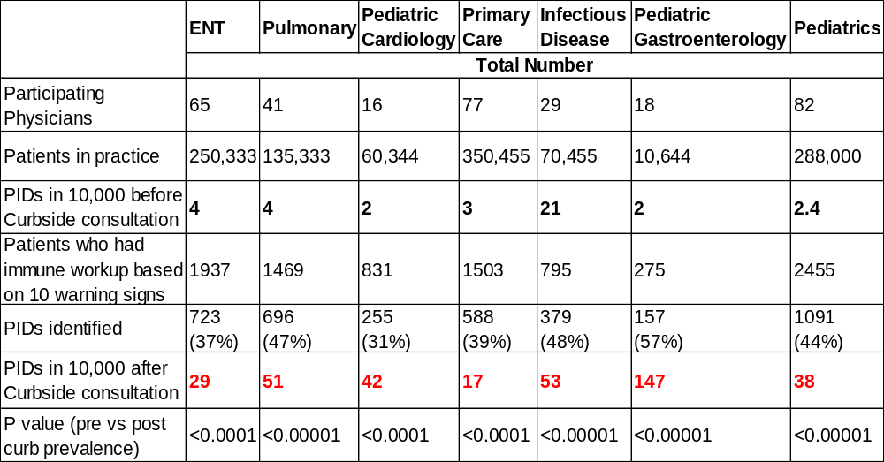
Curbside Study Result: (post-)
Improved Diagnosis Sensitivity
Prevalence of PIDs before and after Curbside Consultation:
Notes:
Primary Immune Deficiency (PID) prevalence (per 10,000 patients) was determined based on number of patients in individual practices and number of diagnosed PID cases within that practice. Numbers are grouped based on specific specialties. The number of patients that went through the full immune work-up and the percentage and number that were diagnosed with a PID is also shown.

Slide 22
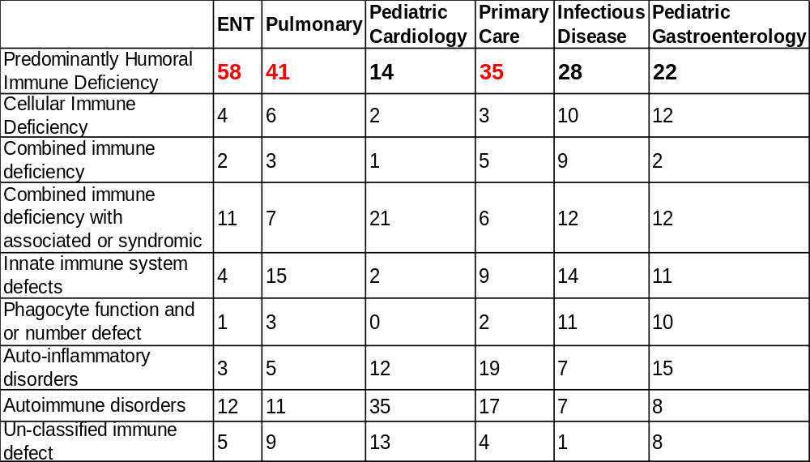
Curbside Study Result: (post-)
Type of PIDs Diagnosed
Distribution PIDs type diagnosed (%):
Notes:
Diagnosis of patients who were found to have PID. A small subset of patients, labeled as un-classified immune defect, does not have a specific diagnosis despite laboratory evaluation. Further genetic evaluation was performed in a subset of patients with abnormal initial screening to come up with a definitive diagnosis.

Slide 23
Curbside Study Overall Result:
Significant Improved Diagnosis
9,265 total patients involved in over 2-year in
northern VA
Increased PIDs prevalence from 5.3 to 33 per
100,000 (p<0.001) before and after consultation
Revealed higher prevalence & incidence of PIDs
Observed significant change in case numbers
of PIDs diagnose in practices include ENT,
pulmonary, and pediatric gastroenterology

Slide 24
Summary
Challenges in the step-wise immune workup method
Our data showed the need for complete assessment
Pre-set Curbside Consultation diagnostic tool significantly impacts:
- narrows gap in identifying PIDs patients
- provides efficient and cost-effective solution
- improves diagnose accuracy, and shortens delays
- solves the problems of inadequate regulated, lab
facilities and shortage of immunologists
- meets the needs of other medical specialties,
and advances patient-care in this field
Notes:
Despite advances in clinical immunology with numerous new immunodeficiencies being identified, there remains a significant gap in identifying patients in clinical practice. Our data demonstrates that physicians play a major role in delaying diagnosis of immune disorders. Offering a pre-set diagnostic tool, such as curbside consultation, is one solution to correct this gap. Since physical referrals are in general not necessary for curbside consultation to be operational, it would not be so much affected by shortage of immunologists, and would also blend in nicely with the newly emerging specialties and health systems such as telemedicine and patient centered medical home. Based on the observations in our cohort, the true prevalence and incidence of immunodeficiencies are significantly higher in the general population than is currently believed¹.
Traditionally, the diagnosis of immune disorders is taught as a step-wise approach and there are no clear guidelines on which step comes first or how far to progress the evaluation⁵⁻⁷. We demonstrate the need for a complete assessment of the immune system, in a quantitative and qualitative manner. There is a statistically significant impact in improving accurate diagnosis of immune disorders. Although our study did not do a cost analysis, we argue that it saves healthcare costs by reducing patient referrals, decreasing exhaustive diagnostic evaluations and interventions, and likely lessening morbidity by shortening delays in diagnosis.
Take home message: we have a pre-set immune workup approach in diagnosing PIDs which the classic approach can never pick up till patients contract long-term illnesses.

Slide 25

Acknowledgment
Amerimmune Lab:
Matthew Plassmeyer
Gerald Marti
Raavi Gupta
Stacie Anderson
Mark Ryherd
Ishmael Mourning Soren Sonder Yuliya Kleschenko
Connor Alexander
Ines Eugenio-Fernandez
Alice Agyeman
Immunology Clinic:
Oral Alpan
Laura Noonan
Denise Loizou
Amer Khojah
Thank
You !!

Slide 26



Amerimmune Lab Services
Services | Tests |  | Diseases or Therapeutics
Diagnostics | 1st Tier: Lymph subset Lymph monitor B cell Maturation Eosinophil Memory T subsets DCs IPF | 2nd Tier: Functional assays | Primary immunodeficiency disorders (PIDs), Asthma, Rheumatoid, IBD
Pre-clinical & clinical trials | Flow Cytometry, ELISA |  | All therapeutics
Clinical Research | Flow Cytometry, ELISA, Gene sequencing… etc. |  | PIDs, Asthma, Rheumatoid, IBD
Notes:
I’d like to take an one-minute pause to tell you what services our lab provides to benefit patients and healthcare. Amerimmune is CLIA and CAP-accredited immunology lab. We perform a variety of lab services, especially in the fields of primary immunodeficiency disorders as well as autoimmune disorders. We develop, validate and perform assays for diagnostics, pre-clinical and clinical studies. We have our own clinical research, focusing on PIDs and autoimmune disorders.

Slide 27
2360 Corporate Circle, Suite 400
Henderson, NV 89074-7722, USA
Amerimmune Immunology Lab at http://www.amerimmune.com/
Amerimmune Curbside Consultation at
http://www.curbsideconsultation.com/
Clinical Diagnostics & Clinical Trials
11212 Waples Mill Road, Suite 100,
Fairfax, VA 22031
Consultations & inquiries send to
Michelle Tseng at mtseng@oandoalpan.com
Matt Plassmeyer at mplassmeyer@oandoalpan.com
Thank
You !!
● Immune
deficiencies
● Gaucher
● IBD
● Asthma
● Rheumatoid
Arthritis

Slide 28
Supplemental Slides

Slide 29
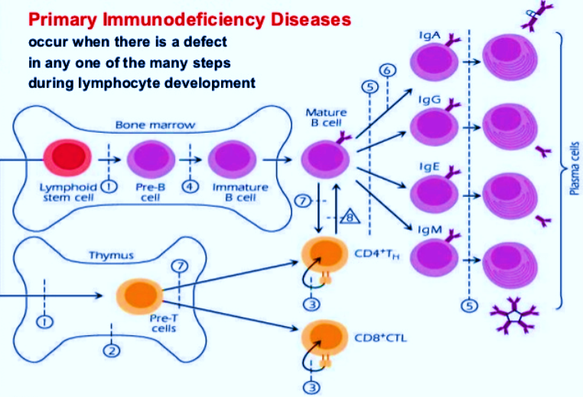
Immune Cell Development & PIDs:
Occurs in Any Defective Step
① Severe combined immunodeficiency syndrome (T-B-SCID)
② DiGeorge syndrome
③ T cell signaling deficiency
④ X-linked agammaglobulinemia
⑤ Common variable immunodeficiency
①
NK cell
MHCII
⑥ Selective IgA deficiency
⑧ Hyper IgM syndrome
⑦ Bare lymphocyte syndrome
Notes:
Complexity of PIDs:
PIDs occur when there is a defect in any one of the many steps during lymphocyte development.

Slide 30
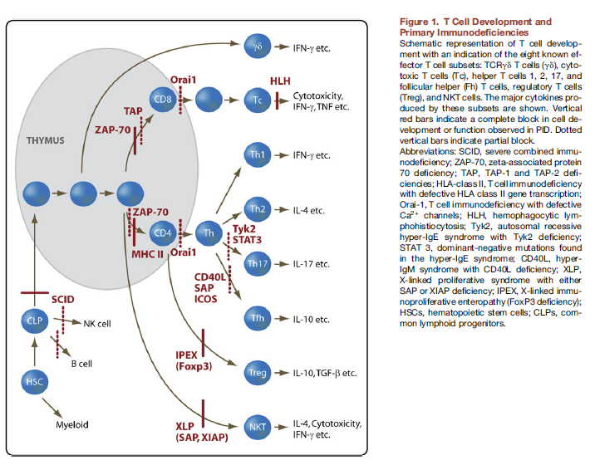
Immune Cell Development & PIDs:
Occurs in Any Defective Step
8 Hyper IgM syndrome
9 IPEX
10 XLP
⑧
9
10
Notes:
.

Slide 31
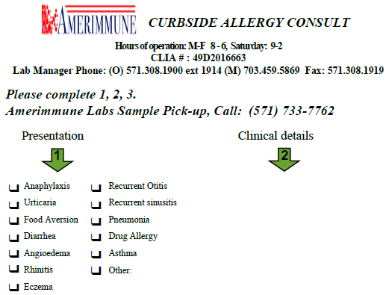
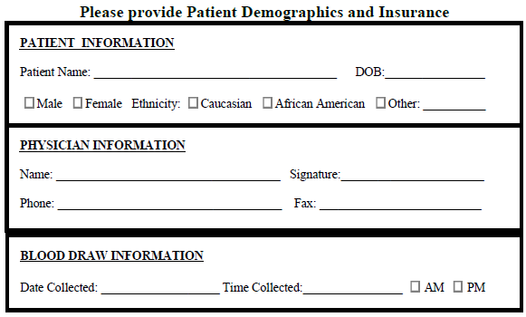
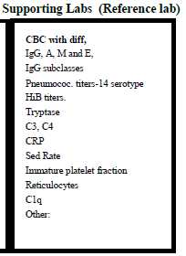
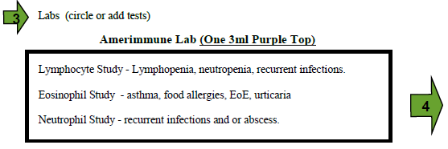
Curbside Consultation Form
Notes:
Now, quite a bit has changed since 1926 when the first case of ataxia telangiectasia or Louis–Bar syndrome. This cartoon shows the early depiction of patients and current patient with CVID receiving IVIG replacement.

Slide 32
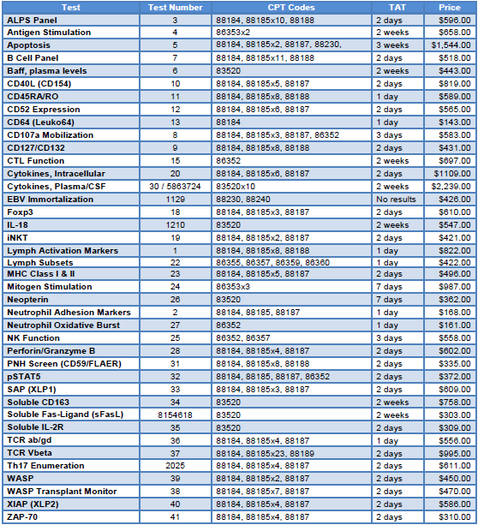
Immune Workup – Lab Test Cost
$1,972

Slide 33
Amerimmune Cellular & Humoral Immune Lab Tests Cost
Cost <65%
Immune Compartment | Tests | Function
Cellular | CBC with differential T-cell (CD3), NK-cell (CD56/16), αβTCR, γδ TCR CD4RO, CD8RO | Non-specific: Mitogen proliferation & DHR CD25 & HLA-DR on T cells,Th17 Specific: antigen proliferation or DTH to candida
Humoral | 1. B cell (CD20/19), 2. CD27⁺ IgG⁺ B cells, 3. CD27⁺IgM⁺ B cells. 4. CD21dim cells 5. IgG+ B cells | Specific: antibody titers to tetanus, pneumococcal 14 serotype and HiB Non-specific: IgG, IgA, IgM, IgE & IgG subclasses

Slide 34

Immune Workup in PIDs Diagnosis
History of PIDs Diagnosis
1st case –
Ataxia
telangiectasia
Shearer, W.T. and Fischer, A. J. Allergy Clin. Immunol., Vol. 117, No.4
Notes:
Now, quite a bit has changed since 1926 when the first case of ataxia telangiectasia or Louis–Bar syndrome. This cartoon shows the early depiction of patients and current patient with CVID receiving IVIG replacement.

Slide 35
A Solution: Curbside Consultation
Pre-set immune diagnostic tool
- “curbside”, same-day pick up specimen from
healthcare facilities to Amerimmune lab
- new quantitative and qualitative “hybrid”
approach for immune workup
- solve the problems of inadequate regulated,
advanced lab facilities and shortage of
immunologists
- meets the needs of other medical specialties,
improves social problem of health status, and
advances patient-care in this field
Notes:
We designed a diagnostic method called “curbside consultation” and offered it to physicians in Northern Virginia, a population of approximately 3 million people.³ We then calculated prevalence of PID before and after our intervention.
If we analyze the data in a step-by-step manner, complete blood count (CBC) with a differential and serum quantitative antibodies alone detected only up to 30% of the PIDs. The addition of a qualitative assay (e.g. vaccine titers) and immune profiling, each by itself had a statistically significant impact on identifying additional cases of PID

Slide 36
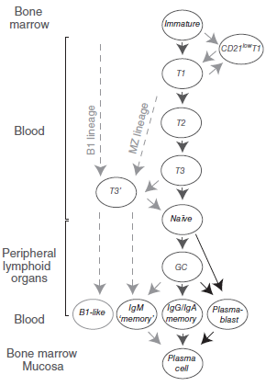
B/T Cell Development & PIDs

Slide 37
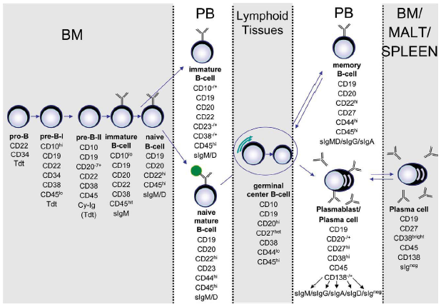
B Cell Development
Notes:
Normal human B cells development in terms of differentiation stages

