Slide 1
About OMICS Group
OMICS Group is an amalgamation of Open Access Publications and worldwide international science conferences and events. Established in the year 2007 with the sole aim of making the information on Sciences and technology ‘Open Access’, OMICS Group publishes 500 online open access scholarly journals in all aspects of Science, Engineering, Management and Technology journals. OMICS Group has been instrumental in taking the knowledge on Science & technology to the doorsteps of ordinary men and women. Research Scholars, Students, Libraries, Educational Institutions, Research centers and the industry are main stakeholders that benefitted greatly from this knowledge dissemination. OMICS Group also organizes 500 International conferences annually across the globe, where knowledge transfer takes place through debates, round table discussions, poster presentations, workshops, symposia and exhibitions.

Slide 2
OMICS International Conferences
OMICS International is a pioneer and leading science event organizer, which publishes around 500 open access journals and conducts over 500 Medical, Clinical, Engineering, Life Sciences, Pharma scientific conferences all over the globe annually with the support of more than 1000 scientific associations and 30,000 editorial board members and 3.5 million followers to its credit.
OMICS Group has organized 500 conferences, workshops and national symposiums across the major cities including San Francisco, Las Vegas, San Antonio, Omaha, Orlando, Raleigh, Santa Clara, Chicago, Philadelphia, Baltimore, United Kingdom, Valencia, Dubai, Beijing, Hyderabad, Bengaluru and Mumbai.

Slide 3
Combining quantitative and qualitative methods in signal detection and evaluation in pharmacovigilance.
Michelle Perry

Slide 4
Scope
Background
Method
Results
Conclusion
Further research

Slide 5

Thalidomide children- born with various limb defects
Notes:
I know this is a picture you have probably all seen many times. However I feel it needs to be remembered.
While much progress has been made since the thalidomide disaster in the early 1960s, PV is an area in which improvement is needed for early detection of adverse drug reactions (ADRs) in addition to reducing their incidence, severity or sequelae.

Slide 6

In an ideal world…
Notes:
In an ideal world we have all the information prior to marketing, we would know the correct dose, the correct time to give the medication, the correct patient in which to administer the product and there would be no detrimental side effects.

Slide 7
Spontaneous Reporting Data
Many types of data that can be used to monitor potential safety signals.
The largest and most important is that gathered from spontaneous reporting
Others include:
PILs SPC Clinical Trials Literature Internet searches
Notes:
The nature of PV means there are many types of data that can be used to monitor potential safety signals.
The largest and most important is that gathered from spontaneous reporting. Other sources include patient information leaflets (PILs), summaries of product characteristics (SPC), CT data and information gathered from literature and worldwide web searches.

Slide 8
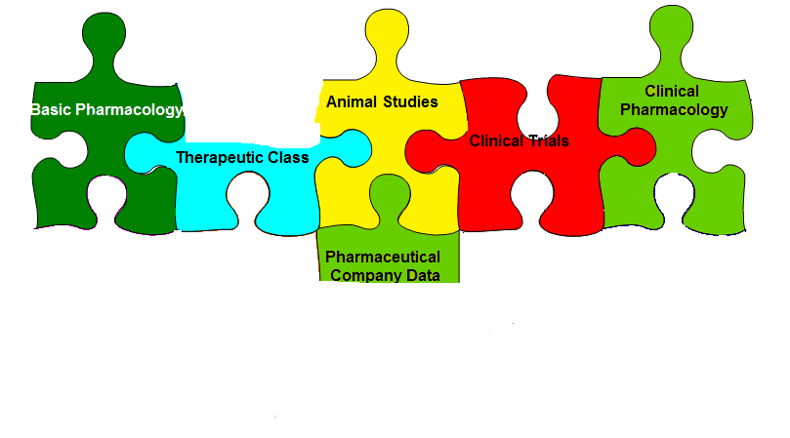
In reality!
Notes:
When a product reaches the market there is much information missing from the overall safety profile and we have much to learn through post marketing, spontaneous reports.

Slide 9
Use of statistics in PV
Disproportionality; comparing the observed number of reports to the expected number of reports in the background data
PRR – Proportional Reporting Ratio calculation = A/(A+B)
C/(C+D) Where….
Notes:
Disproportionality if used in PV to compare the number of reports of a medical term observed with a medicinal product, with the number of reports for that medical term reported for all other medicinal products reported in the database, that is the expected count.
There are various ways of calculating the observed to expected ratio, the disproportionality calculation used is irrelevant as the methods used are shown to be indifferent in generating signals in the literature.
For this study the Proportional Reporting Ratio was used, as it was used by the MHRA for signal generation with Yellow Card reports up until 2006, and the two data sets used start before 2006. Using the calculation used at the time the data was entered will allow for direct comparison of signals generated at each time point without and with the added weighting.

Slide 10
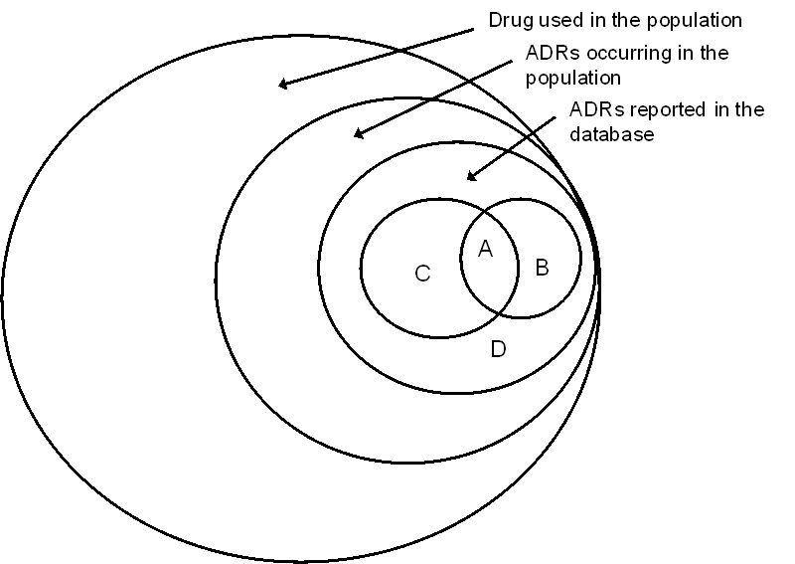
Notes:
A is the number of reports for the medical term investigated reported with the drug in question
B is the number of reports on the same drug but that do not have the reaction term
C is the number of reports for the reaction term but not on the drug in question
D is the number of reports in the database that don’t have the drug of the reaction term
The calculation is carried out so that each report is only counted once. The drug/reaction pair under investigation was not included in the background rate, only the “observed” rate.

Slide 11
Statistical Weighting
Important associations were given a higher numerical value
Augmented disproportionality
Potential signals detected earlier ?
Notes:
By statistical weighting we mean adding a higher numerical value to important associations identified.
The signal detection process operates as usual for disproportionality but was augmented with weightings based on ratings provided by physicians as discussed yesterday.
It’s aim, to identify possible ADRs earlier with enhanced supportive evidence.

Slide 12
    Rationale behind chosen medical concepts to weight
At the centre of this research was the ability to identify the important risk factors to monitor during initiation of a medicinal product to the market from information available prior to widespread marketing authorisation.
The rationale came from SPCs and PILs submitted to the EMA when applying for marketing authorisation.
The main issues with current treatments for diabetic patients were concerns about adding to the cardiovascular risk, weight gain, oedema, potential association with pancreatitis, concerns about renal function, and unknown long-term safety.

Slide 13
SMQs
(standardised MedDRA queries)
SMQs group terms from various SOCs together to aid identification of a medical concept.
The SMQ Cardiac Failure has terms from
Cardiac disorders
Vascular disorders
Investigations
Respiratory, thoracic and mediastinal disorders
Pregnancy, puerperium and perinatal conditions
Notes:
The SMQ was used to model the weighting method while monitoring the terms for cardiovascular risk highlighted from the information available pre-marketing.
It was important that we used the scientific discussion available on the EMA website from before the model products reached the market.

Slide 14
Terms to model weighting and the averages obtained from the physician ratings
Preferred Term | Average rating
Left ventricular failure | 2.82
Oedema | 1.55
Oedema peripheral | 1.70
Cardiac failure | 2.91
Cardiac failure congestive | 3
Pulmonary oedema | 2.18
Notes:
The author decided to weight known “true” signals first as the comparison of when the terms became signals without weighting and with weighting would show the efficiency of the method. The first weighting applied was the crude average of the physician ratings, i.e. the number of reports for each of the six terms was multiplied by the average rating, see Table 3.4. It was clear that the weighting would have little or no effect on those terms with an average rating of 1 or close to 1. For terms with an average of 3 or close to 3, the weighting would mean it became a signal with just one report.
The six terms initially weighted were rated very important or important, with oedema being rated lowest at an average of 1.55. Left ventricular failure, oedema peripheral and oedema were weighted first as left ventricular failure had an average rating close to 3, oedema peripheral was close to 2 and oedema had the lowest average weighting of these six terms providing a good range. Oedema peripheral and oedema were “true” signals for both pioglitazone and rosiglitazone. The five drug-event pairs; pioglitazone with left ventricular failure, oedema peripheral and oedema and rosiglitazone with oedema peripheral and oedema, were examined with and without weighting in the results section. These three terms were part of the SMQ cardiac failure. No terms from the SMQ acute pancreatitis were identified as “true” signals in the dataset prior to weighting.
Taking the average ratings as the weighting factor (WF), i.e. multiplying number of reports by the mean physician rating provided some difficulties. For example rating close to 1 was insignificant and rating close to 3 was overly sensitive. It was decided that a form of shrinkage (see Section 3.3.3) could be adapted to the ratings obtained from the physician study. Thus the second and third weightings applied to the three terms initially weighted were the averages multiplied by 0.6 and 0.7 respectively. Halving the weighting factor would result in the number of reports being less than 1 for terms with a only 1 report, so the WF had to be higher than 0.5. The three weightings applied were; mean, mean*0.6 and mean*0.7, see Table 3.5 (where * means multiplied by).

Slide 15
Terms and weightings applied
Preferred Term | Weight 1 | Weight 2 | Weight 3
Left ventricular failure | 2.82 | 1.69 | 1.97
Oedema | 1.55 | 0.93 | 1.08
Oedema peripheral | 1.7 | 1.02 | 1.19
Cardiac failure | 2.91 | 1.75 | 2.04
Cardiac failure congestive | 3 | 1.8 | 2.1
Pulmonary oedema | 2.18 | 1.31 | 1.53
Where: Weight 1 = mean rating
Weight 2 = Mean*0.6
Weight 3 = Mean*0.7
Notes:
The correct weighting to be applied cannot be defined until sensitivity analysis has been carried out and a review of the number of false positives and false negatives can be assessed. For this reason the method must be tested retrospectively, to show which potential signals identified by disproportionate calculations became true positives and which became true negatives through causality assessment and clinical evaluation.
After the initial modelling of these weightings, other terms from the physician study that were included in the dataset but did not become potential signals in the twenty-four months were weighted. Some of these tables and figures are shown in the results section of this chapter if considered important in demonstrating the method;

Slide 16
Phase 2 – applying weighting
First data set
2 years (2005-2007)
PRRs, Confidence Intervals lower and higher, and chi-squared calculated every month
Dynamic PRR reports produced
Second data set
10 years (2000-2010)
PRRs, Confidence Intervals lower and higher, and chi-squared calculated at the end of the 10 years
Static PRR reports produced
Notes:
Dynamic PRR reports could be generated for each reaction term and the drug being investigated in the two year dataset
Dates were not provided in the second data set spanning 10 years, from 2000-2010, therefore static PRR reports for each reaction term weighted were produced, showing the disproportionality of the drug/ reaction term at the end of the 10 years

Slide 17
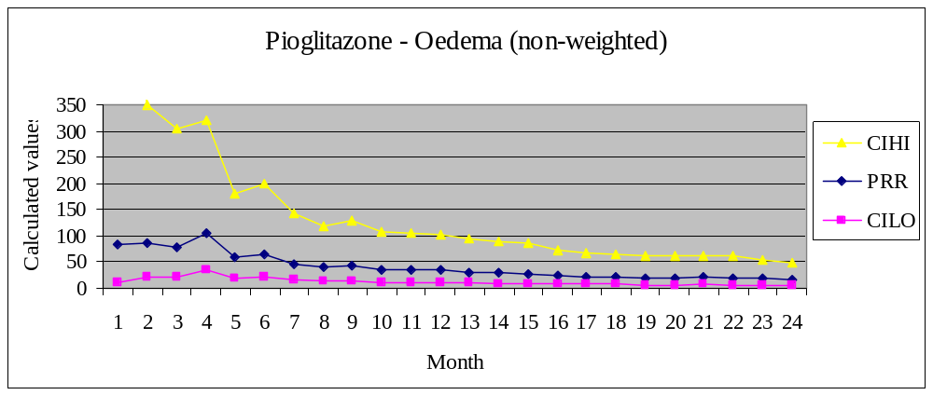
An example of a dynamic PRR report
Notes:
For example, from this dynamic PRR report of pioglitazone reported with oedema, prior to any weighting, there is a clear spike in PRR and CI at month 4. This was when the number of cases reached the limit of 3, and the thresholds for PRR, CI and Chi-squared were all passed.

Slide 18
PRR
The null value for PRR is 1.
If PRR = 1 then the number of drug/event reports for that drug is proportionate to the number of drug/event reports in the whole database.
PRR > 1 means the drug/event combination is disproportionate to the background data and requires further investigation.
Notes:
PRR is a highly sensitive method which may produce a high number of false positive signals when the number of reports is low, which is why the threshold for PRR is set at 2. However this needs further interpretation, as when few spontaneous reports exist in a large PV database for a drug/event, the PRR will be unrealistically high. The use of significance statistics with PRR, such as χ² and CIs, and the recommended threshold of at least 3 cases help to deal with this, along with the more recent development of shrinkage methods.

Slide 19
Summary table for pioglitazone- oedema
Month_signal | Weighting factor | PRR | CILO | CHI2 | No. of cases
4 | none | 104.82 | 34.26 | 247.59 | 3
4 | 1.55 (mean) | 107.84 | 36.06 | 468.48 | 3
4 | 0.93 (mean*0.6) | 71.02 | 9.32 | 109.09 | 3
4 | 1.08 (mean*0.7) | 84.09 | 22.98 | 280.43 | 3
The disproportionality was so far above the thresholds that once the minimum 3 reports were received it was a potential signal for further review.
Notes:
When the three weighting factors were applied to oedema reported with pioglitazone, there was no affect on when oedema became a potential signal.

Slide 20
Oedema Peripheral - Pioglitazone
 | Month became potential signal
PT | Non-weighted | Weight 1 (mean) | Weight 2 (mean*0.6) | Weight 3 (mean*0.7)
LVF | 24 | 24 | 24 | 24
Oedema | 4 | 4 | 4 | 4
Oedema peripheral | 10 | 9 | 17 | 9
CF | - | - | - | -
CF congestive | - | - | - | -
Pulmonary oedema | - | - | - | -
Nausea | - | - | - | -
- PT did not become a potential signal for pioglitazone with that weighting factor applied
Notes:
Oedema peripheral is reported from month 1 in the dataset, and becomes a signal in month 10 with three reports, a PRR of 4.32, CI lower of 1.48 and χ2 value of 7.77

Slide 21
Oedema Peripheral - Rosiglitazone
 | Month became potential signal
PT | Non-weighted | WF 1 (mean) | WF 2 (mean*0.6) | WF 3 (mean*0.7)
LVF | - | - | - | -
Oedema | 19 | 19 | 19 | 19
Oedema peripheral | 19 | 17 | 23 | 18
CF | 3 | 3 | 3 | 3
CF congestive | 15 | 15 | 15 | 15
Pulmonary oedema | 15 | 15 | 15 | 15
Nausea | - | - | - | -
- PT did not become a potential signal for pioglitazone with that weighting factor applied
Notes:
Oedema peripheral now became a potential signal for evaluation in month 17, when the PRR was 2.79, the lower bound of CI was over 1 and the chi-squared was well above 4 at 7.88. With this weighting added it is now a potential signal with just 4 cases reported, rather than the 6 cases reported when it became a potential signal with no weighting.

Slide 22
10 Year data set
Oedema peripheral - pioglitazone
Weight | PRR | CILO | CIHI | CHI²
None | 1.84 | 1.22 | 2.76 | 8.55
1.70 | 3.12 | 2.29 | 4.25 | 51.40
1.02 | 1.87 | 1.25 | 2.81 | 9.28
1.19 | 2.18 | 1.50 | 3.17 | 16.74

Slide 23
Oedema peripheral
Considered a “true” signal for pioglitazone and rosiglitazone in the original non-weighted 2 year data.
Not a “true” signal in the 10 year data set.
Now know from literature that oedema peripheral is associated with pioglitazone(1) and rosiglitazone(2) use(3;4).
Based on clinical studies, fluid retention and oedema peripheral are reported in up to 7% of patients using glitazones, and up to 15% of patients using pioglitazone with insulin(5).
Notes:
In the literature search conducted by the author from 2009 onwards, many studies have discussed the association of glitazones, particularly pioglitazone and rosiglitazone, with cardiac failure, fluid retention and oedema peripheral.

Slide 24
This research aimed to investigate the role of the additional data sources in earlier signal detection.
Fair to moderate agreement for the terms rated as very important (3)
Applying the mean rating had the biggest affect on disproportionality
All true positive drug/event term pairs were identified will all weighting factors

Slide 25
IN CONCLUSION
The enhanced detection process may allow more accurate and earlier prioritisation of ADR reports for further investigation, thus leading to improved, proactive signal detection.

Slide 26
Further research
Rating of terms for more medical concepts by a refined group of experts for each medical area.
Application of weighting factors to more terms for more drugs in a large spontaneous reporting database.
Incorporate visual evaluation tools to aid the signal review phase of PV.

Slide 27
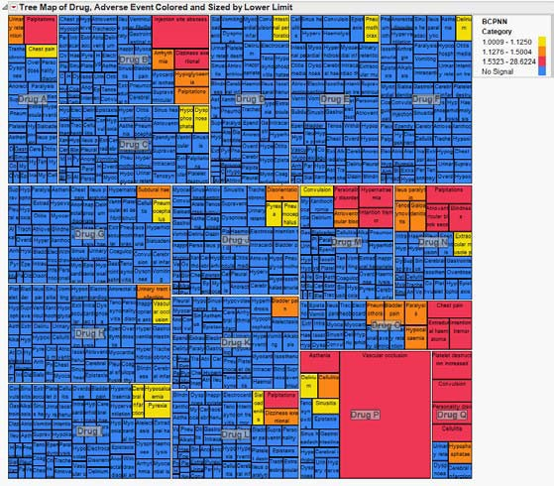
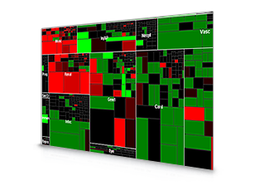
Visual evaluation tools
Examples that exist already include Oracle and JMP clinical tree map of ADRs shown below.
Notes:
But a method that includes a weighting method for terms of special interest and takes into account many other factors, such as age, gender, concurrent conditions, country of occurrence, co-suspects, etc. will aid in evaluation and discovery of trends of suspected ADRs.

Slide 28
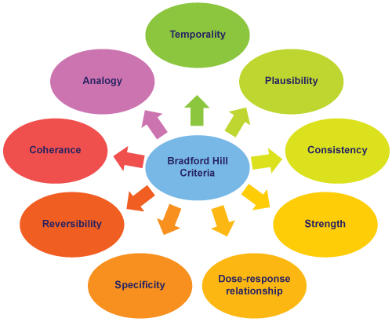
Notes:
If the evaluation tool also took into account criteria used to assess causality and well as a system for prioritisation, for example the impact analysis used at the MHRA, the detection, evaluation and prioritisation phases of signal management can be carried out quickly and effectively.
In 1965 Sir Austin Bradford Hill composed a list of criteria to help evaluate whether an observed association between an exposure and an outcome is likely to be causal. These are now commonly known as the Bradford Hill criteria. Although none of the criteria alone can prove that a relationship is causal, used together, they can help make an overall judgement about whether a causal relationship is likely.

Slide 29
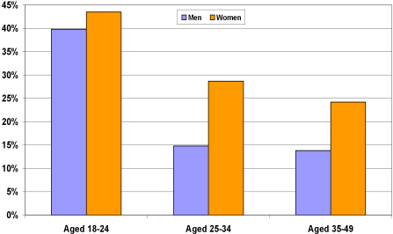
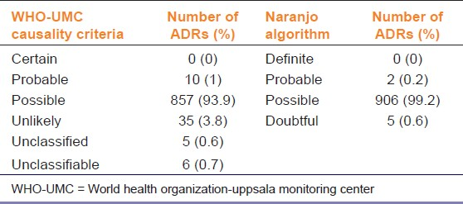
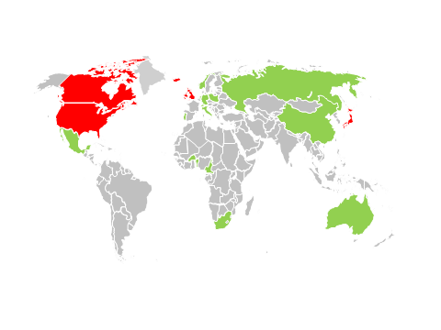
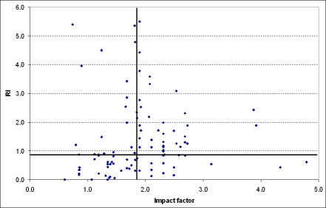
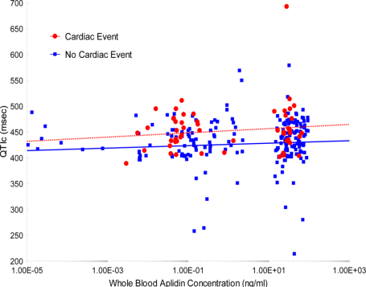
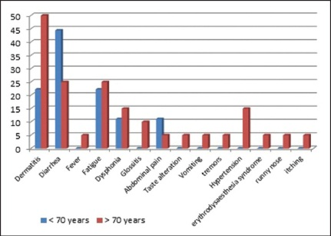
Visual tools
Drug-Active ingredient
Event-Preferred Term
Notes:
Visual tools – potential to add in a lot of various factors, and filters.
Add various statistics.
With any method validation is required retrospectively, to measure numbers of false/true positives and false/true negatives and to ensure no true positive are missed without identifying too much noise with false negatives. Something that is difficult with PV data as defining what is a true positive safety signal is a difficult task.

Slide 30
References
Shah P, Mudaliar S. Pioglitazone: side effect and safety profile. Expert opinion on drug safety 2010;9(2):347-54.
Narang N, Armstead SI, Stream A, Abdullah SM, See R, Snell PG, et al. Assessment of cardiac structure and function in patients without and with peripheral oedema during rosiglitazone treatment. Diabetes and Vascular Disease Research 2011;8(2):101-8.
Kikuchi M, Kaku K, Odawara M, Momomura Si, Ishii R. Efficacy and tolerability of rosiglitazone and pioglitazone in drug-na+»ve Japanese patients with type 2 diabetes mellitus: a double-blind, 28 weeks' treatment, comparative study. Current Medical Research & Opinion 2012;28(6):1007-16.
Derosa G, Tinelli C, Maffioli P. Effects of pioglitazone and rosiglitazone combined with metformin on body weight in people with diabetes. Diabetes, Obesity and Metabolism 2009;11(12):1091-9.
EDWIN HR, HAN DP, RAMSAY RC, CANTRILL HL, BENNETT SR, Dev S, et al. Diabetic macular edema associated with glitazone use. Retina 2006;26(5):562-70.

Slide 31
Let us meet again..
We welcome you all to our future conferences of OMICS International
5th International Conference & Exhibition on Pharmacovigilance & Clinical Trials
On
September 19 - 21, 2016 at Vienna, Austria http://pharmacovigilance.pharmaceuticalconferences.com/

