Slide 1
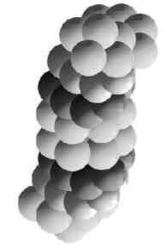

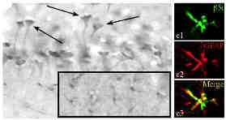
Immunoproteasome in neuroinflammation
Michele Mishto
Institut für Biochemie
Universitätsmedizin Berlin- Charité
Brain Disorder Conference - London
August 24th 2015

Slide 2
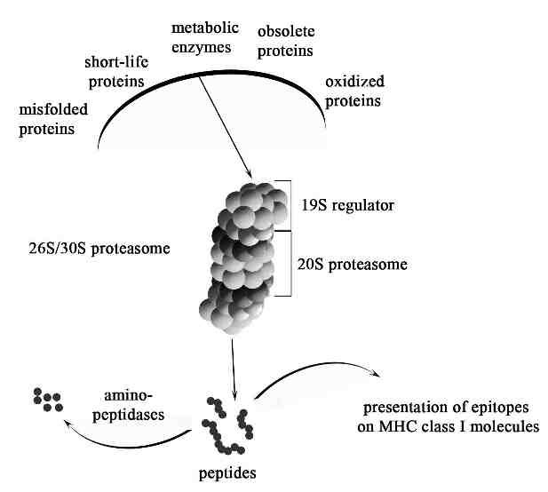

Protein targets of the Ubiquitin-proteasome system (UPS)
Bellavista et al, 2014

Slide 3
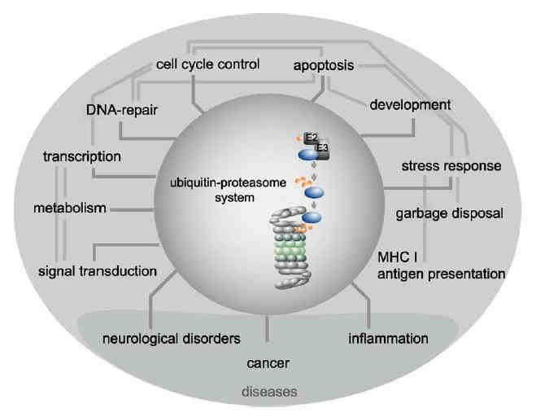
Functions of UPS
Wolf and Hilt, 2004

Slide 4
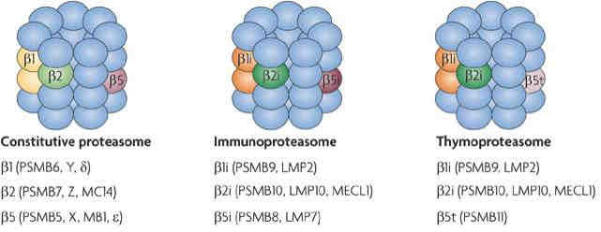
Proteasome isoforms
Catalytic subunits
Quantitatively different cleavage specificity makes immunoproteasome specifically involved in:
Cytokine-mediated inflammation
Cell-mediated immune response and lymphoid cell repertoire
Antigen presentation
Groettrup et al., 2010; Mishto et al., 2014

Slide 5
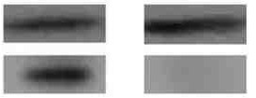
Immunoproteasome in CNS upon ageing
Immunoproteasome is almost absent in healthy young CNS but it is expressed in CNS upon ageing
Human hippocampus elderlies youngs
β1 subunit
β1i immunosubunit
Rat hippocampus elderlies youngs
β5 subunit
β5i immunosubunit
Mishto et al., 2006; Giannini et al., 2013

Slide 6
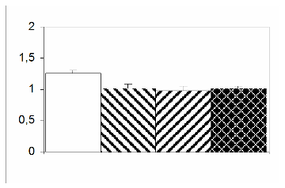
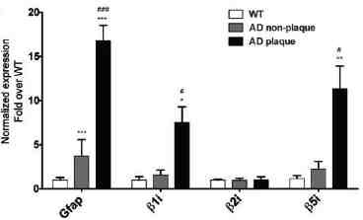
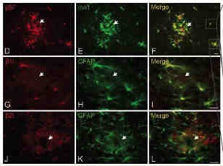
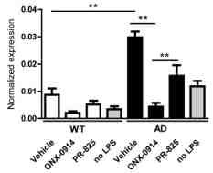
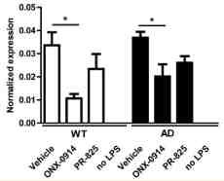
Immunoproteasome in Alzheimer disease
β1i immunosubunit - Human hippocampus
wt vs APPswePS1dE9 mouse hippocampus
relative optical density
*
AD
Cnt
Immunoproteasome expression in
microglia and astrocytes
Immunoproteasome β5i inhibition reduces pro-inflammatory signalling in AD microglia
TLR-2
TNF
Mishto et al., 2006; Orre et al., 2013

Slide 7
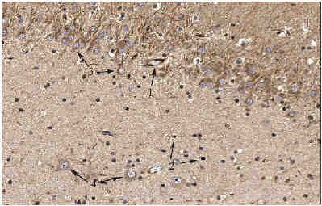
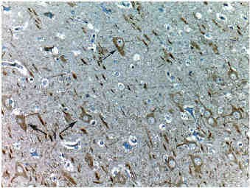
Immunoproteasome in pharmacoresistant epilepsies
Human FCD / TLE hippocampus
Focal cortex dysplasia - β1i immunosubunit
Mesial temporal lobe epilepsy - β5i immunosubunit
1.
2.
3.
4.
Endotelial cells
Glia
Granular neurons Pyramidal neurons
Mishto et al., 2010

Slide 8
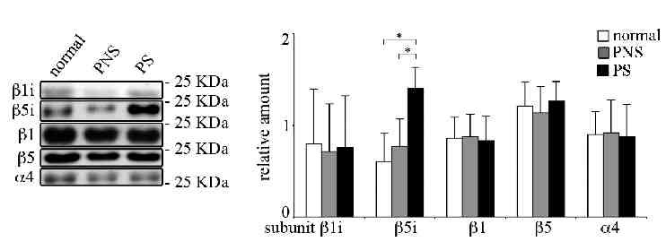
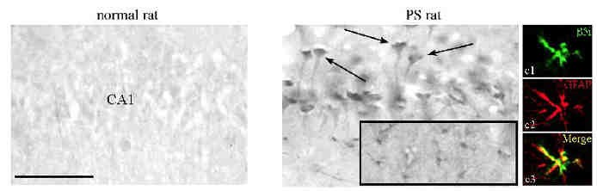
Immunoproteasome in pharmacoresistant epilepsies
Pilocarpine-induced epileptic rat hippocampus
Neurons Astrocytes
Mishto et al., 2015

Slide 9
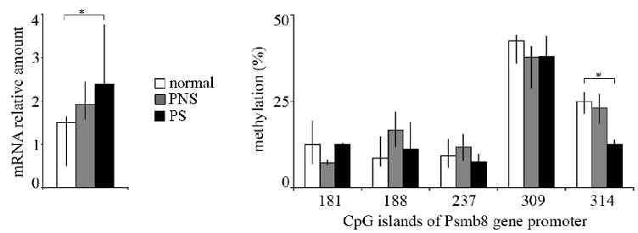
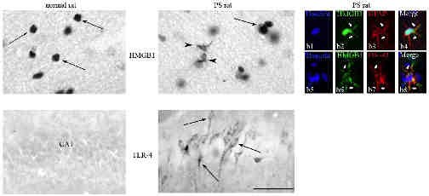
Immunoproteasome in pharmacoresistant epilepsies
Pilocarpine-induced epileptic rat hippocampus
HMGB1-mediated activation of TLR-4
leads to immunoproteasome expression
Mishto et al., 2015

Slide 10
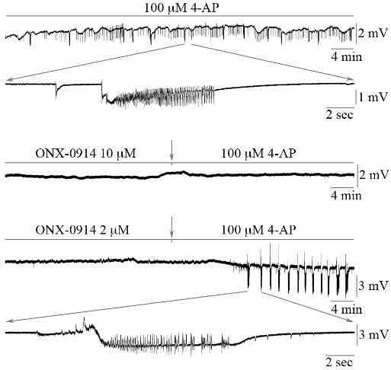
Immunoproteasome in pharmacoresistant epilepsies
Pilocarpine-induced epileptic rat hippocampus
Mishto et al., 2015

Slide 11
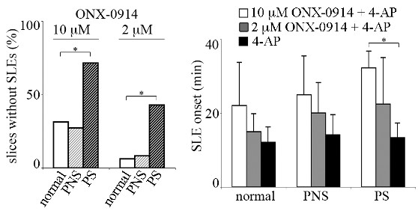
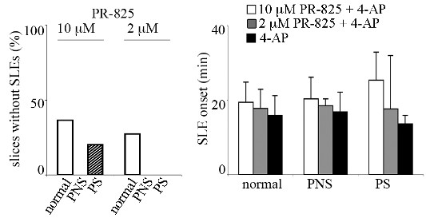
Immunoproteasome in pharmacoresistant epilepsies
Pilocarpine-induced epileptic rat hippocampus
β5i immunosubunit inhibition suppresses or delayes SLEs in epileptic rats
β5 subunit inhibition has no or mild effects on SLEs in epileptic rats
Mishto et al., 2015

Slide 12
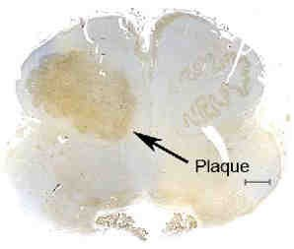
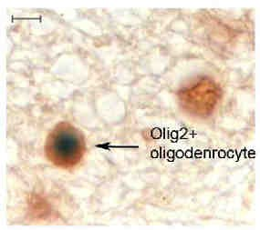
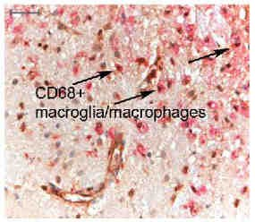
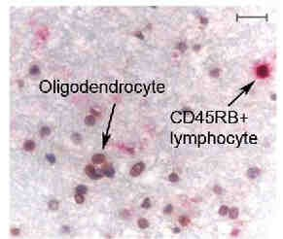
Immunoproteasome in multiple sclerosis
Staining of β1i immunosubunit
Rostral medulla with MS palques
Parietal lobe of MS patient
Mishto et al., 2010

Slide 13
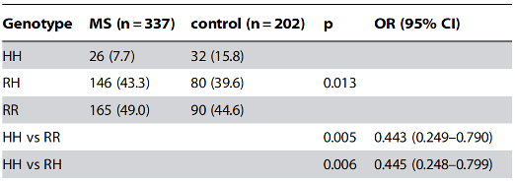
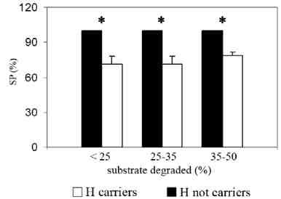
Immunoproteasome in multiple sclerosis
Effect by acting on myelin antigen presentation?
In vitro production
of HLA-A*0201-
restricted MBP₁₁₁₋ ₁₁₉ epitope by 60H⁺ or 60H⁻ β1i immunosubunit
HLA-A*0201+ subjects carrying the 60H polymorphism in β1i immunosubunit are less prone to develop MS
Mishto et al., 2010

Slide 14
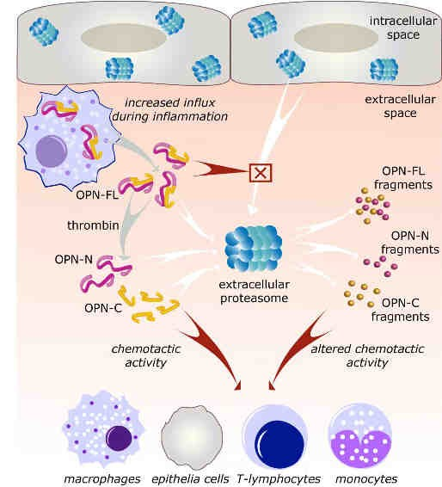
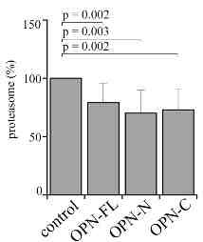
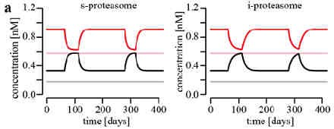
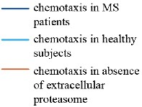
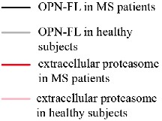
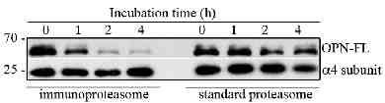
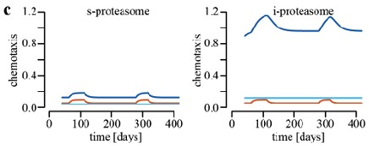
Immunoproteasome in multiple sclerosis
Effect by acting on cytokine circuits?
Bellavista et al., under review

Slide 15
Summary
Immunoproteasome expression is induced in different CNS cell types:
during ageing
in AD patients
in epileptic patients
in Multiple Sclerosis patients
Immunoproteasome expression is involved in neuropathologies in:
cytokine-mediated inflammation
pathology-associated antigen presentation
neuronal activity
The pathology-specific expression of immunoproteasome makes specific immunoproteasome inhibitors interesting for therapy.

Slide 16









Acknowledgements
Institut für Biochemie Kathrin Textoris-Taube Christin Keller
Peter Kloetzel
Institut für Neurophysiologie
Muhammad L. Raza
Uwe Heinemann
Neurocure
Klemens Rupprecht
Luca Gigliotti Annalisa Chiocchetti Cristoforo Comi Umberto Dianzani
 | Teresa Ravizza Annamaria Vezzani
 | Elena Bellavista Dario de Biase Francesco Vasuri Annalisa Pession
Funding bodies: •Young Researcher fund 2007 - Italian Minister of Health •FIRE fund 2012 - Fondazione Italiana Ricerca sull‘Epilessia •Onyx Pharmaceutical fund 2012 (subsidiary of Amgene)
Daniela Galimberti
Friedemann Paul
Melissa Sorosina
Filippo Martinelli Boneschi
Chiara Dianzani
Claudia Verderio
Juliane Liepe Michael Stumpf

Slide 17
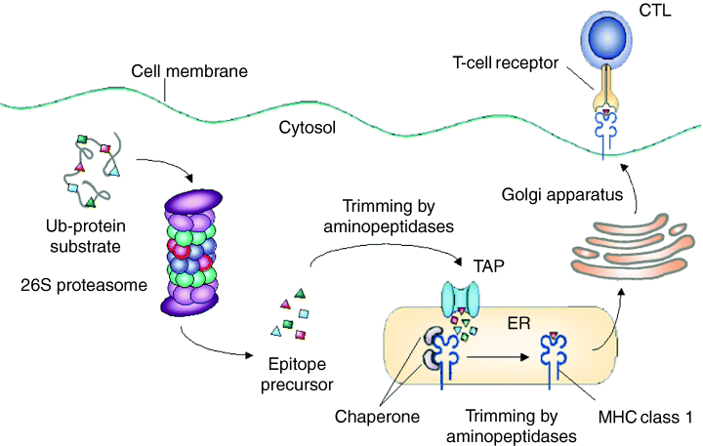
Proteasomes and antigens presentation
Strehl et al, 2005

