Slide 1

Detection and genetic characterization of Seoul Virus and other viruses borne by commensal Norway rats (Rattus norvegicus) in France
Michel Pépin
University of Lyon, VETAGROSUP, Lyon, FRANCE
Notes:
I am Michel Pepin from the Veterinary Faculty in Lyon and I am going to present « detection … » →

Slide 2
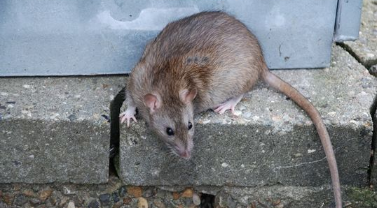
Norway rat (Rattus norvegicus) : an invasive species
http://eol.org/pages/328448/overview
Notes:
As you know, Norway rats or brown rats (Rattus norvegicus) belong to an invasive species →

Slide 3
Norway rat (Rattus norvegicus) : an invasive species = a pest
Commensal rodent species
Responsible for damage/waste to agriculture, forestry, horticulture and infrastructures → huge financial losses
 global demand for food → Damage level is likely to increase
Anticoagulant rodenticides ✚✚✚ … BUT anticoagulant-resistant rats exist now
Notes:
… and rats are considered as pests.
There are three major reasons why rats (and mice) are considered as pests:
1- They consume and damage human foods in the field and in stores. In addition they spoil it by urine and droppings
2- Through their gnawing and burrowing habit, they destroy many articles (packaging, clothes and furniture) and structures (floors, buildings, bridges, etc.). By gnawing through electrical cables they can cause fires,
3- the last but not the least, they are responsible for transmitting diseases which are dangerous to man.
Rats live very close to the human beings and are present in every part of the world : so rats are classified as commensal to the mankind.
Their damages induce huge financial losses (that are difficult to evaluate, we must recognize).
As the global demand for food increases, their damages are likely to increase too.
Control of populations of rats are possible particularly by using rodenticides, mainly anticoagulant ; the difficulty is that now anticoagulant-resistant rats exist. And there is a need to find new ways in order to control populations of rats … and meanwhile there is a need to keep an eye on the huge number of pathogens transmitted by rodents →

Slide 4
Norway rat (Rattus norvegicus) : reservoir of pathogens
VIRUSES | Seoul virus (SEOV; Bunyaviridae; hantavirus) ; cowpox virus (CPXV; Poxviridae) ; hepatitis E virus (HEV; orthohepevirus, Hepeviridae); lymphocytic choriomeningitis virus (LCMV; Arenaviridae); encephalomyocarditis virus (EMCV; Picornaviridae)
BACTERIA | Leptospira interrogans ; Streptococcus moniliformis ; Pasteurella sp ; Yersinia sp ; Francisella tularensis ; Erysipelothrix rhusiopathiae ; Bartonella sp; antibiotic-resistant bacteria
PARASITES & FUNGI | Trichinella sp ; Toxoplasma gondii ; Hyminelopis sp ; dermatophytes
Notes:
… So rats are silent carriers of numerous zoonotic pathogens including viruses, bacteria and parasites … but rats are also professional excretors of pathogens into their environnment, and this concerns particularly pathogens underlined in blue : Seoul virus, hepatitis E virus among known viruses ; Leptospira and Yersinia for the 2 most important bacterial pathogens borne by rats.
So , in order to have a better knowledge about pathogens borne by rats in our region →

Slide 5
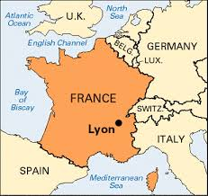
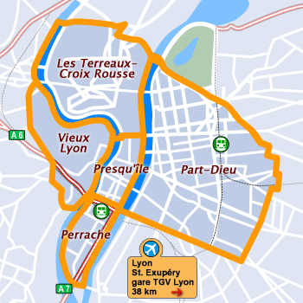
Rat = silent carrier & professional excretor
→ survey of brown rats in and around Lyon (France)
Notes:
… we decided to conduct surveys to answer to this question in and around Lyon; Lyon is the third town in size in France following Paris and Marseille.
You can see on this map he location of Lyon and a detail of the downtown area including the green park, the Parc de la Tête d’Or →

Slide 6
Three populations of rats
178 rats trapped in and around Lyon (EU « Wildtech » survey : Drs F Ayral and M Artois ; Epidemiol. Infect, 2014)
16 rats trapped in the « Parc de la Tête d’Or » (« PERS PTO » survey : Drs T Dupinay, M-H Laaberki, M Attoumane & M Pépin)
28 wild rats trapped and maintained in captivity (« PERS VAS » survey)
Survey | Adults | Male | Female | Total
WildTech | 63% | 96 | 82* | 178
PERS PTO** | 50% | 9 | 7 | 16
PERS VAS | 100% | 0 | 28 | 28
* 18 pregnant femal
** Mean weight = 268 g (373 g-176 g)
Mean length (without tail) = 24.1 cm (27 cm – 22 cm)
PERS = Pathogènes Emergents et Rongeurs Sauvages
(or Emergent Pathogens and Wild Rodents)
PTO = Parc de la Tête d’Or
VAS = VetAgroSup
Notes:
… Three different surveys were conducted :
The first one was performed on the behalf on an European project called Wildtech and it included 178 rats
The second one was performed on rats trapped in the Parc de la Tête d’Or (abreviation PTO), previously mentionned
And the third one on a population of captive wild rats maintained in captivity on the Veterinary campus in Lyon (VetAgroSup, abreviation VAS)
In the table, you see the structure of the trapped population and particurlarly the average size of rats trapped in the PTO group = 268 g for the weight and 24 cm for the length ;
We performed different assays for detecting pathogens borne by these three populations of rats :
Conventional assays including real-time PCR and serology
And a new approach by using next generation sequencing or NGS →

Slide 7
« Wildtech » population
Pathogen | Leptospira interrogans (n= 171) | SEOV (n= 128) | HEV (n= 142) | Toxoplasma gondii (n= 77)
% of positive animals | 26% | 14% | 14% | 8%
Assay | rt-PCR | RT-PCR | RT-PCR | Serology
Sample | Kidney | Lung | Liver & feces | Blood
Adapted from F Ayral et al, Epidemiol Infect, 2014
Doi: 10.1017/S0950268814001137)
Notes:
… For the Wildtech population, using conventional assays, four major pathogens have been identified :
Leptospira in 26% of rats
Toxoplasma goondii in 8% of rats
And two important viruses (SEOV and HEV) in 14% of tested rats for both viruses
→

Slide 8
« PERS » populations → pathogens identified
Leptospira interrogans (about 60% of positive rats in PERS PTO population)(A-L Zilber, personal communication)
Seoul virus (SEOV) ??
r-Hepatitis E virus (r-HEV or HEV-C1#) : 18% positive rats in PERS VAS; no positive in PERS PTO population*
RMV-1** (rat minute virus = parvovirus) : 69% in PERS PTO ; 7% in PERS VAS
#Smith et al (2014), J Gen Virol,95, 2223-2232
*Results confirmed by Dr Rainer Ulrich, FLI, Germany
** not zoonotic
Notes:
… in the two other populations, we identified:
again Leptospira interrogans but at the higher prevalence than in the Wildtech population (about 60% of positive rats)
HEV in rats maintained in captivity but not in the PTO population
A rat-specific parvovirus (rat minute virus, a DNA virus) in both populations and at a high level in PTO population
And for SEOV, we obtained contradictory results.
So we decided to use a SEOV+ sample to develop a NGS approach including 2 steps :
The first one to optimize sample preparation using a SEOV+ sample
The second one on a larger population of rats →

Slide 9
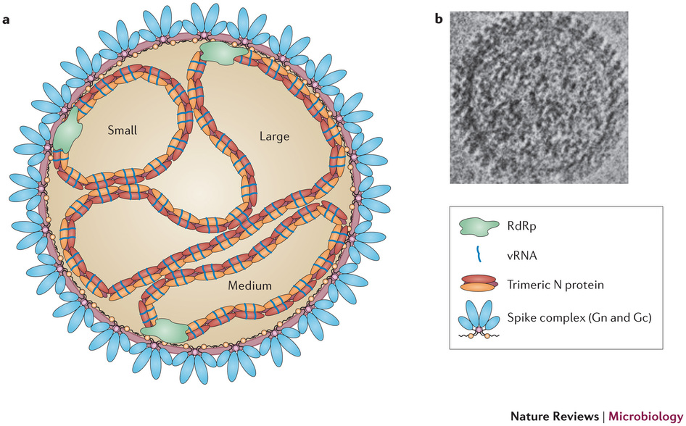
Hantaviruses and SEOUL VIRUS (SEOV)
Hantaviruses belong to the Bunyaviridae family of viruses
  24 hantavirus species in current ICTV (2013 release)
  Negative strand
  Enveloped RNA viruses
  Tri-segmented genome : L, M & S
  Reservoir hosts : rodents, shrews, moles and bats
  HFRS & HPS = hantavirus disease
  HTNV & SEOV, PUUV & DOBV, SNV & ANDV
Figure from A Vaheri, Nature Reviews Microbiology 2013
Notes:
… before presenting results of the NGS approach, I would like to come back to the SEOV virus and hantaviruses.
Hantaviruses are rodent-borne (and now insectivorrous- and bat-borne viruses) and enveloped RNA viruses with a diameter of 120 nm belonging to the family Bunyaviridae. They contain a single-stranded, negative-sense RNA genome consisting of three segments, the small (S), medium (M) and large (L), all of which are required for infectivity.
These hantaviruses induce hantaviral disease in human beings with two major syndromes :
HFRS for haemorragic fever with renal syndrome (by hantaviruses of the Old World = Hantaan virus and SEOV, or Pumuula virus and Dobrava virus as examples
And HPS for hantavirus cardiopulmonary syndrome (by hantaviruses of the New World = Sin Nombre virus and Andes virus as examples →

Slide 10
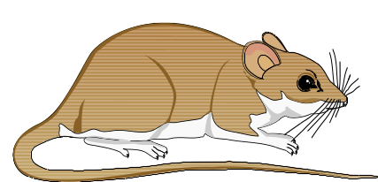

Cycle of transmission of SEOV
Infected rodent : silent carrier & professional excretor
Biting, fighting, sexual behavior
Virions in excreta (urine, feces, saliva)
Naive rodent
Virions in excreta (urine, feces, saliva)
Notes:
.. In rodents, transmission seems to occur by close contact between infected and naïve rodents through aerosols of urine, feces, or by biting, fighting due to their sexual behavior.
When humans are contaminated, the virus is transmitted from animals to humans by inhalation of an aerosol of infected rodent excreta, which supposes a close contact between rat populations and humans (rats I remind you are commensal of the human populations) →

Slide 11
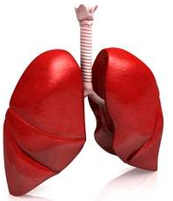

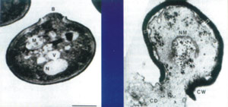
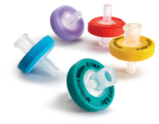
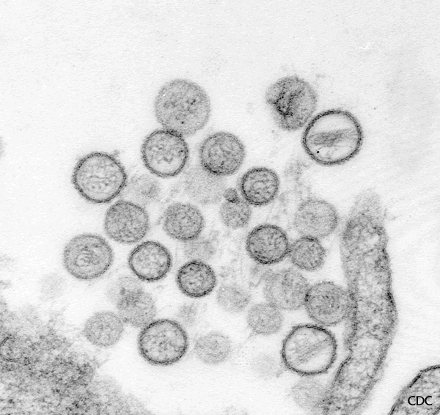
Optimization of sample preparation → NGS
Grinding
Cellular lysis:
Freeze-thaw (3x)
Clarification
DNA
RNA
Nuclease treatment for host genome degradation
Viral RNA Extraction & qPCR
Viral RNA
qPCR : HTNV/GAPDH/β-actin
Notes:
… for the deep sequencing, an important if not the most important parameter is the preparation of sample (good quality, very fast sampling)
Another important step is the purification of the virome obtained from the selected tissue. For this objective, the strong and non-degraded SEOV positive lung tissue sample LYO852 was chosen to optimize the NGS protocol. To ensure this, we tested different steps homogenization, filtration (to remove cells and mitochondria), and/ or nuclease treatment to degrade DNA and RNA host contaminants →

Slide 12
Optimization of NGS (Illumina® & 454®) for complete genome SEOV detection
Lung LYO852
Sample | Read data
 | % rat host | % Ribosomal | % viral reads | % of SEOV reads
1 | 88,16% | 0,99% | 0,34% | 20 %
2 | 71,78% | 30,95% | 0,73% | 21 %
3 | 47,66% | 21,55% | 2,20% | 84 %
1
2
3
Homogenization
Freeze-Thaw 3X
Centrifugation
Filtration 0,45 µm membrane PES
Nuclease
90 min
Extraction
Viral reads were 6 times more abundant in the S3 sample (2.20%) in comparison to the S1 sample (0.34%)
Complete SEOV genome recovery
Ribosomal depletion
Library amplification
Sequencing
Notes:
… Three different protocols were compared and we obtained the best results using the protocol number three which includes a ribosomal depletion
A library of the 3 tissue samples was labeled with a different barcode and was sequenced using the HiSeq 2500 Illumina platform (or in AHVLA laboratory 454 sequencing).
As shown in table, the viral reads were 6 times more abundant in the S3 sample (2.20%) in comparison to the S1 sample (0.34%). Also the S3 sample appeared more enriched in SEOV reads than the two other samples. Mapping sequence reads revealed complete or near complete (>99%) coverage of the SEOV reference genome →

Slide 13
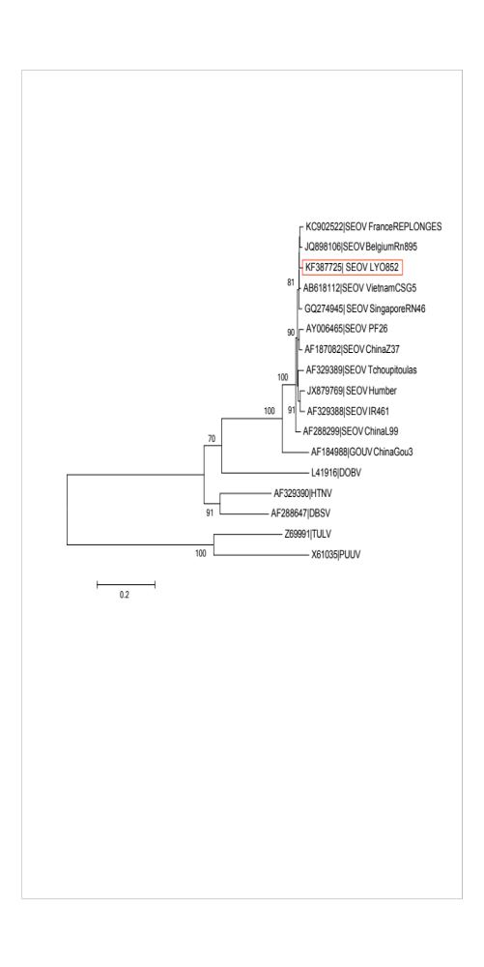
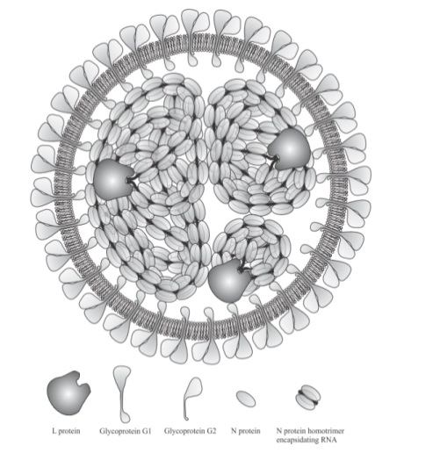
Phylogenetic analysis of the complete SEOV sequence
LYO852 strain genome appears to belong to the lineage 7 of SEOV
Shows a very high identity to European strains
And is very similar to 2012 Human Lyon SEOV
Notes:
… the phylogenetic analysis of the complete S fragment has shown that the isolate of Lyon is included in the clade of the South East Asian virus lineage, also referred to as lineage 7, and the isolate shows a very high identity to European strains and particularly to the 2012 human strain strain isolated from a pregnant woman near Lyon; analysis of the two other segments gave the same results, which have been all reported in the publication in the Virology Journal

Slide 14
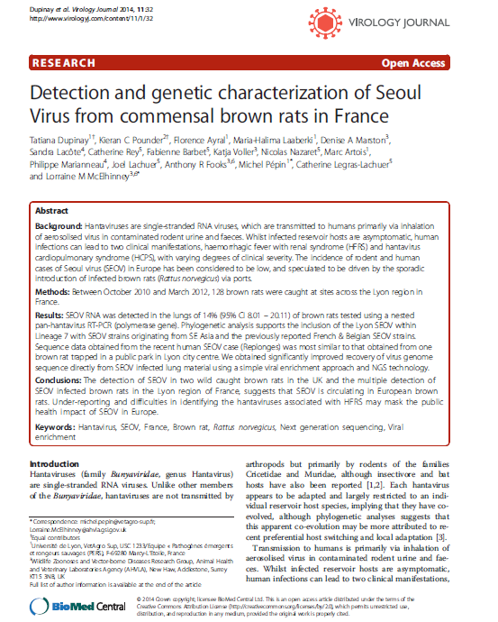
Notes:
… with a colleague of mine as first author, a post-doc Dr Tatiana DUPINAY →

Slide 15
Virome of 10 rats (PERS PTO population)
M &M :
  Illumina HiSeq 2500
  10 rats
  Sample = lungs
Viral enrichment = 3.46% (range : 1.46 – 5.21)
Sequences of phages and endogenous retroviruses
Negative for hantaviruses (SEOV) & HEV = confirmation of PCR results
2 unexpected viruses (>10 aligned reads & >10% of genome covered) :
  Semliki forest virus (SFV) : alphavirus & arbovirus
  Nyamanini virus (NYMV) : nyavirus (order Mononegavirales, family of Nyamiviridae) = a tick-borne virus
Notes:
… in a second step after the optimization of the NGS protocol, we have analyzed the virome of 10 rats from the PTO population using lung samples.
Finally, we got numerous sequences for phages and endogenous retroviruses ; the samples were negative for HEV and SEOV viruses (which was a confirmation of the negative results using PCR assays particularly for SEOV for which results were difficult to interpret), but the samples were positive for unexpected viral sequences similar to the Semliki Forest virus and for a virus unknown for me before that, the Nyamanini virus.
The results have not been confirmed yet and as a consequence must be considered as preliminary results →

Slide 16
Conclusions
Optimisation of sample preparation → full length viral sequences from tissue samples with very low amounts of viral RNA → rodent-borne pathogens (known and unknown)
Confirmation of the relative high prevalence of SEOV in rats both in rural and urban environments → human cases
    First full sequence of SEOV in France
    Despite global distribution, most SEOV are genetically homogenous : >95% nt sequence identity
Analysis of virome by NGS : 2 unexpected viruses (SFV & NYMV) → these results need confirmation !!
Notes:
… so, in conclusion, the investigation of pathogens borne by rats in the Lyon region has permitted :
The optimization of samples for detection of known and (unknown) viruses
The obtention of the first full sequence of SEOV in France
And the finding of two unexpected viruses ; I recall that this interesting result must be considered as preliminary … →

Slide 17




Collaborations
« Wildtech » programme and PERS group, VetagroSup, Veterinary Faculty, Lyon (Fr) = Drs F Ayral & M Artois
ANSES-Lyon (Fr) : Dr P Marianneau
ProfileXpert, University of Lyon (Fr) : Drs C Legras-Lachuer & J Lachuer
AHVLA, Addlestone (UK) = Drs L McElhinney, KC Pounder, DA Marston & A Fooks
PERS group, VetagroSup, Lyon (Fr) : Drs T Dupinay, M-H Laaberki & M Pépin ; student : M Attoumane
Notes:
… these results have been possible, thanks to our collaborators, and particularly :
The AHVLA
And the PROFILEXPERT technology platform which perform NGS

Slide 18

And the winner is ?
Notes:
… and the results tell us that the winners are still the rats, which continue to proliferate and to carry many pathogens.
On this cartoon, rats are laughing when the read the novel written by the French Nobel Prize, Albert CAMUS, « LA PESTE » which means « the plague » the famous bacterium borne by rats (more exactly by the flea of rat).), YERSINIA PESTIS.
THANK YOU VERY MUCH FOR YOUR ATTENTION

