Slide 1
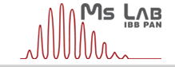
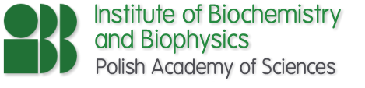
Approach to structures of difficult protein targets by means of monitoring hydrogen-deuterium exchange with mass spectrometry
– new clothes for the old emperor
New Orleans, 14.07.2015
Michał Dadlez
Mass Spectrometry Laboratory
Institute of Biochemistry and Biophysics Pol. Acad. Sci., Warsaw,

Slide 2
Mass spectrometry in protein structure studies
In many instances classic methods of protein structure analysis (crystallography, NMR)
fail or cannot be used.
Difficult Targets:
Intrinsically disordered
domains/proteins
Oligomerising proteins
Complex protein/
DNA/RNA assemblies
Protein-lipid assemblies
Intrinsic disorder
– “Exceptionally abundant exception”
It is estimated that 25–30% (!!)
of eukaryotic proteins are mostly disordered.
More than half of eukaryotic proteins (!!)
and more than 70% (!!) of signaling proteins
have long regions of disorder – IDRs.
Peng Z, et al. Exceptionally abundant exceptions: comprehensive
characterization of intrinsic disorder in all domains of life.
Cell Mol Life Sci CMLS 2014. doi:10.1007/s00018-014-1661-9
Novel Mass Spectrometry-based methods can help:
Hydrogen- deuterium exchange (HDex)
Ion Mobility based collisional cross-section
Oxidative footprinting
Non-covalent complexes mass spectrometry
Protein painting

Slide 3
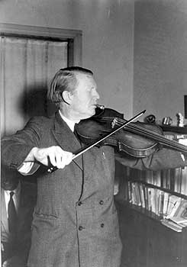
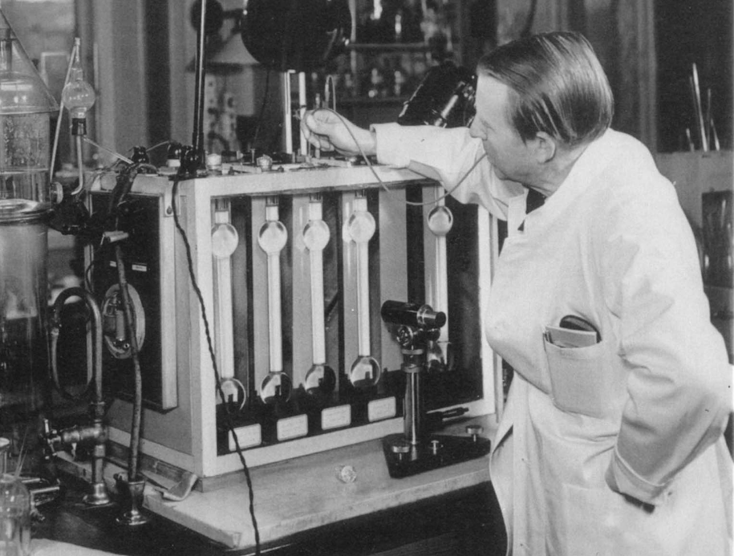
]
Kaj Ulrik Linderstrom-Lang (1896-1959) - HDex comes into focus
Question: Inaccessible at first peptide bonds become accessible
during the course of enzymatic proteolysis. Why?
Hypothesis: Linus Pauling suggested hydrogen bonds
stabilize secondary structure, if so HDex should be retarded.
Tool: use 20 cm glass column with gradient of organic liquids
of differing density to measure protein solution density
(precision 1 μg/mL) after incubation in D₂O
– retarded kinetics of exchange in insulin revealed (1950’s)
Carlsberg laboratories motto:
“No result of the activities of the Institute that is of any
theoretical or practical importance may be kept secret.”
Notes:
He wanted to seek a probe for the presence of
these structures in globular proteins. As mentioned before, he had
already made use of the gradient tube back in 1938 (Linderstram-
Lang et al., 1938) to measure the deuterium content of water
containing various D/H ratios, and he knew that hydrogen-deuterium
exchange took place rapidly when the hydrogen was bonded to a
strongly electronegative atom like N or 0. He reasoned that in
proteins the peptide NH protons that were tied down by the hydrogen
bonds of secondary structures would exchange very slowly,
if at all. He had already introduced the concepts of the primary,
secondary, and tertiary structure of proteins in the third Lane Lecture
(Linderstram-Lang, 1952) to aid in classifying such mechanisms
BENSON EE, LINDERSTROM-LANG K. Deuterium exchange
between myoglobin and water. Biochim Biophys Acta. 1959 Apr;32:579–581. [PubMed]
BERGER A, LINDERSTROM-LANG K. Deuterium exchange of
poly-DL-alanine in aqueous solution. Arch Biochem Biophys. 1957 Jul;69:106–118. [PubMed]
HVIDT A, LINDERSTRØM-LANG K. Exchange of hydrogen atoms in insulin with
deuterium atoms in aqueous solutions. Biochim Biophys Acta. 1954 Aug;14(4):574–575. [PubMed

Slide 4
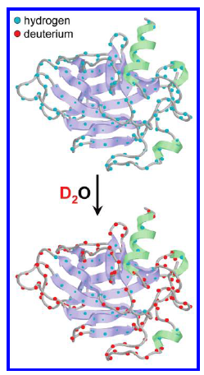
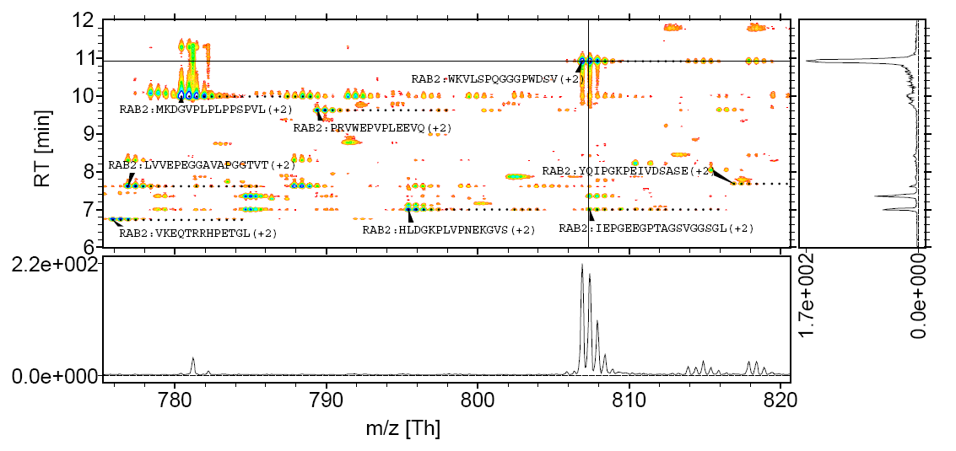
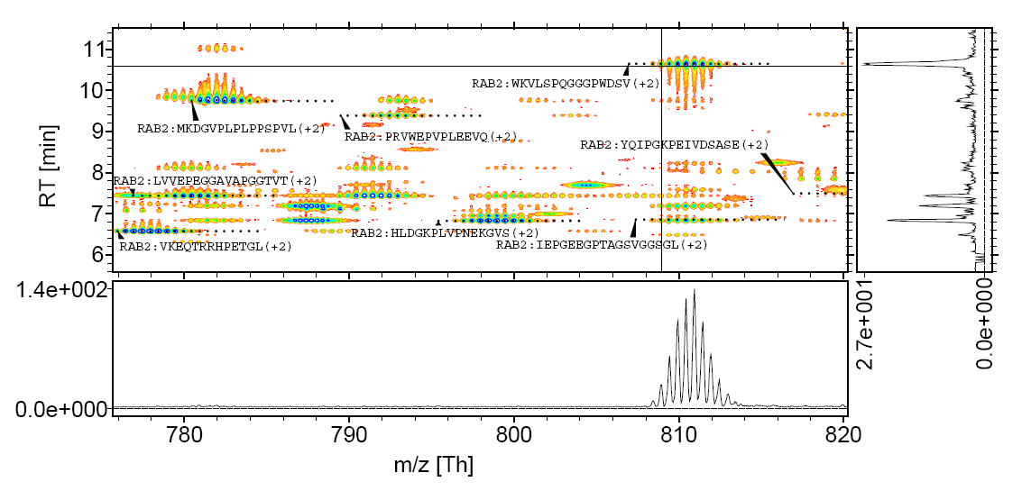
Precise measurements of average mass during exchange are a must
Unexchanged isotopic envelope
Exchanged isotopic envelope
Obwiednia peptydu po wymianie
Notes:
Interesujące było również SKONFRONTOWANIE modeli poszczególnych fragmentów receptora RAGE z INFORMACJĄ NA TEMAT STRUKTURY PEŁNEJ ZEWNĄTRZKOMÓRKOWEJ części receptora. Udało mi się to osiągnąć dzięki zastosowaniu wymiany wodór-deuter sprzężonej ze spektrometrią mas.
Metoda ta jest OPARTA NA FIZYCZNYM ZJAWISKU wymiany wodorów zawartych w białku na deutery obecne w roztworze. Dzięki tej metodzie można WYZNACZYĆ OBSZARY BIAŁKA KTÓRE SĄ DOBRZE USTRUKTURYZOWANE ORAZ OBSZARY EKSPONOWANE DO ROZTWORU.
Po sprzężeniu wymiany wodór-deuter z proteolizą białka, HPLC oraz spektrometrią mas dane można zobrazować w postaci MAP PEPTYDOWYCH, w których każdy peptyd z białka scharakteryzowany jest za pomocą CZASU RETENCJI z kolumny HPLC oraz WARTOŚCI M/Z, która stanowi masę peptydu podzieloną przez jego ładunek.
Im bardziej dany peptyd jest wymieniony tym jego obwiednia jest BARDZIEJ PRZESUNIĘTA w stronę większego m/z. Stopień wymiany oblicza się dzięki OBLICZENIU ŚREDNIEJ MASY każdego peptydu po wymianie i porównaniu do maksymalnej wymiany na danym peptydzie.
Uzyskane dane możemy obrazować też w inny sposób

Slide 5








Selected HDex projects
1. Difficult protein targets/natively unfolded proteins/oligomerising proteins
Intermediate filament oligomers and their interactors
(with H. Herrmann, German Cancer Research Center, Heidelberg, Germany, & A. Edelman, Institut Necker, Paris)
2. Mapping interaction regions with protein partners and small ligands:
- Kinetochore complexes:
COMA (K. lactis) - with F. Schmitzberger (S. Harrison group - Harvard Medical School, Boston, USA)
& Mis12-CenpC (D. melanogaster) with M. Przewłoka (D. Glover group - Cambridge University, UK)
- FLASH-Lsm11-Histone pre-mRNA Cleavage Complex –
with Z. Domiński, University of North Carolina at Chapel Hill, USA
3. Protein-DNA assemblies:
Structural cross-talk between two DNA-binding domains
in R.DpnI restriction endonuclease, with M. Bochtler, IIMCB, Warsaw
4. Protein-lipid assemblies
Perfringolysin and its mutants - with A.Sobota, Nencki Institute, Warsaw
Students involved:
Ewa Sitkiewicz, Magda Richter, Aleksandra Skrajna, Krzysztof Tarnowski, Aiswarya Premchandar,
Aleksandra Kacprzyk, Magda Kaus-Drobek, Magda Kulma, Kaja Przygońska, Kinga Fituch

Slide 6
Selected HDex projects
1. Difficult protein targets/natively unfolded proteins/oligomerising proteins
Intermediate filament oligomers and their interactors
(with H. Herrmann, German Cancer Research Center, Heidelberg, Germany, & A. Edelman, Institut Necker, Paris)
2. Mapping interaction regions with protein partners and small ligands:
- Kinetochore complexes:
COMA (K. lactis) - with F. Schmitzberger (S. Harrison group - Harvard Medical School, Boston, USA)
& Mis12-CenpC (D. melanogaster) with M. Przewłoka (D. Glover group - Cambridge University, UK)
- FLASH-Lsm11-Histone pre-mRNA Cleavage Complex –
with Z. Domiński, University of North Carolina at Chapel Hill, USA
3. Protein-DNA assemblies:
Structural cross-talk between two DNA-binding domains
in R.DpnI restriction endonuclease, with M. Bochtler, IIMCB, Warsaw
4. Protein-lipid assemblies
Perfringolysin and its mutants - with A.Sobota, Nencki Institute, Warsaw
Students involved:
Ewa Sitkiewicz, Magda Richter, Aleksandra Skrajna, Krzysztof Tarnowski, Aiswarya Premchandar,
Aleksandra Kacprzyk, Magda Kaus-Drobek, Magda Kulma, Kaja Przygońska, Kinga Fituch

Slide 7



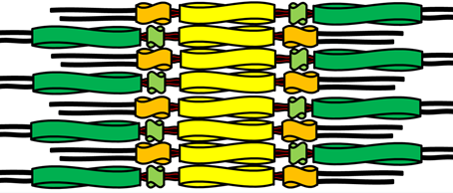
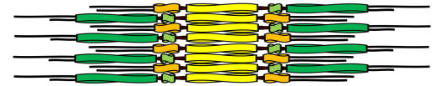
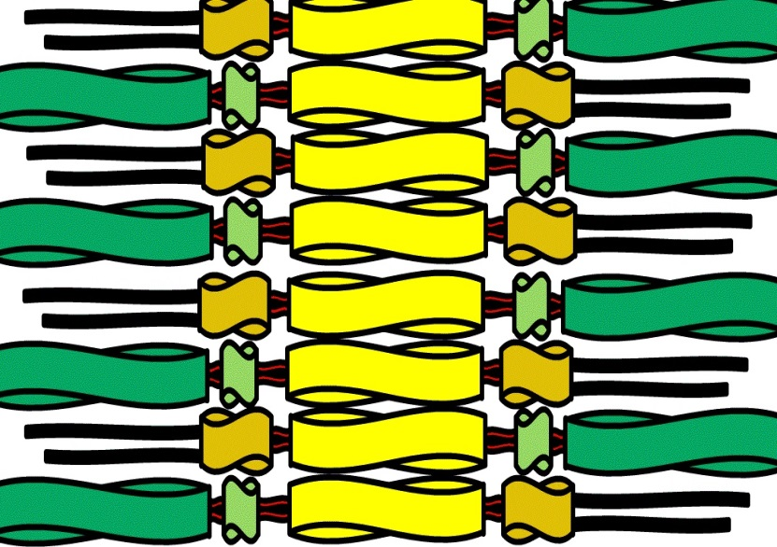
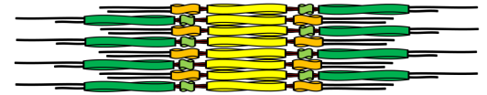
General building plan of IF protein oligomers – vimentin is best studied
Monomers
Dimers
Tetramers
Unit
Length
Filaments
Notes:
Intermediate filaments (IFs) are assembled from a large family of structurally related but sequence-wise very different fibrous proteins. They constitute the principal cytoplasmic and nuclear filament system that is responsible for the plasticity of the cell. Correspondingly, they have been demonstrated to be crucial for buffering shear stress in the cell (1). In addition, IFs are also engaged in multiple signalling pathways involved in cell division, motility and other processes such as the topological organization of transmembrane channels (2, 3). Keratin filaments are hallmark IF structures of all epithelia. Moreover, keratins are associated with diseases as diverse as cancer, viral and bacterial infection or the chronic fatigue syndrome, as well as with a number of pathophysiological processes of the epidermis (4). At present, mutations in IF protein–encoding genes have been indicated as causative for nearly 100 human inherited diseases (5–8). Therefore, keratins are considered as potential drug targets and structural studies may provide important insight for drug design process.

Slide 8

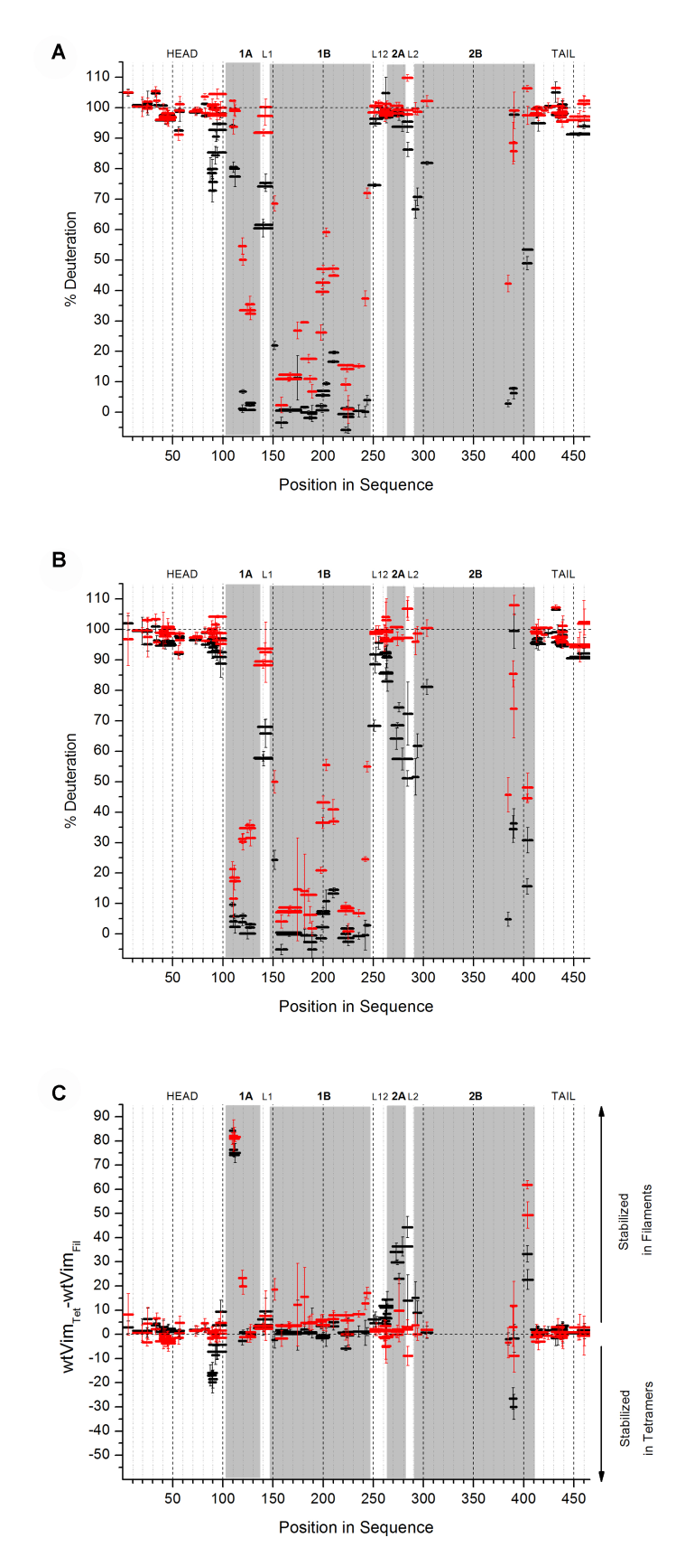
HDex of vimentin tetramers
- low salt buffer

Slide 9

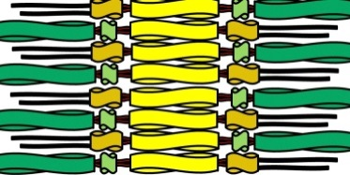

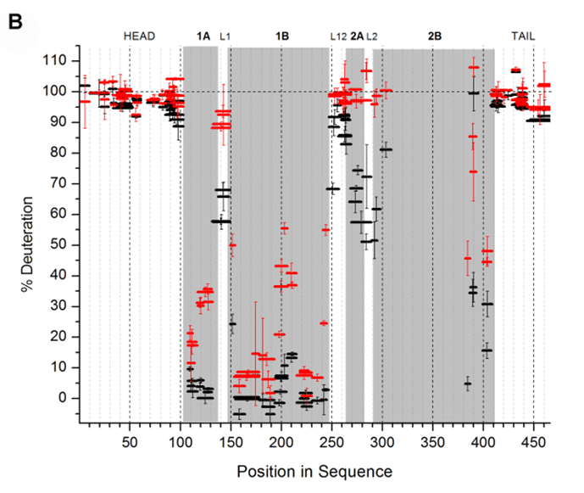
HDex of vimentin ULF’s and filaments - high salt buffer

Slide 10
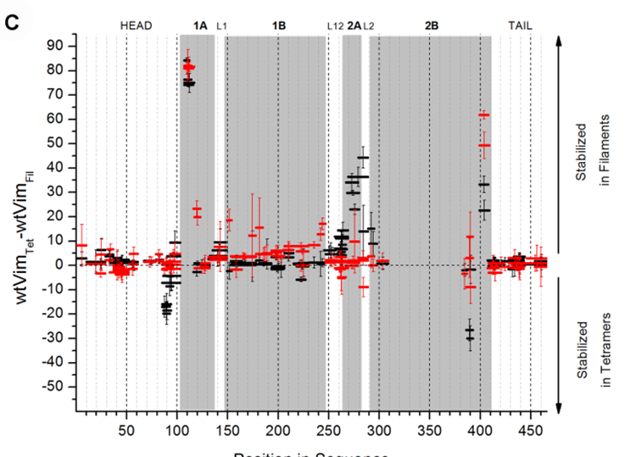

Differential plot indicates contact sites in transition tetramers-filaments

Slide 11
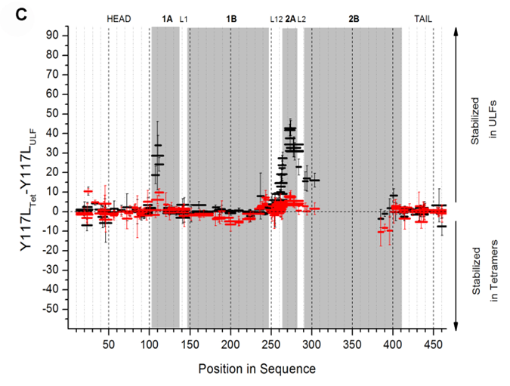
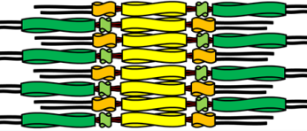
Point mutant Y117L reveals contact sites in transition tetramers-ULF’s
Y117L mutant
Wild Type

Slide 12
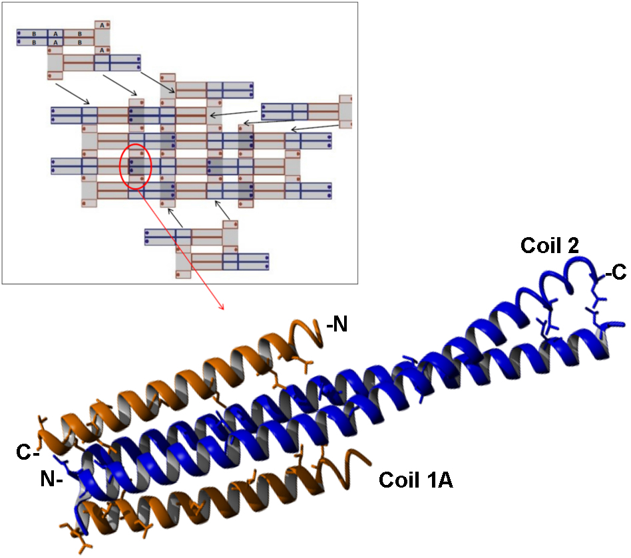
Based on Hdex a cross-coiling molecular model can be constructed
New molecular
model for contact
regions in vimentin
Premchandar, A. et al.

Slide 13
Selected HDex projects
1. Difficult protein targets/natively unfolded proteins/oligomerising proteins
Intermediate filament oligomers and their interactors
(with H. Herrmann, German Cancer Research Center, Heidelberg, Germany, & A. Edelman, Institut Necker, Paris)
2. Mapping interaction regions with protein partners and small ligands:
- Kinetochore complexes:
COMA (K. lactis) - with F. Schmitzberger (S. Harrison group - Harvard Medical School, Boston, USA)
& Mis12-CenpC (D. melanogaster) with M. Przewłoka (D. Glover group - Cambridge University, UK)
- FLASH-Lsm11-Histone pre-mRNA Cleavage Complex –
with Z. Domiński, University of North Carolina at Chapel Hill, USA
3. Protein-DNA assemblies:
Structural cross-talk between two DNA-binding domains
in R.DpnI restriction endonuclease, with M. Bochtler, IIMCB, Warsaw
4. Protein-lipid assemblies
Perfringolysin and its mutants - with A.Sobota, Nencki Institute, Warsaw
Students involved:
Ewa Sitkiewicz, Magda Richter, Aleksandra Skrajna, Krzysztof Tarnowski, Aiswarya Premchandar,
Aleksandra Kacprzyk, Magda Kaus-Drobek, Magda Kulma, Kaja Przygońska, Kinga Fituch

Slide 14
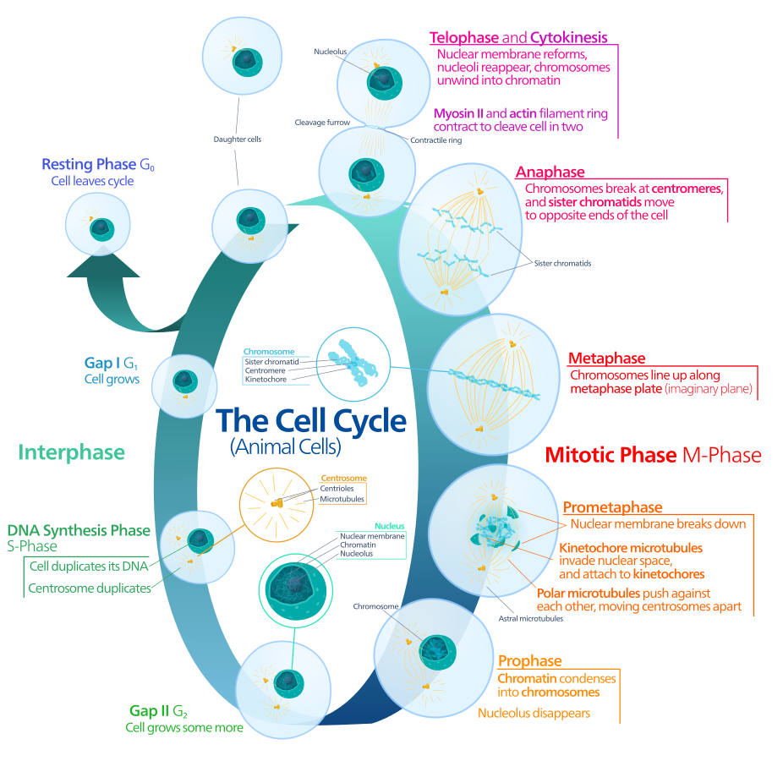
Drosophila centromere – kinetochore junction
Mis 12 Complex
?
Nsl1
Spc105
Centromere
CenpC
Microtubules
Mis12
Nnf1a
Kinetochore
Centromere
Kinetochore
Chromosome

Slide 15
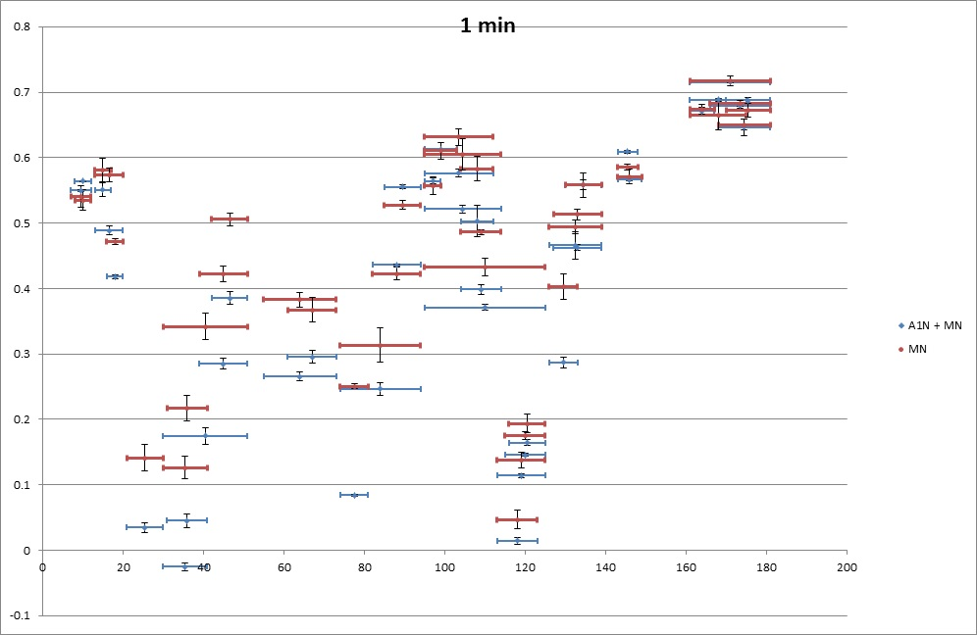
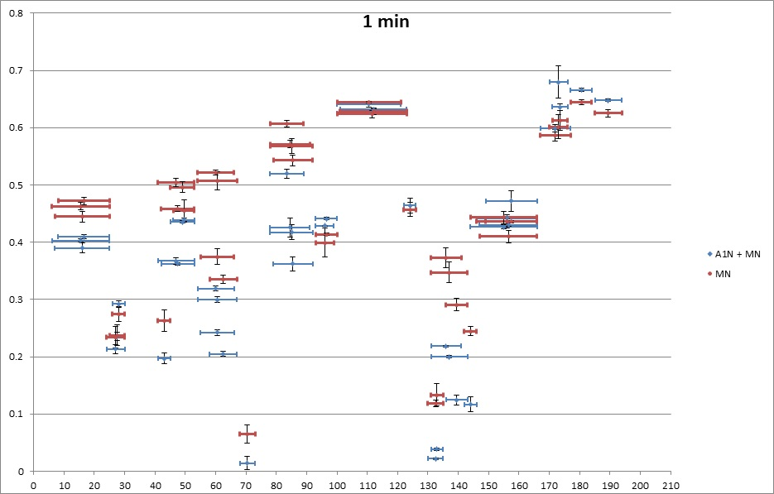
Stage one: Mis12:Nnf1 dimer stability regions
Mis12
Nnf1

Slide 16
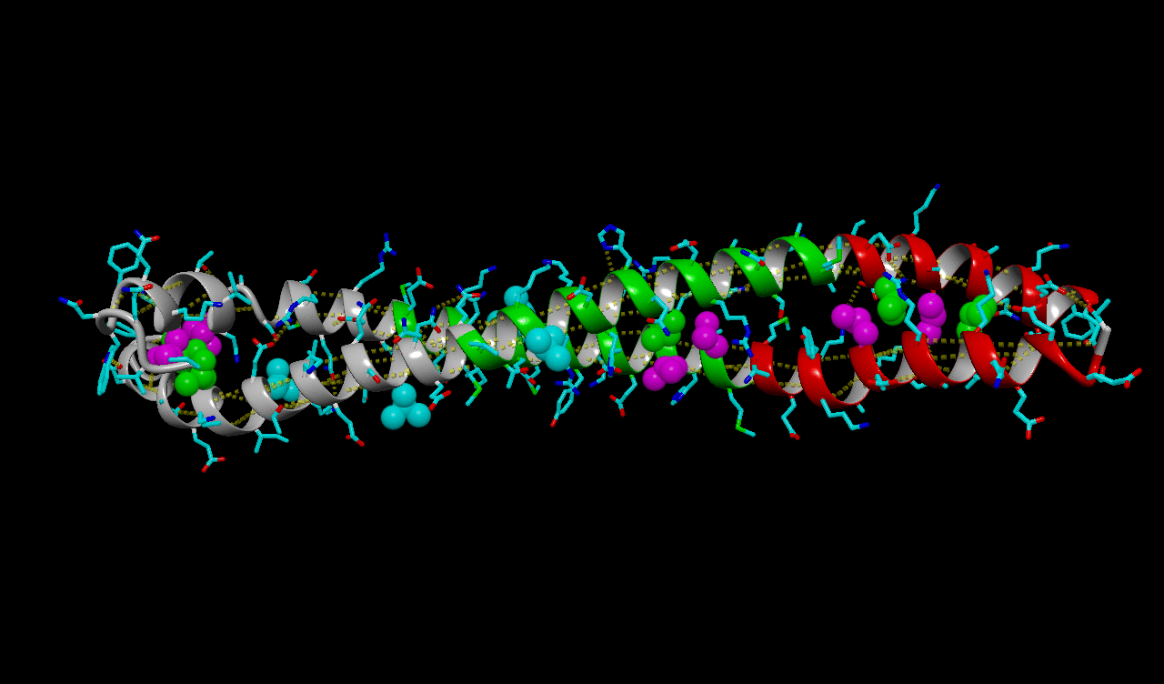
HDex allowed to construct a molecular model of Mis-12-Nnf1 coiled-coil dimer

Slide 17
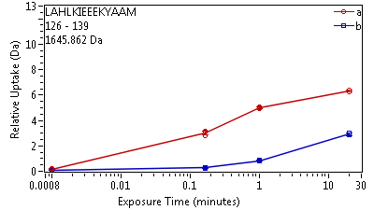
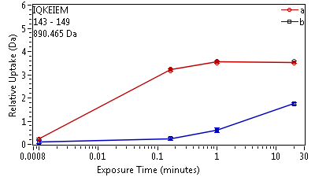
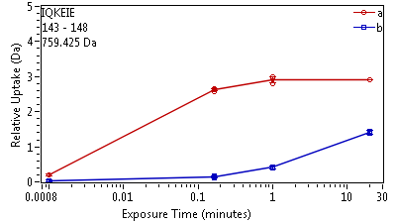
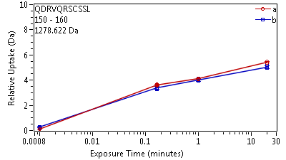
Nsl1 binding site to Mis12-Nnf1 complex is mapped to a defined region
Mis12
Nnf1a
Mis12
Nnf1a
Nsl1
Mis12
1
188

Slide 18
Interaction sites for CenpC and Nsl1 localised
in a new molecular model of Nnf1-Mis12 coiled coil
Mis 12 Complex
CenpC
?
Nsl1
Nsl1
Spc105
CenpC
Mis12
Nnf1a
Centromere
Kinetochore
Richter, M. et al.

Slide 19
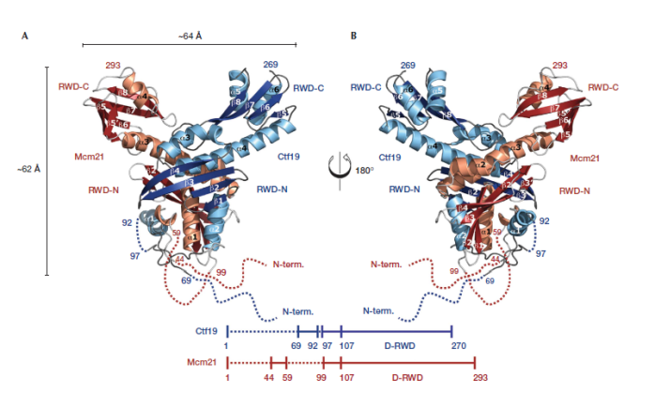
COMA complex – a postdoc’s nightmare
Ctf19
Mcm21
Okp1
Ame1
?
Nkp1
Nkp2
Schmitzberger et al., Embo J 2012
Notes:
Subassembly of budding yeast kinetochores

Slide 20
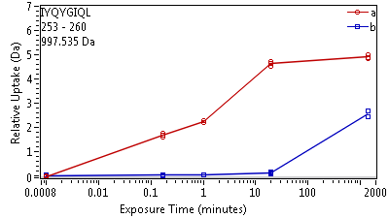
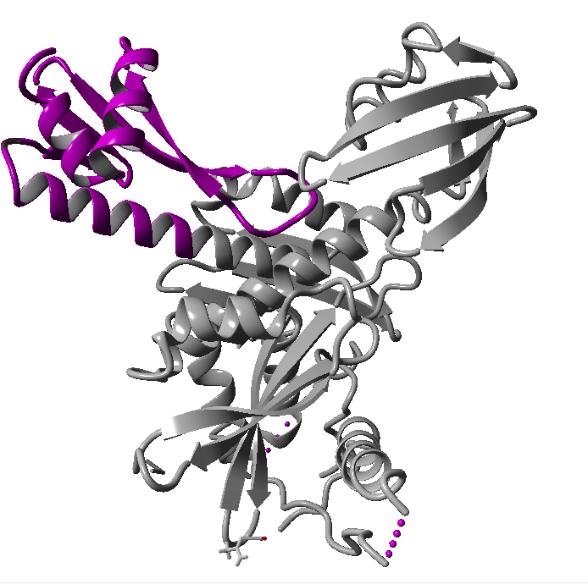
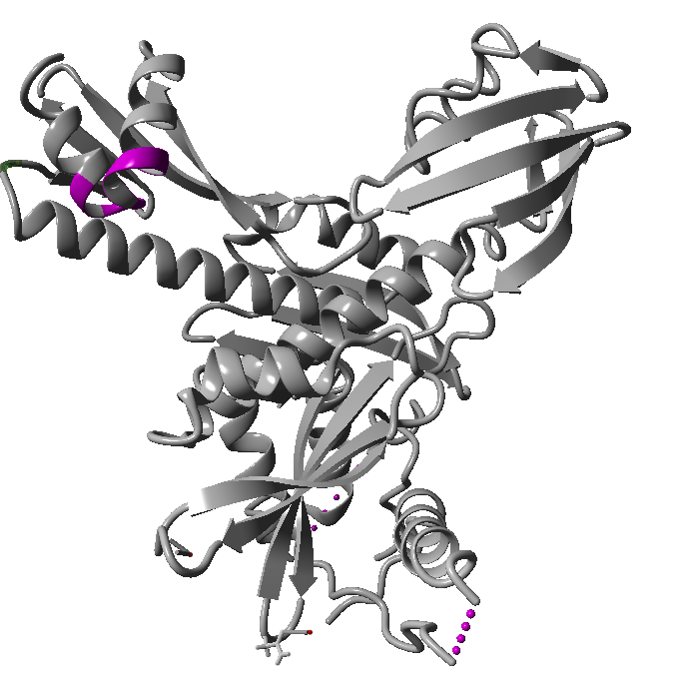
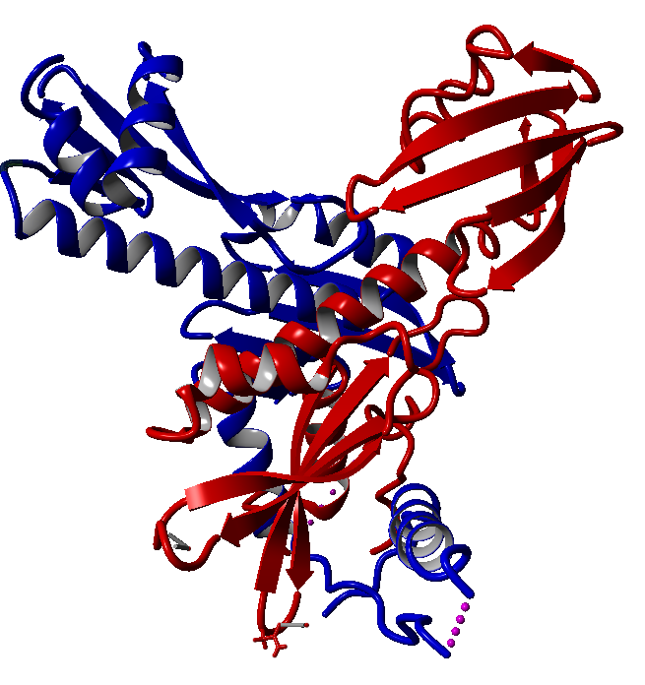
Ctf19
Mcm21
Ctf19
Mcm21
Okp1
Ame1
Notes:
Helisa 6

Slide 21
Contact regions for all partners of COMA complex revealed
Ctf 19
Mcm 21
Ame1
Okp 1
Nkp1
Nkp2
Schmitzberger, F. et al.

Slide 22
Selected HDex projects
1. Difficult protein targets/natively unfolded proteins/oligomerising proteins
Intermediate filament oligomers and their interactors
(with H. Herrmann, German Cancer Research Center, Heidelberg, Germany, & A. Edelman, Institut Necker, Paris)
2. Mapping interaction regions with protein partners and small ligands:
- Kinetochore complexes:
COMA (K. lactis) - with F. Schmitzberger (S. Harrison group - Harvard Medical School, Boston, USA)
& Mis12-CenpC (D. melanogaster) with M. Przewłoka (D. Glover group - Cambridge University, UK)
- FLASH-Lsm11-Histone pre-mRNA Cleavage Complex –
with Z. Domiński, University of North Carolina at Chapel Hill, USA
3. Protein-DNA assemblies:
Structural cross-talk between two DNA-binding domains
in R.DpnI restriction endonuclease, with M. Bochtler, IIMCB, Warsaw
4. Protein-lipid assemblies
Perfringolysin and its mutants - with A.Sobota, Nencki Institute, Warsaw
Students involved:
Ewa Sitkiewicz, Magda Richter, Aleksandra Skrajna, Krzysztof Tarnowski, Aiswarya Premchandar,
Aleksandra Kacprzyk, Magda Kaus-Drobek, Magda Kulma, Kaja Przygońska, Kinga Fituch

Slide 23

Histone pre-mRNA cleavage complex
FLASH - CASP8-associated protein 2
1982 residues - 222,658 kDa
Last 52 residues - SANT DOMAIN
MiniFLASH – splicing variant
First 138 residues plus SANT
CPSF
160
WDR33
30
CstF
64
Symplekin
CPSF
73
CPSF100
Fip1
SLBP
FLASH
Histone
pre-mRNA
Histone Downstream Element (HDE)
LSM11 - U7 snRNA-associated Sm-like protein LSM11
360 residues - 39,500 kDa
Lsm
10
Lsm
11
B
U7 snRNA
Enhancing the stability
of the U7 snRNP on
histone pre-mRNA
D3
F
G
NPAT - Nuclear protein of the ataxia telangiectasia mutated locus
1427 residues - 154,290 kDa
universal transcriptional co-activator of all 5 classes of histone genes
E
Mammalian
U7 snRNP

Slide 24
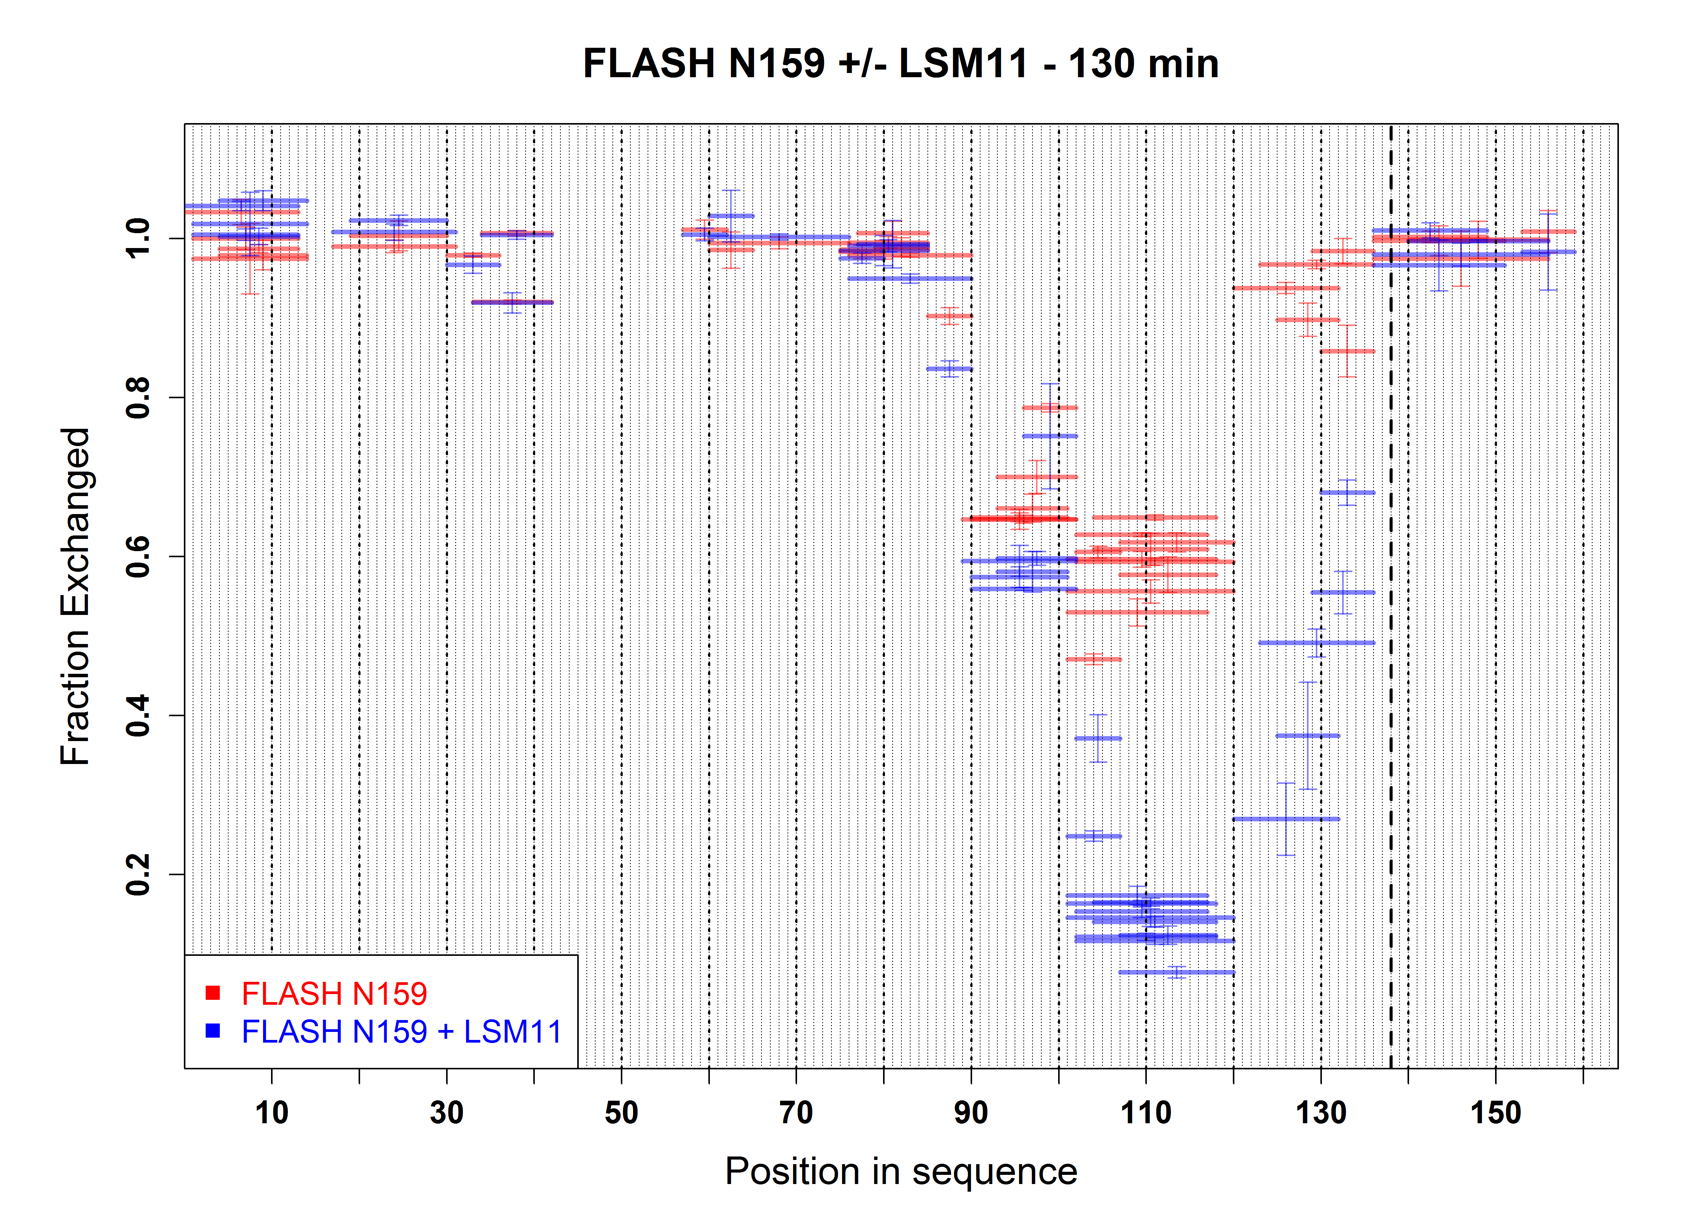
1
159
The most stable region in apo state :
89 - 120
The most stable region upon binding:
101 - 120

Slide 25
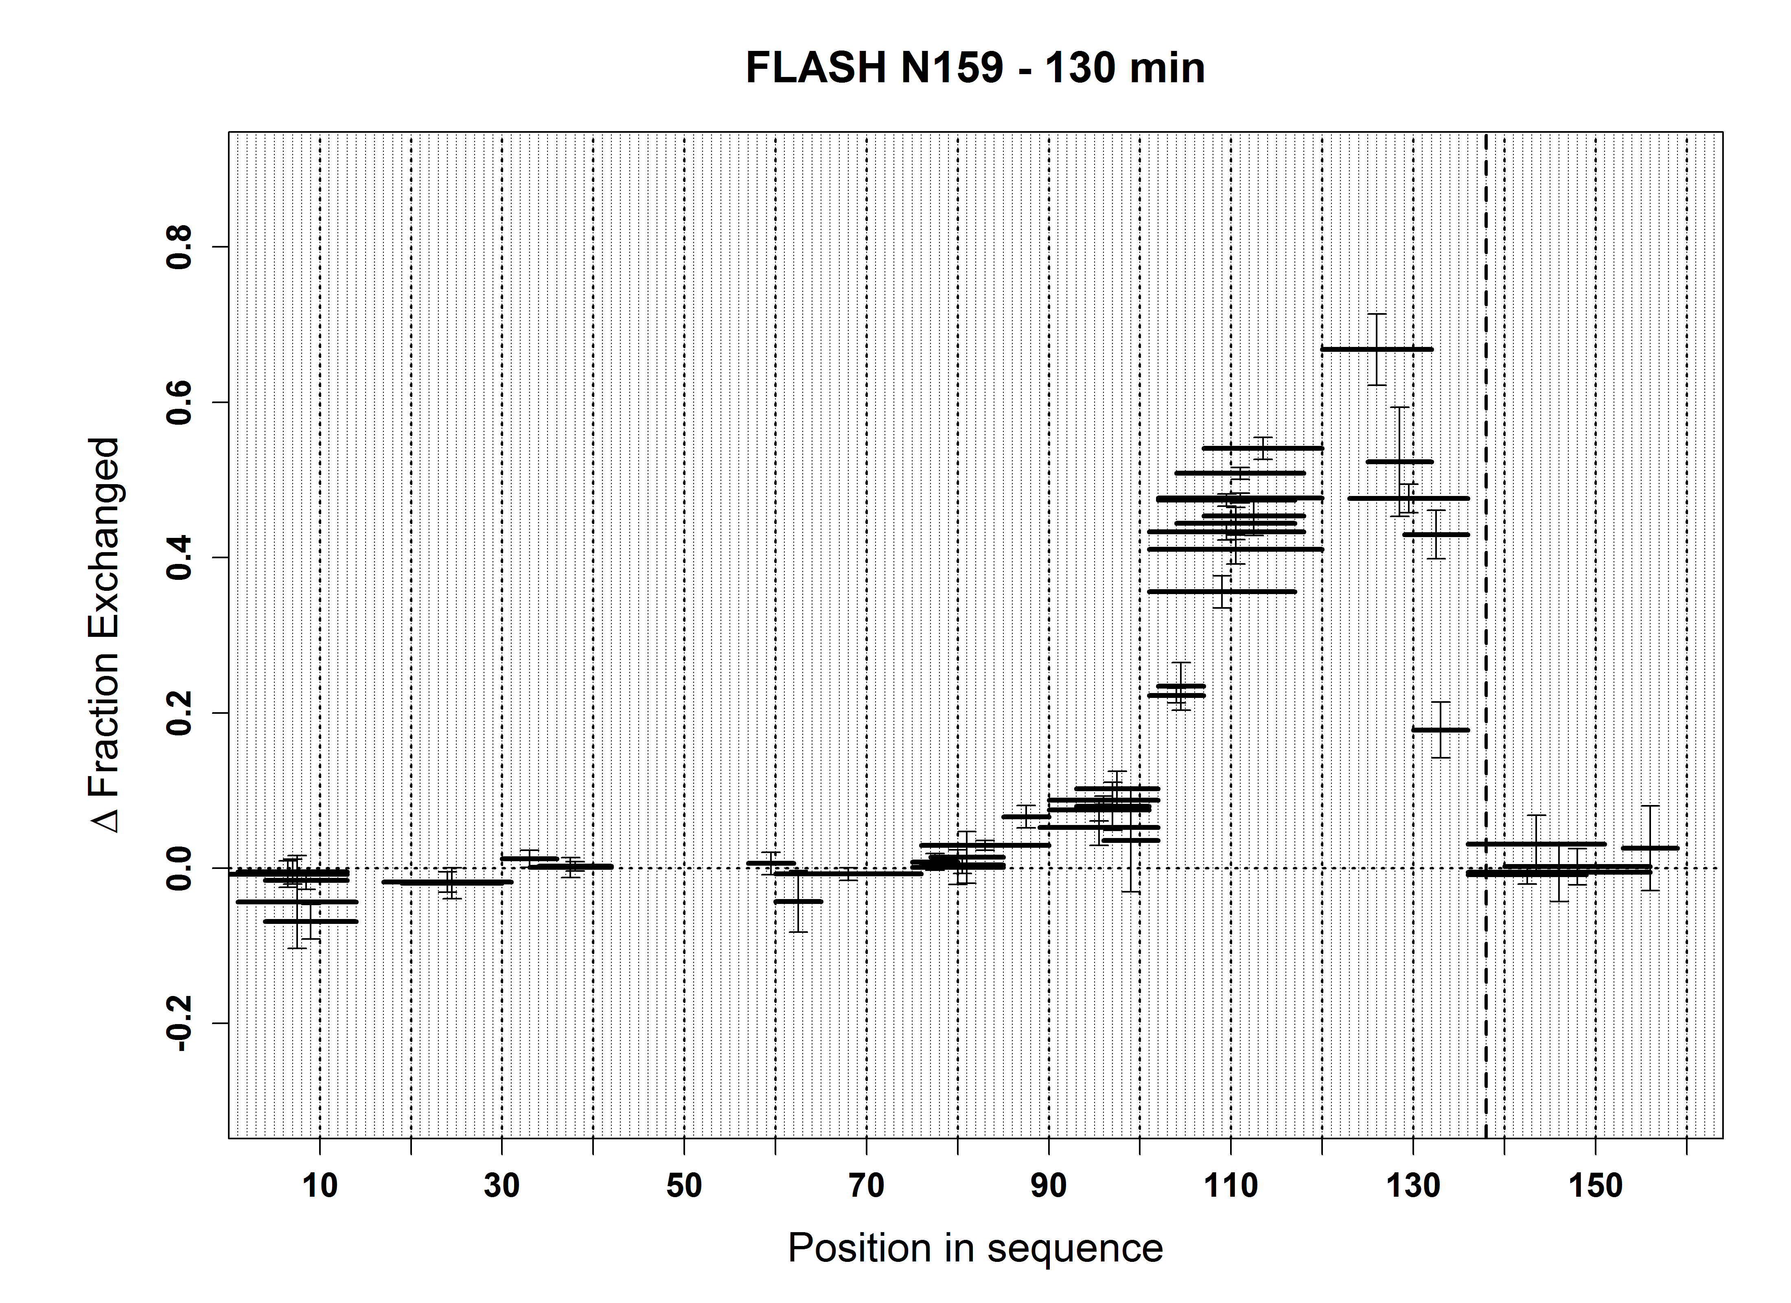
1
159
Stabilization
DEstabilization

Slide 26
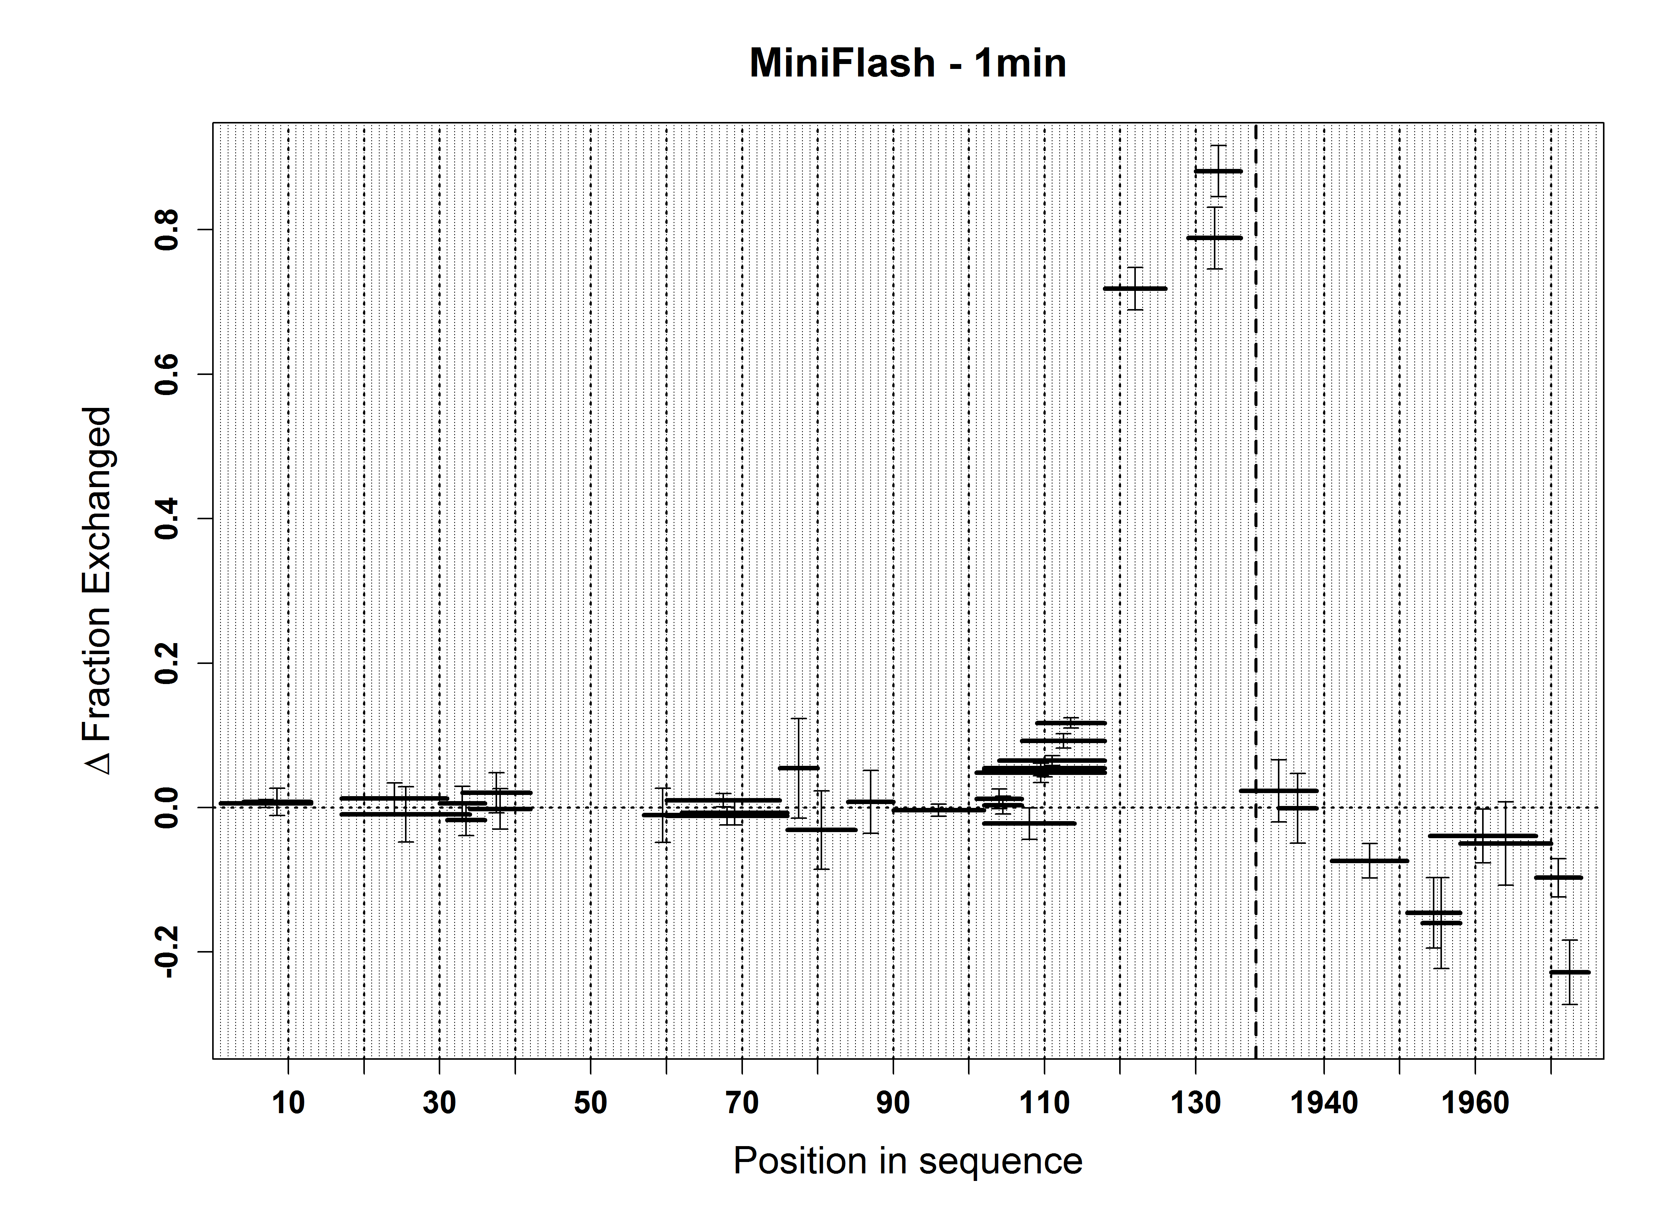
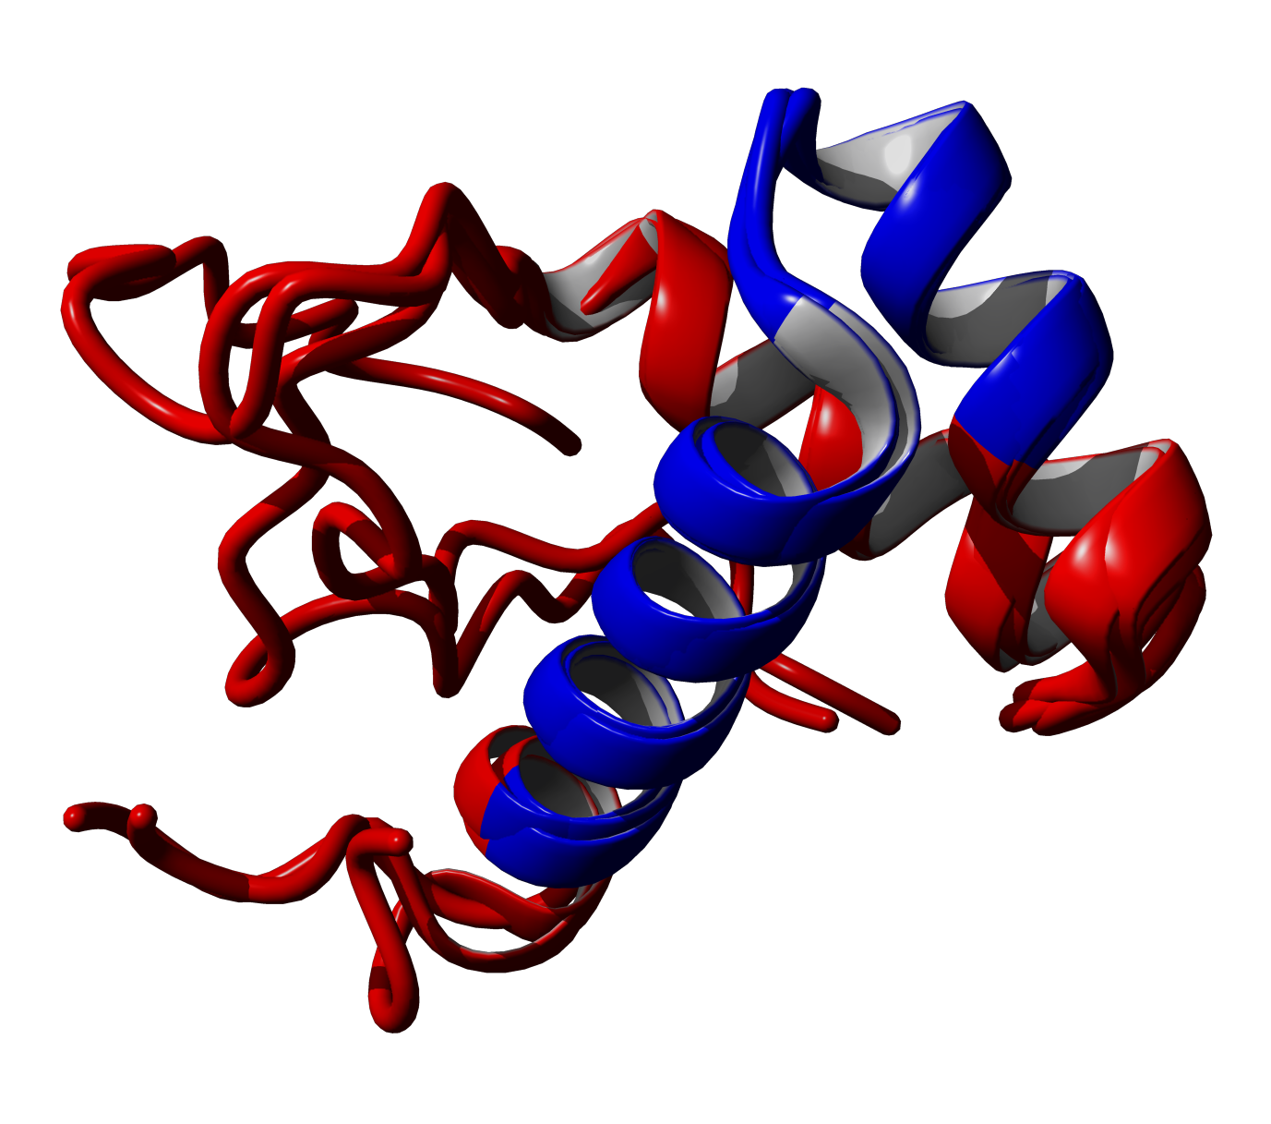
SANT DOMAIN
1
1982
Stabilization
138
52
DEstabilization

Slide 27
N
NPAT
C
N
FLASH
C
New scheme of regulation of
Histone pre-mRNA cleavage
Lsm11
(U7 snRNP)
E/CDK2
N
C
P
P
P
P
N
C
Lsm11
(U7 snRNP)
FLASH
Subunits
of the HCC
N
C
NPAT
Lsm11
From: Skrajna, A. et al.
CPSF73
U7 snRNP
Histone
Pre-mRNA

Slide 28
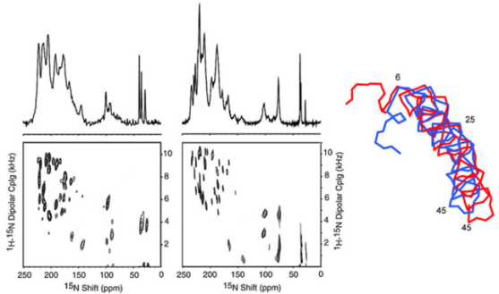
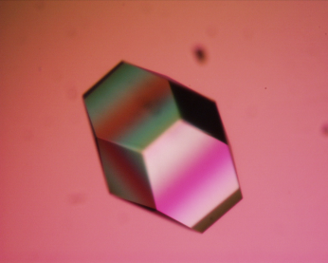
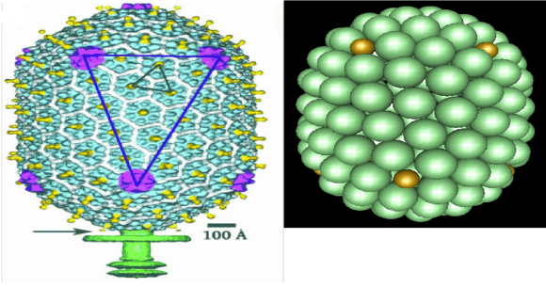
HDex for protein structure studies
Advantages:
- acces to structure in solution in native conditions at low, micromolar concentration, also in the presence of lipids or nucleic acids
- no mass limit
- no need for crystals
- no homogeneity requirement
- efficient in terms of effort required vs. Disadvantages:
- info limited to amide proton susceptibility to exchage
- peptic peptide level resolution (though ETD may change it)

Slide 29


The Team:
Proteomics:
Jacek Olędzki
Agnieszka Fabijańska
Piotr Zarębski
Magda Bakun
Agata Malinowska
Janusz Dębski
Ewa Sitkiewicz
Kinga Fituch
Metabolomics
Radosław Jaźwiec
Emilia Pawłowska
Postdocs:
Dominik Domański
Magda Kulma
Magda Kaus-Drobek
Monika Zaręba-Kozioł
Krzysztof Drabikowski
PhD Students:
Krzysztof Tarnowski
Aiswarya Premchadar
Aleksandra Skrajna
Aleksandra Kacprzyk
Anna Perzanowska
Kaja Przygońska
Katarzyna Bucholc
Magda Richter
Agnieszka Fatalska
Sponsors:
Ministry of Science
and Education
CEPT EU program

Slide 30
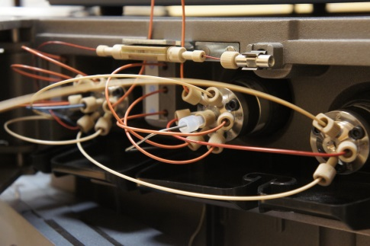
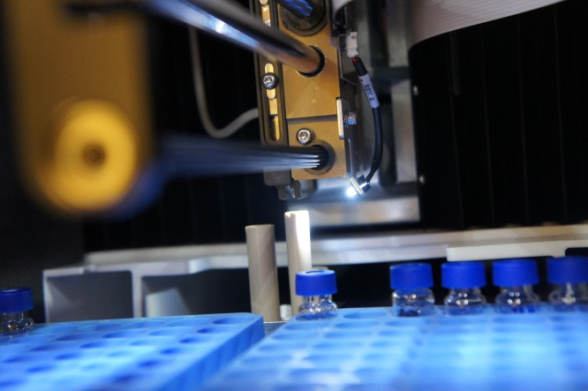
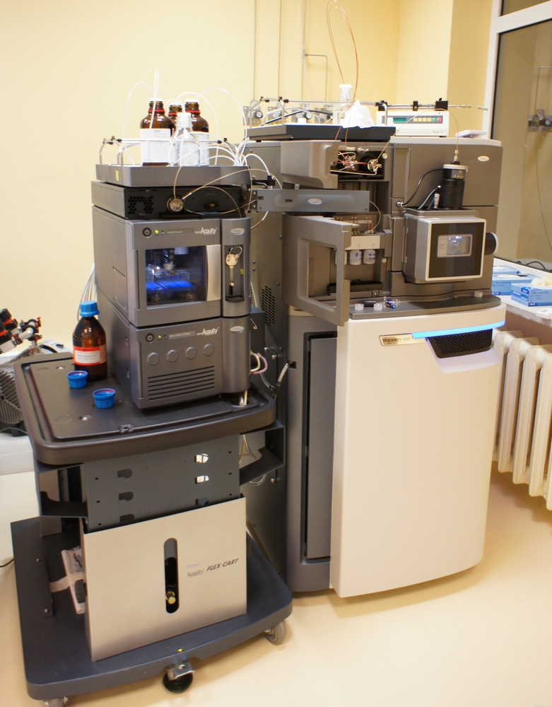
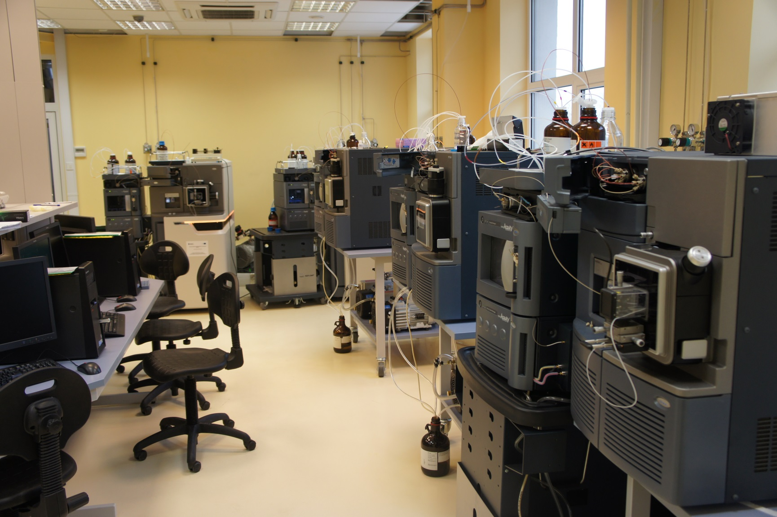
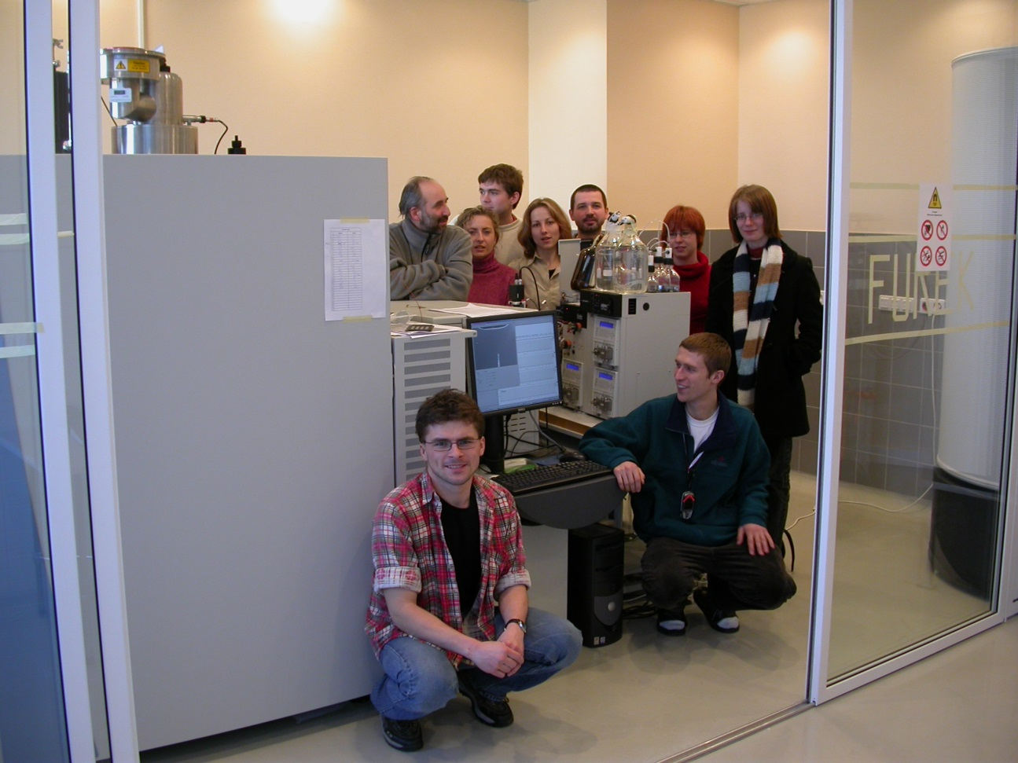
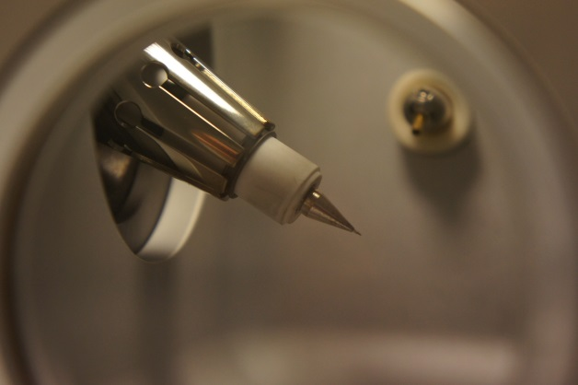
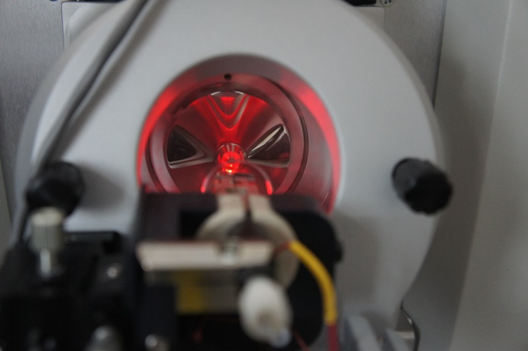
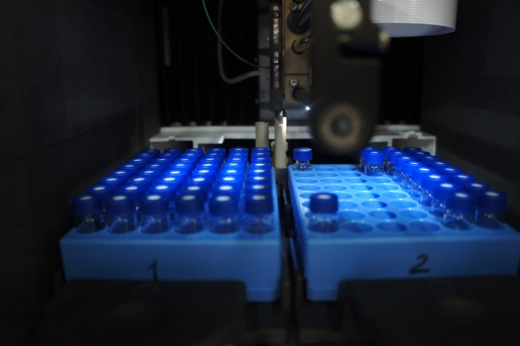

Slide 31
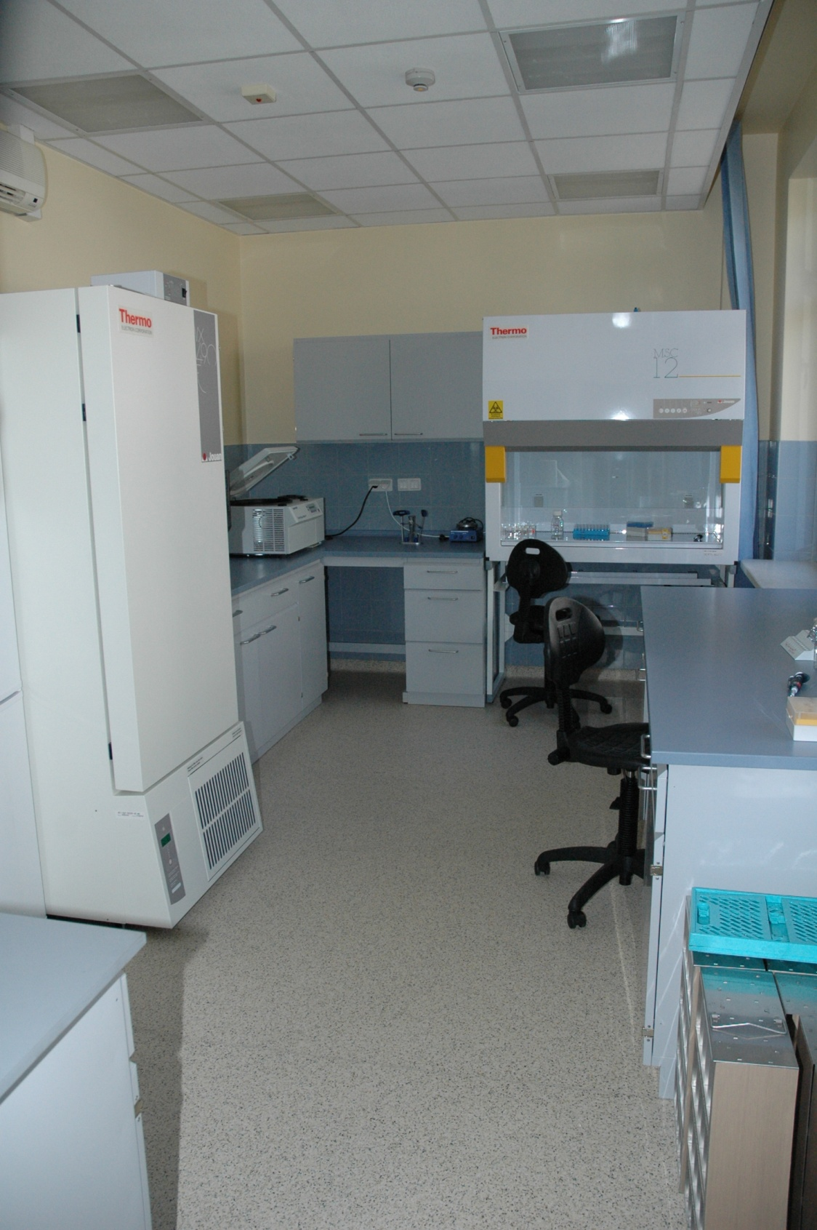
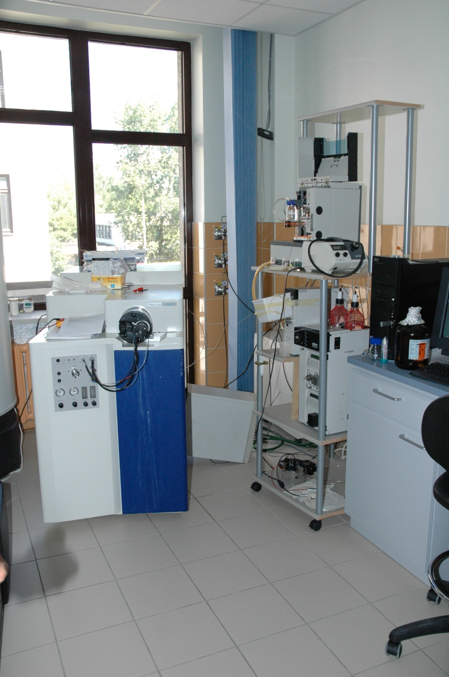

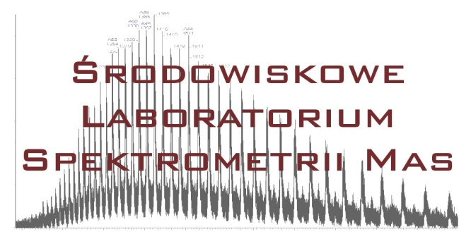
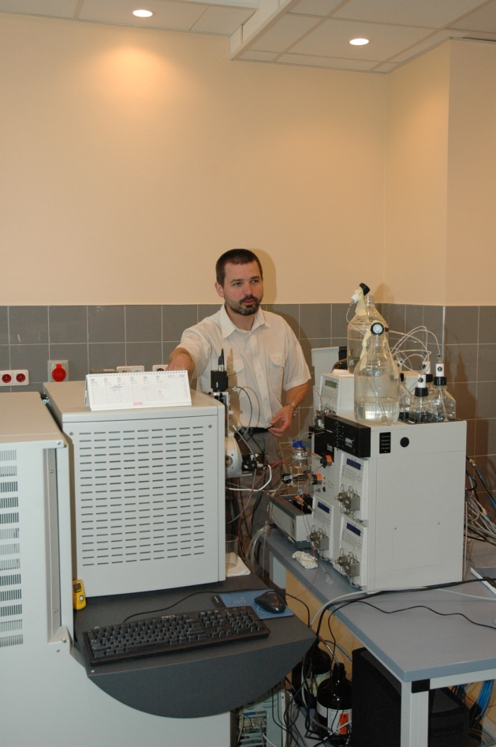

Conclusions:
Based on HDexMS a new model of RAGE oligomer was constructed
HDexMS can provide useful protein structural constraints in a quick experiment,
IMS is helpful to shift the accessible mass range to larger protein assemblies
ETD may improve resolution of the method to single amide protons
Michał Dadlez
Mass Spectrometry Lab

Slide 32
Selected HDex projects
1. Difficult protein targets/natively unfolded proteins/oligomerising proteins
Intermediate filament oligomers and their interactors
(with H. Herrmann, German Cancer Research Center, Heidelberg, Germany, & A. Edelman, Institut Necker, Paris)
2. Mapping interaction regions with protein partners and small ligands:
- Kinetochore complexes:
COMA (K. lactis) - with F. Schmitzberger (S. Harrison group - Harvard Medical School, Boston, USA)
& Mis12-CenpC (D. melanogaster) with M. Przewłoka (D. Glover group - Cambridge University, UK)
- FLASH-Lsm11-Histone pre-mRNA Cleavage Complex –
with Z. Domiński, University of North Carolina at Chapel Hill, USA
3. Protein-DNA assemblies:
Structural cross-talk between two DNA-binding domains
in R.DpnI restriction endonuclease, with M. Bochtler, IIMCB, Warsaw
4. Protein-lipid assemblies
Perfringolysin and its mutants - with A.Sobota, Nencki Institute, Warsaw
Students involved:
Ewa Sitkiewicz, Magda Richter, Aleksandra Skrajna, Krzysztof Tarnowski, Aiswarya Premchandar,
Aleksandra Kacprzyk, Magda Kaus-Drobek, Magda Kulma, Kaja Przygońska, Kinga Fituch

Slide 33


COMA STORY
Protein-DNA complex HDex pattern – endonuclease DpnI
Mis12C+CenpC
STORY
Upon binding of DNA:
Red - region stabilized
Blue - region destabilized

Slide 34

COMA STORY
Both domains cooperate in binding DNA
Yellow domain is the same in the green domain mutants R231A and K229/R231A
but binding to yellow domain is severly compromised
Mis12C+CenpC
STORY

Slide 35

HDex experiment is possible also for protein-lipid complexes

Slide 36


COMA STORY
Perfringolysin regions stabilised in contact with membrane
Mis12C+CenpC
STORY

Slide 37


Different protein protons exchange with different rate constants
Blue – fast exchange rate
Red – intermediate exchange rate
Green – non-exchangeable protons
Intrinsic (unfolded peptide) exchange rate constants of amide protons of different
amino acids depend on pH, temperature and sidechains (also of the nearest neighbor)
Bai, Y. et al. (1995). "Thermodynamic parameters from hydrogen exchange measurements." MethodsEnzymol. 259: 344-356.
Bai, Y. et al. (1993). "Primary structure effects on peptide group hydrogen exchange." Proteins:Struct.Funct. Genet.17: 75-86.

Slide 38


Factors affecting H/D exchange rate which depend on protein structure and dynamics
Intra-/Intermolecular hydrogen bonding
Solvent accessibility

Slide 39

HDex is retarded for amide protons involved in H-bonding or inaccessible to solvent.
UPLC-MS follows (SYNAPT G2 HDMS equipped with HDX manager)

Slide 40




Progress in HDX MS – quite recent

Slide 41



Differential experiments may reveal binding regions
Life is not always
that easy..

Slide 42

1
1982
138
52
The binding surface on N-terminal end remains the same.
C-terminal fragment destabilizes N-terminal region between aminoacids: 118-136
C-terminal fragment destabilizes upon binding to LSM11

