Slide 1


Failure of an Inconel 718 die used in production of hot copper direct extrusion
4th International Conference and Exhibition on Materials Science&Engineering
September 14-16
2015 Florida, USA
M. Schwartz, D. Gheorghe, R. Ciocoiu, I. Ciuca, G. Jula

Slide 2
Research motivation
Steel dies used in hot copper direct extrusion usually fail after only 2-5 tons of extruded copper
Failure modes – mainly plastic deformation and cracks
Cause – severe working conditions stresses and temperatures cause structural changes in the steel
Solution – most convenient solution for S.C. LAROMET S.A. would be to use a die made of a better heat resisting material – the first trial was Inconel 718
Performance – with an Inconel 718 die 40 tons of copper was extruded and the die discarded for study (although the die could be used longer in service)
M. Schwartz

Slide 3
Research program
Inconel 718 die used for direct hot copper extrusion – 40 tons of extruded material and discarded for study
Macroscopic examination
Hardness mapping
Optic and scanning electron microscopy
X-Ray diffraction analysis
Vickers microhardness tests
Results and discussion
Current results and future trials
M. Schwartz

Slide 4
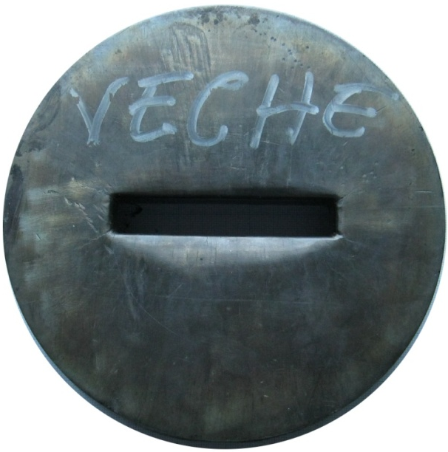
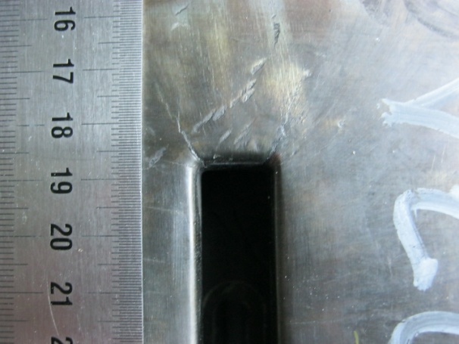
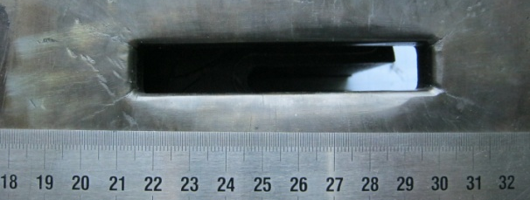
Macroscopic aspects of the die
Plastic deformation
Cracks
M. Schwartz
Notes:
a 320mm diameter die with a rectangular aperture for extrusion
cracks at aperture corners are observed, growing at 45° angles
significant plastic deformation can be observed at the middle of the aperture length

Slide 5
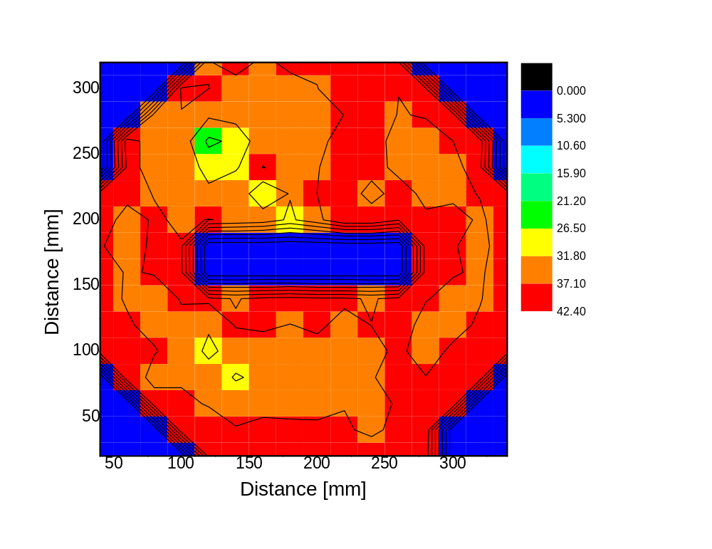
Hardness mapping
HRC map on the die
M. Schwartz
Notes:
Initial hardness had an average value of 43 HRC
On the polished die surface a grid with 20x20mm was traced and at each intersection four HRC measurements were performed, whenever possible
After use, on the back side a 44HRC mean value was found - the back side of the die did not show any damage
hardness for heat treated Inconel 718 ranging from 32 to 37HRC and a 42HRC value is normal for forged, annealed 1065°C/1h/air cooled and aged 760°C/20h
On the face of the die maximum hardness, 42HRC was found near the edge of the die, far from the aperture
minimum value was found at 25HRC, a severe dropdown of 17HRC units
The HRC distribution reveals that the left side of figure has an overall lower hardness while for the right side it is higher. Such unequal distribution could be obtained by a non uniform loading of the die during extrusion producing a shear.

Slide 6
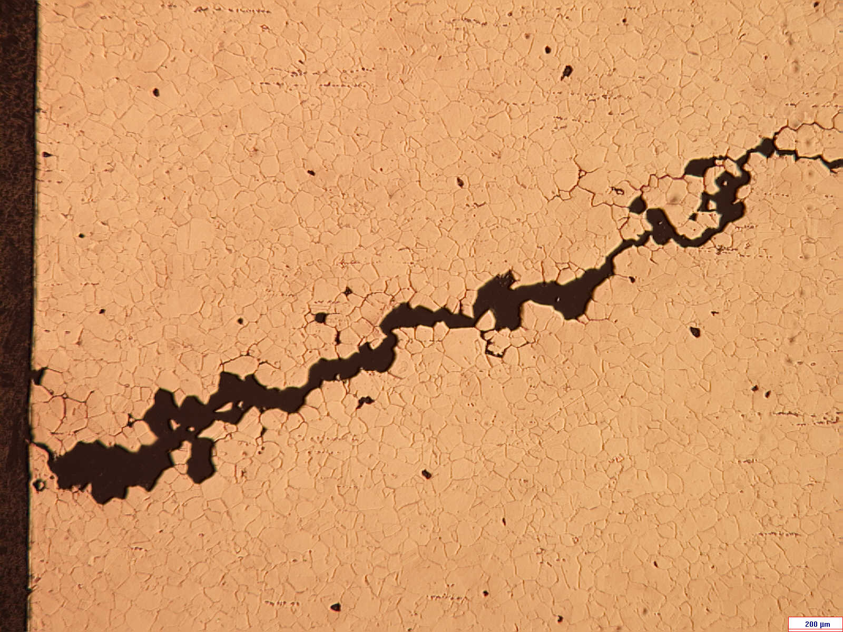
Optic microscopy
Inconel 718 optic micrograph
M. Schwartz
Notes:
The crack is intergranular, it extends on grain boundary
The grain size is uniform; the grains are small and did not coarsen
From the main crack many secondary cracks split, grow on grain boundary and the re-intersect with the main crack the result being isolated grains or groups of grains
The microstructure is normal for Inconel 718 with polyhedral twinned grains. No microstructure change was observed.

Slide 7
Scanning electron microscopy
SEM image showing the normal structure in the median region of the die
M. Schwartz
Notes:
At grain boundary, especially at higher magnification the presence of a phase which gives the serrated aspect was found
based upon morphology and location, this phase was assumed to be the delta phase

Slide 8
Scanning electron microscopy
SEM image detailing serrated grain boundaries
M. Schwartz
Notes:
At grain boundary, especially at higher magnification the presence of a phase which gives the serrated aspect was found
based upon morphology and location, this phase was assumed to be the delta phase

Slide 9
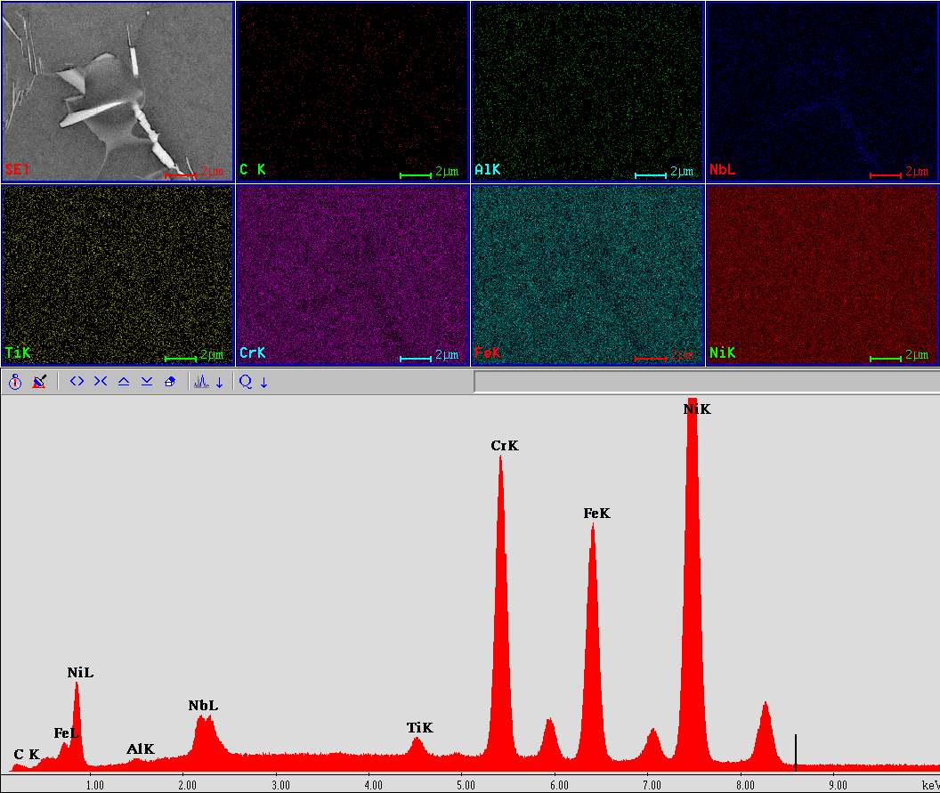
Scanning electron microscopy
Elemental mapping on grain boundary phases
M. Schwartz
Notes:
For Inconel 718 the main hardening precipitate is γ’’ with same chemical composition as δ (Ni3Nb). Near precipitated δ a region with low volume fraction of γ’’ and this zone will have lower mechanical characteristics.
An alloyed austenitic nickel matrix can be distinguished and grain boundary phases, due to their size, cannot be detected. Still, a small region could be captured in which a high niobium and nickel concentration was present, while other alloying elements were absent. This aspect strengthened our assumption that this phase would be the Ni3Nb delta phase.

Slide 10
Scanning electron microscopy
SEM image of cracks
M. Schwartz
Notes:
This crack originates at aperture corner and extends at a 45° angle
The main crack grows at grain boundary and it has a saw-tooth appearance
it can be seen how the crack splits and propagates at grain boundary, surrounds a grain or a group of grain, and the re-intersects with the main crack

Slide 11
Scanning electron microscopy
SEM image showing crack details
M. Schwartz
Notes:
a crack which occurred in the proximity of the main crack can be observed
Its growth direction is nearly parallel to the main one, but no contact with the exterior environment was made
In its path the crack interacts with carbides
the crack is deflected and forced to propagate around these hard phases and then re-intersect

Slide 12
Scanning electron microscopy
SEM image showing an isolated grain
M. Schwartz
Notes:
a detail of an isolated grain can be observed. Cracks at grain boundary split and begin to propagate also on grain boundary
The crack aspect, at higher magnification, appears jagged suggesting that it was deflected by grain boundary precipitated phases – in Inconel 718 the most important being the delta phase

Slide 13
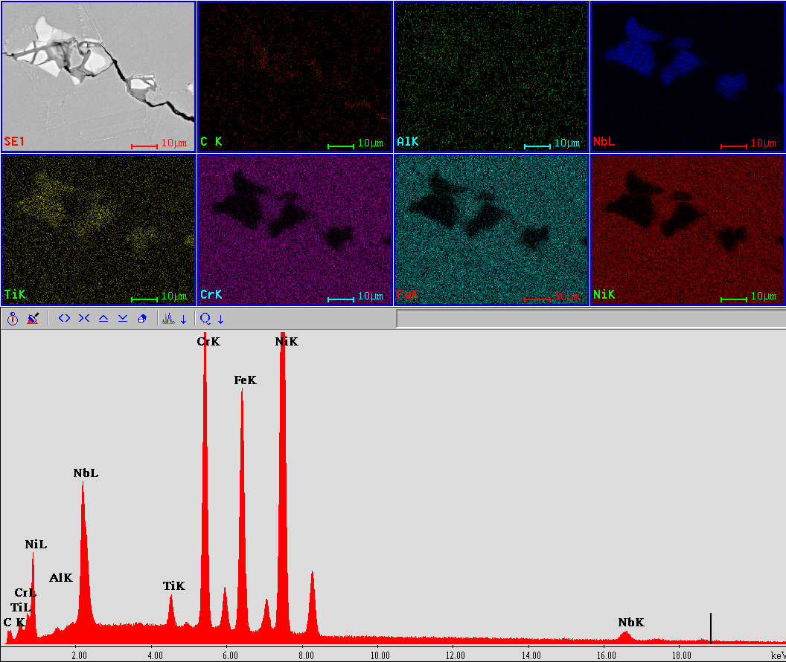
Scanning electron microscopy
Elemental mapping on hard phases near crack
M. Schwartz
Notes:
When an elemental map was performed titanium and niobium carbides were found embedded in an alloyed austenitic matrix
a fine detail regarding small spacing between the carbides was found, the path on which the crack propagated

Slide 14
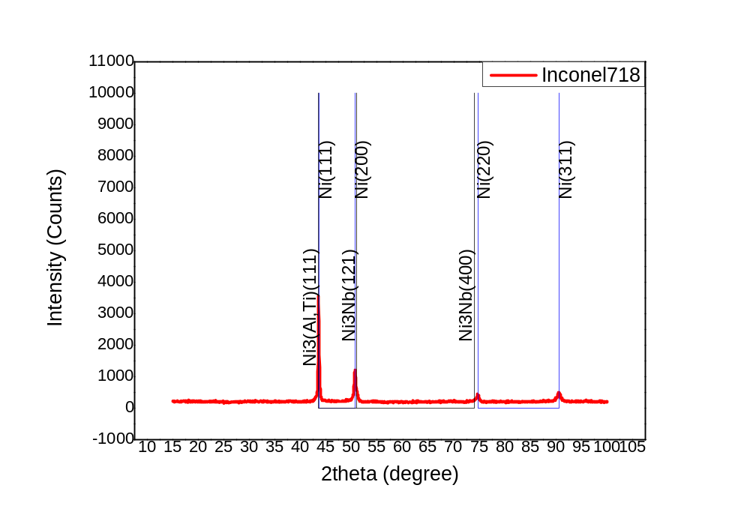
X-Ray diffraction
Inconel 718 XRD pattern
Notes:
Mainly strong peaks from the nickel austenite phase were observed
On closer inspection of the pattern multiple phase presence could be inferred
we were unable to determine precise phase concentration
This analysis revealed the possibility of Ni3(Al,Ti) gamma prime and Ni3Nb delta phase peaks but no phase quantification was possible

Slide 15
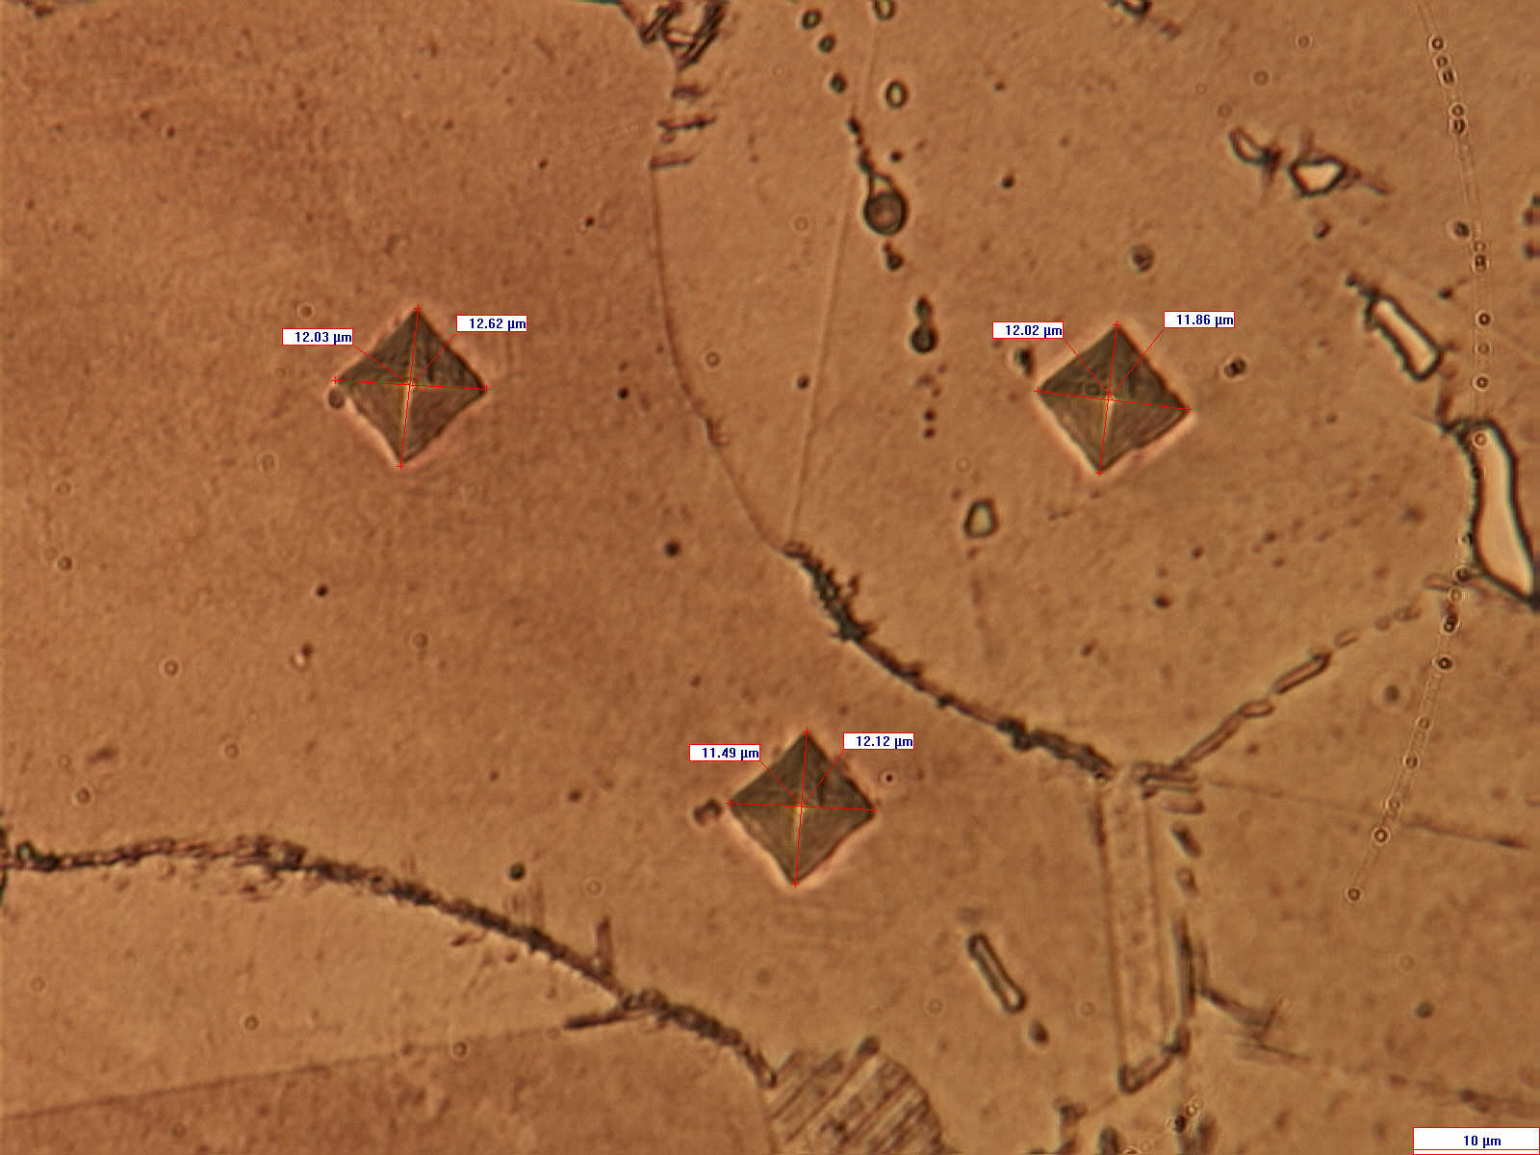
Vickers microhardness
Microhardness imprints in the matrix
M. Schwartz
Notes:
mean Vickers microhardness was at 513 with a 23 standard deviation

Slide 16
Results and discussion
The extruded copper quantity was increased (8 times) when the Inconel 718 die was used
Failure modes of Inconel 718 die resembled those of steel: plastic deformation and cracks
A significant hardness drop was observed near die aperture
The grains did not coarsen, but precipitated phases on grain boundary had an almost film like appearance
Delta phase content increase favors crack growth and high temperature stress rupture in Inconel 718
M. Schwartz

Slide 17
Results and discussion
The cracks appeared as intergranular, saw-tooth like, specific for high temperature working conditions
High temperature oxidation enhances damage effects – local changes in chemical composition and microstructure occur
Near precipitated delta phase a depleted gamma prime volume is expected – this zone has lower mechanical properties
The microstructure was not strongly affected by working conditions, only local changes, mainly on grain boundary are the culprits for die failure
M. Schwartz

Slide 18
Current results and future trials
The use of Inconel 718 as die material for direct copper hot extrusion increased the production/die
These results are found acceptable for S.C. LAROMET S.A.
Another superalloy, Rene 41, is in research stage since the working temperature limit for Inconel 718 is bellow that of the copper billet
With Rene 41 only chromium carbide precipitation is expected
When the research with Rene 41 will be complete a comparison will be made and a final decision made
M. Schwartz

Slide 19
Acknowledgment
These research results are obtained within the project entitled ‘Materiale special destinate confectionarii matritelor pentru extrudarea la cald a cuprului si alamelor’ (Special materials for hot extrusion dies for copper and brass), an effort from Politehnica University of Bucharest and LAROMET S.A.
M. Schwartz

Slide 20
THANK YOU!
QUESTIONS?
M. Schwartz

