Slide 1

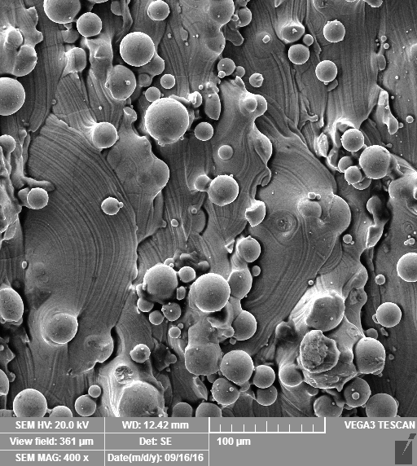
Metallic 3D-printing for orthopedic surgery: question of surface and cell compatibility
Michaela Fousová, Dalibor Vojtěch,
Eva Jablonská, Jaroslav Fojt

Slide 2
Outline
Introduction
Metallic 3D printing
principle of powder-bed techniques
Experimental setup
SLM and EBM technology
Results
surface morphology and chemistry, cell compatibility
Conlusions

Slide 3


Introduction
University of Chemistry and Technology Prague, Czech Republic
Department of Metals and Corrosion Engineering

Slide 4
Metallic 3D printing
3 main categories of manufacturing process:
Powder bed systems
  raking powder across the building plate to form successive layers
  an energy source (electron or laser beam) selectively melts the powder to form desired shape
  advantage: high resolution, dimensional control
Powder feed systems
  powders are conveyed through a nozzle onto the building plate
  a laser is used to melt a monolayer or more of the powder into the shape desired
  advantage: larger build volume, reparation of damaged components
Wire feed systems
  feed stock is wire which is deposited onto the building plate
  upon subsequent passes a 3D structure is built up
  welding by laser, electron beam or plasma arc
  Advantage: high deposition rate

Slide 5
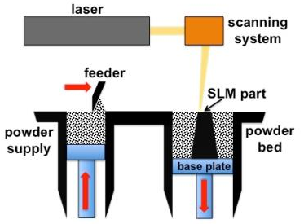
Metallic 3D printing
Powder bed systems
Selective Laser Melting (SLM) and Electron Beam Melting (EBM)

Slide 6
Metallic 3D printing
SLM
EBM
laser beam, 200 W
argon atmosphere
Input Ti6Al4V powder:
15-45 μm
Layer thickness: 30 µm
no preheating
heat treatment necessary
electron beam, 60 kV
vacuum
Input Ti6Al4V powder:
45-105 µm
Layer thickness: 50 µm
preheating every layer at 740 °C
heat treatment not necessary

Slide 7

Metallic 3D printing
SLM
EBM
ProSpon spol. s r.o.,
Czech Republic
development, manufacture and distribution of medical implants and instruments for orthopedics, traumatology and surgery
Metal Industries Research & Development centre, Taiwan
research & development of the leading technology of metal and its related industries in Taiwan

Slide 8
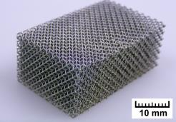
Ti6Al4V alloy
high mechanical properties
excellent corrosion resistance
biocompatibility
much higher stiffness over bone
bioinert - no biological fixation

Slide 9
Experimental
SLM machine M2 Cusing, ConceptLaser
200W Yb:YAG fiber laser
protective argon atmosphere
Input material: gas-atomized Ti-6Al-4V powder
        (rematitan® CL, Dentaurum, 15-45 μm)
Post-production heat treatment: 820 °C, 1.5 h
S400 Arcam machine
electron beam, 60 kV
vacuum
Input material: gas-atomized Ti-6Al-4V powder
        (Arcam, 45-105 μm)

Slide 10
Experimental
Process parameters:
SLM – island scanning strategy, EBM – continuous scanning
Specimens:
blocks of which specimens of 8x8x3 mm³ were cut off
 | Power (W) | Scanning speed (mm/s) | Hatching distance (μm) | Layer thickness (μm)
SLM | 200 | 1250 | 80 | 30
EBM | 900 | 4530 | 200 | 50

Slide 11
Experimental
Characterization of surface
Morphology – SEM (Tescan Vega-3 LMU)
Analysis of chemical composition – XPS (ESCAprobe P, Omicron Nanotechnology Ltd.)

Slide 12
Experimental
In vitro contact tests
U-2 OS cells, seeding density 24.000 cells/cm²
DAPI/phalloidin-TRITC staining (Sigma)
LIVE/DEAD® Viability/Cytotoxicity Assay (Thermo Scientific)
fixation for SEM observation
Fluorescence microscopy – fluorescence confocal microscope Olympus IX81

Slide 13
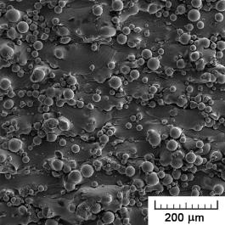
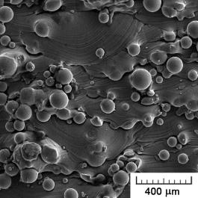
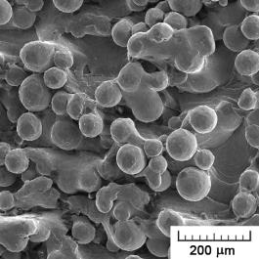
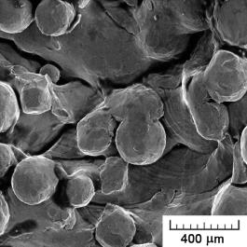
Results
Surface morphology
SLM
av. particle size
~ 30 µm
→lower roughness
Adhering powder particles
EBM
av. particle size
~ 75 µm
→ higher roughness

Slide 14
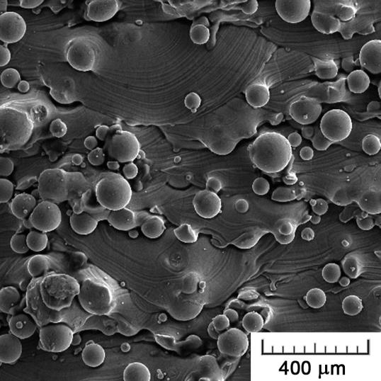
Results
Surface morphology
Arcs of solidified melt

Slide 15
Results
Surface chemistry
Significant changes
SLM
  2fold increase in Al
  no V
  except of Ti and Al oxides, also Ti carbide detected
  Cause: residual oxygen in the argon atmosphere, high temperature of laser beam
  termodynamical explanation
  EBM
  increase in Al, but also in V
  Cause: moisture in powder-bed
  TiO, TiO₂, Ti₂O₃, but also elemental Ti → oxidic layer thinner
Biocompatibility preserved
  Al in the form of inert Al₂O₃
  V in the form of V₂O₅

Slide 16
Results
Cytocompatibility
SLM
EBM
control
24 hours
72 hours

Slide 17
Results
Cytocompatibility
Only comparative chart
Difficulty to assess real number of cells due to high roughness of 3D-printed surfaces
87 and 96 % of positive control (cell culture dish) for SLM and EBM, respectively
60 a 74 % of commercially produced Ti6Al4V with smooth surface
Cell density after 24 hours of cultivation
After 1st day, cells grew preferentially on smooth surface in between adhering powder particles representing too large obstacles. Later, whole surface overgrown.

Slide 18
Results
Cytocompatibility
EBM
control
healthy cell morphology

Slide 19
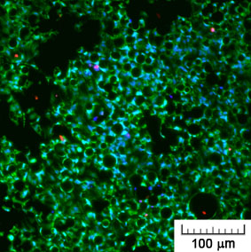
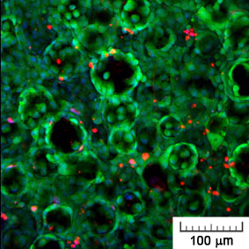
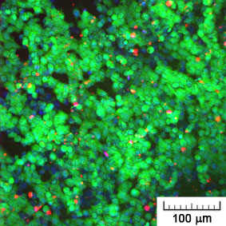
Results
Cytocompatibility
control
SLM
EBM
72 hours of cultivation

Slide 20
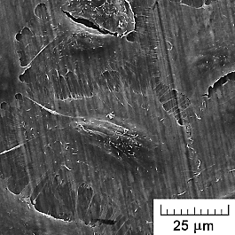
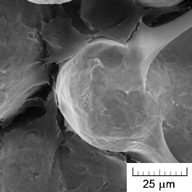
Results
Cytocompatibility
SEM images of cells
24 hours of cultivation
on tested materials
control
preferentially on smooth melted surface
SLM
small adhering powder particles already overgrown
EBM
healthy polyhedral shape

Slide 21
Conclusions
Powder bed technologies finish in product with surface covered with adhering powder particles.
EBM yields surface of higher roughness than SLM.
Surface chemistry is changed by 3D printing process.
Biocompatibility of Ti6Al4V is retained.
Difficulty to simply assess cytocompatibility quantitatively – need of advanced techniques
Risk of particles release – need of surface treatment
3D-printed surface is suitable for orthopaedic applications, but needs to be improved.

Slide 22
Thank you for your attention!

