Slide 1

Genetic Dysregulation in Recurrent Respiratory Papillomatosis
Authors: Regina Rodman MD, Simukayi Mutasa, Crystal Dupuis, Heidi Spratt PhD,
Michael Underbrink, MD MBA

Slide 2
Disclosure
None

Slide 3
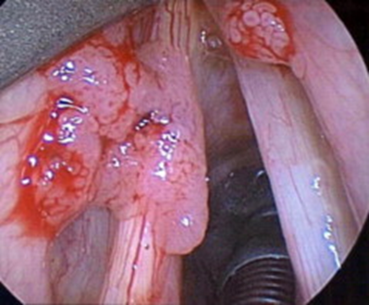
Introduction- Recurrent Respiratory Papillomatosis
HPV types 6 and 11
Children and adults
Relatively rare
  4.3/1,000,000 children
  1.8/1,000,000 adults
In affected patients the disease can
be devastating
  19.7 procedures/lifetime in children
  4.4 procedures/year
Derkay CS, Wiatrak B. Recurrent respiratory papillomatosis: a review. Laryngoscope 2008;118(7):1236-47

Slide 4
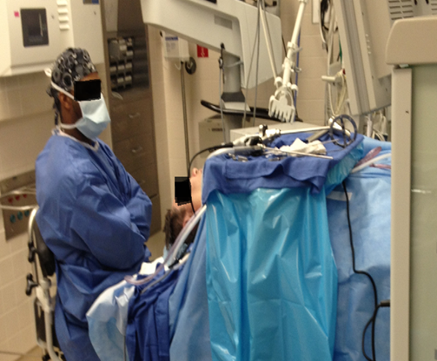
Background
Surgery is mainstay of treatment
Much research has been done on “high risk” HPV types associated with cervical cancer, HPV 16 & 18
Less is known at molecular level regarding RRP related HPVs, 6 & 11
To find a cure, we must better understand the molecular mechanisms of disease

Slide 5
E6 bind to c terminal of p53
Disrupts Apoptosis
E7 targets Rb protein
Dysregulation of cell cycle
E6
E7
URR
E1
E2
E4
E5
L2
L1
Immune “tolerance” to papilloma virus
-altered CD8+ T cell subset
-Th1/Th2 cytokine imbalance
-Defective NK cells
Bonagura Hatam DeVoti 1999
DeVoti Rosenthal Immune dysregulatio and tumor associated gene changes

Slide 6
PURPOSE
Compare genes of
  cell cycle
  apoptosis
  inflammatory cytokines
Laryngeal papilloma vs normal tissue
Goal: to better understand where dysregulation occurs in laryngeal papilloma

Slide 7
Cell Cycle
ATM
TP53
Apoptosis
RB1
Inflammatory Cytokines
CD40
ATR
BRCA1
BRCA2
GADD45A
ABL1
CDKN1B
BID
BAD
BIK
BBC3
BAK1
BAX
BCL2
MCL1
CD27
IL1A
IL6
IL8
IL18
MCM3Ap
CDK2
CDK4
CDK1
CDKN1A
CDKN1B
CDKN2A(1,5)
CDKN2A(4)
NAIP
BIRC2
BIRC3
XIAP
BIRC5
FASLG
FADD
TRADD
IFNG
IFNK
TNF
TGFB1
IL28RA
IL29

Slide 8
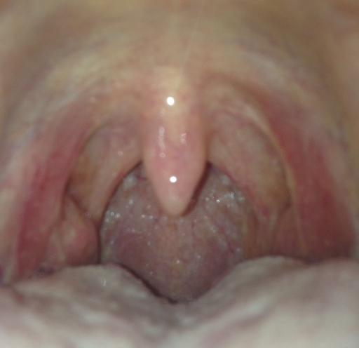
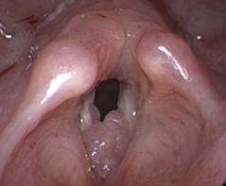
Methods
Patient Selection
Laryngeal Papilloma
Uvulapalatopharyngoplasty
Therapeutic excision
½ sample to pathology
½ sample for study
Therapy for sleep apnea
Mucosa stripped off uvula

Slide 9
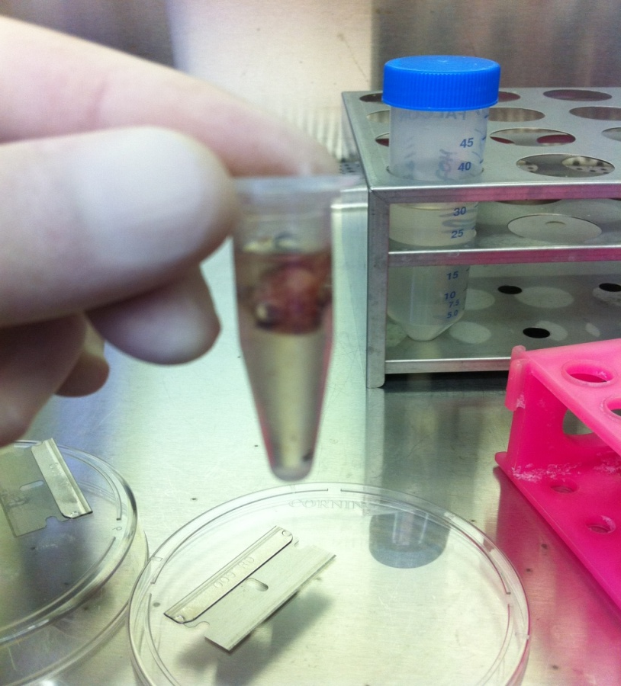
Methods
RNA Extraction and Qualification
11 pairs of papilloma/normal
  Tissues homogenized
  RNA extracted
    Quantity and quality assessed
Custom designed, reverse transcriptase, real time PCR microarrays
  46 disease focused genes
  5 housekeeping, 3 RNA and PCR quality control
-SYBR Green PCR Master Mix
-ABI prism 7500
  -QIAShredder, RNAEasy Mini
  -NanoDrop ND-1000
  -Agilent BioAnalyzer 2100

Slide 10
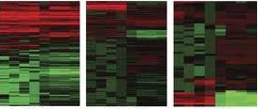
Results
Data Analysis
Threshold cycle numbers (Ct) defined as fluorescence values exceeding baseline
  SYBR green used to bind double stranded PCR products
ΔΔCt Method
  Comparison of measured Ct values for each sample of laryngeal papilloma to paired control
Mann-Whitney test to evaluate statistically significant differences between group of papilloma compared to control group

Slide 11
Results
 | MCL1 | IL1A | IL8 | IL18 | IL31
Mann-Whitney U | 25 | 22 | 27 | 19 | 20
Wilcoxon W | 91 | 77 | 93 | 74 | 86
Z | -2.114 | -2.118 | -2.201 | -2.345 | -2.243
Asymp. Sig. (2-tailed) P value | 0.035 | 0.034 | 0.028 | 0.019 | 0.025

Slide 12
Results MCL-1
Regulation of apoptosis vs. cell survival
Maintenance of viability but not of proliferation
  isoform 1- inhibiting apoptosis
  isoform 2- and isoform 3 promote apoptosis, death-inducing
DOWN Regulation in our papilloma study
  May be the isoform 2 or 3 that was detected →decrease apoptosis
MCL-1 Human 907820. UniProtKB/Swiss-Pot. www.uniprot.org. pub 12/06/2005, updated 3/6/2013.

Slide 13
Results IL1-A
Central role regulating
  immune responses
  inflammatory processes
  hematopoiesis
Induces apoptosis
Activates tumor necrosis factor
DOWN regulated in our study
→lack of inflammatory response
→lack of apoptosis
RefSeq October 2010. Entrez Gene. www.ncbi.mlm.nih.gov/gene updated 3/19/2013.

Slide 14
Results IL-18
Proinflammatory cytokine
Natural killer cell activity
Interferon gamma production in T-helper type 1 cells
DOWN regulated in papilloma
→lack of cell mediated immunity
→may be key to why a Th2 type response occurs when a Th1 response is expected
RefSeq October 2010 IL-18. Entrez Gene. www.ncbi.mlm.nih.gov/gene

Slide 15
Results IL-31
Made by activated Th2-type T cells
Expressed on epithelial cells and keratinocytes
Involved in allergic skin disorders
DOWN regulated in papilloma
→ lack of inflammatory response specifically by the infected epithelial tissue
RefSeq October 2010 IL-31. Entrez Gene. www.ncbi.mlm.nih.gov/gene updated 3/19/2013.

Slide 16
Results IL-8
Major mediator of the inflammatory response
Attracts and activates neutrophils, basophils, and T-cells
Potent angiogenic factor
UP regulated in our study.
Also found to be upregulated in HPV associated lung cancers
Attributed to angiogenic abilities in lung cancer, possible similar mechanism in papilloma
factor IL-8. UniProtKB/Swiss-Pot. www.uniprot.org. pub 12/06/2005, updated 3/6/2013.

Slide 17
Cell Cycle
ATM
TP53
Apoptosis
RB1
Inflammatory Cytokines
CD40
ATR
BRCA1
BRCA2
GADD45A
ABL1
CDKN1B
BID
BAD
BIK
BBC3
BAK1
BAX
BCL2
MCL1
CD27
IL6
IL8
IL18
IL1A
MCM3Ap
CDK2
CDK4
CDK1
CDKN1A
CDKN1B
CDKN2A(1,5)
CDKN2A(4)
NAIP
BIRC2
BIRC3
XIAP
BIRC5
FASLG
FADD
TRADD
IFNG
IFNK
TNF
TGFB1
IL28RA
IL29
IL31

Slide 18
Conclusion
First to study discuss MCL-1, IL1-A, IL- 31 and IL-8 association with papilloma
Our study contributes to the growing evidence that a lack of inflammatory cytokines is associated with inability to clear the virus
    T cells are polarized from a Th1 response to a Th2
    Altered CD8+ T cell subset
    Defective NK cells
Several other genes of cell cycle and apoptosis approached significance and may prove to be significantly different in larger studies
Bonagura Hatam DeVoti 1999
DeVoti Rosenthal Immune dysregulatio and tumor associated gene changes

Slide 19
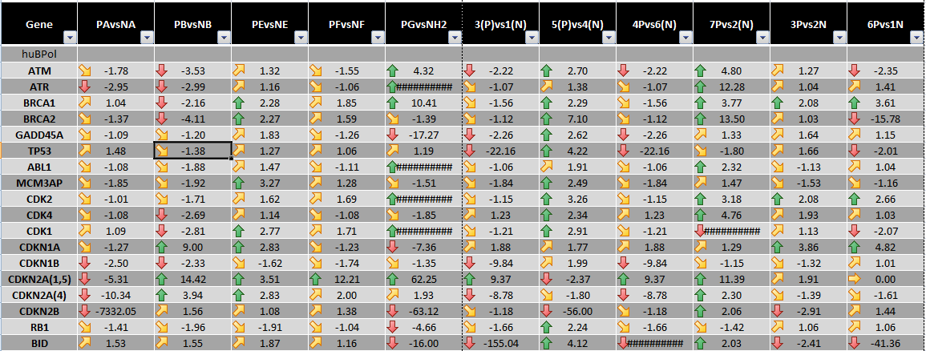
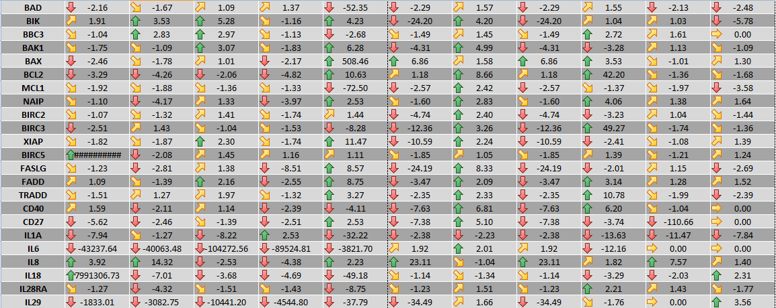
Results

Slide 20
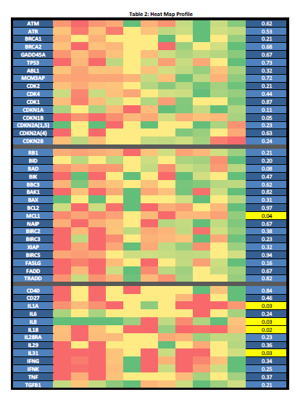
Results
Mann Whitney

