Slide 1
Quantum weirdness
How imagination differs from reality

Slide 2
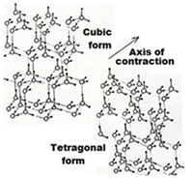
Ice, the ordering force
Using:
H-bond length h = 1.75 Å Dipole moment μ = 1.27 * 10⁻²⁹
OH-bond length b = 1.01 Å Dielectric constant ε = 3.1
Tetrahedral angle θ_{a} = 104.5º Space dielectric constant Ε₀ = 8.85 * 10⁻¹²
H-O-H bond angle θ_{b} = 109.5º Planck’s constant N = 6.02 * 10²³
Charge cloud angle θ_{c} = 120º Velocity of light c = 3 * 10⁸
Molecular coordinates of water in
Ice Ic: ∆x=∆y= 2.26 Å, ∆z = 1.6 Å
Ice It: ∆x=∆y= 2.32 Å, ∆z = 1.5 Å
Latent energy of ferroelectric transition
between ice Ic and ice It ≈ 22.3 kJ/mol,
≈ phosphodiester bond energy of ATP
with wavelength ≈ 4 μ.
Transition temperatures:
Hexagoal/cubic 130 K Nitrogen boils 77 K
Cubic/vitreous 110 K Ferroelectric 72 K

Slide 3
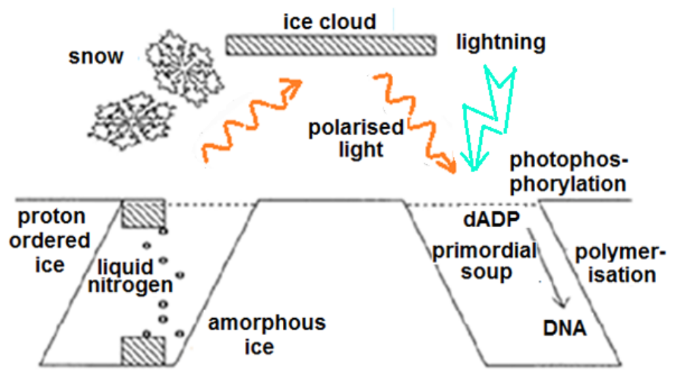
Origin of life
In the mind’s eye, to quote Joan Baez’ Daybreak, My life’s like a crystal teardrop. Life started during a primordial ice age when ice crystallizing in pools of liquid nitrogen on Earth’s poles morphed from cubic to tetragonal, releasing latent energy as ~4μ infrared laser light. Polarized by reflection by ice in clouds and on Earth’s surface, it shone on Darwin’s warm equatorial waters, selectively activating nucleotides. They polymerized, creating a noodle soup of DNA – some formed analogues of transfer RNA, ‘transport DNA’s which fed Oparin’s coacervates with life’s prerequisites. See my recently published book ‘Science Uncoiled’.

Slide 4
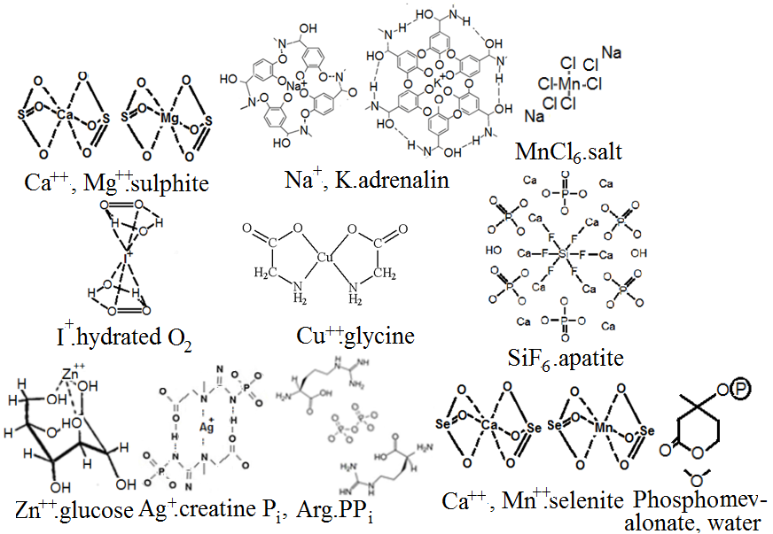
Early life used transfer RNA analogues, ‘transport DNA’s to feed Oparin’s coacervate protocells with substrates, deploying trace element ions as carriers:

Slide 5
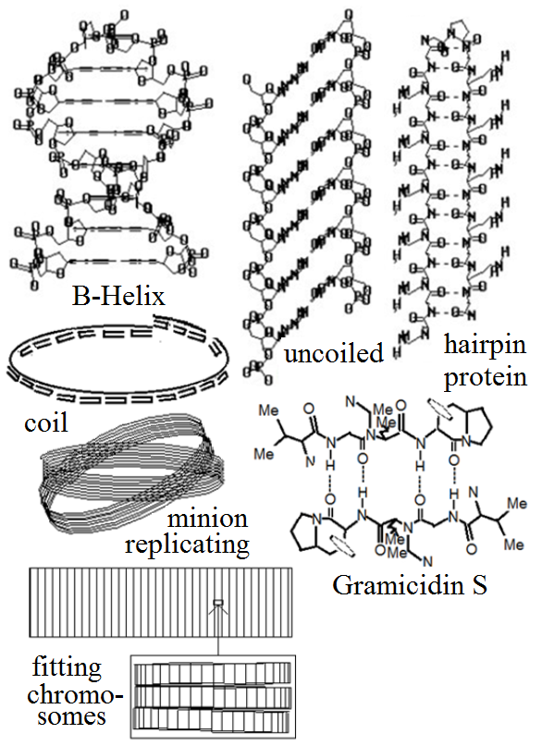
Minions comprise 1701 DNA base pairs, uncoiled but retaining B-helical base-pair spacing and overlap. Anti-parallel β-pleated protein hairpins with alternate neutral (Ala, Leu, Ile & Val) and basic (Arg & Lys) and Pro forming a U-bend hold them flat, Gramicidin S is analogous. 21 hairpin units complete a coil and 9 coils a minion. Minions evolved to pack chromosomes and ensure accurate copying.
One H-bond on each coil surface is reversed, storing a letter of an 18 character word using a 64-character alphabet. Memory recall involves resonance with minions holding similar words. Axons and dendrites serve as optic cables, communicating with other nuclei.

Slide 6
Mental associations with minion coils
# Period Mass Discipline Quality Colour # Period Mass Discipline
-9 8.7 fs m_{e}/7 QM unity red +9 11 Byr* Sun cosmology
-8 5.5 ps m_{p}/7 physics justice silver +8 170 Myr 84 Earths astronomy
-7 350 ps 2 bp chemistry stability blue +7 2.7 Myr 1.8 Moons palaeontology
-6 22 ns 8.3ng computing progress violet +6 43 kyr 31 Pton archaeology
-5 1.4 μs 33ag biochem love bronze +5 685 yr 8 Gton history
-4 87 μs 130pg genetics peace yellow +4 11 yr* 2 Bton politics
-3 5.5 ms 0.51µg biology beauty pied +3 9 wk 0.5 Mton sociology
-2 350 ms 2 mg eng truth gold +2 1 day* 130 ton management
-1 22 s 8.1 g psychol goodness green +1 23 min 32 kg psychiatry
The numbers label inner and outer coil surfaces, * connotes approximation.
Periods = 63^{N} τ, colours feature in metaphors, adverts, flags and politics,
Masses are in ratio 63², m_{e} and m_{p} = electron and proton masses,
a, f, p, n, µ, M, P, G & P = 10⁻¹⁸, 10⁻¹⁵, 10⁻¹², 10⁻⁹, 10⁻⁶, 10⁶, 10⁹, 10¹² & 10¹⁵.
Minion logic favours using µ = √M for measuring mass, E = Mc² becomes: E = µ²c².

Slide 7
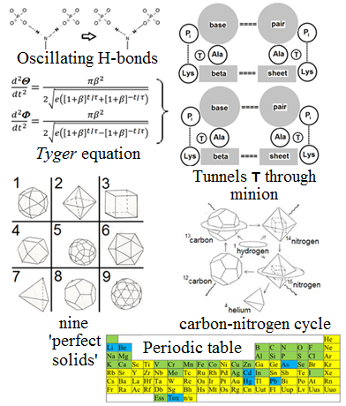
Biological cold fusion
Protons are accelerated by oscillating H-bonds along minion tunnels. According to the Tyger equation (using polar coordinates ϴ and Ф, β=63⁻⁹ and τ ≈1.4 fsecs), protons and neutrons appear to be planes. Substituting concentric polyhedrons for electron orbitals affords new insights to Mendeleev’s periodic table of elements. When protons collide with nuclei blocking their paths, they fuse, driving the carbon nitrogen cycle. The γ-rays released follow Tyger paths, returning as pulsars with the same periods & frequencies.
Notes:
Oscillating hydrogen bonds accelerate protons along minion tunnels. When they collide with nuclei composed of concentric polyhedrons (as particles appear to be according to the Tyger equation), they drive the carbon nitrogen cycle.

Slide 8
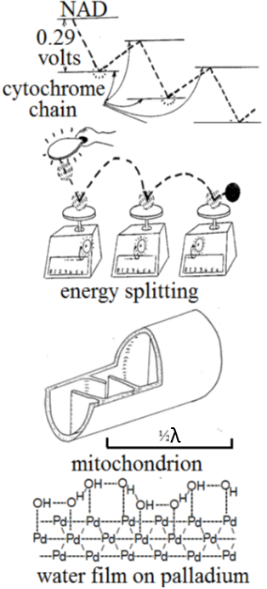
Future prospects
The cytochrome chain resembles a ping-pong ball bouncing on spring balances, mitochondria are ½-wave resonant cavities for λ ~ 4μ, trapping energy. Zeolites might serve to capture γ-rays to harness simulated minion nuclear fusion to address climate change. Fleischmann and Pons bred scepticism (a palladium crystal’s adsorbed water is analogous to minion tunnels).
If you’re persuaded that Einstein’s doubts were valid, please establish an empirical foundation enabling other twenty-first century scientists to resolve malnutrition, ignorance and environmental problems.
Any questions?

