Slide 2


Behavioral Effects of SQSTM1/p62 Overexpression in Mice: Support for a Mitochondrial Role in Depression and Anxiety
Michael Lamar Seibenhener, Ph.D.
Department of Biological Sciences, Auburn University

Slide 3
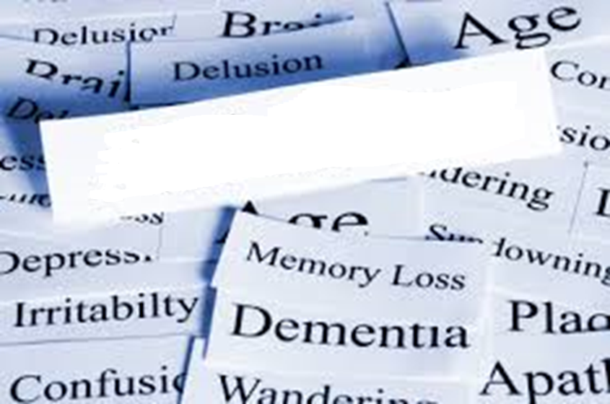
Alzheimer’s
Disease
Dementia

Slide 4
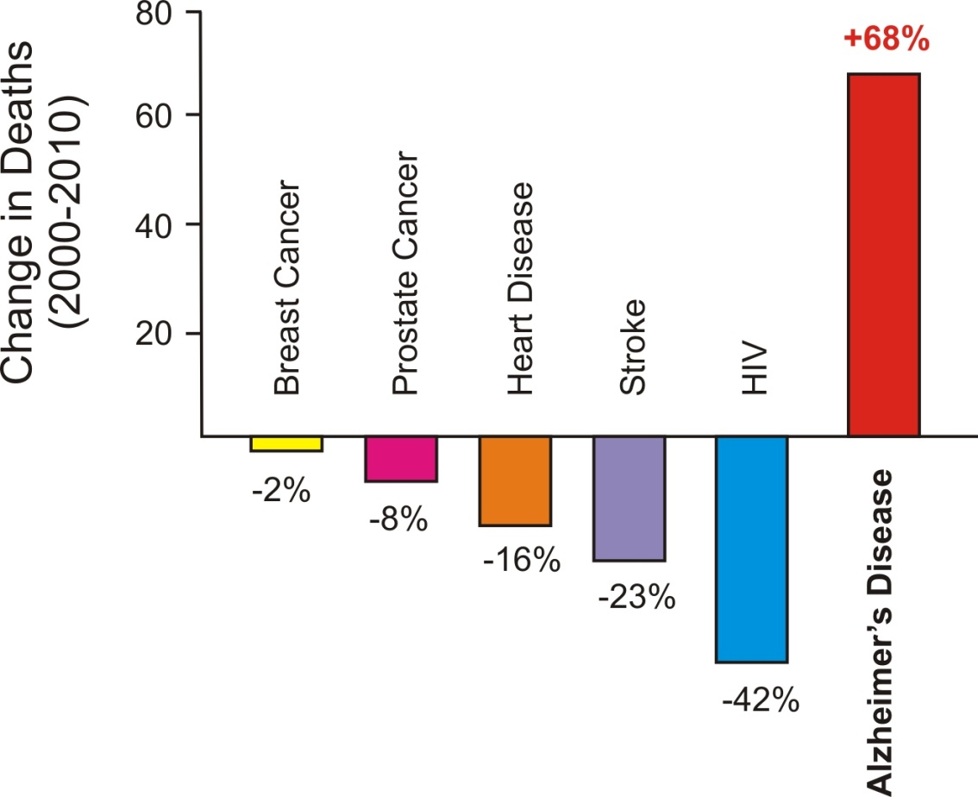



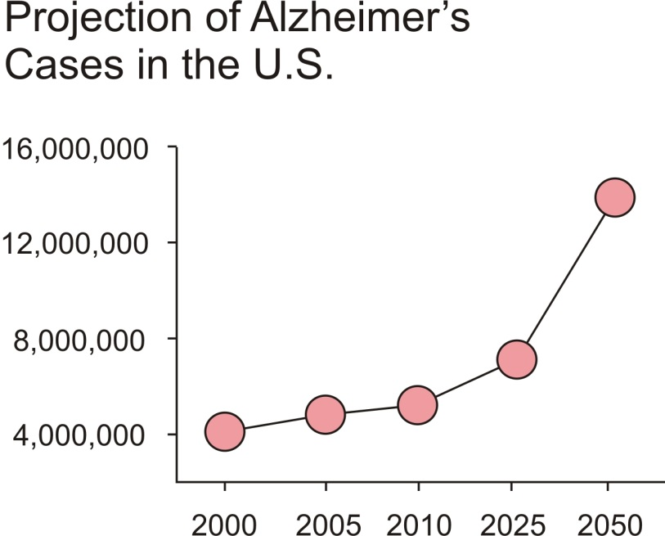


Quick Facts about Alzheimer’s Disease and Dementia:
2014 Costs of Dementia
$603 BILLION
2015 Worldwide Cases of Dementia
47.5 MILLION
2050 Costs of Dementia $3.9 TRILLION
2050 Worldwide Cases of Dementia
150 MILLION
Leading cause of death in the United States
Currently more than 5 million people in the United States are living with Alzheimer’s Disease
1 in 3 elderly people will die with Alzheimer’s or another form of dementia
(current dollars)
Notes:
AD Worldwide case 35+ million
Expected to triple by 2050

Slide 5
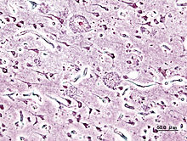
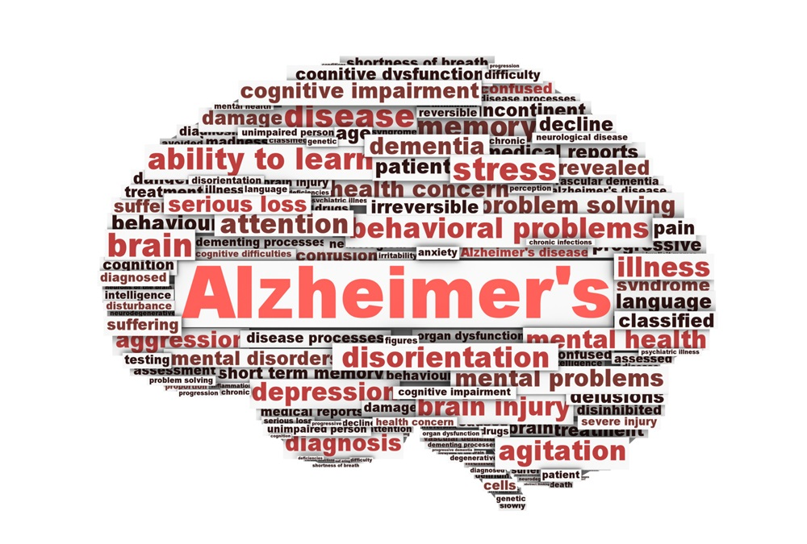
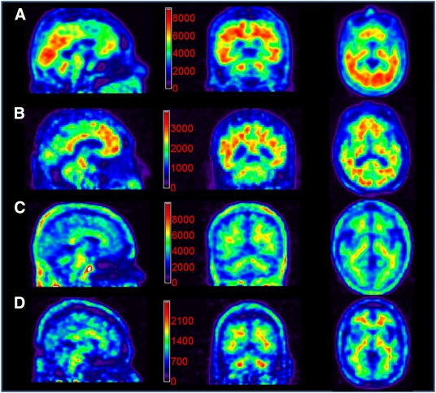

Histochemical
Amyloid plaques
Imaging/PET Scans
A biomarker, or biological marker, generally refers to a measured characteristic which may be used as an indicator of some biological state or condition.
Biological/Biochemical
Notes:
But wouldn’t it be great to see AD before it shows up. Can we find biomarkers for AD?

Slide 6
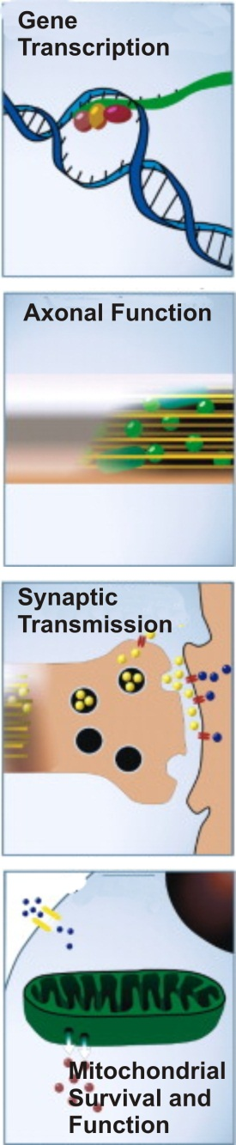
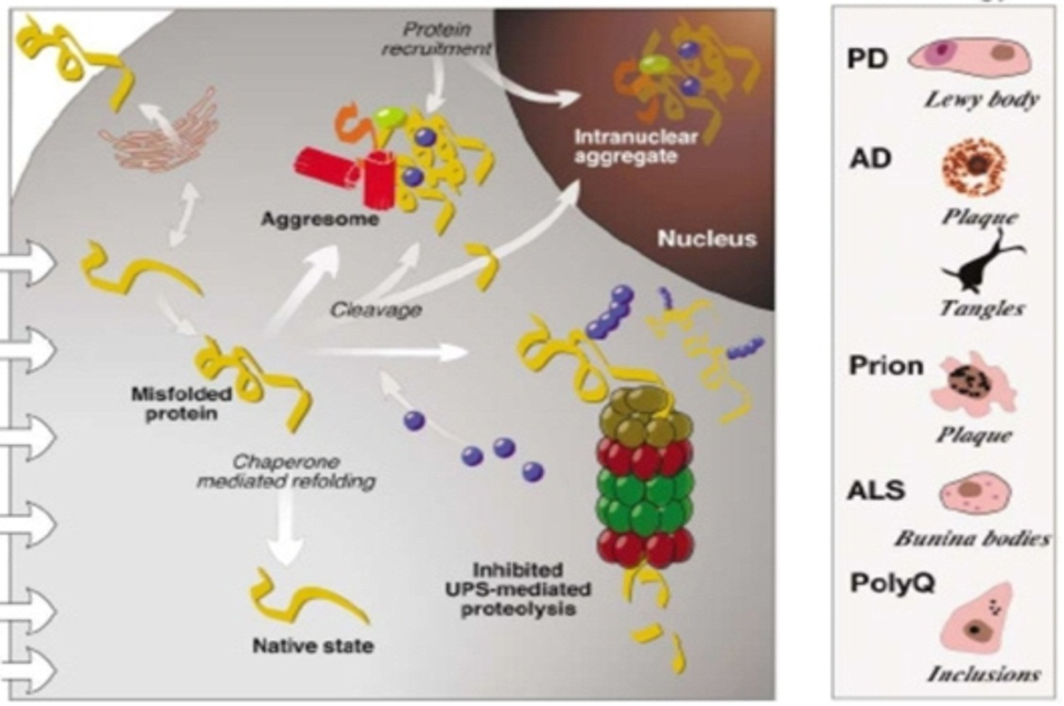
Pathogenesis of Neurodegeneration
TRIGGERS
PRIMARY RESPONSE
PATHOLOGY
Mutations
UPS Dysfunction
Prion Transmission
Ageing
Oxidative Stress
Ciechanover and Brundin, 2003 Neuron 40:427
SQSTM1/p62 is a component of ALL aggregates/inclusions
Notes:
So what do we know about neurodegeneration?
Triggers lead to responses. Protein aggregates in the pathologies.
All affect the same cellular mechanisms.

Slide 7
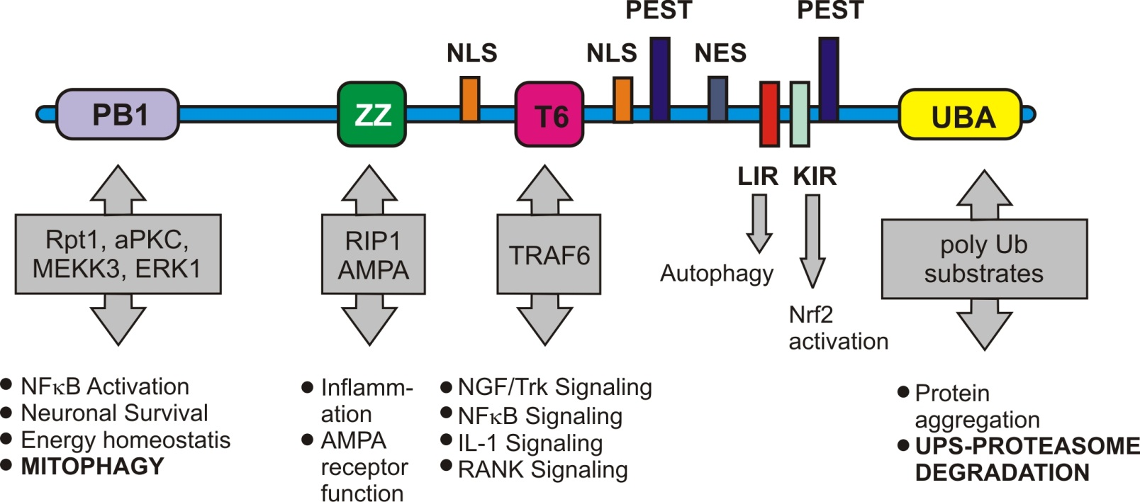
SQSTM1/p62
Adapted from: Salminen, et.al. 2012. Progress in Neurobiology 96:87-95
Neurodegenerative Pathologies
component of specific pathological protein aggregates
Ubiquitin – Proteasome Degradation
removal of misfolded or damaged proteins
Mitophagy/Autophagy
removal of defective mitochondria and proteins
Notes:
All pathways can have some link to neurodegenerative pathologies – protein aggregation
Im interested in the garbage mechanisms – especially as they relate to defective mitochondria and the role p62 plays

Slide 8
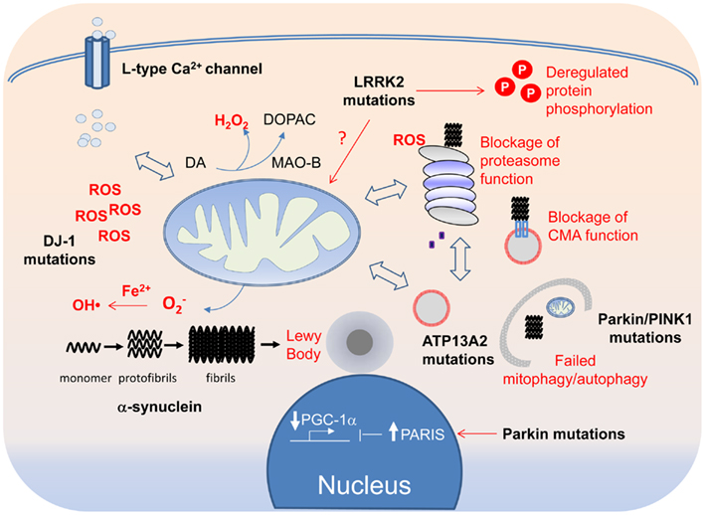
SQSTM1/
p62
Kah-Leong Lim and Cheng-Wu Zhang Front. Neurol., 08 April 2013
p62 shows the potential to be used as a biomarker for
Neurodegenerative Disease.
Notes:
Mitochondrial dysfunction may give rise to neurodegenerative disease cascades.

Slide 9
Examine the relationship between SQSTM1/p62
and mitochondrial functionality under physiological
conditions

Slide 10
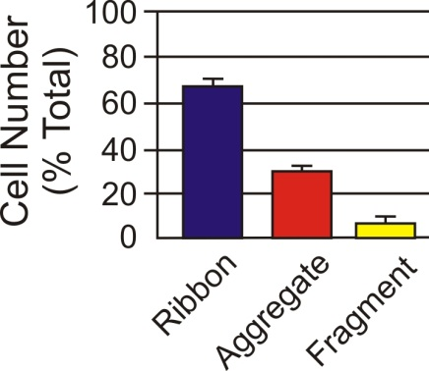


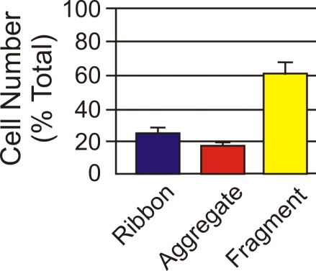

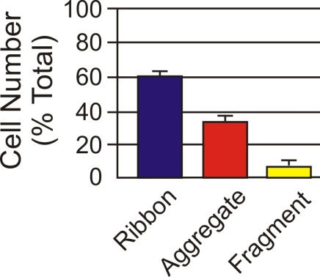
p62 Regulation of Mitochondrial Morphology
WT MEF Cells
KO MEF Cells
KO MEF Cells
+ myc-p62
Mitochondria stained with MitoTracker Red
p62 plays a role in regulating mitochondrial morphology

Slide 11
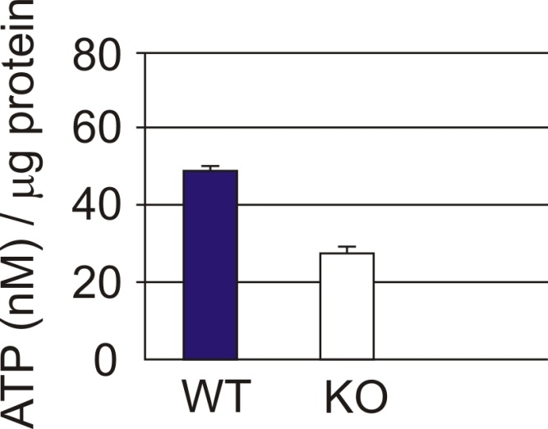
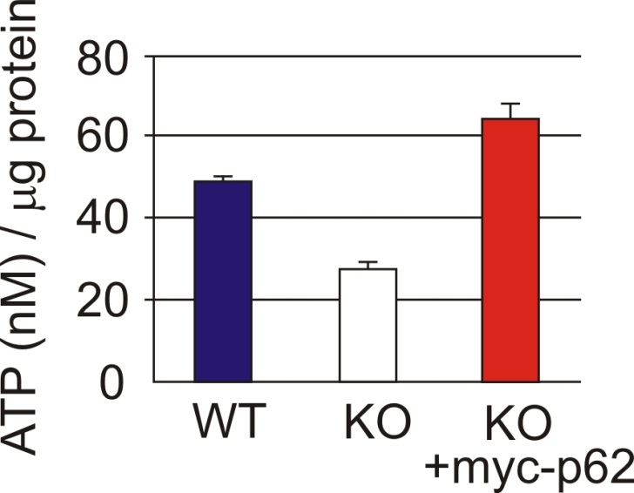
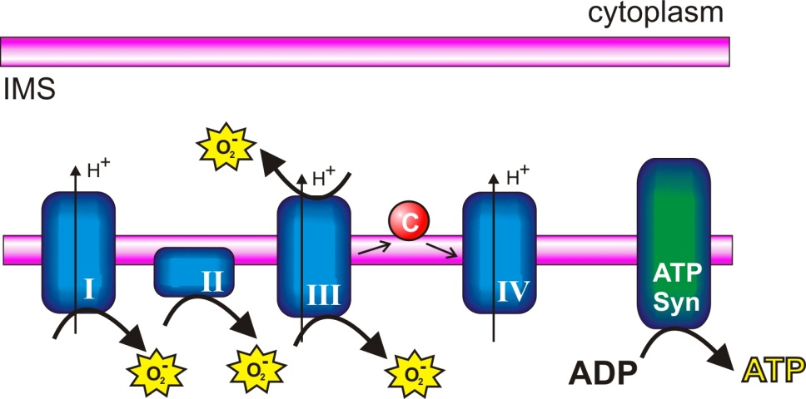
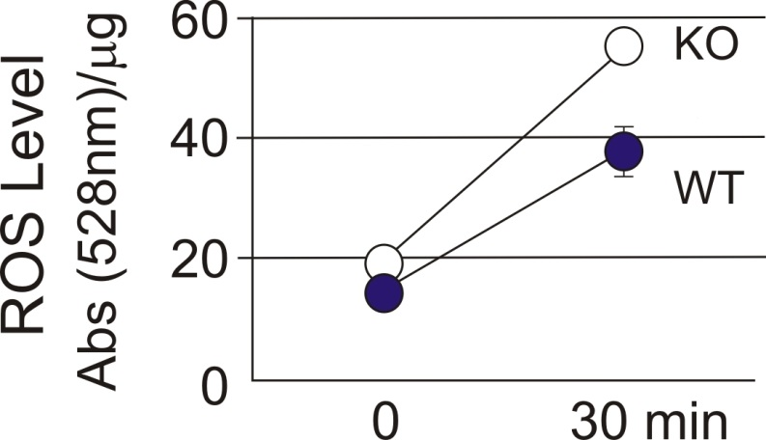
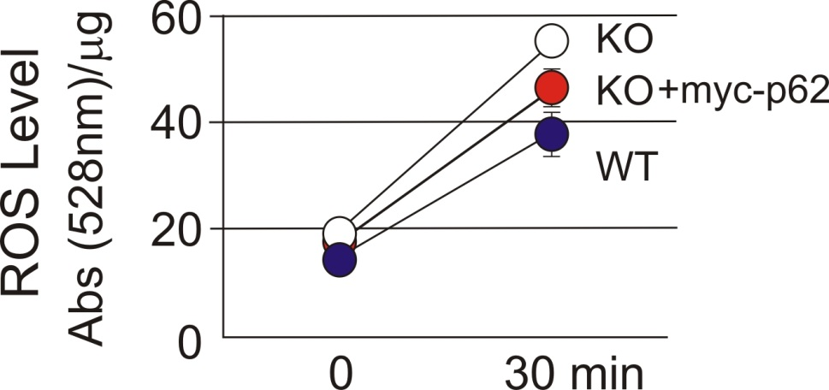
p62 and Mitochondrial Functionality
p62 not only regulates morphology but also affects mitochondrial metabolism and energy production
Notes:
In mitochondria, structure can dictate function. When I looked at mitochondrial functionality in the presence or absence of p62……

Slide 12
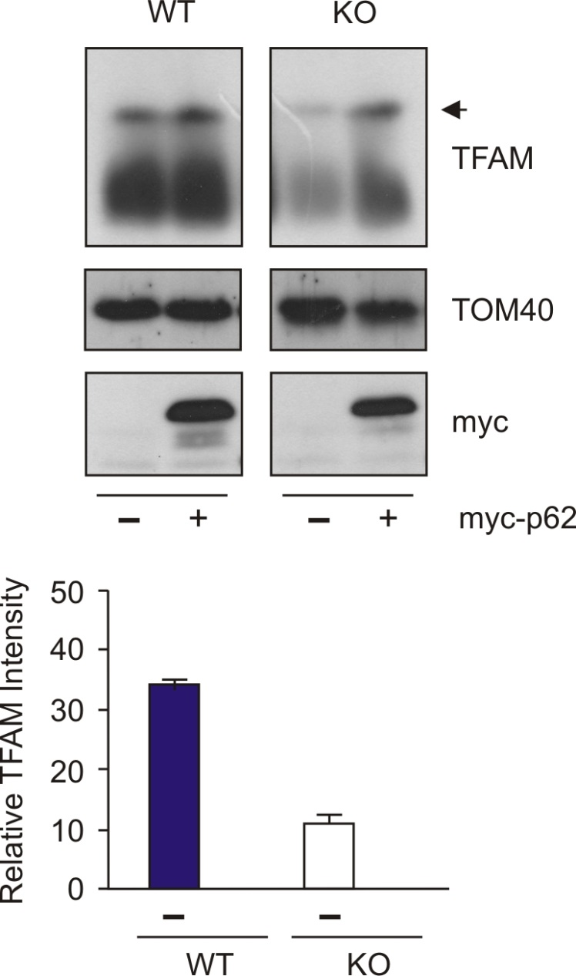

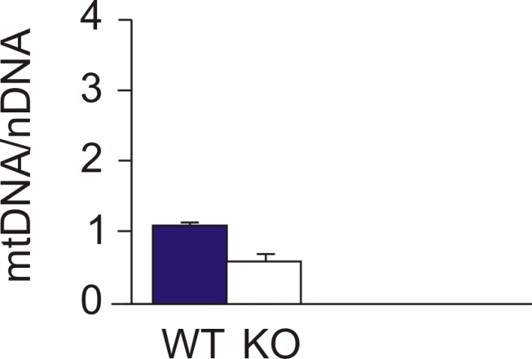
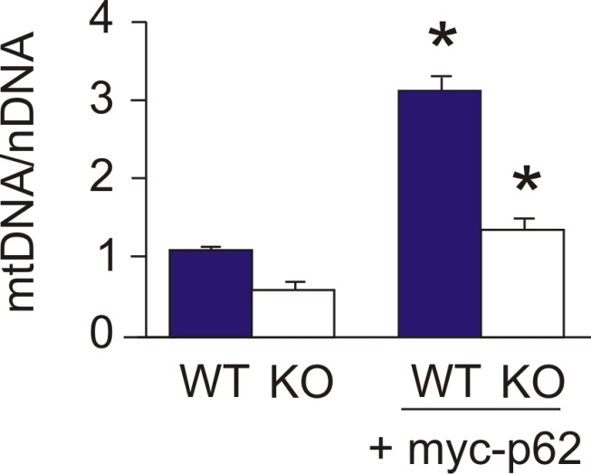
p62 and the Mitochondrial Genome
Dr. Yifeng Du, Wooten Lab
p62 protects mitochondrial genome integrity by a TFAM import related process.
Notes:
Normal mito dynamics maintain mtDNA levels/fragmentation decreases mtDNA
Levels of mtDNA are known to be different between AD and normal patients……
Mito Genome supported and protected by import of TFAM – promotes replication and transcription and also repairs damaged mtDNA

Slide 13
p62 plays an active role in affecting mitochondrial morphology and functionality.
Reintroduction of p62 to a null-background restores mitochondrial function.
Overexpression of p62 improves mitochondrial functionality above what is seen in WT.

Slide 14
Overexpress SQSTM1/p62 in a mouse model.
examine its effects on mitochondrial dynamics
mitochondrial relationship to mouse behavior
anxiolytic behaviors and
learning and memory

Slide 15
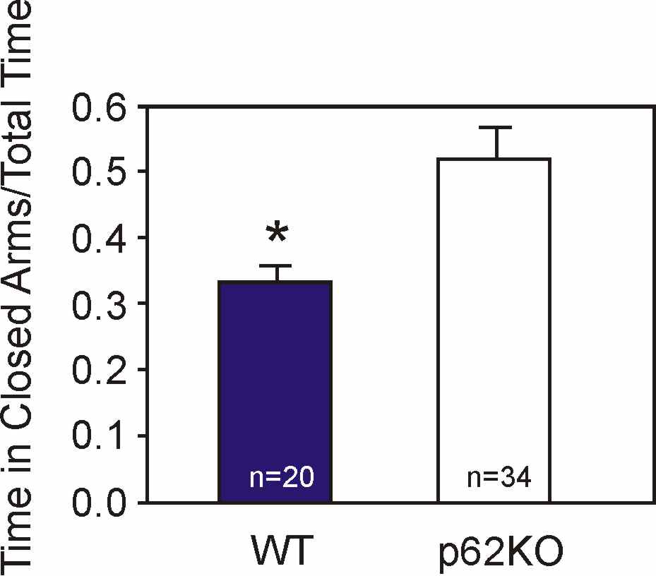
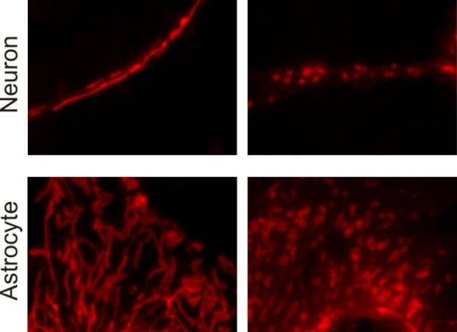
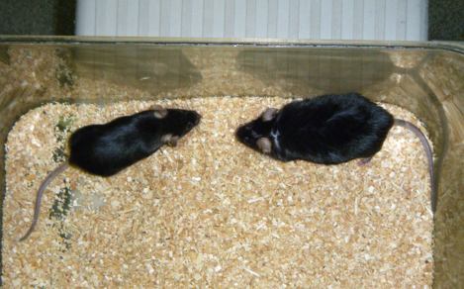
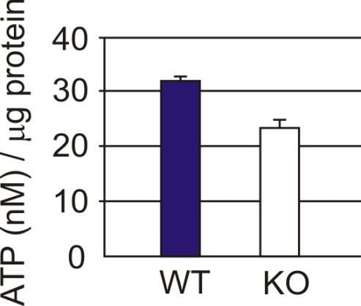
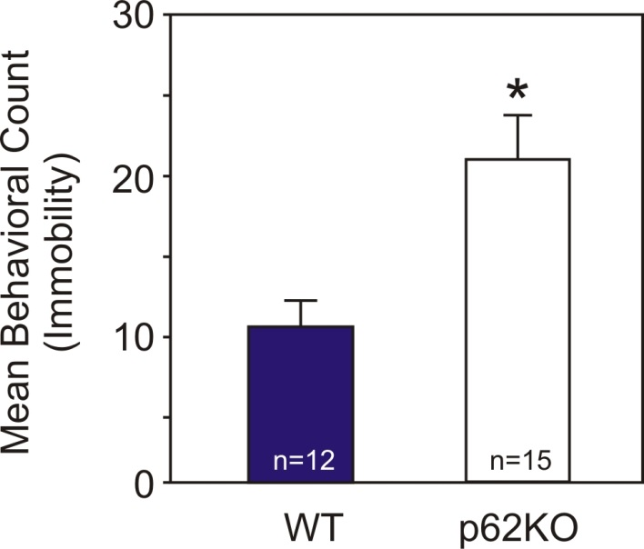
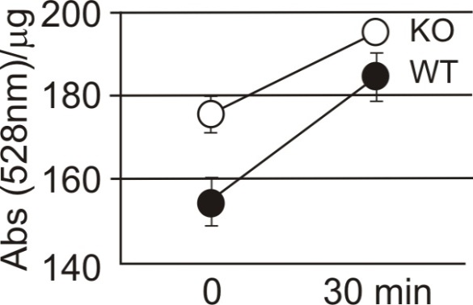
Mitochondrial Function and
Behavior Patterns in p62KO Mice
WT
KO
Elevated Plus Maze - Anxiety
Change in mitochondrial morphology in p62KO
Increased anxiety in p62KO mice
WT
p62KO
Decrease ATP production in p62KO neurons
Forced Swim Test - Depression
Increased depression like behavior in
p62KO mice
p62KO mice exhibit significant levels of mitochondrial dysfunction.
Hippocampal Neurons
ROS
Increase ROS in p62KO neurons
Loss of p62 results in behavior patterns similar to those seen in Alzheimer’s Disease.
Notes:
How does p62KO relate to AD behaviors…comparison symptoms to AD

Slide 16
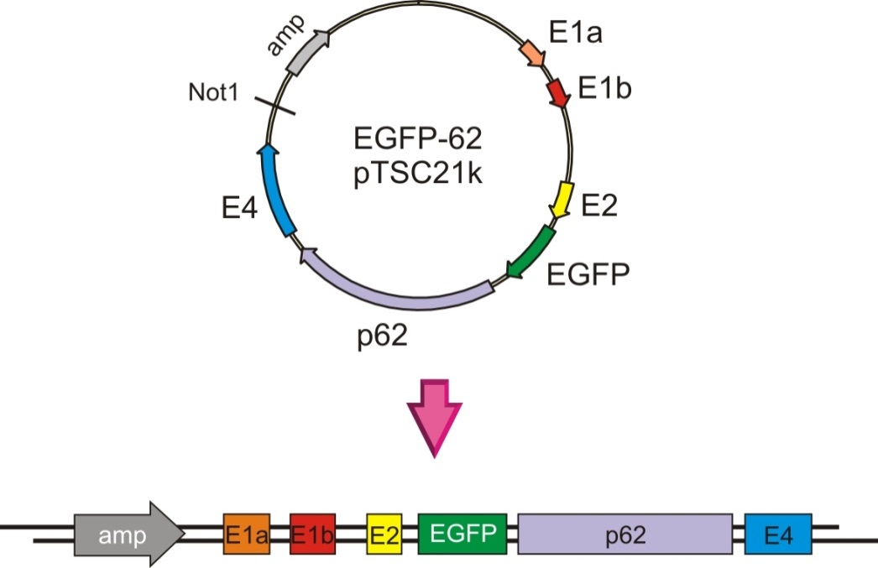
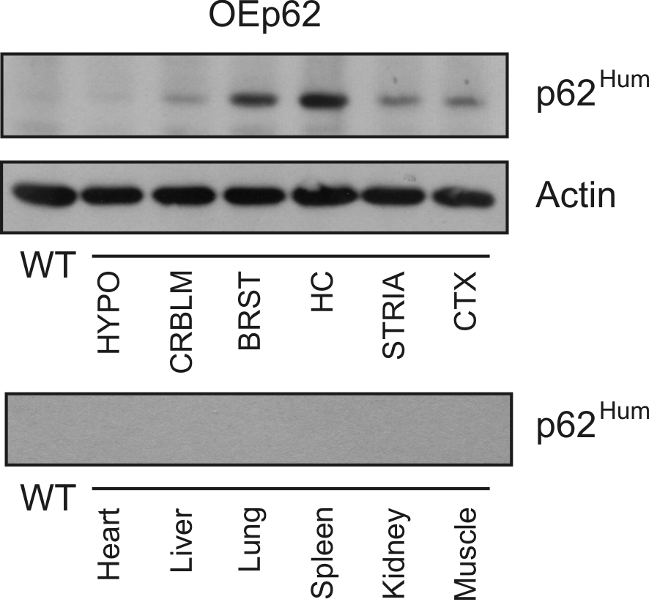
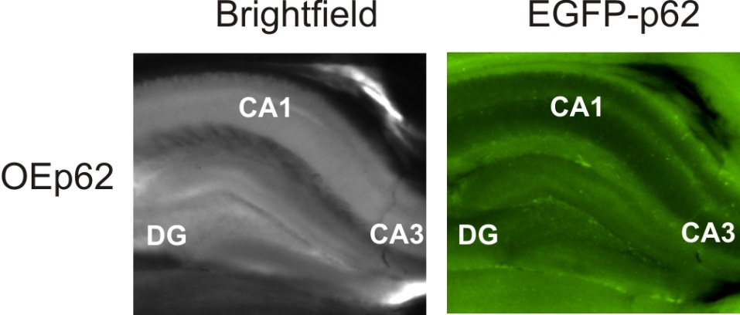
Expression of EGFP-p62 in Mouse Tissue
EGFP-p62 was effectively expressed in mouse brain.

Slide 17
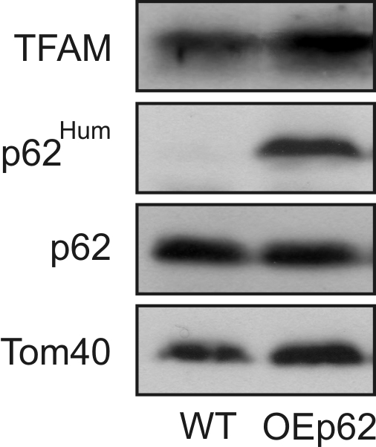
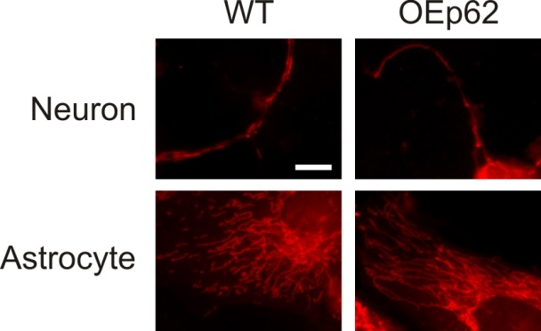
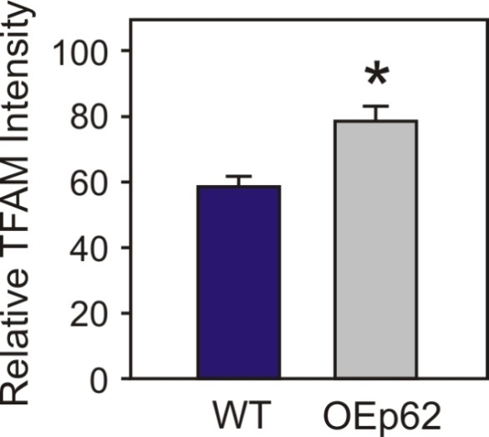
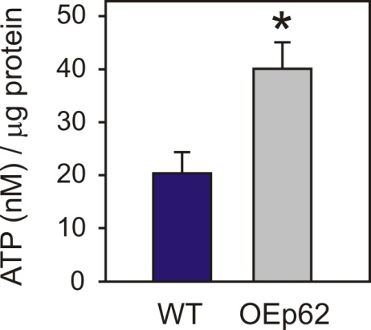
Mitochondrial Metabolism in OEp62 in Hippocampus
p62 overexpression affects mitochondrial morphology and function.

Slide 18
Mitochondrial Functionality
SQSTM1/p62 was effectively expressed in the brain, predominantly in the hippocampus, generating an overexpressing mouse model.
Mitochondrial structure and metabolism improved in the presence of excess SQSTM1/p62.
Does improved mitochondrial function correlate with positive changes in behaviors associated with neurodegenerative disease??

Slide 19
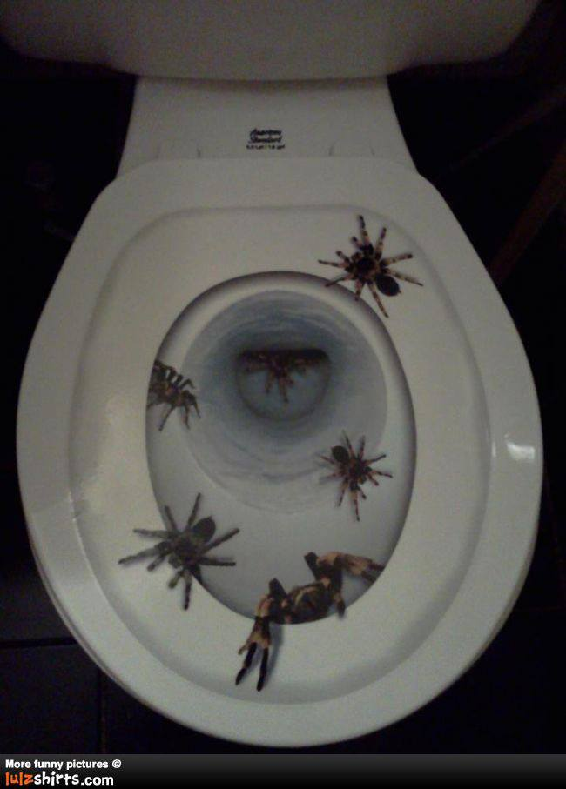
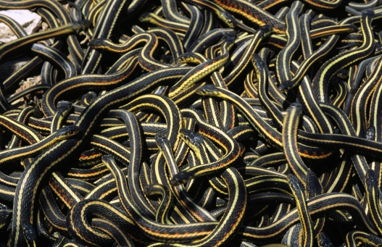




Behaviors Associated with
Alzheimer’s Disease
Irrational fears
Excessive
worry
Anxiety
Panic attacks
Sleep problems
Depression
Compulsive
behaviors
Affective Spectrum Disorders
Notes:
These behaviors indicative of depression and anxiety

Slide 20
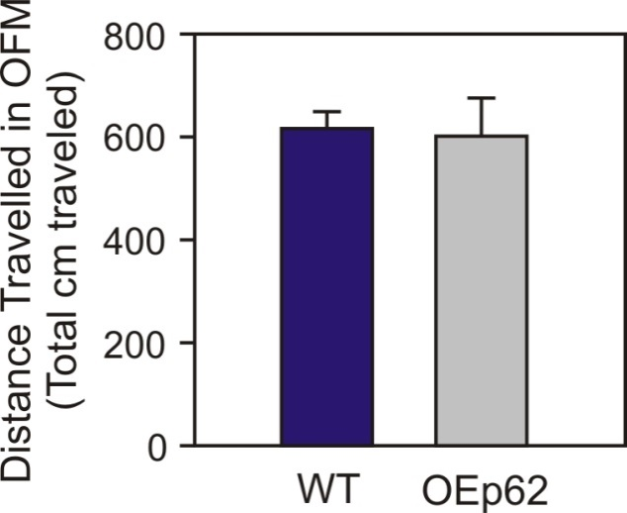
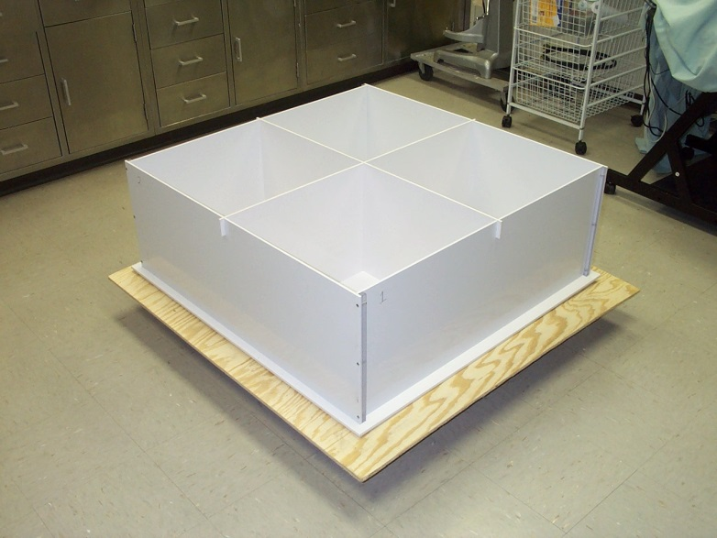
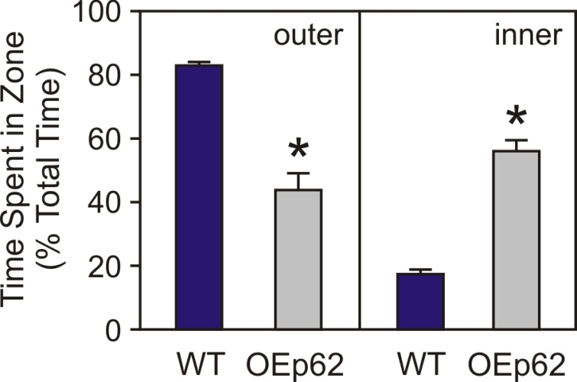
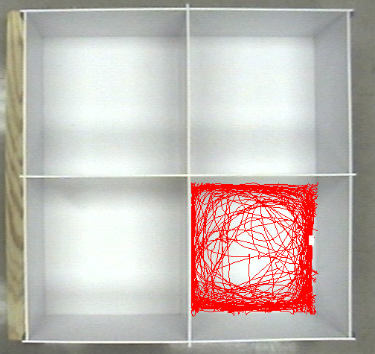
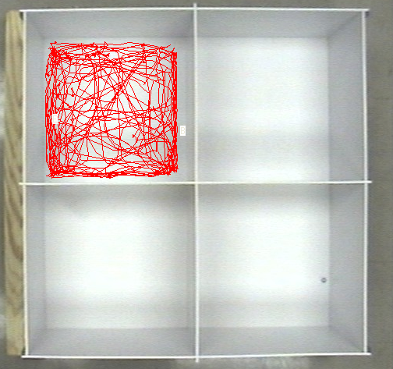
Open Field Maze
Used to measure general locomotor
activity and anxiety
50cm
50cm
WT
OEp62
Distance traveled in the OFM was the same
for overexpressing mice compared to WT.
However, overexpressing mice spent more
time in the inner area of the maze reflecting decreased anxiogenic
behavior.
measure activity for 10 minutes

Slide 21
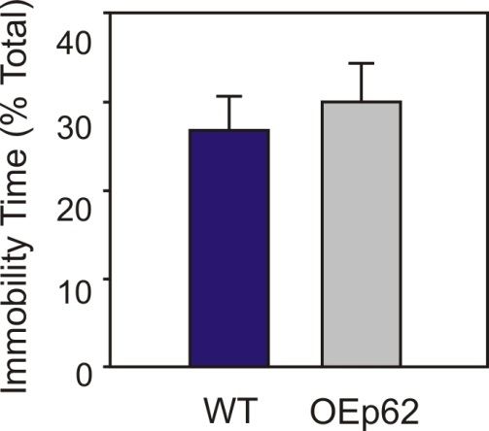
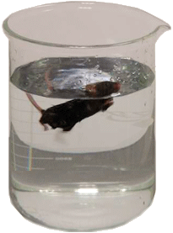
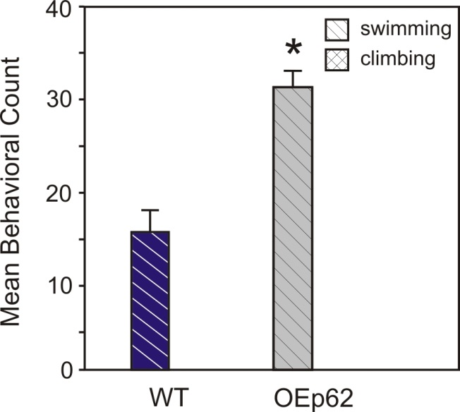
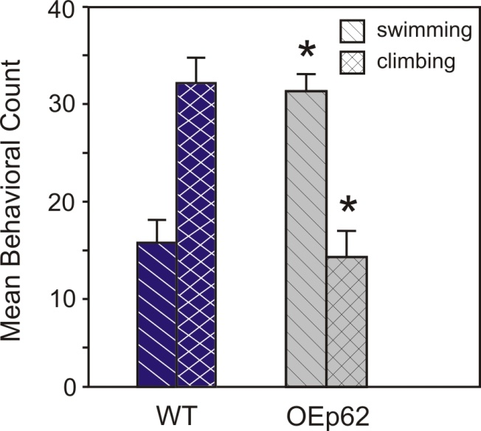
Forced Swim Test
Modification of the Porsalt Swim
test used to measure despair and
depression.
measure activity for 6 minutes
There is no measurable difference in immobility time between genotypes.
record behavior every 5 seconds
Immobile – floating with no or limited movement
Swimming – active movement around beaker
Climbing – actively trying to escape by climbing walls of beaker
However, recorded behaviors during the
test did show significant improvement
in depression like behaviors.

Slide 22
Affective Spectrum Disorder Behaviors
Improvement in anxiety related behaviors.
Distinguishing specific behaviors during the FST show overexpressing mice exhibit decreased depression/despair.
Overall improvement in affective spectrum disorder behavior patterns in SQSTM1/p62 overexpressing mice.

Slide 23


Learning and Memory

Slide 24
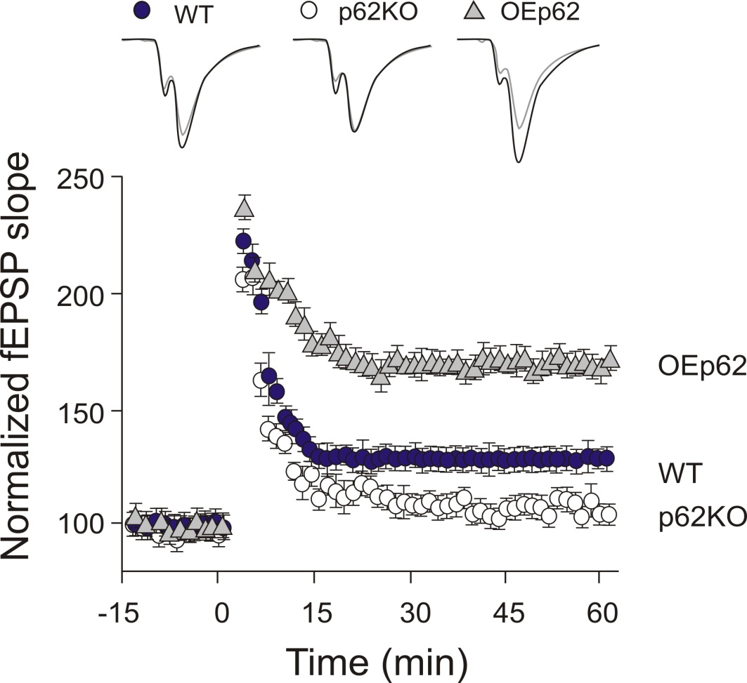
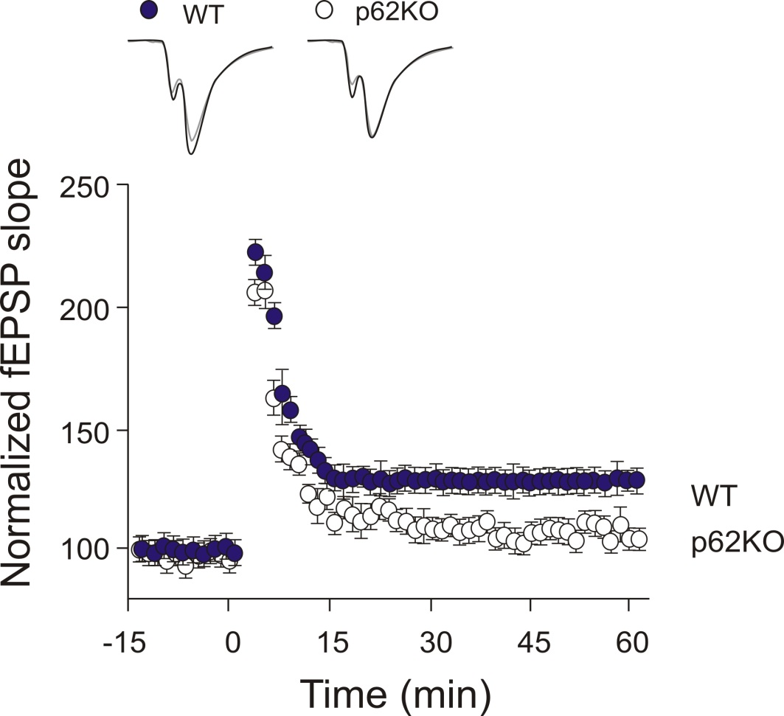
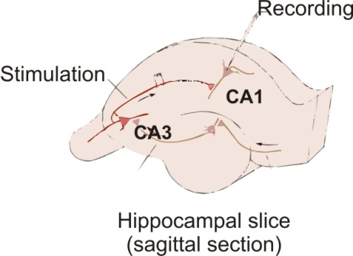
Long Term Potentiation
The long term enhancement of signal
transmission between neurons.
Overexpressing mice show improved LTP compared to WT.

Slide 25
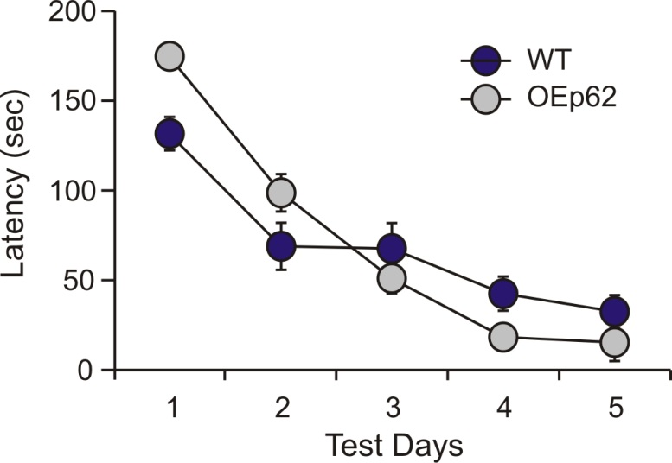
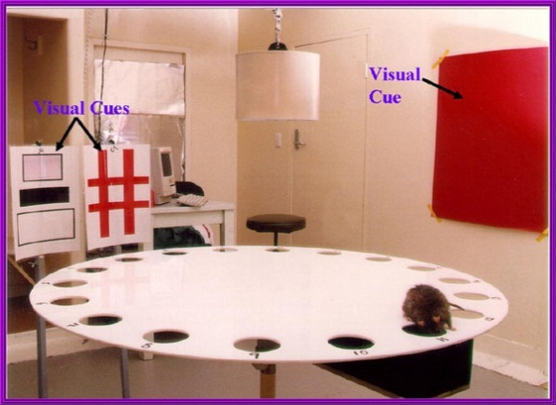


Barnes Maze
Noninvasive test for hippocampal
dependent spatial learning and memory
ADAPTATION (Day 1) – 4 trials/day; max – 3 min
SPATIAL ACQUISITION (Day 2-5) – 4 trials/day;
Max – 3 min
PROBE TRIAL 1 (short term memory) (Day 5) –
2 hours post last acquisition trial; 90 second observation
PROBE TRIAL 2 (long term memory) (Day 12) –
90 second observation
Overexpressing mice showed slight improvement to latency in hidden box search times.
No difference in short term memory was observed, however, long term memory
was improved in overexpressing mice.
Notes:
85 decibals (give a comparison) 2000 lux (give comparison)

Slide 26
Learning and Memory
Overexpression of SQSTM1/p62 shows enhanced LTP compared to WT.
Spatial learning is slightly improved with overexpression of SQSTM1/p62.
Spatial long term memory is strengthened with overexpression of SQSTM1/p62.
Overall, learning and memory are improved with overexpression of SQSTM1/p62 in the brain.

Slide 27
Conclusions
SQSTM1/p62 levels affect mitochondrial functionality as well as behavior patterns associated with neurodegenerative diseases.
SQSTM1/p62 appears to be a prime candidate for a protein that changes mitochondrial functionality and also affects behavior making it a potential biomarker for neurodegenerative diseases.
SQSTM1/p62 could be a novel target for potential drug discovery to treat anxiety and affective spectrum disorders as well as, improve cognitive function associated with neurodegenerative diseases.

Slide 28


Generation of p62OE mice
C57BL/6-Tg(Thy1-SQSTM1)02MCWo/J (Stock# 27258)

Slide 29
Wish to Thank:
Wooten Lab Members:
Michael C. Wooten
Yifeng Du
Luis Calderilla Barbosa
Jin Yan
Denise Landers
Others:
Jorge Moscat
Maria-Theresa Diaz-Meco
Mike Irwin
Carl Pinkert
Vishnu Suppiramaniam
Kodeeswaran Parameshwaran

Slide 31

Qitao Ran, UT Health Science Center

