Slide 1




Long-term Quality of Life of Patients With Permanent End Ileostomy: Results of a Nationwide Cross-Sectional Survey
TS Schiergens, V Hoffmann, TN Schobel, GH Englert, ME Kreis,
WE Thasler, J Werner, MS Kasparek ¹
Dis Colon Rectum 2017; 60: 51 - 60
Department of Surgery, Ludwig-Maximilians-University of Munich, Germany
and
¹ Head of Department of Surgery, Klinik Josephinum, Munich, Germany

Slide 2
Disclosures
Funding Sources – Deutsche Forschungsgemeinschaft
Financial Interests – None
Conflict of Interests – None

Slide 3
Background
Many sudies reported impaired quality of life (QOL) in ostomy patients
Significant interindividual variation of impact on QOL
Lacking data on long-term effects of permanent end ileostomy (PEI) on QOL

Slide 4
aim
Determine long-term QOL of patients with PEI
Identify risk factors for impaired QOL
Notes:
...that might be manipulated in order to prevent impaired or to restore good QOL

Slide 5
Patients and Methods
Patients with PEI were identified in the database of a German self-help organization for stoma patients (ILCO e.V.)
Custom-made questionnaire and 3 QOL instruments werde mailed to 1434 patients with PEI
QOL-instruments:
  Short form 36 (SF-36; generic QOL):
  36 questions, 8 subscales, 2 component-scores (PCS & MCS)
  Gastrointestinal quality of life index (GIQLI or Eypasch-score; health-related QOL):
  36 questions, 5 subscales, 1 summary-score
  Cleveland global QOL Index (CGQL; health-related QOL):
  3 questions / subscales, 1 summary-score
  Healthy controls from literature

Slide 6
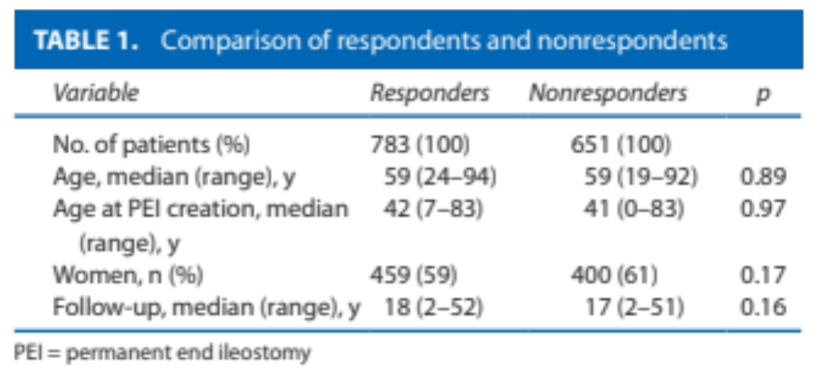
Results: responders vs nonresponders
Response-rate: 55% (783 / 1434)

Slide 7
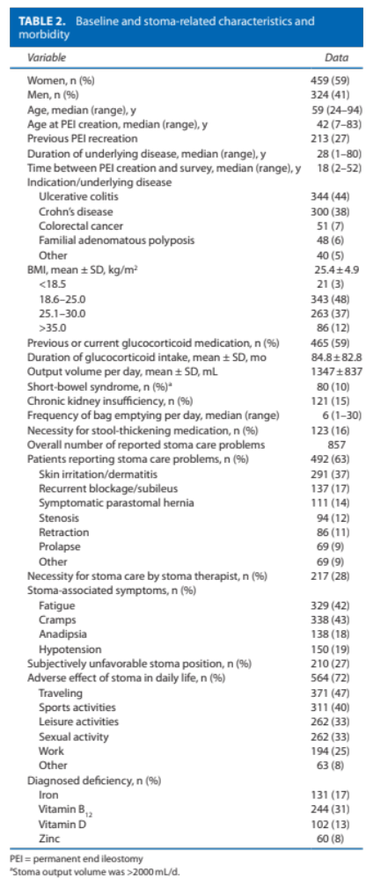
Results
40 female patients pregnant (9%)
62 babys
50% vaginal deliveries
Notes:
9% of the female patients became pregnent with PEI and gave birth to 62 baby. Have of them were delivered vaginally and the other half bei cesaerian section.
Short bowel more common in Crohn´s patients

Slide 8
Results
n=55 (69%) CD
Notes:
9% of the female patients became pregnent with PEI and gave birth to 62 baby. Half of them were delivered vaginally and the other half bei cesaerian section.
Short bowel more common in Crohn´s patients

Slide 9
Results: Stoma-related problems

Slide 10
Results: Stoma-related problems

Slide 11
Results: Stoma-related problems
More common in patients with short-bowel syndrome

Slide 12
Results: SF-36 (generic QOL)
* all p<0.001 vs. controls
% of maximum
*

Slide 13
Results: Effect of stoma problems (SF-36)
% of maximum

Slide 14
Results: Effect of stoma problems (SF-36)
* all p<0.001 vs. no problems
% of maximum
*

Slide 15
Results: Effect of stoma problems (SF-36)
* all p<0.001 vs. no problems
** all p<0.001 vs. no care required
% of maximum
*
**

Slide 16
Results: GIQLI (health-related QOL)
* all p<0.001 vs. controls
score (n)
*

Slide 17
Results: Effect of stoma problems (GIQLI)
score (n)

Slide 18
Results: Effect of stoma problems (GIQLI)
* p<0.001 vs. no problems
*
score (n)
*
*

Slide 19
Results: Effect of stoma problems (GIQLI)
* p<0.001 vs. no problems
** p<0.001 vs. no care required
*
**
score (n)
*
**
*
**
Notes:
It is essecially the same for the CGQL

Slide 20
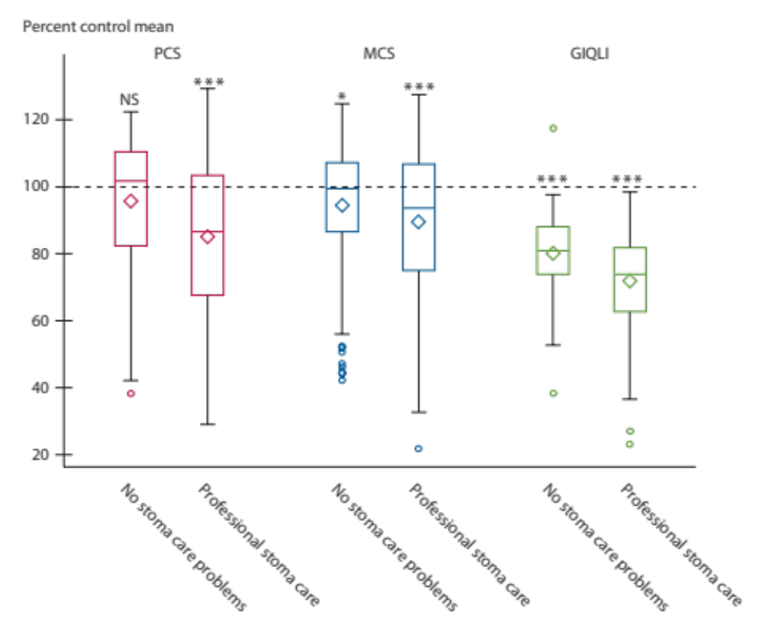
Results: Effect of stoma problems
Notes:
It is essecially the same for the CGQL

Slide 21
Results: Effect of Deficiencies (SF-36)
* all p<0.001 vs. no deficiency
** all p<0.001 vs. no Vit. B12 deficiency
% of maximum
*
**
Notes:
Iron, Zink, Vit B12

Slide 22
Results: Effect of Deficiencies (GIQLI)
* p<0.001 vs. no deficiency
** p<0.001 vs. no Vit. B12 deficiency
*
**
score (n)
*
**
*
**

Slide 23
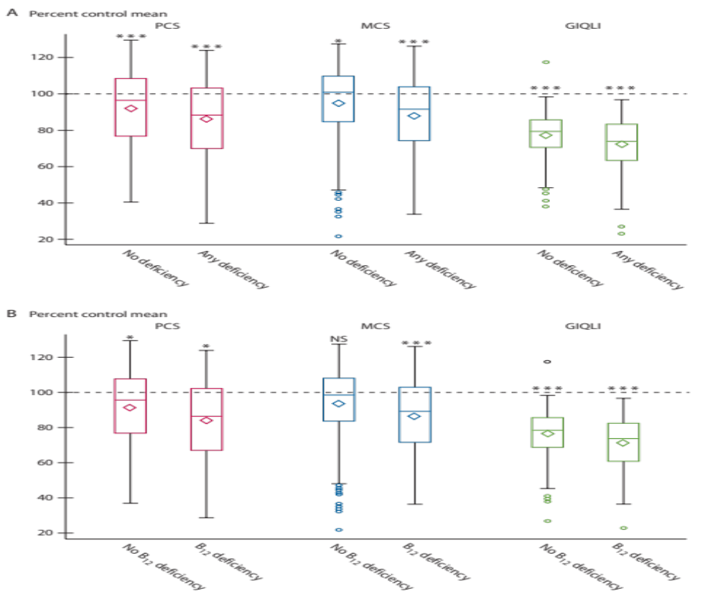
Results: Effect of any Deficiencies
Notes:
It is essecially the same for the CGQL

Slide 24
Results: Effect of Vitamin B12 Deficiency
Vitamin B12 deficiency in 244 patients (31%)
Notes:
Vit B12 deficiency most common in 244 patients (=31% of the cohort)

Slide 25
Results: Effect of underlying disease
SF-36
all p<0.001 vs. controls
* p<0.05 vs. all others
*
*
% of maximum

Slide 26
Results: Effect of underlying disease
GIQLI
all p<0.001 vs. controls
* p<0.05 vs. all others
*
score (n)

Slide 27
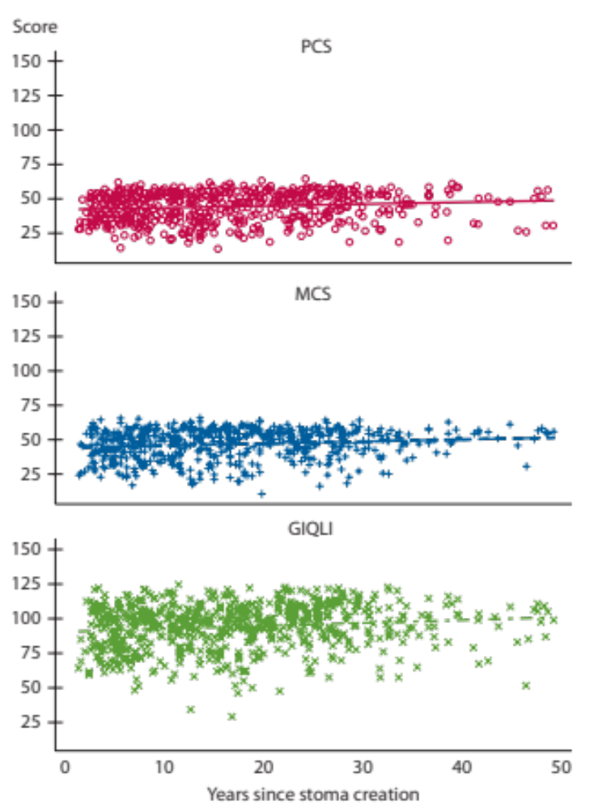
Results: Adaption to the stoma
+1.3 points / 10 years
But: all ns
Notes:
Improvement of 1.3 score points per ten years. Not significant. Large interindividual variation

Slide 28
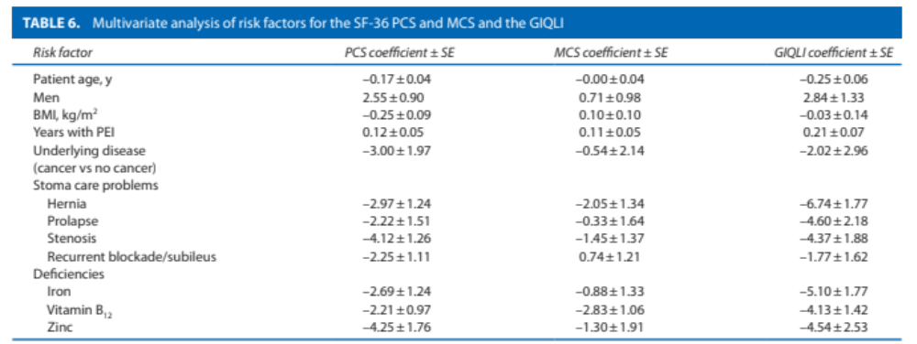
Results: Risk Factors for impaired QOL
Multivariate analysis
Notes:
Improvement of 1.3 score points per ten years. Not significant. Large interindividual variation

Slide 29
Summary
QOL is markedly impaired in patients with PEI
Factors associated with impaired QOL:
  Stoma care problems
  Deficiencies
  Female gender
  Colorectal cancer
  These factors have to be anticipated, prevented, and / or treated aggressively if possible

Slide 30
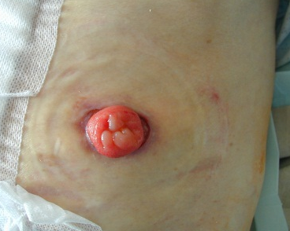
Summary
How???
  Preop. counseling of stoma therapist
  Preop. marking of stoma site
  Technically “perfect” stoma
  Find optimal / adjust
  stoma care and appliances
  Screen for problems or deficiencies
  Treat problems (e.g. hernia) and deficiencies

Slide 31
Summary
However:
Limitations:
  Selection-bias and 45% nonresponders
  Diverse cohort
  Intercultural differences
Not all patients with a stoma experience impaired QOL, e.g.:
  Perianal fistuals in CD
  Low-rectal resection

Slide 32
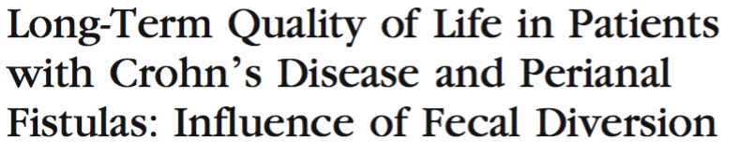
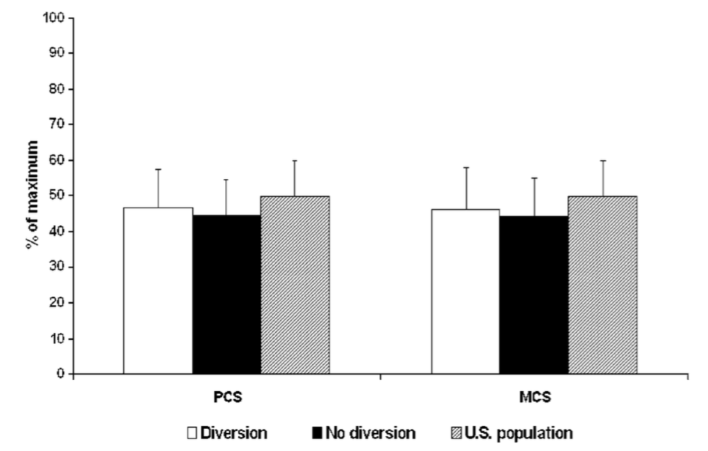
Crohn´s patients with perinal fistulas
Kasparek MS, et al.; Dis Colon Rectum 2007; 50: 2067–2074

Slide 33
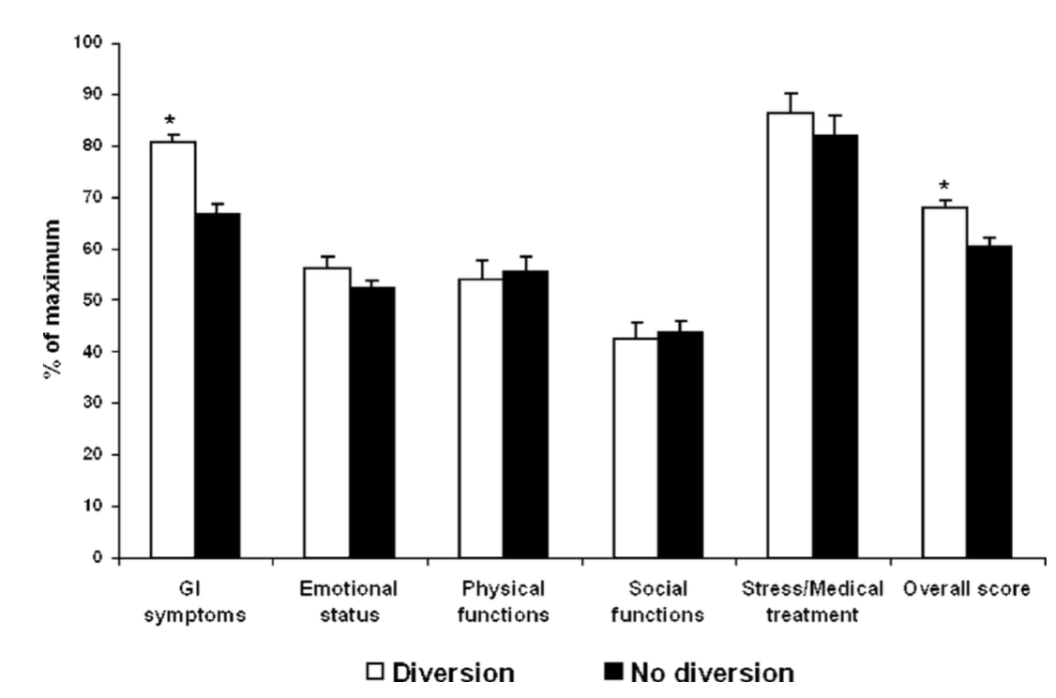
Crohn´s patients with perinal fistulas
Kasparek MS, et al.; Dis Colon Rectum 2007; 50: 2067–2074

Slide 34
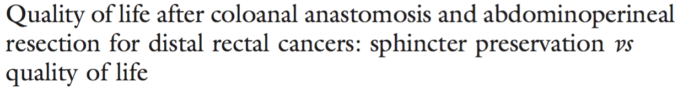
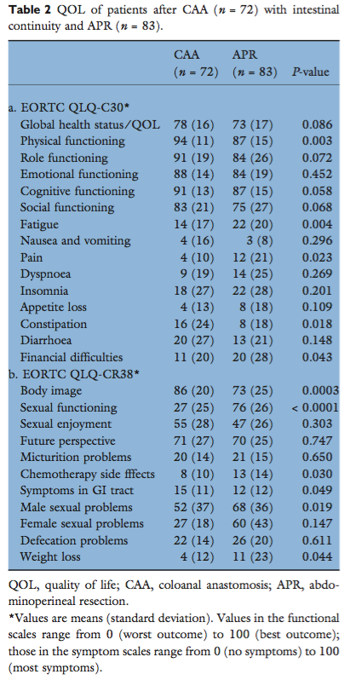
Low rectal resection
Kasparek MS, et al.; Colorectal Disease 2011; 13, 872–877
Generic
Disease-specific
Worst QOL in patients who lost continuity after CAA!!!

Slide 35
Summary
It´s not all bad news for patients with a stoma!!!

Slide 36

Thank you for your attention

Slide 38
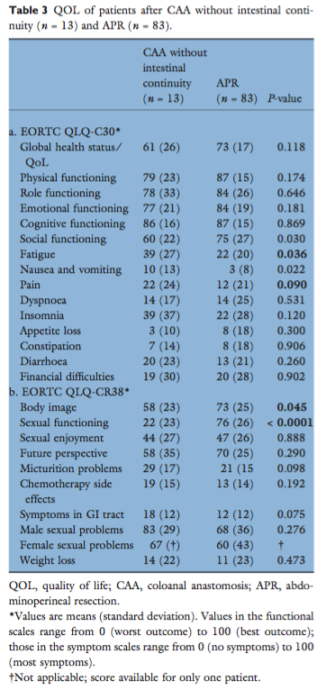
Low rectal resections
Kasparek MS, et al.; Colorectal Disease 2011; 13, 872–877

Slide 39

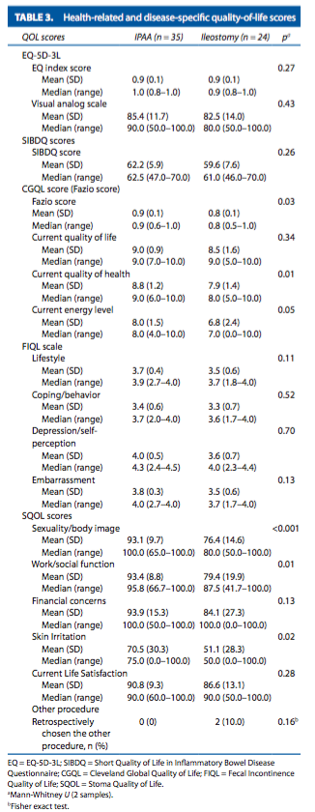
IPAA in UC
Kuruvilla K, et al.; Dis Colon Rectum 2012; 55: 1131

