Slide 1

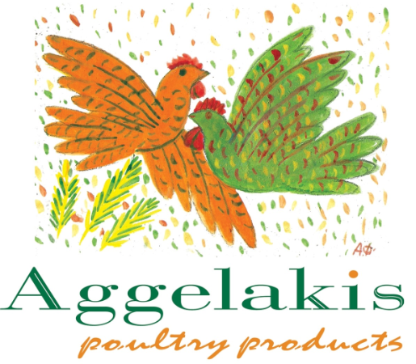
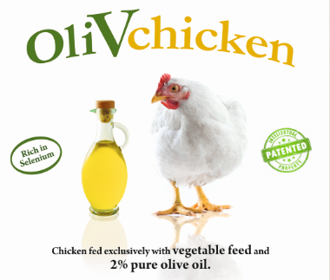
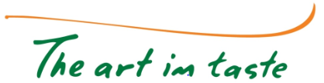
OliVchicken: A functional chicken, enriched with olive oil fatty acids and organic selenium.
Michael Nikolaou
Export Manager
Quality Assurance & Control Manager
4th International Conference & Exhibition on Food Processing & Technology
London, 11/8/2015

Slide 2

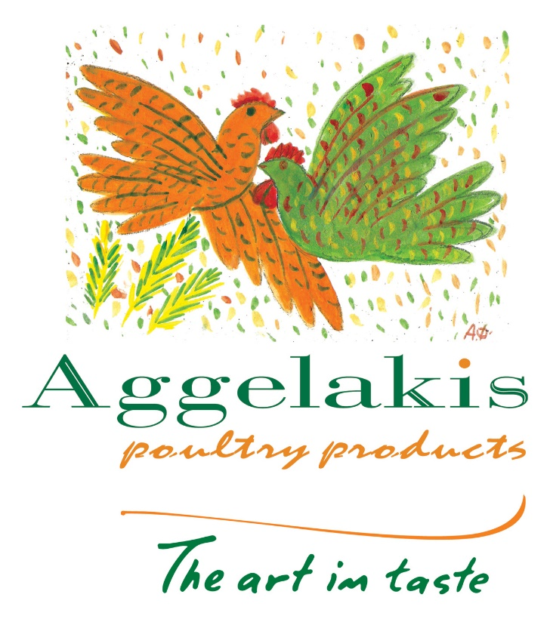
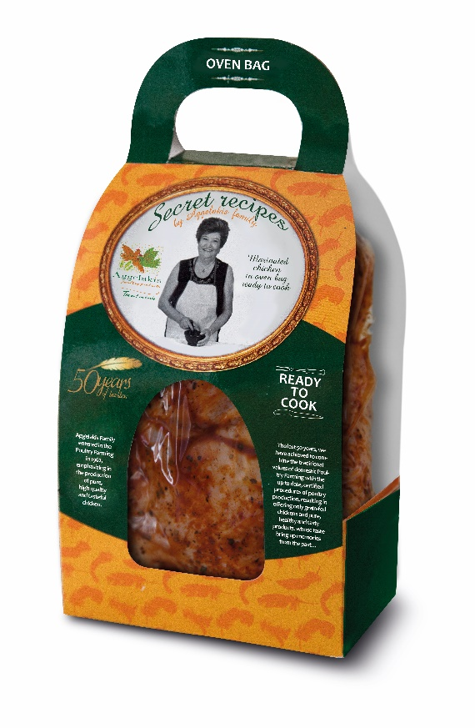
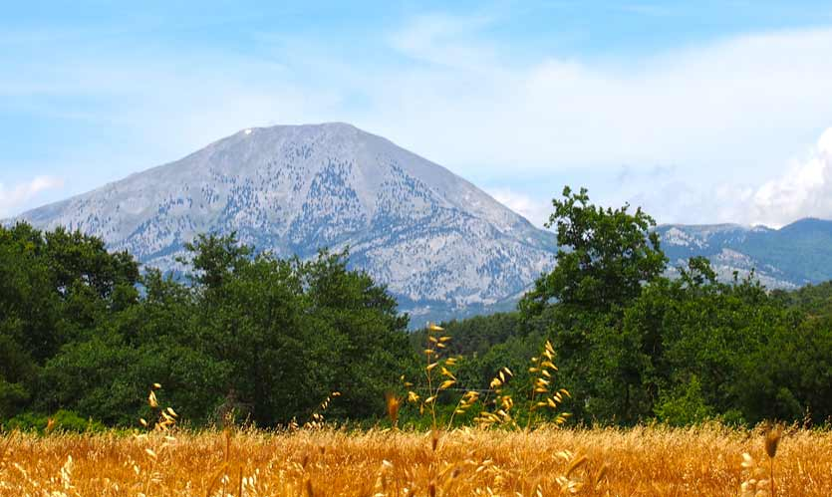
Aggelakis SA: The Company
A fully integrated poultry farming company situated in the Greek island of Euboea.
It produces exclusively naturally fed broilers.
Our company takes under consideration the Greek tradition and we adapt it into the current trends.
Therefore, we are constantly introducing revolutionary products, based on traditional recipes and natural ingredients.

Slide 3
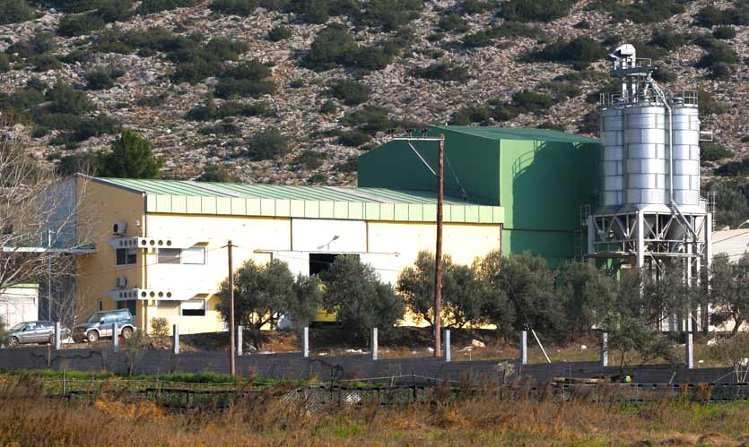
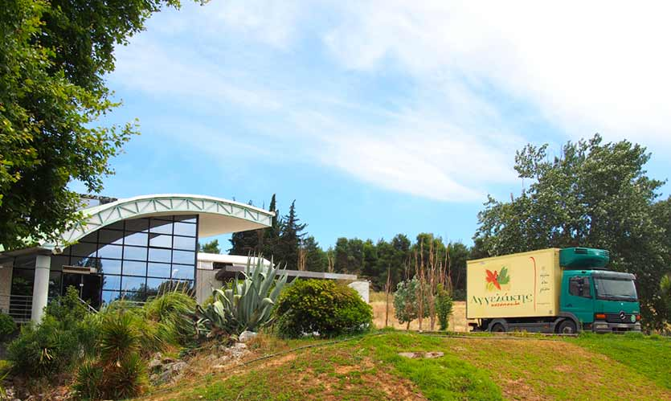
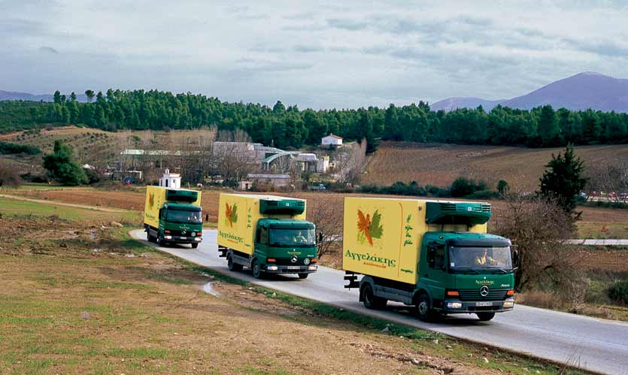
Aggelakis SA: Facilities
Poultry farms with an annual capacity of 4 million birds.
Feed mill plant, where we produce our OWN strictly-vegetable animal feed.
Fully-equipped slaughter house with three rooms of chicken air-cooling, an automatic slicing unit, cutting room and packaging area.
Aggelakis SA owns a fully-equipped transportation for its products (lorries with automatic temperature recorders).

Slide 4
Aggelakis SA: Product Series
Secret Recipes by Aggelakis Family
Aggelakis Poultry Products
Conventional Aggelakis Chicken
Only vegetable fed broilers
This series is comprised of whole chicken, chicken cuts, giblets, deboned and no-skin chicken pieces, chicken souvlaki and chicken roll with Greek bacon & Gouda cheese
50 years of Aggelakis experience are incorporated into Secret Recipes
In this series, four innovative products are included: Marinated Chicken in an Oven Bag, Ready-To-Cook, Chicken Burgers, Chicken Meatballs, which are pre-heated (not pre-fried) and Mediterranean chicken roll with Greek Feta cheese and turkey ham
OliVchicken
The first functional chicken in the global market, patented globally
Rich in oleic acid and selenium
2% of the broilers feed is consisted of natural Greek olive oil
The President of the International Pediatric Association suggests only OliVchicken for the right children’s diet

Slide 5
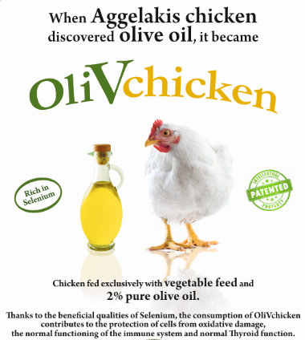
Aggelakis SA: OliVchicken

Slide 6
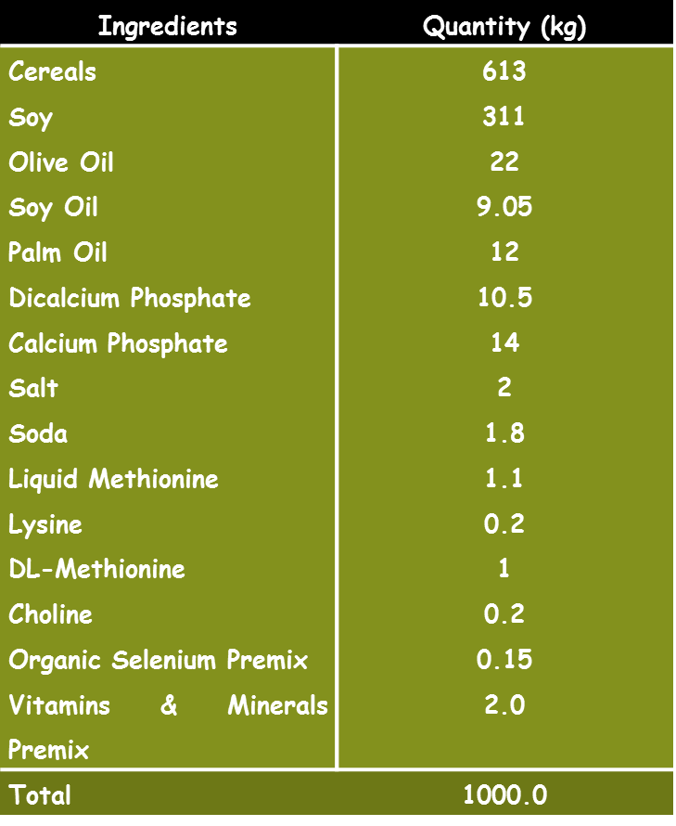
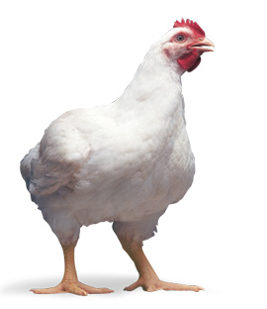
OliVchicken: The Method
Ross 308 of Aviagen broilers are used.
The two first periods (1st-27th day) of their rearing, an 100% vegetable-feed is used, which is produced in our feed mill.
The third (28th-40th day) and the fourth period (40th-end) of their rearing, a fortified feed program is applied.
In this feed, 0.015% w/w is organic selenium and 2.2% w/w is pure olive oil.

Slide 7
OliVchicken: The Method
44% of their rearing period is based upon this feed mixture.
This fortified feed is used for 18 days and it weighs 2.78kg/broiler. 59% of their total feed.
50% of their body mass is acquired in this period.
In the end of their total breeding, their average net weight is 1.85kg/broiler. 0.925kg/broiler have been acquired in this fortified period.

Slide 8
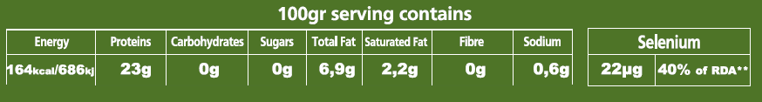
OliVchicken: The Outcome
100gr serving contains (cooked and roasted breast and drumstick, skin on)
Total Fats in 100gr of OliVchicken are 6.9gr, when the conventional ones contain 14gr fats per 100gr.
40% of Total Fats (2.8gr/100gr cooked product) is Oleic Acid
(monounsaturated omega-9 fatty acids).
Saturated Fats in 100gr of OliVchicken are 2.2gr, when the conventional ones contain 3-4gr per 100gr.
100gr of cooked OliVchicken contains 22μg Selenium, when a conventional one contains only 10-14μg Selenium.

Slide 9
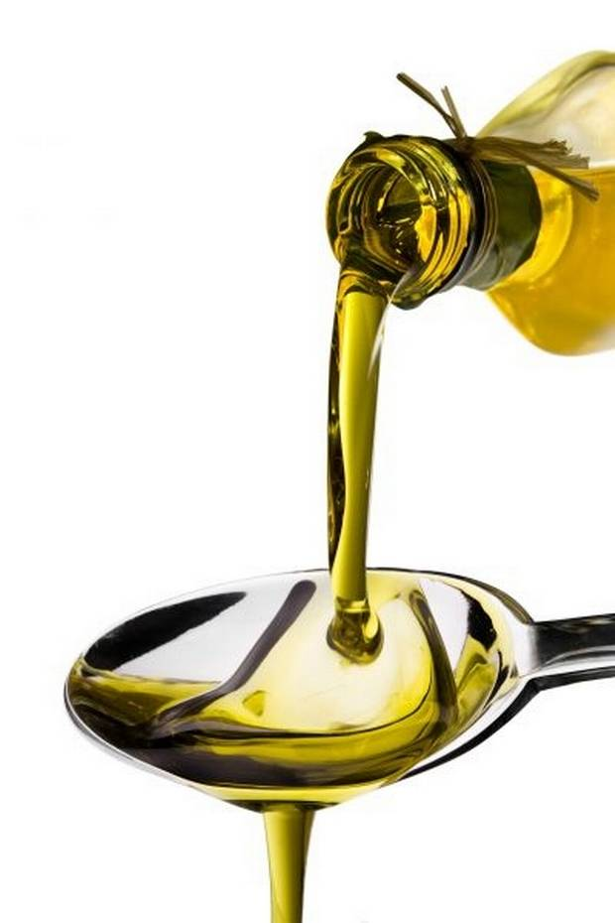
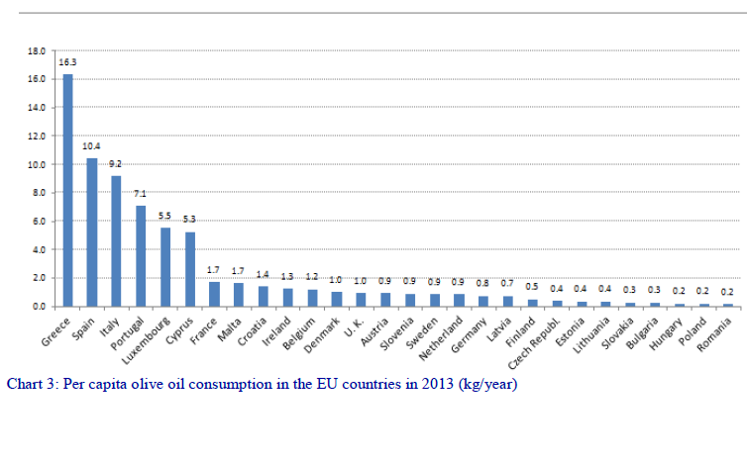
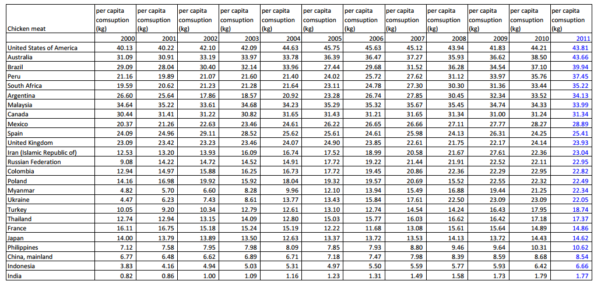
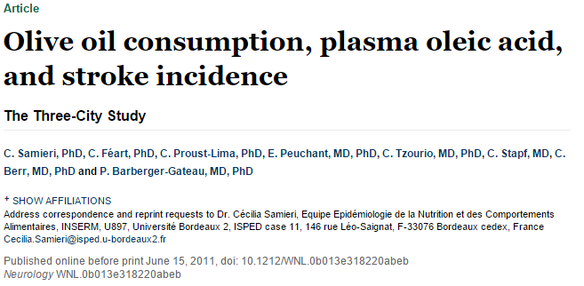
OliVchicken: Its significance
Europeans (except Greece, Spain, Italy, Portugal, Luxembourg & Cyprus) consume extremely low quantities of olive oil¹.
Specifically, a British consumes 1kg of olive oil per year, when a Greek consumes 16.3kg olive oil per year.
Consumption of olive oil can reduce strokes by 40%. This happens due to oleic acid, mostly².
Europeans can add to their diets the OliVchicken, which is high in oleic acid (3.2gr/100 cooked product).
Specifically, a British can benefit more, when he/she consumes 24kg of chicken per year³.

Slide 10
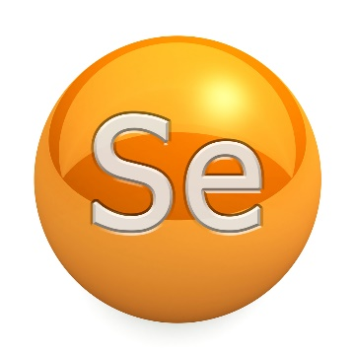
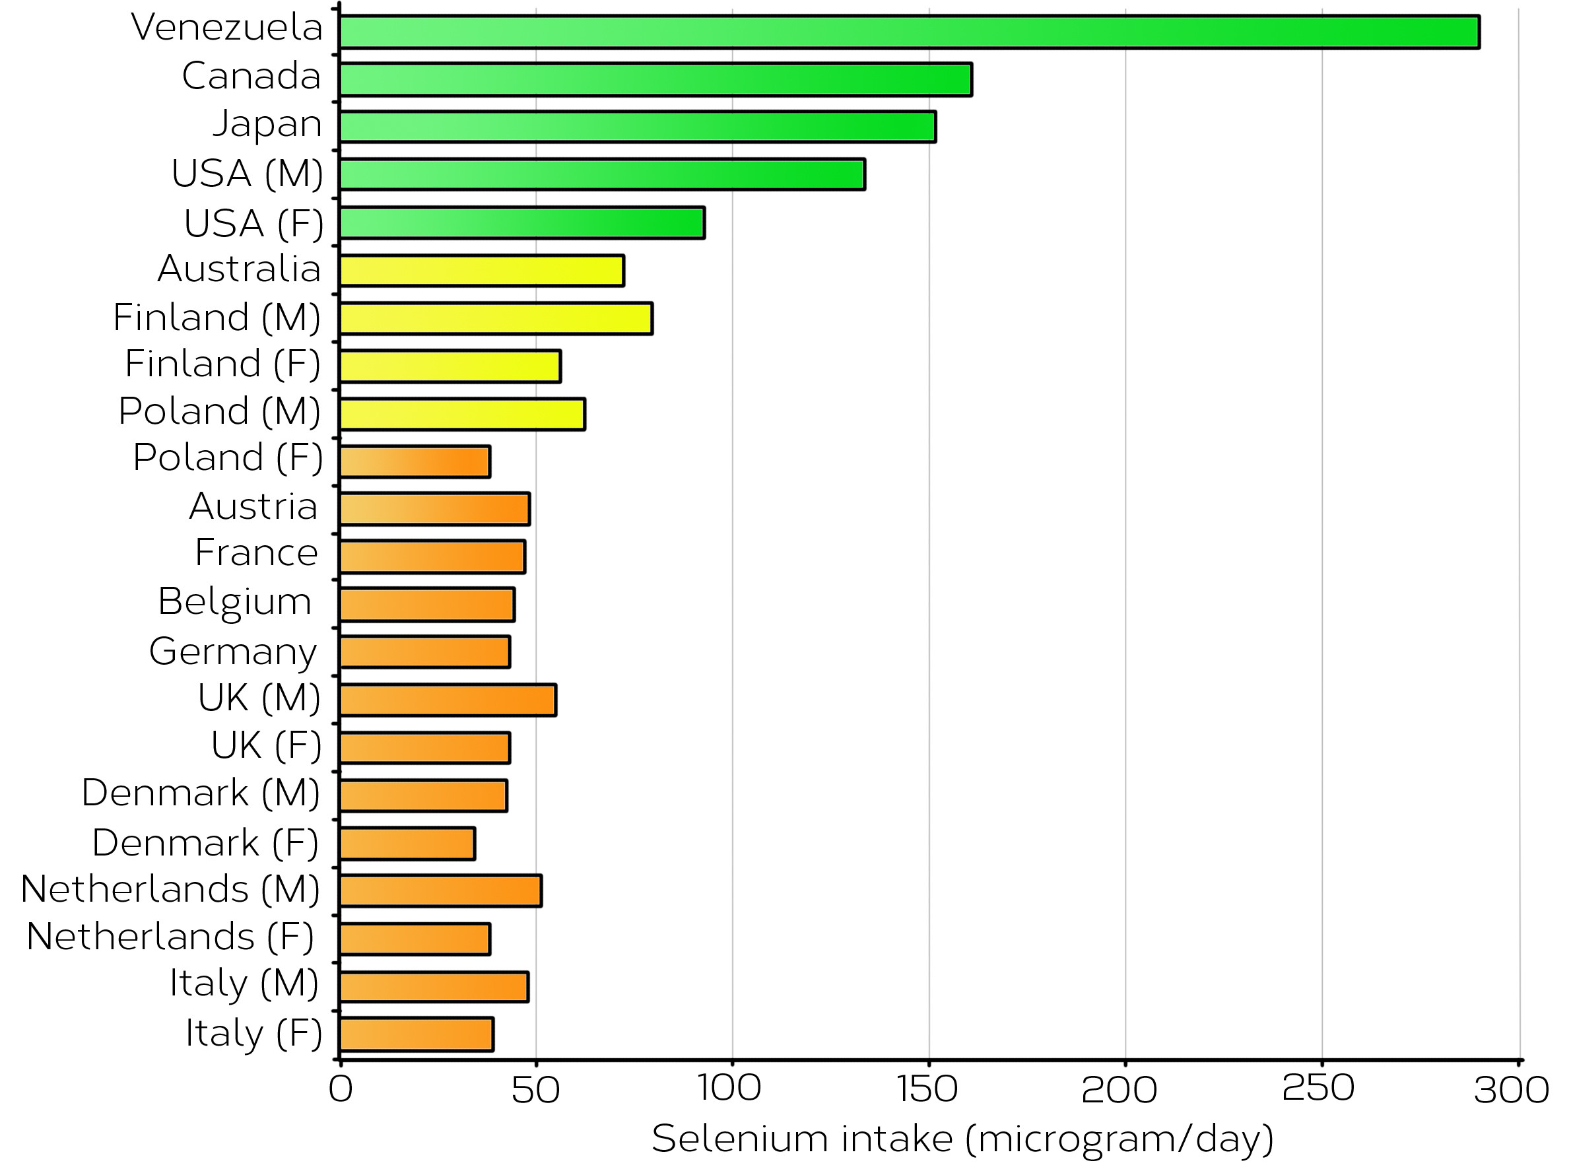
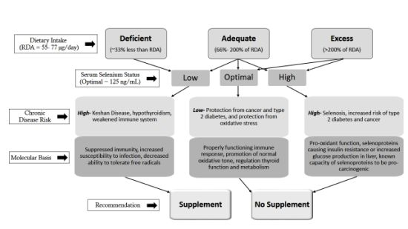
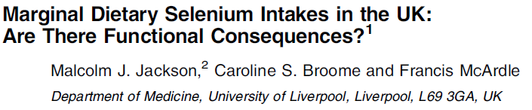
OliVchicken: Its significance
Selenium is a very important micronutrient for humans’ well-being⁴.
Selenium deficiency is very common among the European nations, because the European soils are poor in selenium⁵.
According to NHS, the Recommended Daily Intake of selenium is 60μg for women and 75μg for men. Nowadays, the average selenium daily intake in the United Kingdom is about 40μg per day^{6, 7}.
Europeans can add to their diets the OliVchicken, which is high in selenium (22μg/100gr cooked product).
Specifically, regarding British people, if they replace the chicken which consume with OliVchicken, 20% of their RDA of selenium will be completed annually.

Slide 11

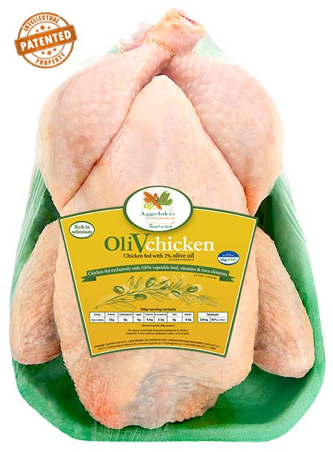

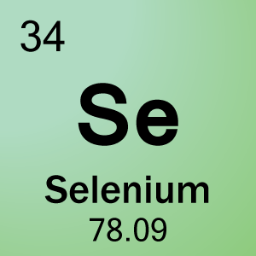

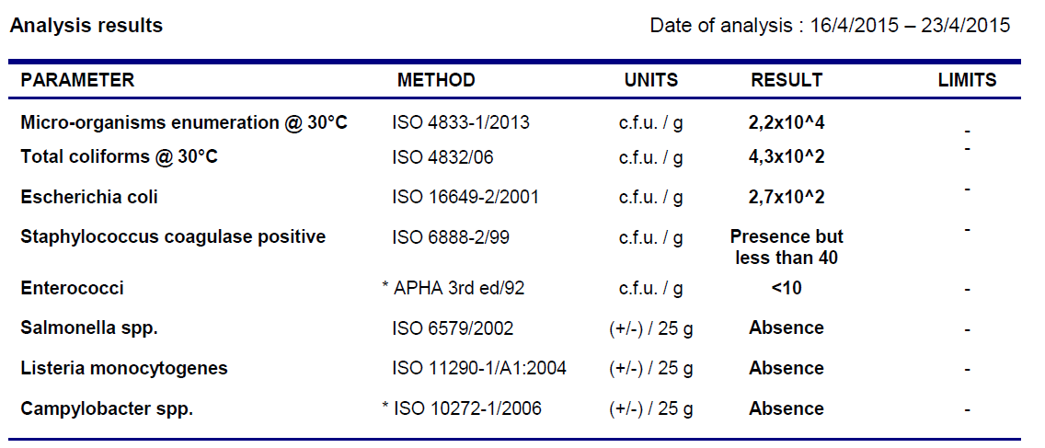
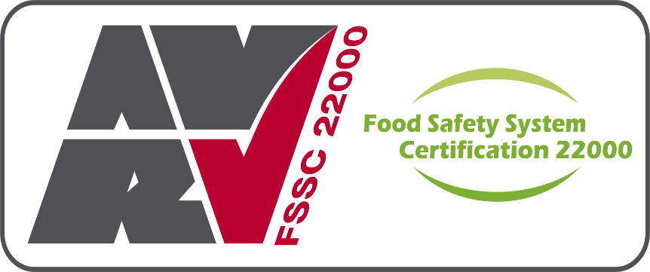
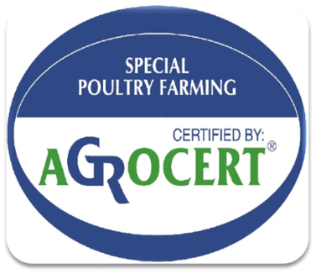
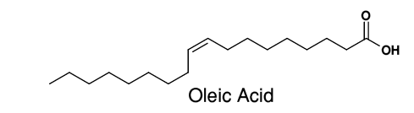

Why Aggelakis’ OliVchicken?
Rich in oleic acid and selenium.
Certified by ISO 9001:2008, ISO 22000:2005, FSSC 22000:2013, AGROCERT for Special Poultry Farming and it is about to be certified by Animal Global Partnership for Animal Production of Step 1.
Free from Listeria, Campylobacter & Salmonella.
Free from any mysterious odors and bad taste, because of the 100% vegetable poultry feed.
Tasteful and tender.

Slide 12
Reference List
3. Anon, (2015). [online] Available at: http://www.internationalpoultrycouncil.org/documents/TopChickenPerCapita.pdf [Accessed 9 Aug. 2015].
4. Rocourt, C. and Cheng, W. (2013). Selenium Supranutrition: Are the Potential Benefits of Chemoprevention Outweighed by the Promotion of Diabetes and Insulin Resistance?. Nutrients, 5(4), pp.1349-1365.
5. Draper, D. (2015). Selenium | Doctor | Patient. [online] Patient. Available at: http://patient.info/doctor/Selenium.htm [Accessed 9 Aug. 2015].
1. oliveoil, (2015). Trends in world olive oil consumption – IOC report | Olive Oil Market. [online] Olive Oil Market. Available at: http://www.oliveoilmarket.eu/trends-in-world-olive-oil-consumption-ioc-report/ [Accessed 9 Aug. 2015].
2. Samieri, C., Feart, C., Proust-Lima, C., Peuchant, E., Tzourio, C., Stapf, C., Berr, C. and Barberger-Gateau, P. (2011). Olive oil consumption, plasma oleic acid, and stroke incidence: The Three-City Study. Neurology, 77(5), pp.418-425.
6. Nhs.uk, (2015). Vitamins and minerals - Others - NHS Choices. [online] Available at: http://www.nhs.uk/Conditions/vitamins-minerals/Pages/Other-vitamins-minerals.aspx#selenium [Accessed 9 Aug. 2015].
7. Jackson, M., Broome, C. and McArdle, F. (2003). Marginal dietary selenium intakes in the UK: are there functional consequences?. The Journal of Nutrition, 133(5), pp.1557S-1559S.

Slide 13
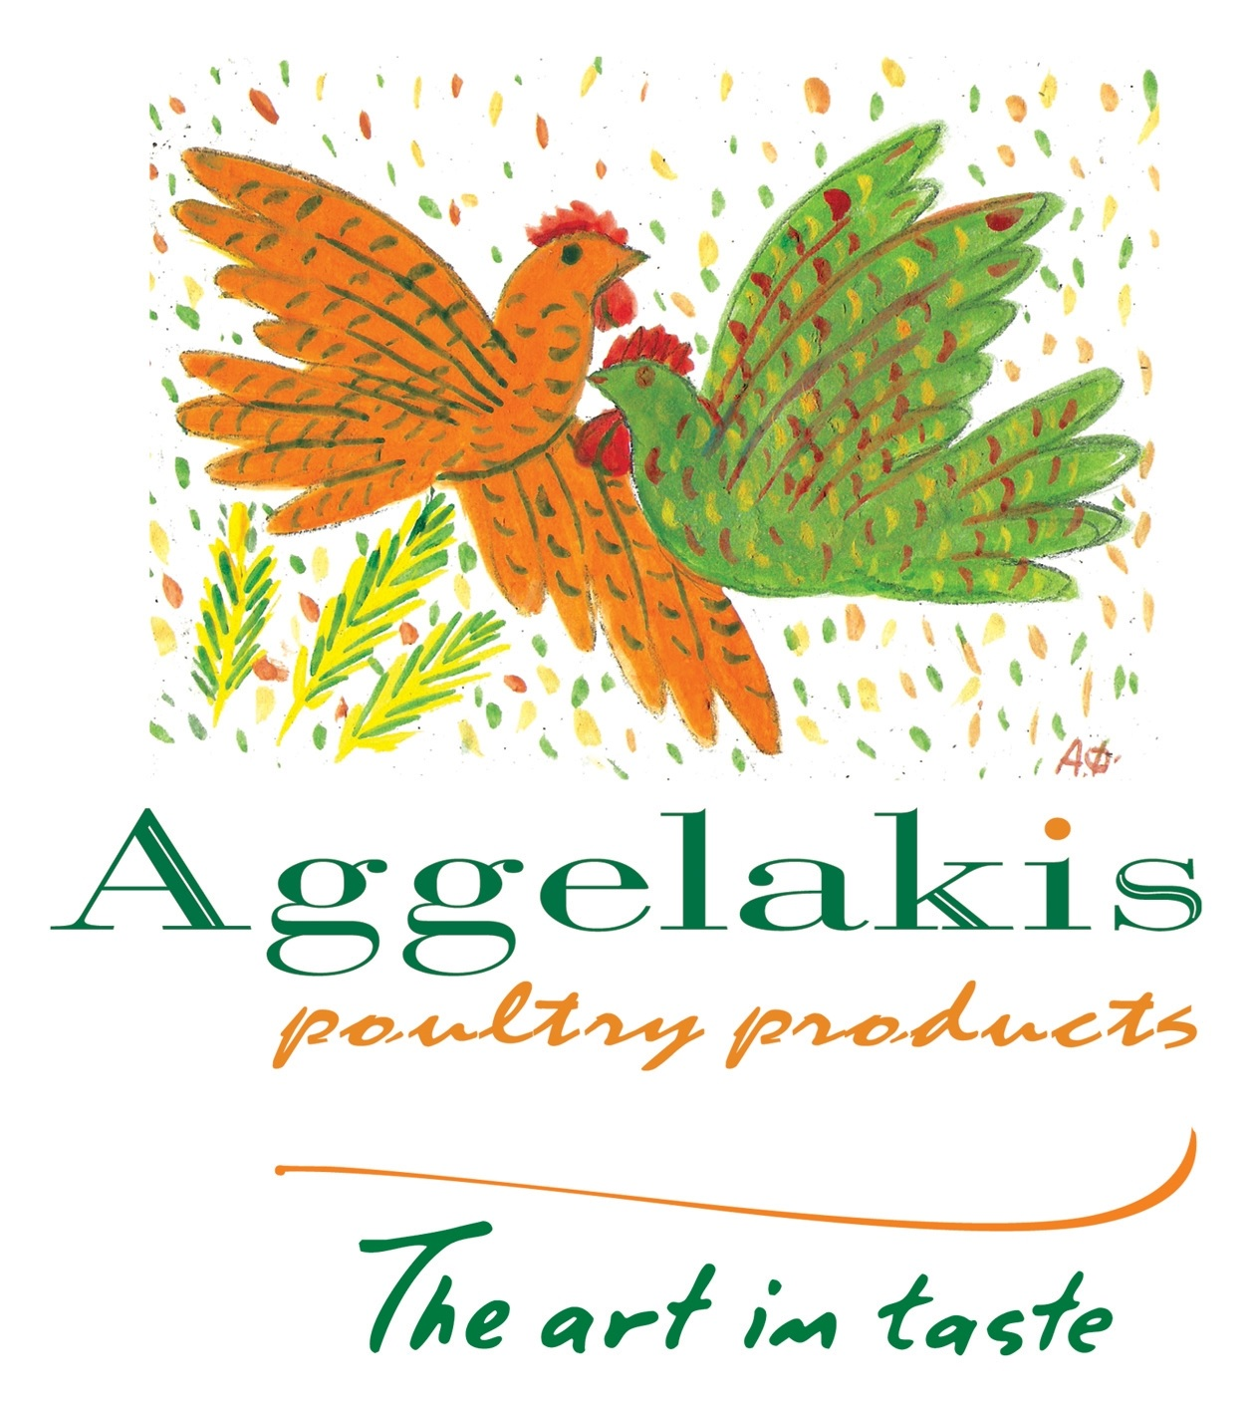

Thank you for your attention!

