Slide 1





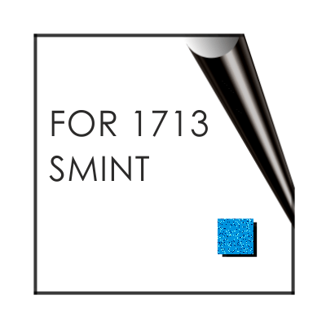
Pattern Control in Molecular Self-Assembly
Michael Hietschold
Technische Universität Chemnitz, Germany
Institute of Physics, Solid Surfaces Analysis Group
DFG Saxonian Research Unit Center for Nanostructured Materials
„Towards Molecular Spintronics“ and Analytics
DFG International Research & Training Unit DFG Research Unit DFG Research Unit
„Advanced Interconnects & Nanosytems“ „Twin Polymerization“ „Sensoric Micro- and Nanosystems“
Nanotechnology, Frankfurt, Germany 12/08/2015

Slide 2
1. Introduction:
2-dimensional molecular self-assembly and its high-
resolution study by scanning tunneling microscopy
(STM)
Molecular Pattern Control by Environmental Parameters
- Control by the nature of the solvent
- Control by concentration
- Coadsorption and packing density-induced esterifi-
cation
3. Some Recent Problems
4. Summary and Outlook

Slide 3
1. Introduction:
2-dimensional molecular self-assembly and its high-
resolution study by scanning tunneling microscopy
(STM)
Molecular Pattern Control by Environmental Parameters
- Control by the nature of the solvent
- Control by concentration
- Coadsorption and packing density-induced esterifi-
cation
3. Some Recent Problems
4. Summary and outlook

Slide 4

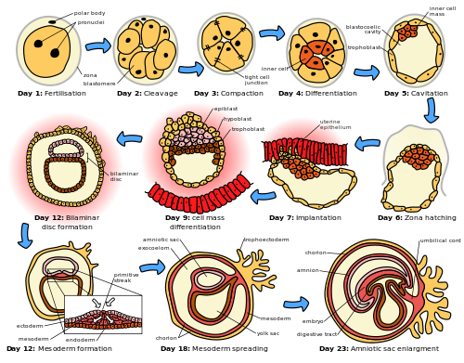
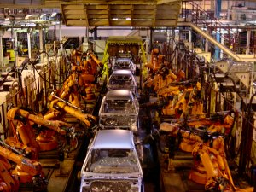
Self-Assembly and Molecules
Hughe variety of organic substances
Self-assembling as „a new production technology“
„industrial“ „natural“
assembly part -by-part self-assembly
http://www.google.de/imgres?imgurl=http://upload.wikimedia.org/wikipedia/commons/thumb/0/06/HumanEmbryogenesis.svg/2000px-HumanEmbryogenesis.svg.png&imgrefurl=http://en.wikipedia.org/wiki/Prenatal_development&h=1564&w=2000&tbnid=ZAMzgvm12_F0xM:&zoom=1&tbnh=101&tbnw=129&usg=__YvOJvyJouuevGO6-70euWr3siBU=&docid=YkCfAt3Q76fONM&sa=X&ei=nojDVPCWAsS3UemihPgF&ved=0CCgQ9QEwAA
http://www.balettie.com/private/England/Pix2001/Rover75AssemblyLine.jpg

Slide 5



Bottom-up approach:
Molecular machines (fiction by K.E.Drexler)
differential gear rotary pump fine motion controller
Possible way to realization:
Supramolecular chemistry and molecular architectures using self-assembly
Necessity for external control of molecular arrangement
either locally on a single-molecule level
or
(complementary) on a global scale by suitable change of
„environmental parameters“
http://www.imm.org/Images/diffGearVS.GIF
http://www.imm.org/Images/PumpCoreSm.jpeg
http://www.imm.org/Images/fineMotionVS.jpg

Slide 6
Method:
Spatially highly-resolving microscopy (STM) and spectro-
scopy (STS) on self-assembled monolayers of various
organic molecular adsorbates on crystalline surfaces
(HOPG, metals)
Long-term goal:
understanding of the surface and molecular physics
principles which determine the structures observed
as a precondition for their controled preparation and
application
recently, chemical reactions as a further „degree of
freedom“ included

Slide 7
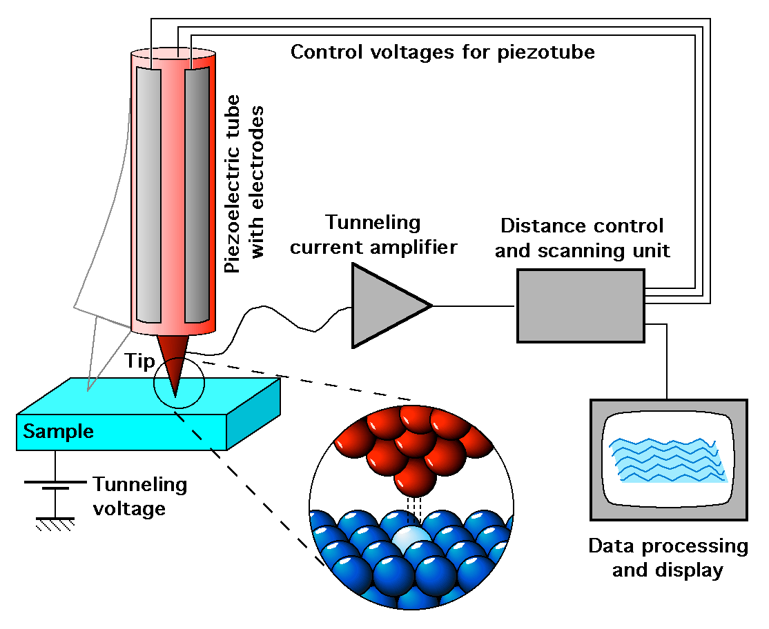
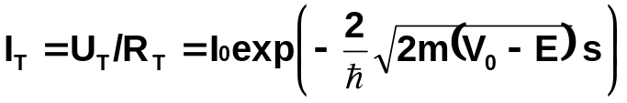
Scanning Tunneling Microscopy (STM)
mesoscopic topography
including aberrations !
microscopicy
profiles of constant
LDOS
(local density of states)
spectroscopy
I_{T}(U_{T}) local measurement
from dI_{T}/dU_{T} → LDOS
http://upload.wikimedia.org/wikipedia/commons/f/f9/ScanningTunnelingMicroscope_schematic.png
Constant current mode:
G.Binnig, H.Rohrer 1981

Slide 8
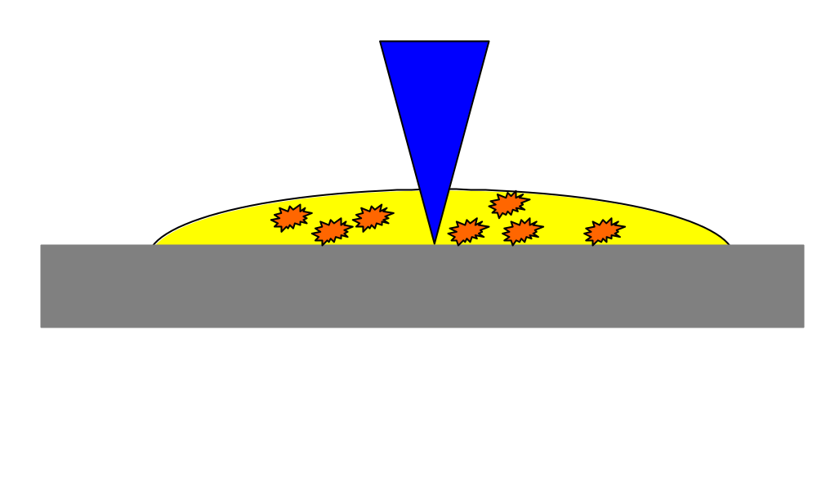
Self-assembly out-of a solution droplet at the liquid-solid interface and in-
situ observstion by ambient STM with tip immersed in the droplet
STM tip
Solvent with solved
molecules
Graphite substrate
Molecules segregate out of the solution. Scanning STM tip introduces energy
and possibly supports self-assembly

Slide 9
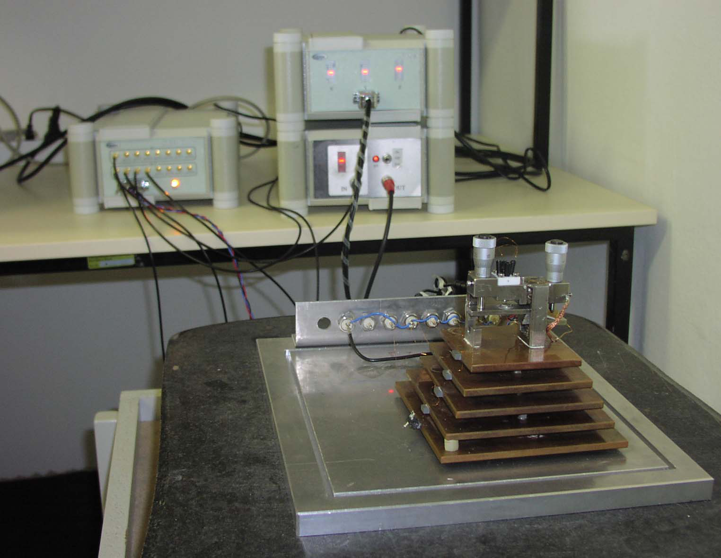
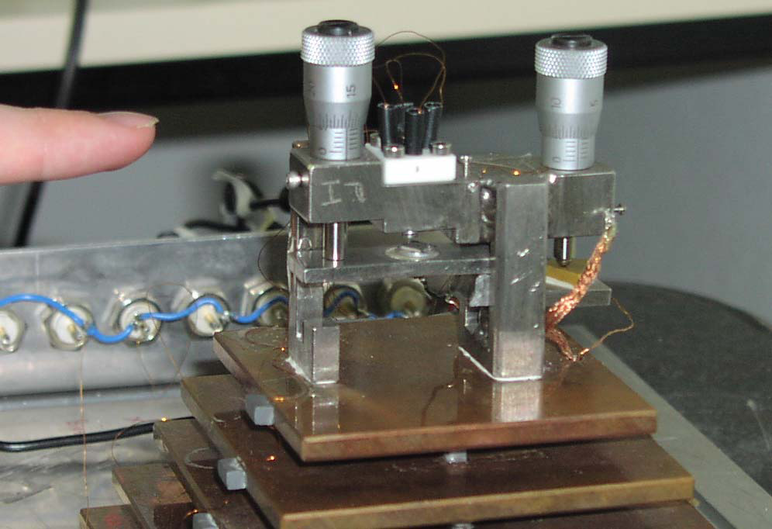
Ambient STM for
investigations at
solid-liquid interface

Slide 10
1. Introduction:
2-dimensional molecular self-assembly and its high-
resolution study by scanning tunneling microscopy
(STM)
Molecular Pattern Control by Environmental Parameters
- Control by the nature of the solvent
- Control by concentration
- Coadsorption and packing density-induced esterifi-
cation
3. Some Recent Problems
4. Summary and outlook

Slide 11
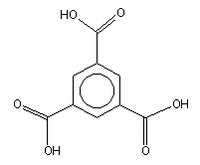
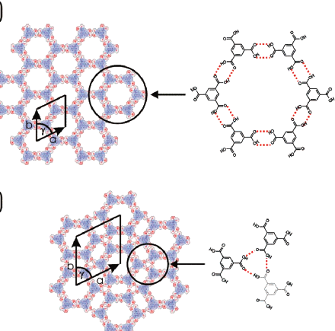
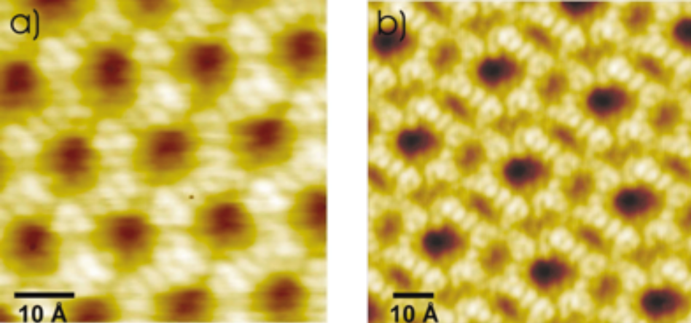
Trimesic acid (TMA) @ HOPG(0001):
Open network-like structures due to H-bonds
Coexistence of both: chicken wire & flower structure
by UHV-STM at free graphite surface
no way, to control the appearance of one
of these particular structures !
S.Griessl, M.Lackinger, M.Edelwirth, M.Hietschold, W.M.Heckl. Single Mol. 3, 25-31 (2002)

Slide 12
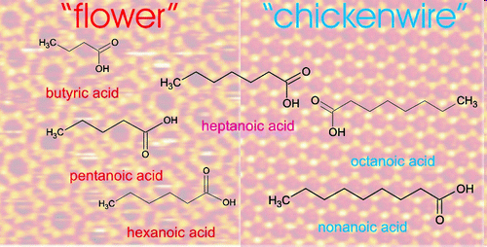
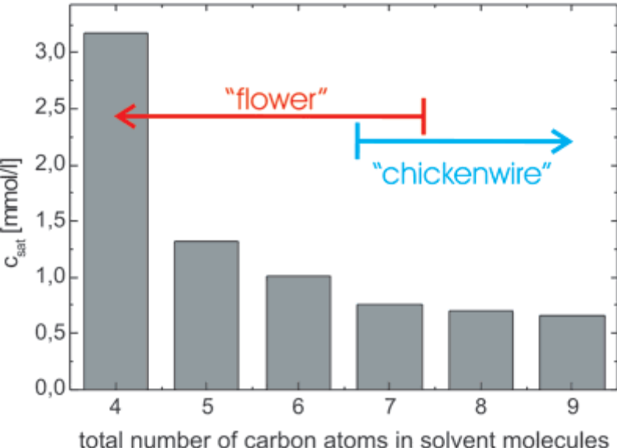
  Trimesic acid (TMA) @ HOPG(0001):
At the liquid-solid interface:
Control of polymorphism by solvent (alkanoic acid)
Long alkan chain: chicken wire structure
Short alkan chain: flower structure
coexistence for heptanoic acid only
M.Lackinger, S.Griessl, W.M.Heckl, M.Hietschold, G.W.Flynn.
Langmuir 21, 4984-4988 (2005)

Slide 13
1. Introduction:
2-dimensional molecular self-assembly and its high-
resolution study by scanning tunneling microscopy
(STM)
Molecular Pattern Control by Environmental Parameters
- Control by the nature of the solvent
- Control by concentration
- Coadsorption and packing density-induced esterifi-
cation
3. Some Recent Problems
4. Summary and outlook

Slide 14
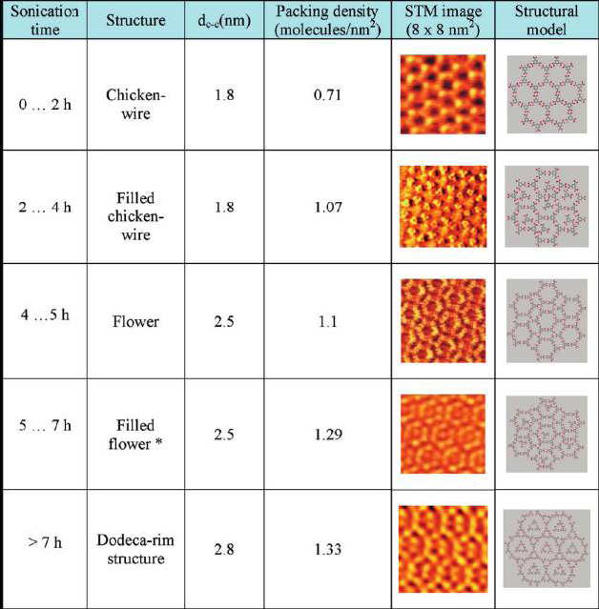
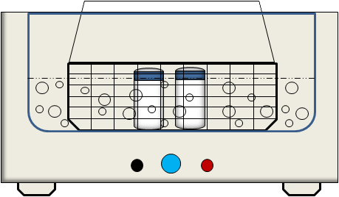
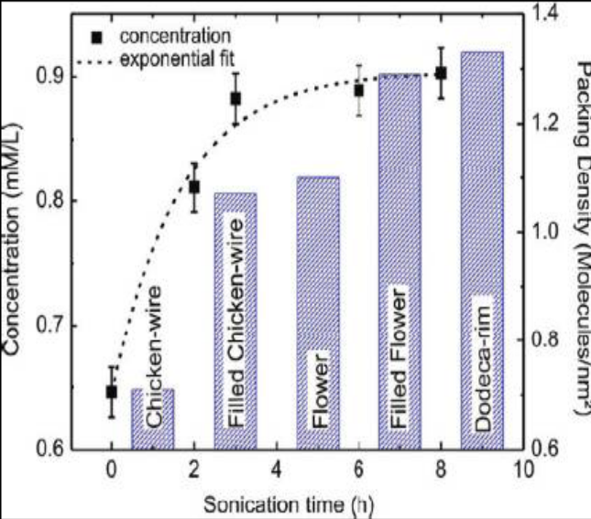
  Trimesic acid (TMA) @
  HOPG(0001):
TMA solved in octanoic acid
Control of TMA concentration
by sonication
Solutions with increased
concentration →
Structures with increased molecular packing density
N.T.N.Ha, T.G.Gopakumar, M.Hietschold. J.Phys.Chem. C115, 21743-21749 (2011)
Surf.Sci. 607, 68-73 (2013)

Slide 15
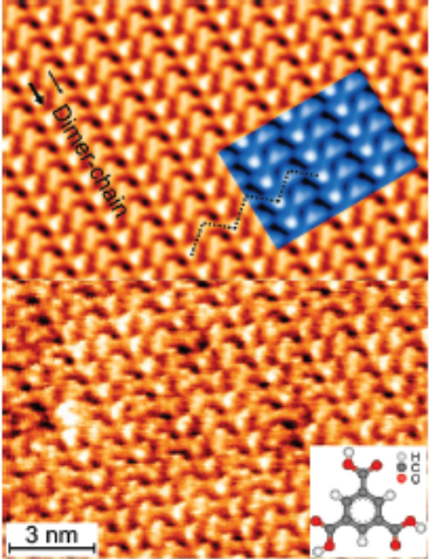
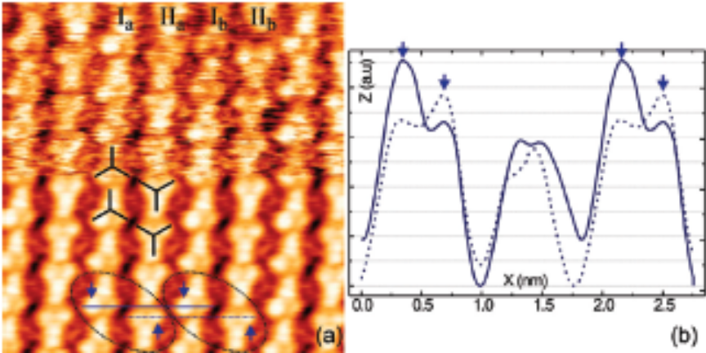
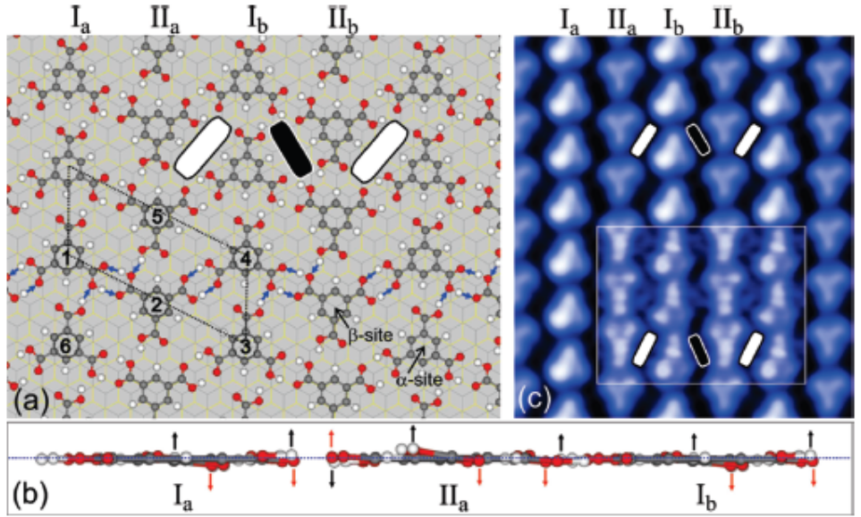
  Trimesic acid (TMA) @ HOPG(0001):
Completely different structure from a sonicated solution in 1-phenyloctane:
zig-zag dimer chain
N.T.N.Ha, T.G.Gopakumar,
R.Gutzler, M.Lackinger, H.Tang,
M.Hietschold.
J.Phys.Chem. C 114, 3531-3536 (2010)

Slide 16
1. Introduction:
2-dimensional molecular self-assembly and its high-
resolution study by scanning tunneling microscopy
(STM)
Molecular Pattern Control by Environmental Parameters
- Control by the nature of the solvent
- Control by concentration
- Coadsorption and packing density-induced esteri-
fication
3. Some Recent Problems
4. Summary and outlook

Slide 17
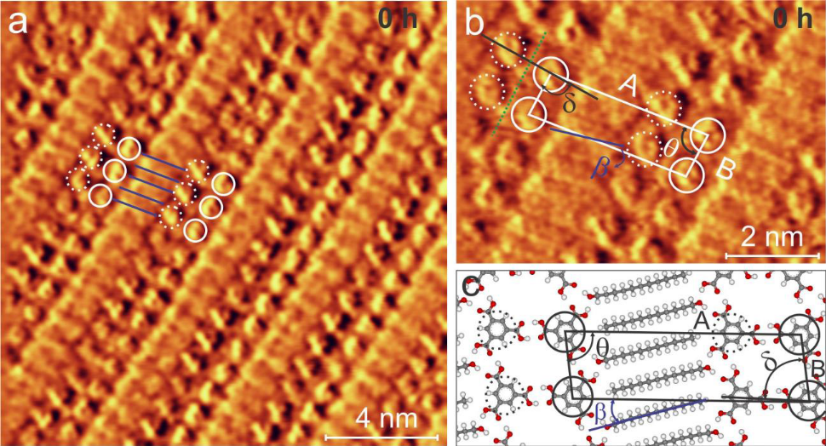
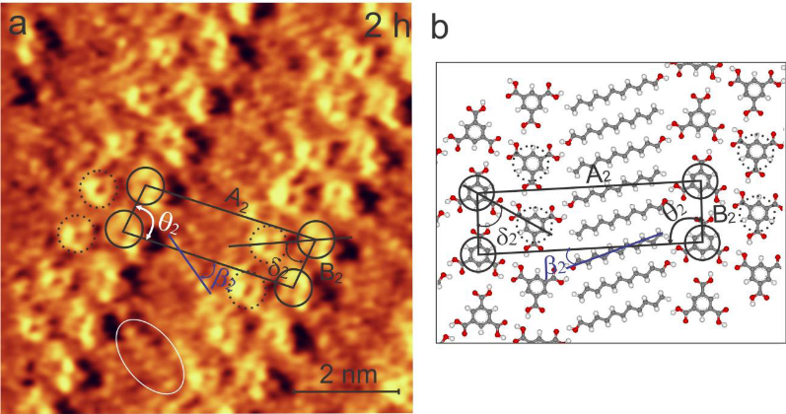
  Trimesic acid (TMA) & undecanol @ HOPG:
Coadsorption of TMA and undecanol molecules (1:1) in linear stripes
2 h sonication
no sonication
Control of TMA concentration
by sonication
Increased TMA concentration leads to a structure with increased
packing density (mainly due to „narrowed“ TMA stripes and steeper
tilted alkane chains)

Slide 18
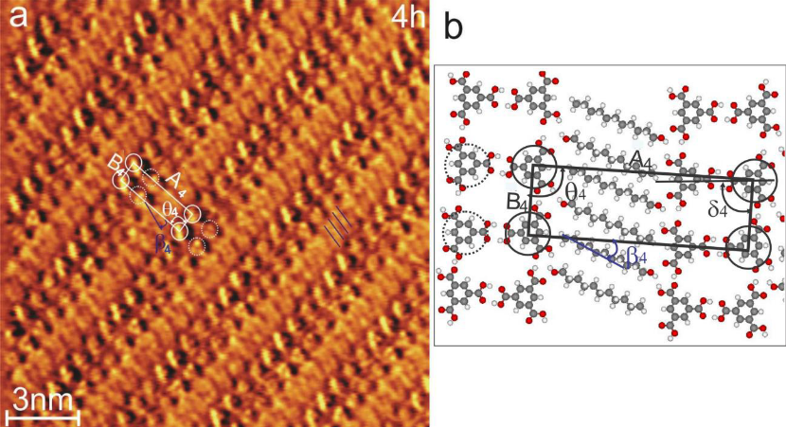
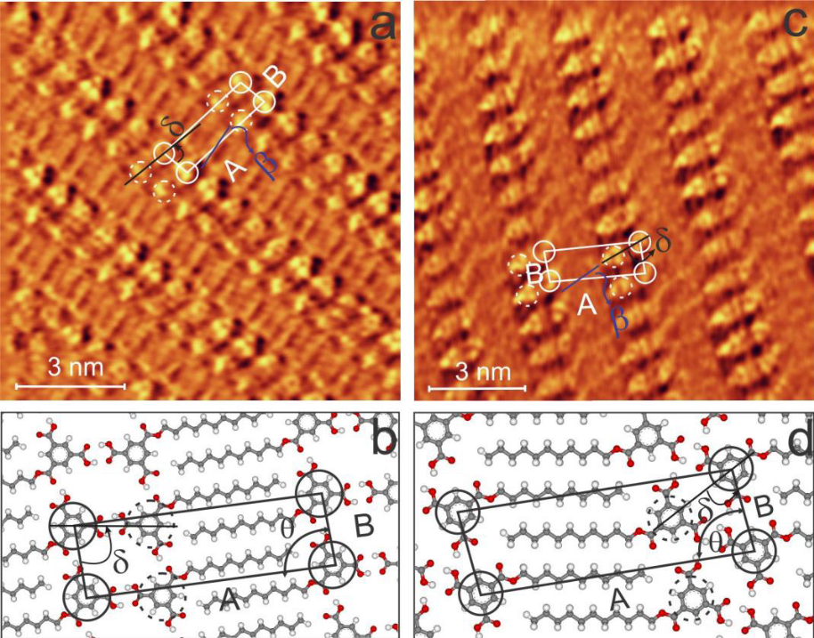
Further enhancing TMA concentration: 4h sonication
coexistence of
linear pattern from TMA & and linear pattern made of
undecanol (packing density TMA-undecyl monoester
does not further increase !!)
2 coexisting phases
no long-time stability of the solution
for solutions older than 12 h no esterification

Slide 19
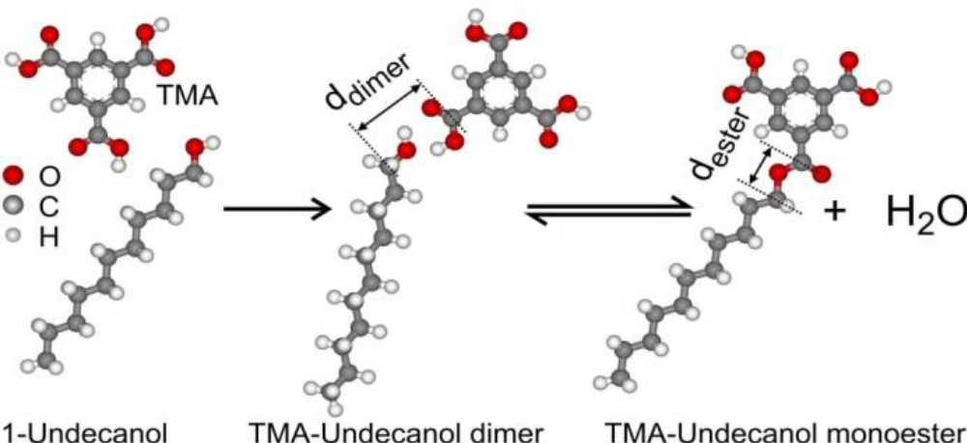
Packing density can be also increased by esterification !
in accordance with Braun – Le Chatelier‘s´principle
Substrate plane acts as a catalyste !
There could be found no indication for the ester in the sonicated solution by H-NMR
N.T.N.Ha. Ph.D. thesis. TU Chemnitz 2014

Slide 20
1. Introduction:
2-dimensional molecular self-assembly and its high-
resolution study by scanning tunneling microscopy
(STM)
Molecular Pattern Control by Environmental Parameters
- Control by the nature of the solvent
- Control by concentration
- Coadsorption and packing density-induced esterifi-
cation
3. Some Recent Problems
4. Summary and outlook

Slide 21
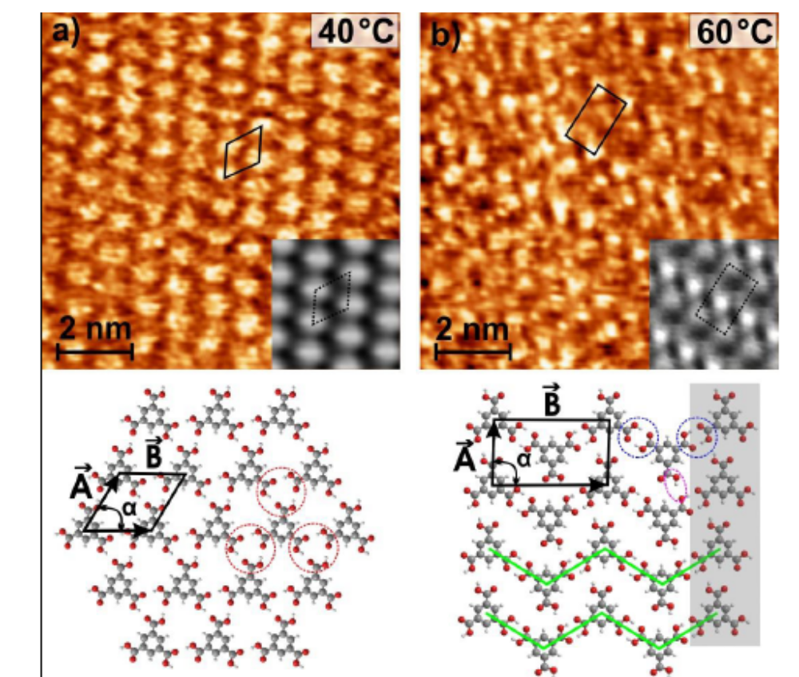
Further control paramter:
Temperature of pre-heated
Substrate
TMA solved in phenyloctane:
novel hexagonal structure →
zig-zag dimer chain
Mechanism:
Enforced evaporation of the
solvent effectively increases
concentration of solute
N.D.C.Yen, L.Smykalla, N.T.N.Ha, M.Hietschold. to be published

Slide 22
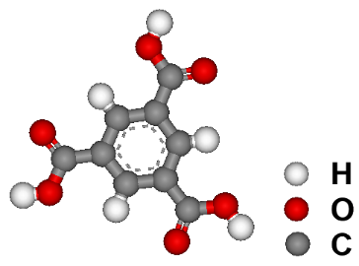
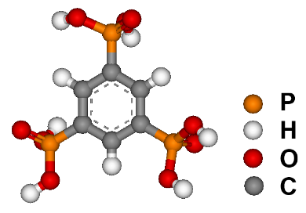
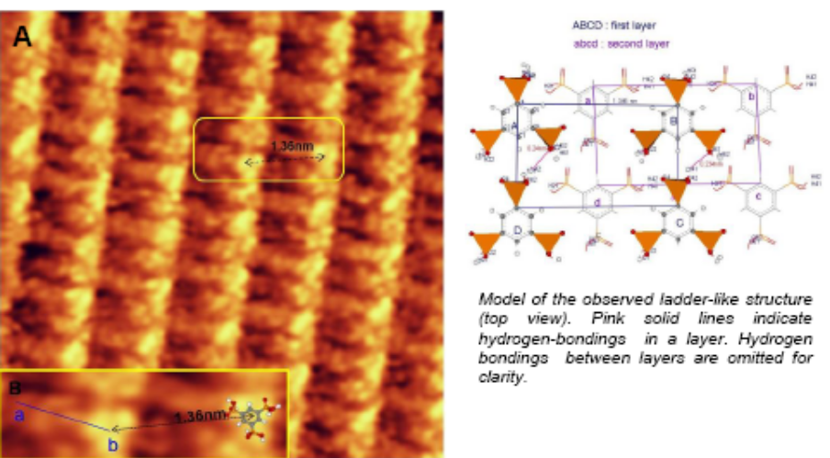
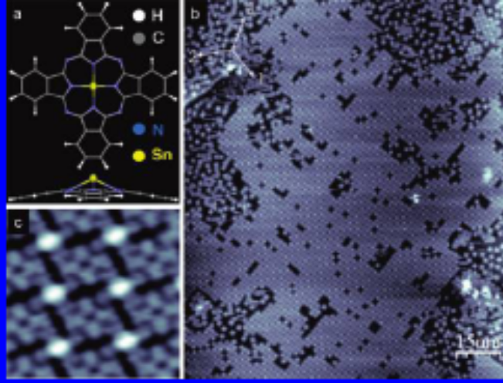
Extending into the 3rd dimension by non-planar molecules
From TMA to PTB
(Benzene 1,3,5-triphophonic acid):
BTP deposited from solution
in octanoic acid
N.T.N.Ha, N.D.C.Yen, M.Mehring,
M.Hietschold. To be published
Non-planar metal-phthalocyanine (SnPc@Ag(111)):
2 species: „up“ and „down“
ordered chess-bord like ground state
self-assembly orders different molecular species
(similar to coadsorption)
M.Toader, M.Hietschold. J.Phys.Chem. C 115, 12494-12500 (2011)

Slide 23
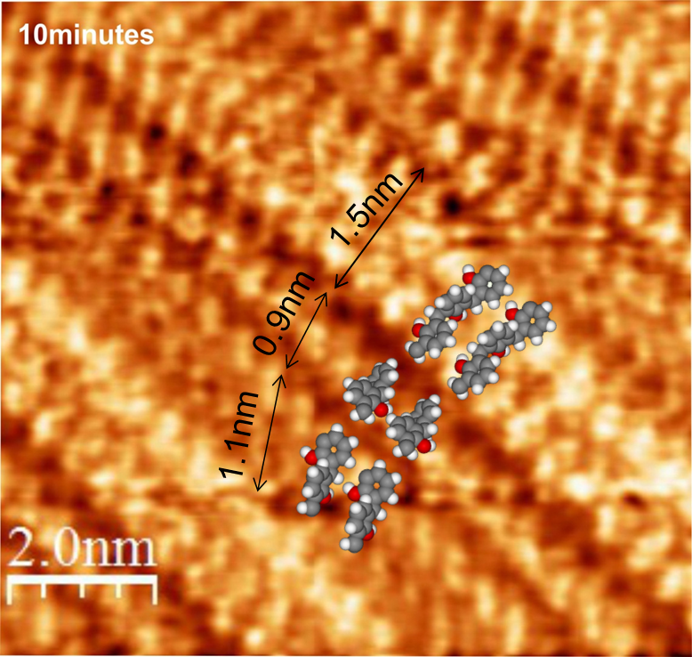
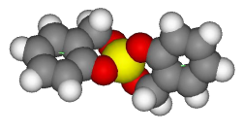
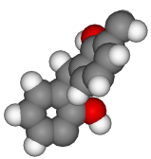
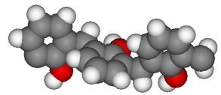
Self-assembly as „analytical tool“
Solution of monomer and several low oligomers
Different molecular species are ordered
along linear stripes
Development of the organic-twin oligomers:
(something similar happens with the inorganic component)
spiro
dimer
trimer
tetramer: 2.01nm
pentamer: 2.45 nm
………
……….
1.38nm
1.05nm
1.52nm
M.Hietschold, N.T.N.Ha, A.Seifert, S.Spange. 247th ACS meeting, Dallas 2014 and to be published

Slide 24
1. Introduction:
2-dimensional molecular self-assembly and its high-
resolution study by scanning tunneling microscopy
(STM)
Molecular Pattern Control by Environmental Parameters
- Control by the nature of the solvent
- Control by concentration
- Coadsorption and packing density-induced esterifi-
cation
3. Some Recent Problems
4. Summary and outlook

Slide 25
Summary
Molecular self-assembly leads to relatively large 2d-periodic structures
on crystalline substrate which can be studied by in-situ STM
Polymorphism of such patterns can be controlled at the liquid-solid
interface by environmental parameters as solvent, concentration, …
Chemical reaction inside of the adsorbed layers can be controlled and
studied by in-situ STM
Challenges: 3-dimensionality; selectivity; complexity; self-repair; ….

Slide 26
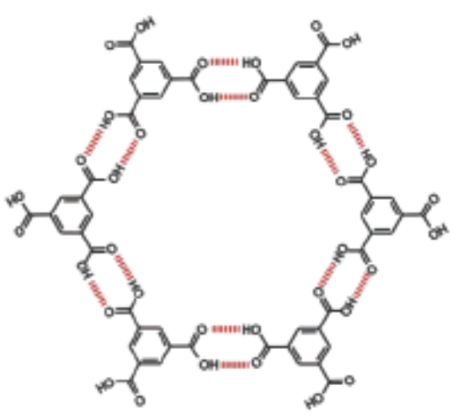
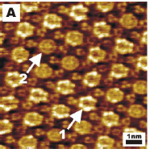
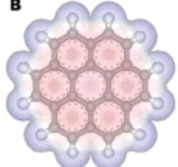
Outlook
Molecular self-assembly is a rich realm, especially for studying
structural and electronic effects
The dynamics of the assembly as well as of those reactions is still an
unexplored and challenging field
Inclusion of increasing complexity into the concept of supra-molecular
architectures opens a broad variety of novel opportunities
Example: molecular bearings made of
single coronen molecules moving in
cavities of a TMA chicken wire tem-
plate
Several millions of quantum rotators
fabricated ot once !
S.J.H Griessl, M.Lackinger, F.Jamitzky, Th.Markert, M.Hietschold, W.M.Heckl.
Langmuir 20, 9403-9407 (2004)

Slide 27
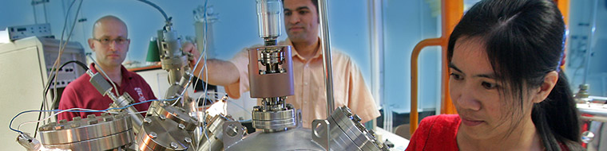
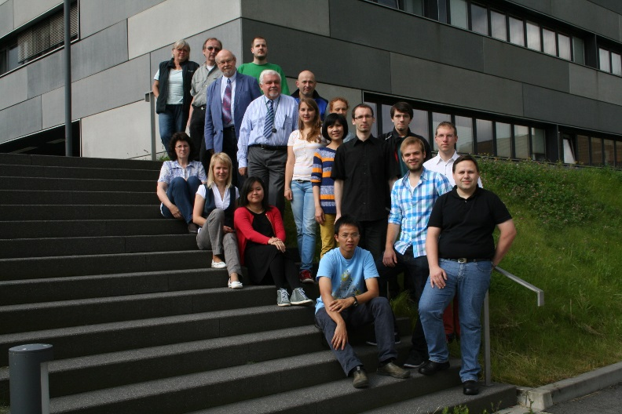
Acknowledgement:
Markus Lackinger (now at LMU Munich)
Thiruvacheril G. Gopakumar (now at IIT Kanpur)
Nguyen Thi Ngoc Ha
Lars Smykalla
Pavel Shukrynau
Marius Toader
Nguyen Doan Chau Yen
Institute of Chemistry (TU Chemnitz)
Heinrich Lang
Michael Mehring
Stefan Spange
Hao Tang (CEMES, CNRS, Toulouse)
George Flynn (Columbia Univ. New York)

Slide 28
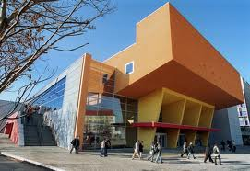
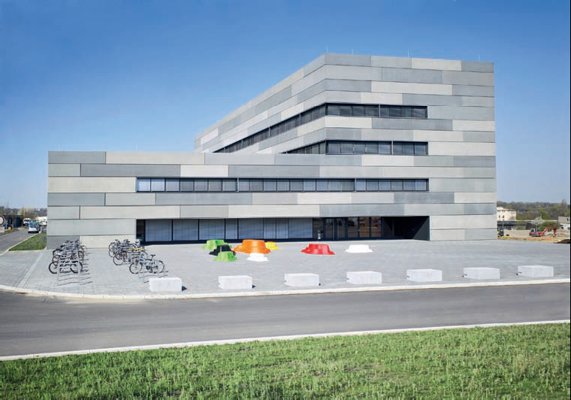
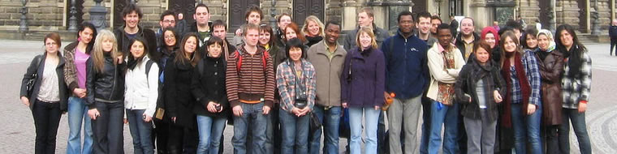
Advertisement:
TU Chemnitz offers 2015 an international master in
„Advanced functional materials“
especially for bachelors in physics and chemistry
starting in October 2015
https://www.tu-chemnitz.de/naturwissenschaften/tmp/Flyer_AFM.pdf

