Slide 1
Reweighting RCT evidence to better reflect real life – a case study of the Innovation in Medicine initiative
(IMI - GetReal).
Michael Happich
2016, July 25th

Slide 2
Objectives
To review the NSCLC case study on RCT reweighting methodology & obtain feedback from participants to refine the approach
Assessment of potential application in regulatory and HTA decision making process
This work has received support from the EU/EFPIA Innovative Medicines Initiative Joint Undertaking (GetReal grant n° 115546)

Slide 3
Study team
Keith Abrams (Uni Leicester)
Pall Jonssen (NICE)
Stefan Schwoch
Mark Belger
Alan Brnabic
Michael Happich
Katherine Winfree
Allicia Girvan

Slide 4
IMI, GetReal & RWE challenges

Slide 5
About IMI
The Innovative Medicines Initiative (IMI) is Europe's largest public-private partnership aiming to improve the drug development process by supporting a more efficient discovery and development of better and safer medicines for patients.
With a €2 billion euro budget, IMI supports collaborative research projects and builds networks of industrial leader, academic experts & health care decision maker in Europe that will boost innovation in healthcare.
IMI supports a number of projects, among them GetReal about „Incorporating real-life clinical data into drug development”

Slide 6
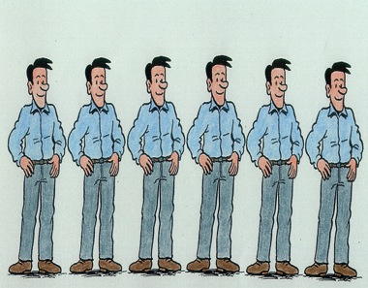
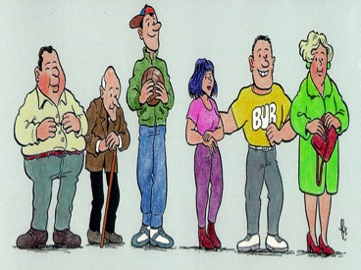
RCT vs RWE
Patient benefit and harm in experimental and closely monitored research studies, normally RCTs.
Design minimises bias - high internal validity
Generalisability questionable
  restricted entry criteria
  unrepresentative settings
Patient benefit and harm when the technology is actually applied in everyday practice.
    pragmatic clinical trials
    observational studies
    synthesis
ISPOR: “evidence used for decision-making that is not collected in conventional randomized controlled trials (RCTs)”
“Dirty” - a lot of variability and biases

Slide 7
RWE Challenges
Phase III trials too short to capture relevant effects, need to use models:
Considerable uncertainty in RWE predictions
RWE likely to be influenced by factors (adherence etc.) not captured in Phase III, model-based estimates unreliable:
RWE biased?
Phase III patient population poor fit for local population/general care received may not reflect care in HTA country:
RWE biased?
Phase III patient population too broad/poor fit to care pathway (?targeting of therapy):
Uncertainty in RWE for target sub-populations
Phase III comparator not appropriate for local HTA: indirect meta-analysis (for RWE) not robust:
No credible RWE estimate
Phase III trial event rates for comparator not in line with available RW evidence for comparator:
RWE biased?

Slide 8
Lung Cancer

Slide 9
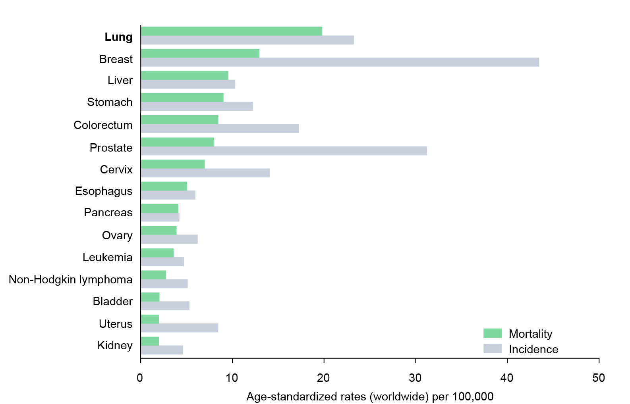
Lung cancer is the most common cause of cancer death worldwide
Epidemiology
Mortality and incidence of lung cancer* worldwide, both genders
In 2012
Lung cancer accounted for 1.6 million deaths worldwide
There were around 1.8 million new cases
58% of new cases occurred in less developed regions
*All types of lung cancer.
Ferlay J et al. GLOBOCAN 2012 v1.0: International Agency for Research on Cancer; CancerBase 2013.
Available from: http://globocan.iarc.fr. Accessed February 2015
Notes:
Lung cancer is the most deadly cancer, and the third most common cancer worldwide
Mortality (absolute numbers, globally; GLOBOCAN 2012):
All 8,201,030
Lung 1,589,800
Liver 745,517
Stomach 723,027
Colorectum 693,881
Breast 521,817
Esophagus 400,156
Pancreas 330,372
Prostate 307,471
(All ages, both sexes)
Ferlay J et al. GLOBOCAN 2012 v1.0: International Agency for Research on Cancer CancerBase 2013. Available from: http://globocan.iarc.fr. Accessed February 2015
Ramu-00073771

Slide 10
Non-small cell lung cancer accounts for 85% of all lung cancer¹
NSCLC
Non-small cell lung cancer histology subtypes
Non-squamous (76%)¹ | Squamous (24%)¹
Major subtype: adenocarcinoma^{1,2} Less common subtypes: large cell, sarcomatoid, and adenosquamous carcinoma³ | Subtypes: basaloid, clear cell type, papillary, small cell non-keratinizing⁸
Cells form recognizable glandular patterns⁴ | Characterized by high keratin production⁸ Sheets or islands of large polygonal malignant cells and intercellular bridges⁸
Usually develops in lung periphery^{2,5} | Generally located centrally and in the larger bronchi^{2,8}
Relatively more common in women¹ | Relatively more common in men¹
Affects smokers and non-smokers⁶ | Linked more strongly with smoking⁶
Incidence increasing in recent years⁷ | Incidence decreasing in recent years⁷
SEER Cancer Statistics Review 1975-2011. National Cancer Statistics.
Accessed January 2015
Merck Manuals. http://www.merckmanuals.com/professional/pulmonary_disorders/
tumors_of_the_lungs/lung_carcinoma.html. Accessed January 2015
American Cancer Society. Detailed guide on NSCLC. Available at http://www.cancer.org
Accessed February 2014
Zugazagoitia J et al. J Thorac Dis 2014;6:S526–S536
Travis WD et al. Cancer 1995;75:191–202
Pesch B et al. Int J Cancer 2012;131:1210–1219
Lortet-Tieulent J et al. Lung Cancer 2014;84:13–22
Jain D. Pathologyoutlines.com. Accessed January 2015
Notes:
The two major histology sub-types of non-small cell lung cancer (NSCLC), squamous and non-squamous, are differentiated by several characteristics
Ramu-00073771

Slide 11
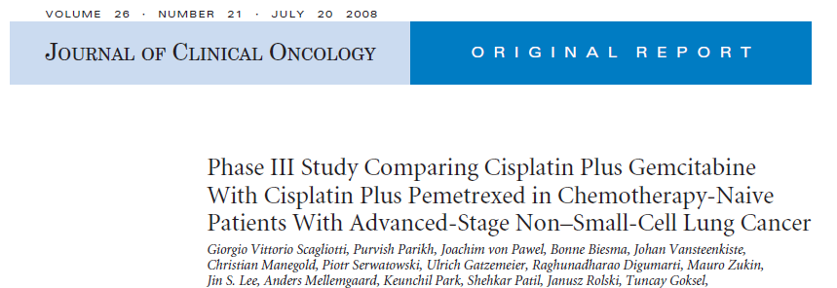
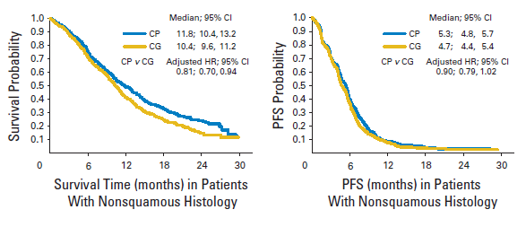
JMDB RCT

Slide 12
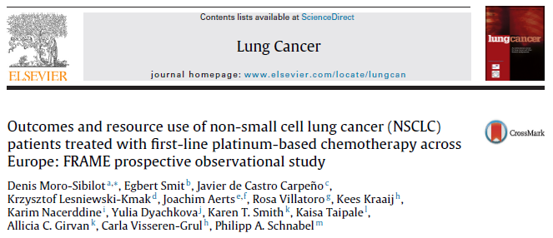
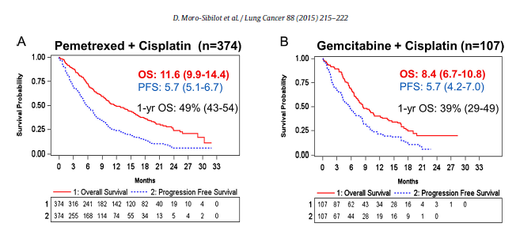
FRAME RWE

Slide 13
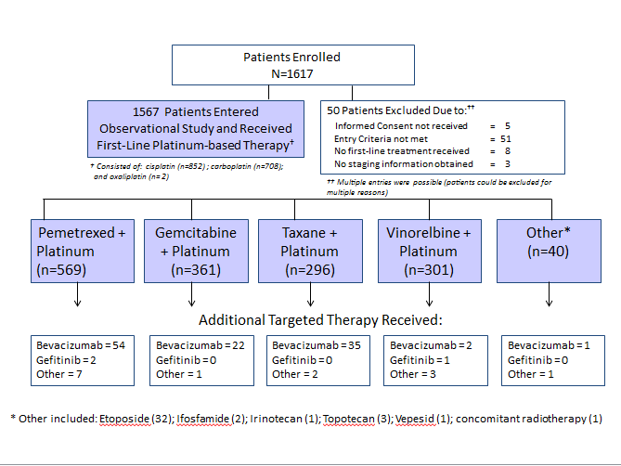
FRAME Patients

Slide 14
Reweighting GetReal case study

Slide 15


“Reweighting” Approach
JMDB
Weighting
FRAME-like
Female
Never smoked
Cardio medical History
66 years old
…
Male
Smoker
Prior Radiotherapy
74 years old
…

Slide 16
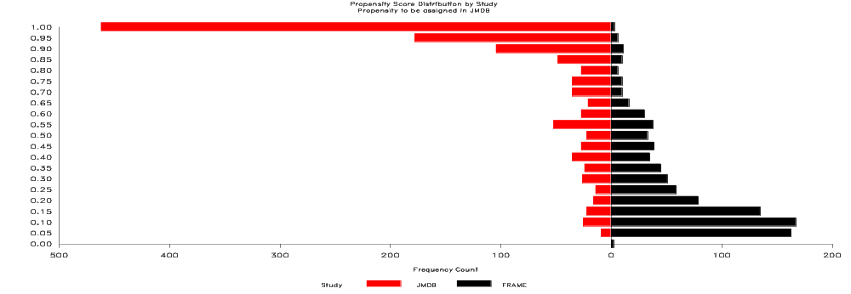
Propensity weighting
Propensity score model predicts participation in either RWE or RCT, given a set of covariates (RWE and RCT data are pooled for that purpose)
Resulting propensity scores are used to
  quantify the difference between the two cohorts, and
  match, subclassify or weight the RCT outcomes to the RWE population
„Classic“ propensity scoring often used to mimmick RCT in RWE setting. Here, propensity scoring is used to mimmick RWE in RCT setting.
Prior to launch, only baseline RWE information needed to assess RCT outcomes under RWE conditions

Slide 17
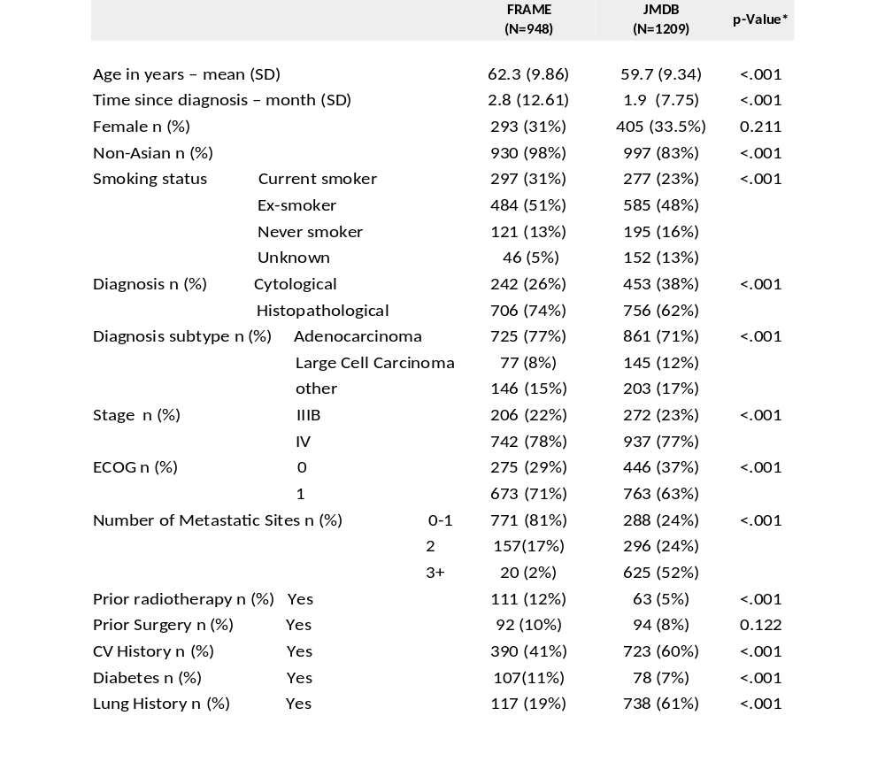
Baseline Characteristics
0.005
0.676

Slide 18
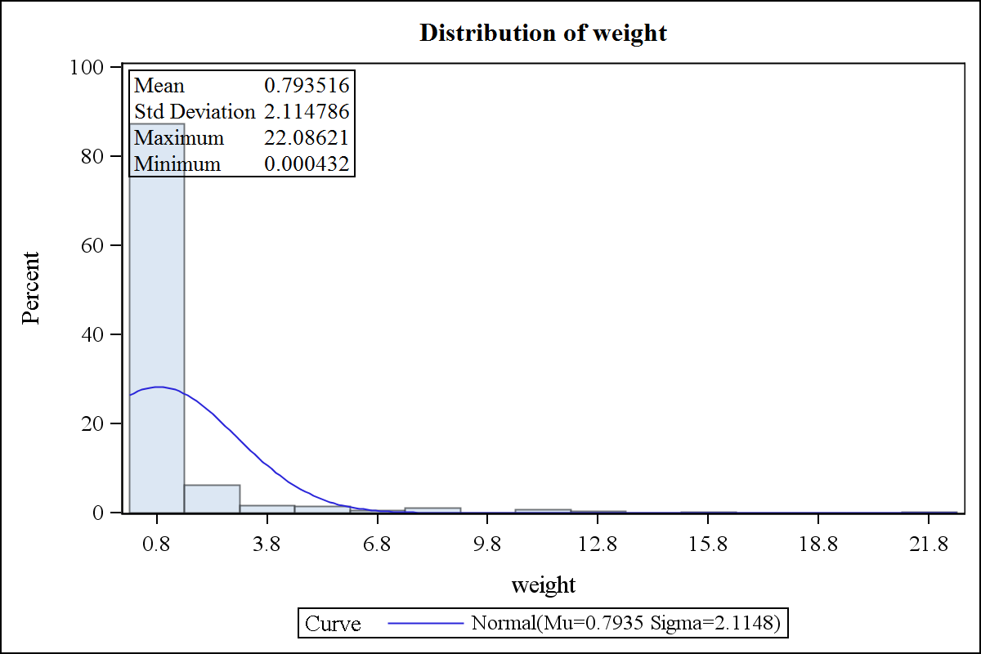
Distribution of weights
– weights to be assigned to JMDB (RCT)

Slide 19
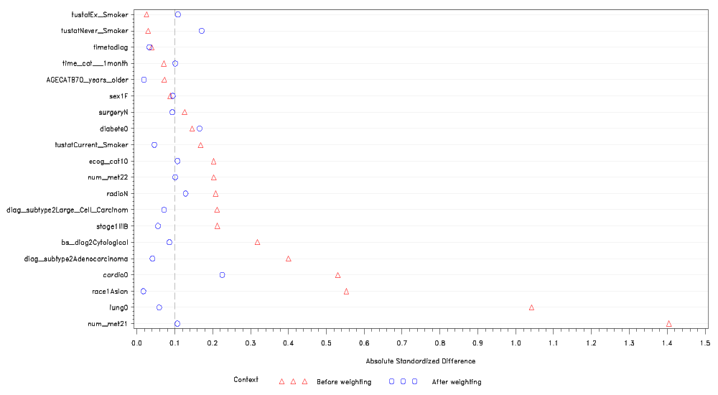
Standard. differences
Standardized difference plot for differences between studies JMDB and FRAME – propensity score weighting

Slide 20
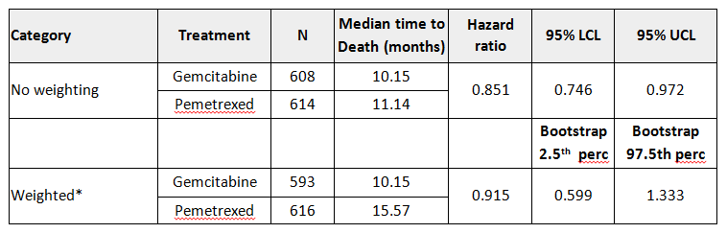
Primary analysis
➔ As reference JMDB (RCT) results:

Slide 21
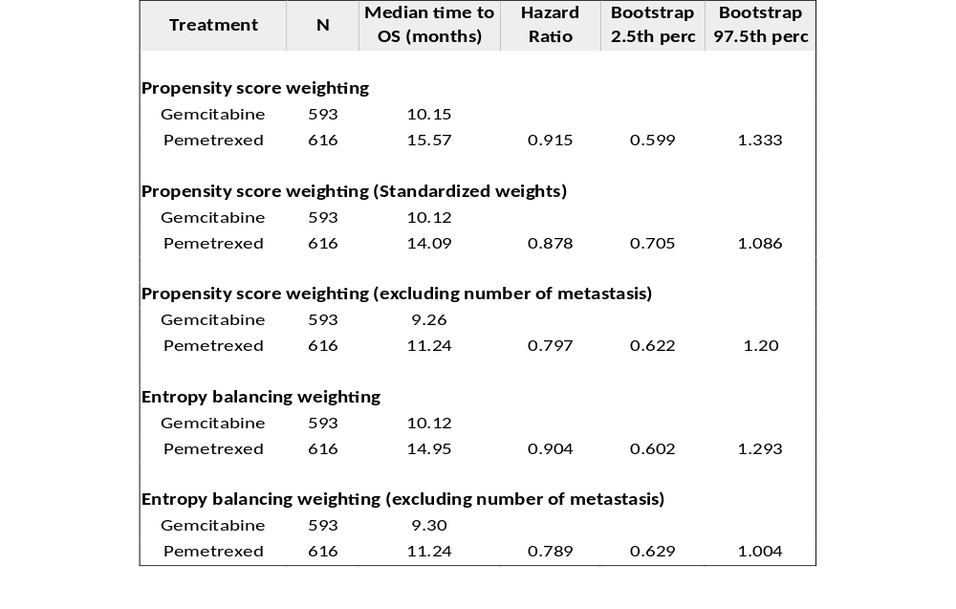
Sensitivity analysis
➔ fairly consistent results for HR
better balance comes at the expense of higher variability

Slide 22
Discussions
  Availability of observational data & varying variable definitions
  What is the target population in the absence of a label?
  What is level in evidence hierarchy?
  Do we break randomization?
  How to integrate dynamic aspects post baseline, eg adherence?
  How to handle imbalances?
  How to handle small RCT populations carrying substantial weight?

Slide 23

Challenges addressed?
Phase III trials too short to capture relevant effects, need to use models:
Considerable uncertainty in RWE predictions
RWE likely to be influenced by factors (adherence etc.) not captured in Phase III, model-based estimates unreliable:
RWE biased?
Phase III patient population poor fit for local population/general care received may not reflect care in HTA country:
RWE biased?
Phase III patient population too broad/poor fit to care pathway (?targeting of therapy):
Uncertainty in RWE for target sub-populations
Phase III comparator not appropriate for local HTA: indirect meta-analysis (for RWE) not robust:
No credible RWE estimate
Phase III trial event rates for comparator not in line with available RW evidence for comparator:
RWE biased?
✓
✓
?
✓
✓

Slide 24
Key questions
Could you envisage using these approaches in your decision making process?
What issues might stand in the way of adopting this approach?
Are there situations where this approach is particularly useful (or not at all useful)?
How can we communicate the implications of this approach to engage a broad range of stakeholders?

Slide 25
Back up

Slide 26
Data Issues
ISSUES
Specific categories of a variable are not available in RCT
Different definitions of a variable
Very distinct distributions of a variable
Unmeasured confounders
EXAMPLE
ECOG 2 and 3 found in FRAME, not present in JMDB
Basis of diagnosis has an extra option in FRAME
Number of Metastatic sites

