Slide 1
Genomics of Induced Tissue Regeneration
Ivan Labat, Ph. D.
Cell Signaling, Cell Therapy and Cancer Therapeutics
September 28th, 2017 Chicago, IL

Slide 2
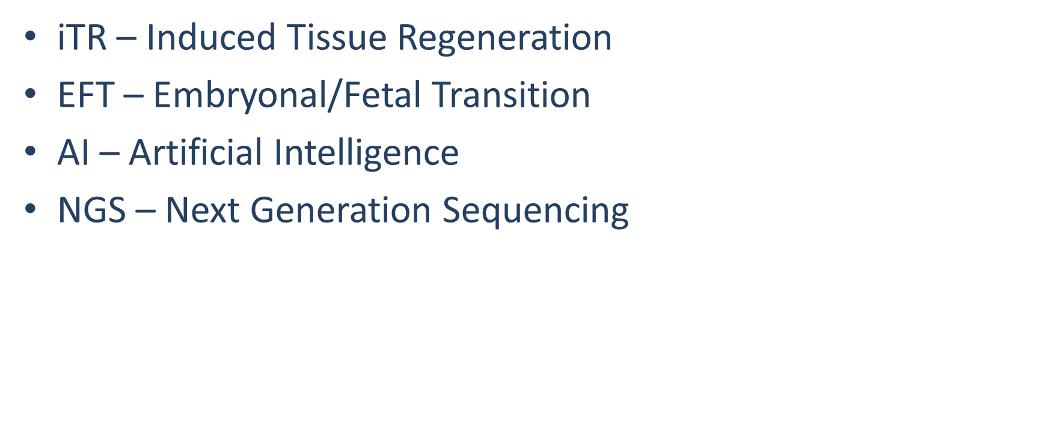
Acronyms
U.S. projected >80 yrs. old

Slide 3
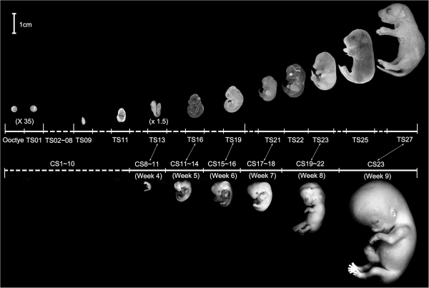
Timing of Mouse EF Transition
U.S. projected >80 yrs. old
EFT

Slide 4
Timing of Mouse EF Transition
U.S. projected >80 yrs. old
EFT

Slide 5
RNA Seq
BGI
U.S. projected >80 yrs. old
Sample | Total CleanReads | Total MappingRatio | Uniquely MappingRatio | Total GeneNumber | Known GeneNumber | Novel GeneNumber | Total TranscriptNumber | Known TranscriptNumber | Novel TranscriptNumber
E10 | 44347980 | 74.36% | 34.09% | 17906 | 17594 | 312 | 28641 | 20563 | 8078
E11 | 44815786 | 58.73% | 24.07% | 17270 | 17009 | 261 | 27609 | 19719 | 7890
E12 | 44562652 | 73.24% | 30.71% | 17492 | 17207 | 285 | 28366 | 20209 | 8157
E13 | 44788536 | 70.92% | 29.22% | 17509 | 17228 | 281 | 28499 | 20229 | 8270
E14 | 44831262 | 70.39% | 29.84% | 18084 | 17770 | 314 | 29142 | 20868 | 8274
E15 | 44779210 | 74.71% | 31.50% | 18165 | 17880 | 285 | 29587 | 21158 | 8429
E16 | 44822046 | 73.52% | 31.37% | 18308 | 17974 | 334 | 29784 | 21224 | 8560
E17 | 44804504 | 70.93% | 30.81% | 18424 | 18104 | 320 | 29753 | 21356 | 8397
E18 | 44743908 | 68.11% | 30.16% | 18595 | 18275 | 320 | 29853 | 21488 | 8365
MRSQ1 | 44869712 | 73.60% | 34.59% | 17104 | 16744 | 360 | 26165 | 18959 | 7206

Slide 6
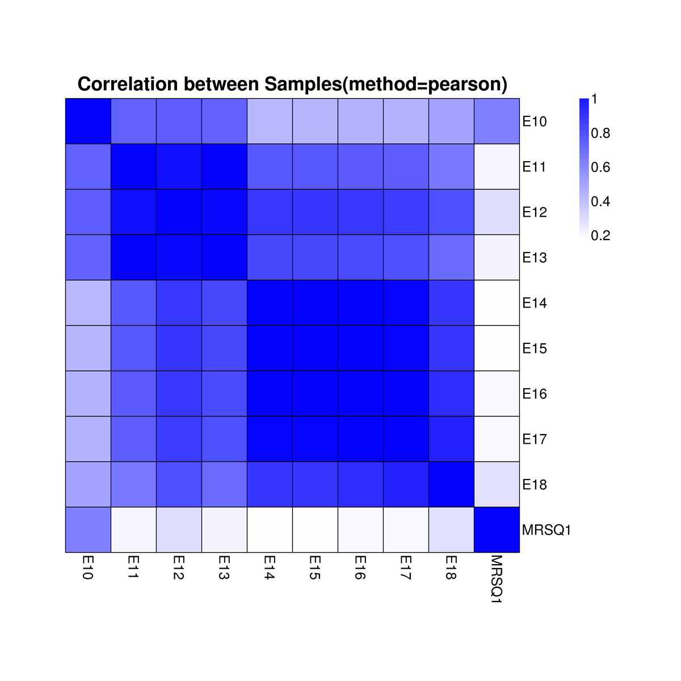
Mouse Embryo Samples Correlation
U.S. projected >80 yrs. old

Slide 7
Cox7a1 Transcription
U.S. projected >80 yrs. old

Slide 8
COX7A1 Transcription – Human Lines
U.S. projected >80 yrs. old

Slide 9
SSDE GENES E11-E13 vs E14-E16
U.S. projected >80 yrs. old
Upregulated | E11-E13 | E14-E16
Total | 653 | 2203
Secreted | 41 | 335
Transcription Factors | 193 | 82
Transcription Cofactors | 6 | 14
Chromatin Remodeling | 2 | 2
Selection Criteria:
genes are at least 2x differentially expressed
P value <= 0.025
Total FPKM are over 98.5% similar between the two groups

Slide 10
Afp Transcription
U.S. projected >80 yrs. old

Slide 11
Embryonal Globins Transcription
U.S. projected >80 yrs. old

Slide 12
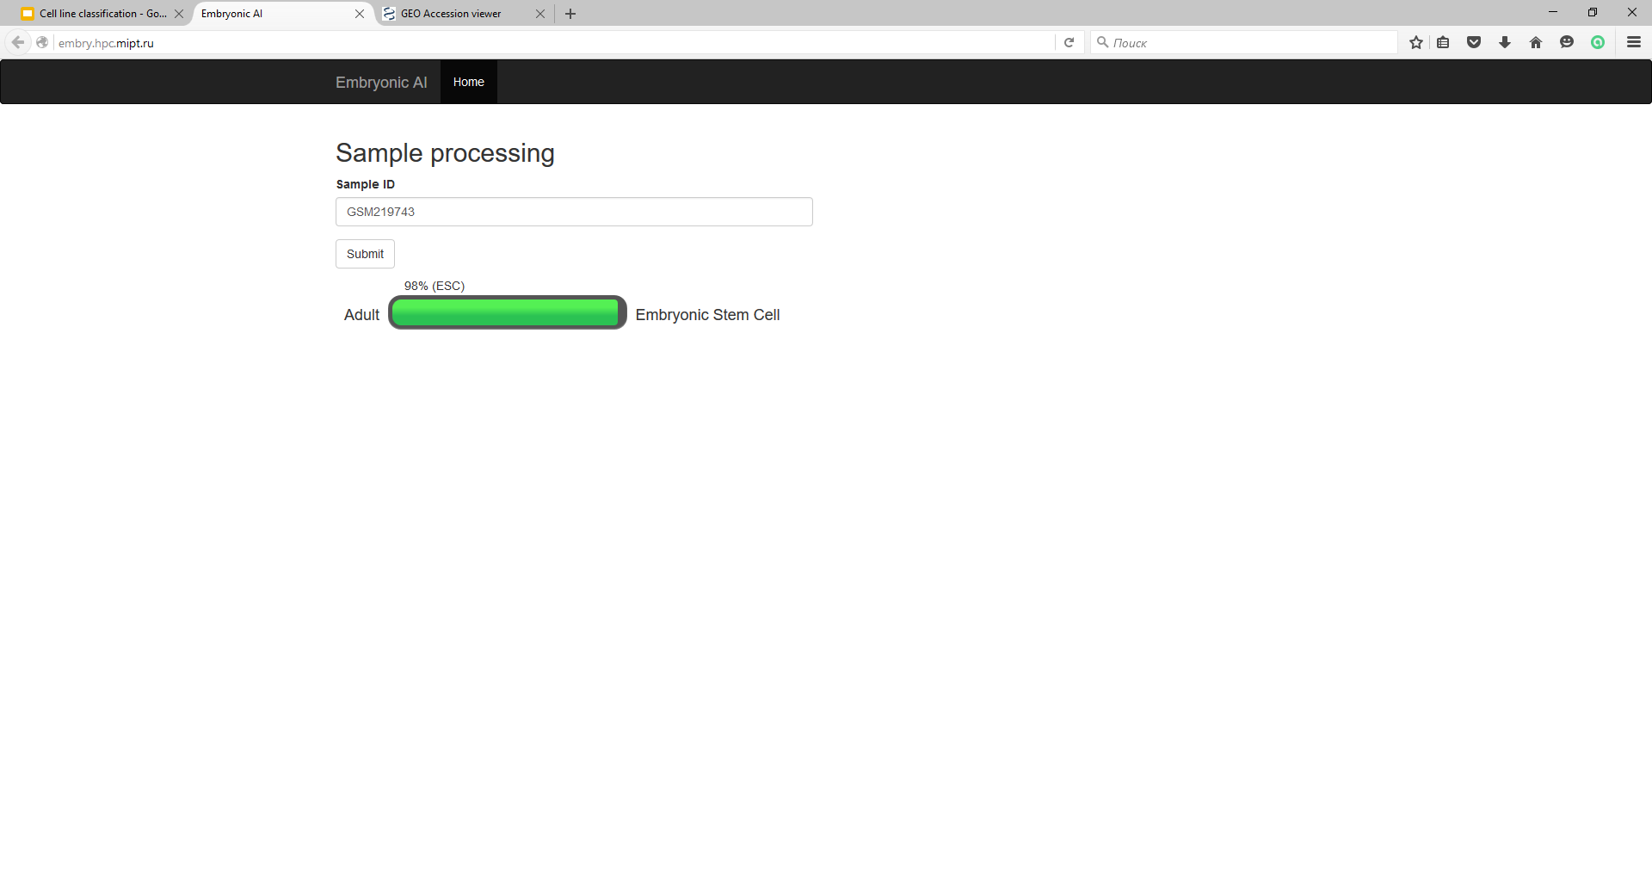
Embryonic AI (InSilico Medicine)
U.S. projected >80 yrs. old
Embryonic.AI

Slide 13
Embryonic AI (InSilico Medicine)
U.S. projected >80 yrs. old

Slide 14
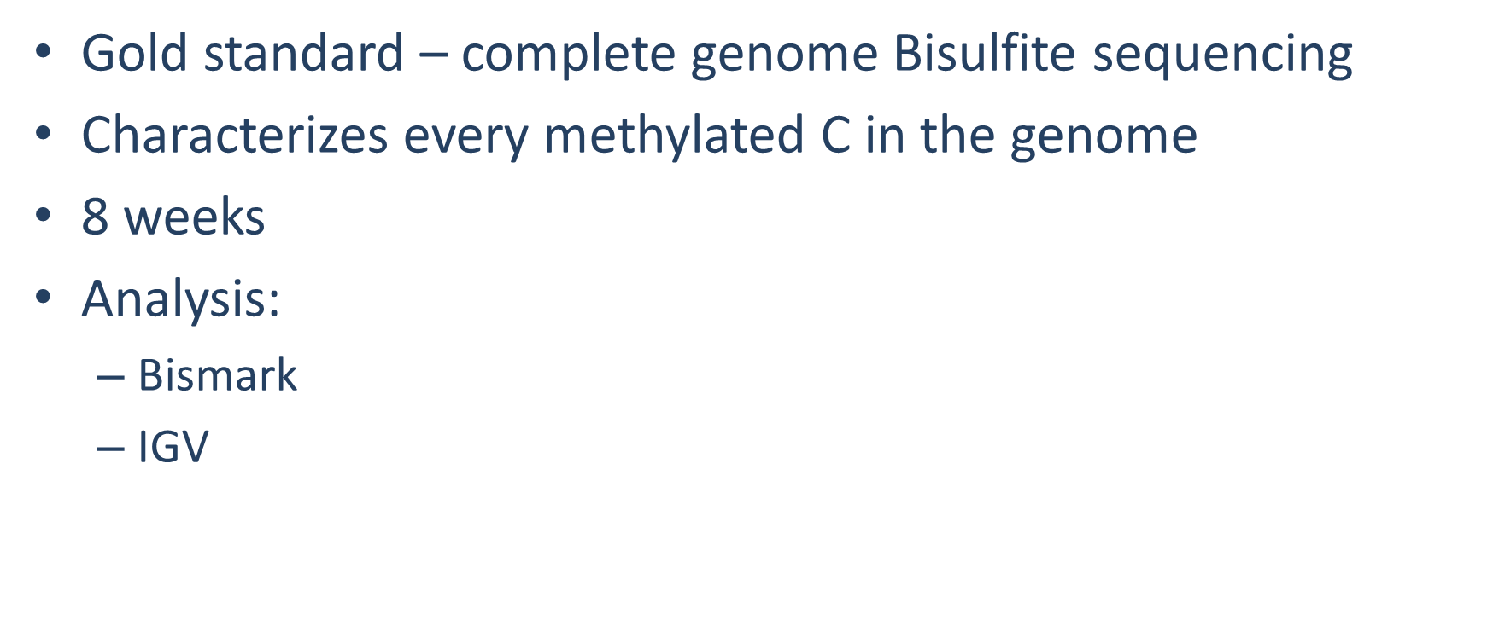
Methylome
U.S. projected >80 yrs. old

Slide 15
Cox7a1 Transcription
U.S. projected >80 yrs. old

Slide 16
COX7A1 Transcription – Human Lines
U.S. projected >80 yrs. old

Slide 17
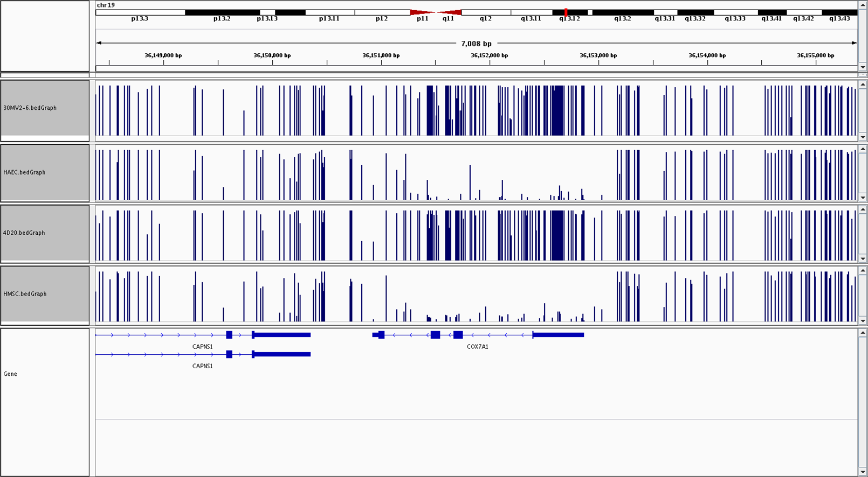
December 24th 2016, 04:30AM
U.S. projected >80 yrs. old

Slide 18
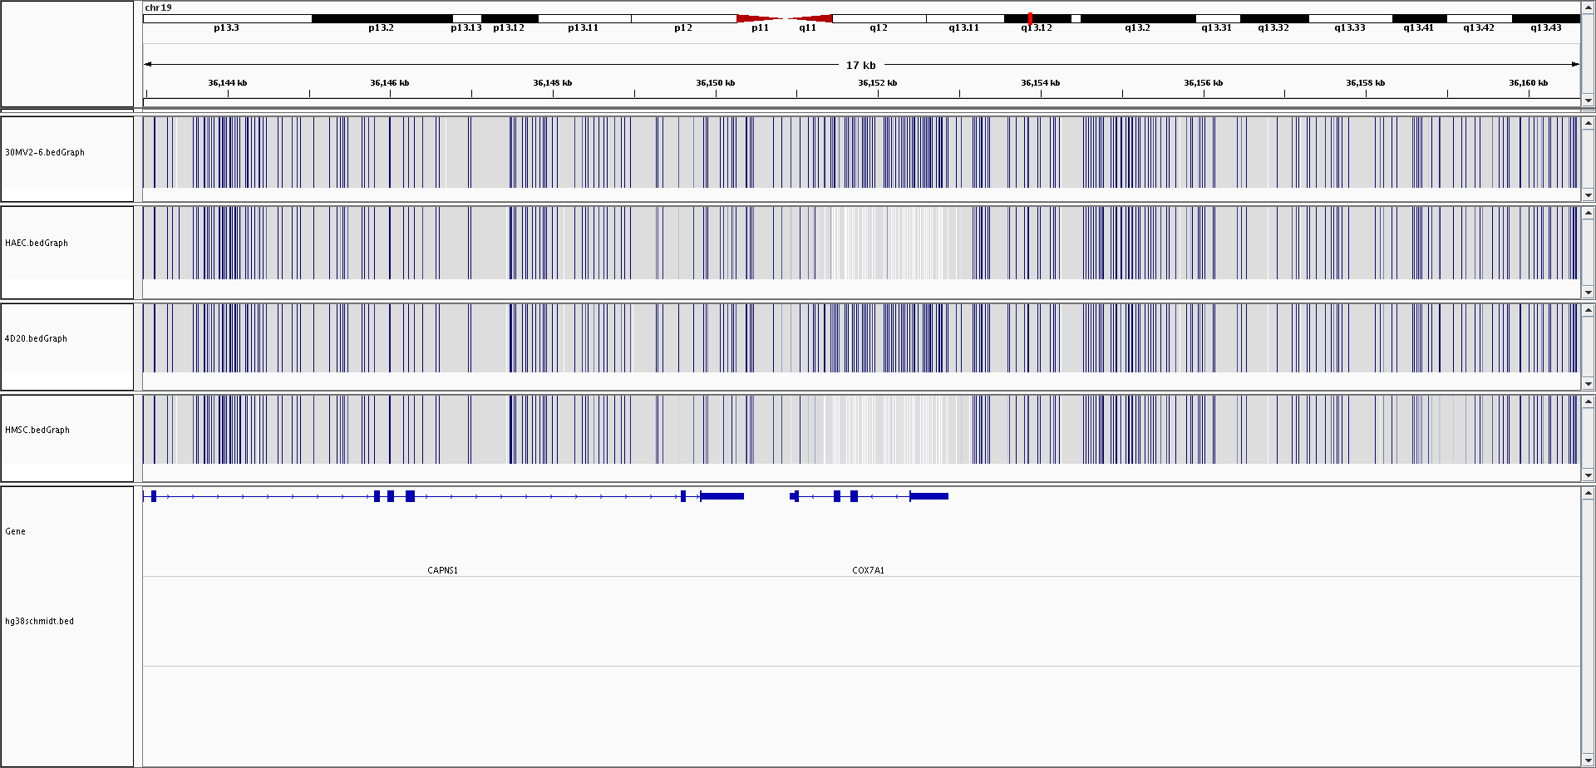
Heatmap View
U.S. projected >80 yrs. old

Slide 19
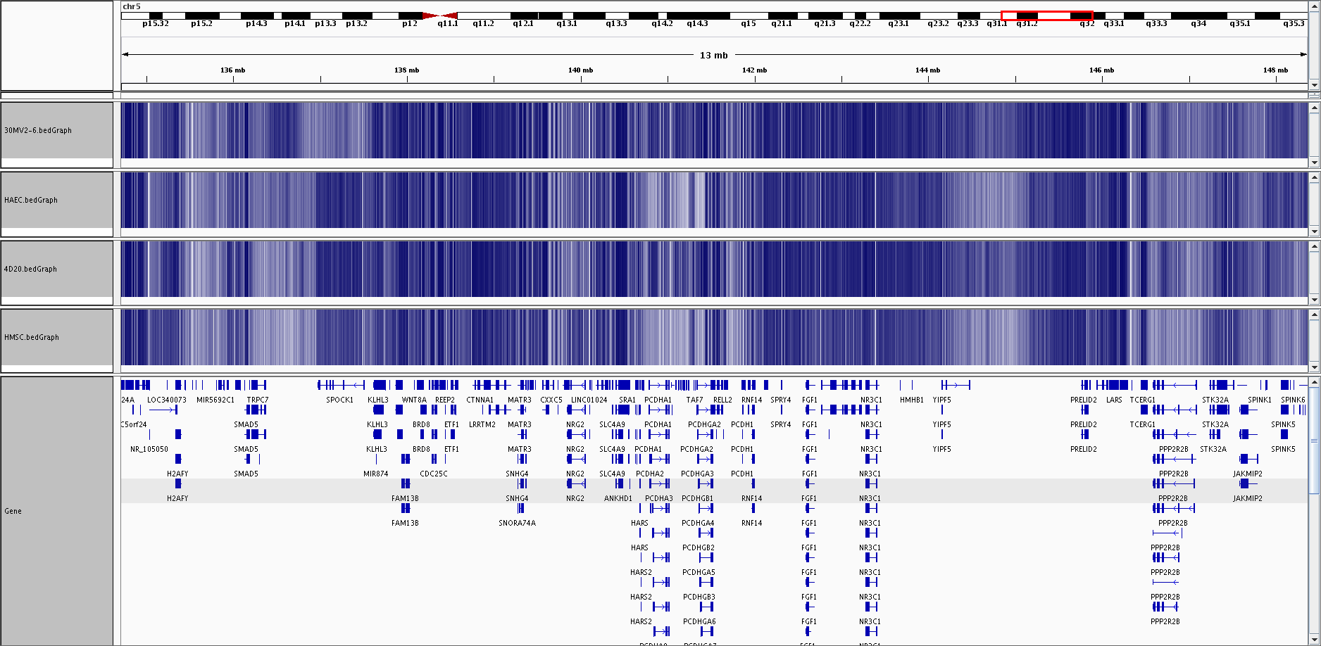
Heatmap View - PCDH
U.S. projected >80 yrs. old

Slide 20
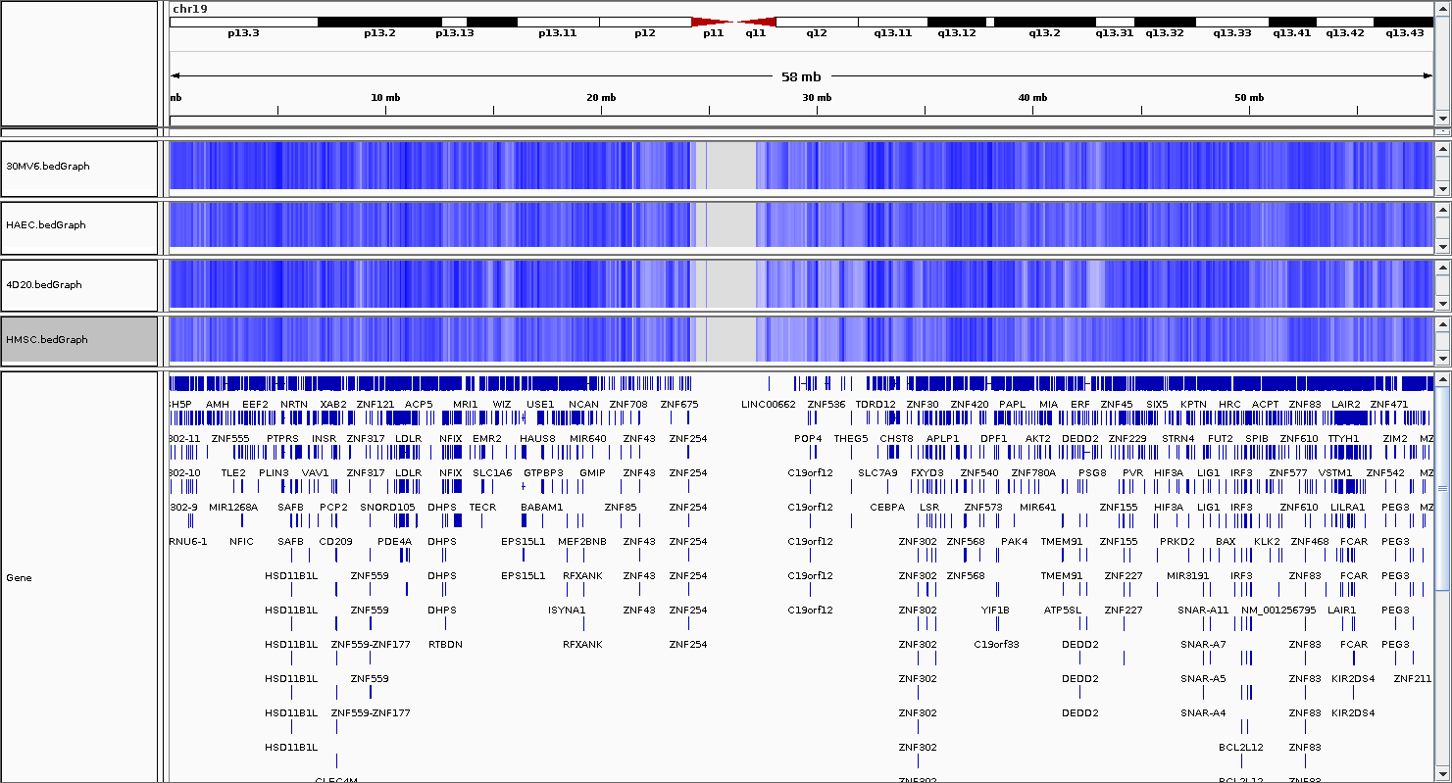
Heatmap View – Chr 19.
U.S. projected >80 yrs. old

Slide 21
Logistic Regression
Developed by David Cox in 1958
Estimates the probability of a binary response based on one or more predictors
Measures relationship between dependent variable and one or more independent variables
U.S. projected >80 yrs. old

Slide 22
A bit of a Detour
20,000+ independent variables
PCA – how many PC describe 90% of variables
In this case – 44
These 44 PCs are used as predictive variables
Dataset binarized to 0/1 values
Question – expression of which genes are best predictors of a phenotype
U.S. projected >80 yrs. old

Slide 23
Predictive Values
TOP |  |  | BOTTOM
Gene | Factor |  | Gene | Factor
PCDHA4 | 0.26637587 |  | NAALADL1 | -0.1783139
PCDHB10 | 0.25442442 |  | CCDC125 | -0.1797954
AMH | 0.25287965 |  | USP32P2 | -0.1825466
PCDHB9 | 0.21843975 |  | APOD | -0.1854934
RGPD2 | 0.2176779 |  | LINC00839 | -0.186106
LINC00649 | 0.21425788 |  | XAF1 | -0.1908669
PCDHB14 | 0.20954457 |  | GPAT2 | -0.1909055
PCDHB2 | 0.20112264 |  | CAT | -0.2043789
CHRM3 | 0.20094598 |  | PCDHGA6 | -0.2051238
SPTLC3 | 0.19883574 |  | PTCHD3P1 | -0.2178673
RHOU | 0.19647146 |  | TRIM4 | -0.2178673
RGPD1 | 0.19217207 |  | MMP17 | -0.2185574
SPINK5 | 0.19216519 |  | PLPP7 | -0.2194865
ALDH5A1 | 0.19019774 |  | PCDHGA2 | -0.2239592
ZCCHC18 | 0.18272886 |  | CALHM2 | -0.2261725
LINC01021 | 0.18058191 |  | URB1.AS1 | -0.2314156
C1orf204 | 0.17724313 |  | MEG3 | -0.2468363
GLUD1P3 | 0.17372586 |  | PCDHGA12 | -0.2712973
PSTK | 0.17200638 |  | PCDHGB5 | -0.282056
FAR2P1 | 0.16817121 |  | COX7A1 | -0.2926597

Slide 24
A bit of a Detour
Mike West
Hal Sternberg
Aubrey de Grey
David Larocca
Jake Larocca
U.S. projected >80 yrs. old

