Slide 1
Laboratory induced estradiol exposure stimulates transcriptional responses in the sea anemone Exaiptasia pallida
Michael B. Morgan, PhD
Berry College
Mount Berry, GA. USA

Slide 2
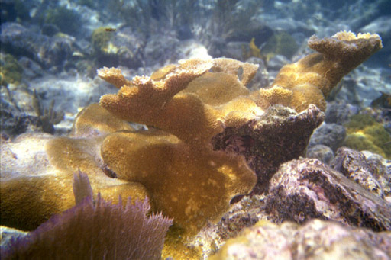
Many stressors impact corals
Nutrient loading
Pesticides, metals,
& organic toxicants
Temperature
Variable salinity
UV stress
Hurricanes
Disease
Grazing
Sedimentation

Slide 3
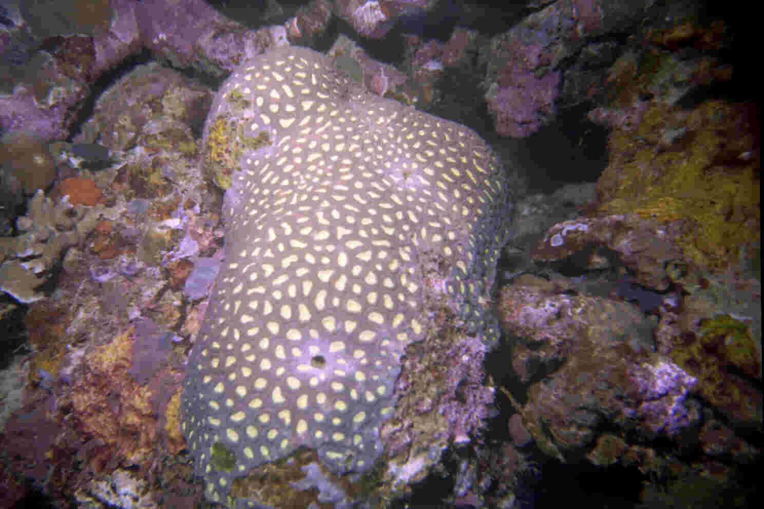
Numerous physiological assessment methods
Photosynthesis/Respiration ratio
Bleaching
Larval development
and recruitment
Growth
Chlorophyll a
Respiration rate
Protein production

Slide 4
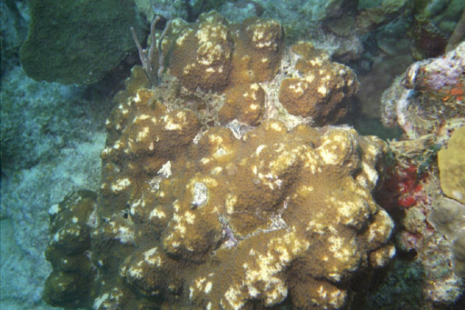
Drawbacks of current assessment methods:
They provide no insight into the nature of the stressor
Cannot prioritize which stressor is inducing the physiological response
UV exposure
Pesticides
Heavy metals
Temperature
Sedimentation
Herbicides

Slide 5
Transcriptional profiling
Has become technically feasible
Stressor-induced genes
  only small portion of genome
  define specific pathways activated by stress
  can be unique signatures of the stressors
Assumes dissimilar responses will lead to different profiles for sub-lethal stress exposures

Slide 6
Stress Gene Expression in Model Eukaryotes
Saccharomyces
cerevisiae
Caenorhabditis elegans
Drosophila melanogaster
Total Genes
6,241
19,099
13,601
Genes Regulated by Stress
900 (14%)
611 (6%)
223 (4.3%)
Gasch et al 2000
Hill et al 2000
Adams et al 2000

Slide 7
Why investigate Estradiol & Exaiptasia?
Estradiol is released into the water column in association with anthozoan spawning
hormonal signaling and bioregulatory pathways are largely uncharacterized in cnidarians
Exaiptasia
  easily maintained in lab
  movement to establish as laboratory model
  No estrogen receptors in cnidarian genomes

Slide 8
Research approach
Anemones were exposed to 20ppb Estradiol for 4 hrs in the lab
Control treatment was also 4 hrs in the lab
Performed Representational Difference Analysis (RDA)
Genes of interest (GOIs) provide sequence information necessary to develop primers for qPCR

Slide 9
Representational Difference Analysis (RDA)
A modified form of Subtractive Hybridization
Can selectively enrich for rarer transcripts
Has a greater probability of amplifying coding regions of expressed genes.
Capable of simultaneously isolating genes that are both up & down-regulated
Products can be basis for developing gene targets for microarray or qPCR assays

Slide 10
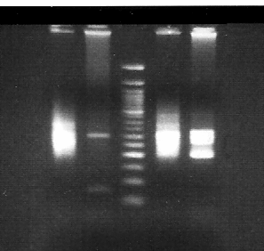
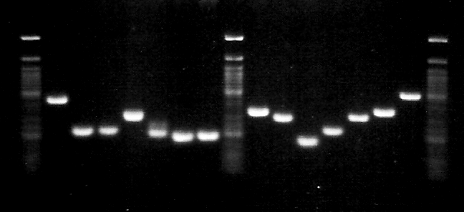
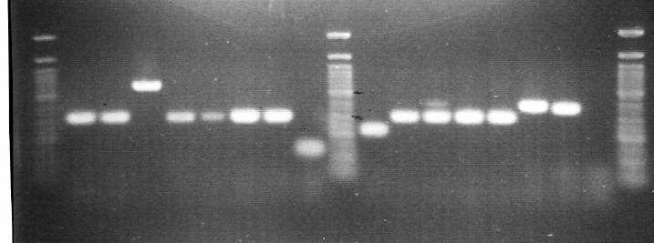
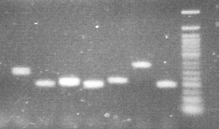
Results from two rounds of
RDA hybridizations
4 hr exposure
20ug/L
Estradiol
Control
Up-regulated
exposed
Round 1
Up-regulated
exposed
Round 2
Down-regulated
control
Round 2

Slide 11
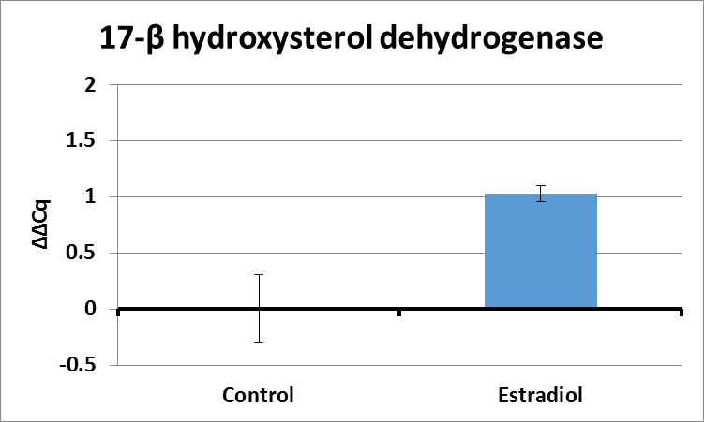
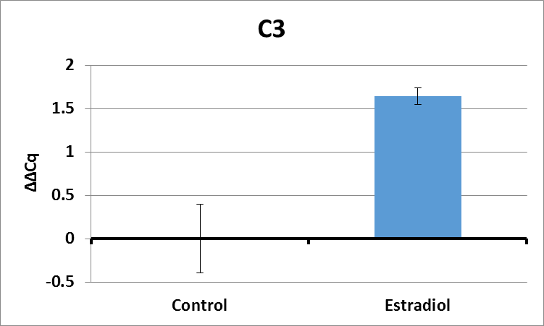
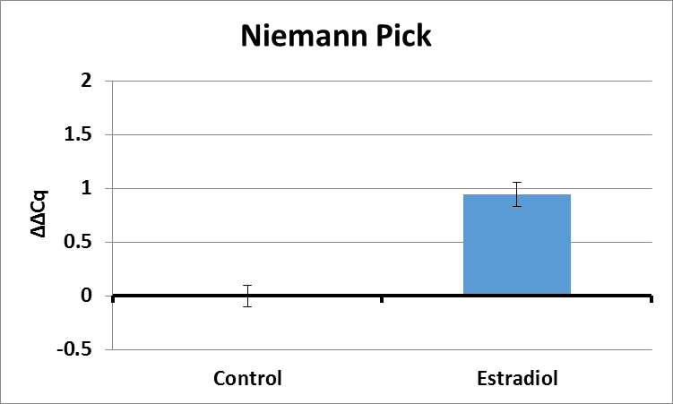
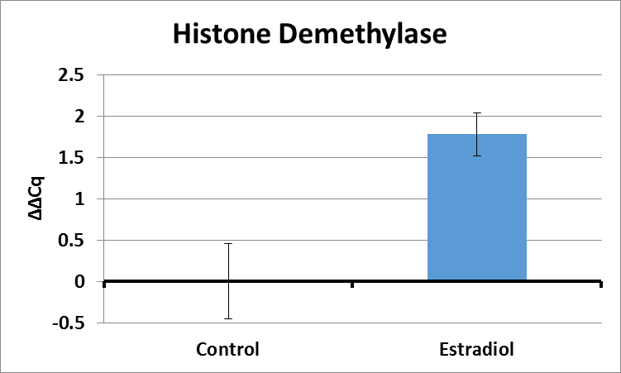

Slide 12
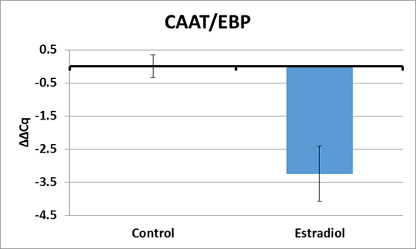
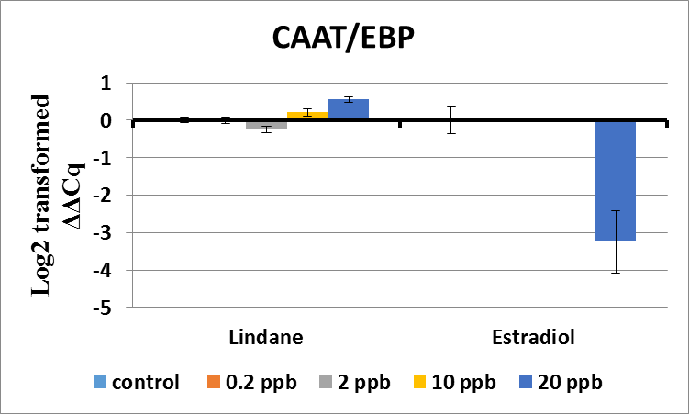

Slide 13
CAAT/Enhancer binding protein
Member of bZIP superfamily of Transcription Factors
Regulates metamorphosis, along with nerve cell development in the hydrozoan jellyfish Podocoryne carnea
An essential regulatory enzyme in the antioxidant pathway essential for the maintenance of homeostasis and prevention of oxidative injury during environmental stress.
Implicated in control of UDP glucuronosyl transferase xenobiotic transformation by activating responding genes
Oxidative stress disrupts normal cytoplasmic distribution, allowing TF to localize to the nucleus where it activates response elements necessary for environmental stress tolerance.

Slide 14
17-β Hydroxysteroid Dehydrogenase
Elevated levels suggest possible conversion to other sterols

Slide 15
Neimann Pick C
Critical mediator in cholesterol absorption
Functions as a sterol transporter
NPC knockouts in mice results in the reduction of estradiol into the cell
In cnidarians, known to play role in endosymbiosis with zooxanthellae

Slide 16
Histone Demethylase
Is a mediator of estrogen-induced growth
Representative of epigenetic changes
  Genome is the “hardware” while the epigenome is “software” that runs the system
Epigenetics are ways the environment can program the genome

Slide 17
C3
Known to be involved in both adaptive and innate immune response systems.
Cnidarian C3-like proteins are known to be induced in response to injury.
Represents a links between immunity and development

Slide 18
Summary of probable functions
NPC transports sterols
17β-HSD modifies sterols
Histone demethylase alters genome accessibility
CAAT/EBP stimulated by oxidative stress
C3 representative of innate immune responses

Slide 19
Next step
Dose-responses to determine if these response can be at environmentally relevant concentrations.
Post-exposure recovery
Comparison between difference species

Slide 20
Conclusions
There are detectable signals in anemones exposed to estradiol compared to unexposed anemones.
A set of estrogen-responsive genes can serve as a biomarker of environmental exposure to xenoestrogens.
Utilizing RDA represents a small-scale alternative to whole transcriptome analyses.
Presently, unknown if these changes are reversible or how long are they evident.
Many human pharmaceuticals have been detected in treated sewage effluent. It seems probable that different suites of GOIs might be capable of discerning different classes of pharmaceuticals

Slide 21




