Slide 1
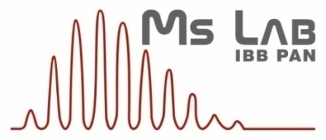
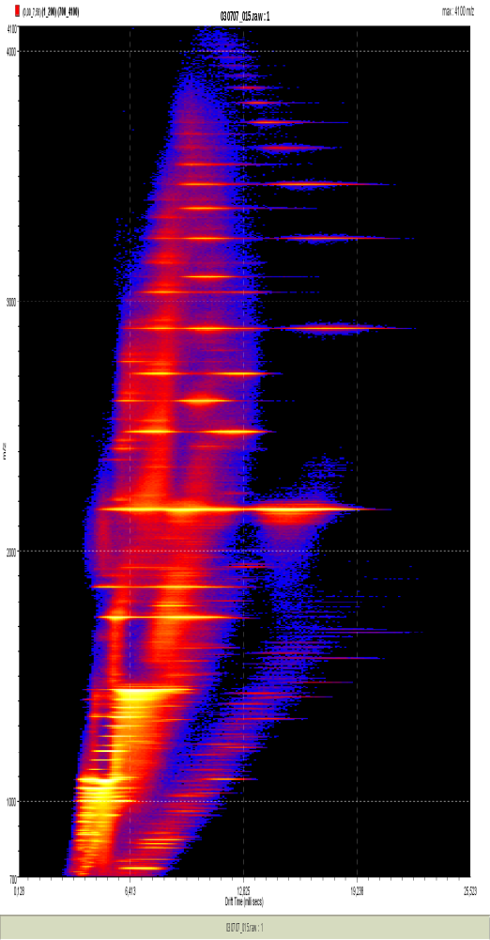
Ion Mobility Separation
coupled with Mass Spectrometry detects alternative structural forms of Aβ oligomers
Michał Dadlez
&
Marcin Kłoniecki,
Ewa Sitkiewcz,
Jarosław Poznański,
Wojciech Bal
James Langridge (Waters),
New Orleans, 14 July 2015

Slide 2
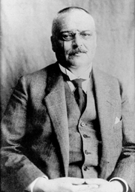


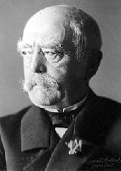
109 years of Alzheimer’s disease
Alzheimer’s disease is the disease
of ageing societies.
30 mln people affected worldwide,
number expected to triplicate until 2050.
No cure available at present.
Alois Alzheimer
1864 - 1915
1889 - Otto von Bismarck – first retirement plan
introduced in Prussia for infrequent cases
of people older than 70!

Slide 3
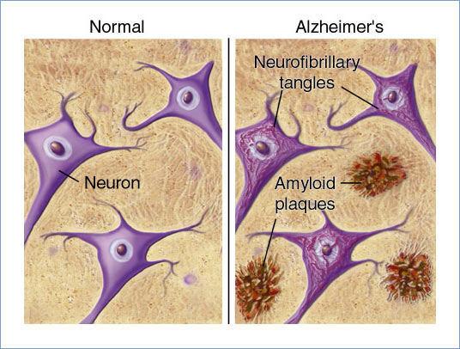
Alzheimer’s postmortem findings – histopathological AD hallmarks
From: www.ahaf.org
Amyloid = starch-like - AD is an amyloidosis, but no starch involved

Slide 4
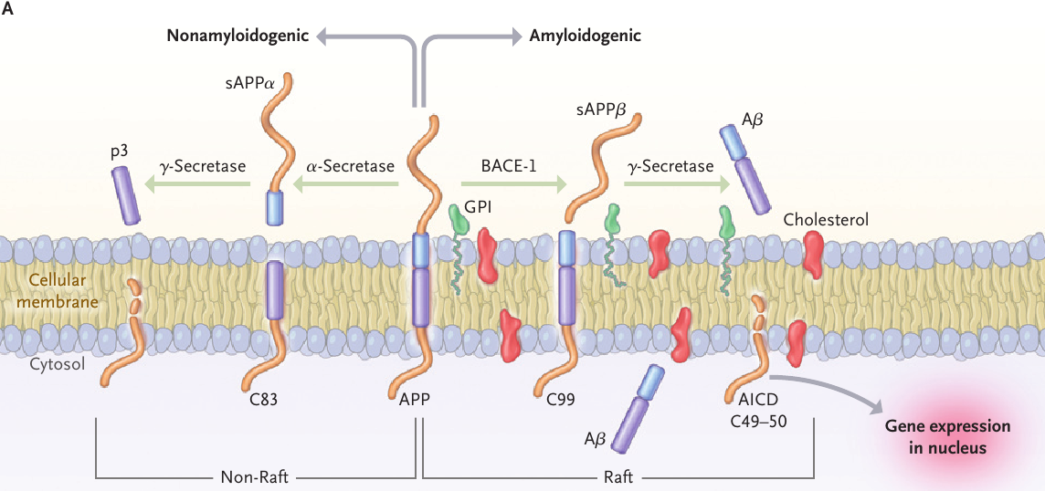
Amyloidogenic proteolysis of APP protein generates Aβ peptide
From:Querfurth, LaFerla 2010

Slide 5
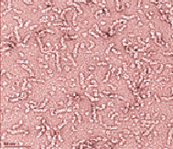
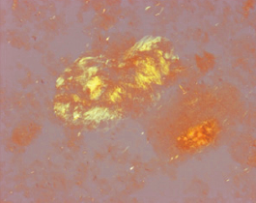
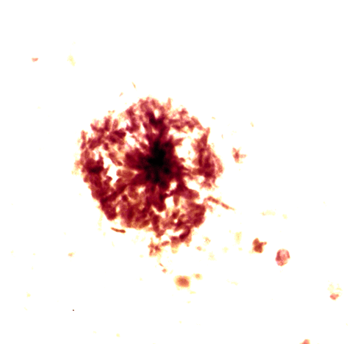
Aggregation of Aβ bifurcates into off-pathway oligomeric species
Aβ
Oligomers
Protofibrils
Neurotoxic/synaptotoxic oligomeric species
Fibrils
November ‘2014:
“..structural motifs and quaternary structures
of these Aβ oligomers are unknown…”
From: Lesne SE. (2014) Toxic oligomer species
of amyloid-β in Alzheimer's disease, a timing issue.
Swiss Med Wkly. Nov 6, 144, w14021
Amyloid plaques

Slide 6
Aβ spans 40 or 42 aa
1 5 10 15 20 25 30 35 40 42
K M D A E F R H D S G Y E V H H Q K LV F F A E D V G S N K G A I I G L M V G G V V I A T V I V I T L V M L K K K Q
Aβ
NH₂
COOH
β-APP
770 aa
Aβ1-40 sequence:
DAEFRHDSGYEVHHQKLVFFAEDVGSNKGAIIGLMVGGV

Slide 7
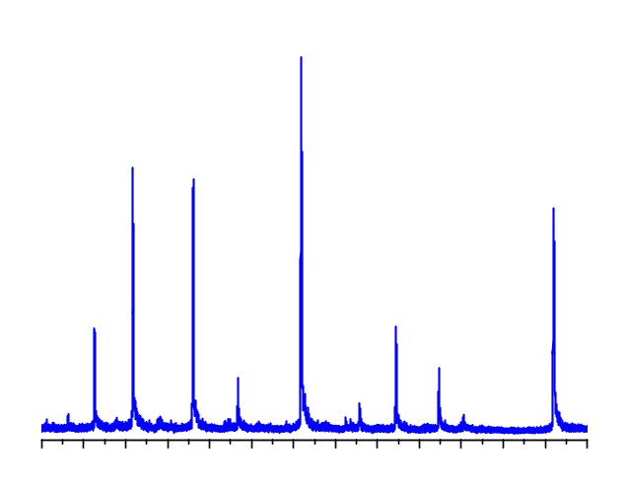
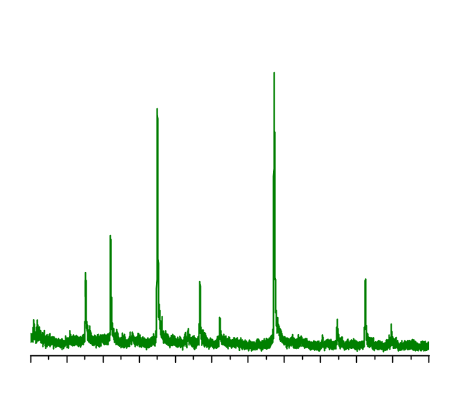
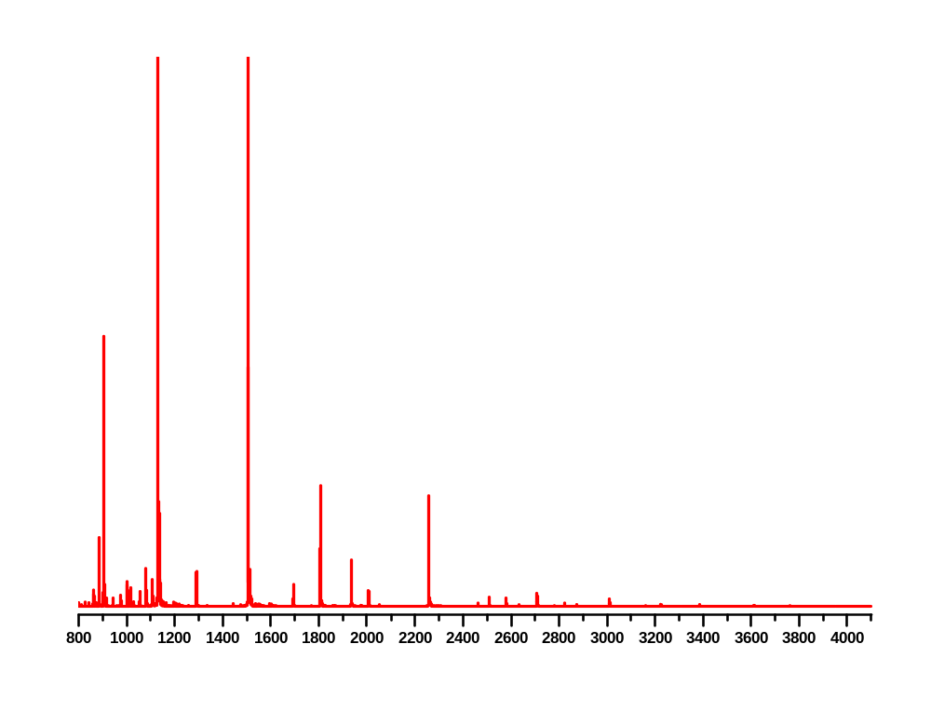
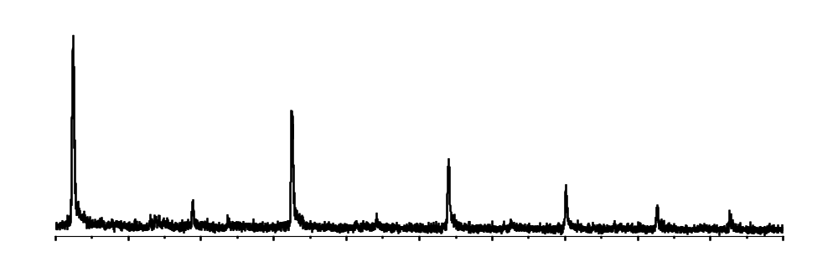
ESI-MS detects multiple oligomeric forms of Aβ peptide
TRI⁵⁺
PEN⁷⁺
TRI⁴⁺
PEN⁹⁺
TET⁷⁺
MON⁴⁺
MON³⁺
DIM³⁺
HEP¹⁰⁺
HEX¹¹⁺
PEN⁸⁺
NON¹³⁺
OCT¹¹⁺
HEP⁹⁺
HEP¹²⁺
HEP¹¹⁺
UDC¹⁵⁺
DEC¹³⁺
HEP¹³⁺
OCT¹³⁺
NON¹⁴⁺
TDC¹⁷⁺
UDC¹⁴⁺
2400
2500
2600
2700
2800
MON²⁺
m/z
2900
3000
3100
3200
3300
3400
3500
3600
m/z
DIM⁴⁺
TET⁵⁺
PEN⁶⁺
MON⁵⁺
HEX⁷⁺
NON¹¹⁺
UDC¹³⁺
HEP⁸⁺
OCT⁹⁺
NON¹⁰⁺
TEDC¹⁷⁺
TDC¹⁵⁺
2164
3600
2166
3700
2168
3800
3900
4000
4100
m/z
DIM⁵⁺
MON²⁺
DIM⁴⁺
DIM⁷⁺
TRI⁷⁺
TRI⁵⁺
TRI⁸⁺
TET⁹⁺
PEN⁹⁺
TET⁷⁺
PEN⁸⁺
DIM³⁺
HEX¹¹⁺

Slide 8
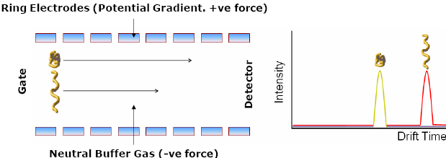
Ion Mobility provides additional separation according to drift time
and allows to measure the collisional cross-section (Ω)
www.waters.com

Slide 9
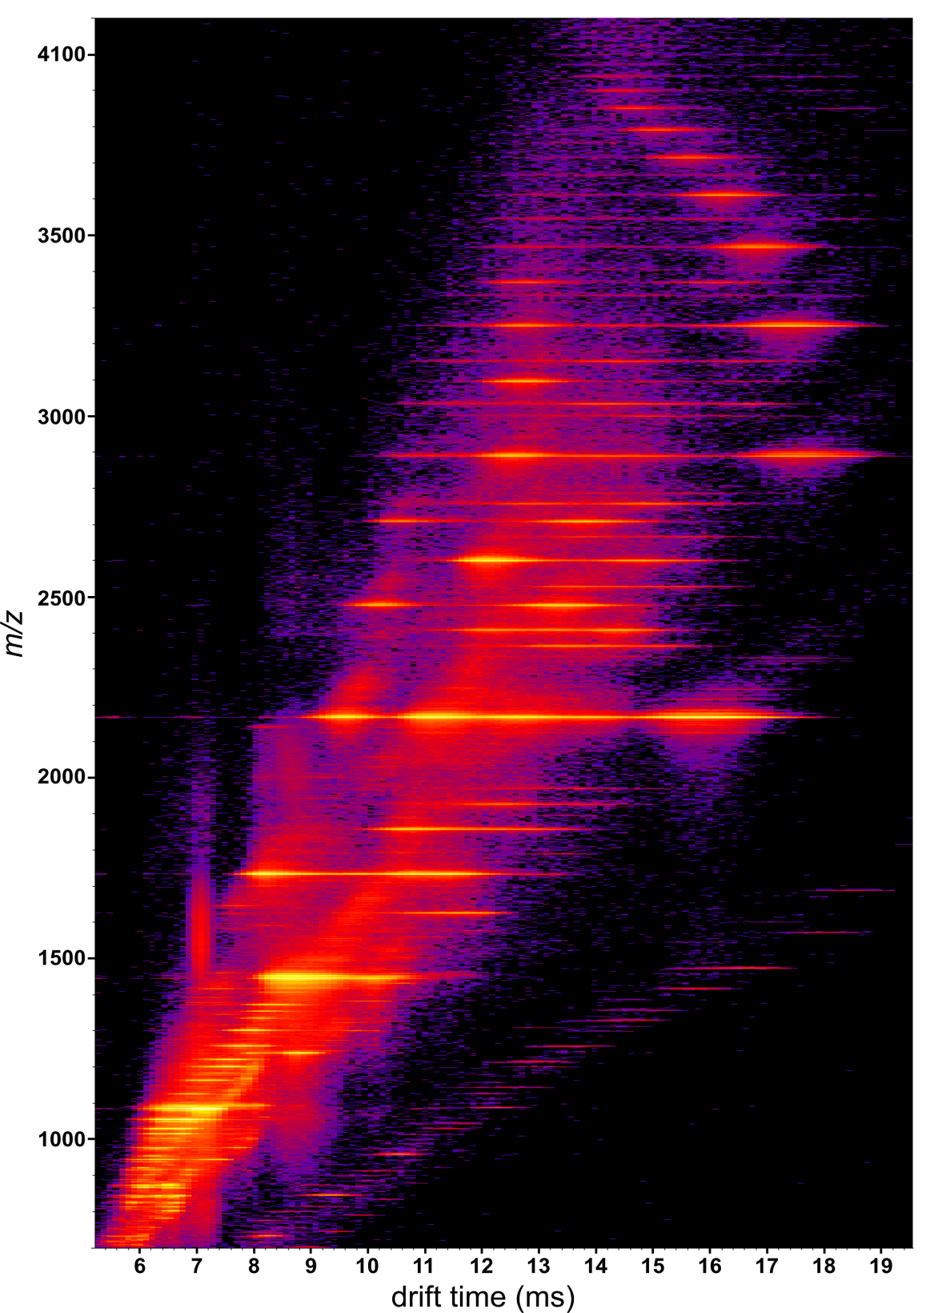
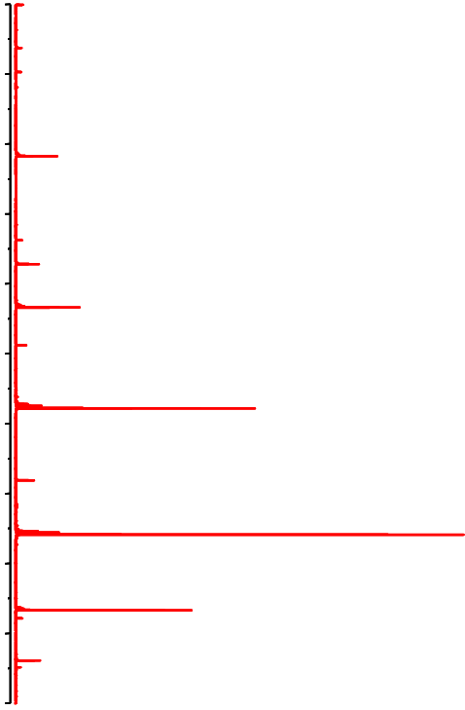
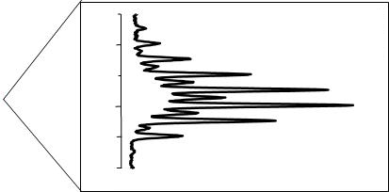
Iso-m/z signals get resolved in drift time dimension
2600
MON²⁺
2168
DIM⁴⁺
2200
2+
2166
2164
1800
m/z
3+
1400
4+
1000
5+
6+
600

Slide 10
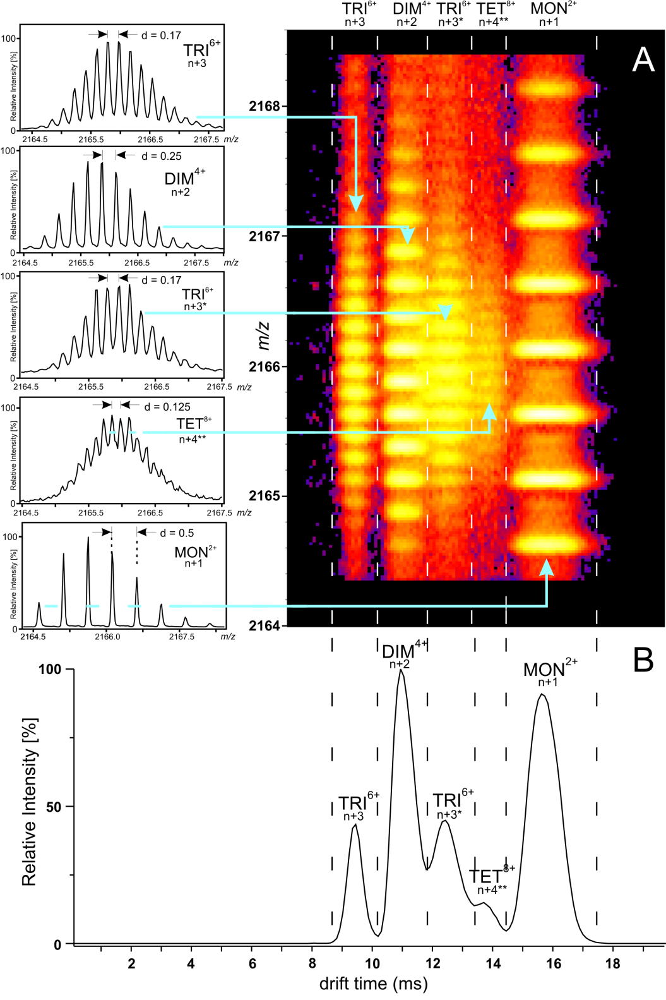


Detail at 2166 m/z
From:
Kłoniecki et al. (2011) J.Mol.Biol. 407, 110-24

Slide 11
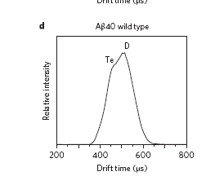
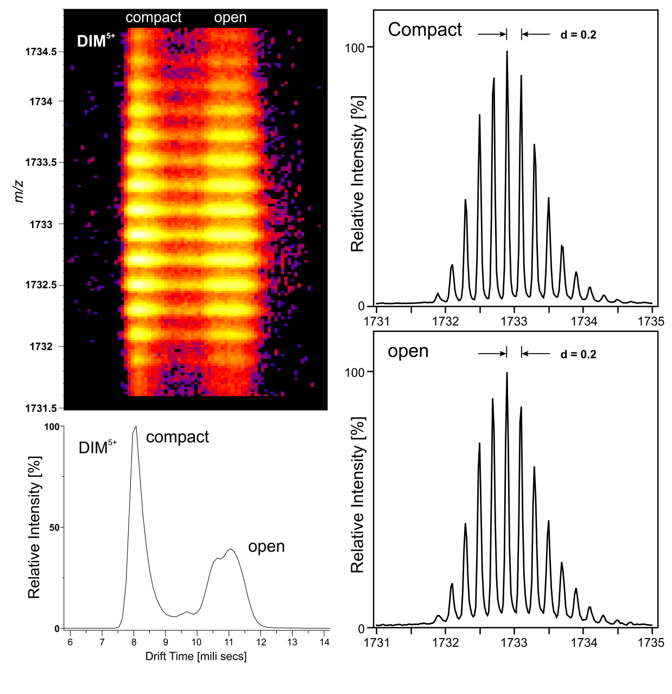
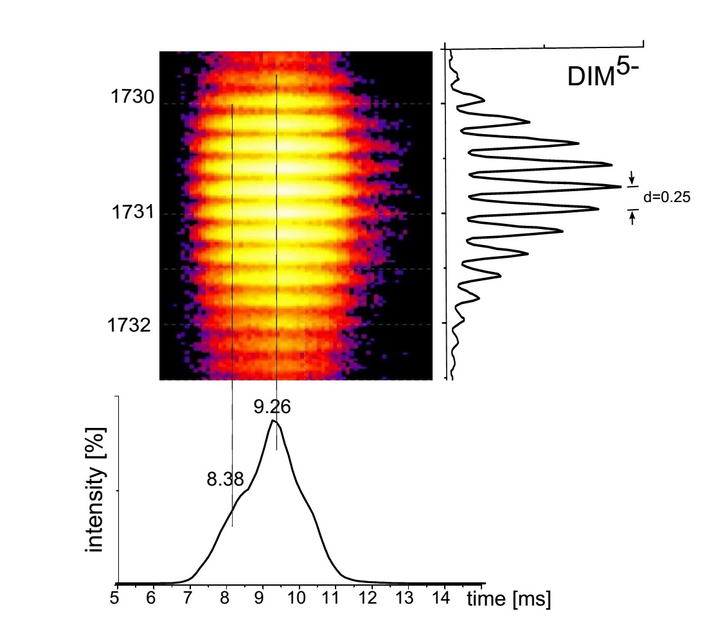
The dimeric signal is also split…..
„Amyloid-β protein oligomerization and the importance of tetramers and dodecamers in the aetiology of Alzheimer’s disease”
Bernstein, et al. Nature Chemistry 1 (2009) 326
Notes:
Bowers group

Slide 12
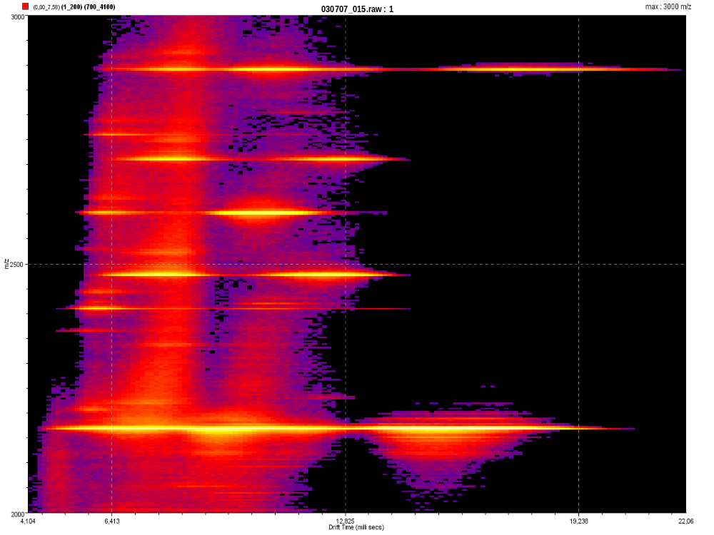
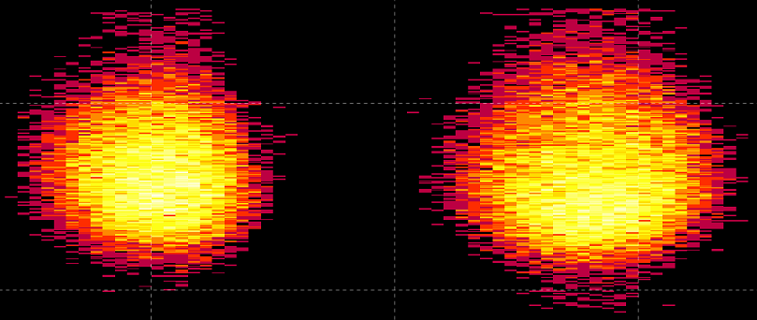
Many peaks are split into two forms: compact and extended
HEX⁹⁺
TET⁶⁺
DIM³⁺
Signals corresponding to two TET⁷⁺ conformers
2476
HEP¹¹⁺
PEN⁸⁺
PEN⁸⁺
m/z
2475
HEX¹⁰⁺
TRI⁵⁺
m/z
HEP¹²⁺
2474
6.42
7.7
8.98
10.26
11.54
12.82
14.1
Drift time [ms]
TET⁷⁺
TET⁷⁺
100
PEN⁹⁺
[%]
HEX¹¹⁺
50
0
6.42
7.7
8.98
12.82
14.1
TET⁸⁺
TRI⁶⁺
DIM⁴⁺
MON²⁺
Drift time [ms]
Czas przelotu [ms]

Slide 13
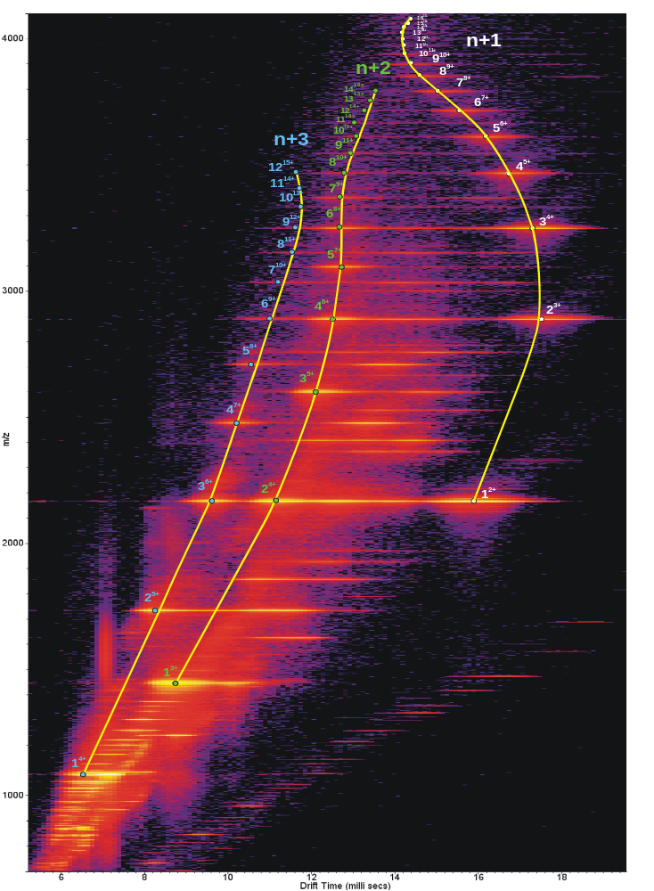
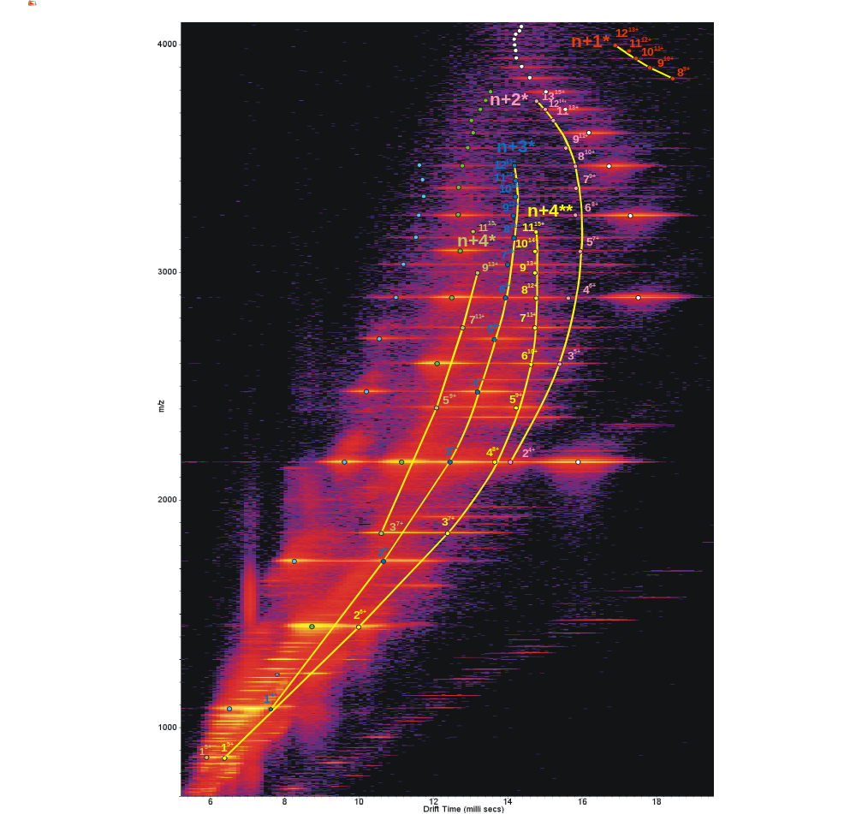
Signals are assigned either to compact series or extended series
Signals were assigned
either to compact
or extened series

Slide 14
Drift time to collisional cross-section (Ω) conversion
Drift time (t_{D}) is linked to the Ω value by a simple formula:
t_{D} ^{X} = c*Ω/q
where:
t_{D} – measured drift time
X – empirically estimated exponent
q – molecular charge
Ω – collisional cross-section
c – constant remaining unchanged in a single experiment.

Slide 15
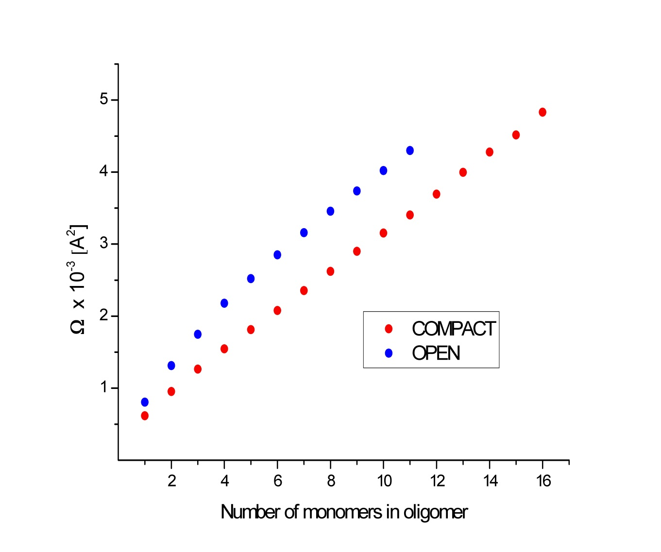
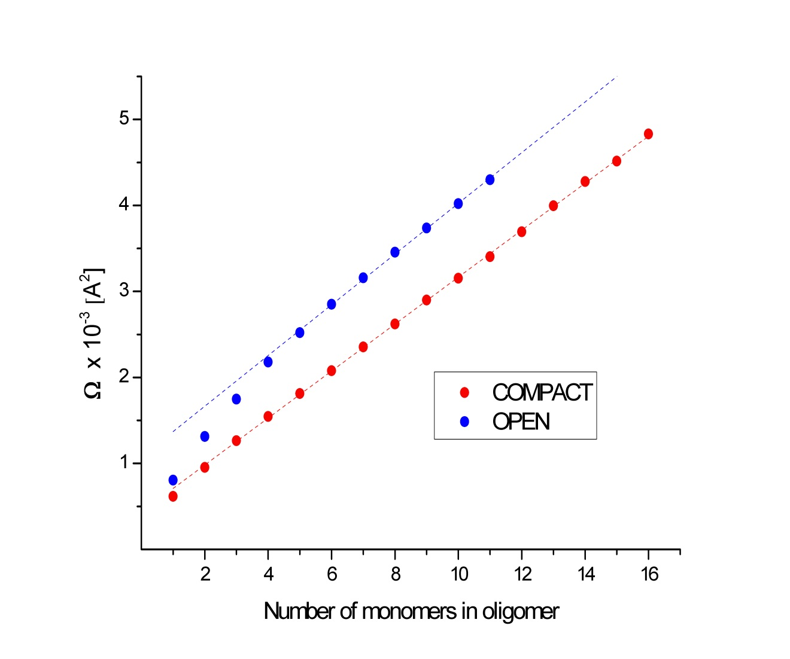
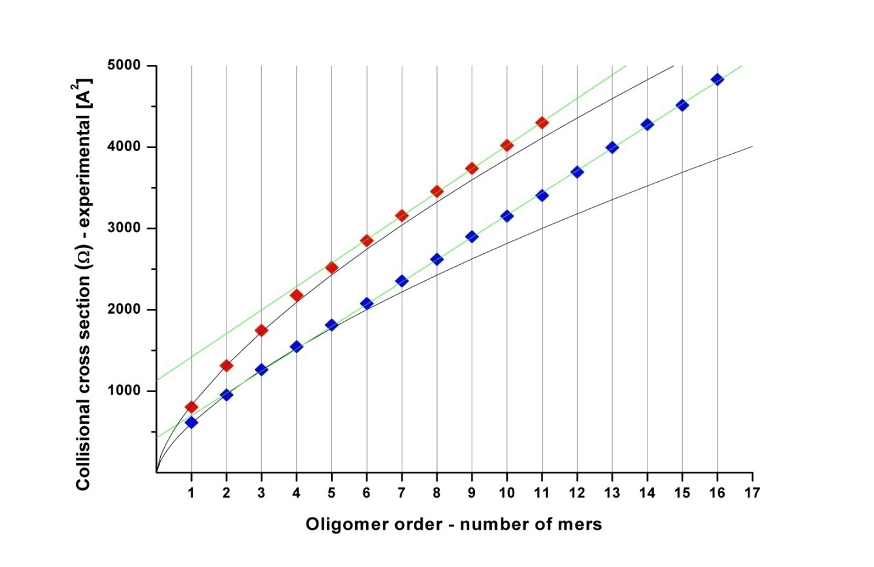
Ω for the compact forms increases linearly
Oligomer growth in 3D is not expected to
show linear increase of Ω
For globular oligomeric forms Ω~n^{2/3}
A linear increase of Ω value is expected
for oligomers growing in 2 dimensions.
“The Ω value of an n-meric oligomer
characterised by a fractal dimension d
is expected to increase proportionally to n^{2/d}.”*
^{1*}Tricot, C. (1981). Douze définitions de la densité logarithmique. (French) [Twelve definitions of logarithmic density]. C. R. Acad. Sci. Paris Sér. I Math. 293, 549–552.
This indicates low order oligomer growth in 3D and higher order in 2D
Notes:
Ruotolo, B. T., Benesch, J. L., Sandercock, A. M.,
Hyung, S. J. & Robinson, C. V. (2008). Ion mobilitymass
spectrometry analysis of large protein complexes.
Nat. Protoc. 3, 1139–1152.

Slide 16
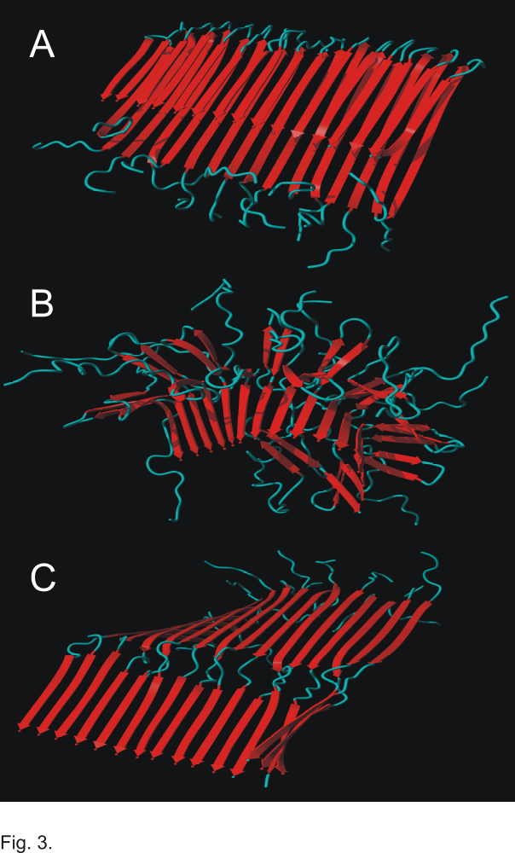
Molecular models of:
Compact (A)
and
Extended (B or C)
Aβ hexadecamer

Slide 17
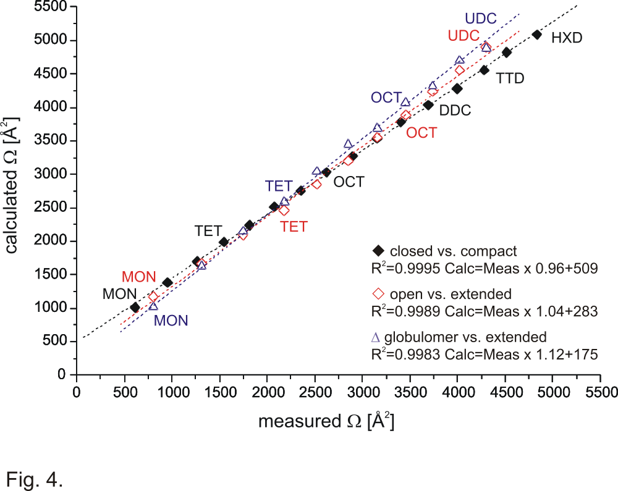
Correlation of experimental Ω vs. theoretical Ω for compact and extended forms

Slide 18
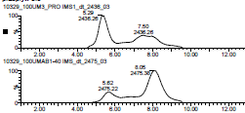
Testing the model:
A. Influence of point mutations
on compact/extended equilibria
DAEFRHDSGYEVHHQKLVFFAEDVGSNKGAIIGLMVGGV
DAEFRHDSGYEVHHQKLVFFAEDVPSNKGAIIGLMVGGV
DAEFRHDSGYEVHHQKPPPFAEDVGSNKGAIPGPMVGGV
DAEFRHDSGYEVHHQKLVFFAEDVGSNKGAIPGPMVGGV
DAEFRHDSGYEVHHQKLVFFAEDVGSNAGAIIGLMVGGV
……
……
Also:
B. Metal binding (Cu,Zn) - Sitkiewicz et al. (2014) J.Mol.Biol. 426, 2871
C. di-Tyrosine x-link - Sitkiewicz et al. PloS One (2014) 9, e100200

Slide 19
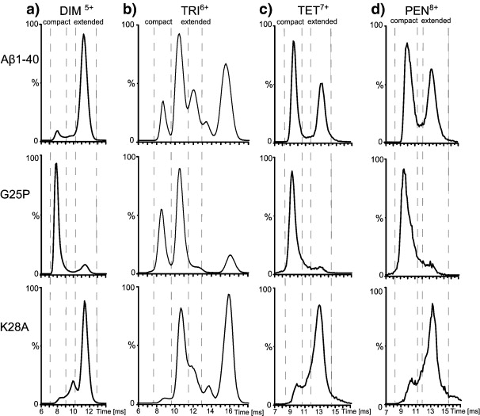
G25P stabilises a compact form and K28A destabilises it
From:
Sitkiewicz et al. (2014) J.Mol.Biol. 426, 2871

Slide 20
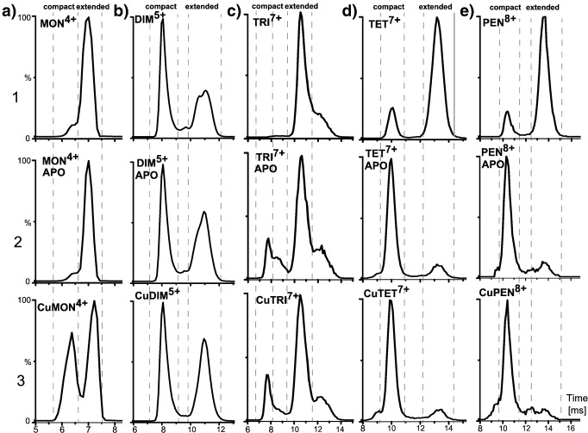
Binding of metal ions stabilizes the compact form
Apo
Metal lost
in ESI
Metal
retained
in ESI
Monomers equilibrate fast in gas phase unlike trimers, tetramers and pentamers

Slide 21
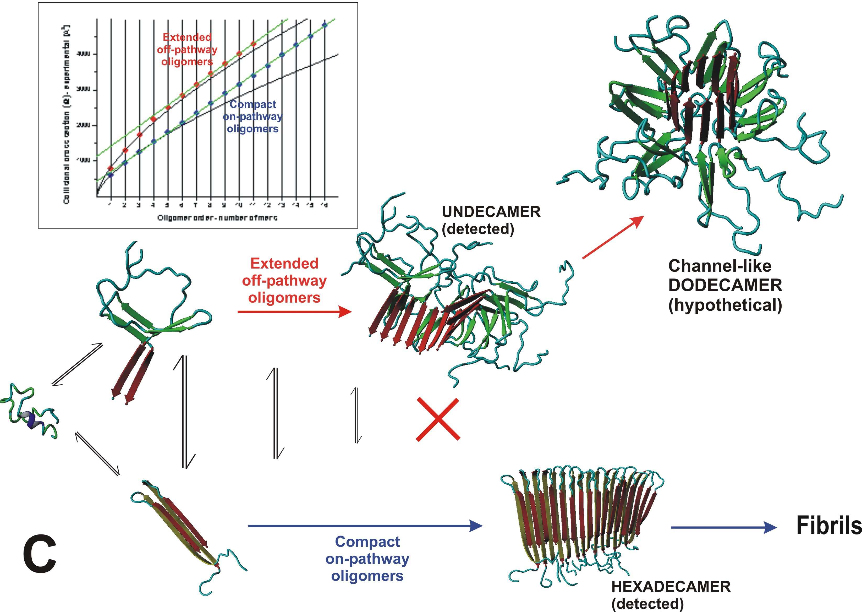
OL
A working hypothesis:
Compact-extended transition may lead to off-pathway evolution towards pore-like neurotoxic oligomers

Slide 22
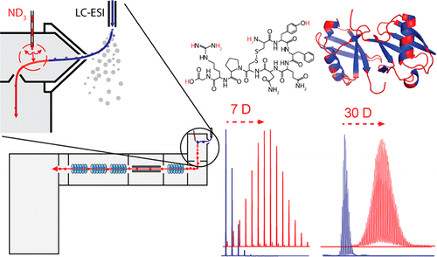
Hydrogen-deuterium exchange in the gas phase –
mapping the structural entanglement of non-amide heteroatom hydrogens
From: Anal Chem. 2014 Dec 2;86(23):11868-76.
Simple setup for gas-phase H/D exchange mass spectrometry coupled to electron transfer
dissociation and ion mobility for analysis of polypeptide structure on a liquid chromatographic time scale.
Mistarz UH, Brown JM, Haselmann KF, Rand KD.

Slide 23
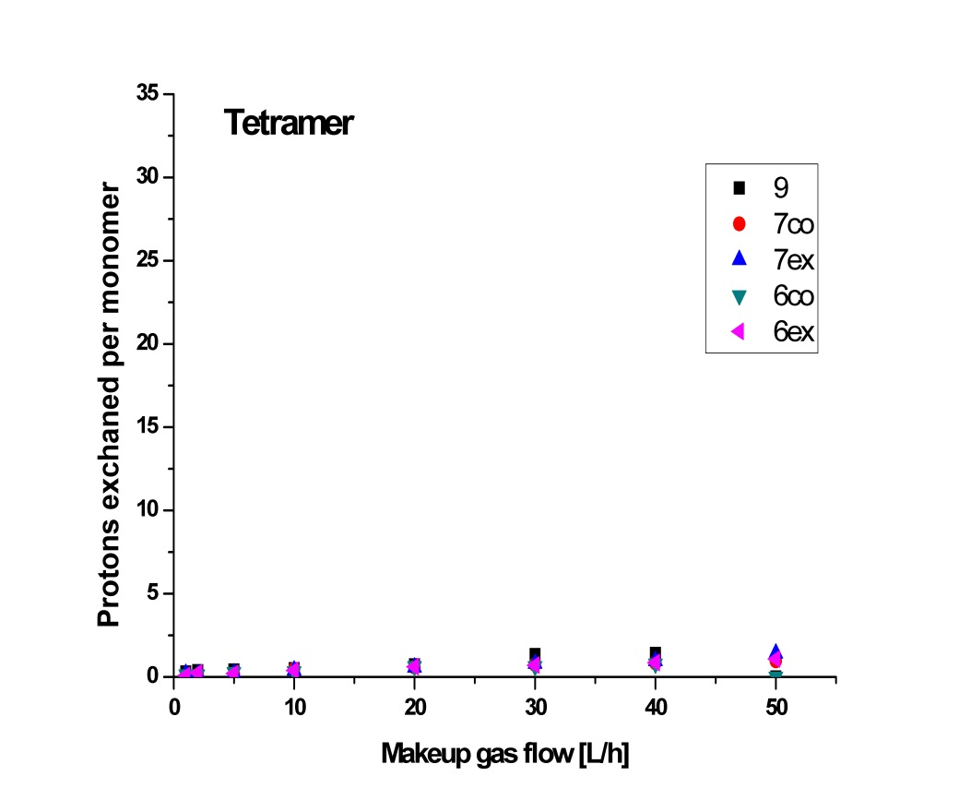
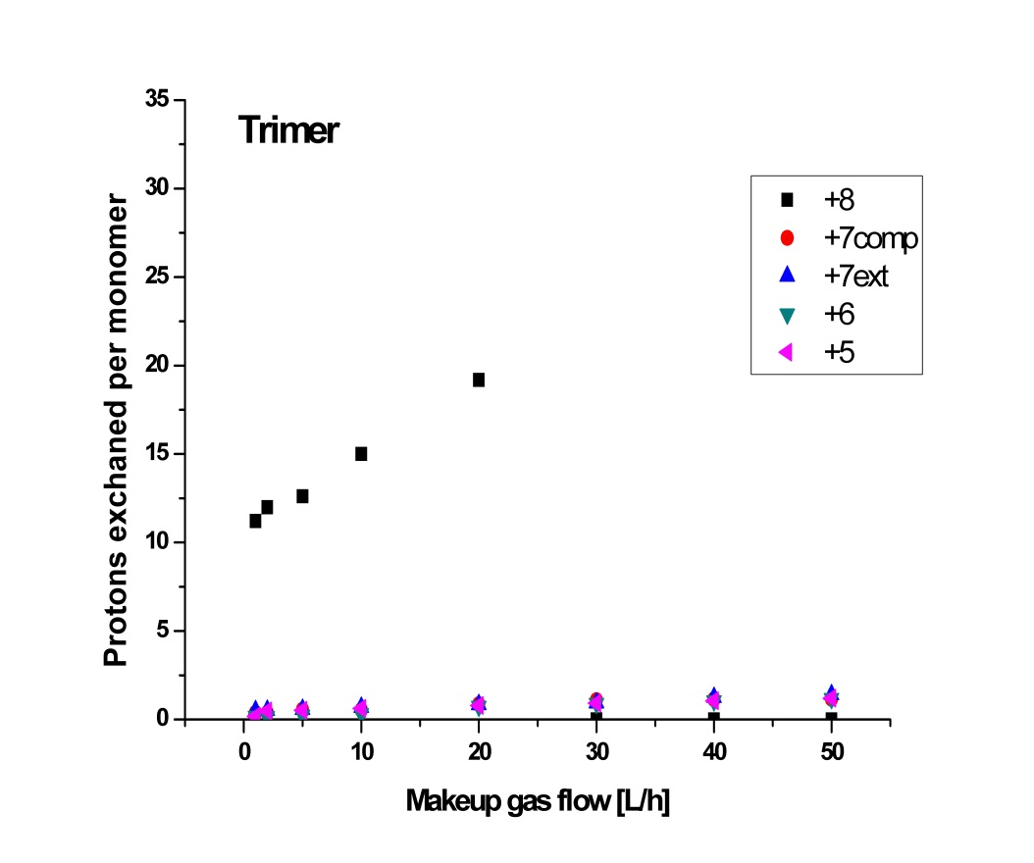
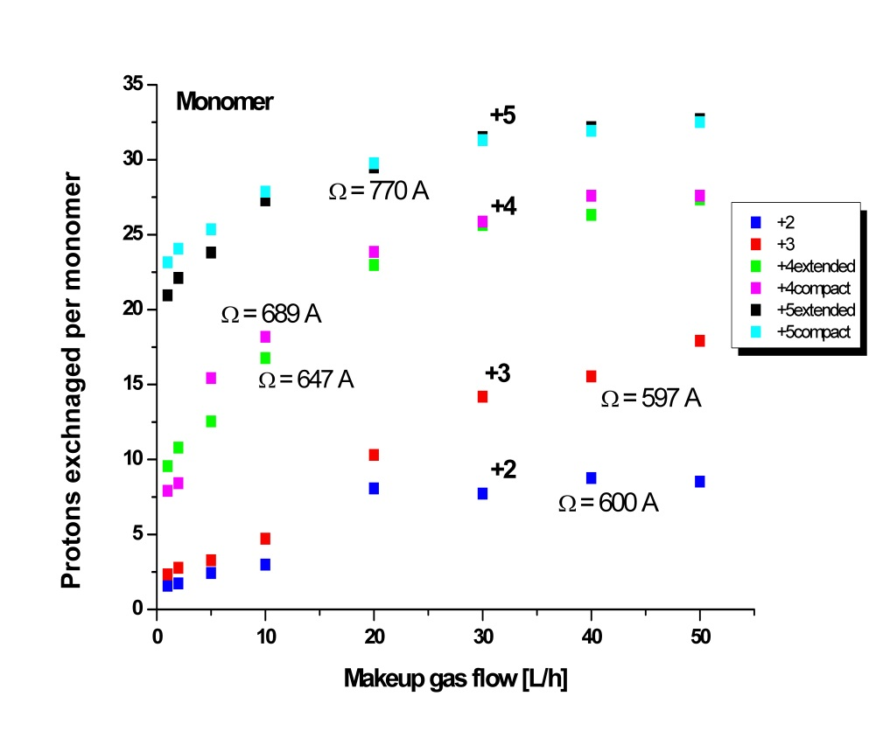
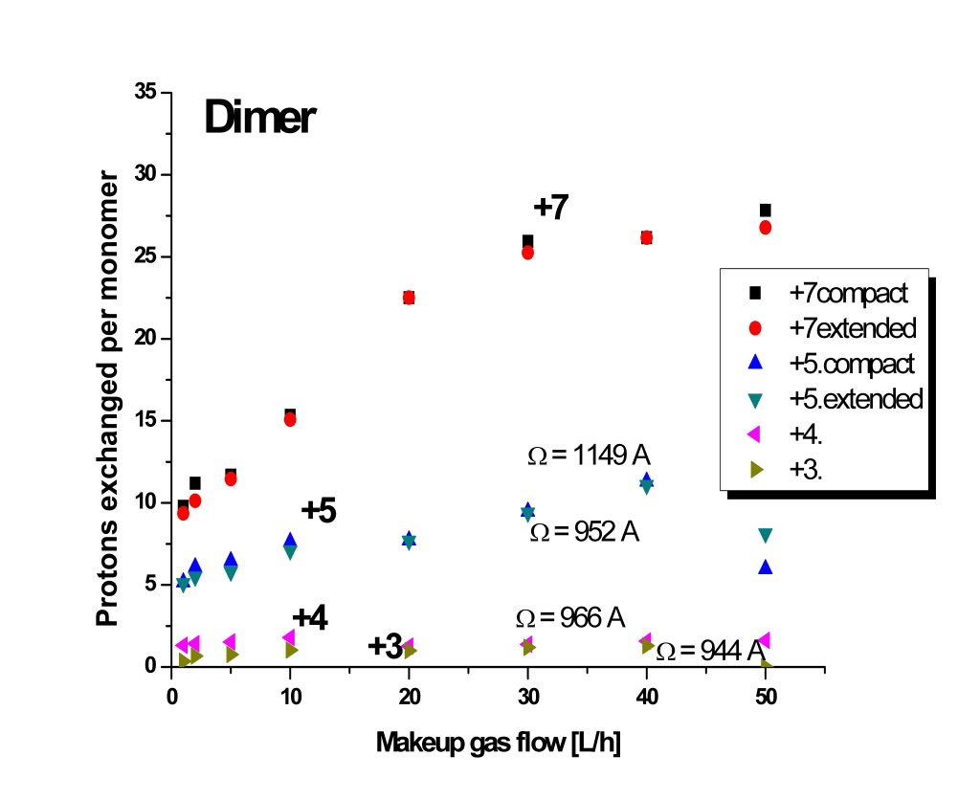
Dense network involving non-amide heteroatom hydrogens stabilises oligomers

Slide 24



Conclusions:
IMS – a useful source of experimental constraints to test molecular models of protein structures
especially useful in case of multiple coexisting species
IMS allows to detect structural heterogeneity
of Aβ1-40 oligomers
detected compact-extended transition
may explain the off-pathway evolution of
oligomeric species responsible for neurotoxicity

Slide 25
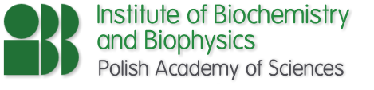
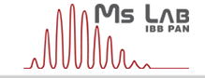


The Team:
Proteomics:
Jacek Olędzki
Agnieszka Fabijańska
Piotr Zarębski
Magda Bakun
Agata Malinowska
Janusz Dębski
Ewa Sitkiewicz
Kinga Fituch
Metabolomics
Radosław Jaźwiec
Emilia Pawłowska
Postdcs:
Dominik Domański
Magda Kulma
Magda Kaus-Drobek
Monika Zaręba-Kozioł
Krzysztof Drabikowski
PhD Students:
Krzysztof Tarnowski
Aiswarya Premchandar
Aleksandra Skrajna
Aleksandra Kacprzyk
Anna Perzanowska
Kaja Przygońska
Katarzyna Bucholc
Magda Richter
Agnieszka Fatalska
Sponsors:
Ministry of Science
and Education
CEPT EU program

Slide 26
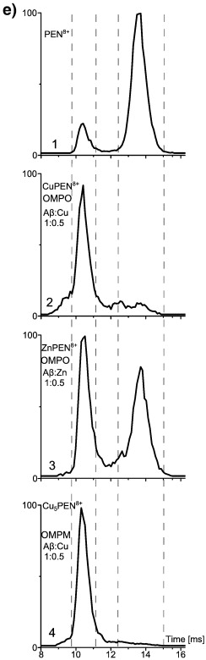

Slide 27
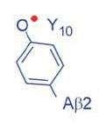
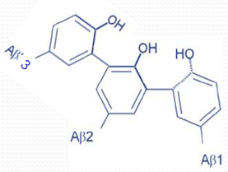

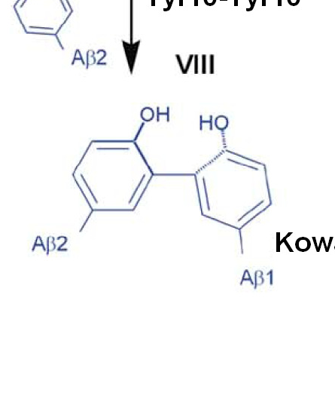
Neurotoxic species may require covalent stabilisation.
di-Tyr bond is one of the candidates
How di-Tyr influences the oligomeric structures?
+
Tyr10-Tyr10 radical coupling
Dityrosine cross-linked Aβ dimer
Trityrosine cross-linked Aβ trimer

Slide 28
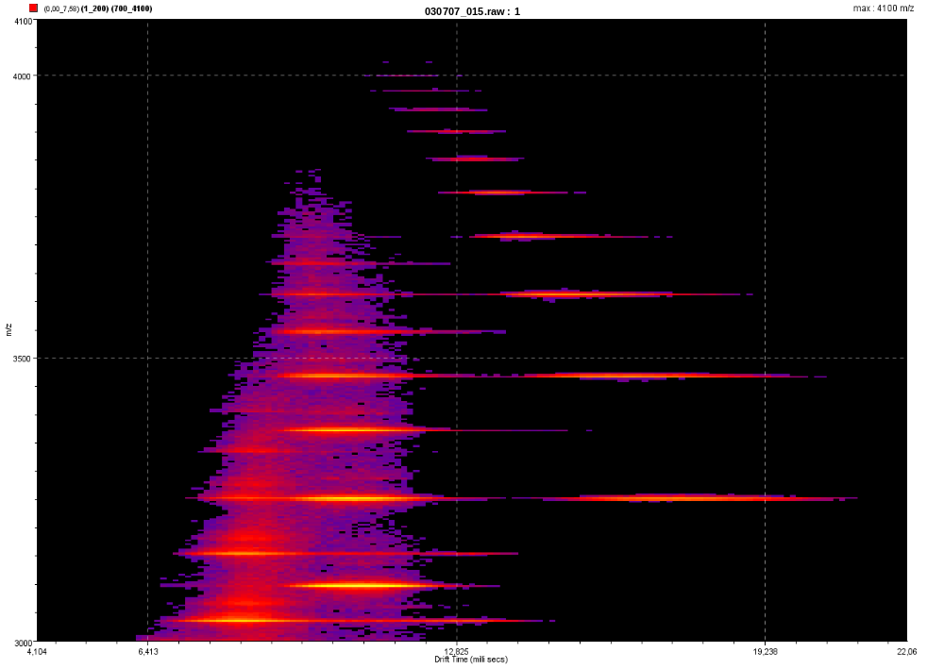
Higher mass range IMS-MS spectrum of Aβ1-40
DDC¹³⁺
UDC¹²⁺
DEC¹¹⁺
NON¹⁰⁺
OCT⁹⁺
HEP⁸⁺
DDC¹⁴⁺
HEX⁷⁺
UDC¹³⁺
DEC¹²⁺
PEN⁶⁺
m/z
NON¹¹⁺
OCT¹⁰⁺
TET⁵⁺
UDC¹⁴⁺
HEP⁹⁺
DEC¹³⁺
NON¹²⁺
HEX⁸⁺
TRI⁴⁺
OCT¹¹⁺
PEN⁷⁺
HEP¹⁰⁺
Czas przelotu [ms]

Slide 29
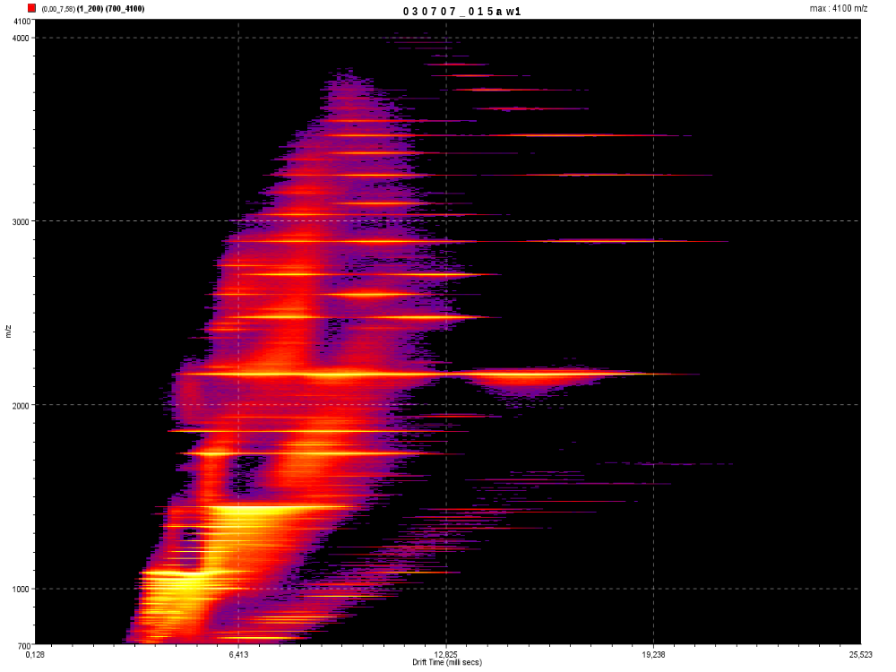
DDC¹³⁺
UDC¹²⁺
DEC¹¹⁺
NON¹⁰⁺
OCT⁹⁺
HEP⁸⁺
HEX⁷⁺
DDC¹⁴⁺
UDC¹³⁺
PEN⁶⁺
DEC¹²⁺
NON¹¹⁺
TET⁵⁺
OCT¹⁰⁺
UDC¹⁴⁺
HEP⁹⁺
DEC¹³⁺
HEX⁸⁺
TRI⁴⁺
NON¹²⁺
OCT¹¹⁺
PEN⁷⁺
HEP¹⁰⁺
HEX⁹⁺
TET⁶⁺
DIM³⁺
HEP¹¹⁺
PEN⁸⁺
PEN⁸⁺
HEX¹⁰⁺
TRI⁵⁺
m/z
HEP¹²⁺
TET⁷⁺
PEN⁹⁺
TET⁷⁺
HEX¹¹⁺
MON²⁺
TET⁸⁺
TRI⁶⁺
DIM⁴⁺
TRI⁶⁺
TET⁹⁺
TRI⁷⁺
TRI⁷⁺
DIM⁵⁺
DIM⁵⁺
TRI⁸⁺
MON³⁺
DIM⁷⁺
MON⁴⁺
MON⁵⁺
MON⁶⁺
Czas przelotu [ms]

Slide 30
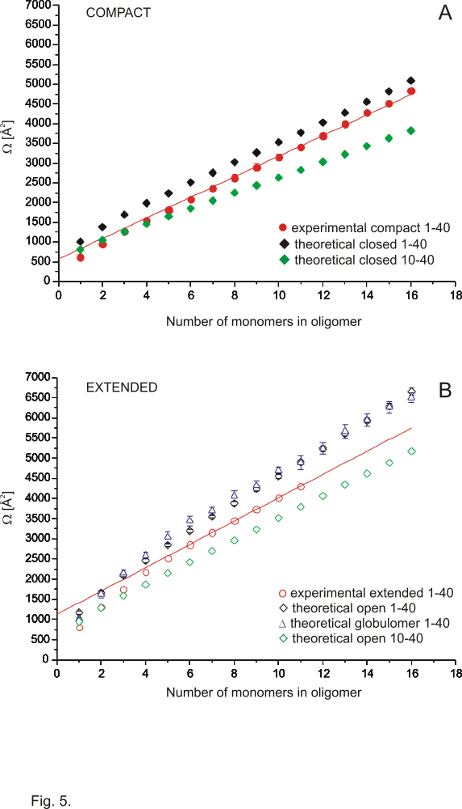
Theoretical Ω are larger
than experimental
A systematic error may be
caused by the improper
modeling of unstructured
10aa N-terminal part.

Slide 31
100 years of Alzheimer’s disease
„…Eine Frau von 51 Jahren zeigte als erste auffällige
Krankheitserscheinung Eifersuchtsideen gegen den Mann. Bald machte sich eine rasch zunehmende Gedächtnisschwäche bemerkbar, sie fand sich in ihrer Wohnung nicht mehr zurecht, schleppte die Gegenstände hin und her, versteckte sie, zuweilen glaubte sie, man wolle sie umbringen und begann
laut zu schreien …”
(Alzheimer’s 1907’s description of Auguste Deter’s disease)
Alois Alzheimer
1864 - 1915
1889 - Otto von Bismarck – first retirement plan
introduced in Prussia for infrequent cases
of people older than 70!
Alzheimer’s disease is the disease
of ageing societies.
30 mln people affected worldwide,
number expected to triplicate until 2050.
No cure available at present.

Slide 32
Peaks can be assigned
to oligomeric species
in three different
charge states series:
n+1, n+2, n+3
No species with charge
>n+3
or
<n+1
are observed

Slide 33
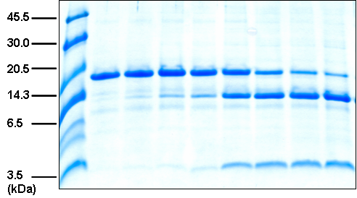
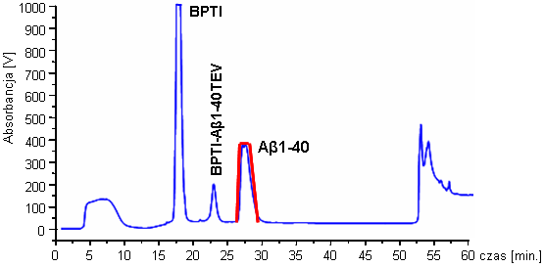
Preparatyka peptydów Aβ1-40/42
Wektor ekspresyjny pAB10-30 (dr Agnieszka Jabłonowska)
pET30a(+)
Aβ10-30
pET30a(+)
Promotor T7 KpnI
Białko BPTI DDDDM
SacI
Wektor ekspresyjny pAB1-40 oraz pAB1-42
ENLYFQ
SacI
pET30a(+)
Aβ1-40/42
pET30a(+)
Promotor T7 KpnI
Białko BPTI
Aβ1-40

Slide 34


W widmach MS widoczne są sygnały oligomerów Aβ1-40
¹²C = 12.000 000 u [98.93 %]
1000
BPTI
¹³C = 13.003 354 u [1.07%]
900
800
MON⁴⁺
700
2 ¹³C
Absorbancja [V]
600
BPTI-Aβ1-40TEV
1 ¹³C
3 ¹³C
4+
500
400
Aβ1-40
4 ¹³C
300
200
0 ¹³C
5 ¹³C
100
0
6 ¹³C
0
5
10
15
20
25
30
35
40
45
50
55
60
czas [min.]
7 ¹³C
MON²⁺
DIM⁴⁺
1083
1084
1085
3+
5+
2164
2166
2168
6+
2+
600
800
1000
1200
1400
1600
1800
2000
2200
2400
2600 m/z

Slide 35



Porównanie spektrometrómetrów mas Q-ToF Premier oraz Synapt HDMS System
ze źródłem jonizacji ESI
Q-ToF Premier
TRI WAVE
Synapt HDMS
www.waters.com

Slide 36
Niekowalencyjne oligomery peptydu Aβ1-42 obserwowane podczas analizy ESI-MS
MON⁴⁺
PEN⁹⁺
HEX¹¹⁺
TET⁷⁺
TRI⁵⁺
HEP¹²⁺
HEP¹³⁺
OKT¹³⁺
PEN⁸⁺
HEP¹¹⁺
2400
2500
2600
2700
2800
2900
MON³⁺
DIM⁶⁺
MON⁵⁺
DIM⁵⁺
MON²⁺
DIM⁴⁺
MON⁶⁺
DIM⁷⁺
TRI⁸⁺
TRI⁷⁺
TET⁹⁺
800
1000
1200
1400
1600
1800
2000
2200
2400
2600
2800
3000 m/z

Slide 37

Korelacja danych eksperymentalnych z modelem teoretycznym dla oligomerów Aβ1-40.

Slide 38
Dynamika molekularna dodekameru peptydu Aβ1-40
Animacje:Folded.avi, Unfolding.avi

Slide 39


Analiza IMS-MS peptydu Aβ1-40
MON²⁺
DIM⁴⁺
Sygnały odpowiadające: MON²⁺, DIM⁴⁺, TRI⁶⁺, TET⁸⁺
2164
2166
2168
m/z
2168
m/z
m/z
2165
2164
5
7
9
12
15
18
21
Czas przelotu [ms]
100
[%]
50
0
5
7
9
12
15
18
21
Czas przelotu [ms]
Czas przelotu [ms]

Slide 40
Rationale for Aβ peptide as a causative agent in AD:
Inherited mutations in Aβ itself, its flanking regions or processing proteases may lead
to early onset or more aggressive forms of AD.
- Down syndrome patients suffer from early onset AD due to increased number of the copies of chromosome 21, which harbors Aβ coding sequence.
Synthetic peptide has been shown to be toxic for hippocampal and cortical neurons.
Some AD symptoms can be induced in Tg mice expressing human Amyloid Precursor Protein (APP).
1992 - amyloid cascade hypothesis (Hardy and Higgins, 1992) claimed neurotoxicity of Aβ fibrils as the main causative pathway of the disease.
1997-1998 - AD symptoms correlate better with soluble pool of Aβ than insoluble aggregates and with synapse loss rather than neuron loss
Revised amyloid cascade hypothesis - Aβ oligomers and the mechanisms of their synaptotoxicity

Slide 41

Aβ1-40 was obtained
by overexpression
in bacteria
45.5
30.0
20.5
14.3
6.5
peptide Aβ1-40
1000
BPTI
3.5
(kDa)
900
800
700
600
Absorbancja [V]
500
400
Aβ1-40
300
200
100
0
0
5
10
15
20
25
30
35
40
45
50
55
60
czas [min.]

Slide 42




Higher order Aβ1-40 oligomers can also be observed
PEN⁷⁺
TRI⁴⁺
TRI⁵⁺
PEN⁹⁺
TET⁷⁺
DIM³⁺
HEP¹⁰⁺
OKT¹¹⁺
TET⁵⁺
PEN⁸⁺
NON¹³⁺
HEP⁹⁺
HEX¹¹⁺
HEP¹¹⁺
DEK¹³⁺
HEP¹³⁺
HEP¹²⁺
UDK¹⁵⁺
UDK¹¹⁺
NON¹¹⁺
OKT¹³⁺
NON¹⁴⁺
m/z
m/z
PEN⁶⁺
TDC¹⁴⁺
TEDC¹⁵⁺
PDC¹⁶⁺
HXDC¹⁷⁺
HPDC¹⁸⁺
HEX⁷⁺
HEP8⁺
OCT⁹⁺
HXDC¹⁹⁺
NON¹⁰⁺
DEC¹¹⁺
TDC¹⁵⁺
PDC¹⁷⁺
HPDC¹⁹⁺
UDC¹²⁺
DDC¹³⁺
TDC¹⁴⁺
3600 3700 3800 3900 4000 4100 m/z

Slide 43






Selected protein structure on-going projects
1. Difficult protein targets/natively unfolded proteins/oligomerising proteins
Intermediate filament proteins - H. Herrmann, German Cancer Research Center, Heidelberg, Germany
2. Mapping interaction regions with protein partners:
- Kinetochore complexes: COMA (K. lactis) - S. Harrison group - Harvard Medical School, Boston, USA
& Mis12-CenpC (D. melanogaster) D. Glover group - Cambridge University, UK
- miRNA-mediated gene silencing complex proteins CNOT1, GW182 –
A. Niedźwiecka, Physics Institute, PAS, Warsaw, N. Sonenberg McGill Univ. Montreal, Canada
- CFTR NBD1 domain interaction with crotoxin and keratin 8 – A. Edelman, Institut Necker, Paris
- FLASH-Lsm11-Histone pre-mRNA Cleavage Complex –
Z. Domiński, University of North Carolina at Chapel Hill, USA
3. Protein-DNA assemblies:
- Structural cross-talk between two DNA-binding domains in R.DpnI restriction endonuclease,
M. Bochtler, IIMCB, Warsaw
4. Protein-lipid assemblies
- Abeta – Alzheimer’s disease peptide transmembrane channels
- Perfringolysin and its mutants - A.Sobota, Nencki Institute, Warsaw

Slide 44




Mass Spectrometry Laboratory,
Institute of Biochemistry and Biophysics,
Pol. Acad. Sci., Warsaw, Poland

