Slide 1

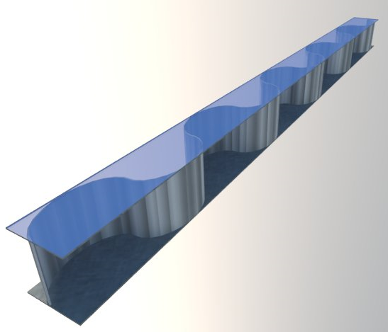
Experimental Investigation of Moment-Rotation Curves of
End-Plate Connection using Sinusoidal Beam
Dr. Merve Sağıroğlu
Assoc. Prof. Dr. A. Cuneyt AYDIN,
Mahyar MAALI, Mahmut KILIC
Steel Structures 2015-Dubai
16-18 November 2015

Slide 2
Abstract
In this study, a new beam model called sinusoidal beam is discussed based on experimental investigation.
The presentation exhibits the moment-rotation curves of fixed end-plate connection made from sinusoidal beams and evaluation the structural performance of sinusoidal beams.
Notes:
In engineering buildings, selecting optimum dimensions is very important. To use bearing elements with optimum dimensions and low weights is important. Using high-strength steel with reduced weight in buildings and industry is important
because, as the weight of the buildings is reduced, the behavior of steel in various situations becomes important. For this reason, many studies are performed to provide optimum dimensions and to reduce weight. And this study, ........
Results were compared with experiments performed not only with IPE profile but also with similar manufactured profile

Slide 3
Details
End-plate connections are used in beam-to-column joints
Connection dimensions are selected from the research of Coelho et al.
This study aims to investigate the effect of the sinus angles in the web of I-beam with end-plate connection to the moment-rotation curves.
Accordingly, moment-rotation curves are drawn for four end-plate optimum connections.
Notes:
Our study’s details....

Slide 4
Details
The purpose of these experiments is to understand the effects of sinus beam connections on the end-plates.
Among these four models,
    two models using sinus beams,
    one manufactured model,
    one IPE beam model are prepared.
The moment-rotation curves are compared and the effects of sinus beams are examined at end-plate connections
Notes:
We prepared 4 models:
First: one IPE model
Second: one manufactured beam
And then: two sinus beams are manufactured with different angles

Slide 5
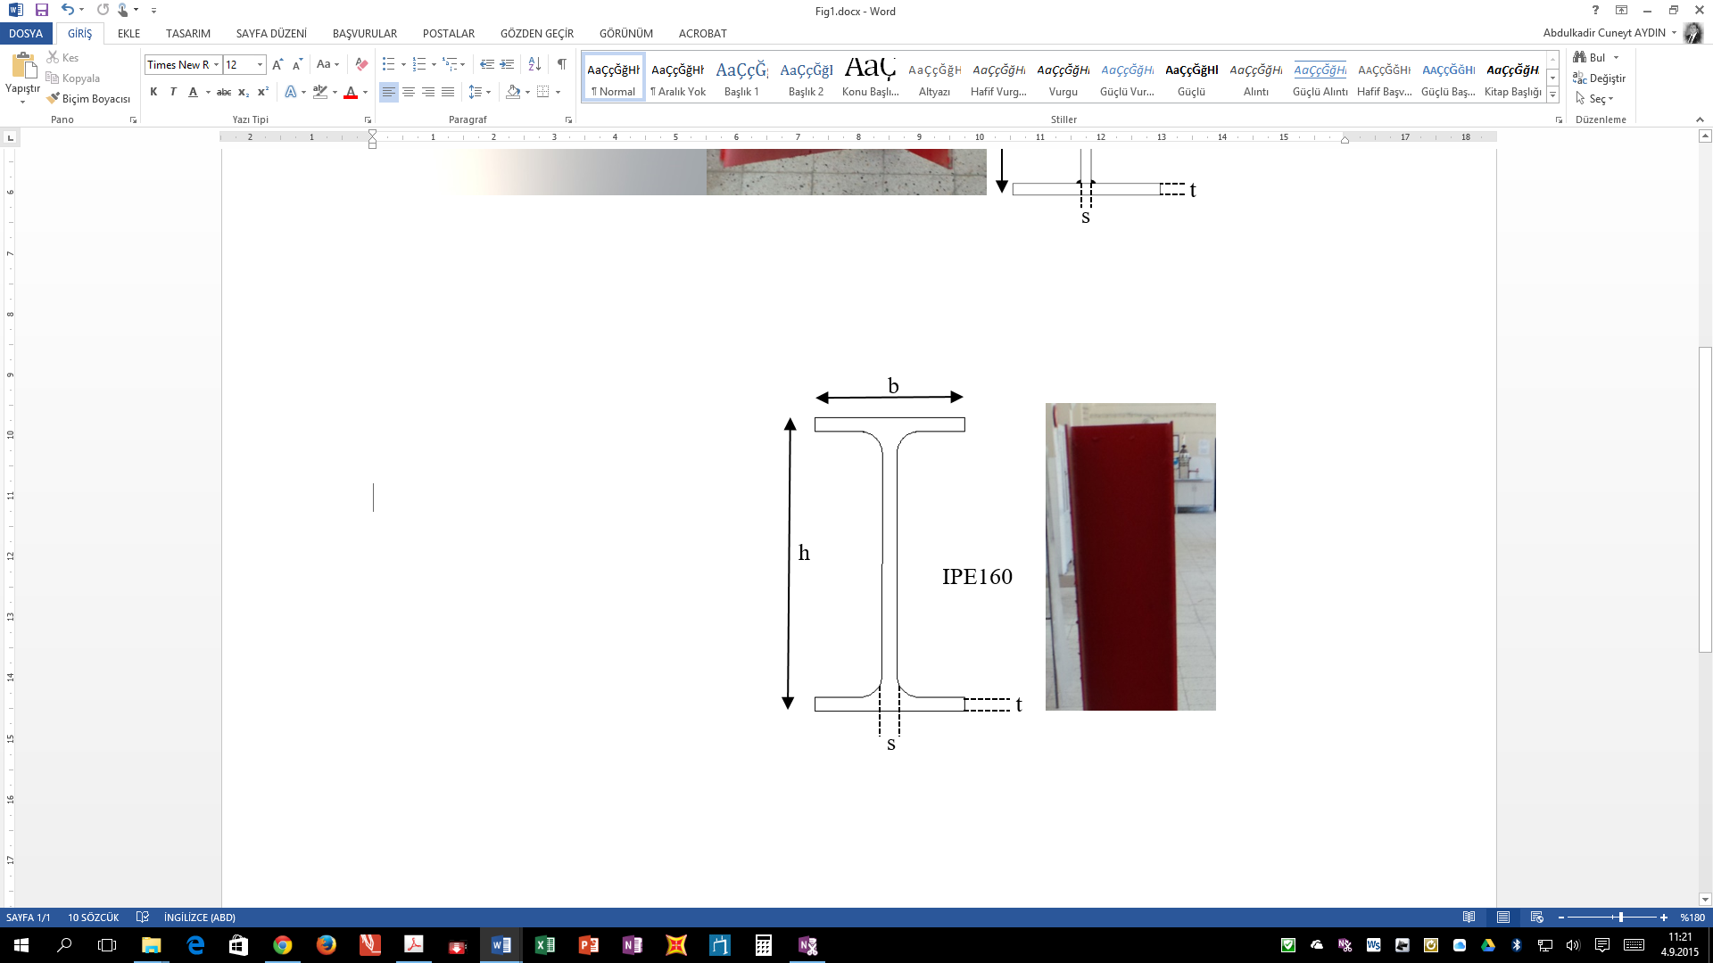
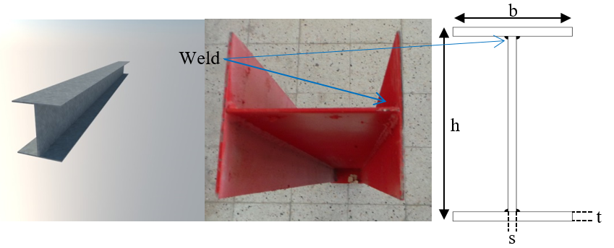
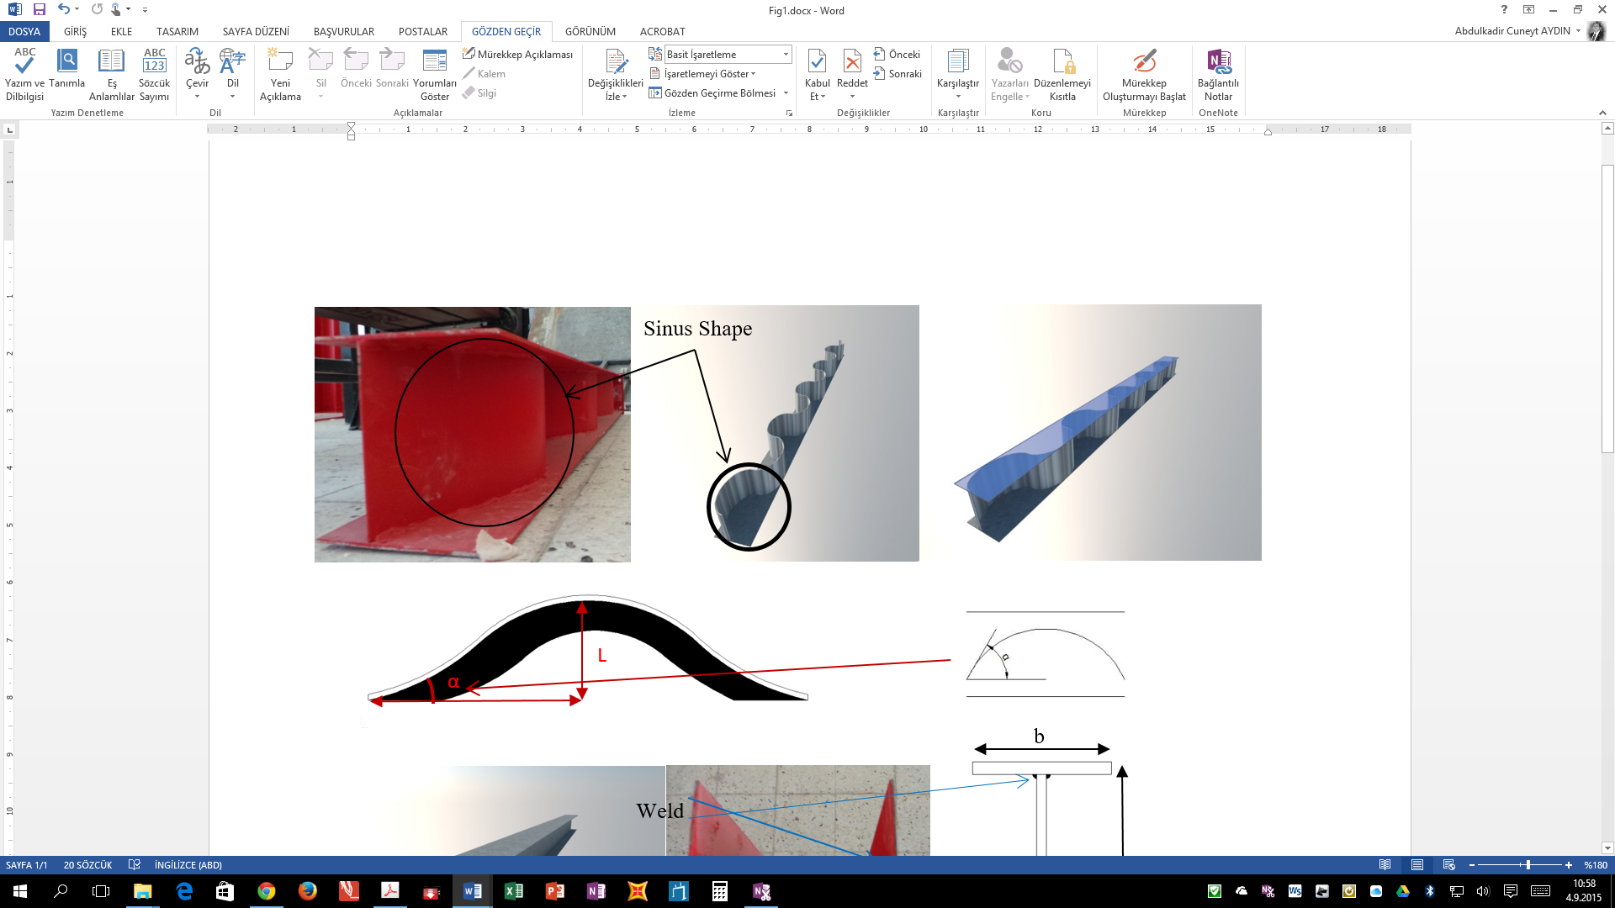
Test specimens
Standart IPE profile
Manufactured beam
Sinusoidal angle/ Sinus shape
Notes:
In this research, a total of four specimens were manufactured and tested.
First: as shown in the Figure standart IPE profile. We used IPE160 profile.
Second: we manufactured a beam made of three plate by welding
And, then we manufactured 2 sinusoidal beams with different angles as shown in Figure
And you can see in this picture, manufactured sinusoidal beams.

Slide 6
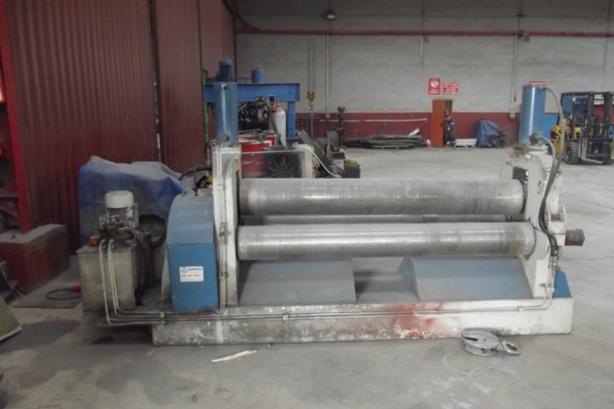
Sinusoidal Sheet Manufacturing System
The web and flange of the sinusoidal beam have 2.5-mm and 4-mm thicknesses, respectively.
Sheets with dimensions of 1500 × 6000 mm were first prepared
These sheets were divided into ten and eighteen parts for the web and flange, respectively, using a cutting device.
The cylindrical device works with three cylinders. To run 30°- and 70°-angles, the upper cylinder and two lower cylinders were made with diameters of 269.1 mm and 238.85 mm, respectively.
Notes:
I would like to explain the sinusodial sheet manufacturing system. ....

Slide 7
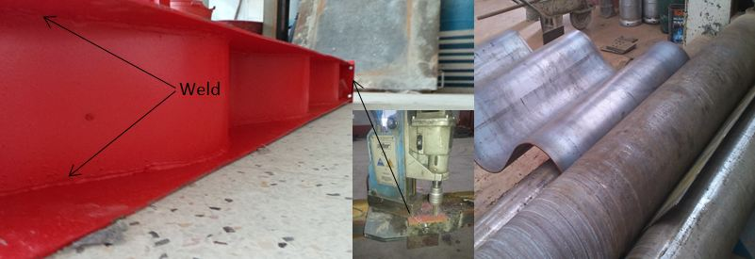
Sinusoidal Sheets
After making the cylinders, the sheets were made into a sinusoidal shape inside this device. These sinusoidal sheets are shown in the Figure (right)
To realize all planned lengths, because the sheet length was 1500 mm, sheets were welded by using arc welding with a continuous 45° fillet weld.
Notes:
......The fillet welds were made in the down-hand position.
The procedure involves manual metal arc welding using a consumable electrode.
This figure (left) shows the shape of the sinusoidal 70° models after completion.

Slide 8
The details of the beams
Name of model | h (mm) | b (mm) | t (mm) | s (mm) | L (mm) | Weight (kg/m) | t_{p} (mm)
Manufactured | 160 | 150 | 4 | 2.5 | - | 15.68 | 8
Sinusoidal 30° |  |  |  |  | 85.8 | 12.7 | 8
Sinusoidal 70° |  |  |  |  | 200.2 | 16.57 | 8
IPE160 | 160 | 82 | 7.4 | 5 | - | 15.8 | 8
t_{p}: thickness of end-plate
Notes:
The details of these beams are shown in Table.
You can see, we used same height in all of the beams and same end-plate.
But the manufatured beams’ width differs from IPE profile. Their width are larger than IPE profile.

Slide 9
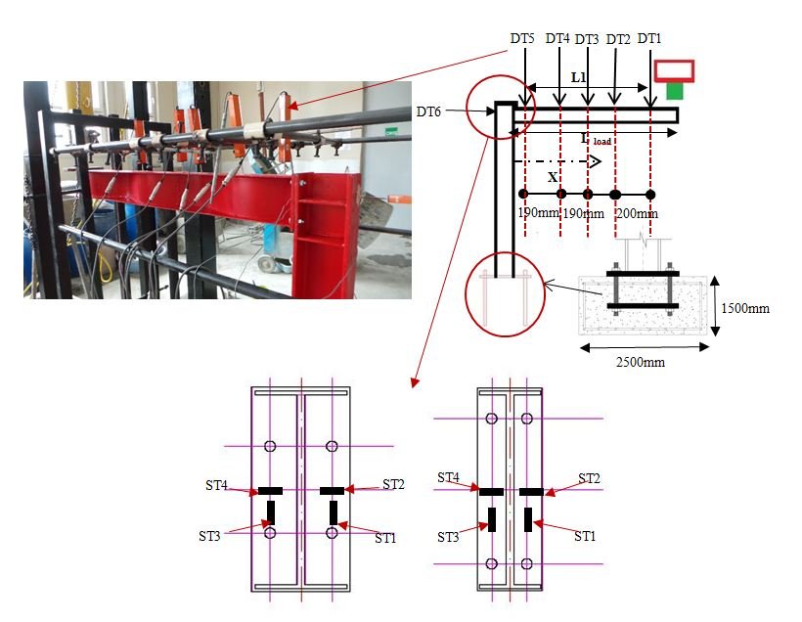
Test instrumentation
Notes:
The test arrangements are shown in the Figure
The primary requirements of the instrumentation are the measurement of applied load (P), displacements (DT) of the beam, and strains (ST) at the end-plate connections. The results are collected using a data-logging device that records all measurements for the load cells at one-second intervals. All the data are recorded for the duration of the tests. Displacements are measured using linear variable displacement transducers with a maximum displacement of 100 mm. strain gauges are added to the system to provide insight into the strain distribution.

Slide 10
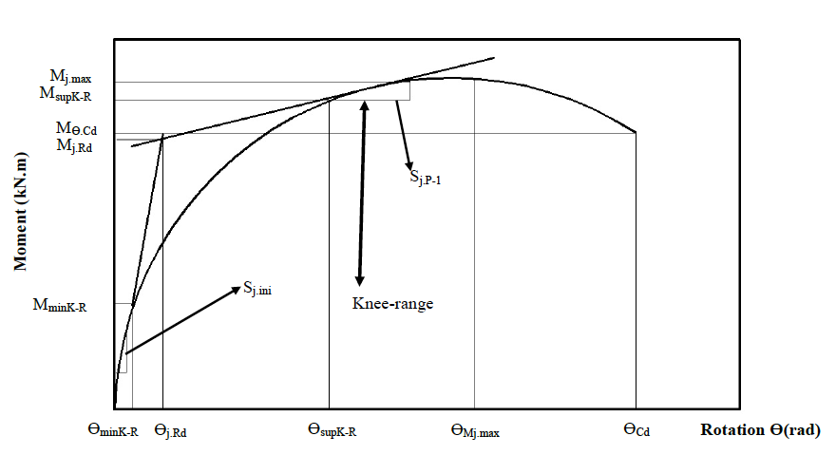
Moment-rotation curve characteristics
The moment-rotation curve shows the behavior of the moment connections that describe the relationship between the applied moment (M) and the corresponding rotation (Ɵ) between the members.
The M–Ɵ curve of the connection may be characterized by using the aforementioned relationships. The main features of this curve are moment resistance, rotational stiffness, and rotation capacity.
Notes:
In particular, the following characteristics are assessed as illustrated in

Slide 11
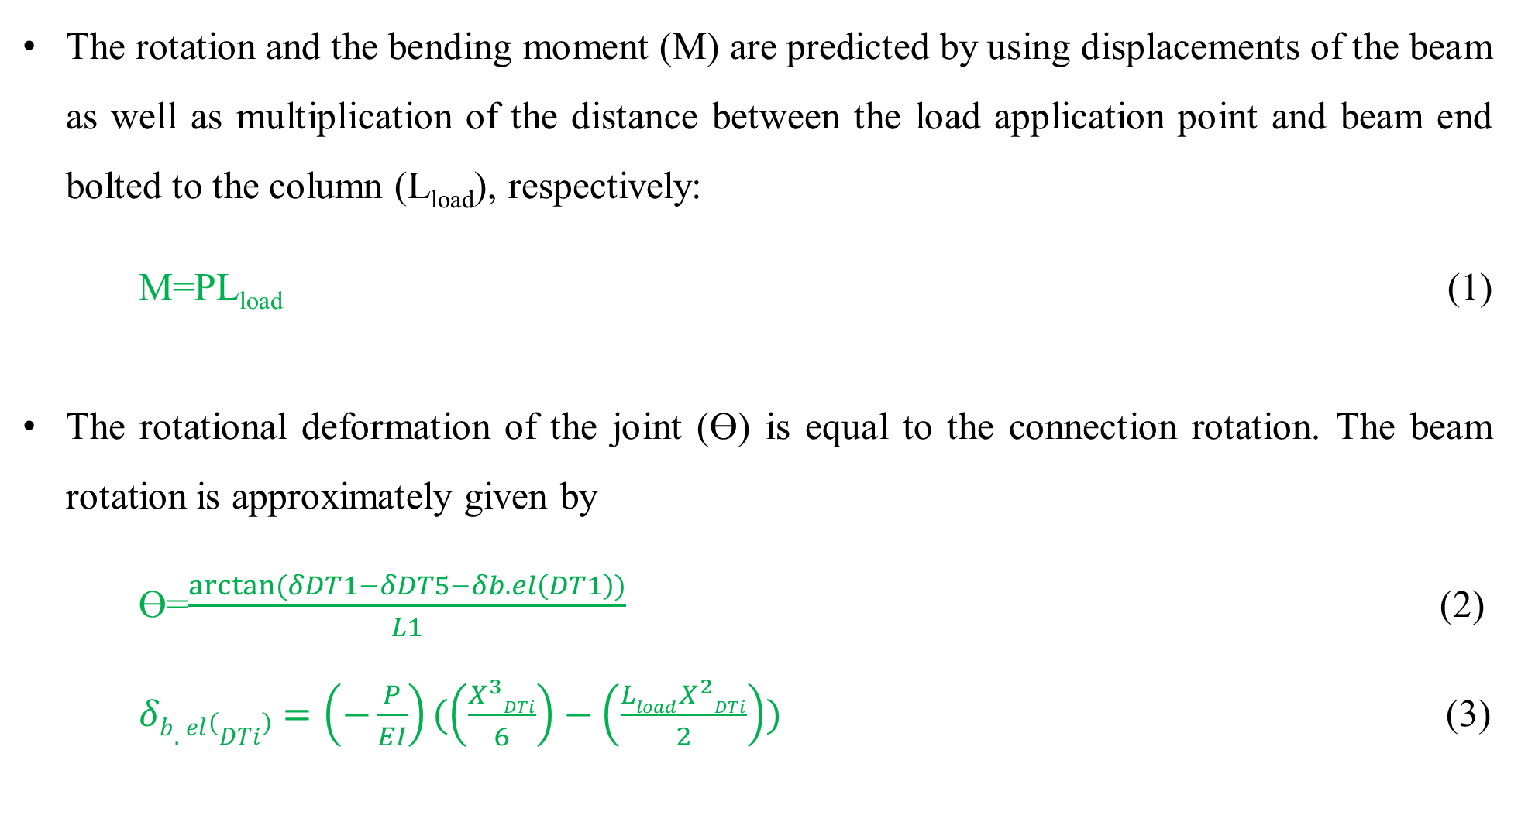
The rotation and the bending moment (M) are predicted by using displacements of the beam as well as multiplication of the distance between the load application point and beam end bolted to the column (L_{load}), respectively:
M=PL_{load} (1)
The rotational deformation of the joint (Ɵ) is equal to the connection rotation. The beam rotation is approximately given by
Ɵ=$\frac{arctan⁡(δDT1−δDT5−δb.el\left(DT1\right))}{L1}$ (2)
$δb.el\left(DTi\right)=\left(−\frac{P}{EI}\right)(\left(\frac{X^{3}DTi}{6}\right)−\left(\frac{LloadX^{2}DTi}{2}\right))$ (3)
Notes:
In these experimental studies, we used these equations to calculate the bending moment, rotation and deformations.

Slide 12
Test results
The table is obtained from the moment-rotation curves of the tested systems.
Specimens | Resistance (KN.m) |  |  |  | Stiffness (KN m/rad) |  |  | Rotation (rad)
 | KR (knee-range) | M_{j.Rd} | M_{j. max} | M_{ӨCd} | S_{j.ini} | S_{j.p−l} | S_{j.ini}/S_{j.p−l} | Ө_{M.Rd} | Ө_{Min.K.R} | Ө_{Msup.k.R} | Ө_{Mj. max} | Ө_{Cd}
Manufactured | 1.56-9.58 | 8.88 | 10.55 | 8.28 | 1.60 | 0.36 | 4.44 | 0.14 | 0.02 | 0.16 | 0.23 | 0.36
Sinusoidal 30° | 3.45-7.86 | 7.06 | 8.91 | 8.22 | 1.73 | 0.45 | 3.84 | 0.09 | 0.05 | 0.14 | 0.25 | 0.30
Sinusoidal 70° | 4.8-11.43 | 9.03 | 11.90 | 11.57 | 1.21 | 0.59 | 2.05 | 0.18 | 0.09 | 0.24 | 0.27 | 0.30
IPE 160 | 2.87-6.14 | 5.45 | 6.57 | 4.573 | 3.09 | 0.43 | 7.18 | 0.08 | 0.04 | 0.15 | 0.22 | 0.39
Notes:
You can see in this table, we obtained the resistance, stiffness and rotation values from the moment-rotation curves of the tests.

Slide 13
Moment-Rotation Curves
Standart IPE profile
Sinusoidal 30º
Sinusoidal 70º
Manufactured beam

Slide 14
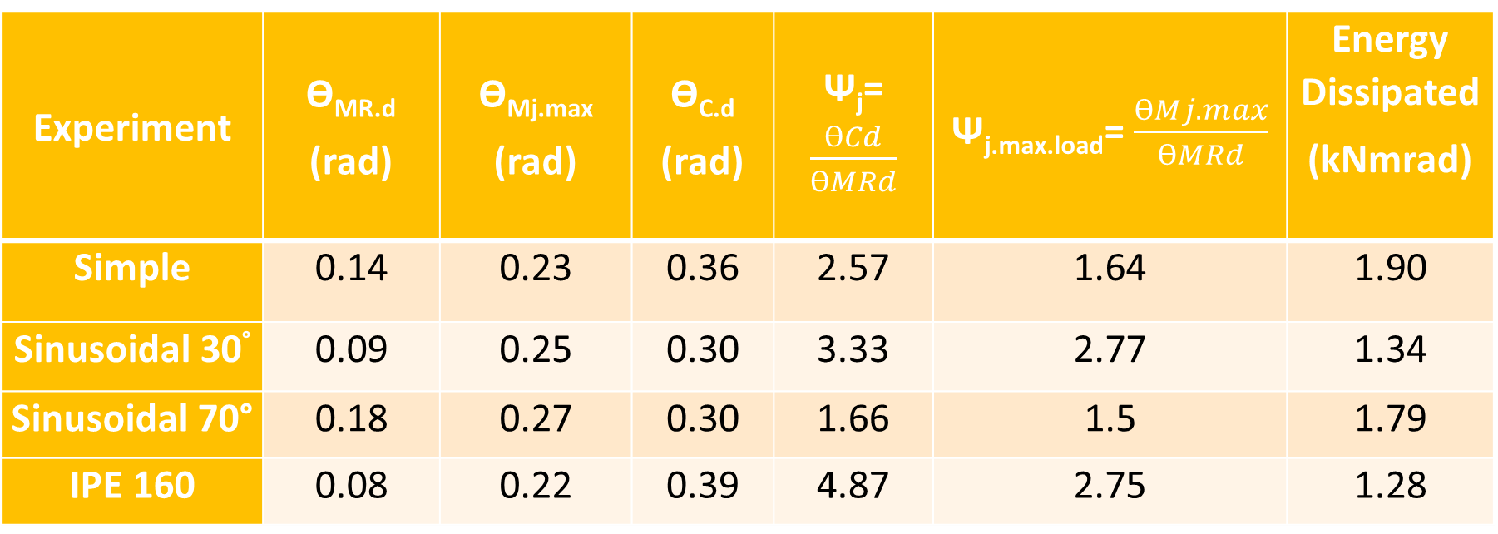
Test results
Experiment | Ө_{MR.d} (rad) | Ө_{Mj.max} (rad) | Ө_{C.d} (rad) | Ψ_{j}=$\frac{ƟCd}{ƟMRd}$ | Ψ_{j.max.load}=$\frac{ƟMj.max}{ƟMRd}$ | Energy Dissipated (kNmrad)
Simple | 0.14 | 0.23 | 0.36 | 2.57 | 1.64 | 1.90
Sinusoidal 30° | 0.09 | 0.25 | 0.30 | 3.33 | 2.77 | 1.34
Sinusoidal 70° | 0.18 | 0.27 | 0.30 | 1.66 | 1.5 | 1.79
IPE 160 | 0.08 | 0.22 | 0.39 | 4.87 | 2.75 | 1.28
Notes:
As shown in the table, We obtained the various values about displacements, ductility, energy dissipated.

Slide 15
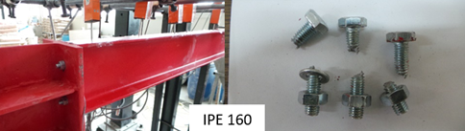
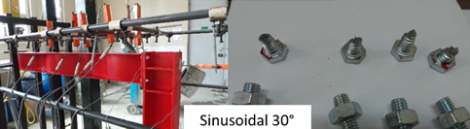
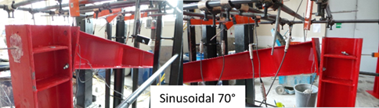
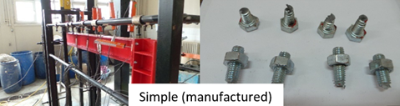
Test specimens
Standart IPE profile
Sinusoidal 30º
Sinusoidal 70º
Manufactured beam
Notes:
The observed collapse modes of the models are presented in Figures. All of the bolts used in the models show similar failure patterns with 45o angles.
The number of broken bolts is three for the sinusoidal 70o model, four for other models.
The failures of the bolts are obtained from the top down, as expected.

Slide 16
Conclusion
The purpose of these experiments is to understand the effects of sinus-type beam composites on end-plates and to provide data necessary to improve Eurocode 3

Slide 17
The knee-range is observed for the manufactured model. The knee-range values of the manufactured model are higher than for other models. Therefore, the knee-range is increased with the increasing sinus degree of the web from 30° to 70°
The plastic flexural resistance, maximum bending moment, and bending moment capacity are increased with the increasing sinus degree of the web. Therefore, the rotation plastic flexural resistance is increased with the increasing sinus degree of the web.
The rate of rise of the initial stiffness to the post-limit stiffness values of the I profile is higher than in the sinus and manufactured models. The rotation at the maximum bending moment and the rotation plastic flexural resistance is increased with the increasing sinus degree of the web.

Slide 18
The Ψ_{j} and Ψ_{j.max.load} values of the sinusoidal 30° model are higher than for the manufactured and sinusoidal 70° manufactured models. Moreover, it is observed that Ψj in the IPE160 model is greater than in the manufactured, sinusoidal 30°, and sinusoidal 70° specimens.
The Ψ_{j.maxload} values of the IPE160 beam are greater than those of the sinusoidal 70° and manufactured models.
The energy dissipation capacity values of the manufactured model are higher than for other models. Moreover, energy dissipation capacity values of the sinusoidal 70° model are higher than for the sinusoidal 30° and IPE160 models.
Therefore, despite the fact that the ductility of a sinus beam joint is lower than for other models, the energy dissipated in sinus models is greater than in other models.

Slide 19
As a result, the sinus models are better than other models for use in industry.
All of the bolts used in the models show similar failure patterns with 45° angles. However, the number of broken bolts is four, except for the sinusoidal 70° models, which have three broken bolts.
The failures of the bolts were obtained from the top down, as expected.

Slide 20
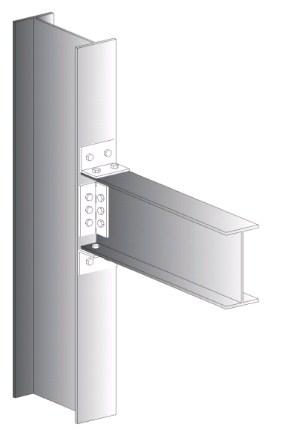
Thanks for your attention
merve.sagiroglu@erzurum.edu.tr
Dr. Merve SAGIROGLU
TURKEY
Steel Structure-2015
Dubai, 16 – 18 November 2015

