Slide 1


Slide 2



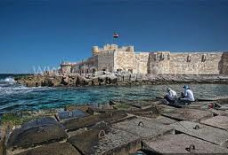
Biosurfactants Production by Bacillus Strain from an Environmental Sample in Egypt
Presented by
Mervat Amin Kassem, M.Sc., Ph.D.
Faculty of Pharmacy, Alexandria University, EGYPT

Slide 3
INTRODUCTION

Slide 4
Notes:
What is surface active agent?
They are cpd that reduce the surface tension at the interface between the oily and aqueous medium. They have many application cosmetics, pharmaceuticals, food and machinery manufacture
They were classified according to their origin into:
Chemically synthesized surfactants e.g sodium lauryl sulphate and naturally produced surfactants
The naturally produced ones are those produce by living organisms
animals e.g lecithin (originally from egg yolk)
Plant e.g saponin
Microorganisms, where 90% of biosurfactants are produced as secondary metabolite by microorgansims

Slide 5
Notes:
biosurfactants could be classified according to their structures to:
Low-Mass Biosurfactants include:
Glycolipids e.g rhamnolipids produce P. aeruginosa
Lipopeptides and lipoproteins e.g surfactin by B. subtilis
Fatty acids, phospholipids and neutral lipids
High-Mass Biosurfactants include:
Polymeric biosurfactants e.g. emulsan produced by Acinetobacter calcoaceticus
Particulate biosurfactants e.g. Whole microbial cells of Cyanobacteria

Slide 6
Advantages of biosurfactants over chemical surface active agents
Low toxicity
Good biodegradability
Effectiveness at extreme temperatures or pH values
Ecological acceptability
Selectivity
Suitability for large-scale production
Notes:
Therefore, biosurfactants attracted attention in various fields.

Slide 7
Notes:
Biosurfactants have:
1- Medical and pharmaceutical application
e.g. in nanotechnology and drug delivery system and cosmetics
As antimicrobial agents as antibacterial, antifungal , antiviral, and anti biofilm e.g. gramicidin S of B. brevis and polymyxins
Biomedical application e.g agents supplementing the pulmonary surfactant and as adjuvants for vaccines, suitable anti-adhesion biological coatings for implant materials.
2- Environmental application
e.g. in biodegradation of hydrocarbon and oil recovery

Slide 8
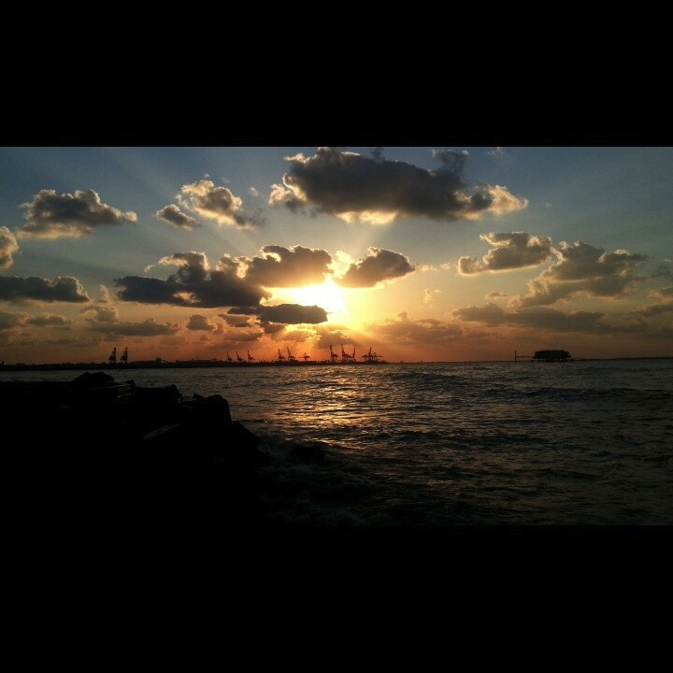
Aim of the work
Alexandria

Slide 9
Aim of the Study
Optimize the yield of biosurfactants produced by B. subtilis isolated from environmental sample in Egypt

Slide 10
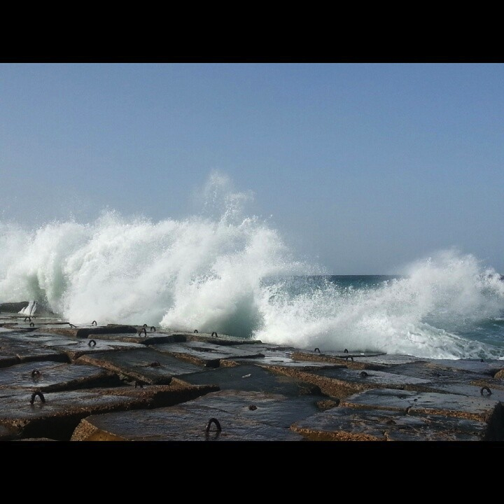
Results
Alexandria

Slide 11
RESULTS
Notes:
68 microorganisms were collected and isolated from different sources
13 were standard strains
17 were isolated from cliniical samples and the majority were isoalted from environmental samples

Slide 12
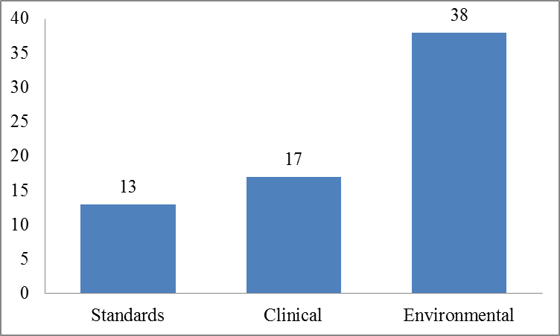
Isolation and Collection of Microbial Isolates
38
17
13
Notes:
In this study, a total of 68 microbial strains were collected from different sources under aseptic conditions.
13 strains were standard strains obtained from ATCC, NCTC and DSM).
17 microbial isolates were collected from various clinical sources.
38 strains were isolated from environmental sources including different type of soils, sewage and water

Slide 13
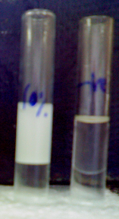
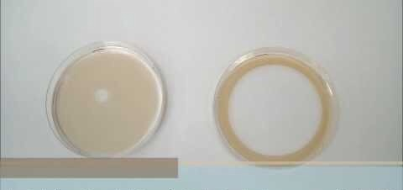
Screening of Biosurfactants-Producing Microbial Isolates using OST (mm) and EI24 (%)
Notes:
Oil spreading technique:
A small Petri dish (140 mm in diameter) was filled with 40 mL DW, 20 µL of n-hexadecane was added to the surface of the water then 20 µL of the resultant culture was aseptically withdrawn and placed in the centre of the oil drop.
The spreading of oil on the surface of water was measured in mm using graph paper.
The spreading of oil on the surface of water is directly proportional to concentration of the biosurfactants in the culture.
The more was the spreading of oil on the surface of water, the higher was the concentration of biosurfactants in tested culture.
Emulsification Index (%) (EI24
Volume of paraffin oil was vortexed using vortex with equal volume of the resultant bacterial CDM culture for 1 min. After 24 h the EI24 was measured as follows:
(Height of emulsified layer/total height of the both layers)*100
In this experiment, 10% sodium dodecyl sulphate (SDS) solution was used as a positive control and E. coli NCTC 8739 culture in CDM was used as a negative control and sterile CDM was used as a blank.

Slide 14
Screening of Biosurfactants-Producing Microbial Isolates using OST (mm) and EI24 (%)
Isolate Code | Average oil spreading (mm) | EI24 (%)
P103 | 140 | 45.2
6 | 90 | 44
B4 | 60 | 44
Notes:
The results showed that 12 isolates are biosurfactants producer, where P103, isolate 6 and B4 were the most potent biosurfctants producing isolates

Slide 15
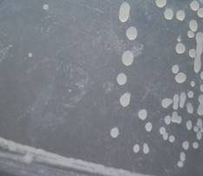
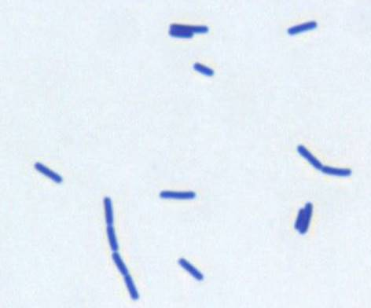
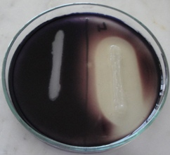
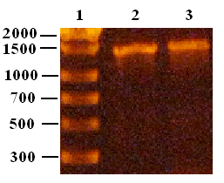
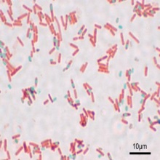
Characterization of B4 Biosurfactants-
Producing Microbial Strain
Notes:
The study was continued on isolate B4 which was isolated from environmental sample (sea water in Alexandria)
First morphological characterization showed Large white opaque colony
Microscopical charcterization, examined using gram stain and spore stain
Gram stain: Gram positive thick long rods
Spore stain: they spore forming
2- Biochemical charcterization: through Detection of amylase enzyme production using starch agar as a medium and Lugol’s solution as indicator using E.coli as negative control. The results showed positove amylase production
3- Molecular charcterization using PCR of 16S rDNA followed by sequencing of PCR products

Slide 16
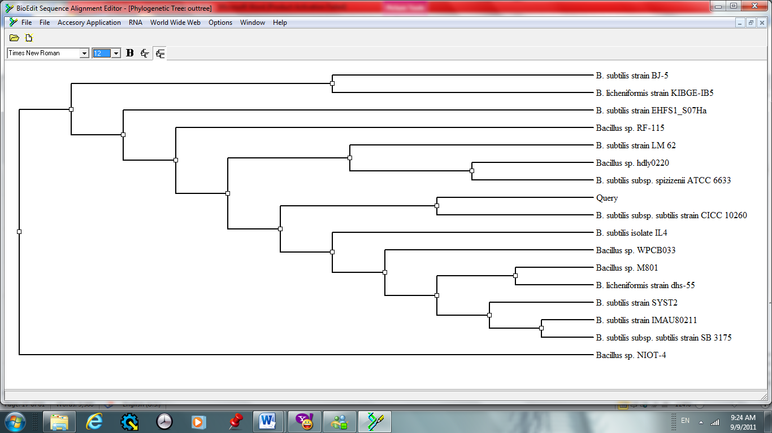
Sequence alignment and construction of phylogenetic tree of isolate B4 using Nucleotide BLAST and BioEdit Sequence Alignment Editor Program
Notes:
The nucleotide sequences were searched for homology against GenBank database using Nucleotide BLAST search tool (blastn). The obtained homology matches for each isolate were then aligned together with the isolate sequence to obtain multiple sequence alignment. The multiple sequence alignments were used to construct Maximum Likelihood Phylogenetic tree using BioEdit Sequence Alignment Editor Program. After construction of phylogenetic trees it was verified that B4 is B. subtilis strain.

Slide 17
Optimization of Biosurfactants Production from B. subtilis isolate Using Experimental
Factorial Design
Notes:
The second step in our study was to optimize the culture medium for the maximum production of biosurfactants. This optimization step was done using experimental factorial design.
The experimental design envolved 3 steps:
1- placket burman
2-box behken
3- model verification

Slide 18
1- Screening for 11 Variables Affecting the Biosurfactants Production in 2 Different Levels Using Plackett-Burman Design
Variables | Variables name | Low level (-1) | High level (+1)
F1 | Inoculum size | 10⁵ cell/mL | 10⁶ cell/mL
F2 | Temperature | 30°C | 37°C
F3 | pH | 6.5 | 7.5
F4 | Glucose | 0.5 % | 2 g%
F5 | Glycerol | 0.5 % | 2 g%
F6 | Yeast extract | 0 | 0.01 g%
F7 | Peptone | 0 | 0.01 g%
F8 | NH₄Cl | 0 | 0.02 g%
F9 | NH₄NO₃ | 0 | 0.02 g%
F10 | (NH₄)₂SO₄ | 0 | 0.02 g%
F11 | Mineral salts | 0 | present*
Notes:
1- placket buramn design
11 variables which may affect the biosurfcatnts pdtn were selected in two different levels (high and low levels) sympol by +1 and -1
They were (and mention the 11 variable)
Then they were screened experimentally in 20 trial using placket burman design matrix and the surface tension was tested for each trial. The response was the reciprocal of surface tension multiplied by 1000.

Slide 19
1- Screening for 11 Variables Affecting the Biosurfactants Production by B4 in 2 Different Levels Using Plackett-Burman Design
Exp # | F1 | F2 | F3 | F4 | F5 | F6 | F7 | F8 | F9 | F10 | F11 | Response*
1 | 1 | -1 | 1 | 1 | 1 | 1 | -1 | -1 | 1 | 1 | 1 | 68
2 | -1 | -1 | -1 | -1 | -1 | -1 | -1 | -1 | -1 | -1 | -1 | 19
3 | 1 | 1 | -1 | -1 | 1 | 1 | -1 | 1 | 1 | -1 | -1 | 30
4 | -1 | 1 | -1 | 1 | -1 | 1 | 1 | 1 | 1 | -1 | 1 | 45
5 | -1 | -1 | -1 | 1 | -1 | 1 | -1 | 1 | 1 | 1 | -1 | 61
6 | -1 | 1 | 1 | -1 | 1 | 1 | -1 | -1 | -1 | -1 | 1 | 37
7 | -1 | 1 | 1 | -1 | -1 | -1 | -1 | 1 | -1 | 1 | 1 | 19
8 | 1 | 1 | -1 | -1 | -1 | -1 | 1 | -1 | 1 | -1 | 1 | 18
9 | 1 | -1 | -1 | -1 | -1 | 1 | -1 | 1 | -1 | 1 | 1 | 21
10 | 1 | 1 | 1 | -1 | -1 | 1 | 1 | -1 | 1 | 1 | -1 | 45
11 | 1 | -1 | -1 | 1 | 1 | -1 | 1 | 1 | -1 | -1 | 1 | 20
12 | -1 | 1 | -1 | 1 | 1 | 1 | 1 | -1 | -1 | 1 | 1 | 19
13 | -1 | -1 | 1 | 1 | -1 | 1 | 1 | -1 | -1 | -1 | -1 | 39
14 | -1 | -1 | -1 | -1 | 1 | -1 | 1 | -1 | 1 | 1 | -1 | 33
15 | -1 | -1 | 1 | -1 | 1 | -1 | 1 | 1 | 1 | 1 | 1 | 46
16 | 1 | -1 | 1 | 1 | -1 | -1 | -1 | -1 | 1 | -1 | 1 | 56
17 | 1 | -1 | 1 | -1 | 1 | 1 | 1 | 1 | -1 | -1 | -1 | 45
18 | 1 | 1 | 1 | 1 | -1 | -1 | 1 | 1 | -1 | 1 | -1 | 18
19 | 1 | 1 | -1 | 1 | 1 | -1 | -1 | -1 | -1 | 1 | -1 | 22
20 | -1 | 1 | 1 | 1 | 1 | -1 | -1 | 1 | 1 | -1 | -1 | 78
Notes:
1- placket buramn design
11 variables which may affect the biosurfcatnts pdtn were selected in two different levels (high and low levels) sympol by +1 and -1
They were (and mention the 11 variable)
Then they were screened experimentally in 20 trial using placket burman design matrix and the surface tension was examined for each trial. The response was the reciprocal of surface tension multiplied by 1000.
When analyzing the regression coefficients for the 11 variables, pH, glucose, glycerol, yeast extract, ammonium chloride and ammonium nitrate showed positive effect on the biosurfactants production. On the other hand, all the other variables showed negative effect. From the statistical analysis of the Plackett-Burman design using Microsoft Excel tools, ammonium nitrate, pH and glucose were having the least P-values in an ascending order, therefore, they were most significant factors affecting the biosurfactants production from isolate B4

Slide 20
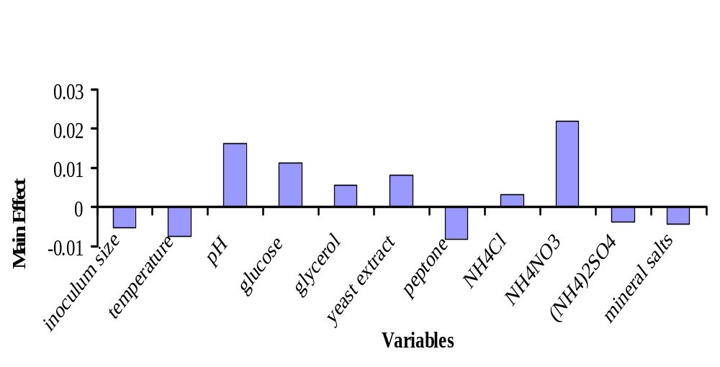
1- Screening for 11 Variables Affecting the Biosurfactants Production by tested Bacillus in 2
Different Levels Using Plackett-Burman Design
Notes:
1- placket buramn design
When analyzing the regression coefficients for the 11 variables, pH, glucose, glycerol, yeast extract, ammonium chloride and ammonium nitrate showed positive effect on the biosurfactants production.
On the other hand, all the other variables showed negative effect.
From the statistical analysis of the Plackett-Burman design using Microsoft Excel tools, ammonium nitrate, pH and glucose, were the most significant factors affecting the biosurfactants production from isolate

Slide 21
2- Optimization of the Level of the 3 Significant Independent Variables in Culture Conditions Using Box-Behnken Design (Response Surface Methodology)
level | pH | Glucose | Ammonium nitrate
1 | 7.8 | 3% | 0.30%
0 | 7.3 | 2% | 0.20%
-1 | 6.8 | 1% | 0.10%
Notes:
The significant independent variables (pH, X₁; glucose, X₂; ammonium nitrate, X₃) were further explored at three levels

Slide 22
2- Optimization of the Level of the 3 Significant Independent Variables in Culture Conditions Using Box-Behnken Design (Response Surface Methodology)
Exp # | pH | Glucose | Ammonium nitrate | Response*
1 | -1 | -1 | 0 | 52.5
2 | 0 | -1 | -1 | 44.6
3 | -1 | 0 | 1 | 45.4
4 | -1 | 1 | 0 | 54.05
5 | 0 | 0 | 0 | 54.05
6 | 1 | 1 | 0 | 53.19
7 | 0 | 1 | -1 | 46.08
8 | 0 | -1 | 1 | 45.04
9 | 0 | 0 | 0 | 53.19
10 | 1 | 0 | -1 | 44.24
11 | 1 | -1 | 0 | 46.51
12 | 0 | 0 | 0 | 53.19
13 | 0 | 1 | 1 | 49.26
14 | 1 | 0 | 1 | 45.45
15 | -1 | 0 | -1 | 46.94
Notes:
Table presents the design matrix for the variables and the response of each trial, where the response here was the reciprocal of the corrected surface tension (measured by tensiometer).

Slide 23
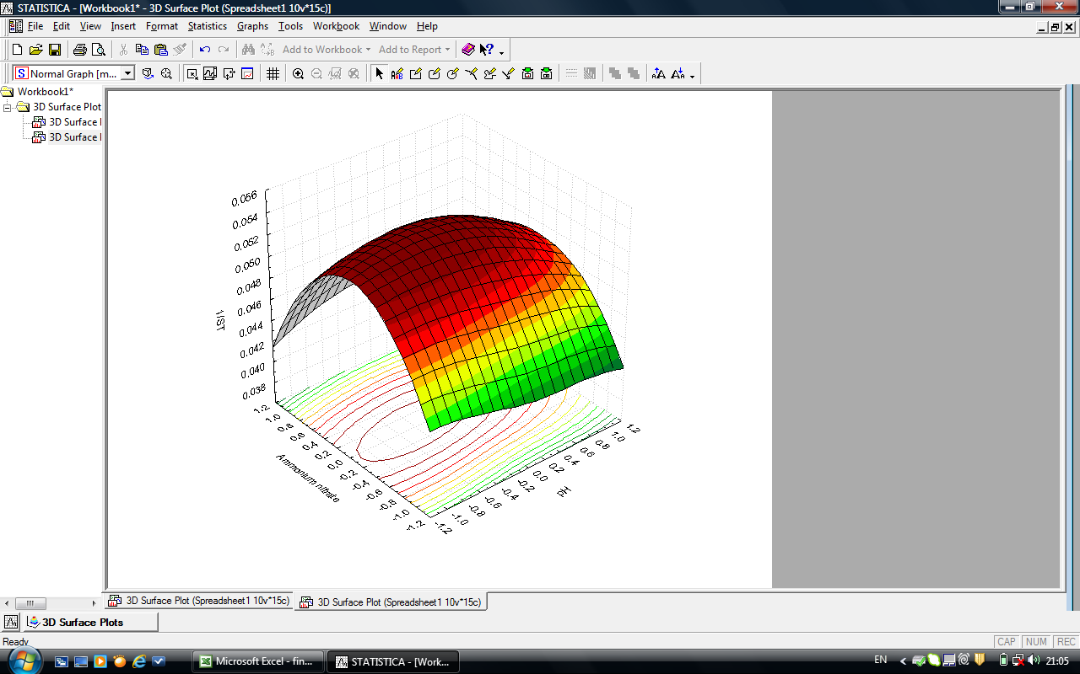
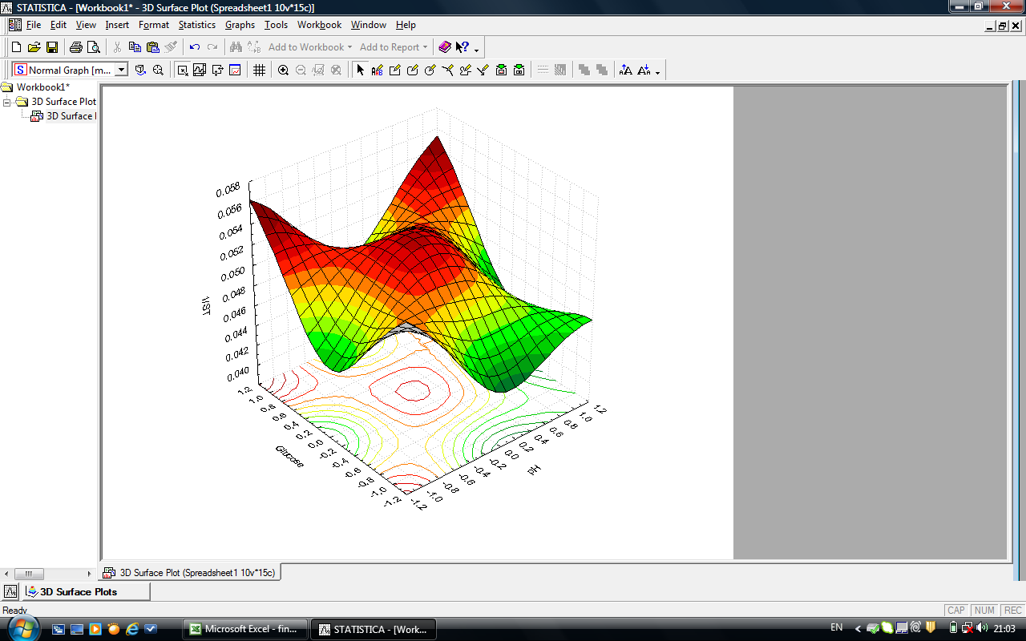
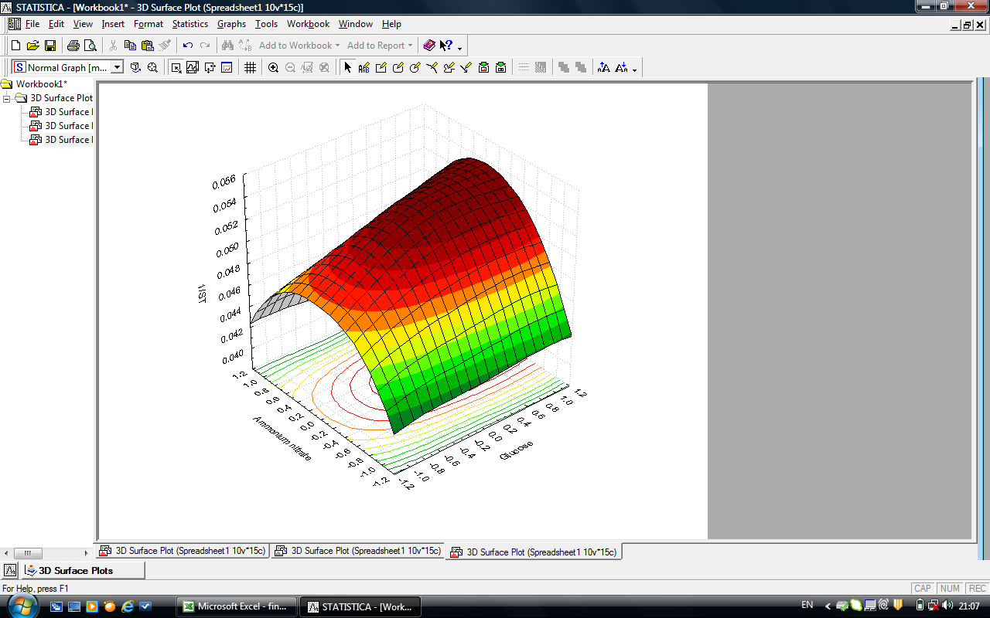
2- Optimization of the Level of the 3 Significant Independent Variables in Culture Conditions Using Box-Behnken Design (Response Surface Methodology)
Notes:
The optimal levels of the three factors were:
pH equal to 7.323, 3 g% glucose and 0.208 g % ammonium nitrate with the predicted surface tension equal to 18.29 mN/m.
These Figures show the simultaneous effects of the three most significant independent factors on each response using three-dimensional graphs generated by STATISTICA 5.0 software. Graph A showed the interaction of pH and glucose. Moreover, many foci of maximum reciprocal of surface tension were shown in Graph A while in Graph B, there is a great area of maximum 1/ST due to the interaction of pH and ammonium nitrate at low pH value. In Graph C, high glucose value with -middle values of ammonium nitrate gave the maximum biosurfactants yield.

Slide 24
3- Verification of the Final Culture Condition Model for Maximum Biosurfactants Production by B4 Isolate
Components | Concentration (g)
Na₂HPO₄ | 0.36
KH₂PO₄ | 0.24
NH₄Cl | 0.2
NH₄NO₃ | 0.208
Yeast Extract | 0.1
Glycerol | 2
Glucose* | 3
H₂O | to 100 mL
pH | 7.323
Inoculum size | 10⁵ cells/mL
Incubation temperature | 30°C
Predicted ST | 18.29 mN/m
Experimental ST | 18.16 mN/m
Notes:
The estimated surface tension was 18.16 mN/m, whereas the predicted value from the polynomial model was 18.29 mN/m. The optimum formula for the maximum production of biosurfactants from B. subtilis isolate B4 was as in the slide

Slide 25
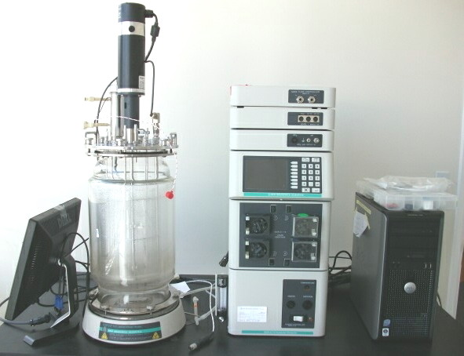
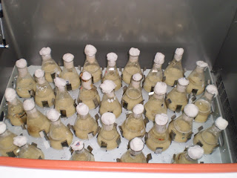
Study of Cell Growth and Biosurfactants Production of isolate B4 Kinetics on Shake Flask and Bioreactor Scales

Slide 26
Comparison of Kinetics Parameters in Shake Flask and Bioreactor Culture
Parameter | Type of cultivation vessel
 | Shake flask | Bioreactor
OD_{max} | 0.87 | 1.09
Growth rate [h⁻¹] | 0.1325 | 0.115
µ [h⁻¹] | 0.305 | 0.468
ST_{min} [mNm⁻¹] | 11.1 | 11.2
Q_{P} [mNm⁻¹ h⁻¹] | -7.35 | -4.5
Qglu [g L⁻¹ h⁻¹] | -0.225 | -0.65
Notes:
5.2.1. In Shake Flask Culture:
As shown, the cells grew exponentially and reached its maximal OD value of 0.87, at 600 nm, after 12 h with maximum specific growth rate of 0.305 h⁻¹. As seen from Table and as examined using the phase contrast microscope, the cells of tested isolate were in the vegetative form of the thick long rods with chain arrangement up to 29 h. From the 32nd h and up to the end of the run, the microscopical examination demonstrated the sporulated form of Bacillus together with the vegetative cells. In addition, during this growth, the glucose consumption was with volumetric rate (Qglu) of 0.0225 g%h⁻¹. On the other hand, it was observed that the surface tension of the medium was reduced reaching minimum surface tension of 11.1 mN/m.
5.2.2. In Bioreactor Culture:
The patterns of OD at 600 nm, glucose consumption, pH, DO and surface tension of the medium during biosurfactants production from B. subtilis isolate B4 in bioreactor culture for 54 h were presented in Figure 31 and Tables XXVI and XXVII. Compared to shake flask culture, it was found that the maximum specific growth rate and glucose consumption rate were higher in bioreactor culture by 53% and 188%, respectively, where the cell growth reached a high value of 0.97 at 16 h in specific growth rate of 0.468 h⁻¹. It was also seen, using the microscopical examination, that the grown cells passed different stages, beginning with the vegetative form, then vegetative cells with their terminal spores, and finally the scattered oval spores.
Furthermore, during this growth, the volumetric consumption rate of glucose was 0.065 g%h⁻¹ while the DO decreased and reached the minimum value of almost 2 % after 36 h and then increased to 56% of saturation at the end of the run. The value of pH almost decreased from 7.3 to 6.92 from the beginning of the run and up to 16 h then began to increase again but within the same range of pH. On the other hand, for biosurfactants production, it was observed that the surface tension of medium was reduced to minimum value of 11.2 mN/m, at 16 h too.

Slide 27
Kinetics on Shake Flask and Bioreactor Scales
Notes:
5.2.1. In Shake Flask Culture:
As shown the cells grew exponentially and reached its maximal OD value of 0.87, at 600 nm,
5.2.2. In Bioreactor Culture:
The patterns of OD at 600 nm, and surface tension of the medium during biosurfactants production from B. subtilis isolate B4 in bioreactor culture for 54 h presented in Figure. Compared to shake flask culture, it was found that the cell growth reached a high value of 0.97 at 16 h.

Slide 28
CONCLUSIONS
The combined pharmaceutical activities for some biosurfactants together with their stability at extreme condition may allow their use as a multifunctional material in pharmaceutical preparation.
Statistical experimental design is an accurate, easy and time saving technique for preparing an optimized medium necessary for the maximum production of secondary metabolites, such as biosurfactants, for scaling up modeling.
For more application studies, further researches are needed for good recovery and purification of biosurfactants in high concentration.

Slide 29
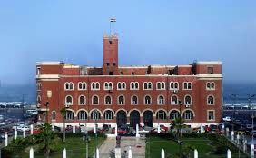
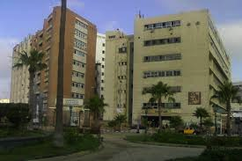
Acknowledgement
Alexandria University
Faculty of Pharmacy
Assistant Prof. Fatma Dabous, Prof. Dr. Hamida AbouShlieb,
Prof. Dr. Nourhan Fanaki.

Slide 30
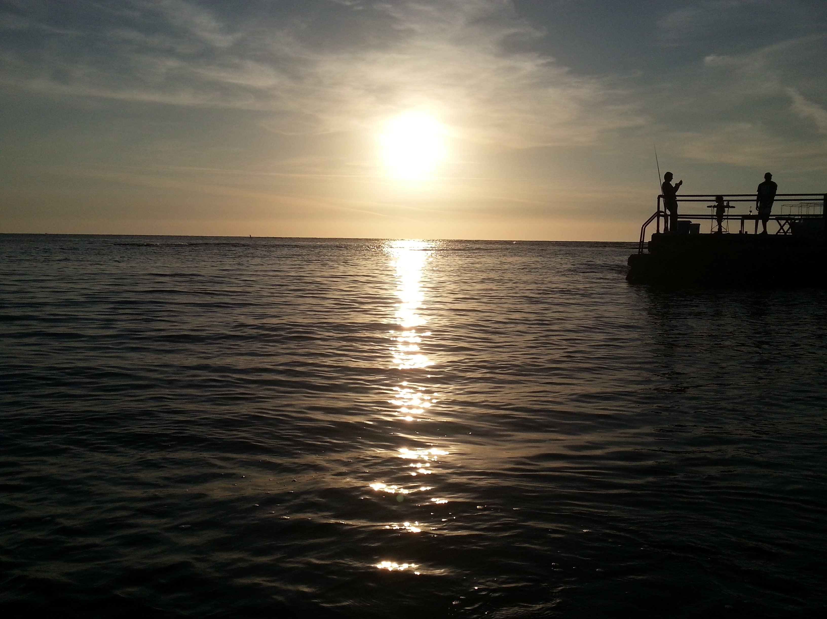
Lovely Alexandria
Schönen Alexandria
EGYPT
Ägypten
THANK YOU
DANKE

