Slide 1


Slide 2



Characterization and kinetics study for rhamnolipids produced by an environmental
Pseudomonas aeruginosa isolate
Presented by
Mervat Amin Kassem, M.Sc., Ph.D.
Faculty of Pharmacy, Alexandria University, EGYPT

Slide 3
Notes:
What is surface active agent?
They are cpd that reduce the surface tension at the interface between the oily and aqueous medium. They have many application cosmetics, pharmaceuticals, food and machinery manufacture They were classified according to their origin into:
Chemically synthesized surfactants e.g sodium lauryl sulphate
The naturally produced ones are those produce by living organisms …. animals e.g lecithin (originally from egg yolk) …. Plant e.g saponin
Microorganisms, where 90% of biosurfactants are produced as secondary metabolite by microorganisms

Slide 4
Notes:
biosurfactants could be classified according to their structures to: …. Low-Mass Biosurfactants include:
Glycolipids e.g rhamnolipids produce P. aeruginosa… Lipopeptides and lipoproteins e.g surfactin by B. subtilis… Fatty acids, phospholipids and neutral lipids
High-Mass Biosurfactants include:… Polymeric biosurfactants e.g. emulsan produced by Acinetobacter calcoaceticus
Particulate biosurfactants e.g. Whole microbial cells of Cyanobacteria

Slide 5
Advantages of biosurfactants over
chemical surface active agents
Low toxicity
Effectiveness at extreme temperatures or pH values
Good biodegradability
Selectivity
Suitability for large-scale production
Notes:
Therefore, biosurfactants attracted attention in various fields.
They are considered as low or non-toxic products and therefore, they are suitable for pharmaceutical, cosmetic and food
Desai & Banat reported CMC about 10–40 times lower than that of chemical surfactants, Thus smaller concentrations of biosurfactant are needed to effectively reduce the surface and interfacial tensions
Nitschke & Pastore reported a lipopeptide from B. subtilis LB5a was stable after autoclaving (121°C/20 min) and after 6 months storage at –18°C. this biosurfactant could also tolerate pH 5 and up to 11 and in presence of NaCl up to 20% concentrations.
Because of this environment friendly nature, they are easily degraded which suited them for environmental applications such as bioremediation and dispersion of oil spills
Biosurfactants are highly Specific therefore they are used in detoxification of specific pollutants, de-emulsification of industrial emulsions and specific cosmotics.

Slide 6
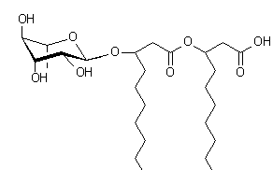
Glycolipids
Mono- or disaccharides combined with long-chain aliphatic acids
Rhamnolipids
The principal glycolipids produced by P. aeruginosa

Slide 7
Physiological Role of Biosurfactants
Nutrient transport
Protection against many bacteria and fungi
For the motility of microorganisms
e.g. surfactin and rhamnolipids
For the attachment and detachment of microorganisms
e.g. rhamnolipids maintain architecture of Pseudomonas biofilms

Slide 8
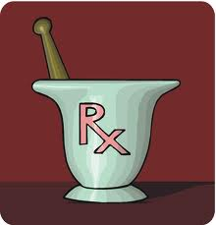

Notes:
Biosurfactants have:
1- Medical and pharmaceutical application
e.g. in nanotechnology and drug delivery system and cosmetics
As antimicrobial agents as antibacterial, antifungal , antiviral, and anti biofilm
Biomedical application e.g agents supplementing the pulmonary surfactant and as adjuvants for vaccines, suitable anti-adhesion biological coatings for implant materials.
2- Environmental application
e.g. in biodegradation of hydrocarbon and oil recovery, Biosurfactants can be efficiently used in handling industrial emulsions, control of oil spills, biodegradation and detoxification of industrial effluents and in bioremediation of contaminated soil

Slide 9
II-As Antimicrobial Agent
Antibacterial agent
Rhamnolipids E. coli, S. marcescens, M. phlei , S. epidermidis
Lipopeptide Gram negative bacteria
Antifungal agent (Iturin A and rhamnolipids)
Antiviral agent
Glycolipids HSV and influenza
Surfactin HSV, HIV-1

Slide 10
III- Other Biomedical Applications
Cosmetic and healthcare industries
Anti-adhesion biological coatings for implant materials
e.g. Biosurfactants of L. acidophilus uropathogens E. coli, Enterococcus faecalis and yeast on silicone rubber
Emulsifying agents for drug transport to the infection site
Agents supplementing the pulmonary surfactant
Adjuvants for vaccines
Anti-cancer activity

Slide 11

Aim of the work
Alexandria

Slide 12
Aim of the Study
Select biosurfactants-producing microorganisms in Egypt and Optimize the yield of biosurfactants
Study of kinetics of rhamnolipids for large scale economical production.
Testing some of rhamnolipids characters such as; emulsification, antimicrobial and antibiofilm activities.

Slide 13
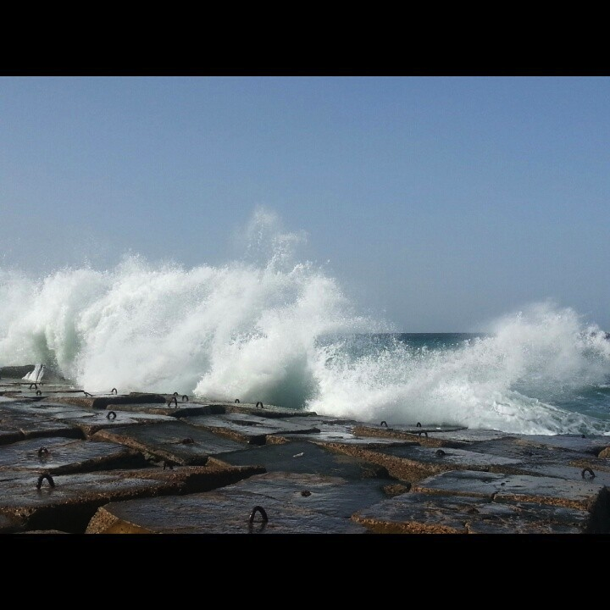
Results
Alexandria

Slide 14
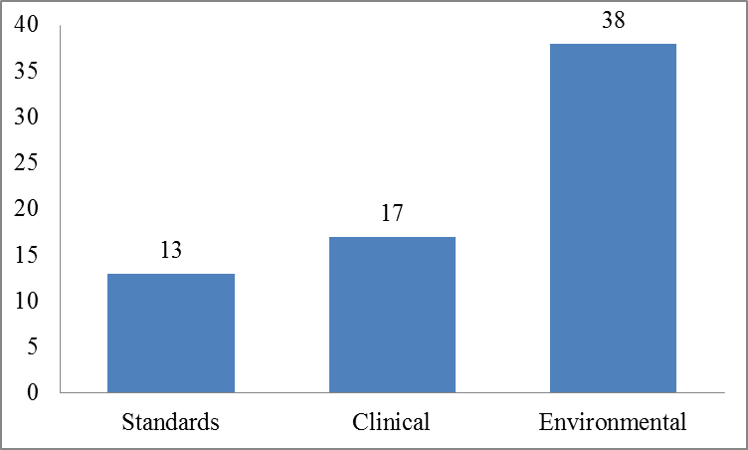
Isolation and Collection of Microbial Isolates
38
17
13
Notes:
In this study, a total of 68 microbial strains were collected from different sources under aseptic conditions.
13 strains were standard strains obtained from ATCC, NCTC and DSM).
17 microbial isolates were collected from various clinical sources.
38 strains were isolated from environmental sources including different type of soils, sewage and water

Slide 15
Screening of Biosurfactants-Producing Microbial Isolates using OST (mm) and EI24 (%)
Isolate Code | Average oil spreading (mm) | EI24 (%)
P103 | 140 | 45.2
6 | 90 | 44
B4 | 60 | 44
Notes:
The results showed that 12 isolates are biosurfactants producer, where P103, isolate 6 and B4 were the most potent biosurfactants producing isolates
The study was continued on isolate B4 which was isolated from sea water in Alexandria

Slide 16
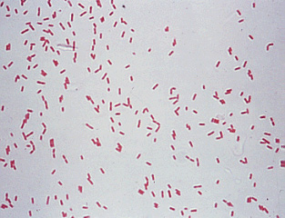
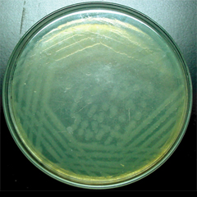
Characterization of Biosurfactants-Producing Microbial Strains
Macroscopical and Microscopical Characterization
Biochemical Characterization
Molecular Characterization

Slide 17
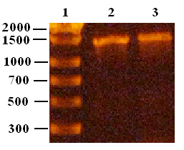
Molecular Characterization Using 16S rDNA gene of Isolates P6
i- PCR amplification of 16S rDNA gene
ii- Sequencing of PCR product

Slide 18
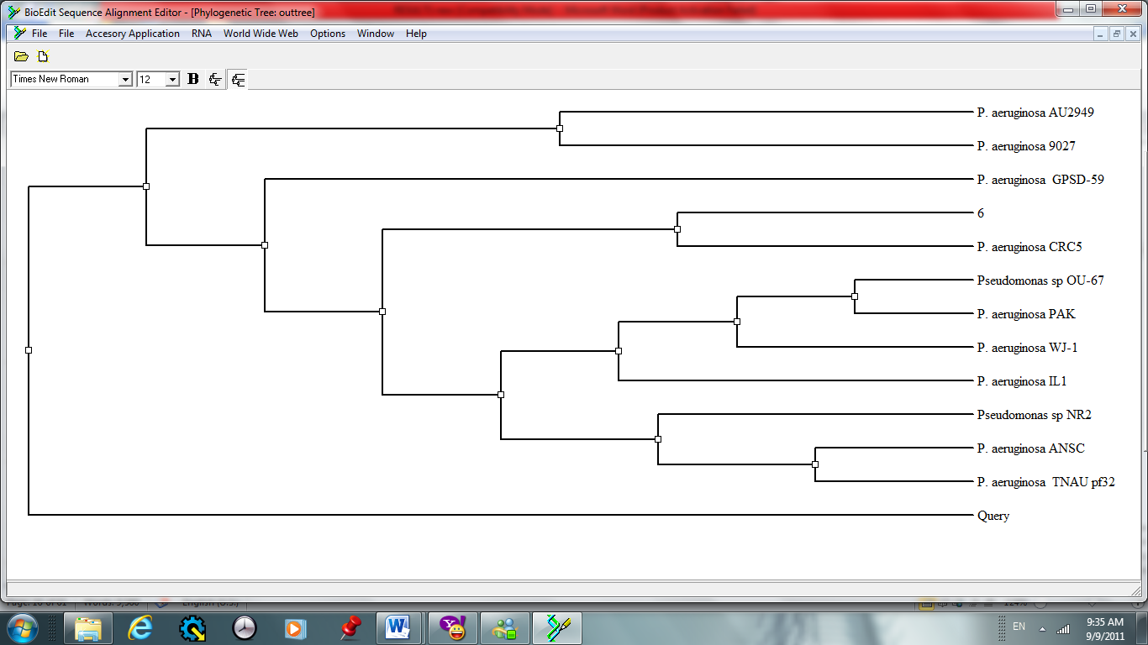
Sequence alignment and construction of phylogenetic tree of isolate P6

Slide 19
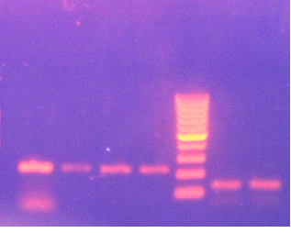
Detection of rhlB and rhlC genes in P. aeruginosa Isolate Using PCR
1 2 3 4 5
rhlB
rhlC

Slide 20
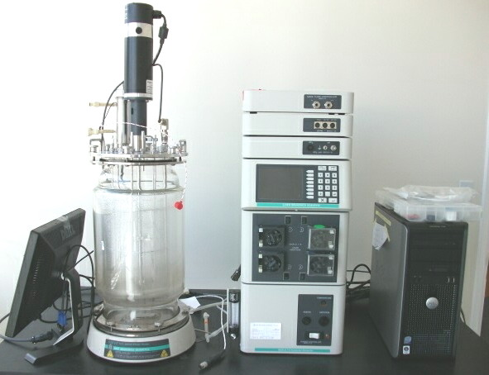
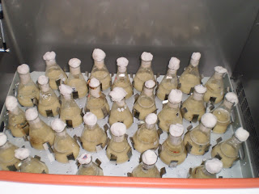
Study of Cell Growth and Biosurfactants Production Kinetics on Shake Flask and Bioreactor Scales
Notes:
The kinetics of cell growth and biosurfactants productionl were compared in shake flask and the fermentor Using a batch culture, where the seed culture was inoculated into a 7 L flask containing 4 L of an optimized medium.
the bioreactor was characterized by about 35% higher cell mass and specific growth rate (µ). The increased growth in the bioreactor may be due to higher aeration and agitation which reflected better mixing between the air/liquid phase and increased oxygen availability in culture

Slide 21
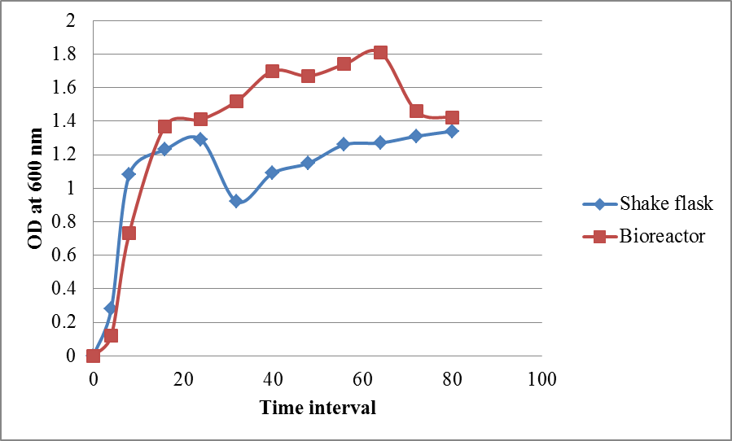
Kinetics of Cell Growth
Notes:
In shake flasks, the cells grew exponentially and reached its maximal OD600 value of 0.87 after 12h, whereas the cell growth reached a high value of 0.97 at 16 h in the Bioreactor.

Slide 22
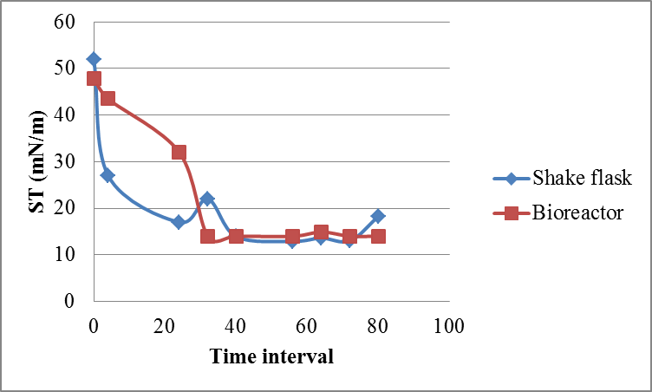
Kinetics of Biosurfactants Production
Notes:
In shake flasks, the surface tension of the medium was reduced reaching minimum surface tension of 11.1 mN/m.
In bioreactor, the surface tension of medium was reduced to minimum value of 11.2 mN/m
The 75% and 70% reduction of ST was due to maximum rhamnolipids production

Slide 23
Kinetics of Cell Growth and
Biosurfactants Production

Slide 24
Kinetics of cell growth and biosurfactants production during batch cultivation of P. aeruginosa in shake flask
Surface tension in mN/m
pH
OD at 600 nm
Glucose conc (g%)

Slide 25
Kinetics of cell growth and biosurfactants production during batch cultivation of P. aeruginosa in bioreactor
Surface tension in mN/m
pH
OD at 600 nm
Glucose conc (g%)
DO %

Slide 26
Kinetic parameters of cell growth and biosurfactants production during shake flask and bioreactor cultivations
Parameter | Cultivation Vessel
 | Shake flask | Bioreactor
OD_{max} | 1.34 | 1.81
Growth rate [h⁻¹] | 0.2 | 0.15
µ [h⁻¹] | 0.337 | 0.451
ST_{min} [mNm⁻¹] | 12.9 | 13.9
Q_{P} [mNm⁻¹ h⁻¹] | -6.25 | -4.3
Qglu [gL⁻¹ h⁻¹] | -0.18625 | -0.12
OD_{max}: the maximum optical density at 600 nm, µ: specific cell growth rate
ST_{min}: minimum surface tension (mN/m), Qglu: glucose consumption rate
Q_{p}: the surface tension reduction rate (biosurfactants production rate)

Slide 27
In order to apply the rhamnolipids biosurfactants in industry, it was necessary to characterize the biosurfactants solution. Therefore, the biosurfactants solution was subjected to some stability studies including many factors

Slide 28
Effect of pH on the surface activity of the biosurfactants solution
Notes:
They were stable at pH range 2 to 14, however, they precipitated at pH 2.
Therefore, at pH 2, about 2 units below its pKa, the acidic form predominated and precipitation occurred. This may explain why precipitation occurred at low pH without losing the activity.

Slide 29
Effect of different sodium chloride concentrations on the surface activity of the biosurfactants solution
Notes:
as the concentration of NaCl increased, the ST increased indicating instability of rhamnolipids with increasing the salinity strength

Slide 30
Study of Application of Biosurfactants Solution
Emulsification Activity
Antimicrobial Activity
Anti-biofilm Activity

Slide 31
I- The Emulsification Activity
1. The emulsifying activity of the rhamnolipids solution with different oils measured using the emulsification index EI24 (%)
Oil name | EI24 (%) | EI7days
n-hexadecane | 57 | 57
Sesames | 55.5 | 55.5
Wheat germ | 14.3 | 0
Camphor | 58.3 | 58.3
Olive oil | 33.2 | 10.2
Peppermint | 36.4 | 18.2
Paraffin | 47.2 | 44.4
Notes:
The emulsification index EI (%) of partially purified Ps. 6 rhamnolipids solution measured after 1 and 7 days with different oils varied from 33.3% to 57% except in the case of wheat germ oil it was 14.3%,

Slide 32
I- The Emulsification Activity
2. EI 24 (%) of the Biosurfactants Solution Isolated from P. aeruginosa Isolate When Using Different Ratios of Oily and Aqueous Layers
 | Oil : Biosurfactant
 | 1:4 | 1:3 | 1:1 | 3:1 | 4:1
Oil layer volume | 1 | 1 | 1 | 3 | 4
Biosurf. layer volume | 4 | 3 | 1 | 1 | 1
Emulsion layer length | 0.8 | 0.9 | 1 | 2.7 | 3.8
EI 24(%) | 16 | 22.5 | 50 | 67.5 | 76
Notes:
denoting that rhamnolipids emulsions are formed in the oily layer. Similarly, the emulsification indexes EI24 of the biosurfactants isolated from isolate Ps. 6 varied from 33.3% to 58% and it was demonstrated that the emulsion formed was always in the oily layer. In other word, Ps. 6 biosurfactants form water in oil emulsion.

Slide 33
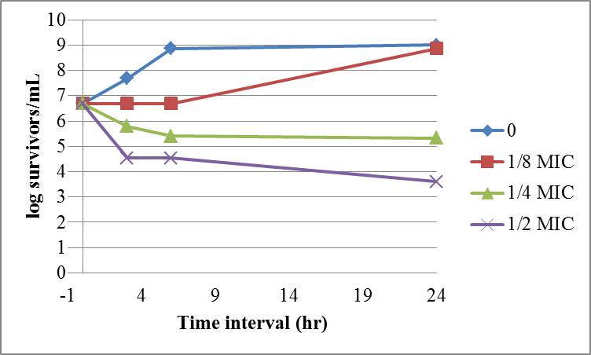
II- Antimicrobial Activity
1- Effect of Biosurfactants Solutions of P. aeruginosa Isolate on the Growth of S. aureus ATCC 6538p

Slide 34
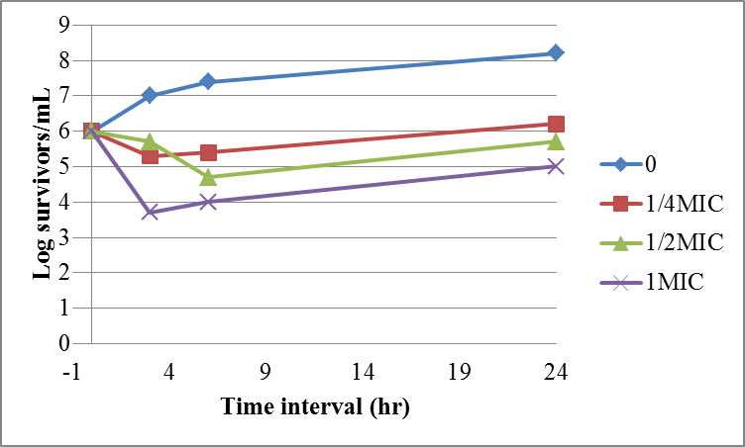
II- Antimicrobial Activity
2- Effect of Biosurfactants Solutions of P. aeruginosa Isolate on the Growth of B. insolitus DSM 5

Slide 35
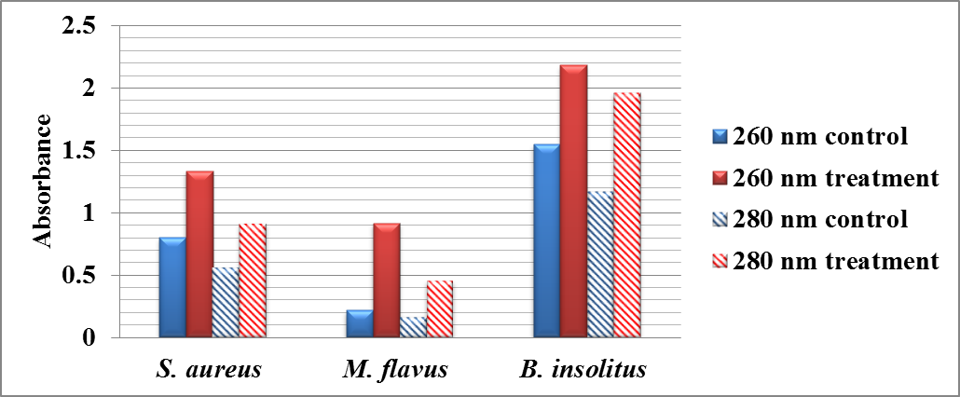
3- Effect of Biosurfactants Solution of P. aeruginosa Isolate on the Leakage of 260 & 280 nm-Absorbing Materials from the Gram Positive Bacterial Cells
Notes:
Biosurfactants enhanced the non-specific permeability of the cytoplasmic membrane in sensitive cells.
In this study, the biosurfactants solution also caused a net loss of the 260 and 280 nm-absorbing materials (proteins and nucleic acids) from the cytoplasmic membrane of some Gram positive bacteria. This may be due to their action on the lipid part of cell membrane or the outer protein causing structural fluctuations in the membrane.

Slide 36
Antimicrobial susceptibility of the rhamnolipids solution
Isolate code | MIC (µg/mL)
Sarcina spp. | 3000
S. aureus | 1500
S35 | 3000
S37 | >3000
S34 | >3000
MRSA | >3000
B.lichenformis | 375
B.subtilis | 375
B.insolitus | 187.5
B.sphericus | 187.5
E2B | >3000
E6B | >3000
K103 | >3000
K104 | >3000
A79 | >3000

Slide 37
Effect of the rhamnolipids solution of on the cytoplasmic membrane of selected Gram positive strains
Strain | 260 nm |  | 280 nm
 | control | treatment | control | treatment
S. aureus ATCC 6538p | 0.801 | 1.336 | 0.561 | 0.918
M. flavus ATCC 9341 | 0.217 | 0.917 | 0.171 | 0.459
B. insolitus DSM 5 | 1.547 | 2.184 | 1.173 | 1.963

Slide 38
4- Efficiency of Biosurfactants Solution of P. aeruginosa Isolate as Preservative Using the Challenge Test
Contact time | Log number of survivors
 | S. aureus | E. coli | P. aeruginosa | C. albicans | A. niger
0 | 6.079 | 6.07 | 6.07 | 5.0 | 5.47
48 hr | 5.6 | 7.07 | 6.414 | 6.47 | 2.3
7 days | 4.44 | 6.255 | 7.3 | 5.8 | 3.17
14 days | 5.74 | 7.24 | 8.3 | 6.9 | 6.09
21 days | 5.6 | 6.8 | 9.3 | 7.23 | 4.69
28 days | 6.47 | 7.3 | 7.39 | 7.24 | 7
Notes:
However, it was found that the tested concentration of the crude biosurfactants solution, <0.3 g%, was not sufficient for preservation.

Slide 39
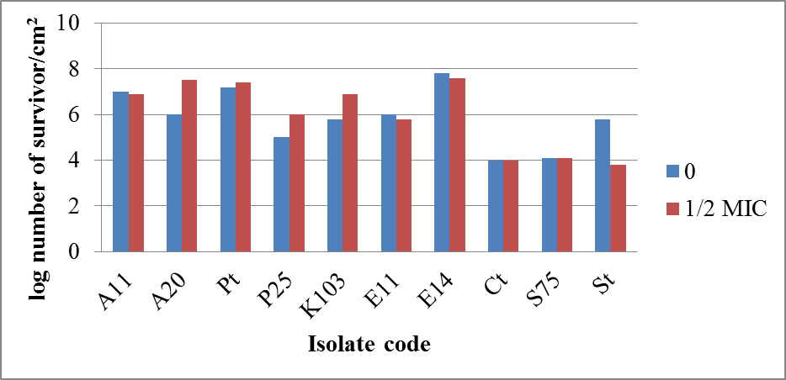
III- The Anti-biofilm Activity of Biosurfactants Solution of P. aeruginosa Isolate
1- Using Surface Viable Count
Notes:
Since the biofilm formation represents a great problem in pharmaceutical and medical field it was important to test the antibiofilm-forming activity of Ps. 6 biosurfactant solution
Ps. 6 rhamnolipids reduced the biofilm formation by S. aureus ATCC 6538p by > 2 log units
However, it was found that this biosurfactants solution increased the biofilm formed by some Gram negative isolates, in this study. It could be explained by that rhamnolipids are essential to maintain the architecture of Pseudomonas biofilms and they are considered as one of its virulence factors

Slide 40
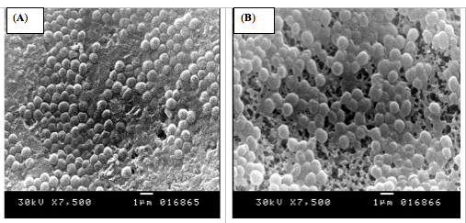
III- The Anti-biofilm Activity of Biosurfactants Solution of P. aeruginosa Isolate on the biofilm formation by S. aureus ATCC 6538p
2- Using scanning electron microscopy
(A): the control,
(B): treated with 1/2 MIC of rhamnolipids solution
Notes:
of 1/2 MIC of the rhamnolipids solution
using scanning electron microscopy (JEOL, JSM-5300, Japan)

Slide 41
CONCLUSIONS

Slide 42
The antimicrobial activity of the biosurfactants of the tested Pseudomonas may be due to their effects on the cytoplasmic membrane.
The combined emulsification, antimicrobial and anti-biofilm activities of the biosurfactants together with their stability at extreme condition may allow their use as a multifunctional material in pharmaceutical preparation.
Biosurfactants, such as rhamnolipids, reduced the biofilm formation by standard S. aureus strain. Hence, they can reduce the bacterial resistance to some antimicrobial agents.
Further researches are needed for good recovery and purification of biosurfactants in high concentration, for more application studies

Slide 43
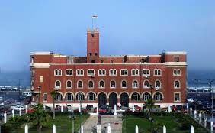
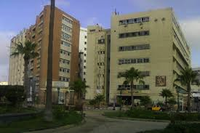
Acknowledgement
Alexandria University
Faculty of Pharmacy
Assistant Prof. Fatma Dabous, Prof. Dr. Hamida AbouShlieb,
Prof. Dr. Nourhan Fanaki.
Prof. Dr. Yasser R. Abdel-Fattah
Notes:
This study was done in the Faculty of Pharmacy Alexandria university
Thisis a part of the Phd thesis for Assistant prof Fatma and I supervised this work togather with

Slide 44

Lovely Alexandria
EGYPT
THANK YOU

Slide 45


