Slide 1
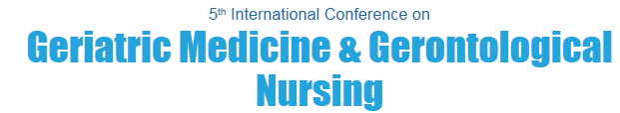
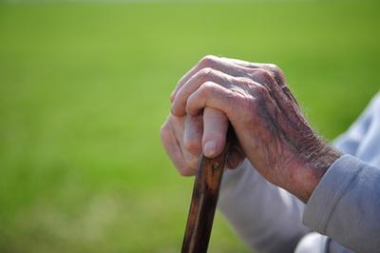
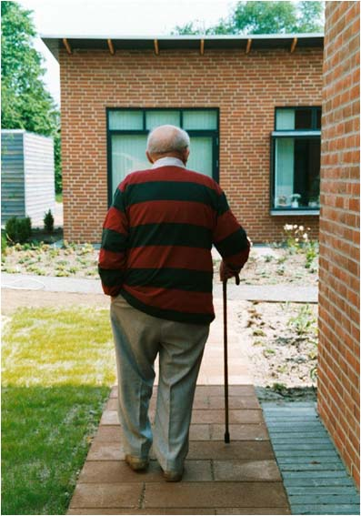
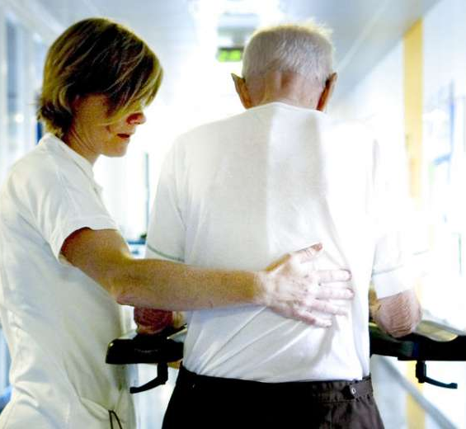
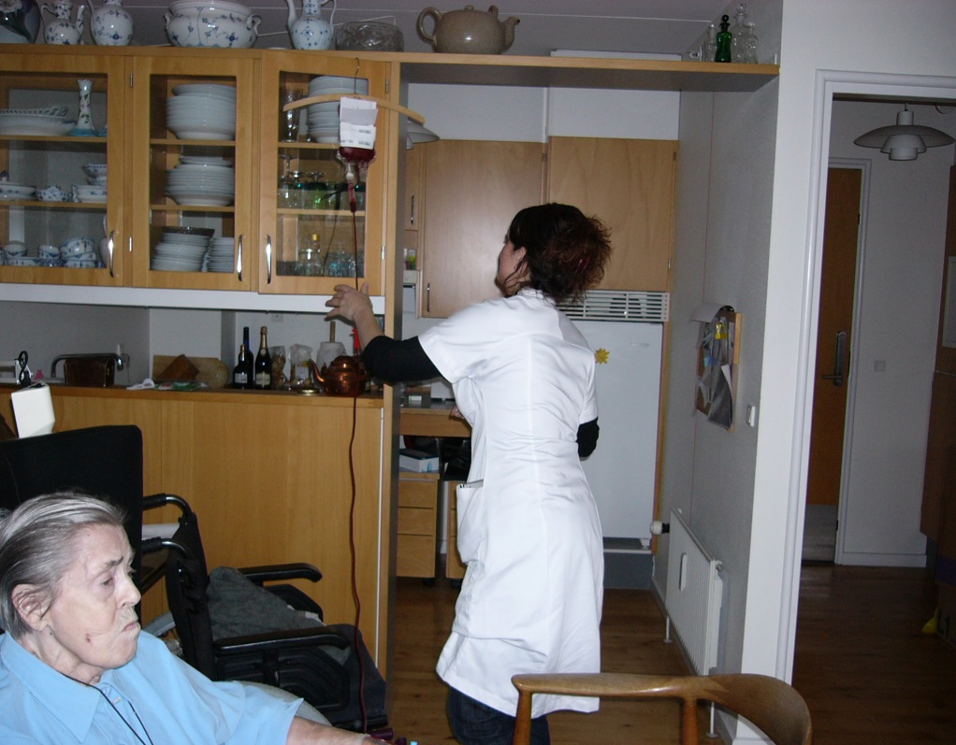
Overall quality of life in frail elderly with hip fracture
Aarhus University Hospital
Department of Geriatrics
Central Denmark Region
Notes:
My topic today is overall quality of life in frail elderly with hip fracture

Slide 2
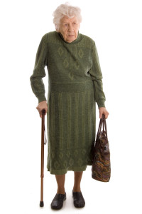
94 years old
living in a nursing home
physical disabilities
cognitively well-functioning
osteoporosis
previous stroke
several medications
feeling lonely
Notes:
Here you have a typical older person who a in high risk of hip fracture and low Quality of Life.
Mrs Hansen is a 94 year old woman, who are living in a nursing home. Previously, she had a busy life with 4 children, a husbond, a big house, and a job in the food industry. She is cognitively well-functioning. She has osteoporis. 10 years ago she had a stroke and is now using several medications. Her husbond and many of her friends have died, and sometimes she feels lonely. However, she has good relationships with her children.
What can we do for Mrs Hansen, so that she will have a good life in the last years she has left. First of all we have to prevent that she will fall and breaking her hip, when we know that it can have fatal consequences.

Slide 3
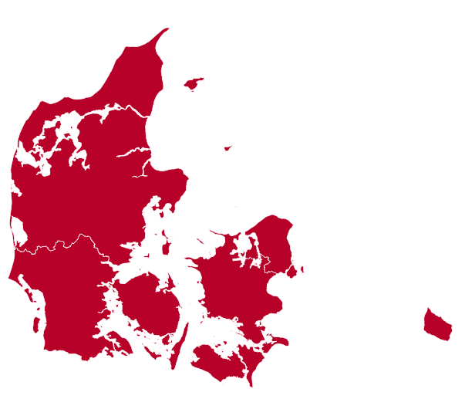
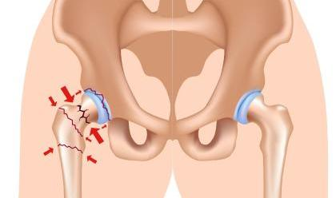
6%
Notes:
In Denmark, which is a country in Europe, we are 5.5 million citizens. More than one million are more than 65 years old. Of those, 6% are living in nursing homes.
Approximately, 25% of the hip fracture patients in our hospitals are nursing home residents. Surgery treatment is given to all these patients - with few exceptions.

Slide 4
Fall
Osteoporosis
Hip Fracture
Anæmi
Notes:
We know that when an elder and frail person is admitted to the hospital due to a hip fracture it is most commonly associated with fall and osteoporosis

Slide 5
Fall
Osteoporosis
Hip Fracture
Anemia
Blood transfusion
Notes:
During surgery and in the days after, the patient may become anemic and at blood transfusion is needed

Slide 6
Fall
Osteoporosis
Hip Fracture
Infection
Anemia
Death
Blood transfusion
Notes:
Observational studies have shown that blood transfusion is associated with infection and death, since the one who needs a blood transfusion typically are the frail older patient.
We also know that a low hemoglobin can cause death. 10% of the older hip fracture patients die within 30 days after surgery and one out of four dies within the first year. In the frail older person this frequency is even higher. Up to 50 percent will die.

Slide 7
Physical
disability
Quality of Life
Fall
Osteoporosis
Hip Fracture
Anemia
Infection
Death
Blood transfusion
Notes:
The older hip fracture patients with physical disabilities before the fracture occurs, are at higher risk af dying. Many of the frail older persons do not recover physically after the trauma, and we know the physical disabilities can impair the persons QoL.
At the same time anemia can cause a lack of oxygen to the muscles and recovery is even more deteriorated and can increase the risk of another fall and a re-fracture.
Anemia also seems to be associated with QoL.

Slide 8
Physical
disability
Quality of Life
Fall
Osteoporosis
Hip Fracture
Anemia
Infection
Death
Blood transfusion
Notes:
But this picture is even more complicated than this for the frail elderly hip fracture patient.

Slide 9
Physical
disability
Quality of Life
Fall
Sarcopenia
Osteoporosis
↓ Cognitive function
Readmission
Hip Fracture
Anoxia
↑ Delirium
Anemia
Infection
Comorbidity
AMI
Death
Blood transfusion
Surgery delay
Gender
Age
Gastric ulcer
Notes:
The are many other factors, which have an impact on the older frail person.
Men are in a higher risk of dying than women
Demented are in higher risk of delirium during hospitalization
Surgery delay, more than 48 hours, also increases the risk of death
The frail elderly with many comorbidities have a higher risk of infections and a higher risk of being readmitted to the hospital.
All these circumstances will have a huge inpact on the frail older persons physical abilities and overall quality of life.

Slide 10
Frail older patients with hip fracture
CGA* Frailty Index | Nursing home n=179 | Sheltered accomodation n=105
Physical disability | 70 % | 35 %
Severe comorbidity | 19 % | 22 %
Cognitive impairment | 83 % | 32 %
Malnutrition | 46 % | 45 %
Multimedication (>7) | 35 % | 39 %
*CGA: Comprehensive Geriatric Assessment
Notes:
Our clinical experience tells us that it is the elderly from nursing homes and sheltered accomodation (care homes), who are the most frail elderly in our hospitals. In Danmark there are access to more help in the nursing homes than in the sheltered accomodation, but the residences are equally handicap-friendly.
In our department we have studied this group of older patients with hip fracture at admission.
We used the CGA frailty index to assess these patients. 96% of the nursing home residents were assessed frail and 78% of the older patients from sheltered accomodation were frail.
We found that a large proportion of the nursing home residents have physical and cognitive disabilities. These disabilities are more frequent in our nursing home residents than in the older patients from sheltered accomodation. However, otherwise the nursing home residents and the residents from sheltered accomodation were equally malnutritioned at admission, equally burdened with severely illness, and therefore equal numbers of medication.

Slide 11

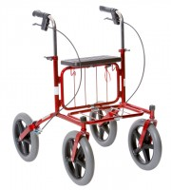

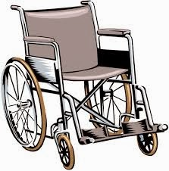
Walking ability 10 days after surgery
%
Notes:
When we looked at the total group of these - more or less frail hip fracture patients - 10 days after hip fracture surgery we found that almost none were able to walk with a stick.
18% were able walk when they used af walker, 43% were only able to walk if the were assisted by one or two persons using a high walker, and 38% were not able walk at all.

Slide 12
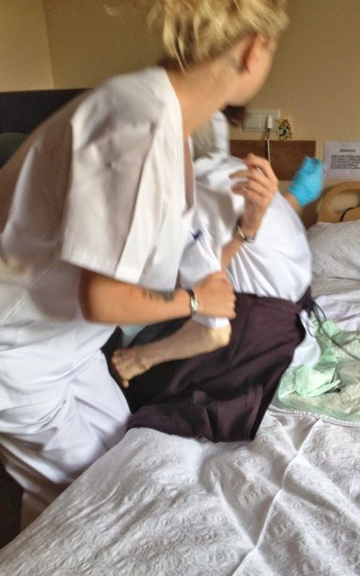
Transferring 10 days after surgery
%
Notes:
Most of the patients needed help if they should move from the bed to a chair and back again.
As you see here, this proportion of patient who could do this on their own, were reducing very slowly from day 10 to 90 days after hip fracture surgery.

Slide 13
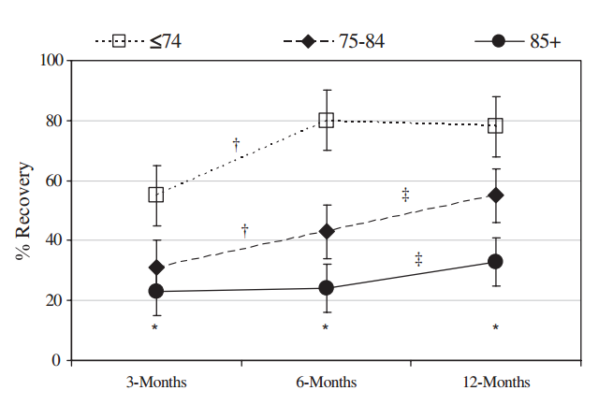
Ambulation after hip fracture
Ortiz-Alonso. 2012. J. Gerontol.A.Biol.Sci.Med Sci.
Notes:
This figure shows the longitudinal changes in ambulation in older persons by age groups following hip fracture surgery. The values are the estimated percent of patients who recovered ambulation at each follow-up time with the 95% confidence interval. E.g. 22% in the patients more than 85 years recovered after 3 months. Only 24% had recovered after 6 months and after 1 year 32% had recovered, it means that 68 did not.
The stars mark a linear age effect at every follow-up time. One cross shows a statistical significant improvement in recovery between 3 and 6 months follow-up and two cross shows improvement in recovery between 6 and 12 months. The analysis was controlling for dementia, postoperative medical complications, and baseline ADL and ambulation.
As you can see, improvements in walking abilities move very slow after a hip fracture and more slow in the oldest old.

Slide 14
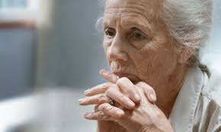
Quality of life (QoL)
Subjective concept
Impact on well-being and life-satisfaction
Reflecting the overall condition of human life
E.g. physical health, moral, and social environment
Notes:
And now to the subject QoL.
QoL is a subjective concept describing the general well-being and life-satisfaction of an individual.
It is outlining negative and positive features of life by reflecting the overall condition of human life.
It observes life satisfaction, including everything from physical health, family, education, employment, wealth, religious beliefs, finance and the environment.

Slide 15
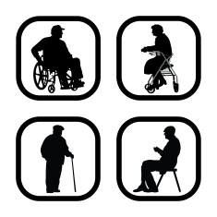
QoL in frail elderly
Nursing home residents
    - lower health-related QoL than older people from the general population (Drageset 2008. J Clin Nurs)
    - frail residents lower QoL vs. non-frail residents
    (Kanwar 2013. J Aging Health)
    - QoL is decreased 12 months after hip fracture
    (Beaupre 2012. J Am Geriatr Soc)
Notes:
We know from the litterature, that the nursing home residents have a lower health-related QoL than older people from the general population. Several chronic illnesses, a high level of severe comorbidities, and significant physical impairments may affect their QoL.
The nursing home residents have a lower QoL compared to the non-frail residents measured in the same nursing home.
Nursin home residents with a hip fracture are at higher risk of not recovering to prefracture basic mobility. It might cause the decreased measured QoL 12 months after hip fracture surgery

Slide 16
QoL in older hip fracture patients
Hip fracture patients
    - report lower QoL
    (Beaupre 2012. J Am Geriatr Soc)
    - lower QoL before the fracture occured
    (Rohde 2008. Health Qual Life Outcomes)
    - lower QoL by internal fixation compared to hemiarthroplasty
    (Gjertsen 2012. J Bone Joint Surg Am)
    - good mobility is associated with better QoL
    (Hall 2000. Aust New Zealand J Med)
Notes:
In the litterature we found that these patients report lower QoL than older persons without a hip fracture.
And the hip fracture patients resport a lower QoL even before the fracture occurred, and they seem to be less satisfied with life as a whole.
12 months after HF surgery, older persons with internal fixation reports a lower QoL than patients with arthroplasty, whereas the opposite is the case when QoL is assessed by proxies.
Older persons with a hip fracture are at higher risk of not recovering to prefracture basic mobility and good mobility is associated with better QoL.

Slide 17

Measuring QoL
generic questionnaires
health-related questionnaires
    self-rating is the golden standard
    face-to-face interview
    proxy-sources
Notes:
How to measure QoL.
The most common method of measuring Qol is the use of a questionnaire instrument.
The generic questionnairre is used for both sick and healthy people, and some of them are large and wide-ranging, and thereby demanding prolonged attention and concentration from the respondents.
Health-related questionnaires are developed for a specific disease.
Self-rating is the golden standard, and must be the one we choose for having the correct answer.
Face-to-face interviews can be used for those who can not fill-in the questionnaire themselves, however they are asked the questions and they answers the questions, but another are writing down.
Proxy sources can be used. Family members and care staff can fill-in the questionnaires on how they think the older person would assess their own QoL.

Slide 18
Measuring QoL in frail older persons
Geriatric QoL (Guyatt 1993. J Clin Epidemiol)
QoL in nursing home residents (Kane 2003. J Gerontology)
QUALIDEM (Ettema 2007. Int J Geriatr Psych)
QoL-AD (Logsdon 2002. Psykosom Med) (Edelman 2005. Gerontologist)
EuroQoL-5 (Health Policy 1990)
Dementia-QoL (Brod 1999. Gerontologist)
Depression List (Gerritsen 2007. Qual Life Res)
Notes:
In Denmark, about 65% of the nursing home residents suffer from dementia. This implies that many QoL instruments are not suitable for these people. However, demented people are abel to co complete a self-reported QoL questionnaire. It is concluded by both Selai et al, and Trigg et al.
I will here present the most usable questionnaires for the frail older persons.
Geriatric Quality of Life Questionnarie contains of 25 questions focusing on activities of daily living, symptoms, and emotional function. One third of the geriatric patients can not use this questionnaire
Kane developed a questionnarie for nursing home residents. It is a good self-report questionnaire, but very time-consuming with 47 items. It takes about an hour for each interview.
Qualidem is based on proxy ratings by the health care professionals
The QoL questionnaire for Alzheimers disease measures QoL in individuals with a MMSE greater than 10. It has 13 items. Edelman et al developed a version of the QoL-AD specifically for people in residential settings
EuroQoL- 5 is a health-related questionnaire used also for proxy-ratings. There is a poor agreement between the demented older persons and their care givers.
The Dementia-QoL questionnaire is suitable for demented people with a MMSE-score of more than 12. Some of the questions might not be relevant for the nursing home residents fx. the one on economi.
Depression List is feasible in responders with a MMSE as low as 5. It measures Overall QoL. The questions in a face-to-face interview are supported with visual expression.

Slide 19
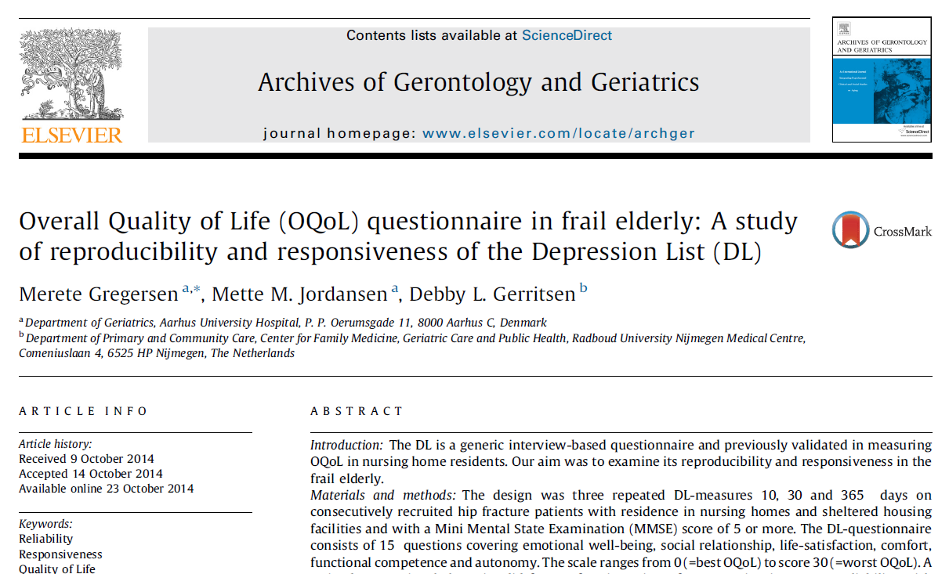
Notes:
We wanted to examine the Depression List in a Danish context.
We choosed it when it was able to measure Overall QoL in person with a MMSE-score as low as 5.
The originally questionnaire was in Dutch. So we followed the WHO’s (v-age-O) translation procedure and in cooperation when the researcher from the Netherlands, we made a Danish questionnaire.
Then we examined the reproducibility and responsiveness of the tool.

Slide 20
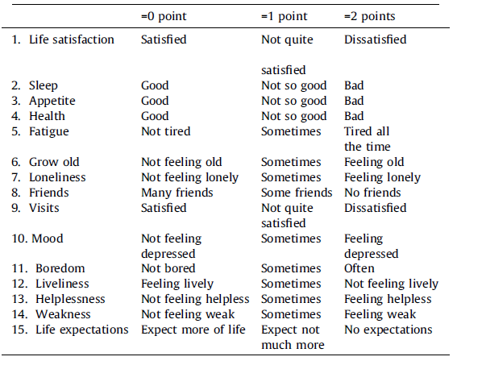
Notes:
The Depression List contains of 15 items covering emotional well-being, social relationship, life-satisfaction, comfort, functional competence and autonomy.
Along with each short and simple question, its keyord is presented on a card. For instance, the first item ”Are you satisfied? is accompanied by a card saying ‘satisfied’. Each question has a 3-point response-scale. The total sumscore ranges form 0, meaning the best QoL to 30, which is the worst assessed QoL-score.
Most of the face-to-face interviews took place in the respondent’s residence – after a MMSE was conducted and measured higher than 5. Only the respondent and the interviewer were present in the room during the interview to avoid influence by care staff or relatives. It was conducted over a short period of time in order to avoid tiredness and rejection by the residents.

Slide 21
Reproducibility
Agreement
Reliability
Staple measurements (test-retest)
Measurement errors
The degree respondents can be
disinguished from each other
despite measurement errors
Notes:
To test the reproducebility of the DL - witch represents both agreement and reliability – we made a test-retest on the same patient with a time interval long enough to prevent recall and short enough to ensure that a clinical change has not occured. Also we tested the interobserver-variation: One interviewer asked the questions and noted down her opinion of the patients answer, and at the same time, a second observer also listened to the patients and noted down her opinion of the patients answer. All this was done to test similar answers between the two observers. The agreement is expressed by Standard Error of the Mean and by Minimal Detectable Change. The reliability that concerns the degree to which the respondents can be distinguished from each orther - despite measurement error - is expressed by Intraclass correlation. We examined this in 130 patients

Slide 22
Responsiveness
DL-test
(=t¹)
DL-test
(=t²)
A clinical relevant change over time (t² - t¹) ?
An expected improvement in ADL over time ?
12 months
Notes:
The responsiveness is the ability of the DL instrument to detect change over time when a clinical change has occured. In this case we expected that the physical ability was improved one year after a hip fracture.
130 patients was interviewed 10 days after hip fracture and after one year, the survivors were interviewed again.

Slide 23
Results
Reproducibility | SEM | MDC | ICC
Intra-observer variation | 3.02 | 8.37 | 0.70
Inter-observer variation | 0.92 | 2.55 | 0.97
Responsiveness | Day 10 | Day 365 | p-value
Median sumscore | 9.0 | 6.5 | < 0.001
Notes:
The results from our analyses of the DL instrument showed that the reproducebility was good and the instrument was able to detect an expected change over time.

Slide 24
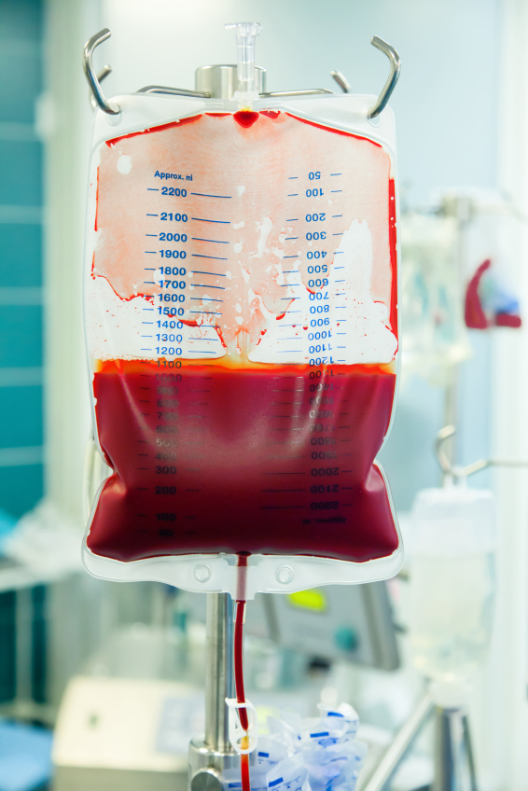
Hemoglobin level
Quality of Life Physical ability
Notes:
One of another studies, we made in our geriatric department, was a randomized controlled trial. In the first slides I showed you, we know from the litterature that anemia is associated with physical disabilities and lower QoL. And that physical ability is associated with QoL.
In this RCT we examined the hemoglobin thresholds after hip fracture. Within 30 days after hip fracture surgery we gave all the patients from nursing homes and sheltered accomodation a blood transfusion if the blood test showed a hemoglobin level less than 9.7 g/dl.

Slide 25

Randomized controlled trial
65+ years old patients with hip fracture from nursing homes or sheltered accomodation
Liberal strategy
Hb 11.3 g/dL
Restrictive strategy
Hg 9.7 g/dL
Notes:
This figure illustrates the interventions in the two groups.
Consecutively, all 65+ years with a hip fracture admitted to the orthopedic ward from nursing homes or sheltered accomodation were randomized to either a restrictive blood transfusion strategy where we gave a transfusion of the hemoglobin level were less than 9.7 g/dL. and a liberal strategy were we gave blood if the Hb level was less than 11.3 g/dL. 75% of the blood transfusions were given within the first week after surgery.
A blinded therapist measures the physical abilities and QoL after 30 days and after one year. Also, we measured infections and mortality.

Slide 26

Blood tests
Hb
Hb
Hb
Hb
Hb
Hb
Hb
Hb
Day 1
Day 30
CRP
Leukocytes
CRP
Leukocytes
CRP
Leukocytes
CRP
Leukocytes
CRP
Leukocytes
Notes:
The intervention period lasted 30 days after surgery. And the Hb was measures continiously. The first days at the hospital and the following in the patients residence. As well the blood transfusion were given in the residence within 24 hours after the blood test. At the same time, we measured the leukocytes and the CPR.
The patient, the caregivers and the relatives were not informed about the HB values of the blood tests.

Slide 27
Follow-up
Physícal ability
MBI-100
CAS
NMS
Physícal ability
MBI-100
CAS
NMS
12 months
Notes:
Follow-up period was one year. An assessor were blinded to the randomization assignment. She collected intormation on the physical abilities measured by three tests Modified Barthel index, which assess the ability to conduct the activities of daily living, the Cumulated ambulation score and new mobility score.
She visited the patient 10, 30, 90 days after surgery and 1 year after. The assessor also collected information on pre-fracture abilities as they were experienced of the patietn 14 daygs before the fracture. If the patient was unable to remember their own abilies ,the cargivers or the relatives supplid this information.

Slide 28
Follow-up
Physícal ability
MBI-100
CAS
NMS
Physícal ability
MBI-100
CAS
NMS
12 months
QoL
Depression List
QoL
Depression List
Notes:
Also, the assessor measured the patients QoL 30 days after and 1 year after the hip fracture.

Slide 29
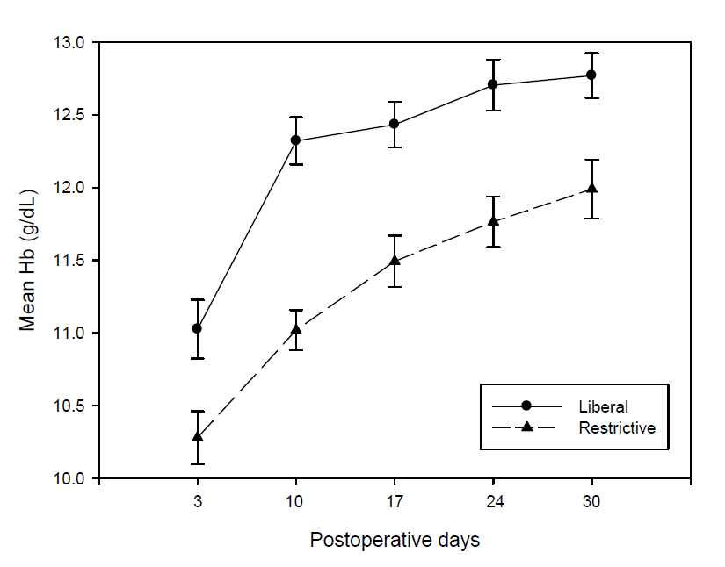
Hemoglobin
Notes:
As you can se here on this slide, the intervention succeeded. There is a statistically significant difference between the two groups.
Both groups recieved the same comprehensive geriatric assessment except for the number of blood transfusions.

Slide 30
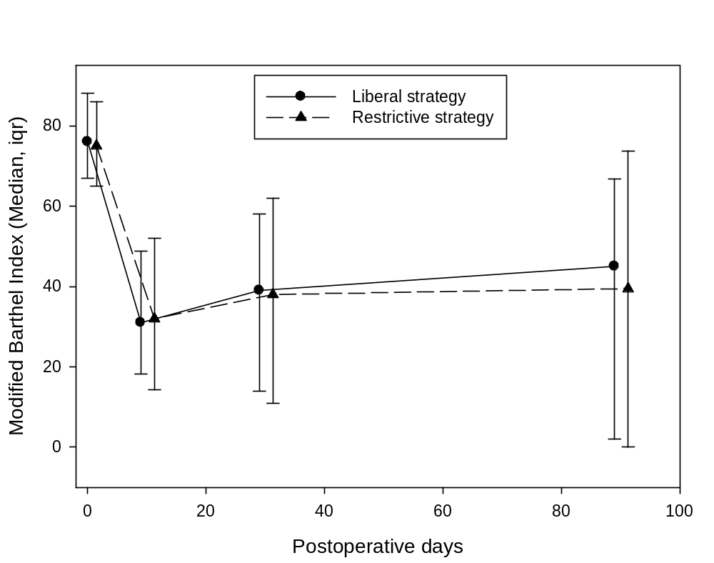
Modified Barthel Index
Notes:
The sumscores of the Barthel score were equal in the two groups. There was a significant reduction in physical abilities from before the fracture and 10 days after. After that only an slowly upward-sloping curve is seen, as I previously showed you found in the study of Ortiz-Alonso and his collegues.

Slide 31
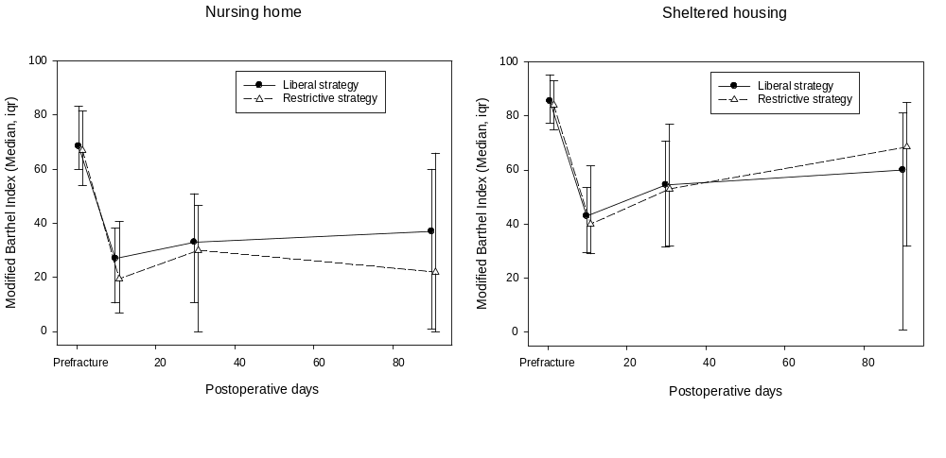
Modified Barthel Index
Notes:
In a sub-group analysis we could see that the nursing home residents were slower to recover than the patients from sheltered housing.

Slide 32
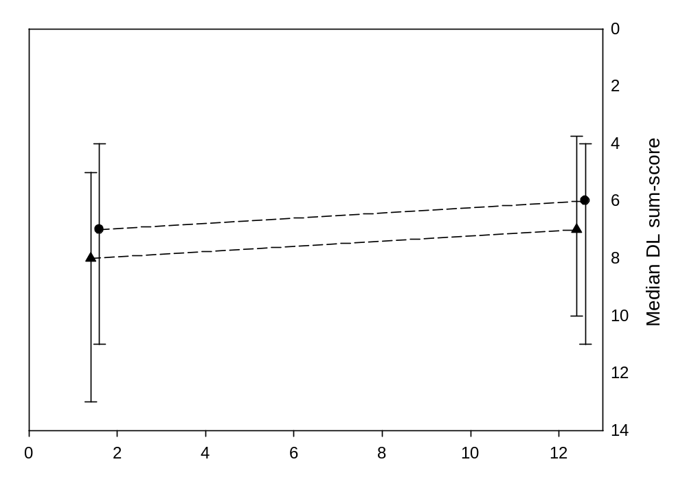

Quality of Life
Notes:
The QoL were equally better in the two groups one year after the hip fracture, as you can see here on this slide. The restrictive transfusion group is marked with a circle and the liberal strategy with a triangle.
The QoL improve by 1.27 point, and assessed clinical relevant.

Slide 33
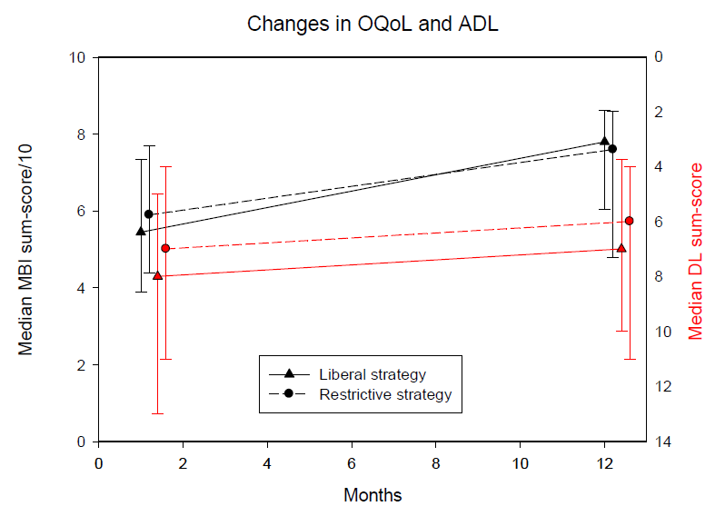
QoL and ADL
Notes:
Now we add the figure for the physical abilities. During one year, the Barthel score in the liberal group is more improved than that of the restrictive group.
We also found that there is an association between the improved physical ability and the better QoL in the hip fracture patients that survived.

Slide 34

What is QoL in nursing home residents?
Social status
Physical and social well-being
Environment of the residence
Relation to the staff
Express what is important
Basis understanding
(Gerritsen 2004. Qual Life Res)
Notes:
The frail elderly must consider that functional loss makes it no longer possible to achieve all goals in life:
However, when the resident loses social status, other goals must be pursued
The higher physical and social well-being the resident can realize the higher QoL
The physical and social environment of the recidence are important for QoL
Most residents rely on the staff to generate the necessary resources for QoL
Demented residents are sometimes unable to express and even assess what is truly important to them
There is a need for basis understanding of the QoL in residents
Higher levels of QoL can not be achieved if the basic level of needs is not met

Slide 35
CGA
Basic needs
Training
Listen
Environment
Competent staff
Prevent falls
Notes:
So what can we do for frail Mrs. Hansen when she had a hip fracture?
In the first place we can secure that the comprehensive geriatric assessment and intervention are fulfilled, also the anemic state is taken care of, if the Hb is too low.
And that all basic needs are taken care of
Also, we must do what we can to get her back on her feet so she may reach her former physical abilities – by daily training.
We must listen to Mrs. Hansen. What does she want – what is important to her, and witch goals do she wants to achieve after this hip fracture.
We must do one's best, that the residence is a nice place to live and the staff is kind, understanding, and well-educated, so that new falls, new fractures, and hospitalization is prevented.

Slide 36
Take home message
QoL assessment is a valuable supplement to the objective measurements in clinical reseach and in clinical practice
It is possible to measure QoL in frail older persons
If the frail older patient with hip fracture recovers the physical disabilities, the patient’s QoL improves likewise

