Slide 1
About OMICS Group
OMICS Group is an amalgamation of Open Access Publications and worldwide international science conferences and events. Established in the year 2007 with the sole aim of making the information on Sciences and technology ‘Open Access’, OMICS Group publishes 500 online open access scholarly journals in all aspects of Science, Engineering, Management and Technology journals. OMICS Group has been instrumental in taking the knowledge on Science & technology to the doorsteps of ordinary men and women. Research Scholars, Students, Libraries, Educational Institutions, Research centers and the industry are main stakeholders that benefitted greatly from this knowledge dissemination. OMICS Group also organizes 500 International conferences annually across the globe, where knowledge transfer takes place through debates, round table discussions, poster presentations, workshops, symposia and exhibitions.

Slide 2
OMICS International Conferences
OMICS International is a pioneer and leading science event organizer, which publishes around 500 open access journals and conducts over 500 Medical, Clinical, Engineering, Life Sciences, Pharma scientific conferences all over the globe annually with the support of more than 1000 scientific associations and 30,000 editorial board members and 3.5 million followers to its credit.
OMICS Group has organized 500 conferences, workshops and national symposiums across the major cities including San Francisco, Las Vegas, San Antonio, Omaha, Orlando, Raleigh, Santa Clara, Chicago, Philadelphia, Baltimore, United Kingdom, Valencia, Dubai, Beijing, Hyderabad, Bengaluru and Mumbai.

Slide 3
Skin Metabolism of Biotherapeutics as a Limiting Factor for Subcutaneous Bioavailability
Mengmeng Wang
LM ADME,
Pharmacokinetics, Dynamics and Methabolism, Pfizer
European Pharma Congress, August 26, 2015, Valencia, Spain

Slide 4
Outline
Introduction of bioavailability
Introduction of peptide PK
Overview of technologies for peptide half-life extension
Case Study of Understanding Low SC F% of a Peptide
  Introduction of Oxynmodulin
  Problem
  Methods
  Results

Slide 5
Bioavailability
Fraction of the dose of a drug contained in any dosage form that reaches the systemic circulation in unchanged or active form administered through any route is known as bioavailability.
Drugs injected using intravenous route of administration have 100% bioavailability, while others have much less bioavailability, because:
  All of the drug may not be adsorbed
  Metabolism of the drug might occur before reaching the site of action
Drug
Destroyed at site of absorption
Not absorbed
Metabolized before entering circulation

Slide 6
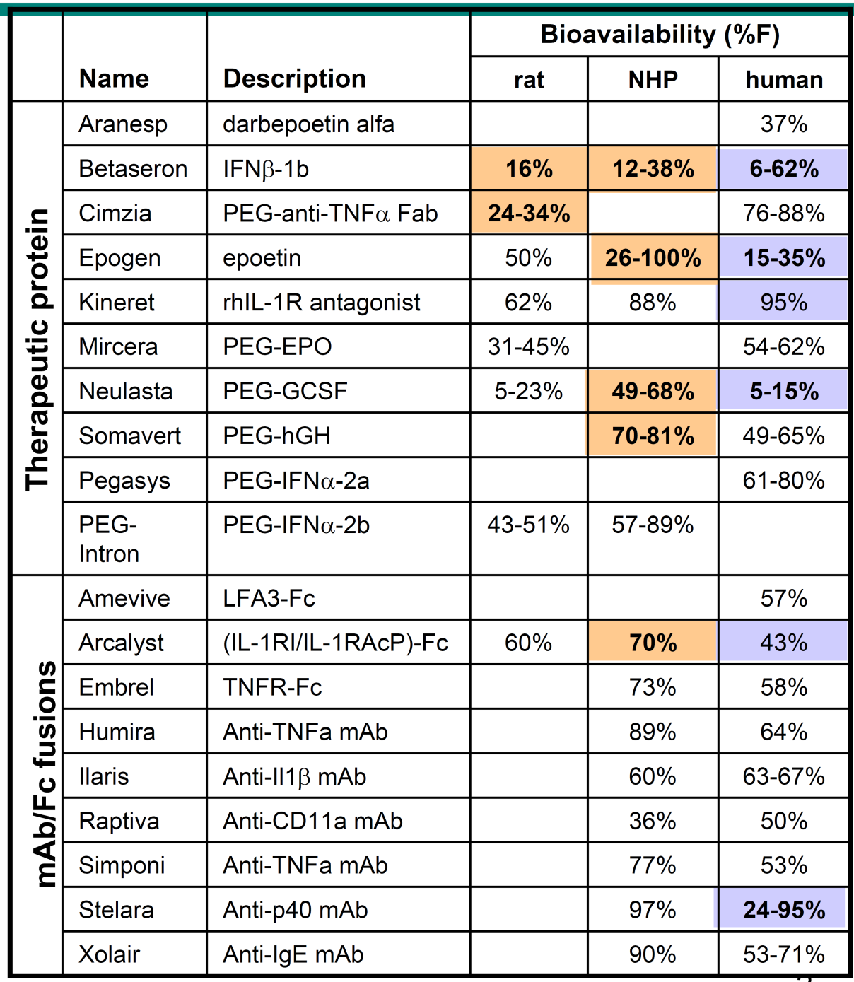
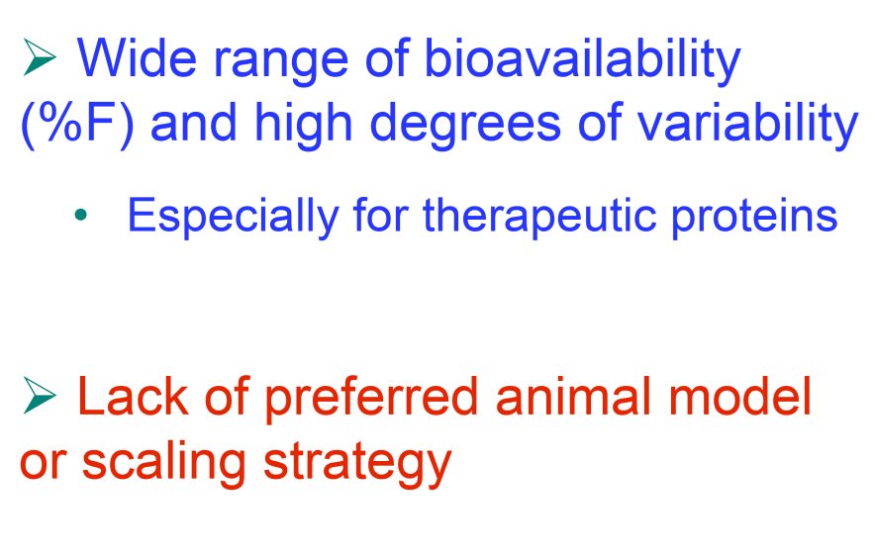

Challenges to Predict Subcutaneous Bioavailability of Biotherapeutics in Human
The prefered %F is > 60%

Slide 7
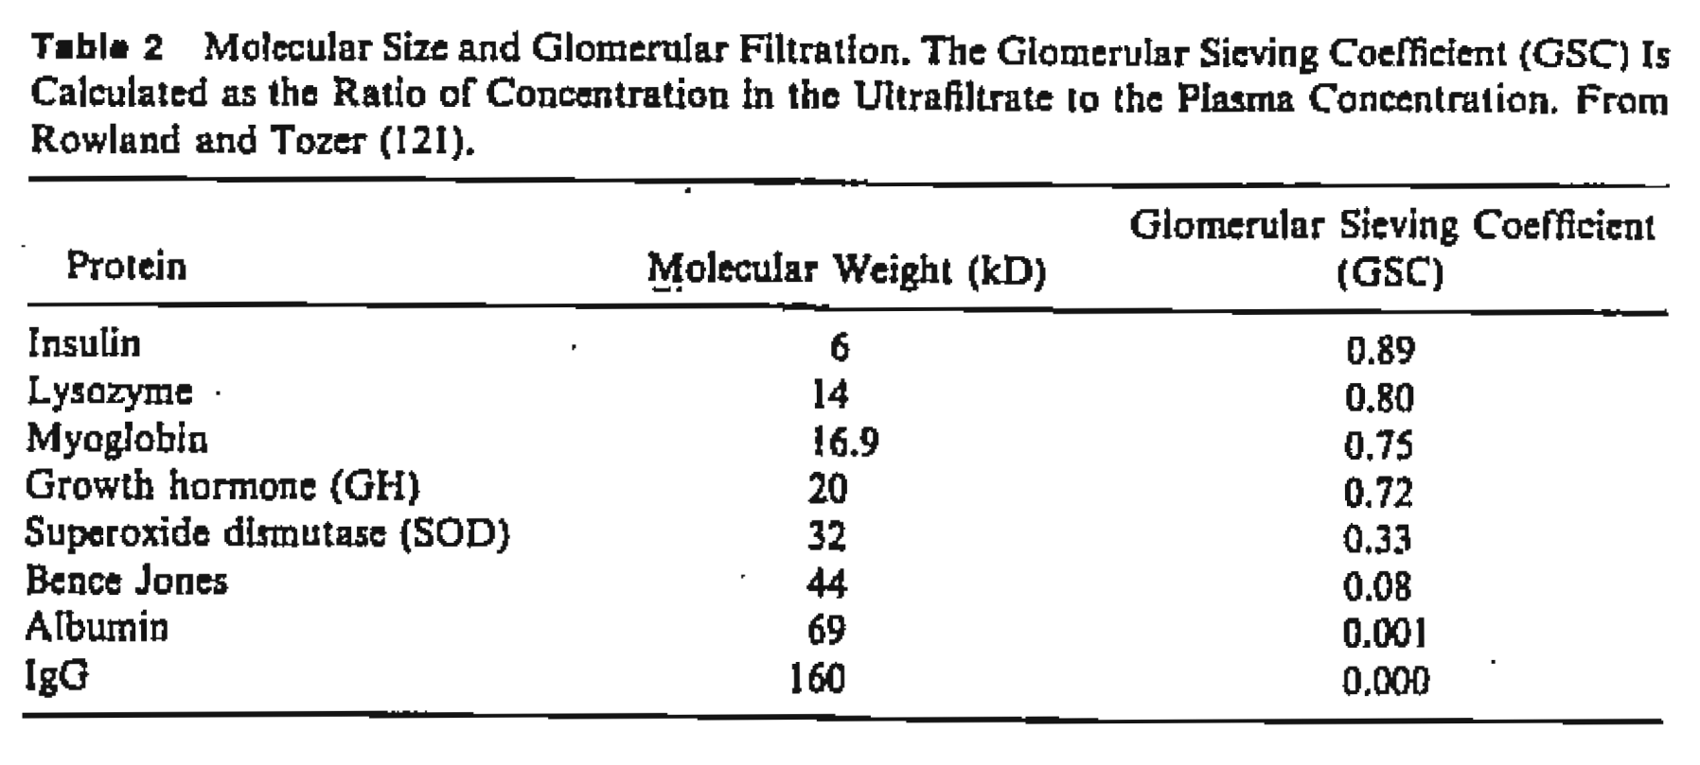
Peptide Usually Pertains Short Half-Life (t_{1/2})
Peptide with size <20 kD has t_{1/2} ranging from minutes to hours, rending BID or QD dosing

Slide 8
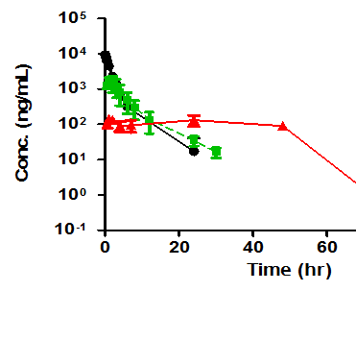
Ways to Extend Peptide Half-Life
Conjugation:
Pegylation
Others such as Hesylation etc.
Sustained Release:
transdermal patches
polymeric micelles
Complexation, injectable depots such as those in which the drug is embedded in
  polymeric matrix, vesicles (e.g. liposomes)
  biodegradable microspheres, hydrogels
  formation of a reversible, water insoluble complex of the protein with divalent metal cations
  combination of the above
-- peptide alone
-- sustained release
In addition to improving half-life, the sustained-released formulations can also help to reducing the fluctuation between peak and trough concentrations and maintain the serum concentration relatively constant within the therapeutic window, in contrast to the PK profiles obtained in soluble solutions

Slide 9
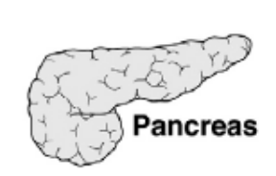

Oxyntomodulin as a Target for Type 2 Diabetes and Obesity
Oxyntomodulin is a 37 amino acid peptide secreted by the L-cells of the small intestine
It is derived from the processing of the preproglucagon gene by prohormone convertase (PC)
Signal peptide
GRPP
Glucagon
GLP-1
GLP-2
Glucagon
GLP-1
GLP-2
Glucagon
GLP-1
GLP-2
Oxyntomodulin

Slide 10
Oxyntomodulin is Cleaved by Two Major Peptidases
Oxyntomodulin contains entire glucagon sequence plus 8 amino acids (octapeptide)
100% homologous between human, mouse, rat
Cleaved by 2 major peptidases: DPPIV and neutral endopeptidase (NEP)
Oxyntomodulin is not an appropriate therapeutic due to proteolysis and poor PK properties.
Oxyntomodulin is Cleaved by Two Major Peptidases
DPPIV
NEP
Glucagon
N-term
His
Ser
Gln
Gly
Thr
Phe
Thr
Ser
Asp
Tyr
Ser
Lys
Tyr
Leu
Asp
Ser
Arg
Arg
Ala
Gln
C-term
Asp
Ala
Ile
Asn
Asn
Arg
Asn
Arg
Lys
Thr
Asn
Met
Leu
Trp
Gln
Val
Phe
Octapeptide

Slide 11
Generation of OXM Analog: Peptide A
Peptide A is an OXM analog that was designed to be stable against DDPIV and NEP
Resulting peptide is resistant to proteolysis (DPPIV and NEP degradation) with an in vivo half-life of 3 hrs in humans (versus 10 minutes for oxyntomodulin).
Optimal short-term weight loss observed in human after SC injection of Peptide A.
Two formulations (IR: instant release; CR: controlled release) have been evaluated in animals with the primary objective of evaluating CR formulations intended to provide prolonged Peptide A exposure compared with the IR formulation

Slide 12
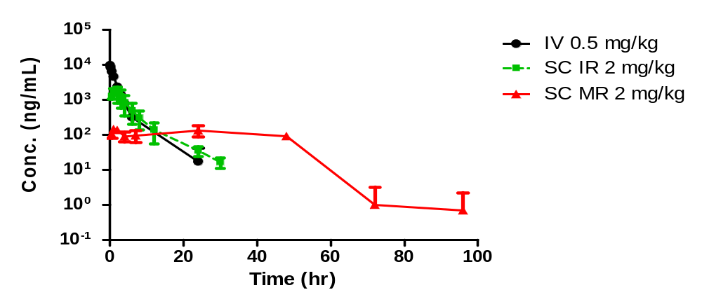
Decreased Exposure with CR Formulation Was Observed in Rats
CR
Route | Dose | C_{max} | T_{max} | t_{1/2} | AUC_{last} | CL | V_{ss} | F
 | (mg/kg) | (ng/mL) | (hr) | (hr) | (hr*ng/mL) | (ml/hr/kg) | (mL/kg) | (%)
IV | 0.5 | 9638 | NA | 2.9 | 15757 | 30 | 68 | NA
SC | 2, IR | 1835 | 1.3 | 4.7 (n=1) | 9653 | NA | NA | 15
SC | 2, CR | 160 | 10 | 10 (n=1) | 5506 | NA | NA | 9
Wang et al., J Bioequiv Availab 2012, 4:5

Slide 13

Why Low SC BA of IR Form, and Even Lower for CR Form
Possibilities:
Where does the drug (IR and CR Form) go - why lower BA):
does the drug stay in skin or degraded in the skin
or something else?
Plans:
Dose recovery study (where does the drug go)
In vitro stability study in skin
Metabolite investigation (in vitro and in vivo)
2:20

Slide 14






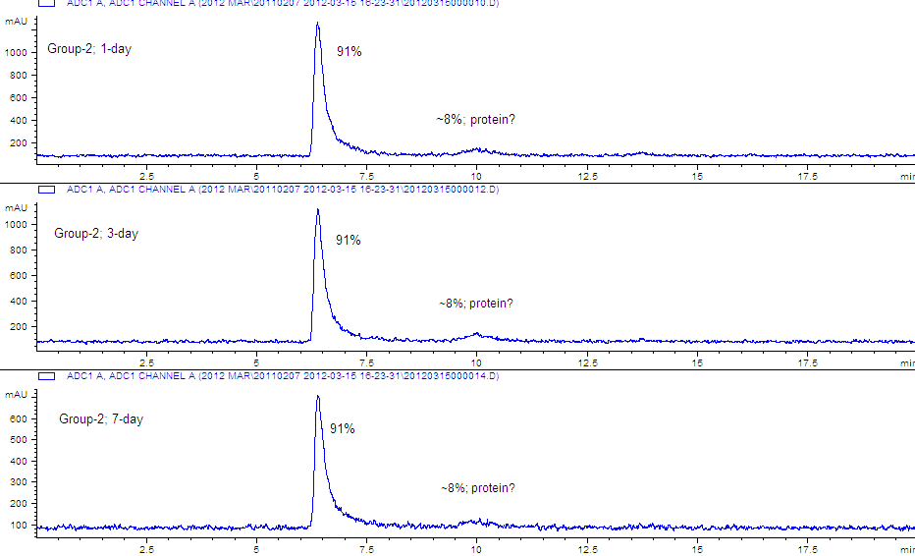



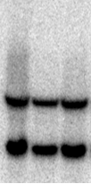
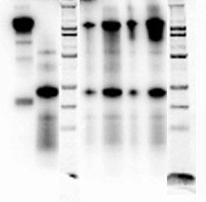
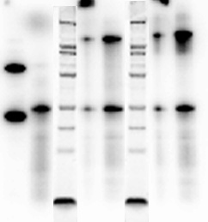

Analysis of Drug Disposition in Plasma/Tissue
Measuring total drug counts together with precipitable drug counts indicates degree of free radiolabel or proteolytic drug degradation (ie too small to precipitate)
Sample characterization
Cell pellet
SDS-PAGE/autorad
HPLC-SEC
Drug conc. from precipitable counts (intact drug)
¹²⁵I-IgG
Dosing
solution
¹²⁵I-IgG
Samples
(reduced)
Add precipitator (TCA or acetone)
spin
d1
Further
characterization
d3
Total cpm plasma/tissue
cpm %TCA in S/N (free/degradants)
d7
NR R M

Slide 15
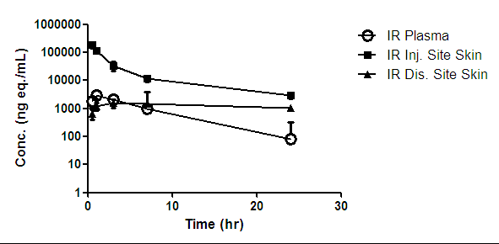
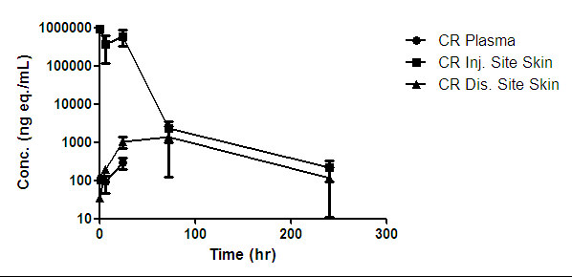
Good Recovery of ¹²⁵I Radioactive Dose Injected in Rats
---- Radiolabled dose was well absorbed from injection site
Groups | Route | Formulation | Dose | Conc. | Dose vol.
 |  |  | (mg/kg) | (mg/mL) | (mL/kg)
1 | IV | IR | 0.5 | 5 | 0.1
2-7 | SC | CR | 2 | 5 | 0.4
SD rats, N=3, serum, tissues, urine and feces were collected at various time points up to 10 days.
%Dose Recovery | IV group 0.5 mg/kg |  | SC group 2 mg/kg
 | Ave. | Stdev | Ave. | Stdev
Tissue | 2 | 1 | 1 | 1
Urine | 85 | 7 | 95 | 16
Fece | 2.5 | 5.4 | 0.0 | 0.1
Total | 90 | 6 | 97 | 16

Slide 16
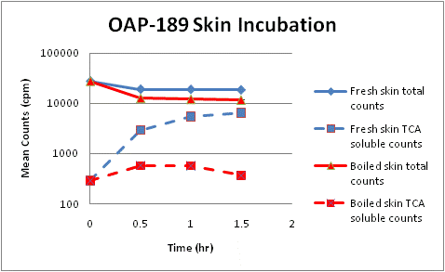
Metabolism was Observed in Skin – In Vitro Study
Skin sample (1 inch in diameter, freshly cut or boiled) was incubated with 2 µg/mL [¹²⁵I]Peptide A in PBS at 37ºC (total incubation volume: 1 mL). The incubation solution was analyzed for total and TCA soluble counts)

Slide 17
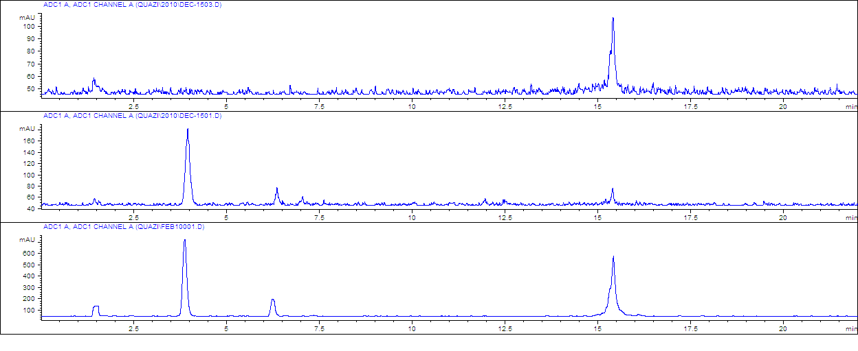
Metabolites Observed in Skin from In Vivo and In Vitro Studies
In-Vitro: 90 min incubation with boiled skin
Intact
In-Vitro: 90 min incubation with fresh skin
Metabolite(s)
In-Vivo SC (IR Form): 30 min after SC injection in skin
44%
40%
LC-Radio-chromatogram of Peptide A Metabolism in Skin

Slide 18
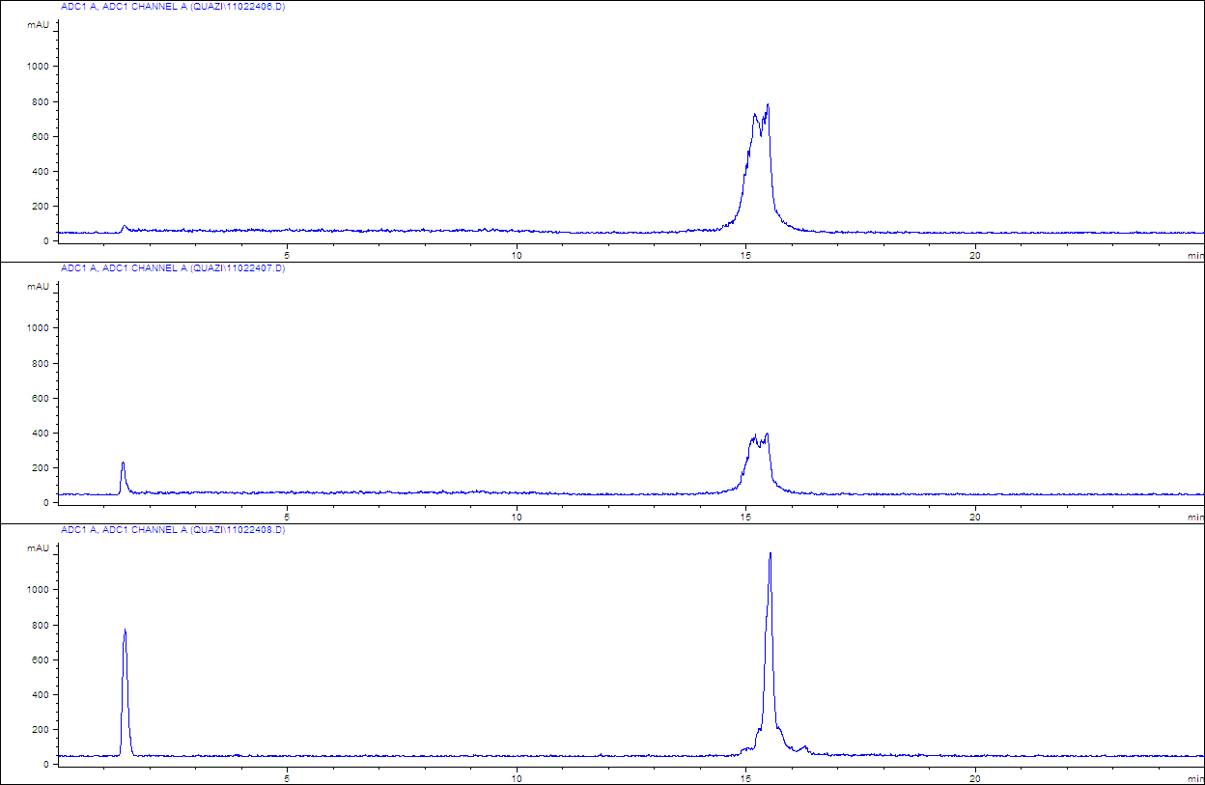
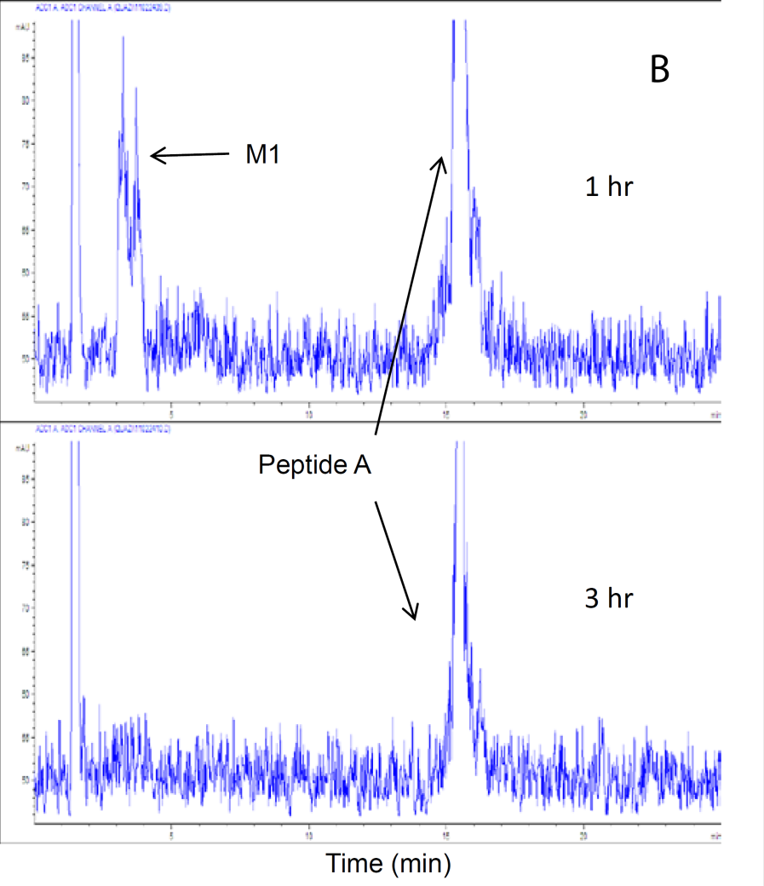
Skin Mediated Metabolite(s) Observed in Plasma after SC Administration
5 min
IV
Metabolite(s)
SC
1 hr
3 hr
(LC-Radio-chromatogram after IV and SC Dosing of Peptide A in IR Form)

Slide 19
Conclusions
The dose recovery data from radiolabeled PK studies in rats revealed that Peptide A related radioactivity was completely absorbed into systemic circulation after SC injection.
In vitro study showed increased formation of degradants of [¹²⁵1]Peptide A during the incubation with fresh rat skin but not with boiled skin. A major metabolite peak was detected in the skin incubation sample using the HPLC radiochromatography.
The metabolite peak at the same retention time was also observed in plasma of rats after SC adiminstration of [¹²⁵1]Peptide A, but not in samples after IV dosing.
Results from this study demonstrated that while CR formulation prolonged the systemic t_{1/2} of Peptide A, metabolism of the peptide in skin during its prolonged residence could potentially offset its systemic exposure. Thus, caution needs to be taken to balance the increase of half-life and the decrease of exposure while choosing a right formulation.

Slide 20
Acknowledgements
Roger Pak,
Ramin Darvari,
David Chen,
Aadithya Krishnan,
Heather Farrell
Terrie Cunliffe-Beamer,
Cyndi Filliettaz,
Rich Miller,
Kimberly Muzzi,
Todd Turner,
Barbara Countey,
Laura Danner,
Jerome Giddings
Jim Rohrbacher
David DeFranco,
Jennifer Spencer-Pierce,
Jianqing Chen,
Quazi Shakey,
Josef Ozer,
Xin Xu,
Bonnie Rup
Katherine Wright,
Dawn Dufield

Slide 21


Slide 22

Boston
Thank You!

Slide 23
Let us meet again..
We welcome you all to our future conferences of OMICS International
4th Annual Conference on European Pharma Congress
June 18-20,2016, Berlin, Germany.
http://europe.pharmaceuticalconferences.com/

