Slide 1

Cell Incorporation Studies with ^{99m}Tc Labeled
Methotrexate Loaded Chitosan Nanoparticles for Breast Cancer Diagnosis
Meliha Ekinci, MSc. Pharm.
Ege University, Faculty of Pharmacy
Department of Radiopharmacy
35100 Bornova, Izmir, TURKEY
Notes:
Thank you very much for your kind introduction. (I received my master degree in Radiopharmacy from Ege University (Turkey) in 2015. I am currently a Research Assistant at Radiopharmacy Department and also a doctoral student at Biopharmaceutics and Pharmacocinetics Department, Ege University.) First of all, I would like to thank to organizing committee for giving me this opportunity. Today I'm going to talk about “Cell incorporation studies with technetium-99m labeled methotrexate loaded chitosan nanoparticles for breast cancer diagnosis” which is part of my postgraduate master study.

Slide 2
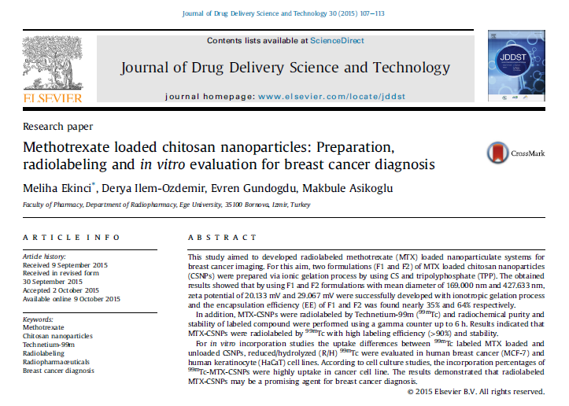
Notes:
Our study was published at Journal of Drug Delivery Science and Technology in October, 2015. If you desire, you can read the whole paper.

Slide 3
Outline
Breast and Breast Cancer
Preparation of Methotrexate (MTX) Loaded Chitosan Nanoparticles (CSNPs)
Radiolabeling of MTX-CSNPs
In vitro Incorporation Studies
Conclusion
Introduction
Methods and Results
Conclusion
Notes:
As you can see on the slide, I have divided my presentation into five parts.

Slide 4
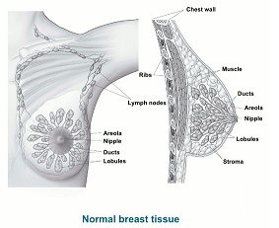
Breast
The breast is an apocrine gland which is made up mainly of lobules (milk-producing glands), ducts (tiny tubes that carry the milk from the lobules to the nipple), and stroma (fatty tissue and connective tissue surrounding the ducts and lobules, blood vessels, and lymphatic vessels).
Notes:
First of all, the breast is an apocrine gland which is made up mainly of lobules, ducts and stroma.

Slide 5

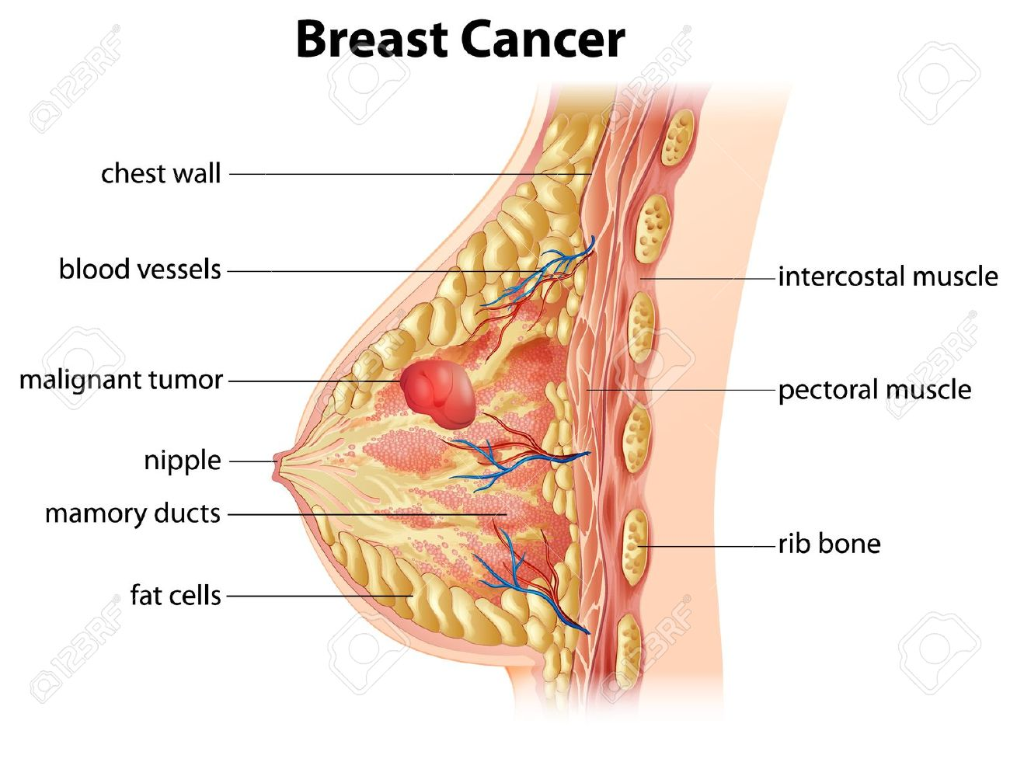
Breast Cancer
Breast cancer is the most common invasive cancer in women worldwide.
The American Cancer Society's estimates for breast cancer in the United States for 2015 are:
  About 231,840 new cases of invasive breast will be diagnosed in women.
  About 60,290 new cases of carcinoma in situ (CIS) will be diagnosed (CIS is noninvasive and is the earliest form of breast cancer).
  About 40,290 women will die from breast cancer.
  At this time there are more than 2.8 million breast cancer survivors in the United States.
Notes:
Breast cancer is the most common invasive cancer in women worldwide. In 2015 231,840 new cases of breast cancer diagnosed.

Slide 6
Breast Cancer Diagnosis
Medical history and physical exams
Mammograms
Breast ultrasound
Magnetic resonance imaging
Biopsy
Notes:
Breast cancer can be diagnosed by medical history and physical exams, mammograms, breast ultrasound, magnetic resonance imaging and biopsy.

Slide 7
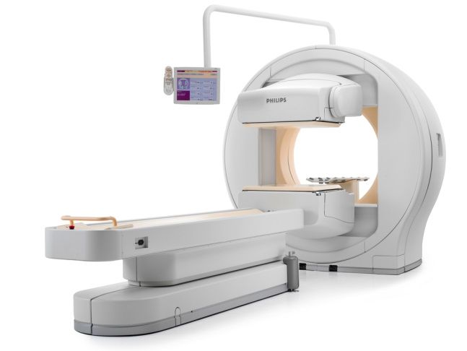
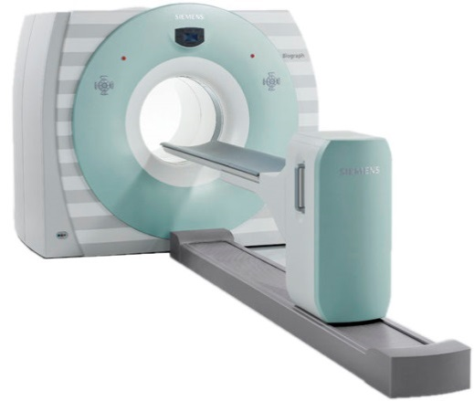
Nuclear Medicine Imaging
Nuclear medicine imaging differs from other radiological imaging techniques in that the radiotracers used in nuclear medicine relate to the function of an organ system or metabolic pathway.
SPECT
PET
Notes:
Nuclear medicine imaging differs from other radiological imaging techniques that the radiotracers used in nuclear medicine relate to the function of an organ system or metabolic pathway.

Slide 8

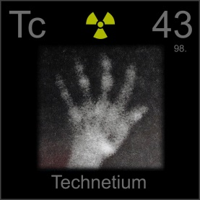
Radiopharmaceuticals
Radiopharmaceuticals are drugs which include pharmaceutical and radioactive parts together.
Technetium-99m (^{99m}Tc) is the most popular radionuclide to prepare radiopharmaceuticals with its versatile chemistry, near-ideal energy (140 KeV), low radiation dose and short half-life (6 h).
Radiolabeled NPs can be designed and used for cancer diagnostic purposes when tagged with appropriate radionuclides.
Notes:
Radiopharmaceuticals are drugs which include pharmaceutical and radioactive parts together. Since Technetium-99m (^{99m}Tc) is the most popular radionuclide to prepare radiopharmaceuticals with its ideal properties, in this study we aimed to design 99mTc labeled NPs for cancer diagnosis.

Slide 9
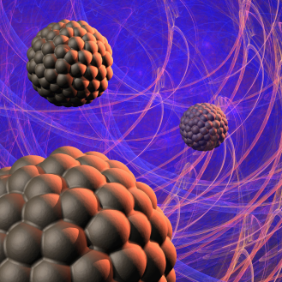
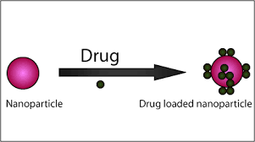
Nanoparticles
NPs are materials with typically overall dimensions less than several hundred nanometers and about 2-4 orders of magnitude smaller than human cells. Because of this unique physical property, NPs demonstrate marvelous interactions with both on surface and inside the cancer cells.
Notes:
Nanoparticles (NPs) are materials with typically overall dimensions less than several hundred nanometers and smaller than human cells. Because of this unique physical property, NPs demonstrate marvelous interactions with both on surface and inside the cancer cells.

Slide 10
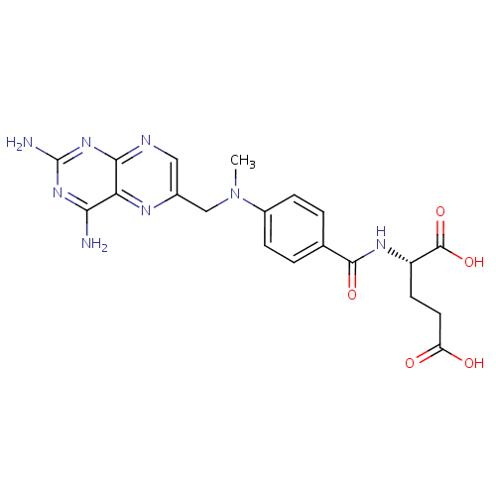
Methotrexate
MTX is one of the most widely and effectively use anticancer drug in human malignancies such as breast cancer, acute lymphoblastic leukemia, malignant lymphoma, osteosarcoma and neck cancer.
Notes:
Methotrexate (MTX) is one of the most widely and effectively use anticancer drug in human malignancies such as breast cancer, acute lymphoblastic leukemia, malignant lymphoma, osteosarcoma and neck cancer.

Slide 11

Aim
The aim of this study is to evaluate newly developed radiopharmaceutical’s (^{99m}Tc-MTX-CSNPs) incorporation to human breast cancer (MCF-7) and human keratinocyte (HaCaT) cell lines for breast cancer diagnosis.
Notes:
After all this information, the aim of our study is to evaluate newly developed radiopharmaceutical’s (^{99m}Tc-MTX-CSNPs) incorporation to human breast cancer (MCF-7) and human keratinocyte (HaCaT) cell lines for breast cancer diagnosis.

Slide 12
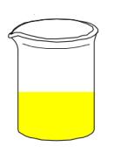
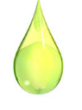
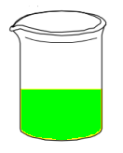
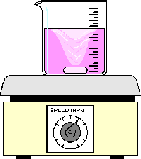
Preparation of MTX-CSNPs
MTX-TPP in distilled water
(10 mL)
Chitosan in 1% acetic acid solution
(10 mL)
Ionic gelation process
1000 rpm
10 drop/min
30 min
MTX-CSNPs
Formulation | Chitosan (%) | TPP (%) | MTX (mg)
F1 | 0.250 | 0.125 | 1
F2 | 0.500 | 0.125 | 1
Notes:
Firstly, methotrexate loaded chitosan nanoparticles were prepared by ionotropic gelation of chitosan with methotrexate-tripolyphosphate. You can see the processing procedure on the slide.

Slide 13
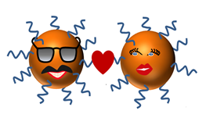
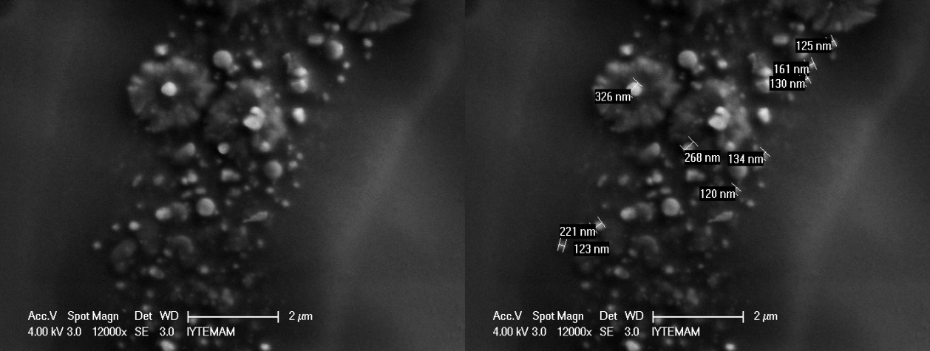
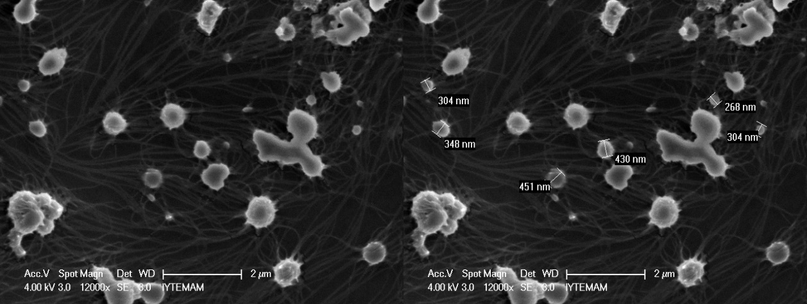
Characterization of MTX-CSNPs
Formulation | Particle size (d.nm) ± ss | Polydispersity index ± ss | Zeta potential (mV) ± ss
F1 | 169.000 ± 10.316 | 0.499 ± 0.020 | 20.133 ± 1.144
F2 | 427.633 ± 61.312 | 0.594 ± 0.076 | 29.067 ± 2.201
F1
F2
Notes:
Then, the obtained nanoparticles were characterized in terms of particle size, polydispersity index, zeta potential and surface morphology.
As it can be seen from the table, all parameters were found in proper range.
Also, SEM images showed that all the particles had nearly smooth surface.

Slide 14
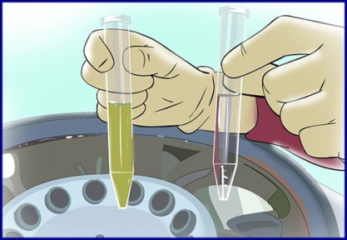
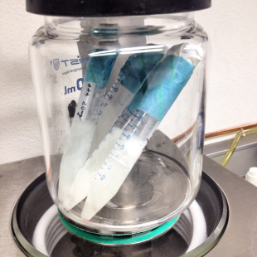
The yield of MTX-CSNPs
MTX-CSNPs
Centrifugation
4750 rpm
10 min
Lyophilisation
Yield (%) = (Practical weight / Theoretical weight) x 100
Formulation | Yield (mg) ± ss | Yield (%) ± ss
F1 | 28.433 ± 1.710 | 66.124 ± 3.976
F2 | 13.767 ± 3.539 | 20.245 ± 5.204
Notes:
To calculate the yield, nanoparticles were centrifugated for 10 minutes and then the obtained nanoparticles were lyophilised. You can see the results on the slide.

Slide 15
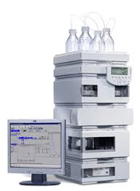

The encapsulation efficiency (EE) of MTX-CSNPs
MTX-CSNPs
Centrifugation
4750 rpm
10 min
HPLC
EE (%) = [Total amount of MTX/(The amount of free MTX+Total amount of MTX)] x 100
Formulation | EE (%) ± ss
F1 | 35.209 ± 1.333
F2 | 63.539 ± 3.931
Notes:
In addition, for the encapsulation efficiency, nanoparticles were centrifugated as prescribe before. Then, HPLC study was performed with supernatant. Likewise, you can see the results on the table.

Slide 16
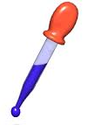
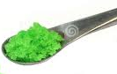


Radiolabeling of MTX-CSNPs
1 mg MTX containing MTX-CSNPs
0.1 mg
Ascorbic Acid
1 mL
Stannous Tartrate
1 mCi TcO4-
Antioxidant agent
Reducing agent
5 min incubation time
6 h stability studies
Notes:
After all these studies, Methotrexate loaded chitosan nanoparticles were radiolabeled with technetium-99m according to our previous study. For this purpose, antioxidant agent and reducing agent were added to nanoparticle formulations, respectively and nanoparticles were radiolabeled with technetium-99m.

Slide 17
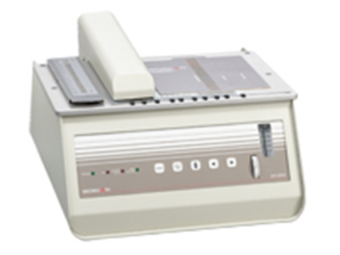
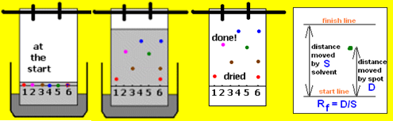
Quality control of MTX
For free technetium-99m (^{99m}TcO₄⁻):
  Stationary phase: Whatmann 3MM Chromatography Paper
  Mobile phase: Acetone
For reduced/hydrolised technetium-99m (R/H ^{99m}TcO₄⁻):
  Stationary phase: Instant Thin Layer Choromatography Paper
  Mobile phase: Acetonitrile/Water/Trifluoroacetic acid (50/25/1.5)
Notes:
After labeling studies, quality control studies were performed by instant thin layer chromatography as can be seen on the slide.

Slide 18
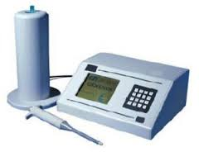
Stability studies of MTX-CSNPs
Centrifugation
2822 rpm
10 min
MTX-CSNPs
Gamma counter
% Yield of labeling=
NP Activity/ (NP Activity + SN Activity) * 100
(NP=Nanoparticle, SN=Supernatant)
Notes:
To evaluate the stability of nanoparticles, centrifugation method was used. Briefly, prepared nanoparticles were centrifuged; then nanoparticle part and supernatant part were counted at gamma counter separately.

Slide 19
Radiolabeling yield of MTX-CSNPs
Notes:
As can be seen on the slide, during six hours of stability studies, the labeling yield of formulations was found over 90%.

Slide 20
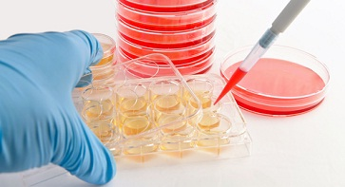
Cell culture studies
Cell binding studies of ^{99m}Tc labeled F1, F2, Blank F1, Blank F2 and Reduced/Hydrolized (R/H) ^{99m}Tc were performed using the MCF-7 and HaCaT cells in order to investigate whether there is a difference between the incorporation of cancer and normal cell lines.
% Radioactivity of Cells = (Radioactivity of Cells/Total radioactivity) x 100
Notes:
The cell binding studies were performed using cancer and normal cell lines. For this purpose, ^{99m}Tc labeled F1, F2, Blank F1, Blank F2 and Reduced/Hydrolized (R/H) ^{99m}Tc were apply to the cells.

Slide 21


Cell binding studies
Formulations which had 0.1 mCi radioactivity were added to cell lines. Then, cells were incubated during 120 minutes.
In different time intervals, cell medium and cells were taken to eppendorf tubes and then, were determined about their radioactivity.
% In vitro incorporation = Activity of cells/[(Activity of cells+Activity of medium)] * 100
Target (MCF 7)/Non target (HaCaT) Incorporation Ratio
Notes:
After radioactive formulations were added, the cells were incubated during 2 hours. In different time intervals, cell medium and cells were taken to eppendorf tubes and then their radioactivity was determined with gamma counter.

Slide 22

Target/Non Target Cell Incorporation
Formulation/Time (min) | Blank F1 | F1 | Blank F2 | F2 | R/H ^{99m}Tc
60 | 0.606 ± 0.249 | 4.030 ± 3.054 | 0.995 ± 0.433 | 2.204 ± 0.899 | 0.221 ± 0.061
120 | 1.077 ± 0.317 | 3.084 ± 0.498 | 1.203 ± 0.567 | 1.254 ± 0.541 | 0.218 ± 0.049
Notes:
On the slide you can see the results. In brief, the incorporation ratios of MTX loaded CSNPs were found higher than blank CSNPs and high incorporation ratios were reduced in time.
Also, the incorporation percentage of both F1 and F2 in cancer cell line was found higher than reduced/hydrolyzed technetium-99m. This indicated that, NP formulations were behaved different than R/H 99mTc which confirm high labeling efficiency and stability of the labeled formulations in cell medium. F1 had a greater incorporation activity on cancer cell line than normal cell line and maintained its activity longer than F2.

Slide 23
Conclusion
F1 formulation has
Proper particle size, polydispersity index and zeta potential,
High preparation yield, proper encapsulation efficiency,
High radiolabeling efficiency and stability,
High Target/Non target cell incorporation.
^{99m}Tc-MTX-CSNPs might be used in human breast cancer diagnosis in nuclear medicine patient.
Notes:
As a conclusion, F1 formulation has proper particle size, polydispersity index and zeta potential, high preparation yield, proper encapsulation efficiency, high radiolabeling efficiency and stability, high Target/Non target cell incorporation. So, our results indicated that, ^{99m}Tc-MTX-CSNPs might be used in human breast cancer diagnosis in nuclear medicine patient.

Slide 24


Acknowledgments
This study was supported by Ege University Scientific Research Project Comission (project no: 14/ECZ/037) and Aliye Uster Foundation in Turkey.
Notes:
I would like to thank to Ege University Scientific Research Project Commission and Aliye Uster Foundation for financial supports.

Slide 25



Notes:
Thank you for your attention.

