Slide 1
Using Imaging Tools to Track the Phenotype Changes to Capture Potential Genotype Changes
Mei Xiao
The Jackson Laboratory

Slide 2
Phenotype and Genotype
The relationship between genotype and the corresponding phenotype is still in its infancy.
Neuroimaging genetics
  Using brain imaging as quantitative phenotype
  Investigate the role of genetic variation in brain structure and function
KOMP
  Create knockouts mouse strains in the form of embryonic stem (ES) cells.
KOMP2
  Expand the KOMP effort to characterize phenotypes of the mutant strains.
  A broad set of phenotypes allow direct comparisons and result in a thorough description of gene functions.
  Novel genes will be brought to light that would otherwise be ignored.

Slide 3
High-throughput bio-imaging
Multiple modalities
  CT, OCT, ultra sound, MRI, fMRI etc.
Benefits
  Understand in vivo functions of genes
  Find disease patterns
Problems
  Image noises
  Image differences at different times

Slide 4
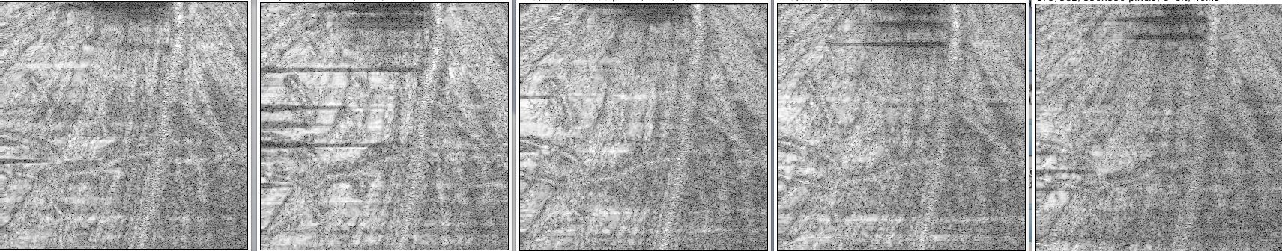
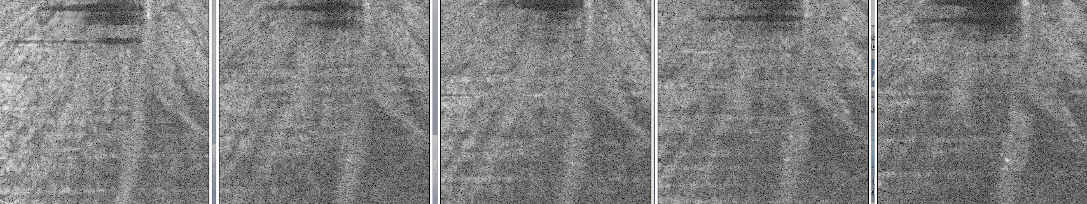

Slide 5
Averaging and Registration of the images
Averaging the images taken at the same position but at different time points
  Remove the speckle noises
Registration of the same image volume
  Enhance image quality to remove the noise caused by body movements
Registration of the same slice from different image volumes
  Enhance image quality to remove the noise caused by body movements and device system errors

Slide 6
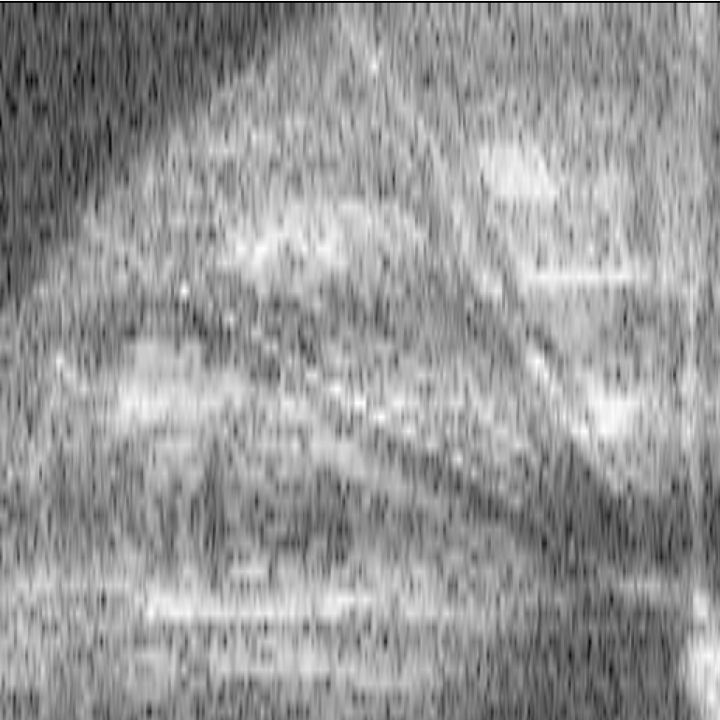
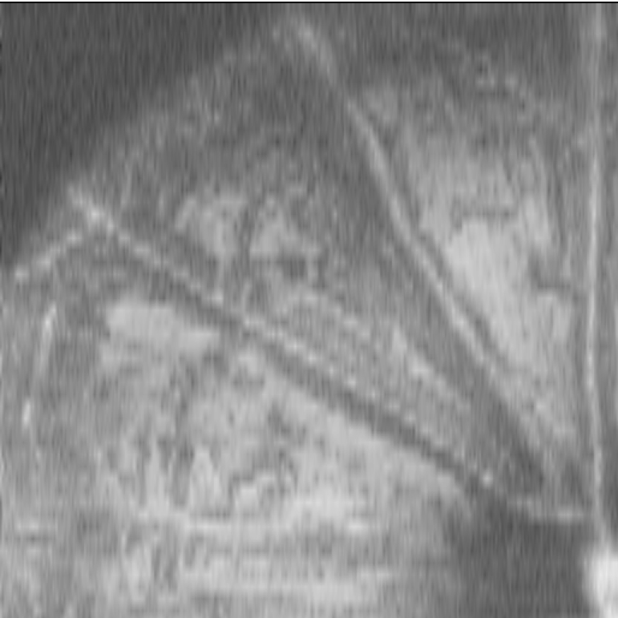

Slide 7
Develop 3D Model
3D models can reveal in vivo spatial and temporal differences.
3D models can intuitively show disease patterns.
3D models are needed for certain calculations such as the electromagnetic wave propagation for sensor antenna used in organisms.

Slide 8
Retrieve 3D models
3D models can be created from 2D image stacks such as Micro CT, MRI, etc.
Partial 3D models can be created operations on a bigger 3D original model.
Registrations of the image stacks will produce generic models that can be used for further analysis of individual data set.

Slide 9
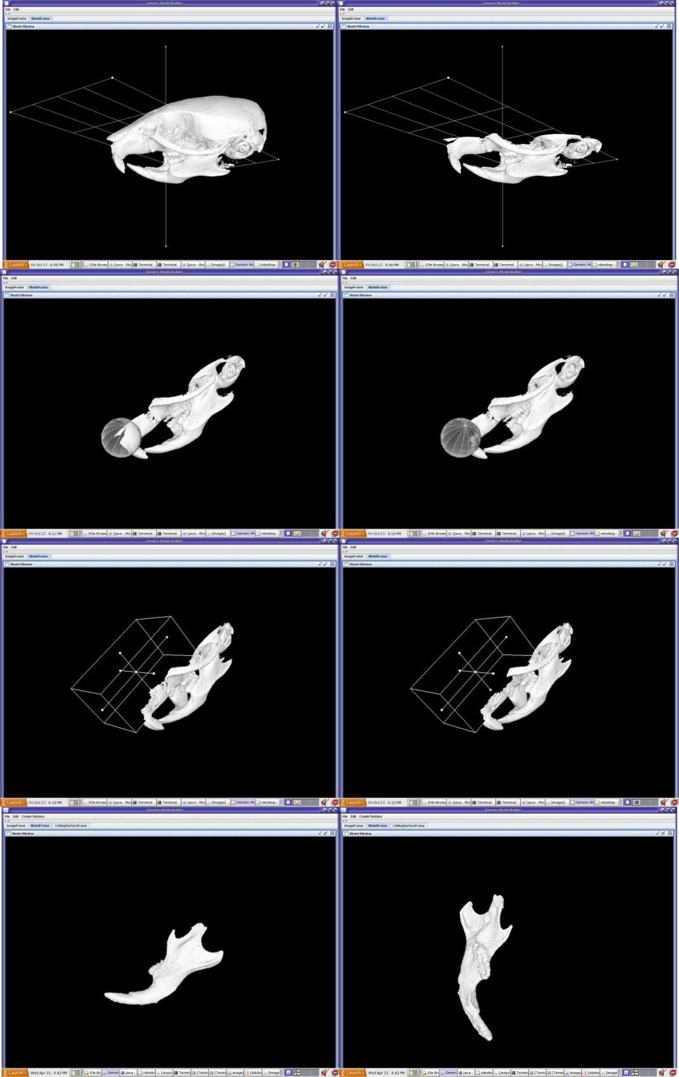
Building generic anatomical models using virtual model cutting and iterative registration
Xiao et al. BMC Medical Imaging 2010, 10-5

Slide 10
Landmark Based Shape Comparison
To find covariance of organisms’ shapes, landmark based shape analysis is a powerful statistical tool.
Landmarks allow robust, quantitative analysis of shape characteristics.

Slide 11
Transformation
To visualize the homology differences based on landmarks, deformation algorithms can be used to change one shape into another.
Thin-Plate Spline (TPS) is one algorithm for the comparison of two different shapes by distortion of one shape to another one.

Slide 12
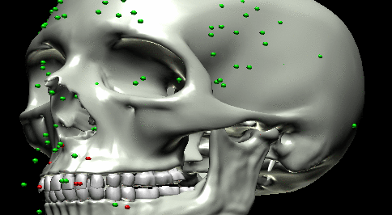

Slide 13
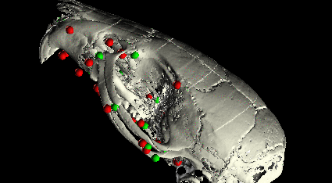

Slide 14
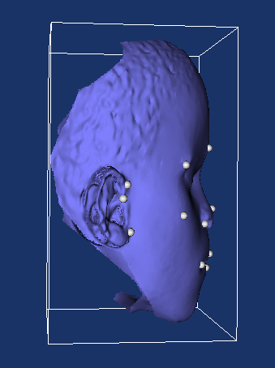
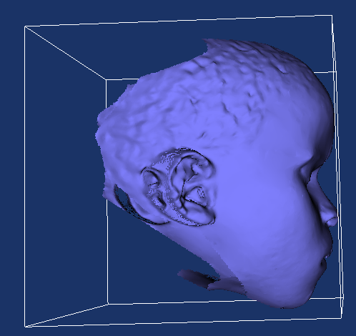
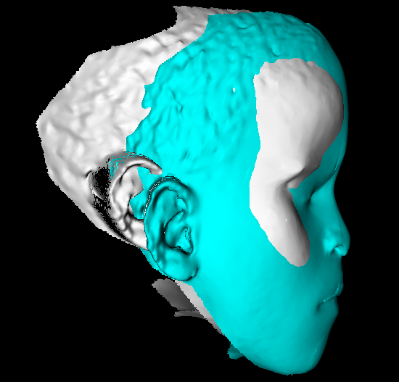

Slide 15
Acknowledgment
The Jackson Laboratory
  Keith Sheppard
  Mark Krebs
  Patsy M. Nishina
  Dave Walton
University of Calgary
  Jung Soh
  Christoph W. Sensen
  Benedikt Hallgrimsson

Slide 16
Thank you

