Slide 1
About Omics Group
OMICS Group International through its Open Access Initiative is committed to make genuine and reliable contributions to the scientific community. OMICS Group hosts over 400 leading-edge peer reviewed Open Access Journals and organize over 300 International Conferences annually all over the world. OMICS Publishing Group journals have over 3 million readers and the fame and success of the same can be attributed to the strong editorial board which contains over 30000 eminent personalities that ensure a rapid, quality and quick review process.

Slide 2
About Omics Group conferences
OMICS Group signed an agreement with more than 1000 International Societies to make healthcare information Open Access. OMICS Group Conferences make the perfect platform for global networking as it brings together renowned speakers and scientists across the globe to a most exciting and memorable scientific event filled with much enlightening interactive sessions, world class exhibitions and poster presentations
Omics group has organised 500 conferences, workshops and national symposium across the major cities including SanFrancisco,Omaha,Orlado,Rayleigh,SantaClara,Chicago,Philadelphia,Unitedkingdom,Baltimore,SanAntanio,Dubai,Hyderabad,Bangaluru and Mumbai.

Slide 3


Comparison of ZnMgO/ZnO Coaxial Core-Shell Structures with ZnO Nanorods for UV detection and Gas Sensors
Abdiel Rivera, Anas Mazady, Mehdi Anwar
University of Connecticut
Storrs, CT
School of Engineering

Slide 4
ZnO Properties & Applications
Property | Value
Lattice parameters at 300 K (nm) | a₀: 0.32495 c₀: 0.52069
Density (g cm⁻³) | 5.606
Stable phase at 300 K | Wurtzite
Melting point (ºC) | 1975
Thermal conductivity | 0.6, 1-1.2
Linear thermal expansion coefficient | a₀: 6.5 × 10⁻⁶ c₀: 3.0 × 10⁻⁶
Static dielectric constant | 8.656
Refractive index | 2.008, 2.029
Energy bandgap (eV) | Direct, 3.37
Exciton binding energy (meV) | 60
Electron effective mass | 0.24
Electron Hall mobility, n-type at 300 K (cm²V⁻¹s⁻¹) | 200
Hole effective mass | 0.59
Hole Hall mobility, p-type at 300 K (cm²V⁻¹s⁻¹) | 5 - 50
Applications
UV-Diode¹
Gas Sensor²
Bio-Sensors³
Solar Cells⁴
Nano-generators⁵
FETs⁶
Thermoelectric Applications⁷
1-Min-Chang Jeong (2006)
2-Sachindra Nath Das (2010)
3- A. Wei (2006)
4- O. Lupan (2010)
5-Seung Nam Cha (2010)
6- G. F. Boesen (1968)
7-Chul-Ho-Lee (2009)

Slide 5
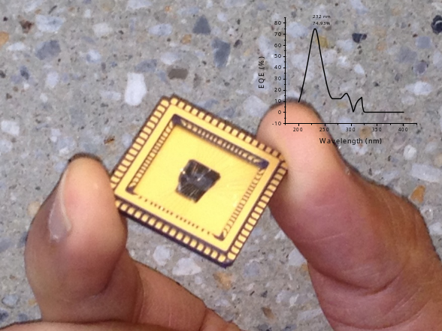
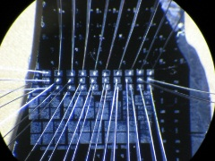
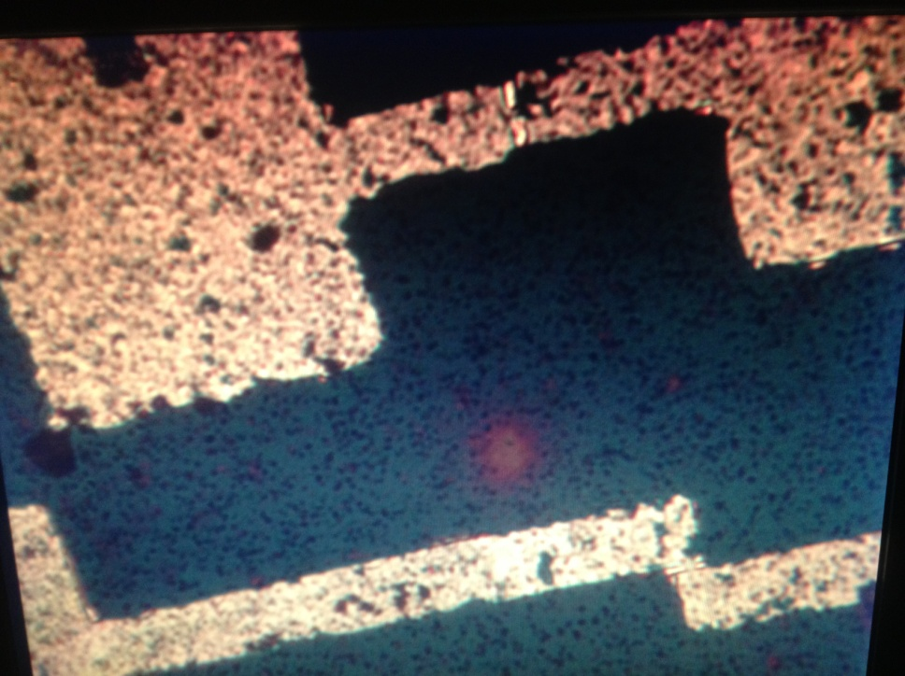
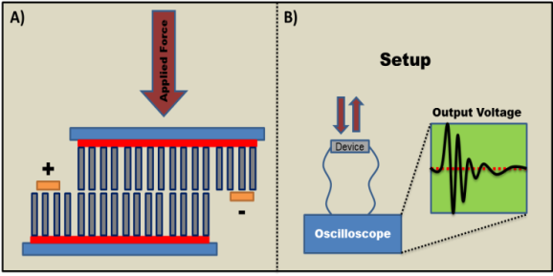
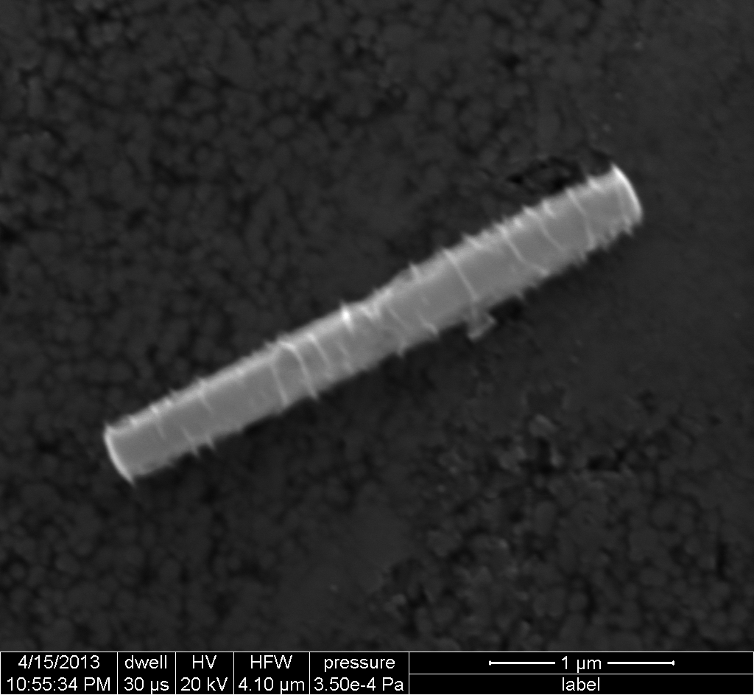
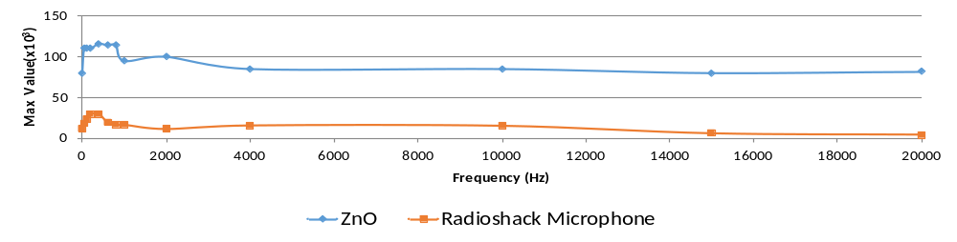
Applications Demonstrated by our group
Deep UV Detector
Energy Harvesting
Memory Device
Al
ZnO
Al
Gas Sensing
Optical Microscope image
570 nm
2.15 µm
Acoustics
SEM Image of ZnO horizontal NW

Slide 6
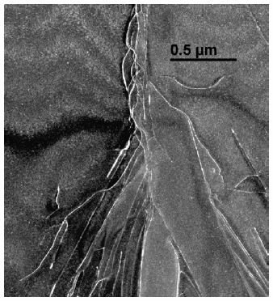
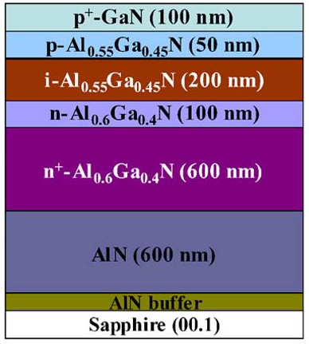
Material Choice
ZnO Features
Large direct bandgap energy ~3.37 eV
The direct bandgap of ZnO can be engineered to larger values by doping with Mg
Capability to be grown on cheap Si substrates
Piezoelectric property and biocompatibilty
Weak beam image showing dislocations in AlGaN [D.M. Follstaedt et al. , J. Crystal Growth 310 (2008) 766–776]
Device cross section of a AlGaN-based uv detector Cicek et al. (Razeghi’s group)
[Optics Lett. Vol. 37, No. 5, Mar 1, 2012])
Detectors using Al_{x}Ga_{1-x}N-based materials generate dislocations and cracks due to lattice and thermal mismatch
Lack of free standing substrates for III-N films
Layered structure introduces added complexity to the growth process

Slide 7
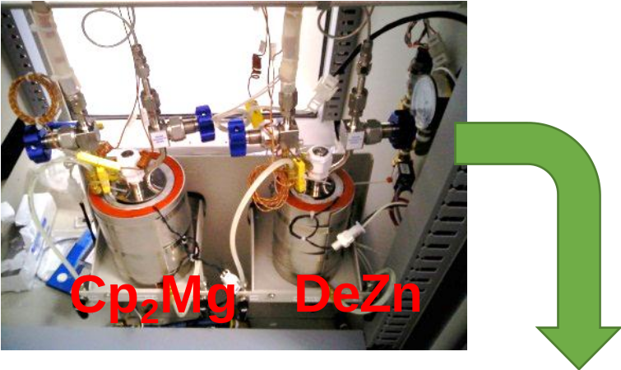
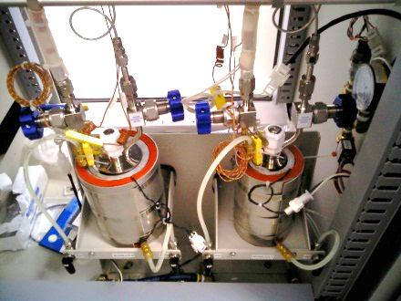
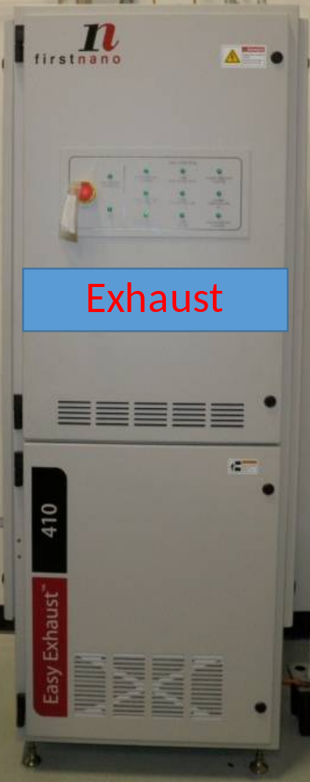
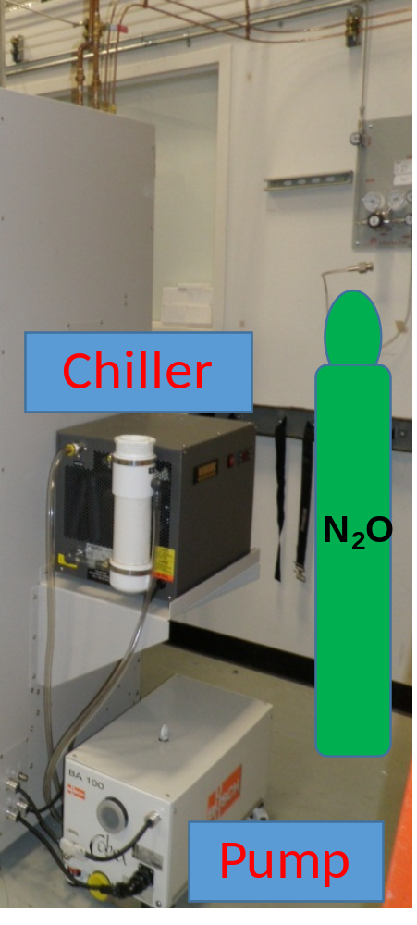
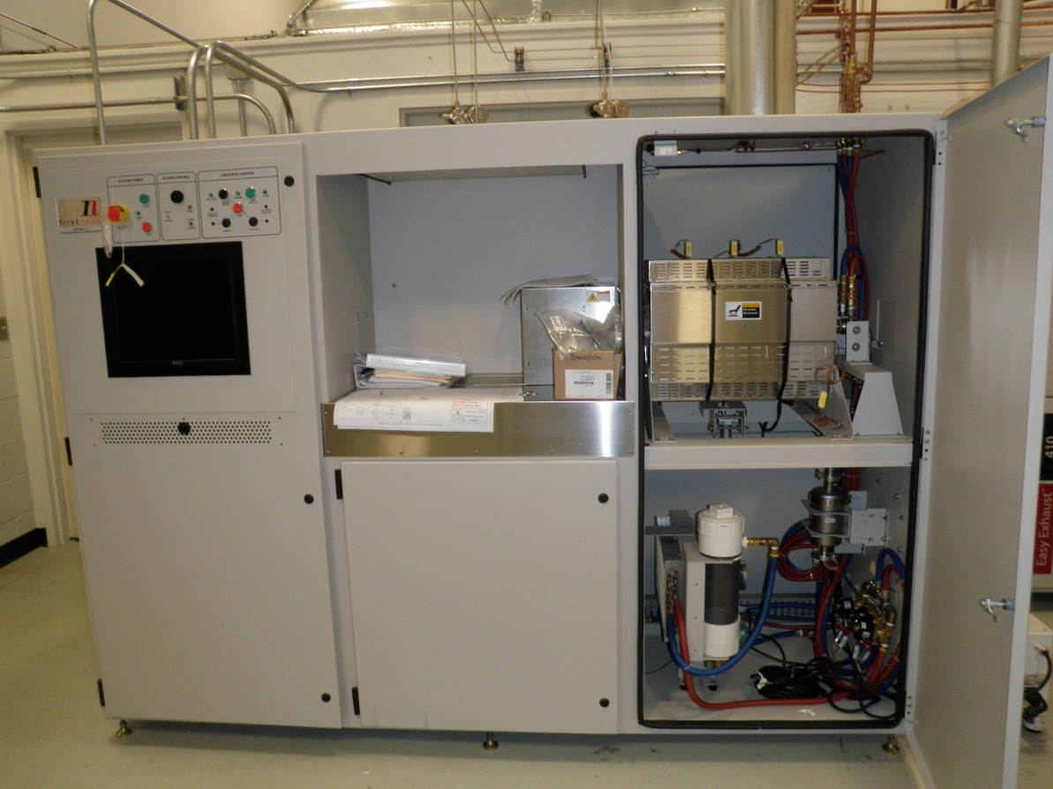
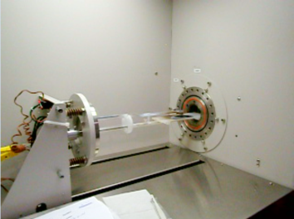
MOCVD Growth
First Nano EasyTube 3000
3 zone resistance furnace for temperature upto 1100 ⁰C
5” quartz reaction chamber
Base pressure <50 mTorr
Cp₂Mg
DeZn
Backside

Slide 8
u-GaN
p-Si (100)
p-Si (111)
Diameter: 20 – 40 nm
Length: 0.70 – 1.00 µm
Diameter: 150 – 200 nm
Length: 1.00 – 1.50 µm
Diameter: 90 – 150 nm
Length: 1 – 2 µm
Top View
Top View
Top View
1μm
1μm
4μm
45˚ Shift with respect to Electron Beam
45˚ Shift with respect to Electron Beam
45˚ Shift with respect to Electron Beam
1μm
2μm
4μm
200nm
Abdiel Rivera et al., “A Comparison of ZnO Nanowires and Nanorods Grown Using MOCVD and Hydrothermal Processes”, J. Electron. Mater., Vol. 42, No. 5, pp. 894-900, May 1, 2013.

Slide 9
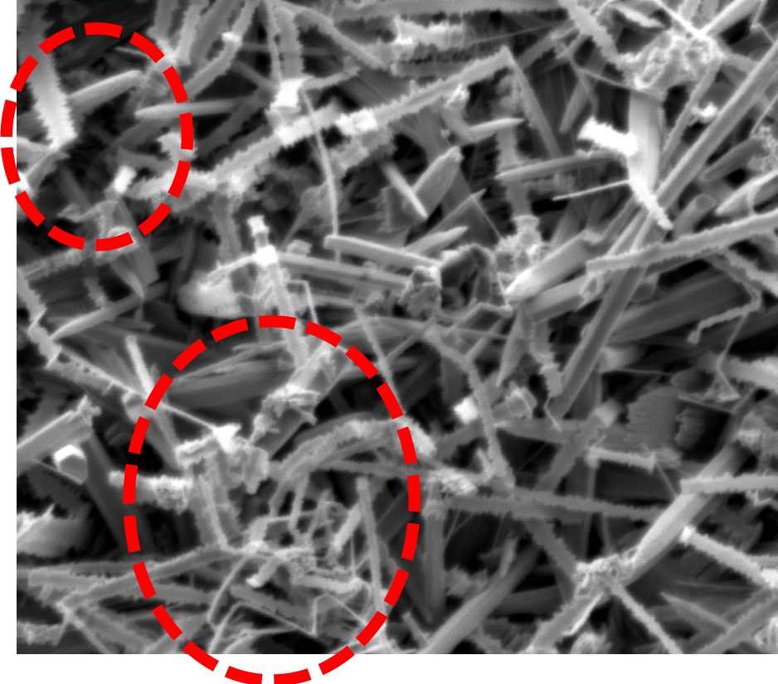
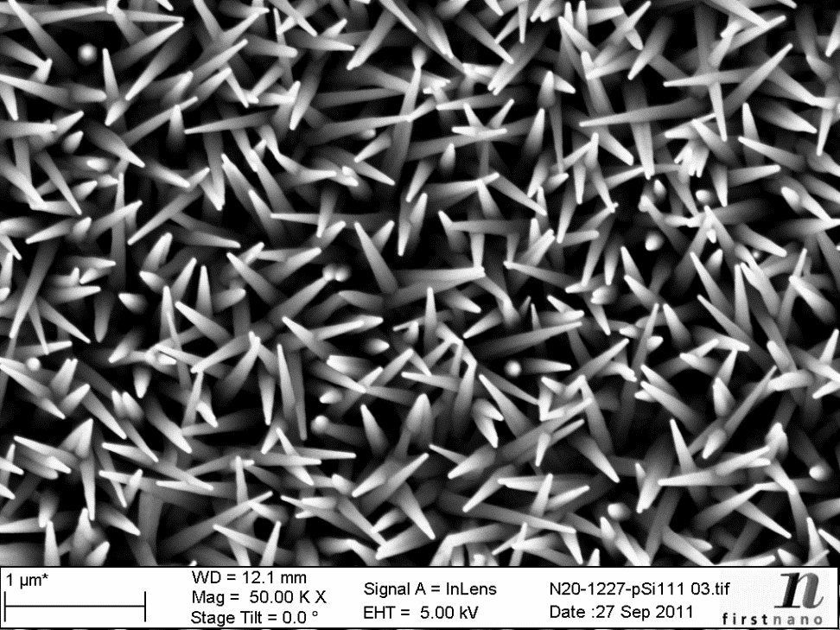
Comparison of Au Catalyst assisted/No Catalyst assisted: Growth Direction and Alignment
Catalyst assisted growth
Growth using MOCVD without catalyst
Differences: Size (length & diameter), Orientation, Gold Particles, Tip Shape.

Slide 10
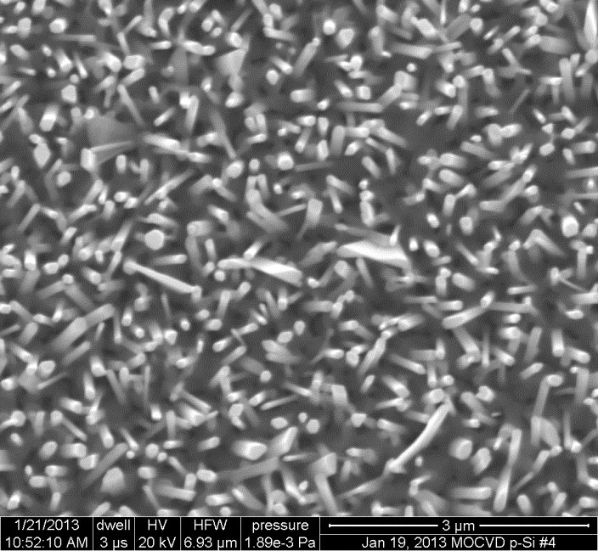
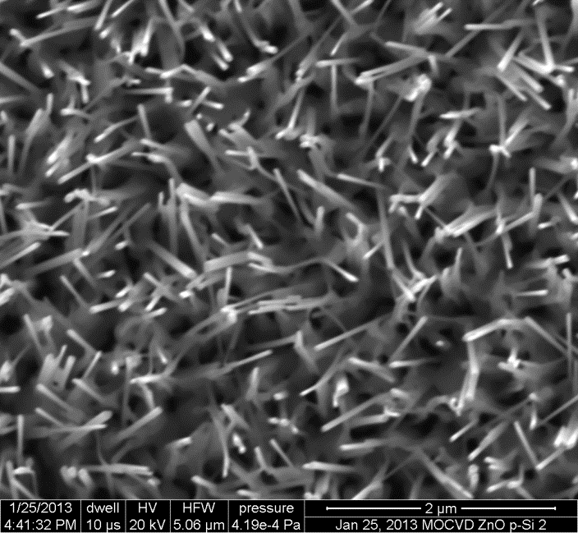
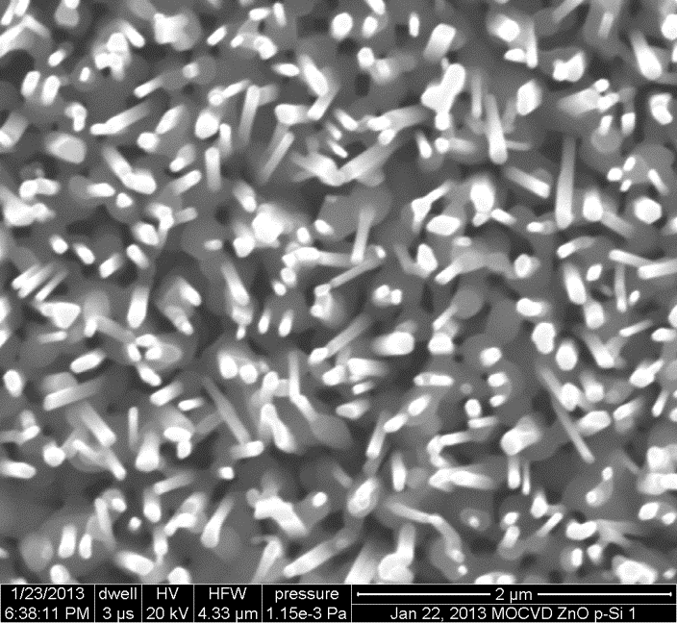
Structural Quality Vs. Annealing
ETA 635
ETA 800
ENTA 800
ZnO epitaxy annealed at 635C
NWs are NOT annealed
ZnO epitaxy annealed at 800C
NWs are NOT annealed
ZnO epitaxy annealed at 800C
NWs are annealed at 800C
Annealing the epitaxy does not affect the ZnO NWs morphology because the NWs are already lattice matched with the ZnO epitaxy
Annealing the NWs decreases the surface area to volume ratio which may be related to the decrease in c-lattice constant of the NWs
Anas Mazadyet al., "Effects of Annealing on Structural and Optical Properties of ZnO Nanowires", Materials Research Society (MRS) Spring Meeting & Exhibit, San Francisco, CA, April 21-25, 2014. and to be published on MRS Proceedings

Slide 11
ZnO Nanorods via Hydrothermal Synthesis
2 Step Epi-Layer
Solution:
50mL Methanol
0.09g Zn(CH₃COOH)₂
0.12g KOH
Spin
500 rpm, 5 sec
3000 rpm, 30 sec
10min at 60˚C
Suspend sample in:
0.1M Zn(NO₃)₂
0.1M HMTA
60min at 90˚C
Hydrothermal
Suspend sample in:
0.1M Zn(NO₃)₂
0.1M HMTA
7h at 70˚C
ZnO Nanorods
ZnO Epi-Layer
Flexible Substrate

Slide 12
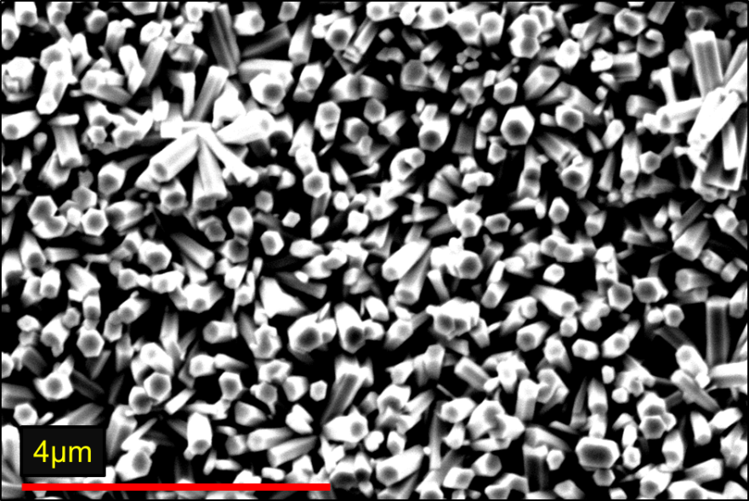
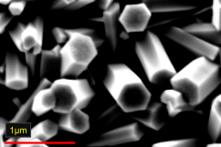
SEM of ZnO Nanorods grown on Flexible Substrate, p-Si, GaN and SiO₂/p-Si
Flex Subs
p-Si
ZnO NRs with seed layer via
Chemical Bath Deposition
1μm
GaN/Sapp.
SiO₂/p-Si
Abdiel Rivera et al., “A Comparison of ZnO Nanowires and Nanorods Grown Using MOCVD and Hydrothermal Processes”, J. Electron. Mater., Vol. 42, No. 5, pp. 894-900, May 1, 2013.
400nm
4μm
4μm

Slide 13
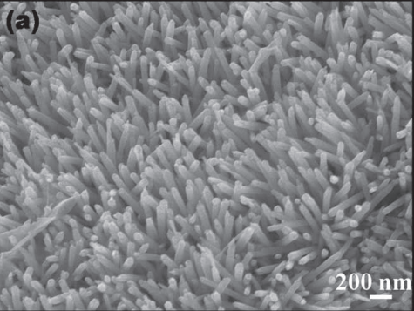
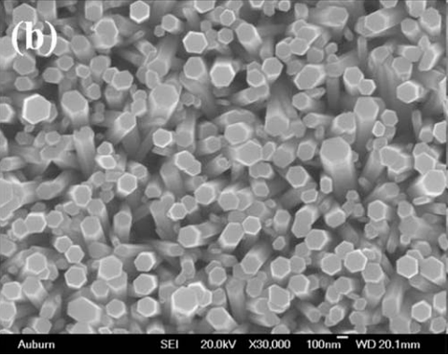
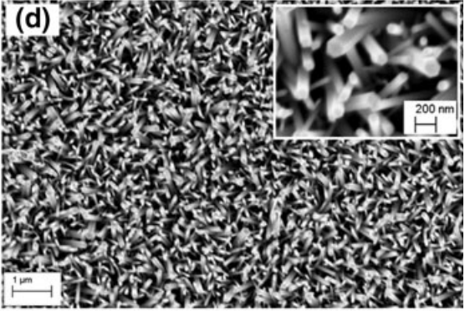
Reported Work
ZnO grown on paper using hydrothermal
ZnO grown on flexible polyimide film grown via chemical solution
ZnO grown on flexible substrate using CBD, with seed layer deposited via RF sputtering
Thickness: 60-70nm
Length: 1.5um
Thickness: 100-250nm
Length: 1.5um
T.A. Nirmal et al J. Nanopart Res (2013) 15:2115
A. Manekkathadi et al Adv. Mater. 22, (2010) 4059
H. Ahn et al Electrochemical and Solid-State Lett. 13, (11) (2010) J125

Slide 14
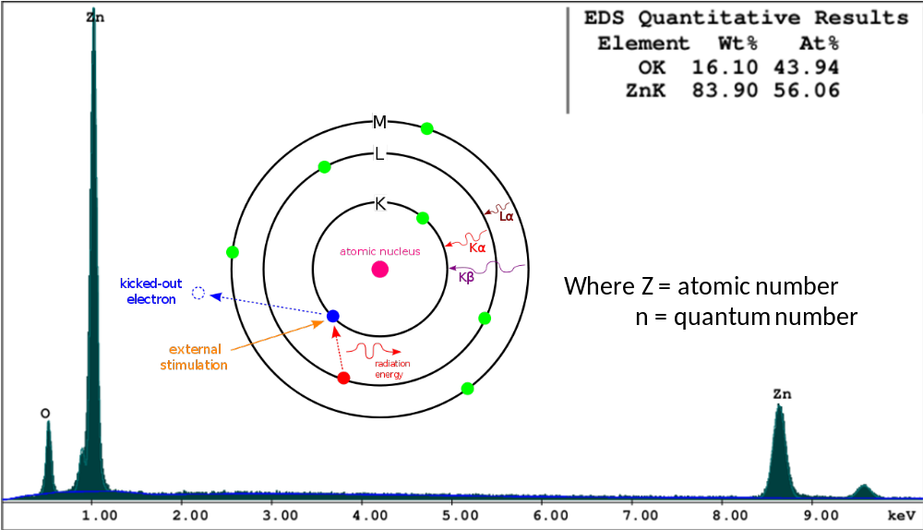
Energy Diffraction X-Ray
Spectroscopy (EDS)

Slide 15
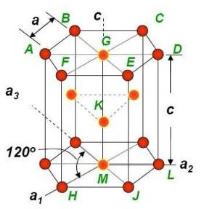
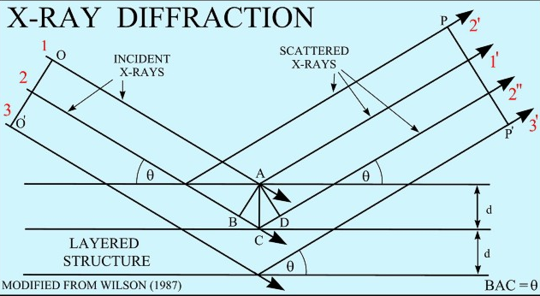
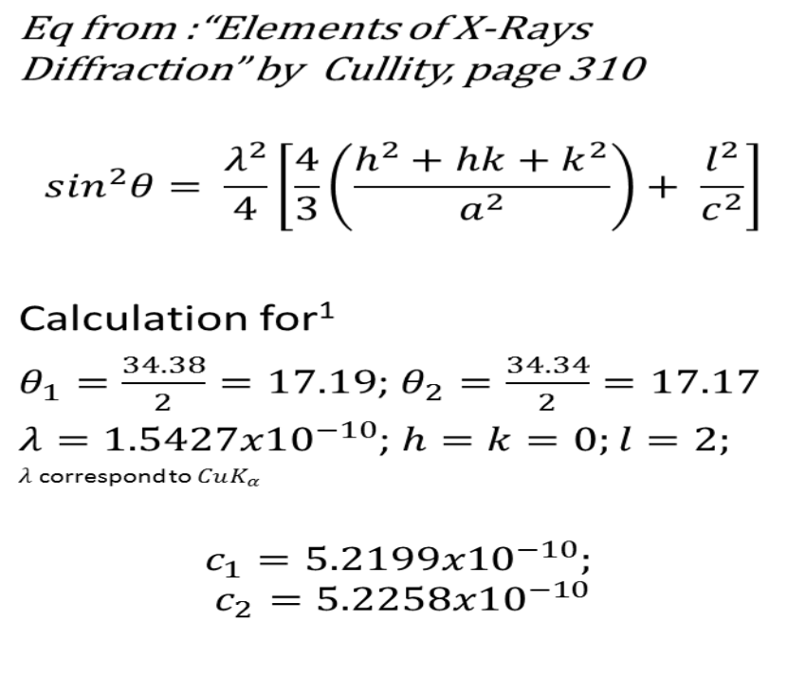
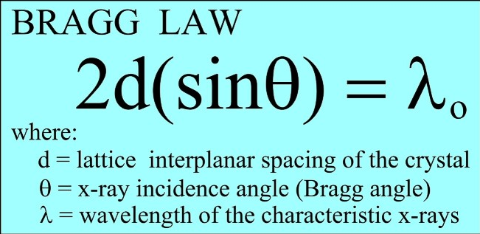
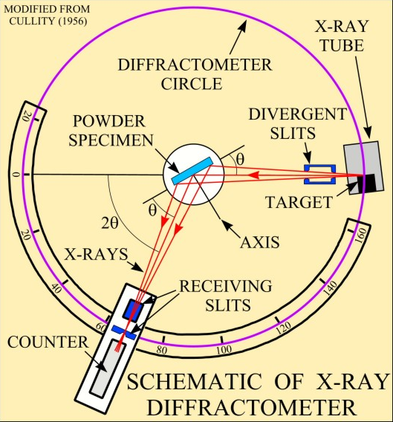
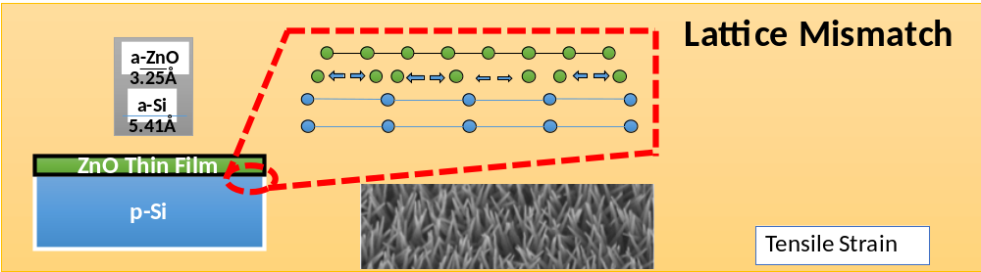
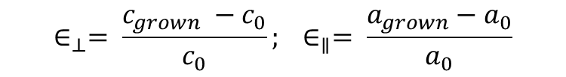
X-Ray Diffraction
Calculate the c & a-lattice constant
Wultzite crystals
ZnO Wurtzite Atoms Arragement
Stress-Strain Calculation
$$∈_{⊥}= \frac{c_{grown} −c_{0}}{c_{0}}; ∈_{∥}= \frac{a_{grown}−a_{0}}{a_{0}}$$
Lattice Mismatch of seed layer with substrate
FWHM

Slide 16
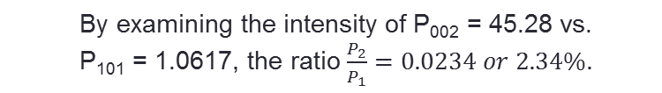
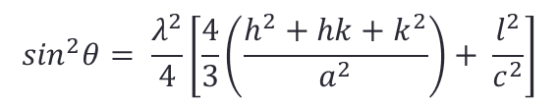
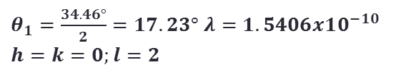
X-Ray Diffraction – ZnO/Al₂O₃
FWHM = 0.0830˚(θ)
c-lattice = 5.2011 Å
Substrate | Growth Method | c-lattice | FWHM | Reference
GaN | Electrodeposition |  | 0.09˚(θ) | Lupan et al. Adv. Mater. 2010, 22, 3298–3302
GaN | CVD | 5.208Å |  | Tsao et al. Appl. Phys. Lett. 92, 203110 (2008)
GaAs | MOCVD | 5.216Å | 0.323˚(θ) | Lee et al. Acta Materialia 52 (2004) 3949-3957
Taken using Brunker D8 Advance CuK_{α}
(λ = 1.54 Å)line at Room Temperature
Al₂O₃
ZnO (002)
ZnO (101)
Calculate c-lattice constant
ZnO c-lattice = 5.206Å
(JCPDS card No. 361451)

Slide 17
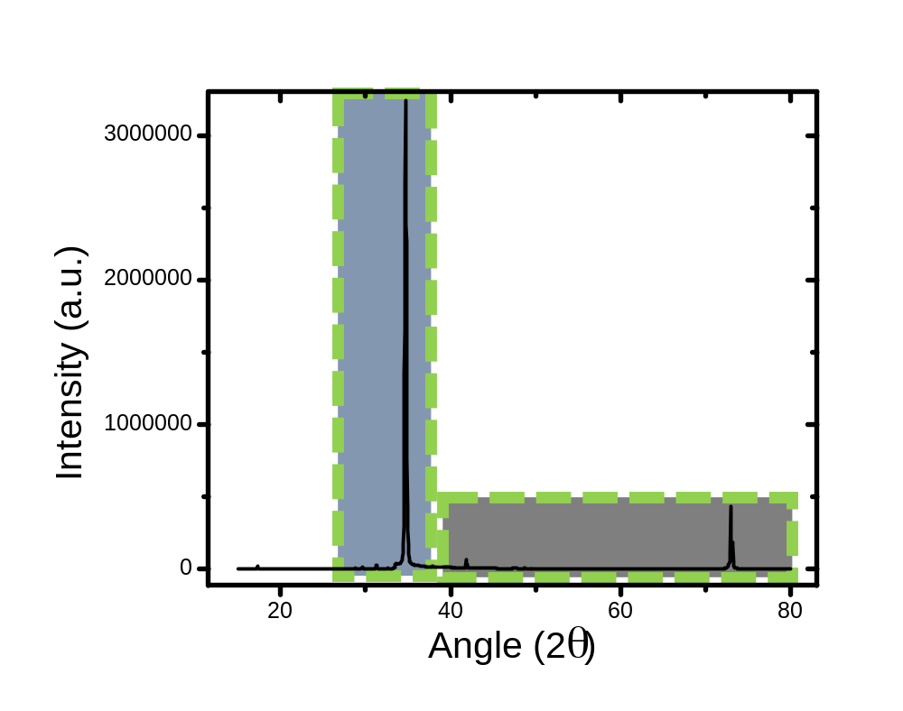
X-Ray Diffraction
p-Si (100)
FWHM = 0.0498˚(θ)
c-lattice = 5.1982 Å
Diffraction Peak for ZnO (002)
Confirming Vertical Alignment
ZnO/u-GaN
ZnO (002)
FWHM = 0.0497˚(θ)
c-lattice = 5.1838 Å
ZnO (101)
ZnO (002)
ZnO (004)
ZnO (103)
ZnO (102)
Sapphire

Slide 18
XRD – ZnO NRs on p-Si, GaN and SiO₂
 | p-Si | GaN | SiO₂
c-lattice (Å) | 5.1971 | 5.1942 | 5.19
FWHM 2θ (deg.) | 0.0591 | 0.052 | 0.0776
Abdiel Rivera et al., “A Comparison of ZnO Nanowires and Nanorods Grown Using MOCVD and Hydrothermal Processes”, J. Electron. Mater., Vol. 42, No. 5, pp. 894-900, May 1, 2013.

Slide 19
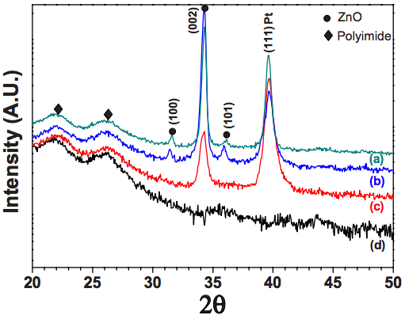
XRD – ZnO NRs
C-lattice 5.1923
FWHM 0.0502
XRD of a) postannealed ZnO NRs, b) as-deposited,
c) ZnO seed layer on Pt electrode substrate, d)flex.
substrate
H. Ahn et al Electrochemical and Solid-State Lett. 13, (11) (2010) J125

Slide 20
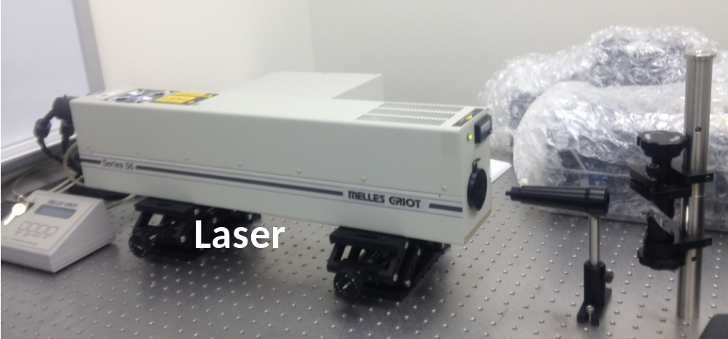
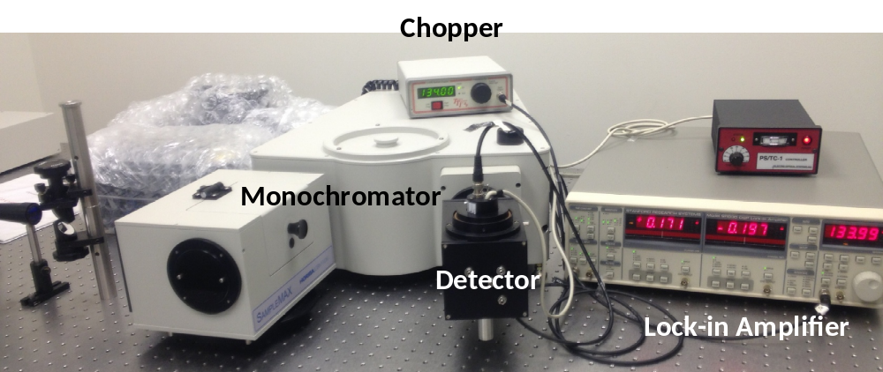

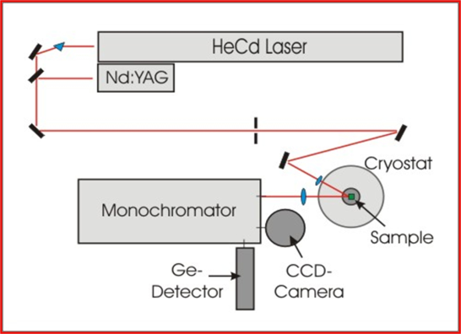
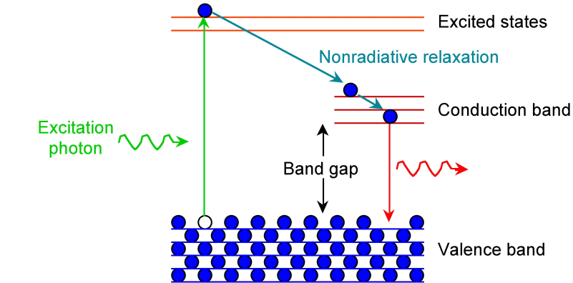
Photoluminescence (PL) Measurement Setup
Laser
Horiba 550
Si

Slide 21
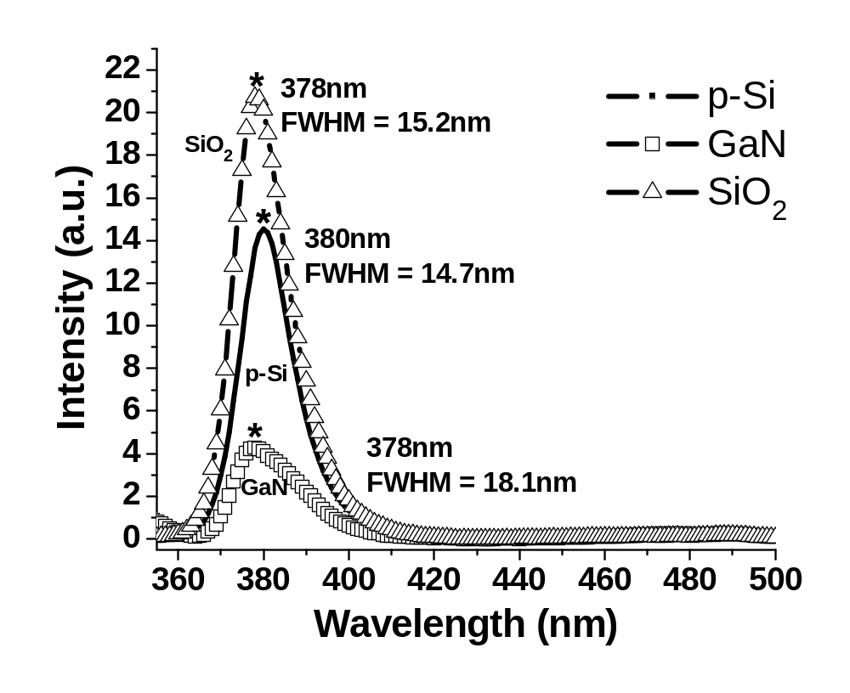
Photoluminescence (PL)
FWHM
SiO₂
15.2286 nm
p-Si
14.6932 nm
GaN
18.1446 nm
378 – 381nm
Direct recombination of exciton through exciton-exciton collision.
Abdiel Rivera et al., “A Comparison of ZnO Nanowires and Nanorods Grown Using MOCVD and Hydrothermal Processes”, J. Electron. Mater., Vol. 42, No. 5, pp. 894-900, May 1, 2013.

Slide 22
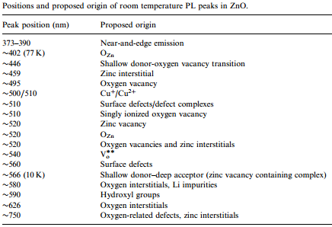
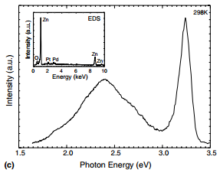
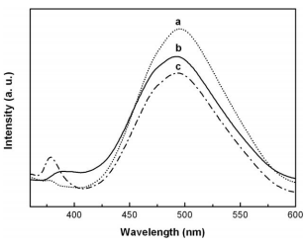
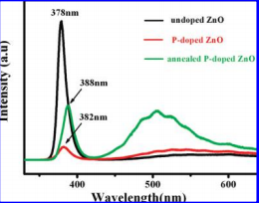
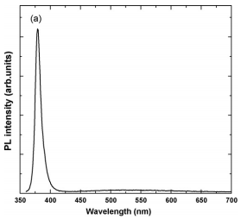
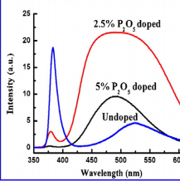
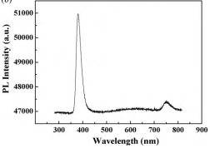
PL Of ZnO Grown using
Other Growth Techniques
A.J. Djurisic et al. Progress in Quantum Electronics
Volume 34, Issue 4, July 2010, Pages 191–259
Traps/Defects in the Visible Spectrum
Lee et al. Acta Mater., Vol. 52, (2004) 3949-3957
Zeng et al. Acta Mater., Vol. 57, (2009) 1813-1820
Fang et al. J. Phys. Chem. C.
Vol 113, No. 50 (2009) 21210
ZnO NWs grown on GaAs using Thermal Evaporation
ZnO NWs grown on TCO using CVD
ZnO NWs grown on Si using Hydrothermal Synthesis
Choi et al. Sensor and Actuators B 148 (2010) 577-582
Suh et al. Applied Surface Science 257 (2010) 1454-1456
Liu et al. Material. Letter., Vol. 70, (2012) 80-82
ZnO NWs grown on Sapp. Via catalyzed VLS
ZnO NWs grown on Si using CVD
ZnO NWs grown on Sapp using Au film using CVTC

Slide 23
UV of ZnMgO NWs Based Sensor
UV Light 355nm with 3V DC Bias
Light ON
Light OFF

Slide 24
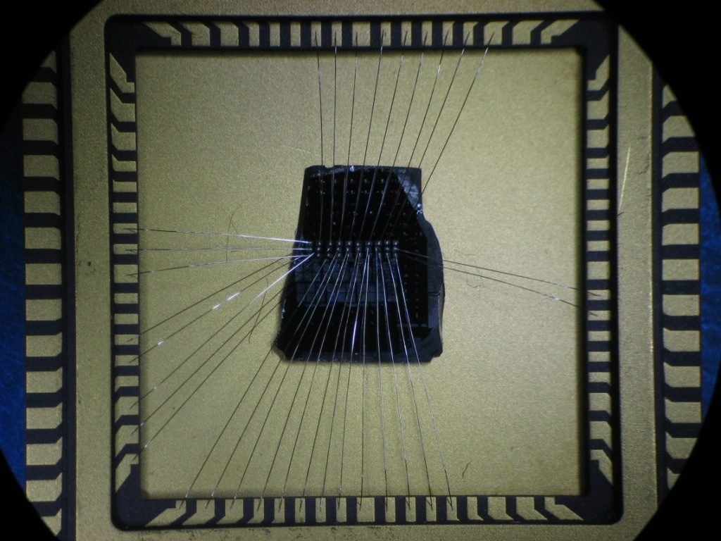


Bonded 9x3 Array of ZnMgO NW-Based Solar Blind Detector
The 9x3 array of solar blind detectors provides resolution upto 1⁰ in the deep uv range (200-300 nm)
Maximum external quantum efficiency (EQE) obtained was 75% at 232 nm with an applied bias of -1 V
Anas Mazady et al.,"Zn_{1-x}Mg_{x}O-based Deep-Ultraviolet Solar Blind DetectoZn_{1-x}Mg_{x}O-based Deep-Ultraviolet Solar Blind Detector" to be submitted ACS Nano

Slide 25


Application – Energy Harvesting
Abdiel Rivera et al., "Energy scavenging using ZnO nanorods grown on flexible substrates," Lester Eastman Conference on High Performance Devices (LEC), 2012 , vol., no., pp.1,4, 7-9 Aug. 2012, doi: 10.1109/lec.2012.6410973

Slide 26



Application – Pulse Monitoring

Slide 27


ZnO NRs on Flex. Substrate
Gas Sensor
H. Ahn et al Electrochemical and Solid-State Lett. 13, (11) (2010) J125
5V
+
-
Sensitivity = 6
+
Concentration > 5000ppm
Initial 14.1MΩ
3500ppm < Concentration < 5000ppm
Sensitivity = 3.5
99.8kΩ
ZnO Nanorods
V

Slide 28
ZnO Horizontal Nanowires
2 Step Epi-Layer
Solution:
50mL Methanol
0.09g Zn(CH₃COOH)₂
0.12g KOH
Spin
500 rpm, 5 sec
3000 rpm, 30 sec
10min at 60˚C
Suspend sample in:
0.1M Zn(NO₃)₂
0.1M HMTA
60min at 90˚C
Hydrothermal
Horizontal ZnO Nanorods
Suspend sample in:
5mM Zn(NO₃)₂
25mM HMTA
18h at 90˚C
ZnO Epi-Layer
Flexible Substrate

Slide 29




ZnO Horizontal Nanowires
Diameter: 200 – 500nm
Lengths: 1 – 7 µm
Depending upon:
-growth time
-Zn/OH ratio
Our Method is:
Simple
Fast
Provides TRULY horizontal NRs
Other Methods Require:
Pre-treatment of surface
Patterned and etched seed layer
Layer to inhibit the nucleation of NRs
AND Don’t provide HORIZONTAL NRs
Abdiel Rivera et al., "Low Temperature Horizontal ZnO Nanorods", Materials Research Society (MRS) Spring Meeting & Exhibit, San Francisco, CA, April 21-25, 2014. and to be published on MRS Proceedings

Slide 30





ZnO Memristor
Al
ZnO
Al
Memristor
16058A Test Fixture
HP4145B Parameter Analyzer
Micromanipulator 6200 Probe Station
Anas Mazady et al., “Bipolar Resistive Switching Transients in ZnO Nanowire Memristors” submitted to: Electron Device Letter

Slide 31


Mg-Incorporation in Zn_{1-x}Mg_{x}O via Hydrothermal
ZnMgO seed layer spin coated 5 times and annealed for 1hr at 150˚C
  The NWs was grown at 70C for 7hr using
    25mM of Zn(NO3)2
    25mM of HMTA
  The NWs was grown at 70C for 7hr using
    25mM of Zn(NO3)2
    25mM of HMTA
    100mM of Mg
2% Mg
Limitation: ZnO-MgO
Low Solubility
B. Amrani et al., Computational Materials Science 40 (2007) 66–72

Slide 32
Overcoming 4% Mg-Incorporation in Zn_{1-x}Mg_{x}O via Sonochemical
Diameter: 30 – 60 nm
EDS = 5-7.5% Mg
ZnO (002) @ 34.4895
c-lattice = 5.1967
NBE Shifted from 389nm to 360nm
Abdiel Rivera et al., “Overcoming 4% Mg-Incorporation in Zn_{1-x}Mg_{x}O via Sonochemical”, in preparation

Slide 33







Core-Shell Photovoltaic Applications
Sun Light is Absorbed along the NW (axial)
While collection of e⁻ depends radially
Therefore, less recombination
And Higher Absorption Coeff. due to size of
structure.
Photo-detector Setup
CuInS2/ZnS core shell quantum dots
Efficiency of 11%
Appl. Phys. Lett. 104, 183902 (2014)
Relative intensities RT PL of quantum dots
e⁻
Dependence of Photovoltaic Characteristics of SiNW array/CQD heterojunction device
Plot of Voc, Jsc, FF and PCE as function of CQD layer number
Energy band diagram of Au/SiNW Schottky junction
SiNW/CQD heterojunction
ACS Nano 8, 4015-4022 (2014)

Slide 34
ZnMgO/ZnO Coaxial Core-Shell
Growth ZnO NRs:
Growth
ZnMgO/ZnO
Core-Shell
ZnO seed layer
50mL Methanol
0.09g Zn(CH₃COOH)₂
0.12g KOH
ZnO seed using MOCVD:
50sccm DEZn @ 300Torrs
35sccm N₂O + 0.5slpm N₂
For 20 min, 70 Torr, 300°C
Spin
500 rpm, 5 sec
3000 rpm, 30 sec
10min at 60˚C
ZnMgO NWs (Shell) using
MOCVD:
10sccm DEZn @ 300Torrs
200sccm Cp2Mg @ 250Torrs
499sccm N₂O + 0.5slpm N₂
For 15 min, 0.5 Torr, 650°C
ZnO thin film using Hydrothermal
Suspend sample in:
0.1M Zn(NO₃)₂
0.1M HMTA
60min at 90˚C
ZnO
ZnO
ZnO
ZnO
ZnO (Shell)using MOCVD:
50sccm DEZn @ 300Torrs
35sccm N₂O + 0.5slpm N₂
For 20 min, 70 Torr, 300°C
ZnO NWs using Hydrothermal:
Suspend sample in:
0.1M Zn(NO₃)₂
0.1M HMTA
7h at 70˚C
ZnO
ZnMgO
ZnO Film
Flexible Substrate
p-Si

Slide 35



ZnMgO/ZnO Coaxial Core-Shell
Core:80 – 100 nm
Shell: 20 – 40 nm
~10% Mg
Abdiel Rivera et al., "Performance of ZnO NWs and Core-Shell Structures as Gas and UV Sensors", International Semiconductor Device Research Symposium, Bethesda, MD, Dec 11-13, 2013. and under review Solid State Electronics
1µm
MOCVD -> No catalyst
Mg mole Fraction 1 – 30%
On Si with HIGH Quality
Vertically aligned
1µm

Slide 36







Reported Work
ZnMgO 10 – 25nm
ZnO 70 – 150nm
Multiples ZnO/ZnMgO Core-Shell layers grown
Using Metal Organic Vapor Phase Epitaxy
ZnO/ZnMgO Core-Shell grown Using Hydrothemal and Pulsed Laser Deposition
NWs arrays are grown radially around to the optical fiber with the c-axis pointing outwards.
R Thierry et al Nanotechnology 23 (2012) 085707
Defects at
450 – 800nm
Multiples ZnO/ZnMgO Core-Shell layers grown Using Pulsed Laser Deposition
C. Pan, Adv. Mater. 24 (2012) 3356-3361
W. Liu et al J. Phys. Chem. C 114 (2010) 16148
B.Q. Cao et al Nanotechnology 20 (2009) 305701

Slide 37


XRD – ZnMgO/ZnO Coaxial Core-Shell
No other crystal observed
  No Metal Catalyst
  High Quality ZnO Film layer
c = 5.1849
FWHM = 0.0427
c = 5.1868
FWHM = 0.0823
p-Si
p-Si
No MgO phase is observed

Slide 38




Reported Work
Core-Shell
C. Chem et al J. Phys. Chem. C 114 (2010) 3863
W. Liu et al J. Phys. Chem. C 114 (2010) 16148

Slide 39

DEVICES I-V Characterization
ZnO NRs
ZnMgO/ZnO Core-Shell
Indium
Initial 14.1MΩ
Cu
ZnO Nanorods
Cu
Cu

Slide 40

UV Response of ZnMgO/ZnO Core-Shell Structure
λ = 370nm
UV Light ON
UV Light ON
UV Light
OFF
UV Light
OFF
UV Light OFF

Slide 41


Gas Sensing
ZnMgO/ZnO Core-Shell
ZnO Nanorods
10% Mg
Abdiel Rivera et al.,"ZnMgO/ZnO Core-Shell Structures for Gas and UV Sensing”, Connecticut Microelectronics and Optoelectronics Consortium (CMOC) Symposium, Storrs, CT, April 9, 2014.

Slide 42





Activation Energy of Traps From Methanol Adsorption
Activation Energy:
$$t_{d}= \frac{1}{σ_{n} v_{th} N_{C} e^{−(E_{c}−E_{T})/kT}}$$
Core-Shell = 1.16eV
$t_{d}$ (= 0.130 s for CS and, 3.3 and 5 s for NRs) is the detrapping time,
$σ_{n}$ (= 1.6x10⁻¹³ cm⁻² [41]) is the electron capture cross section, $v_{th}$ = thermal velocity ($\sqrt{3kT/m_{e}^{∗}}$),
$N_{C}$ (= 1x10¹⁸ cm⁻³) is the effective density of states,
$E_{c}$ and $E_{T}$ are the conduction and trap energy levels, and $m_{e}^{∗}$ (= 0.734 for CS and 0.138 for NR ) is the electron effective mass.
Energy Trap with Eg = 3.48eV
Vo
(neutral oxygen vacancies )
Nanorods = 1.25-1.26eV
A.J. Djurisic et al.
Progress in Quantum Electronics
Volume 34, Issue 4, July 2010, Pages 191–259
Energy Trap with Eg = 3.27eV
V⁺o (single charged
oxygen vacancy)

Slide 43


Response Magnitude
Core-Shell vs ZnO Nanorods
Measured response magnitude (RM) of ZnMgO/ZnO core-shell structure at low methanol concentration (solid black line with left y-axis and bottom x-axis) carried out at room temperature. Top x-axis and right y-axis (red-dash line-square) shows the RM of the CS at larger methanol concentration carried at 75 ˚C. The blue triangles are the RM for ZnO nanorods (NR) recorded at 75 ˚C with methanol concentration of 3000 and 5000ppm.
S. Hwang et al. / Sensors and Actuators B 148 (2010) 595–600

Slide 44





SEM Images of ZnO (thin film)/p-Si
As Grown
ZnO/ p-Si
500 °C Annealed
ZnO/ p-Si
600 °C Annealed
ZnO/ p-Si
700 °C Annealed
ZnO/ p-Si
750 °C Annealed
ZnO/ p-Si
In the 500 – 600 C window, the ZnO thin film is smoother
Recipe
50sccm of DEZn
35sccm of N2O
300 C and 70 Torrs
20 mins
Anas Mazadyet al., "Optimization of Annealing Conditions for ZnO-based Thin Films Grown Using MOCVD", Materials Research Society (MRS) Spring Meeting & Exhibit, San Francisco, CA, April 21-25, 2014. and to be published on MRS Proceedings

Slide 45



SEM Images of ZnO (thin film)/GaN
As Grown
ZnO/ GaN
500 °C Annealed
ZnO/ GaN
600 °C Annealed
ZnO/ GaN
At high annealing temperature of 700 – 750 C, the ZnO thin film is smoother (smaller RMS roughness)
Smoother film is obtained on GaN substrates than p-Si due to smaller lattice mismatch
700 °C Annealed
ZnO/ GaN
750 °C Annealed
ZnO/ GaN
Anas Mazadyet al., "Optimization of Annealing Conditions for ZnO-based Thin Films Grown Using MOCVD", Materials Research Society (MRS) Spring Meeting & Exhibit, San Francisco, CA, April 21-25, 2014. and to be published on MRS Proceedings

Slide 46

Slow Vs. Fast Annealing Ramp: ZnO/p-Si
600 °C Annealed
ZnO/ p-Si
Annealing Rate 5 C/min
600 °C Annealed
ZnO/ p-Si
Annealing Rate 2.5 C/min
Annealing rate did not change the surface roughness
The grains are not due to thermal coefficient mismatch and are rather due to the annealing condition
High temperature causes migration of grain boundaries and coalescence of grains [Lee et al., J. of Luminescence, 129 (2009) 148-152]
700 °C Annealed
ZnO/ p-Si
Annealing Rate 5 C/min
700 °C Annealed
ZnO/ p-Si
Annealing Rate 2.5 C/min
Anas Mazadyet al., "Optimization of Annealing Conditions for ZnO-based Thin Films Grown Using MOCVD", Materials Research Society (MRS) Spring Meeting & Exhibit, San Francisco, CA, April 21-25, 2014. and to be published on MRS Proceedings

Slide 47

Slow Vs. Fast Annealing Ramp: ZnO/GaN
600 °C Annealed
ZnO/ GaN
Annealing Rate 5 C/min
600 °C Annealed
ZnO/ GaN
Annealing Rate 2.5 C/min
Annealing rate did not change the surface roughness
The grains are not due to thermal coefficient mismatch and are rather due to the annealing condition
High temperature causes migration of grain boundaries and coalescence of grains [Lee et al., J. of Luminescence, 129 (2009) 148-152]
700 °C Annealed
ZnO/ GaN
Annealing Rate 5 C/min
700 °C Annealed
ZnO/ GaN
Annealing Rate 2.5 C/min
Anas Mazadyet al., "Optimization of Annealing Conditions for ZnO-based Thin Films Grown Using MOCVD", Materials Research Society (MRS) Spring Meeting & Exhibit, San Francisco, CA, April 21-25, 2014. and to be published on MRS Proceedings

Slide 48
Surface Roughness Vs. Annealing Temperature
Substrate | Annealing | Surface Roughness
p-Si | As grown | Fine grains
p-Si | 600 °C | Smooth surface
p-Si | 700 °C | Grain size: 36-154 nm
p-Si | 700 °C (slower ramp) | Grain size: 40-153 nm
p-Si | 750 °C | Grain size: 34-140 nm
GaN | As grown | Fine grains
GaN | 700 °C | Very smooth
GaN | 700 °C (slower ramp) | Very smooth
GaN | 750 °C | Very smooth
Anas Mazadyet al., "Optimization of Annealing Conditions for ZnO-based Thin Films Grown Using MOCVD", Materials Research Society (MRS) Spring Meeting & Exhibit, San Francisco, CA, April 21-25, 2014. and to be published on MRS Proceedings

Slide 49
Crystalline Structure of ZnO (thin film)/p-Si
ZnO becomes more single crystalline for higher temperature annealing at a slower rate
High temperature causes migration of grain boundaries and coalescence of grains [Lee et al., J. of Luminescence, 129 (2009) 148-152]
Anas Mazadyet al., "Optimization of Annealing Conditions for ZnO-based Thin Films Grown Using MOCVD", Materials Research Society (MRS) Spring Meeting & Exhibit, San Francisco, CA, April 21-25, 2014. and to be published on MRS Proceedings

Slide 50
Crystal Quality of ZnO (thin film)/p-Si
ZnO/ p-Si | As-Grown | 500C Annealed | 600C Annealed | 700C Slow Annealed | 700C Fast Annealed
c-lattice (Å) | 5.1921 | 5.1906 | 5.1820 | 5.1870 | 5.1891
a-lattice (Å) | 3.2430 | 3.2430 | 3.2406 | 3.1792 | 3.2417
Misfit Strain | 67.47% | 67.47% | 67.59% | 70.83% | 67.53%
FWHM (deg) | 0.2225 | 0.1279 | 0.1280 | 0.09695 | 0.1239
The FWHM decreases with increasing annealing temperature
Crystal quality can be improved by slowing down the annealing rate
Anas Mazadyet al., "Optimization of Annealing Conditions for ZnO-based Thin Films Grown Using MOCVD", Materials Research Society (MRS) Spring Meeting & Exhibit, San Francisco, CA, April 21-25, 2014. and to be published on MRS Proceedings

Slide 51
Optical Quality of ZnO (thin film)/p-Si
Anneal | Peak Position (nm) | Relative Peak Intensity | Other peaks | FWHM (nm)
none | 386.8 | 0.31 |  | 5.2108
600 °C | 387.4 | 72.54 |  | 4.377
700 °C | 387.4 | 29.36 | Broad peak at lower wavelengths | 5.2107
700 °C (slow) | 387.4 | 103.12 | Small peak at 359.4 nm | 4.79
750 °C | 385.6 | 4.41 | Peaks at 357.6, 393.8 nm | 4.377
As grown
600 C annealed
700 C annealed
(fast)
700 C annealed
(slow)
Near band-edge (NBE) energy (~387 nm) is the dominant peak
The peak at ~358 nm (3.45 eV) corresponds to electronic band to band transition [G.H. Lee et al., Thin Solid Films 386 (2001) 117-120]
Samples annealed at 600 C has minimum defects/ impurity
Slower annealing rate results in better optical quality
750 C annealed

Slide 52
Optical Quality of ZnO (thin film)/GaN
Anneal | Peak Position (nm) | Relative Peak Intensity | Other peaks | FWHM (nm)
none | 387.4 | 19.84 | 359.6 nm | 4.5854
600 °C | 387.6 | 33.478 | 359.6 nm | 4.585
700 °C | 387.4 | 52.44 | 359.8 nm | 4.7938
700 °C (slow) | 387.2 | 23.77 | 359.6 nm | 4.5854
750 °C | 387.4 | 0.37 |  | 4.7939
As grown
600 C annealed
700 C annealed
(fast)
700 C annealed
(slow)
The peak at ~358 nm (3.45 eV) corresponds to electronic band to band transition [G.H. Lee et al., Thin Solid Films 386 (2001) 117-120]
Optical quality deteriorates for annealing temperatures > 700 C.
Slower annealing results in better optical quality
750 C annealed

Slide 53
Summary
ZnMgO/ZnO Core-Shell
Sun Light is Absorbed along the NW (axial)
While collection of e⁻ depends radially
Therefore, less recombination
And Higher Absorption Coeff. due to size of
structure.
ZnO Nanorods
10% Mg
ZnMgO (Core)
C-lattice 5.1868
FWHM 0.0823
ZnO (Shell)
C-lattice 5.1849
FWHM 0.0427
ZnO NRs
C-lattice 5.1923
FWHM 0.0552
Response Magnitude of 1 – 37%
For Methanol Concentration of 1 – 3000ppm
At 75˚C
Sensitivity of 5 - 6 at Room Temperature For Methanol Concentration of XX
e⁻

Slide 54
Let Us Meet Again
We welcome all to our future group conferences of Omics group international
Please visit:
www.omicsgroup.com
www.Conferenceseries.com
http://optics.conferenceseries.com/

