Slide 1

Development and Characterization of Lidocaine Transdermal System with In-Situ Self-Emulsifying Nanosystem (i-SENS)
International Conference and Expo on Biopharmaceutics
Presented By:
Meghana Vidiyala
Ascent Pharmaceuticals Inc.

Slide 2

OBJECTIVE
The objective of this work is to develop and characterize
in-situ Self-Emulsifying Nanosystem (i-SENS) based Lidocaine
Transdermal System having Lidocaine in Nano-emulsion form
Fig 1: i-SENS Transdermal System

Slide 3
INTRODUCTION
SENS
Gel
TDS
Patient compliance
Easy to use and noninvasive
Easy to modulate the drug release rate
Long-term duration
Poor oral absorption drugs
High drug load
Stable
i-SENS
TDS
Figure 2: Conceptual Diagram of i-SENS TDS
Notes:
i-SENS transdermal system has unique advantages over conventional transdermal patches, and gels topical drug delivery systems. i-SENS transdermal drug delivery system combines the benefits of three drug delivery systems (DDS) SENS, gel and transdermal patches (systems) to overcoming their limitations such as stability (crystallization), solubility, patient compliance, poor bioavailability, low drug load, skin irritation etc., Furthermore, with i-SENS TDS, duration of action can be customize by adjusting the ratio between SENS and transdermal base or by adjusting ratio bet ween surfactant-cosurfactant and oil. Also, the most noted side effect of skin irritation in conventional gel and transdermal patches can be eliminated by this technology.

Slide 4
INTRODUCTION
Self-Emulsifying Nanosystem (SENS) – isotropic mixtures of oils, surfactants, solvents and co-solvents/surfactants that can be used for the design of formulations in order to improve the absorption of highly lipophilic drug compounds
Advantages:
Solubility
Bioavailability
Dissolution Rate
Thermodynamically Stable
Enhances therapeutic efficacy
Importance of SENS:
Improve transdermal permeation
Surfactants act as penetration enhancers
High solubilization capacity
Examples: gamma tocopherol, caffeine, plasmid DNA, aspirin, methyl salicylate, insulin and nimesulide
Notes:
Increases solubility of poorly soluble drugs, improves dissolution rate, improves bioavailability, thermodynamically stable system and the stability allows self-emulsification of the system
Why does solubility increase?
Enhance solubility by considerably reducing droplet size.

Slide 5
Technology Extension
i-Parenteral
CR-SENS
i-TDS
AR-SENS
i-SENS
Softgel
i-Liquid
i-SDF
SENSOGEL
Fig 3: Technology Extension
Notes:
Ascent Pharmaceuticals has developed and commercialized different drug delivery systems using SENS proprietary technology including softgels, topical solutions, oral solutions, solid dosage forms, topical SENSOgels, controlled release capsules and abuse resistant capsules. These innovative technology details are presented on various scientific platforms and more information available on request.
Now in-situ SENS systems are extended to develop various analgesic and local anesthetic molecules.

Slide 6
Transdermal Drug Delivery System
INTRODUCTION
Advantages
Disadvantages
Biological half-lives
Therapeutic value
Avoid first pass effect
Patient compliance
Easy to use and noninvasive
Controlled release
Long-term duration
Poor oral absorption drugs
Low molecular weight compounds
Skin irritation
Uncomfortable
Environmental Conditions
Stratum corneum as barrier
Not economical
Notes:
Advantages: 1. Allows for the effective use of drugs with short biological half-lives
Administration of drugs with poor oral absorption

Slide 7
Introduction
Lidocaine:
Local anesthetic and cardiac depressant used as an antiarrhythmia agent.
Physiochemical Properties of Lidocaine
Attributes | Observations
Molecular Formula | C₁₄H₂₂N₂O
Molecular Weight | 234.33728 g/mol
Color | White or Slightly Yellow, crystalline powder
Boiling Point | 159-160 °C at 2.00E+00 mm Hg
Melting Point | 68 °C
Solubility | Very soluble in alcohol, chloroform; freely soluble in ether, benzene and dissolves in oils
pKa | 8.01
Notes:
Lidocaine was selected as a model drug for development of i-SENS TDS.

Slide 8
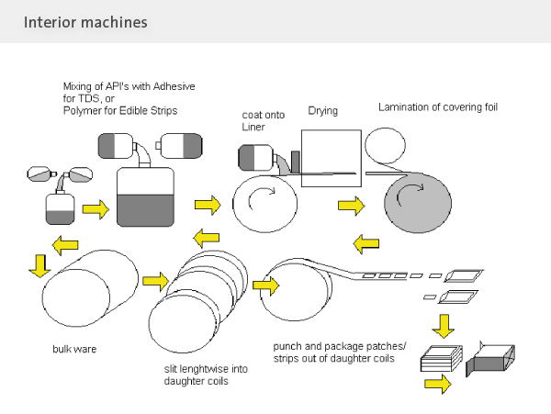
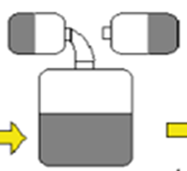
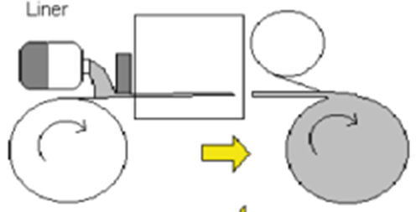
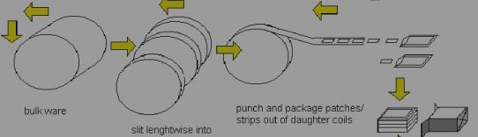
Methods and Experiments
SENS Preparation
i-SENS TDS BASE
Preparation
i-SENS Coating on Felt
Fig 5: Flow diagram showing the steps of Manufacturing
Notes:
I-SENS TDS manufacturing procedure is described here and prepared in Four stages. Stage 1: SENS preparation with Lidocaine Stage 2: Preparation of TDS base with SENS Stage 3: Coating on felt and laminae with liner Stage 4: Stripping and pouching.

Slide 9
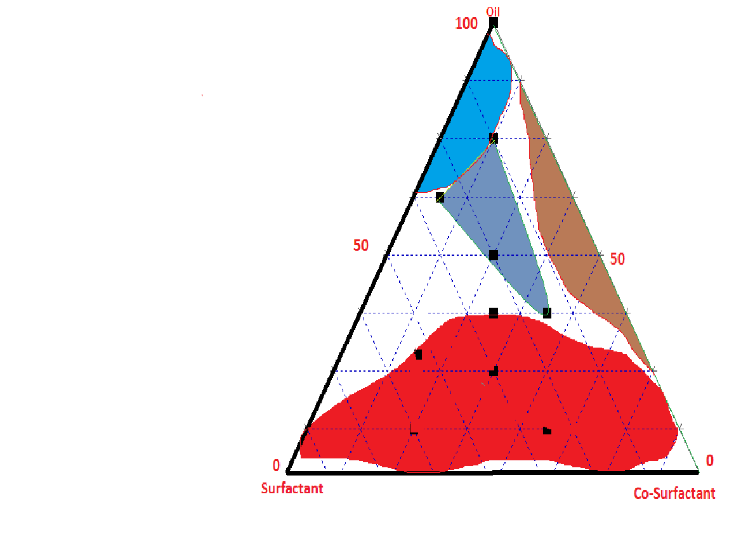
Introduction
Phase Diagram
Microemulsion
Stable Nanoemulsion
Unstable Nanoemulsion
Macroemulsion
Fig 6: Phase Diagram
Notes:
In-situ lidocaine pre-nanoemulsion mixture was prepared with polar, semi-polar, non-polar, surfactant and co-surfactants at different concentrations to obtain stable and nano-sized emulsion upon dilution with aqueous system. A tertiary phase diagram was conducted baseed on different combinations of surfactants and co surfacants with semi polar, mono diglyceride oils at a constant temperature using tri plot software
A

Slide 10
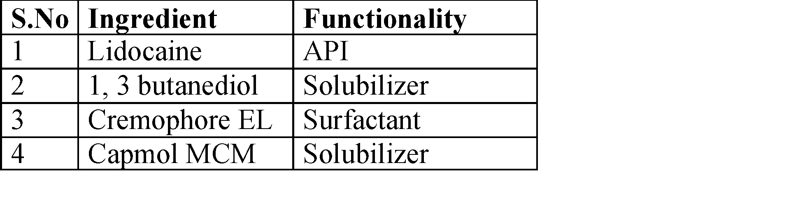
Methods and Experiments
Preparation of in-Situ Self-Emulsifying NanoSystem (i-SENS):
Lidocaine i-SENS was prepared by dissolving Lidocaine in a hydrophilic, lipophilic, surfactant and co-surfactant matrix. The resultant was a clear isotropic mixture.
Notes:
In-situ lidocaine pre-nanoemulsion mixture was prepared with polar, semi-polar, non-polar, surfactant and co-surfactants at different concentrations to obtain stable and nano-sized emulsion

Slide 11
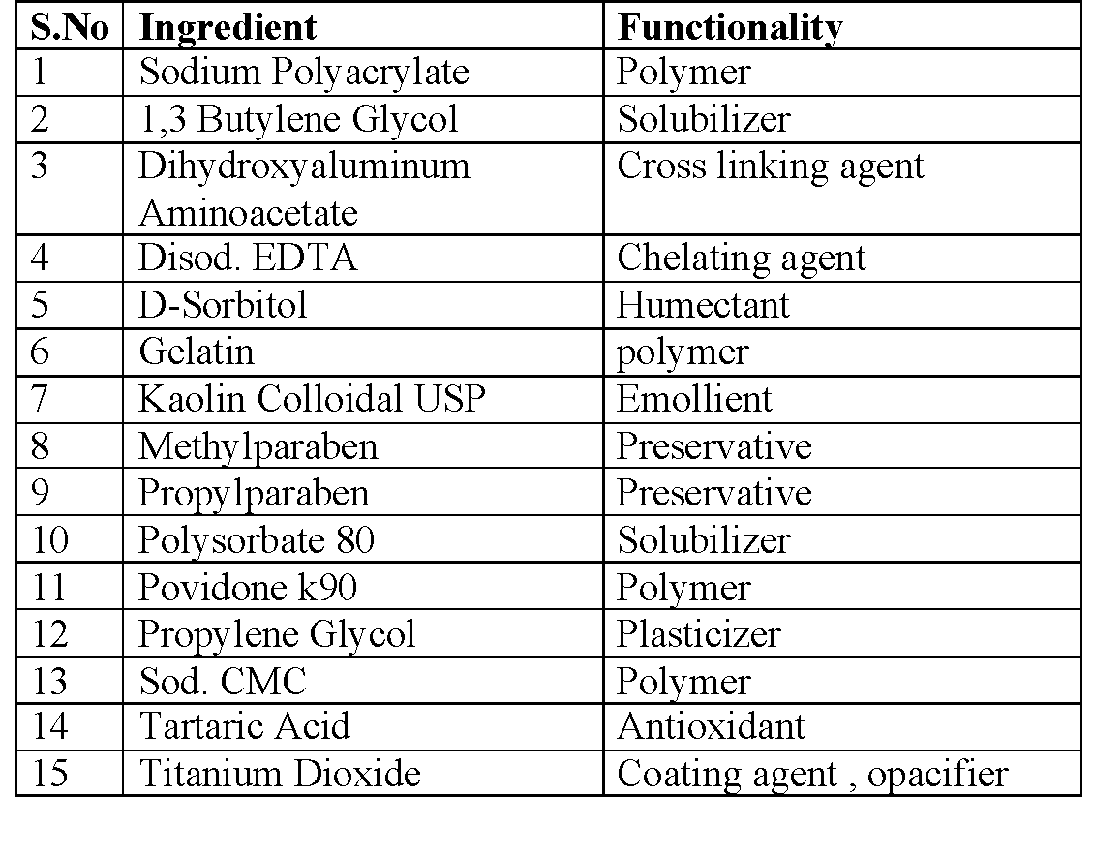
Methods and Experiments
Preparation of Transdermal patches containing i-SENS:
Lidocaine i-SENS was added to a base to create a formulation for a transdermal system. This formulation was coated on a felt using the Optimags Coating Machine with optimized parameters.

Slide 12
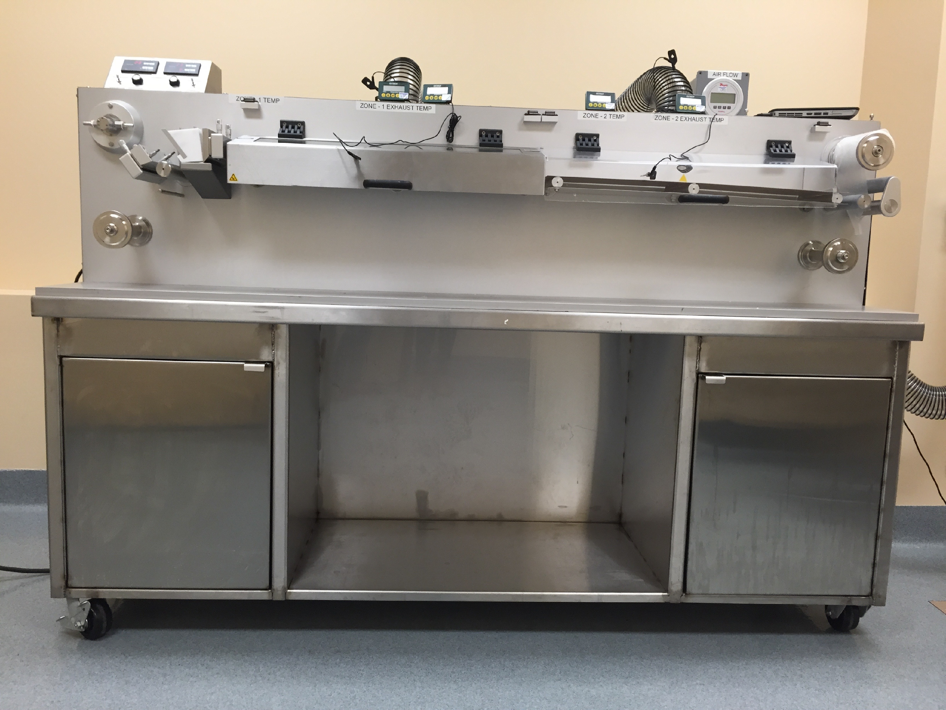
Methods and Experiments
Fig 7: Coating Machine
Notes:
The felt comes from shaft A and passes through a temperature controlled and air flow controlled zones and it is lined with a release liner at shaft B. The patch dried in this temp zone for about 20 min. After peeling the release liner from the backing film, the patch looked good and uniform spreading was observed.

Slide 13
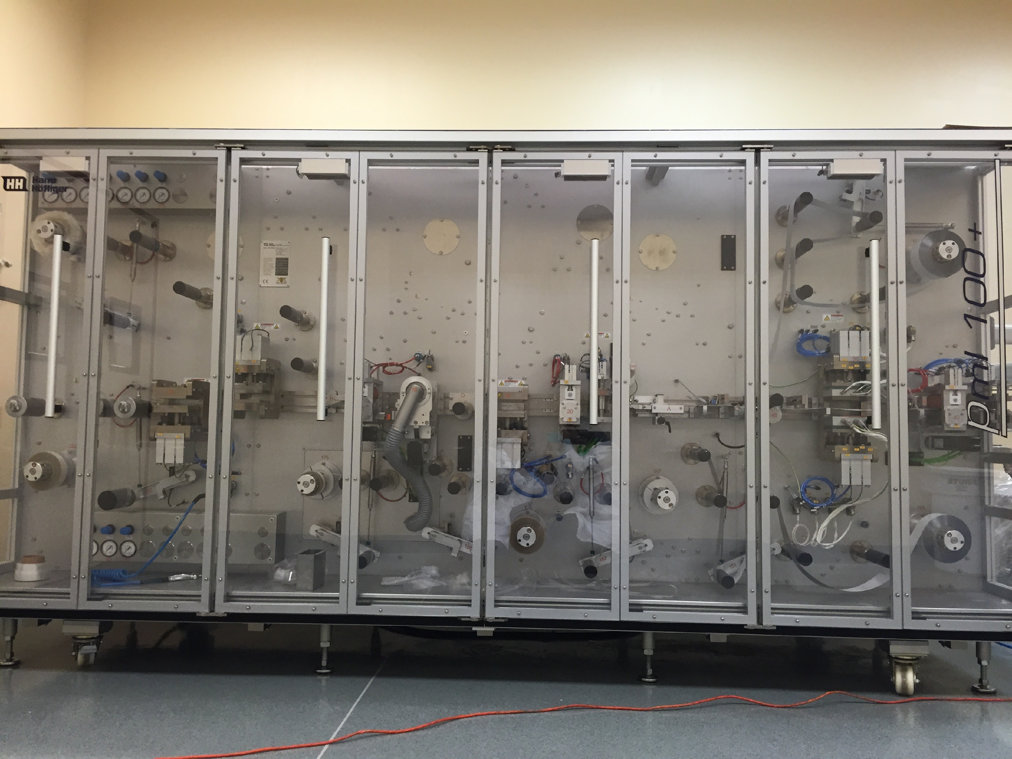
Methods and Experiments
Fig 8: Harro Hofliger Packaging Machine
Notes:
.

Slide 14
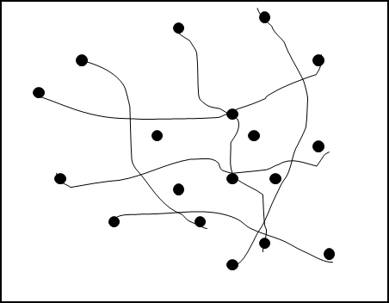

Methods and Experiments
RELEASING LINER
FELT
SENS
Fig 10: Physically Bonded SENS
Network in Polymer
Fig 9: i-SENS Transdermal Patch:
POLYMER CHAINS
Fig 11: Microphotograph of
i-SENS Transdermal Patch Gel
Notes:
The picture on the left represents a i-SENS transdermal patch. It consists of a release liner, felt, and adhesive. The picture on the right represents physically bonded sens network in a polymer. The bottom picture is a picture of a patch we created at Ascent pharmacueticals, and as you can tell it is uniform and continuous.

Slide 15
MECHANISM OF ACTION
Drug release from i-SENS into SC
Stratum Corneum
Drug Release Stages: 1. Drug release from formulation
2. Diffusion across SC via intercellular & intracellular
3. Transfer from SC to epidermis
4. Systemic circulation via capillary network
Figure 12: i-SENS TDS Mechanism of Action
Notes:
The skin is the largest organ in the human body and it provides the largest interface between the human body and the external environment. It is divided into three layers: the epidermis, dermis and hypodermis. The outermost layer of the epidermis is the stratum corneum. This consists of many layers of compacted, flattened and dehydrated keratinized cells in the stratified layer. It is responsible for the barrier function of the skin. The application of transdermal delivery to a wider range of drugs is limited due to the significant barrier to penetration across the stratum corneum. Despite the significant permeability barrier of the stratum corneum, drug delivery via the skin is a very attractive option.

Slide 16
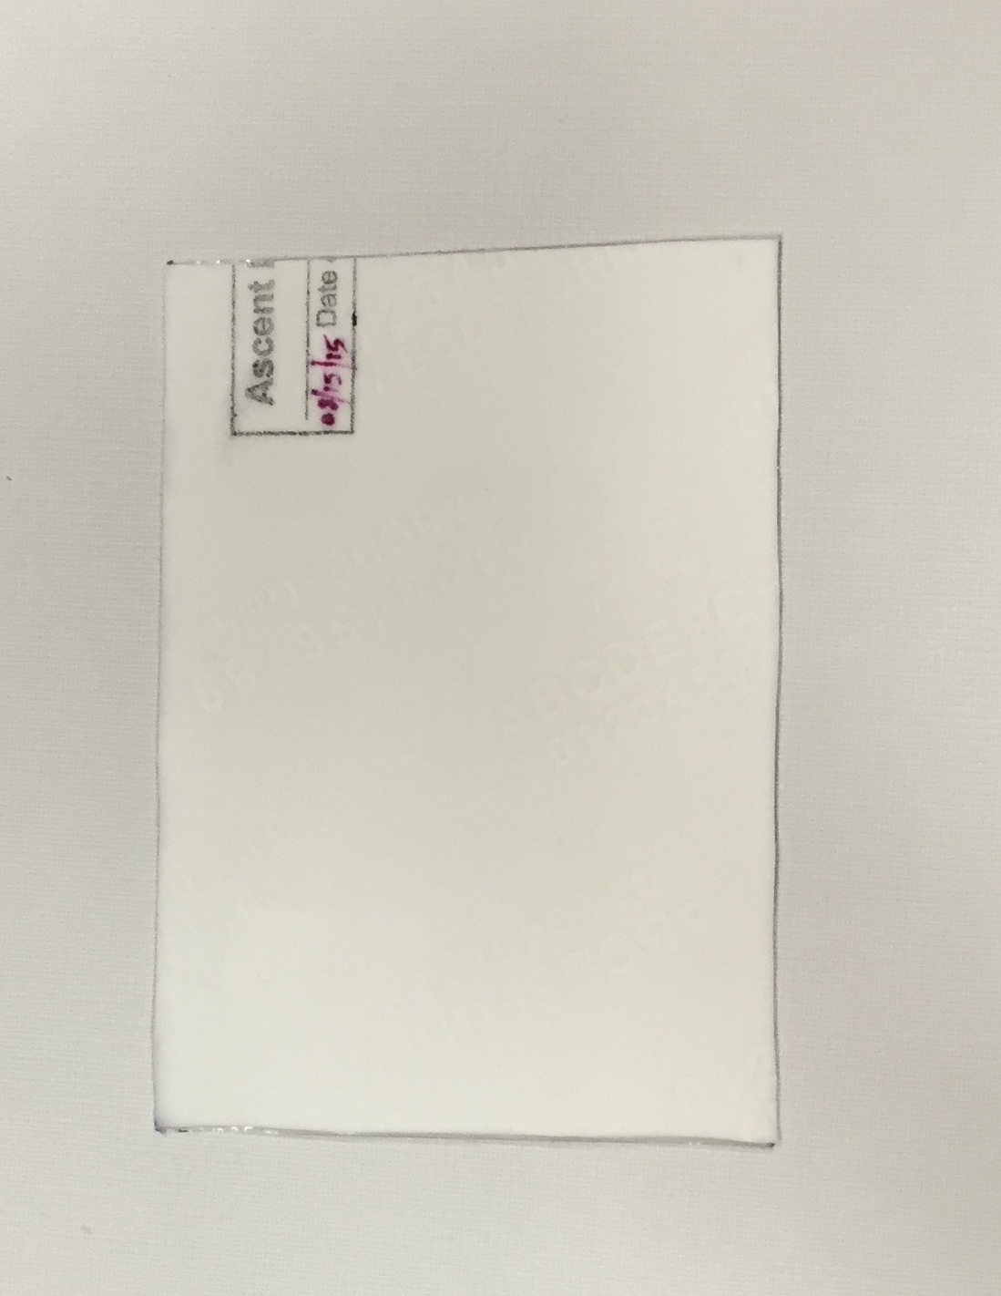
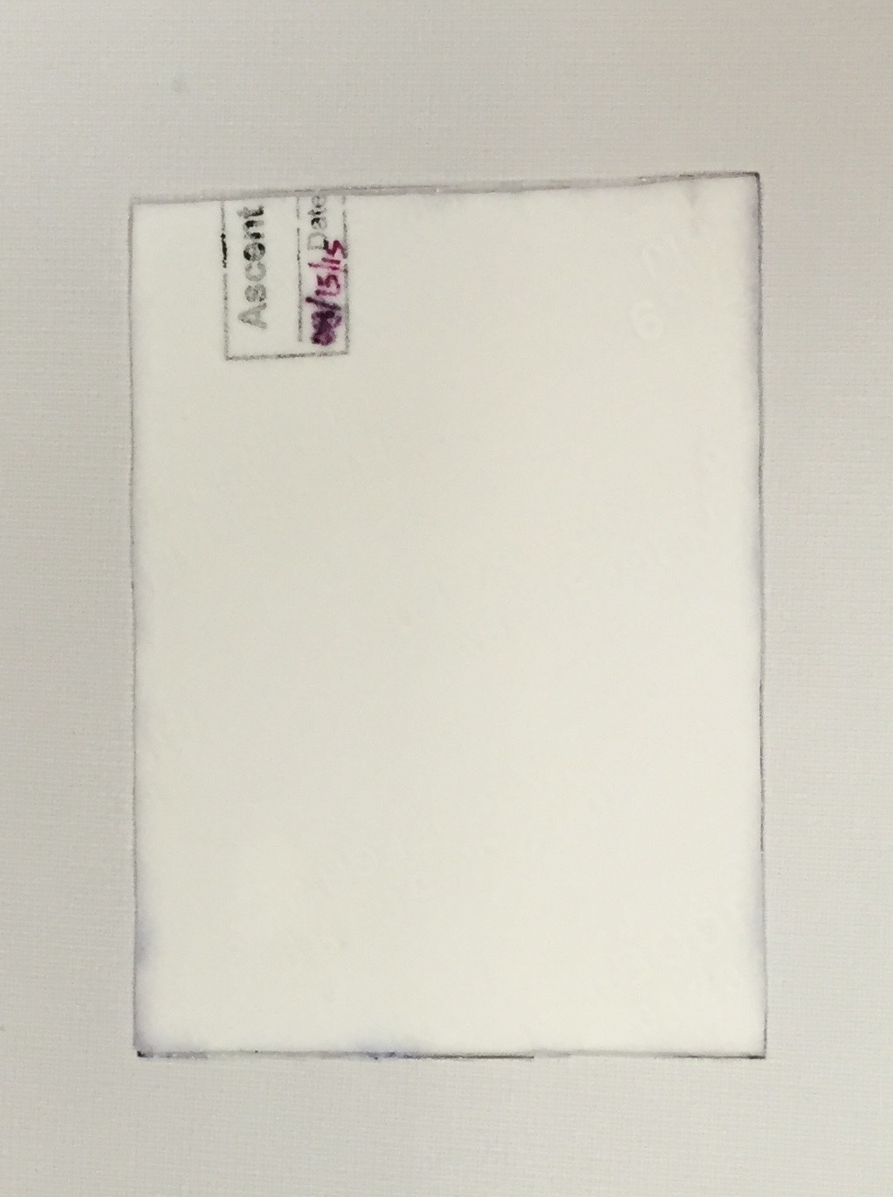

Methods and Experiments
i-SENS Lidocaine TDS
Control
Fig 13: Patches

Slide 17
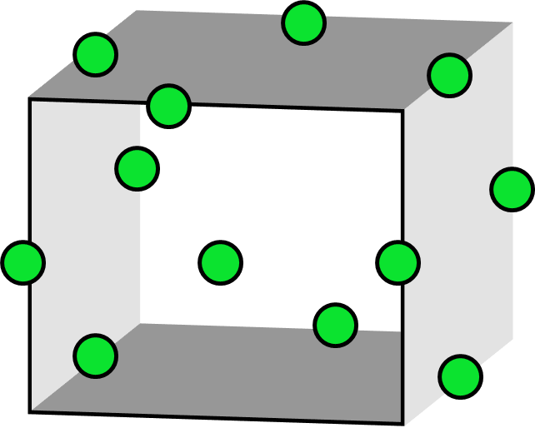
Methods and Experiments
Optimization DoE for formulation variables
A Box Behnken DoE with randomized runs was generated to map the effects of different formulation variables.
Variables
Polymer/Cross-linking agent/Chelator
Figure 14 : Box-Optimization DoE for investigating the effect of formulation variables
Drug Release
Moisture Level
Viscosity
Peel Strength
Notes:
i-SENS TDS was developed using risk based approach using Box Behnken DOE method. Various critical quality attributes were identified and optimized to achieve optimum drug release rate, viscosity and peel strength. Furthermore, the most important and critical moisture and three dimensional network structure of TDS abse was obtained by optimizing the ratio between cationic, non-ionic polymer and cross-linking agents.

Slide 18
Methods and Experiments
Lidocaine i-SENS
Transmittance – Using a UV Spectrophotometer, absorbance spectra of various compounds can be measured
Emulsification Rate – Preparing a solution of API and excipients in a water immiscible solvent which is emulsified into an aqueous surfactant solution. The solvent is removed from emulsion droplets to form particles
Viscosity – Brookfield Viscometer measures fluid viscosity at given shear rates. The principal of operation is to drive a spindle through a calibrated spring.

Slide 19
Methods and Experiments
Lidocaine i-SENS
Water Uptake Study – Percentage of water uptake can be calculated by measuring how much water can be added to 1 gram of fill material until precipitate is formed.
Potency – Drug content was found by making a 1000 ppm solution and further diluting it and measuring absorbance using UV spectrophotometer
Stability – Conducted to observe the influence of temperature and relative humidity on the drug content

Slide 20
Methods and Experiments
Transdermal System
Description – 10 cm x 14 cm Patch
Thickness – The thickness of the film was measured using electronic vernier calipers. Measurements were taken at five different points on the film and the average of these readings were taken
Percentage of Moisture Content – The prepared formulation was kept in the Ohaus machine and percent moisture content was calculated
Cold Flow – Caused by the viscoelastic creep of the adhesive layer
Content Uniformity – 10 patches are selected and content is determined for individual patches. The transdermal patches pass the test if they fall in a specific range

Slide 21
Methods and Experiments
Transdermal System
Folding Endurance – It was determined by repeatedly folding the film at the same place until it breaks or cracking has been observed
Sheer Adhesion Test – Resist flow; Measurement of cohesive strength of an adhesive polymer
Peel Adhesion Test – Resist removal; Force required to remove adhesive coating from the test substrate
Potency – Drug content was found by dissolving a 0.64cm² patch for 2 hours and then the filtrate was analyzed using UV Spectrophotometry

Slide 22
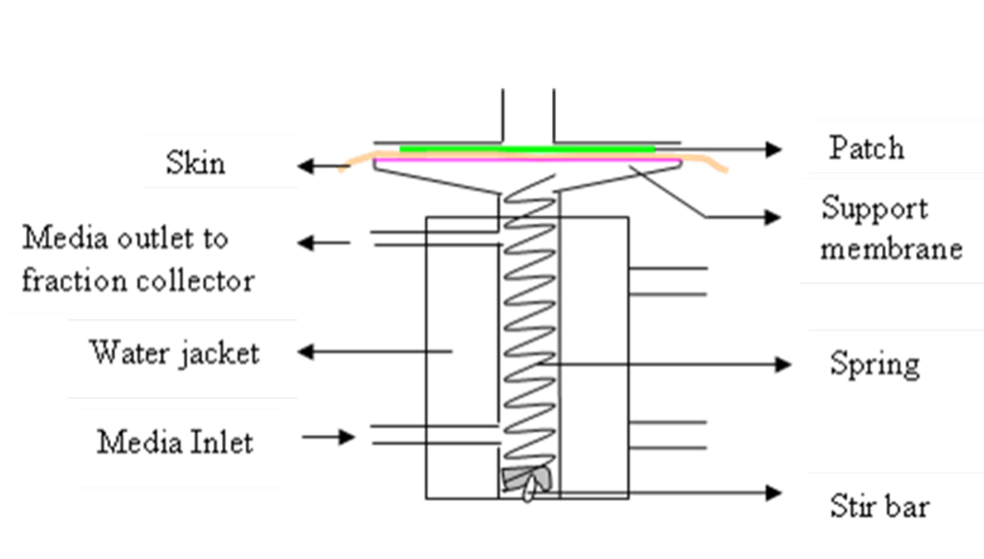
Methods and Experiments
In-Vitro Drug Release Studies – Evaluates the rate and extent of release of a drug substance from a transdermal patch
Figure 15: Franz Cell – in-Vitro Dissolution Studies

Slide 23
Methods and Experiments
In-Vitro Permeation – In-vitro studies can help find the mechanism of skin permeation of the drug before it can be developed into a TDDS
Factors Affecting In-Vitro Permeation:
Hydration time
pH
Transdermal Enhancers
Temperature
Thickness of skin
Sampling intervals

Slide 24
Methods and Experiments
Franz-diffusion cells were used in our studies, in which drug leaves an unstirred donor compartment, crosses through a membrane of thickness h and cross sectional area A, and accumulates in a stirred receiver compartment for which sink conditions were maintained. For this type of steady-state diffusion, we can use Fick’s First law,
J = ^{dM}
^{A*dt}
Where, J = Flux (µg cm⁻² hr⁻¹)
A = Cross sectional area of membrane (cm²)
^{dM} = Amt of drug permeated vs. time (µg/hr.)
^{dt}
From, experimental point of view, the flux can be calculated by below equation,
J = ^{Slope}
^{Diffusion Area}
Where, Slope = resultant slope of ^{dM} vs. time
^{dt}
Diffusion area = A = 0.64 cm²

Slide 25
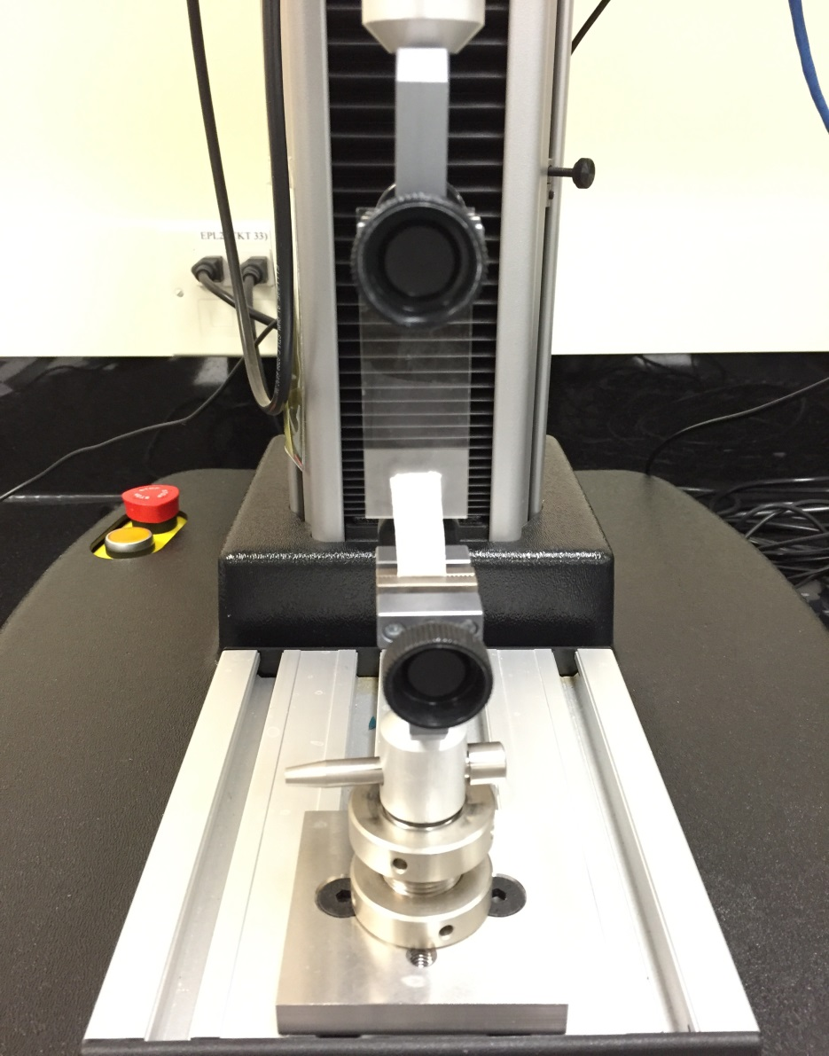
Methods and Experiments
Shear Adhesion Test:
Measurement of the cohesive strength of an adhesive polymer
Influenced by weight and composition
Shear adhesion determined by time it takes to pull patch off the plate
Fig 16: Force Tester
Notes:
This test is to be performed for the measurement of the cohesive strength of an adhesive polymer. It can be influenced by the molecular weight, the degree of cross linking and the composition of polymer, type and the amount of tackifier added. An adhesive coated tape is applied onto a stainless steel plate; a specified weight is hung from the tape, to affect it pulling in a direction parallel to the plate. Shear adhesion strength is determined by measuring the time it takes to pull the tape off the plate.

Slide 26
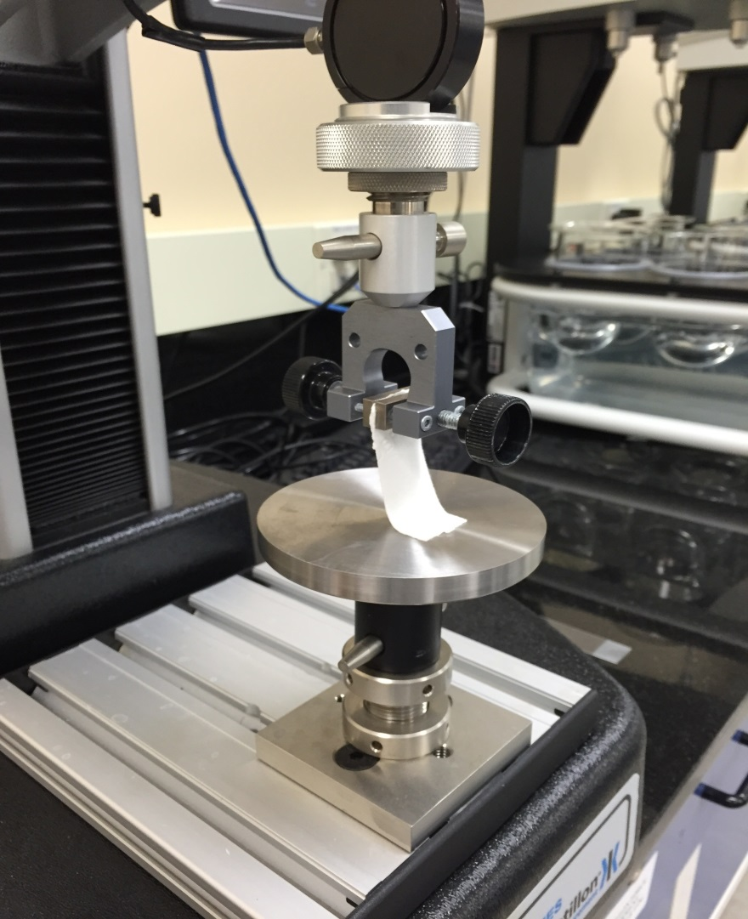
Methods and Experiments
Peel Test from the Surface
Force required to remove an adhesive coating from a test substrate
Applied to steel plate
Force required for patch to be removed is measured
Fig 17: Force Tester
Notes:
Peel Test from the Surface: In this test, the force required to remove an adhesive coating from a test substrate is referred to as peel adhesion. A single tape is applied to a stainless steel plate and then the tape is pulled from the substrate at a 180° angle, and the force required for the tape removed is measured

Slide 27
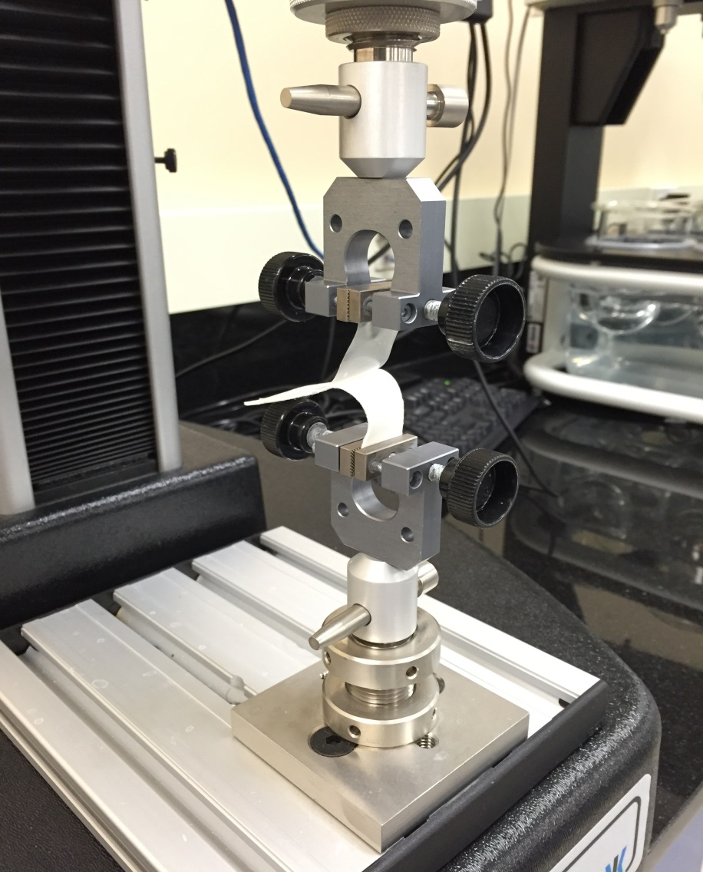
Methods and Experiments
Peel Test from the Release Liner
Liner is peeled from adhesive
Peeled from panel at 180° at a specified rate
Force required to peel from adhesive is measured
Fig 18: Force Tester
Notes:
Peel Test from the Release Liner: A strip of tape is adhered to a standard steel test panel with the liner side up. The liner is peeled from the adhesive in the same manner as in peeling a strip of single coated tape from a standard panel with controlled pressure. The tape is peeled from the panel at 180° angle at a specified rate, during which time the force required to effect peel is measured.

Slide 28
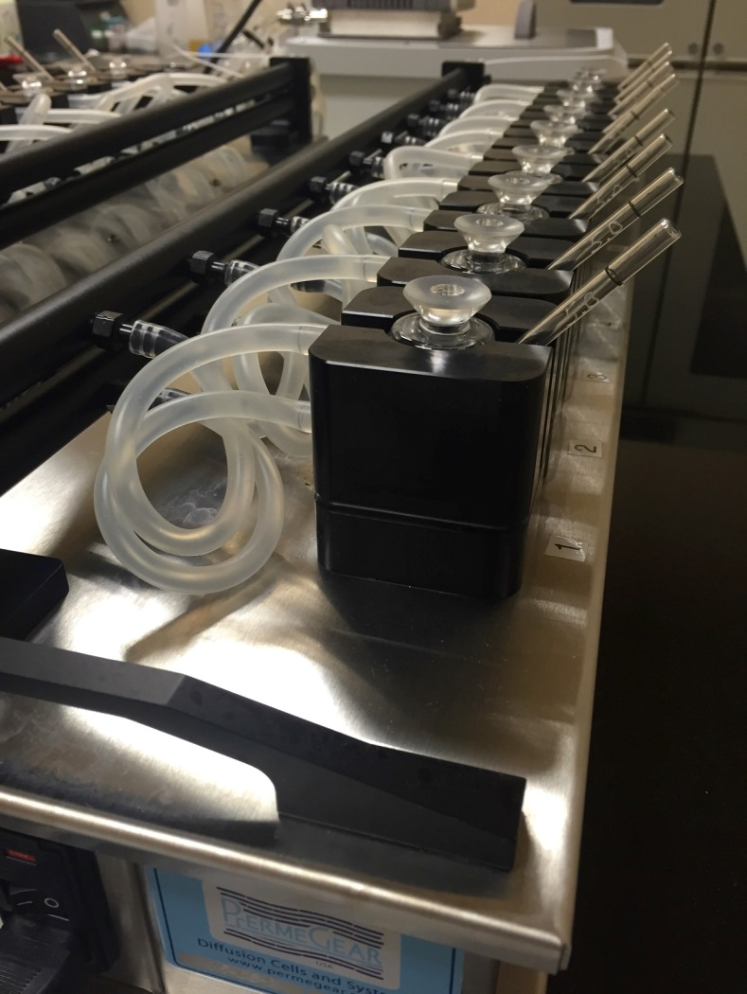
Methods and Experiments
Skin Permeation Study
In-vitro skin permeation assay
Samples were taken out every 2 hours
Analyzed by UV Spectrophotometer at specified wavelength for drug content
Fig 19: Franz Diffusion Cell
Notes:
The Franz Diffusion Cell for skin permeation studies is an in vitro skin permeation assay frequently used in formulation development. It consists of an upper part (cell cap, cell top and donor chamber) and a lower part (body of the cell). It has two primary chambers separated by a membrane (preferably human skin).

Slide 29
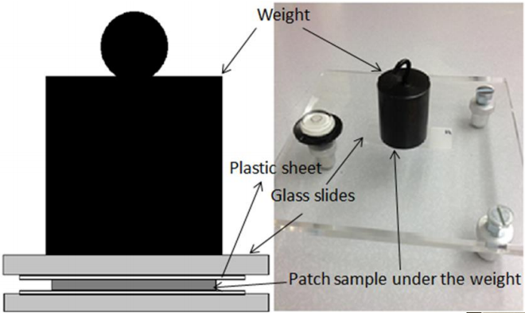
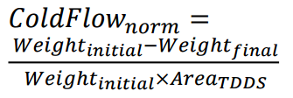
Methods and Experiments
Cold Flow
Fig 20: Cold Flow

Slide 30
Results and Discussion
Drug Solution
Properties | SENS | Control
pH | - | 9.5
Water Uptake | 11.097% | -
Viscosity | 77 cP | 39 cP
Emulsification Rate | 80 sec | -

Slide 31
Results and Discussion
Lidocaine formulation
Properties | i-SENS | Control
pH | 8.5 | 8.66
Water Content | 6.34% | 5.04%
Viscosity | 447,505 cP | 667,058 cP

Slide 32
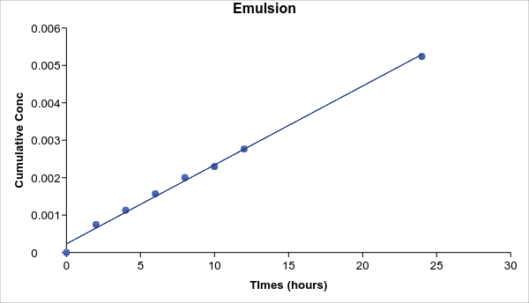
Results and Discussion
Graph 1

Slide 33
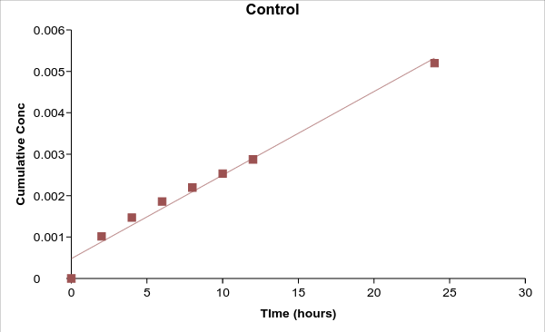
Results and Discussion
Graph 2

Slide 34
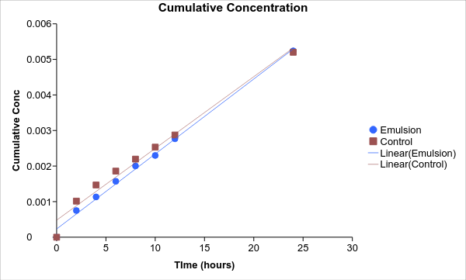
Results and Discussion
Graph 3

Slide 35
Results and Discussion
Flux
 | Emulsion | Control
Flux | 2.2 | 2.3

Slide 36
Results and Discussion
Physical Parameters
Physical Parameters | Emulsion | Control
Weight of Patch | 16.23 grams | 16.19 grams
Weight of Liners | 2.22 grams | 2.21 grams
Weight of Adhesive | 14.01 grams | 13.98 grams

Slide 37
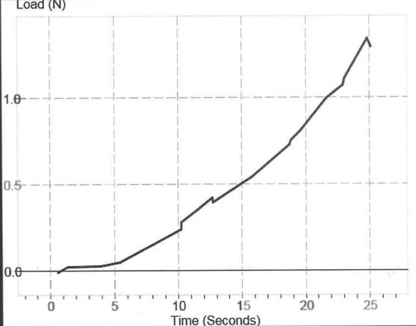
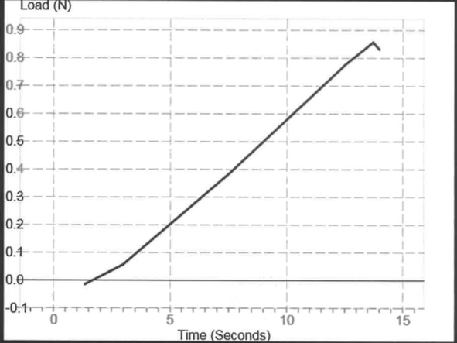
Results and Discussion
Shear Adhesion Test
Emulsion
Control
LP 1.35
RT Pass
LP 0.85
RT Pass

Slide 38
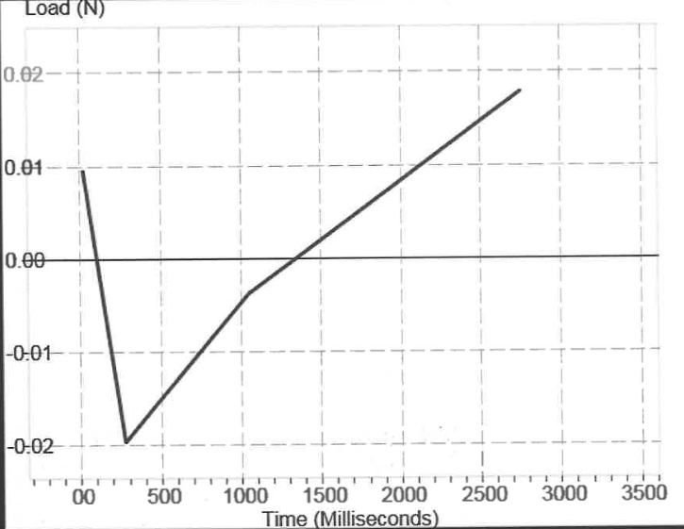
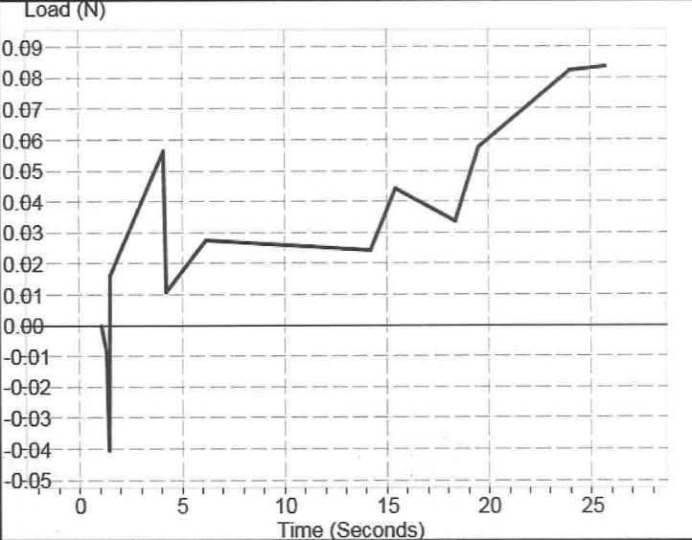
Results and Discussion
Peel Test from Release Liner
Emulsion
Control
LP 0.00
RT Pass
LP -0.70
RT Pass

Slide 39
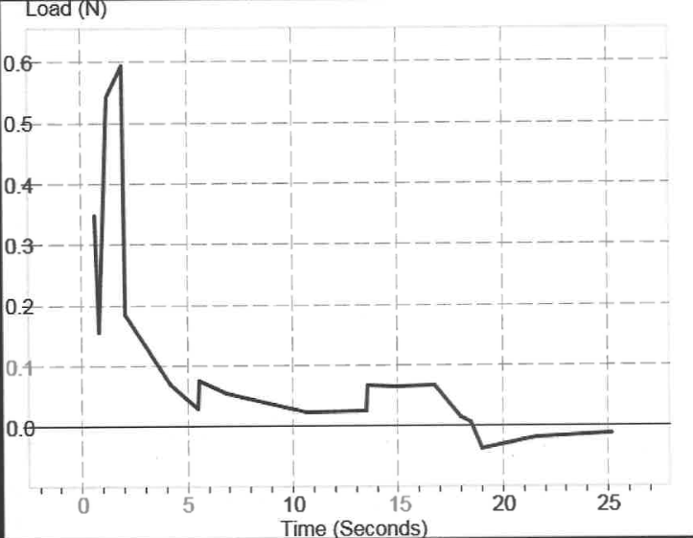
Results and Discussion
Peel Test from Surface
Emulsion
Control
LP 0.60
RT Pass
LP 0.10
RT Pass

Slide 40
Results and Discussion
Cold Flow = Weight Initial – Weight Final
Weight Initial x Area TDDS
Emulsion | Control
0.000792 g/cm² | 0.000591 g/cm²

Slide 41
CONCLUSION
i-SENS TDS are promising and innovative drug delivery systems
that can be tailored to achieve desired drug release profile in-vivo.
i-SENS TDS can be considered as an alternative topical drug
delivery systems to address the problems such as low drug load,
irritation, and stability are associated with traditional/conventional
topical drug delivery systems gels, SENS lotions, and TDS.
i-SENS TDS is an ideal to deliver hydrophilic and lipophilic
molecules.

Slide 42
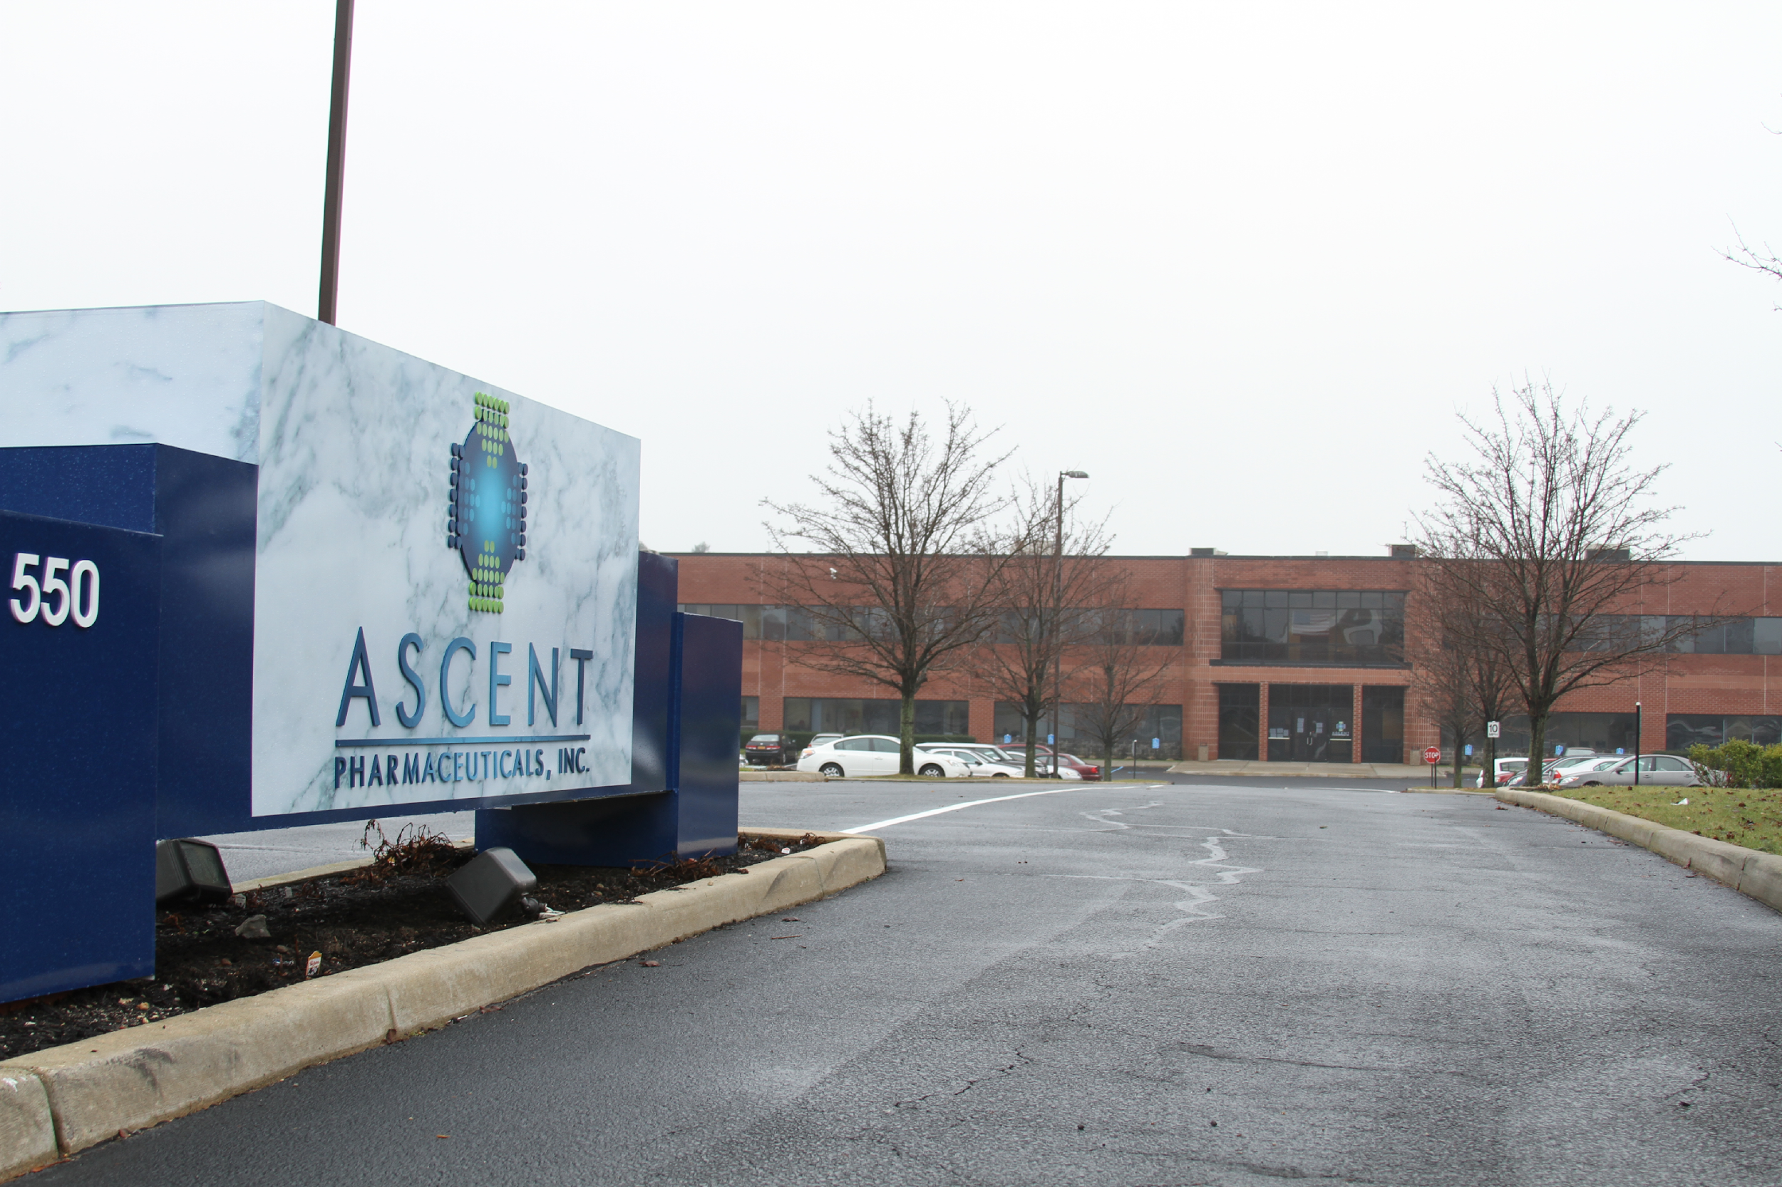
Thank you!
Any Questions
Please Email : R&D Department
Ascent Pharmaceuticals
gsridhar@ascentpharm.com

