Slide 1
Acute Toxicity of Alum to Newzealand Rabbits
Medani, A. B.; El Badwi, S. M. A. and Amin, A. E.
Department of Pharmacology & Toxicology, University of Medical Sciences &Technology , Khartoum , Sudan.
B. M. Amna is with the University of Medical Sciences and Technology, Faculty of Pharmacy, Dept. of Pharmacology and Toxicology , Khartoum, 12810 Sudan. (corresponding author to provide phone: +249912369706; fax: +249/83/224799; e-mail: amna_medani@ yahoo.com).
M. A.E. Samia, is with University of Khartoum,Faculty of Veterinary Medicine, Department of
Pharmacology & Toxicology, Khartoum, Sudan. (e-mail: samiaelbadwi@yahoo.com).
E. A. Ahmed is with the Department of Pharmacology & Toxicology, University of Khartoum,Faculty of Veterinary Khartoum, Sudan. (e-mail: aeamin@yahoo.com).

Slide 2
Acute Toxicity of Alum to Newzealand Rabbits
Newzealand rabbits were purchased, weighed and divided into 3 groups, each of three. Group 1 animals were the undosed controls. Test groups were given alum at the dose rates of 1% and 20% for groups 12 and 13 respectively for acute toxicity under ideal experimental conditions.

Slide 3
Clinical signs, postmortem and histopathological changes were observed. Serum investigations included enzymatic concentrations and metabolic changes.
Mortalities occurred to variable degrees respective to the dose level. The tested rabbits showed uncontrolled diarrhoea, uncontrolled salivation, dullness, shivering, inappetance and finally recumbence depending in severity on the dose.

Slide 4
On atomic absorption only the lungs kept residual alum , while the livers washed it out . Oral dosing with alum caused congestion of livers with white spots, stiff-greenish lungs and inflamed empty intestines. The un-dosed group 1 goats showed a normal picture.
On histopathology, alum-dosed group of rabbits showed nephro- necrosis in the cortex and medulla , emphysema in the lungs and congestion and necrosis of the hepatocytes . Alum was considered toxic to Newzealand rabbits at all dose rates tried.

Slide 5
Keywords:
Alum ,Acute toxicity , Drinking water ,Newzealnd rabbits.

Slide 6
1.Introduction
Aluminium sulphate is the world's third most abundant material. (Aluminum , 2009 and Sposito, 2008). It makes up to 7.9 percent of the earth's crust by weight and is naturally found in water. It was first used at the beginning of the twentieth century as a water coagulant for colour and turbidity removal and as an integral part of the multibarrier approach to drinking water treatment for the aim of protection from some life threatening diseases and making water more palatable. It is preferred by many water utility mangers for its effectiveness, availability, purity and cost.( GHEF,2007 and Kvech and Edwards, 2002) .

Slide 7
The amount of alum taken from drinking water is nearly 0.I percent of the total intake of aluminum. 99.9 percent of the ingested aluminum is excreted though normal bowl functions (Stauber,etal.1999), because its acidity is naturalized in the duodenum and thus most of the aluminum is precipitated and not absorbed into blood. In some individuals, the long term accumulation of aluminum may lead to a dementia due to the formation of a myeloid protein disposition that is similar to those of Alzheimer’s disease. (Rondeau ,et.al. 2008).

Slide 8
The water companies should treat water with ferric sulphate rather than aluminum sulphate. (Martyn ,etal.1989) .University of Toronto researchers found in 1991 study that they could slow the rate of deterioration in Alzheimer's patients by treating them with a drug that removed the aluminum from their bodies.( Don, etal. 1991)

Slide 9
In an article with 250 foot notes recently published in the Journal of Orthnomolecular Medicine, an alternative publication, Foster cited on an Ontario study involving 668 autopsy-verified Alzheimer's brains, showing an increased risk by a factor of 25 in people drinking water with more than 100 microgrms of aluminum. Foster says Alzheimer is among the toughest diseases to investigate because it can be proven only by autopsy.( Oteiza, et.al. 1993) .

Slide 10
2.Material
2.1.Animals
Nine 5-7 month old mixed Newsealand rabbits were purchased and housed in cages within the vivarium of Faculty of Veterinary Medicine, University of Khartoum. Animals were clinically healthy , given prophylactic doses of oxytetracycline 5% and sulphamethazine 33.3% against bacterial infections and coccidiosis respectively, ear-tagged and allowed a two-week preliminary period during which time lucerne and drinking Nile water were provided ad libitum.

Slide 11
2.2. Administration of the doses
Stock materials were prepared of 1% and 20% solutions of ALSO₄. Rabbits of the control group were given the untreated Nile water ad libitum.
2.3.Parameters
Clinical signs and mortality rates were recorded. Samples from lungs , intestines , livers and kidneys were taken and smeared on slides for histopathological results .Blood samples were obtained from the jugular vein before the start of the experimental dosing and there after fortnightly for serum analysis and haematological investigations.

Slide 12
Sera were analyzed for the activities of ALP, AST, CK, GPT and LDH and also for the concentrations of cholesterol, creatinine, bilirubin, uric acid, urea, albumin, total protein, glucose, calcium, inorganic phosphorus, iron, sodium and potassium. Haemoglobin concentration (Hb), Packed Cell Volume (PCV), Red Blood Cell (RBC) and White Blood Cell (WBC) counts were estimated.

Slide 13
3. Methods
This work was conducted with the formal approval of the local animal care committee at the vicinity of the Veterinary Hospital ,Faculty of Veterinary Medicinbe University of Khartoum .
3.1. Histological methods
The specimens were collected immediately after death or slaughter and fixed in 10% normal saline, embedded in paraffin wax, sectioned at 5 µm and stained with haemotoxylin and eosin (H & E) using Mayer's haemalum.

Slide 14
3.2. Chemical methods
Blood samples obtained from the ear vein of rabbits before and after dosing with AlSO₄. Venous blood samples were centrifuged at 3000 r.p.m. for 5 minutes and stored at -20ºC until analyzed for LDH, GOT, ALP, CK, cholesterol, creatinine, total bilirubin, urea, total protein, calcium ,albumin, phosphorus, iron and magnesium
by a colorimetric method using a commercial kit.

Slide 15
3.3. Haematological methods
These were described by Schalm 1965. Blood samples from rabbits were collected into clean dry bottles containing the anti-coagulant heparin from the ear vein. The concentration of haemoglobin was determined by the cynomethaemoglobin technique in g/dl of blood, fresh blood samples were centrifuged in a microhaematocrit centrifuge to read off the packed cell volume percentage .The red and white blood cells were counted with an improved Neubauer haemocytometer .

Slide 16
3.4. Determination of Al
Preparation of Al standard solution
I gm of Al wire was dissolved in 1 ml HCl, then diluted to 1 litre with 1% NaCl. From the 1000 ppm solution transfer 5 ml into 100 ml beaker, add the brine solution and shake well ending into serial dilutions for calibration.
Reagents for Al
These were six reagents, Calcium chloride , prepared from CaCo₃ and HCl 10% Hydroxylamine Hydrochloride ; 0.75% Pottassium ferricyride; 4%Thiogollic Acid (Mercuptic Acid); Sodium acetate; acetic acid buffer solution and 05% Alizarin Red solution.

Slide 17
Preparation of the sample
Weigh 1 gm of lung tissue into a tefler beaker, add 30 ml of 6 N -Nacl, seal the cover properly and put it on a low hot plate to dissolve. After venting, add 10 ml of white spirit (petroleum ether ) to extract the fats, shake well, filter into 500 ml v-flask. Transfer 5 ml into 100 ml v-flask. (Microwave Accelerated Reaction System, MARS).

Slide 18
Protocol
Add sample, standards and 2,1,1,2,10 and 10 ml of the blank to the aforesaid reagents respectively. Sample color was then read in the KAL /L Milton RO 4 Spectoronic 1001 C (Scientific Technical Supplies, UK) at 475 nm.
3.5. Statistical methods
The difference between mean values of data were analysed by the un-paired students- t-test (Snedecor and Cochran, 1967).

Slide 19
4.Results
4.1. Effect of 1% alum in drinking water on Newzealand rabbits
4.1.1 Clinical signs and mortality rates
Newzealand rabbits (group 12) showed inappetance, nervous signs and were finally recumbent and the mortality rate was 100 percent. A normal behavior was characteristic for group 1 rabbits of the undosed controls.

Slide 20
4.1.2. Post-mortem Changes
Empty intestines were the most prominent feature. Stiffness of lungs was also pronounced in addition the presence of white foci in the intestines and livers. A normal scene was observed in the control group.

Slide 21
4.1.3. Histo- pathological picture
Oedema and emphysema were obvious in lungs, intestines suffered from catahrral inflammation (Fig. 1) and in the livers, generalized necrosis and lympthocyte infiltration were very clear. Normal organ pictures were clear in the control rabbits.

Slide 22
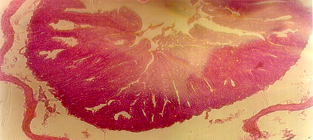
Fig.1) Catahrral Inflammation Of the ) Intestines of 1% alum –dosed Rabbits

Slide 23
4.2. Effect of 20% alum in drinking water on Newzealand rabbits
4.2.1.Clinical signs and mortality rates
The uncontrolled diarrhoea, uncontrolled salivation, dullness, shivering, inappitance and finally recumbency (Fig. 2) were the most obvious sings in rabbits of (group 3) with a mortality rate of 100 percent. No abnormality in behavior was observed in the control rabbits.

Slide 24
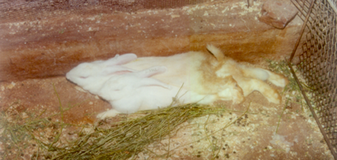
(Fig. 2)Recumbency in Newzealnd Rabbits Intoxicated with 20% alum

Slide 25
4.2.2. Post mortem changes
Intestines and livers were spotted with white foci and lungs were stiff and greenish, where as group 1 rabbits showed a normal picture.

Slide 26
4.2.3. Histo-pathological picture
Lung sections of the 20% alum -dosed group of rabbits showed emphysema and the intestines were edematous with catarrhal inflammation, hearts slightly necrotic, spleens slightly congested and the liver showed degenerative necrosis and lymphocytic infiltration (Fig. 3). The control rabbits showed a normal picture.

Slide 27
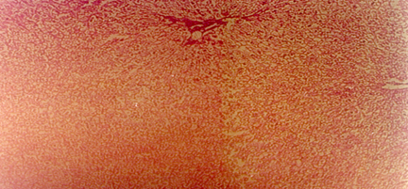
(Fig. 3)liver with lymphocytic infiltration and necrosis

Slide 28
4.3.Chemical Analysis
4.3.1. Fluctuations in serum enzymes

Slide 29
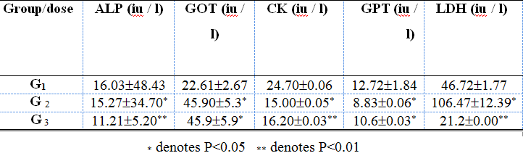
4.3.Chemical Analysis
Fluctuations in serum enzymes
Table (1 ): Average values (mean ± SD) of serum enzymes of the alum - dosed rabbits.

Slide 30
Serum levels of ALP, CK, and GPT in rabbits of both test groups decreased (P<0.05-0.01) in comparison to the un-dosed control group , whereas test groups concentrations of GOT and LDH showed obvious increases (P<0.05-0.01). Normal readings were obtained from the un-dosed control group.

Slide 31
4.3.2.Change in Serum Metabolites
.

Slide 33
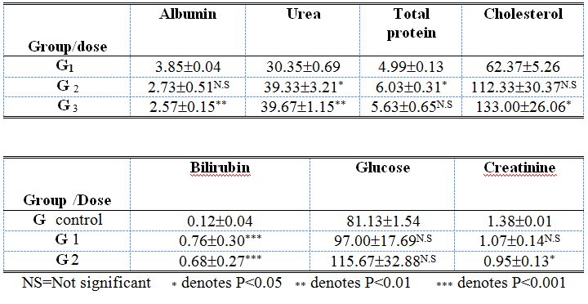
Change in Serum Metabolites
Table (2 ): Average values (mean ± SD) of serum metabolites of the alum -dosed rabbits.

Slide 34
Both test groups evaluated for uric acid and glucose levels showed no significant changes (P>0.05) compared to the control group. On evaluation of creatinine and cholesterol levels , only the group dosed with 20% alum manifested significant (P<0.05) increases compared to the control group. Test groups bilirubin values were highly (P<0.001) increased in comparison to the control group. Urea and total protein concentrations of the group dosed with 1% alum increased significantly (P<0.05) whereas the albumin value of the same group decreased insignificantly (P<0.05) in comparison to the control. Urea and albumin of the group dosed with 20% alum showed significant (P<0.01) respective increased and decreased values in comparison to the control group, while the total protein value increased insignificantly (P>0.05). Acceptable Newzealand rabbit normal values of the serum metabolites were obtained from the un-dosed group .

Slide 35
4.3.3.Changes in serum electrolytes

Slide 36
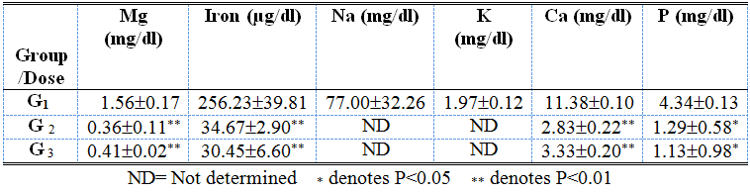
Changes in serum electrolytes
Table (3 ): Average values (mean ± SD) of serum electrolytes of the alum -dosed rabbits.

Slide 37
Both test groups showed significantly decreased values (P< 0.05 - 0.01) in magnesium, iron, , calcium, and phosphorus when compared to the control group which showed normal electrolyte values.

Slide 38
4.3.4.Hematological values
Table (4 ): Average haematological values (mean ± SD) of the alum -dosed rabbits.

Slide 39
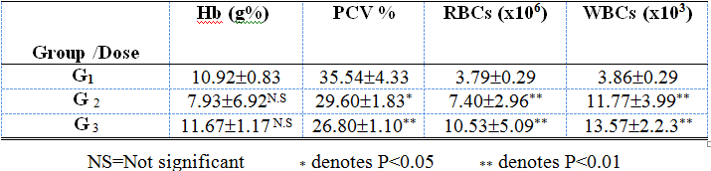
Hematological values
Table (4 ): Average haematological values (mean ± SD) of the alum -dosed rabbits.

Slide 40
Both groups showed serum intensities of Hb that were similar (P>0.05) to the levels obtained from the control group. Both groups also highlighted significant (P<0.05-0.01) decreases of PCV, RBCs and WBCs values compared to those of the untreated control rabbits. Control hematological values were normal.

Slide 41
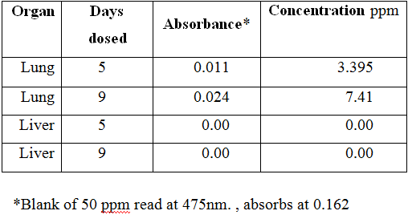
* denotes P<0.05 ** denotes P<0.01
4.3.5.Concentrations of alum in the vital organs of Newzealand rabbits
Table ( 5 ). Average concentrations of Al2 (SO₄)₃ in the lungs and livers Of Newzealand rabbits dosed with 20% alum in
drinking water.

Slide 42
The average atomic absorption values and relevant concentrations of alum in the lungs and livers of Newzealand rabbits were shown inTable (5). Average absorbance in the livers was zero.

Slide 43
5. Disscussion
In addition to the shouting mortality rates, all alum-dosed rabbits , to varying extents with dose rates, showed inappetance, uncontrolled diarrhea and salivation leading to empty intestines ,dullness, shivering ,nervous signs ,motor and behavioral disturbances and finally recumbency (Shu, et.al.1986) (MSDS,2007).

Slide 44
All these results indicates an anticholinesterase activity of alum. Due to The direct injury by alum and/or its metabolites seen sedimented as white foci in the necrotic inflamed livers (Chen,et.al. , 2004) and the edematous and cataharraly inflamed intestines (Menkin , 1940).

Slide 45
The stiff lungs were due to the direct injury to lung tissue leading to edema caused by the escape of fluids from the vascular bed to the breathing sacs causing the subsequent emphysema(Smolley , et.al. , 1998).The anaemia and depletion were mainly indicated by the decrease in PCV, RBCs and WBCs.

Slide 46
This can be a result of low dietary intake ,diarrhoea and renal dysfunction (Yuan, et.al.1989). The hepatic injury together with the decrease in ALP, CK, and GPT (P<0.05-0.01) and increased concentrations of GOT and LDH (P<0.05-0.01) in addition to bilirubin values which were highly (P<0.001) increased supported by abdominal pain suggest that alum interferes with excretory ability of the liver cells ( Hodsman ,et.al. 1982)(Mailboux. et.al.2011) .

Slide 47
The renal dysfunction was manifested by creatinine, urea, albumin and total protein concentrations significant (P<0.05) fluctuations (Stevens, 2006 and Stevens and Levin, 2013) added to significantly decreased values (P< 0.05 - 0.01) in magnesium, iron, calcium, and phosphorus indicating uremia as a terminal manifestation of kidney failure . (Almeras and Argiles, 2009 ; Dobre, et.al. , 2012 and Meyer, and Hostetter, 2007) .

Slide 48
In reference to all results in this acute experimental trial ,alum was concluded to be fatally toxic to Newzealand rabbit .

Slide 49
6. Acknowledgements
Hereby I, acknowledge Dr. Ghusai Husein Abdalsamad for his laboratory assistance to deliver accurate results and Dr. Alwaseela Mukhtar for his efforts doing statistics stated in this paper. My gratitude and thanks are extended to all the digital network staff in the University of Medical Sciences and Technology.

Slide 50
7. References
Aluminum. “ The Columbia Encyclopedia ,” 6th ed. (2009) New York: Columbia UP.
Don, R.C.; Daniel P.and Peter D. The Rate of Deterioration in Alzheimer's (1991).University of Toronto. Canada.
First Conference on Metabolism of Trace Elements Related to Human Diseases .
Acta Pharmacologica et Toxicologica ,vol.59. (1986)SupplementVII.Norway.

Slide 51
GHEF ,Global Health and Education Foundation. "Conventional Coagulation-Flocculation-Sedimentation ,". Safe Drinking Water is Essential. National Academy of Sciences. Retrieved 2007-12-01.
Hodsman ,Sherrard ,Alfrey A.C. " Aluminium Toxicity ,". J.Clin. Endocrine.Metab. (1982)54:539-45.
Mailboux R.J., Lemire J. and Appanna V.D. " Hepatic Response to Aluminium toxicity : Dyslipidemia and Liver Diseases,".Exp. Cell Res. (2011). 317 (16): 2231-8.

Slide 52
Kvech S, Edwards M. "Solubility controls on aluminum in drinking water at relatively low and high pH ,". WATER RESEARCH (2002) 36 (17): 4356–4368.
Martyn C.N. , Barker D.J. , Osmond C. Harris E.C. ,Edwardson J.A. and Lacey R.F . "Geographical Relation between Alzheimer's Disease and Aluminium in Drinking Water ,". Lancet .(1989) (8629):59-62.
MSDS(Material Saftey Data Sheet) " Aluminium-induced Osteomalacia,". (2007).www.proliberty.com/observer/20071207.htm
www.frankmckinnon.com/aluminium . Idaho Observer.

Slide 53
Nicolas Albery. " Aluminum Precaution Notice .Aluminum Poisoning ,". Albery foundation (1921). Canada.
Oteiza, P. I., Keen, C. L., Han, B. and Golub, M. S. " Aluminum
Accumulation and Neurotoxicity in Swiss-Webster mice after Long-termDietary Exposure to Aluminum and Citrate ,". Metabolism (1993)42(10): 1296-1300.
Rondeau, V.; Jacqmin-Gadda, H.; Commenges, D.; Helmer, C.; Dartigues, J.-F. "Aluminum and Silica in Drinking Water and the Risk of Alzheimer's Disease or Cognitive Decline: Findings From 15-Year Follow-up of the PAQUID Cohort,". American Journal of Epidemiology (2008)169 (4): 489–96.

Slide 54
Shu HD, Zhang LH, Gu JW, Chen LA.
"Inhibitory Action of Ribostamycin Sulfate on Neuromuscular Transmission,".
.Zhongguo Yao Li Xue Bao. (1986)7(1):26-30.
Sposito, G. "The Environmental chemistry of Aluminum ,".2nd Ed.CRC Press, Inc. Lewis Publishers (1996)p 57-72.
Stauber JL, Florence TM, Davies CM, Adams MS, Buchanan SJ. "Bioavailability of Al in alum-treated drinking water ,". J AWWA (1999) 91(11) p84-93.

Slide 55
Schalm O.W. "Minutes of The Regents of the University of California ,". (1965). http://dynaweb.oac.cdlib.org:8088/dynaweb/uchist/public/regentminutes/regents865/@Generic__BookTextView/, p. 111.
Snedecor, G.W. and Cochran,W.G. "Statistical Methods ,". 8th Edition Ames: Iowa State University Press. (1989) p. 158-160.
Water Services Association of Australia (WSAA) . "Assessment of Coagulants for Water Treatment SSynopsis ," .Report No. WSAA 41.(1992) . Australia.

Slide 56
William Forbes. "Apparent Connection between Mental Impairment and Aluminum in the Water Supply," . (1995)Index of Patents Issued from the United States Patent Office.
Yuan B.,Klein M.H. ,Contiqualia R.S.,Mishell J.L. ,Seligman P.A.,Miller N.L. ,Molitoris B.A.,Alfrey A.C. and Shapiro J.I.. "The Role of Aluminium in the Pathogenesis of Anemia in an Outpatient Hemodialysis Population ,".Pubmed . (1989)11(2-3):91-6.

