Slide 1


Monitoring Acid-Catalyzed Hydrolysis of Sucrose Through Low-Resolution NMR Relaxometry
Simge Tutku Yildirim, Alper Söyler, Mecit Halil Oztop
Department of Food Engineering, Middle East Technical University, 06800, Ankara, Turkey

Slide 2
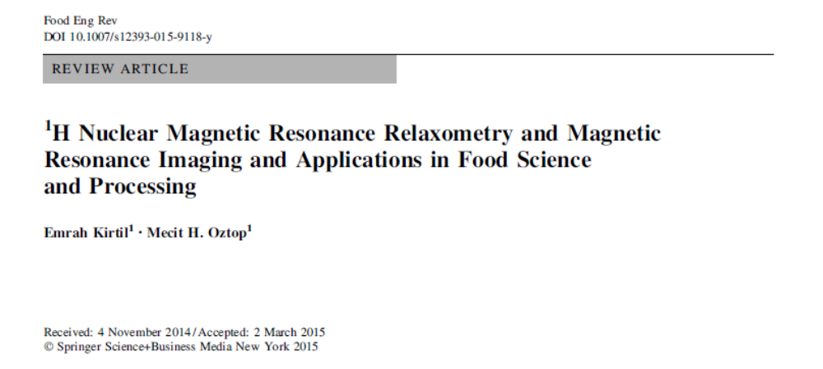
NMR Relaxometry ? MRI in Foods?

Slide 3
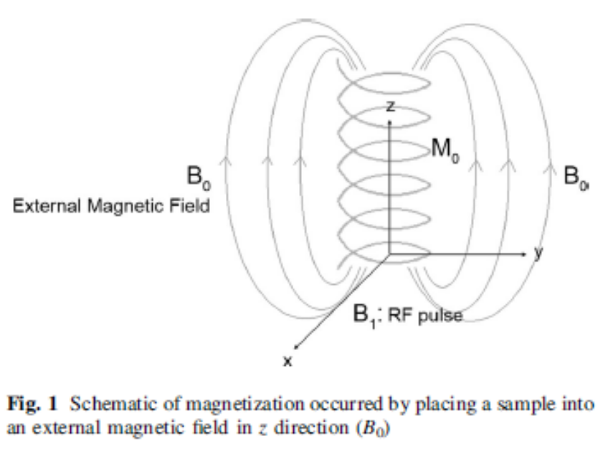
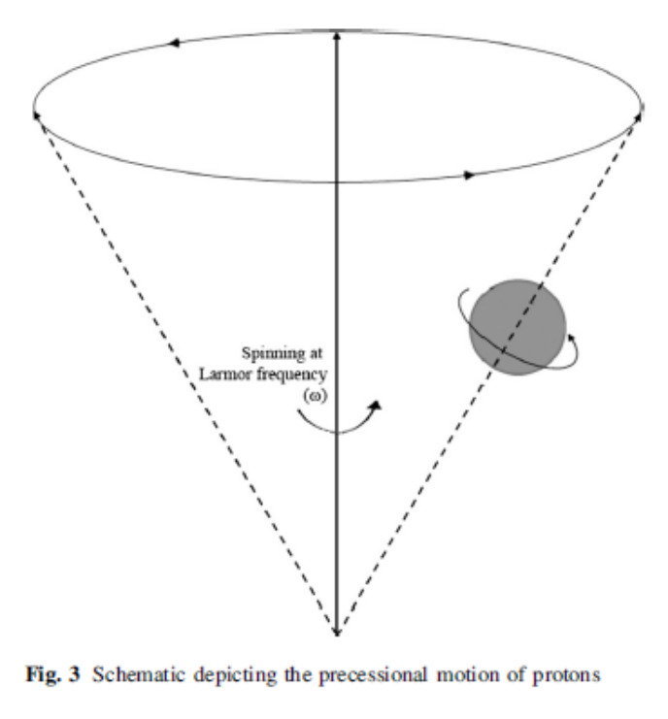
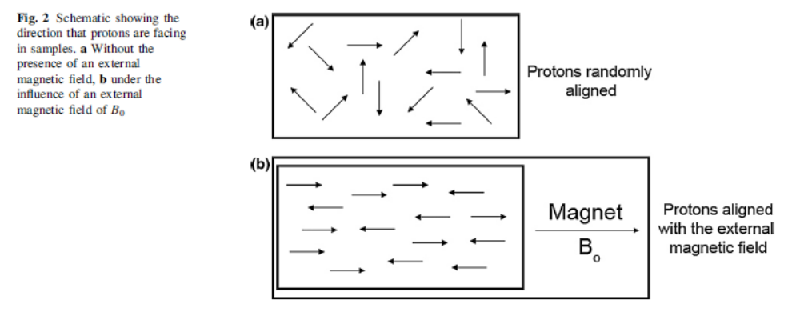

Slide 4
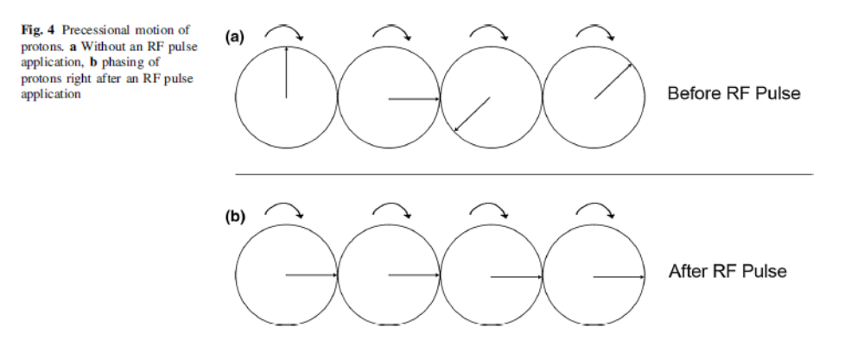
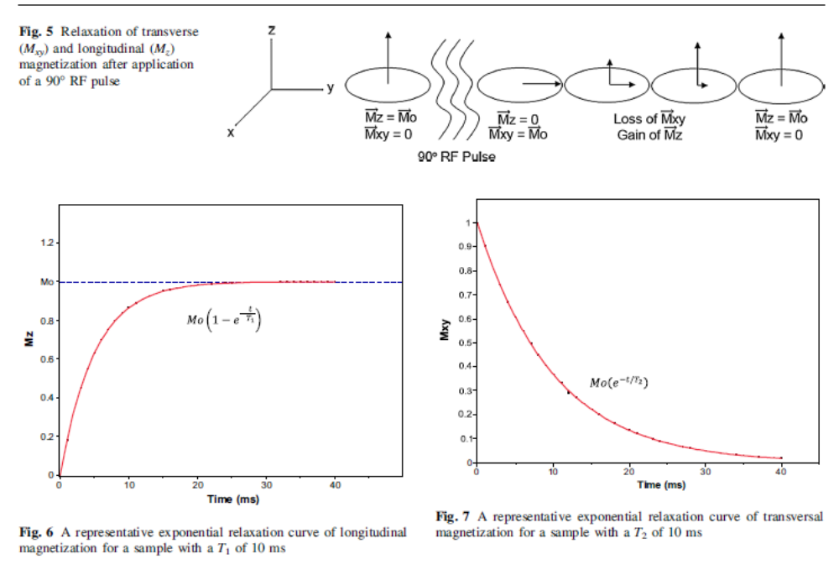

Slide 5
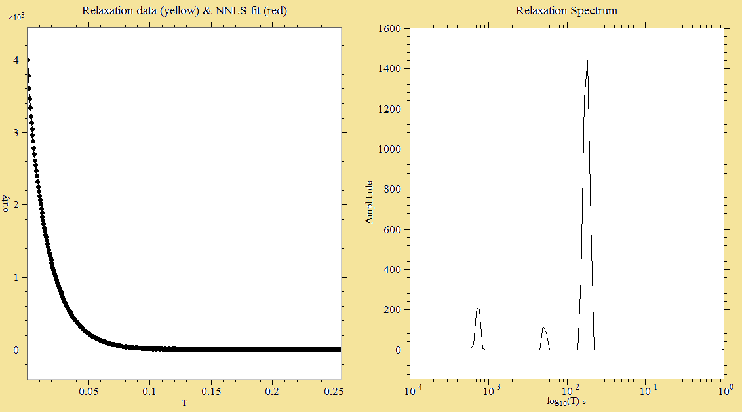
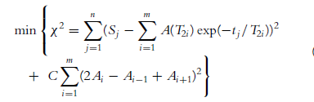
Spin-spin Relaxation Time -T₂-
Relaxation Spectrum
CPMG Decay
Relaxation Spectrum
Non negative Least Square Analysis (NNLS)
M0
1st Peak 2nd Peak 3rd Peak
Time (ms)
Log (T2)

Slide 6
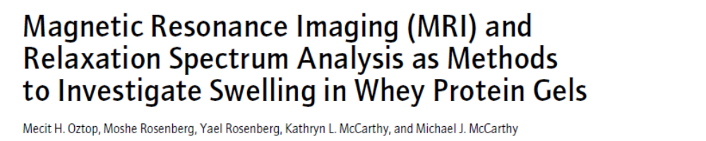
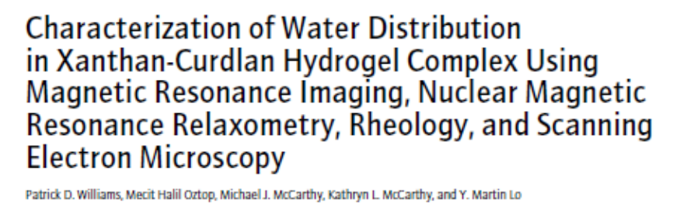
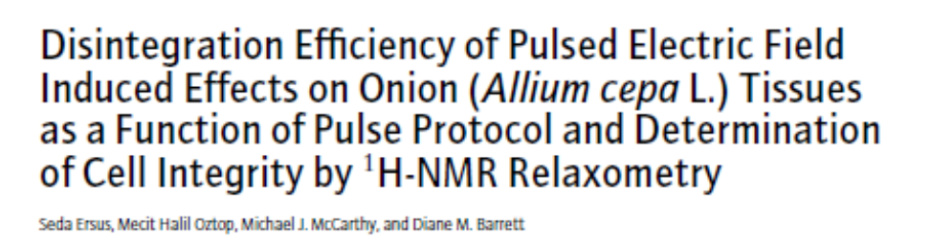
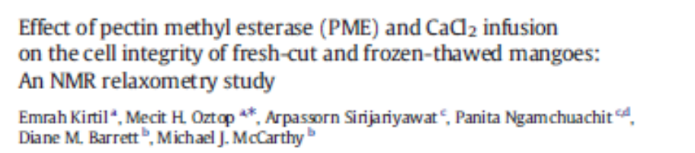
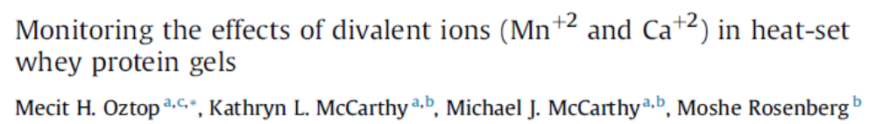
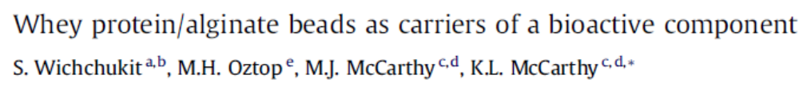
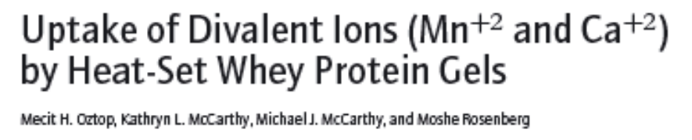
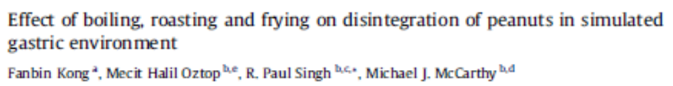
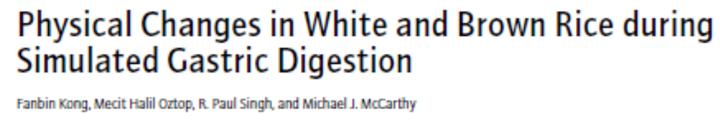
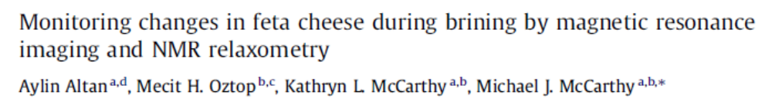

Slide 7
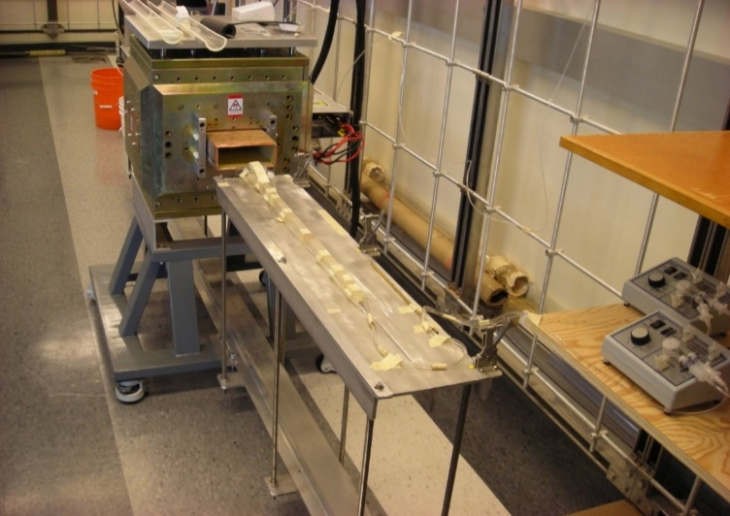
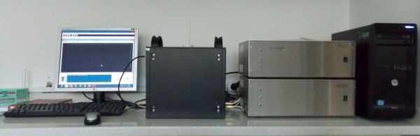
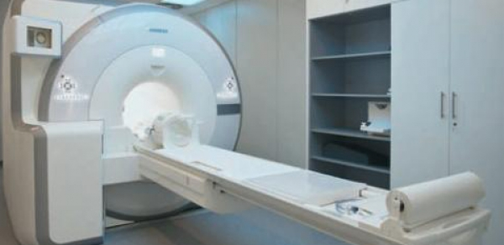
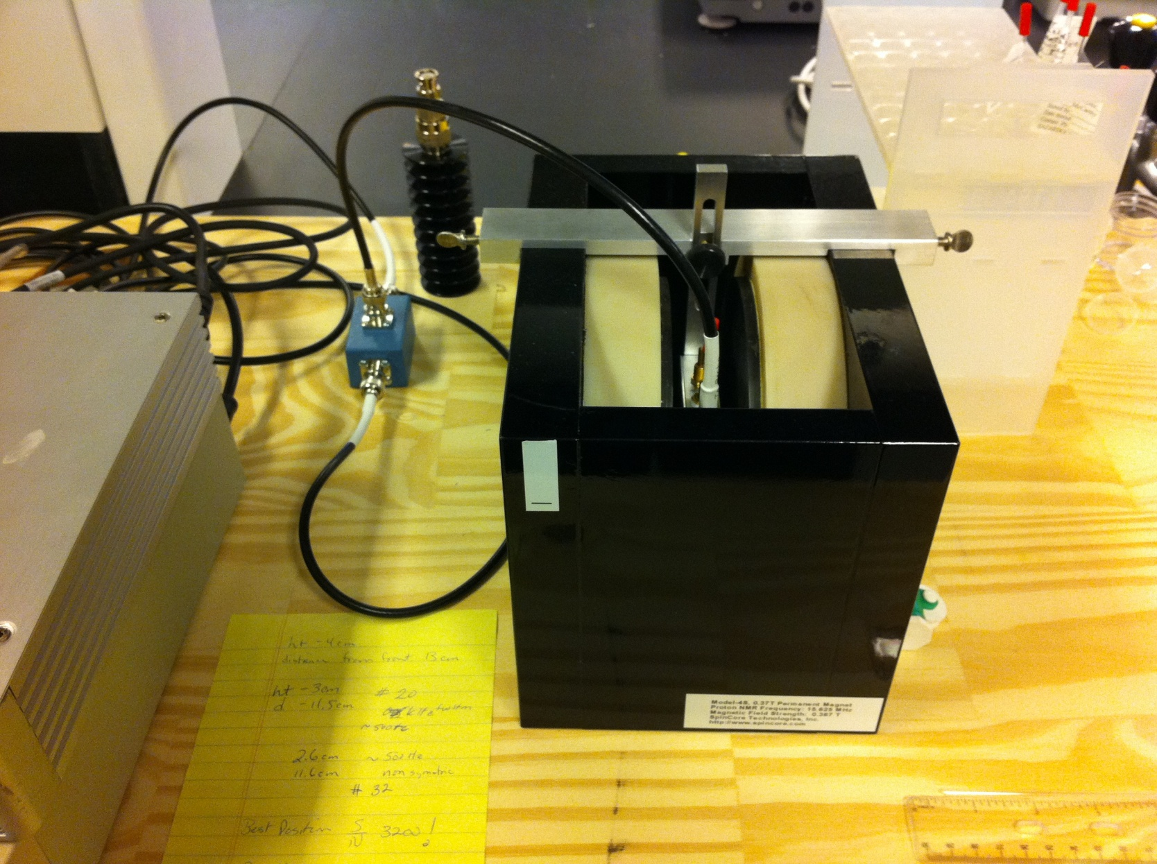
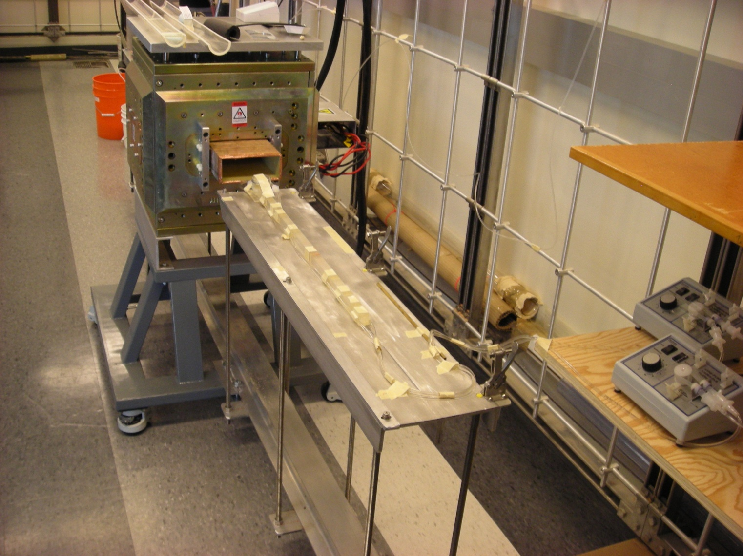
1 Tesla
0.32 Tesla
3 Tesla
0.5 Tesla

Slide 8
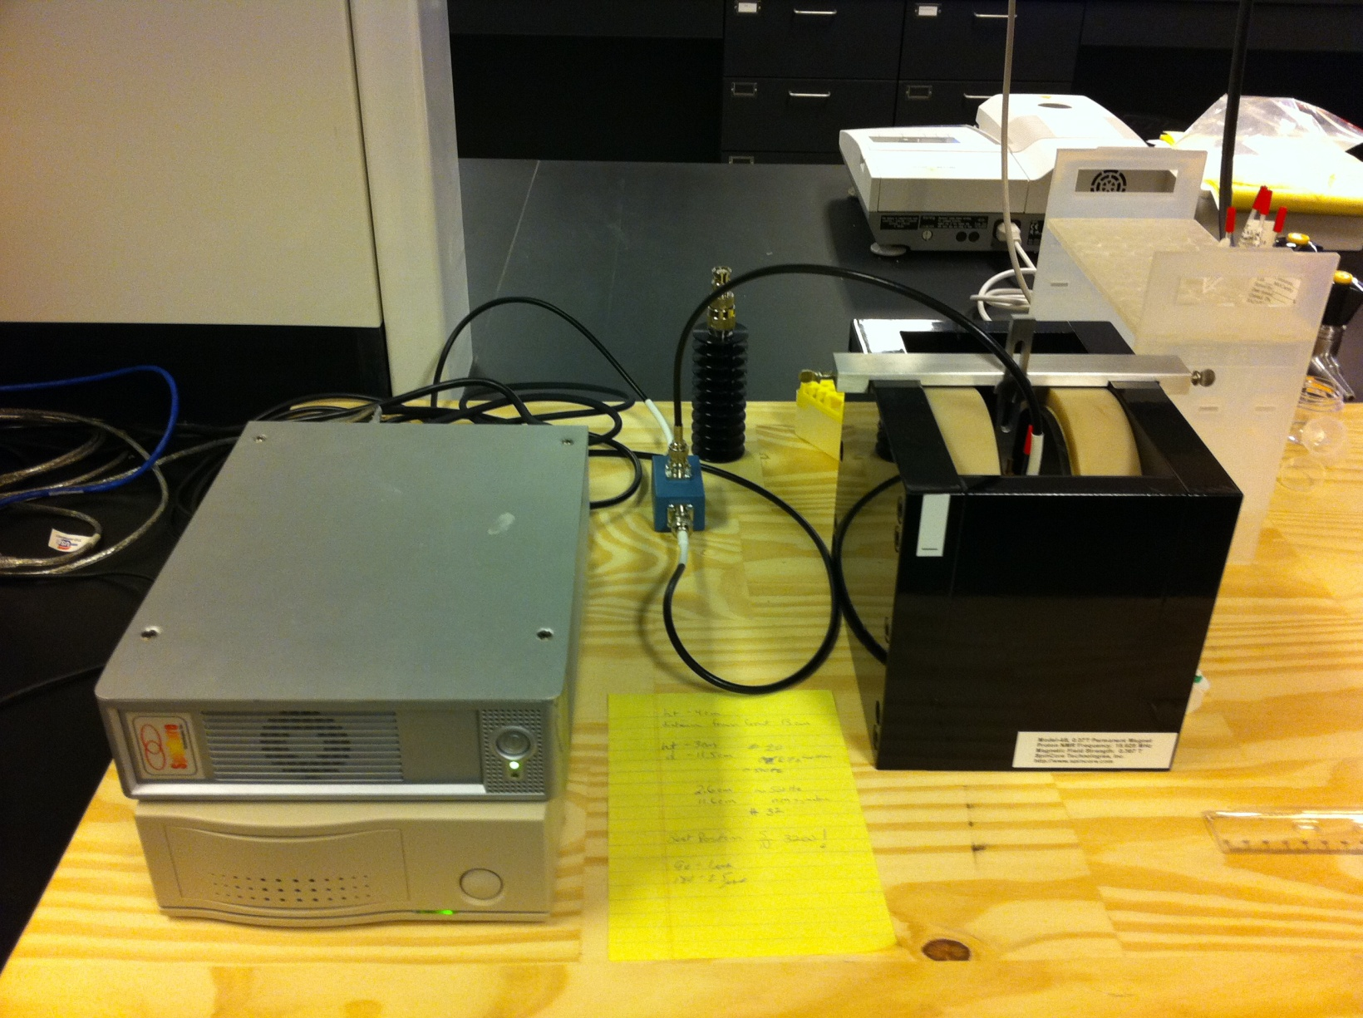
MAGNET
SPECTROMETER

Slide 9
Monitoring Chemical Reactions
Many analytical techniques (IR, UV, Raman) are used to monitor chemical reactions.
–For many reactions these techniques show important features of the reaction process and therefore provide a great deal of information to apply to a process.
–Some features, such as structural isomers and low level impurities are not typically observed.
–Utilization of NMR provides additional “molecular resolution” at the process development stage to provide many details about the process (e.g. mechanistic details, kinetics of impurity formation, etc…)
•On-line NMR is a very powerful tool for monitoring reaction progression as well as providing mechanistic insight into the synthesis.
What type of NMR experiments are talking?

Slide 10
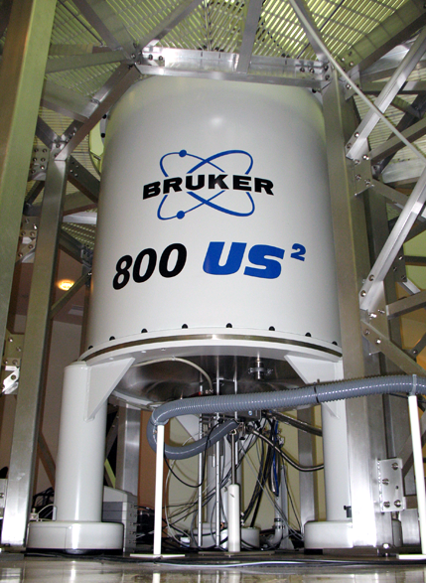
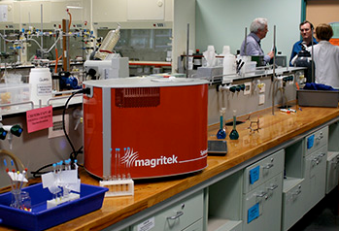

Slide 11
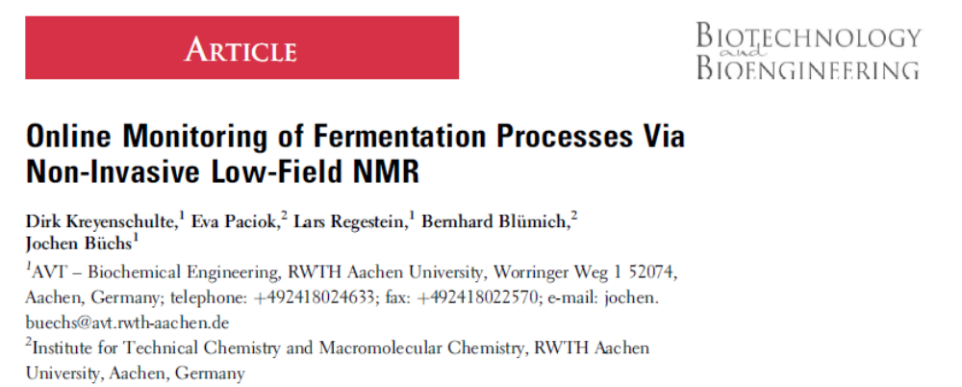
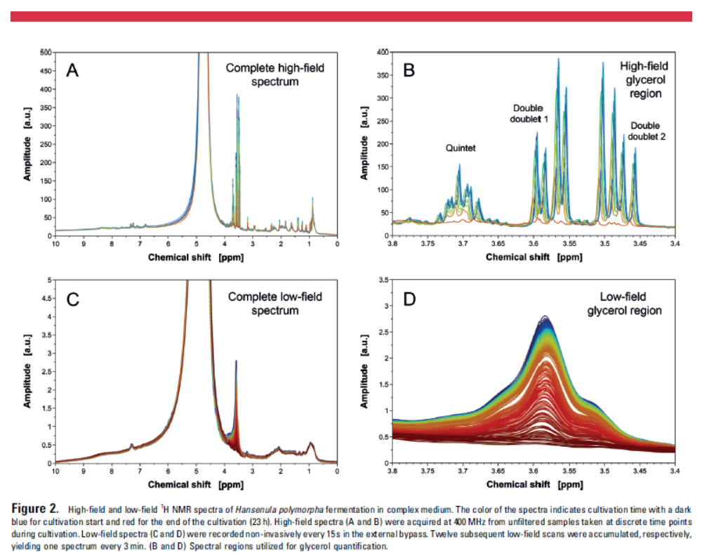

Slide 12
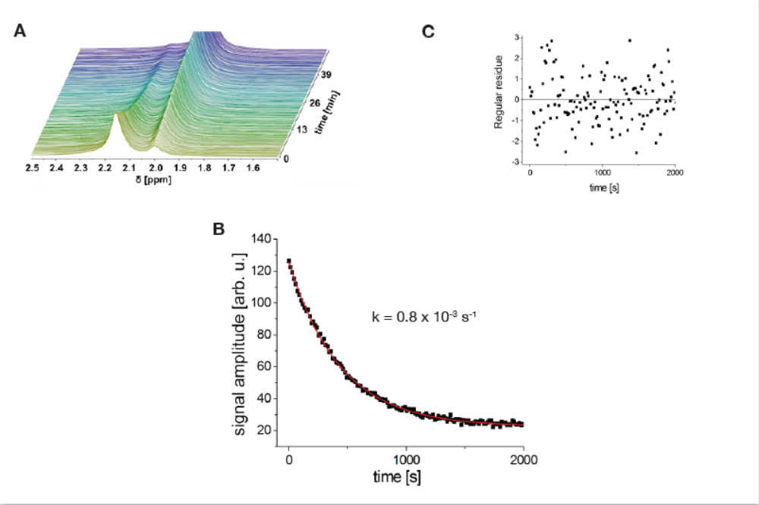
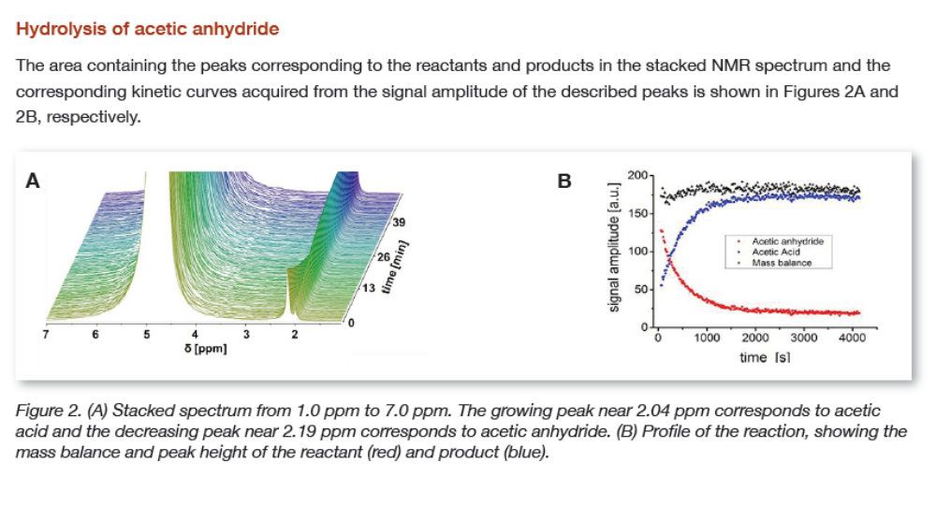
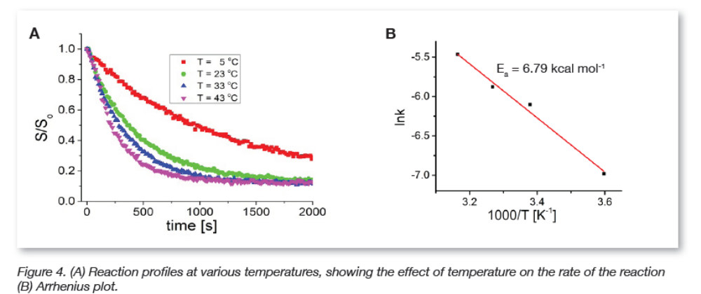

Slide 13
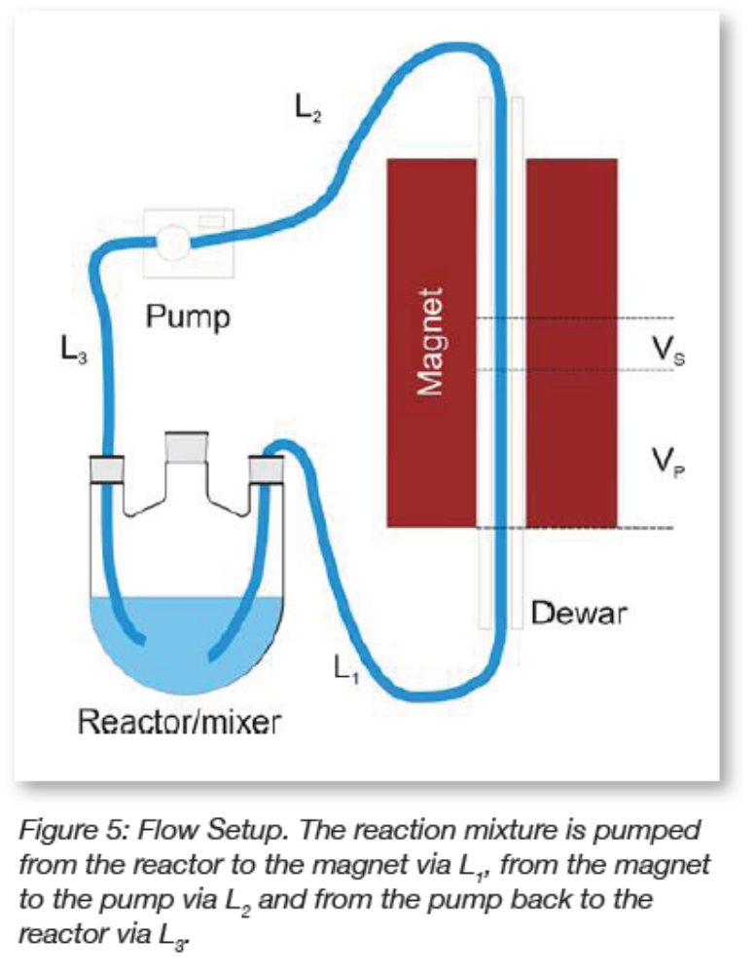
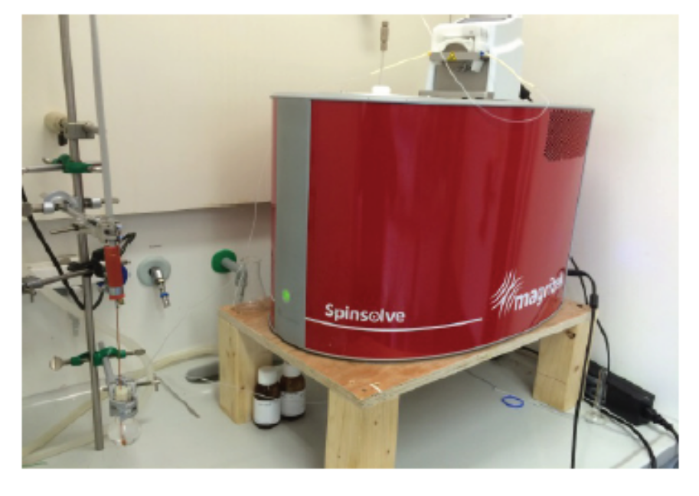
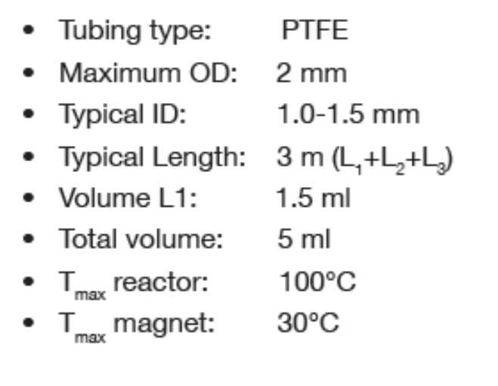

Slide 14
What about Medium and Low-Resolution NMR (<0.5 T)?

Slide 15
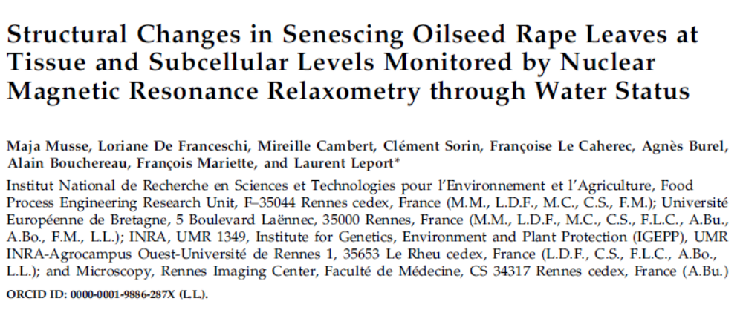
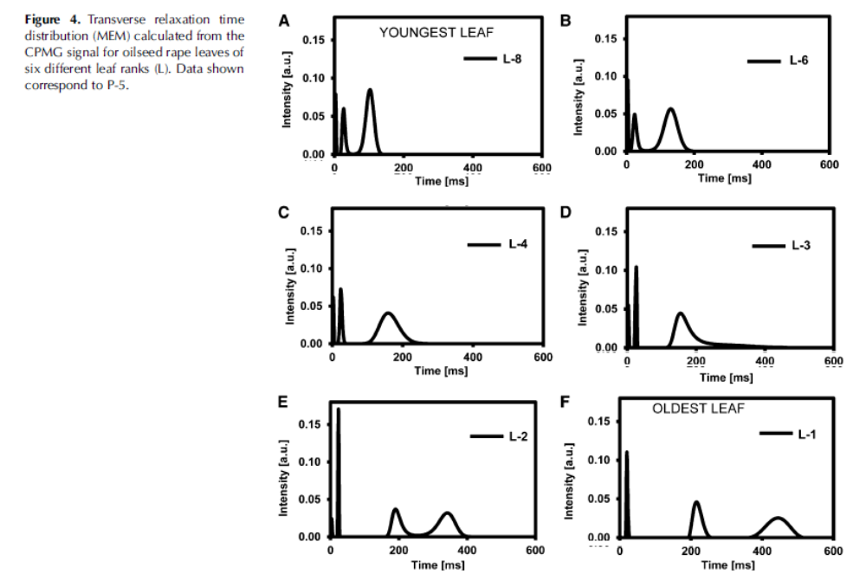

Slide 16
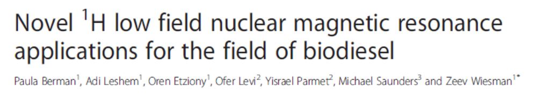
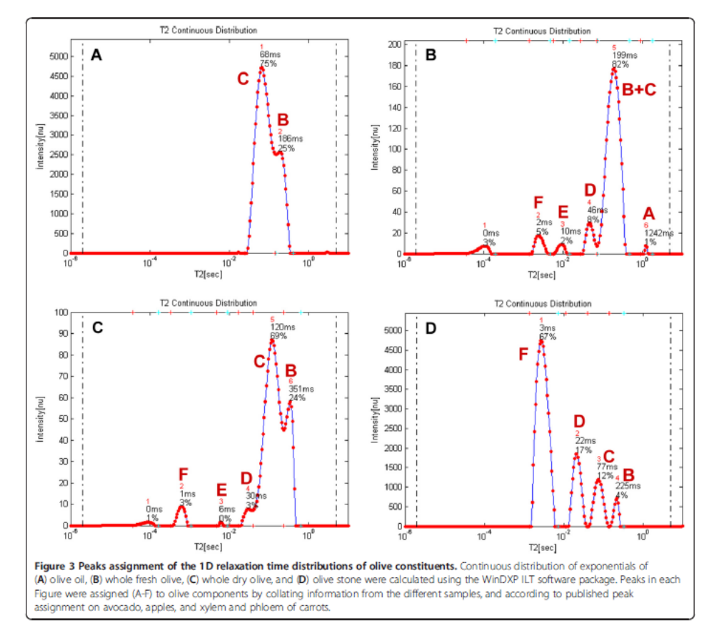

Slide 17
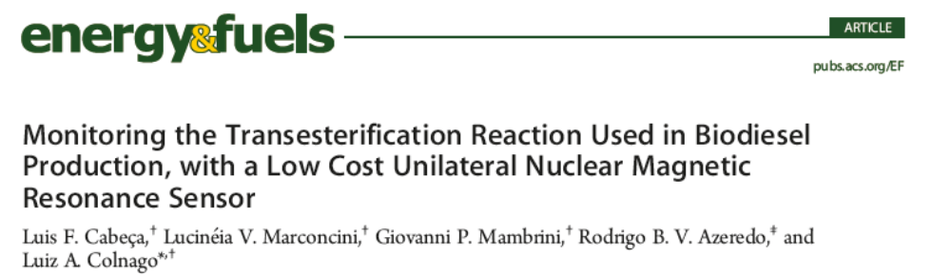
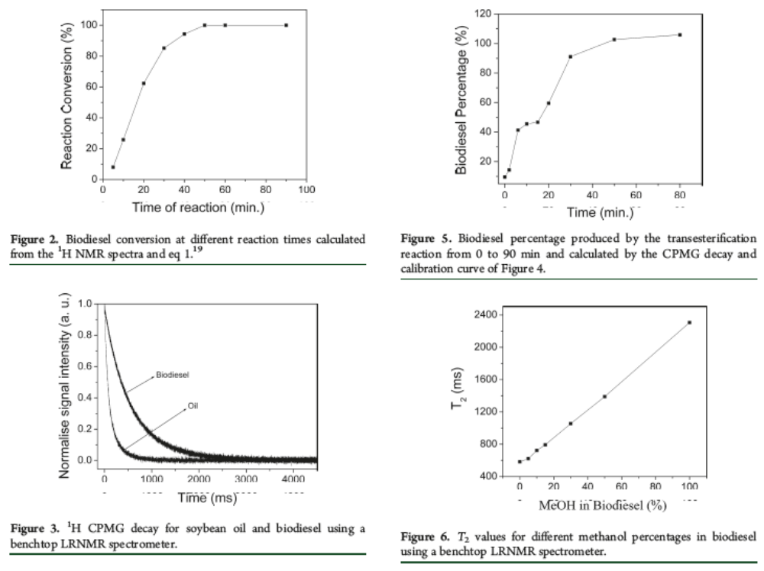

Slide 18
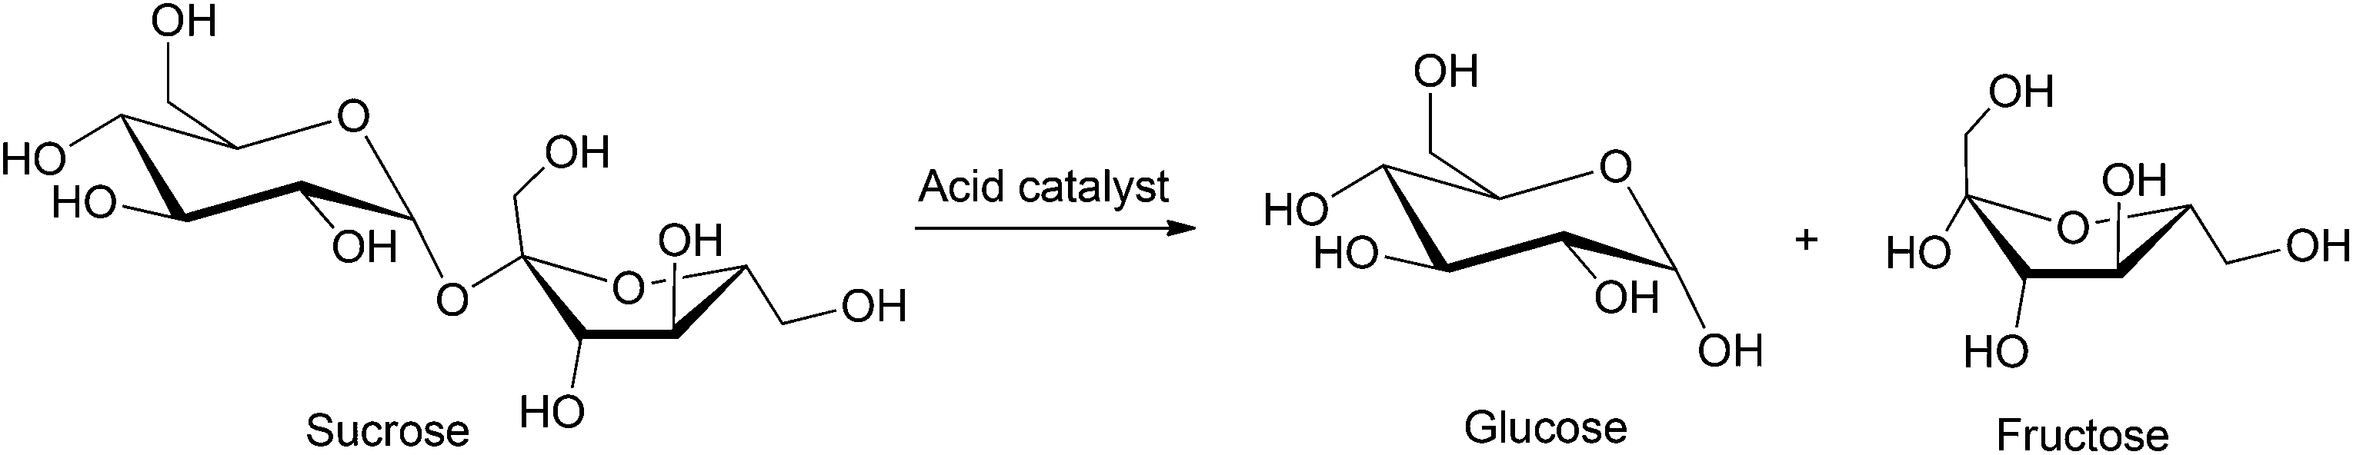
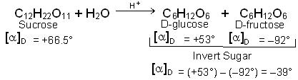
What we did ?

Slide 19
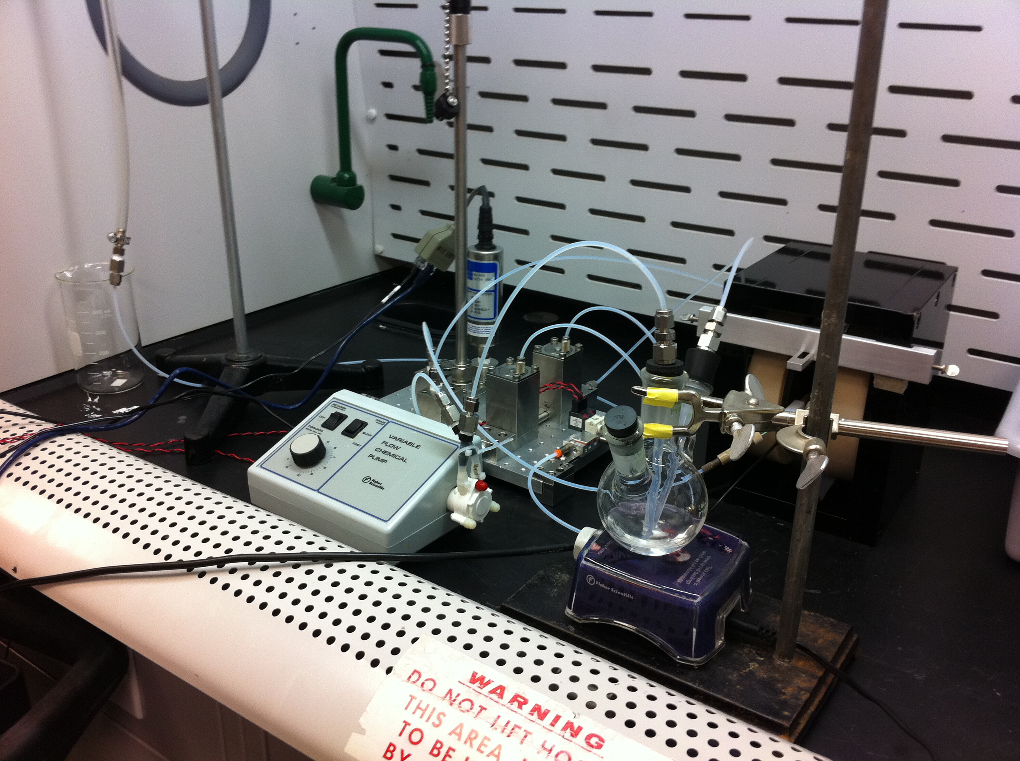
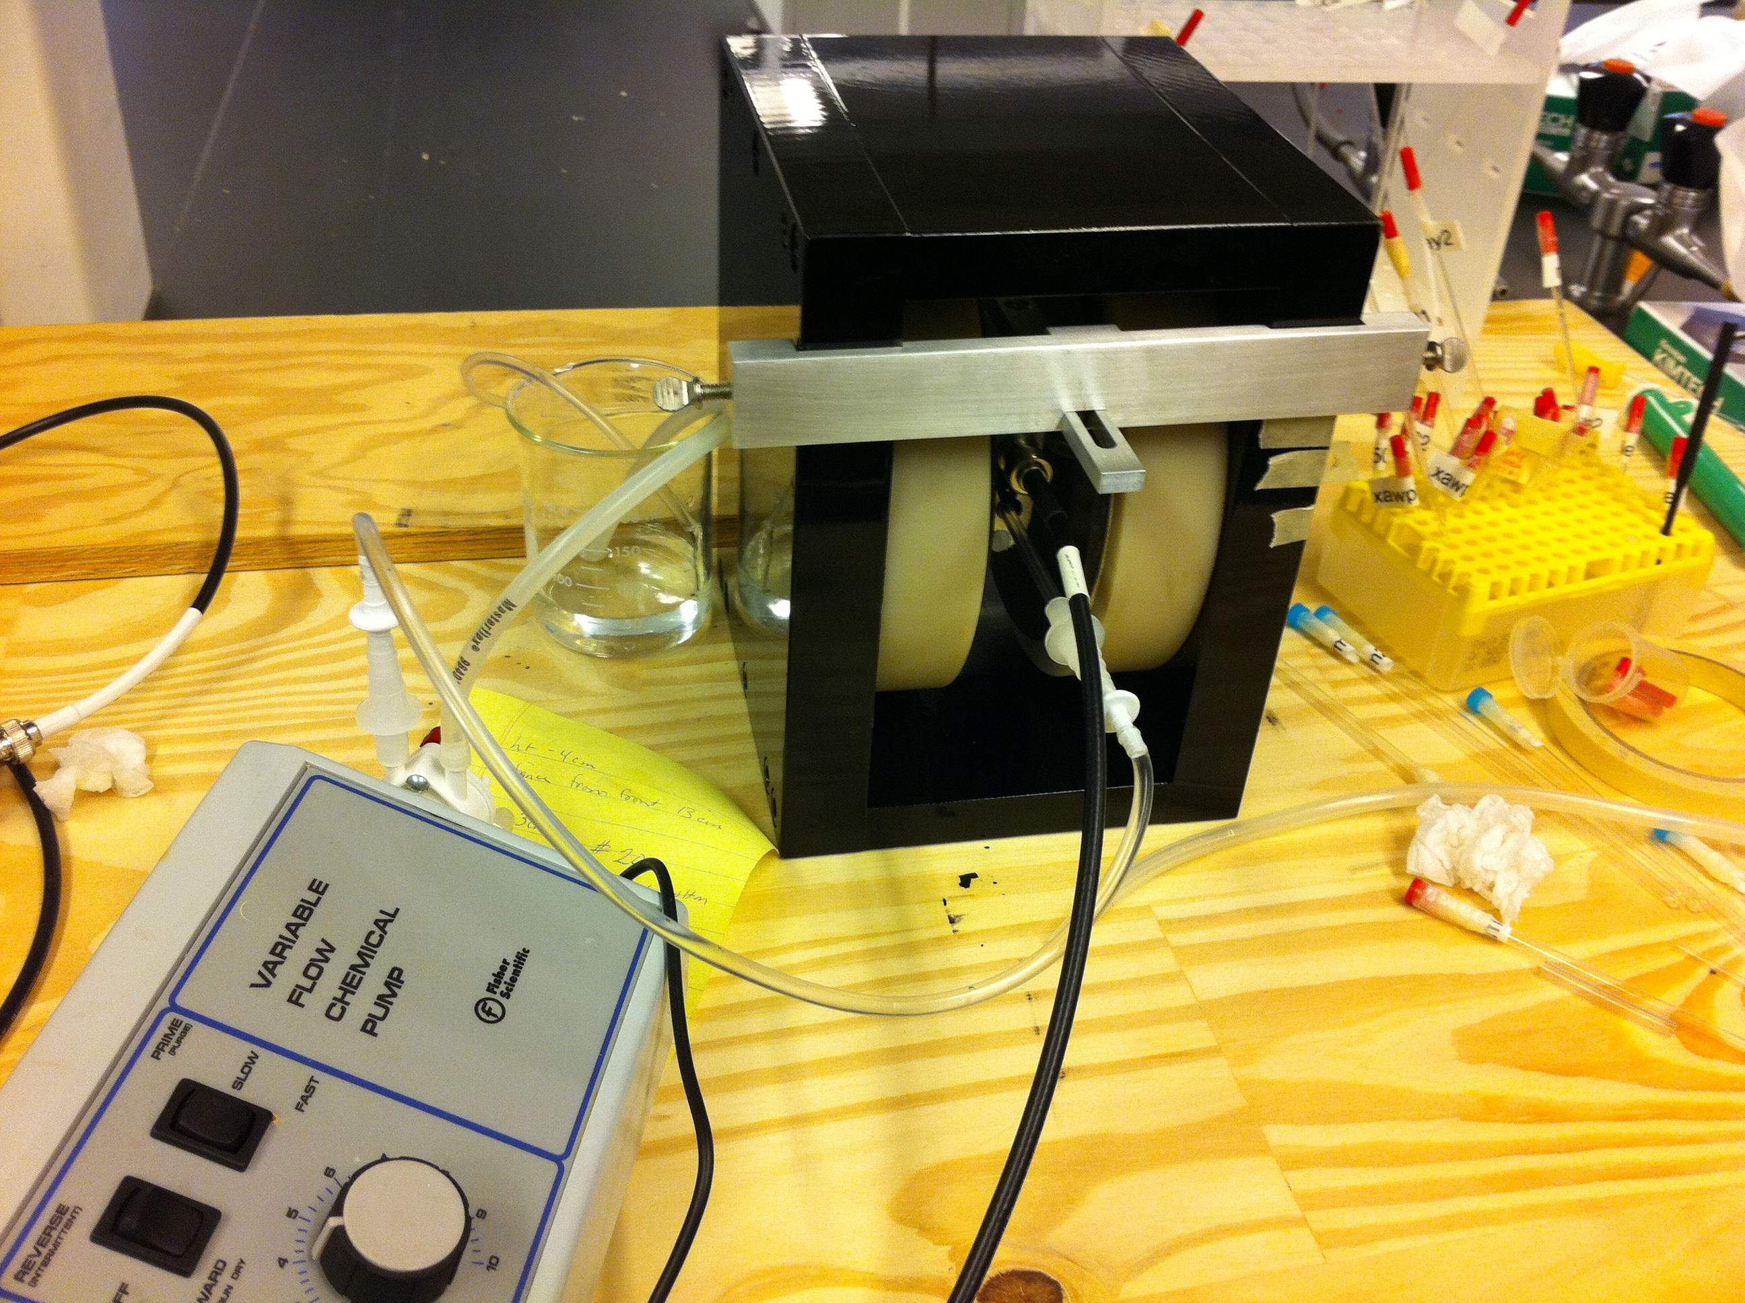

Slide 20
Acid Catalyzed Sucrose Hydrolysis at 10 % , 15 , 20 % sucrose concentration for 30 ºC and 45 ºC

Slide 21
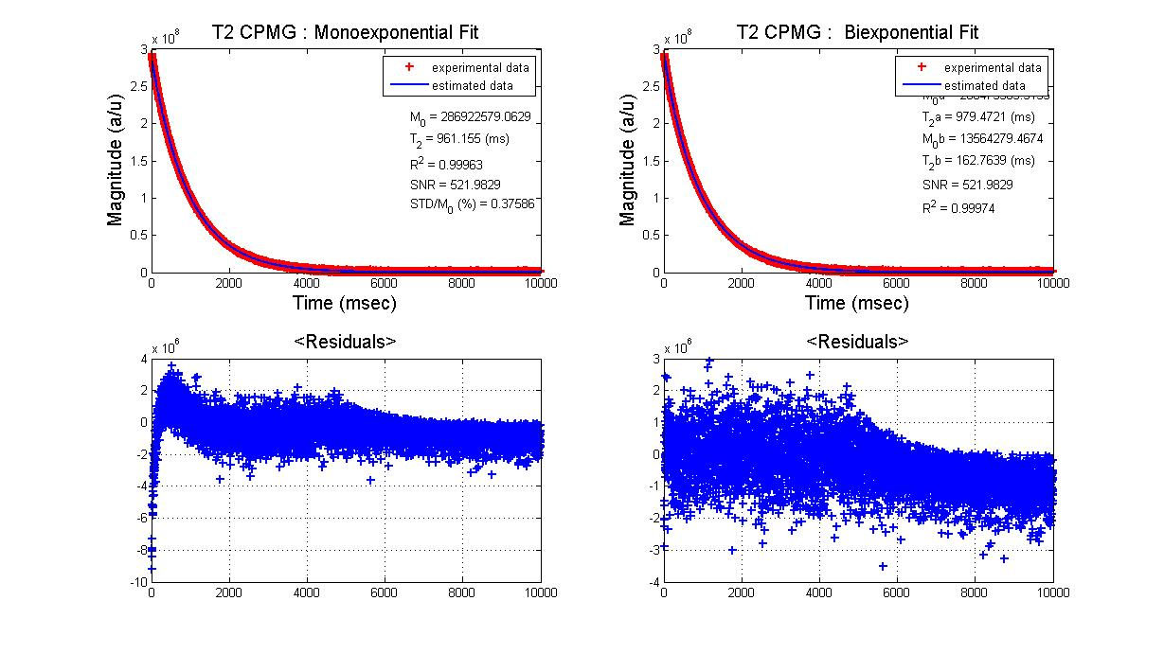
T2_Mono
T2_Bi_a
T2_Bi_b
Representative T₂ CPMG Decay Curves
Mono-Exponential Fitting
Bi-Exponential Fitting

Slide 23
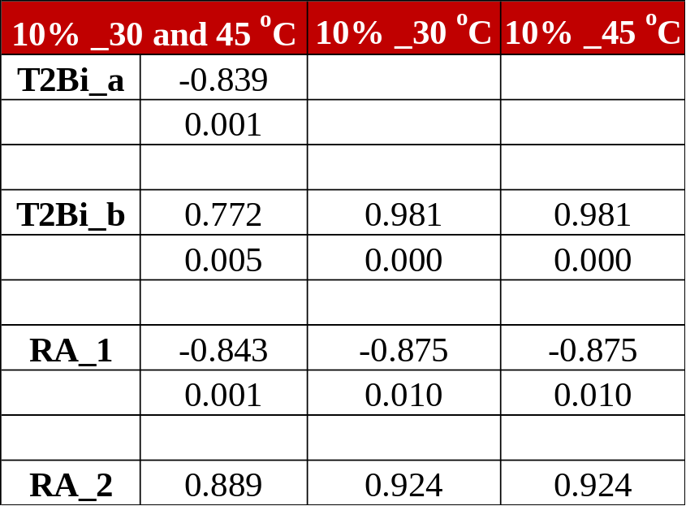
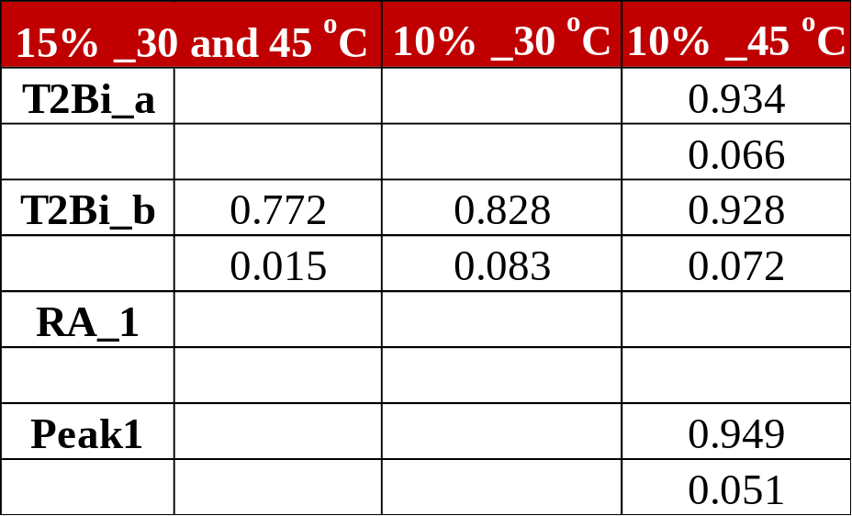
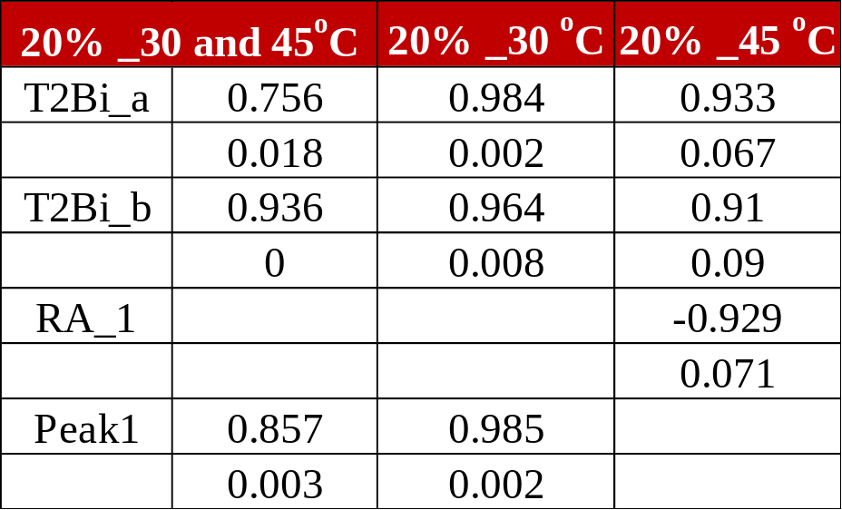
Monitoring Reaction by T₂ ?

Slide 24
Conclusion
It is definitely true that sucrose in solution is expressed as two compartments in a T₂ Relaxation spectrum.
Longer T₂ compartment’s is well correlated at different temperatures and concentrations during hydrolysis
It is mostly associated with exchanging –OH groups in the solution.
Fructose and Glucose –OHs could be the reason of this behavior.
Fructose and Glucose’s individual relaxation behavior should be examined.
NMR T2 Relaxometry has the potential to be used as a reaction monitoring tool
Wider concentration range can be used to obtain concrete results.

Slide 25
Questions ?

