Slide 1
Conference Series LLC Conferences
Conference Series LLC is a pioneer and leading science event organizer, which publishes around 500 open access journals and conducts over 500 Medical, Clinical, Engineering, Life Sciences, Pharma scientific conferences all over the globe annually with the support of more than 1000 scientific associations and 30,000 editorial board members and 3.5 million followers to its credit.
Conference Series LLC has organized 500 conferences, workshops and national symposiums across the major cities including San Francisco, Las Vegas, San Antonio, Omaha, Orlando, Raleigh, Santa Clara, Chicago, Philadelphia, Baltimore, United Kingdom, Valencia, Dubai, Beijing, Hyderabad, Bengaluru and Mumbai.

Slide 2

Growth Potential of Biosimilar Products in Bangladesh
Md. Abu Zafor Sadek, M. Pharm, MBA
Doctor of Business Administration Candidate
IBA, University of Dhaka, Bangladesh
&
Senior Additional Manager, Renata Limited
5th Int’l European Biosimilars Congress. 27-29 June 2016, Valencia, Spain

Slide 3
Contents
Changes in Disease Pattern
Market Trend of Biological Products
Health Budget & Expense
Scope of Biosimilar Products
At a glance Economic Status of Bangladesh
Pharmaceutical Buying Pattern in Bangladesh

Slide 4
Contents
A Snapshot on Pharma Industry of Bangladesh
Changes in Healthcare Sector of Bangladesh
Present Status of Biological Products in Bangladesh
Why Bangladesh is Preferable for Biosimilars
Selected Articles of Drug Policies of Bangladesh
Preferable Mode of Entry for Multinational Companies

Slide 5
Changes in Disease Pattern

Slide 6
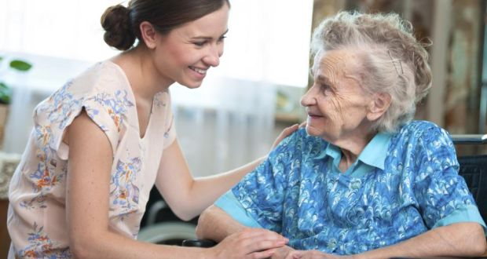
Changes in Disease Pattern (Cont’d)
In 2010 there were 10% old people (60 yrs) but in 2050 this figure will be increased by 21%.
Therefore, chronic care diseases like
Asthma, Alzheimer’s
Bone Density
Hypertension
Cancer & Diabetes
are becoming the major health concern.
Ref. pwc, 2012 & Where is the Pharmacy to the world & Working Paper on Pharmacy (09-118), Harvard Business School

Slide 7
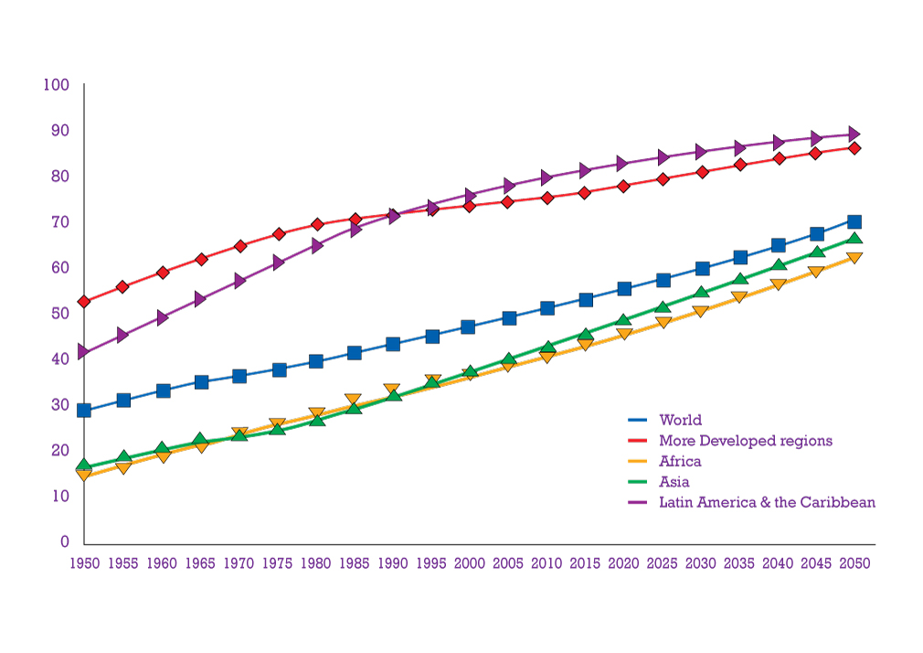
Changes in Disease Pattern (Cont’d)
The urban population in developing countries is projected to increase from 2.3 bln in 2005 to 4 bln by 2030. This group are vulnerable to climate change effects especially stroke, Diabetes & cancer.
% Urban
Ref. The Lancet, 2009

Slide 8
Changes in Disease Pattern (Cont’d)
Five NCDs (cardiovascular, cancers, diabetes, obesity & chronic respiratory) factors are the world’s leading causes of death
They kill an estimated 35 mln people each year-60% of all deaths globally-with 80% in low and middle income countries.
WHO estimates that total deaths from non-communicable diseases will increase by a further 17% over the next 10 years.
Ref. Non-Communicable Diseases (2016), World Media Association, Inc.

Slide 9
Biological Products

Slide 10
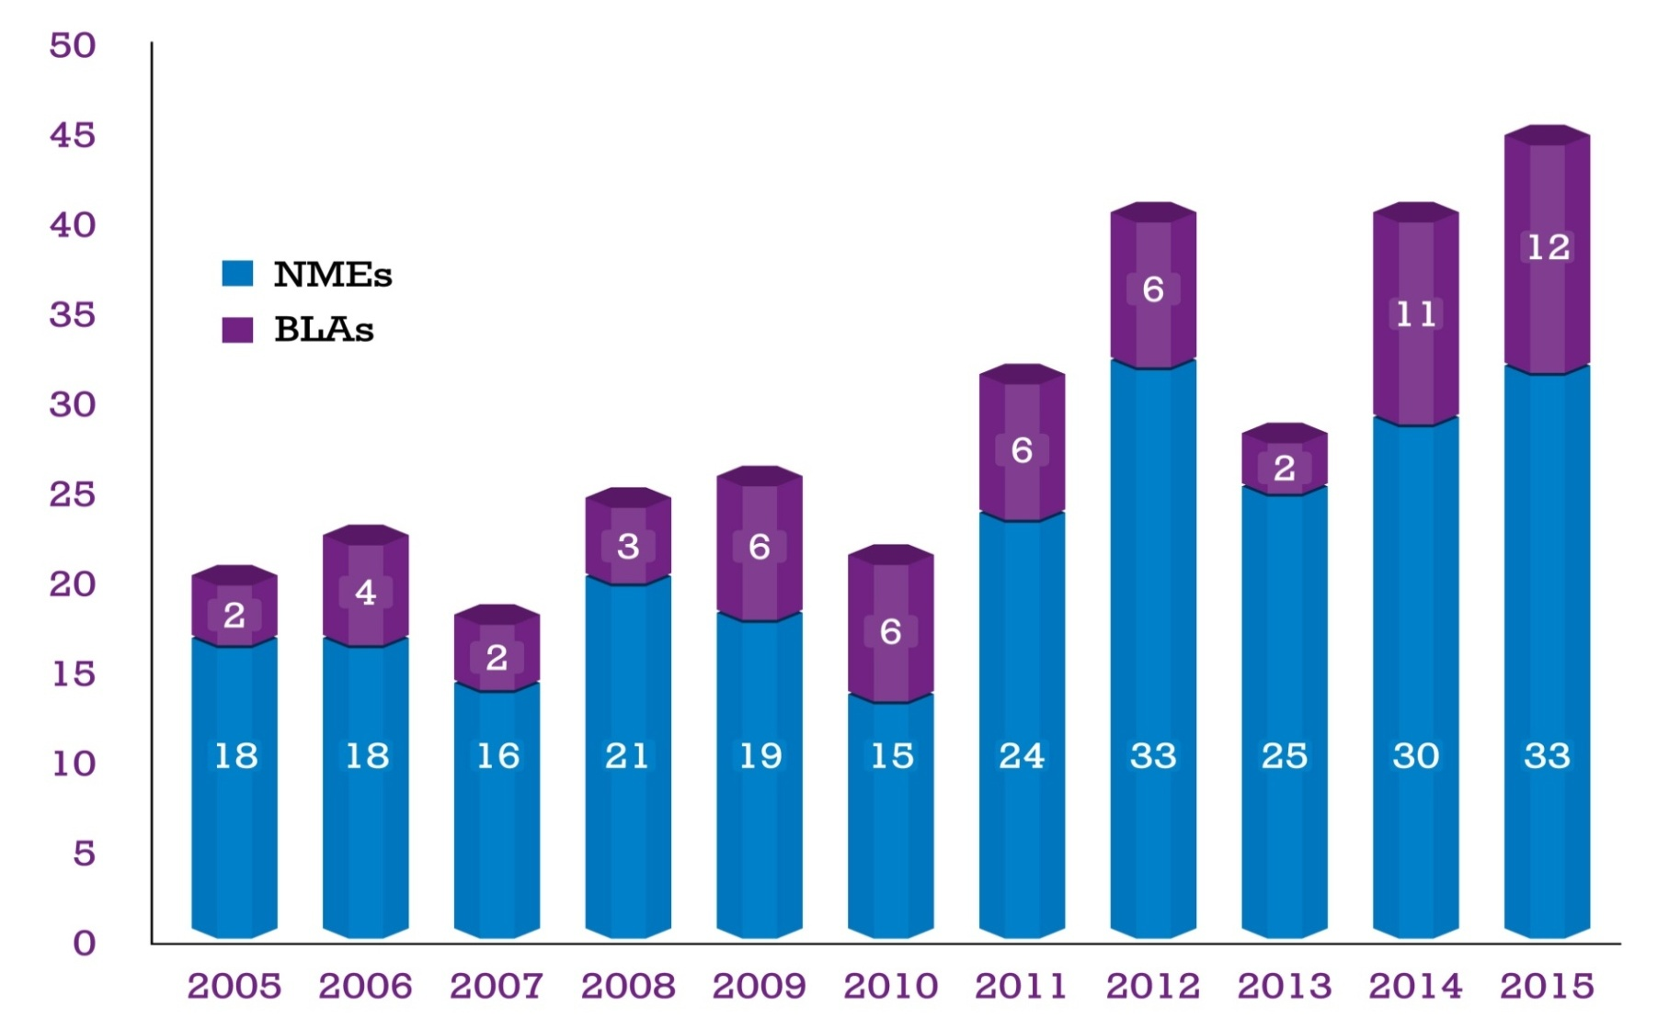
No. of New Biologics Approved (FDA) in Different Years
Ref. USFDA

Slide 11
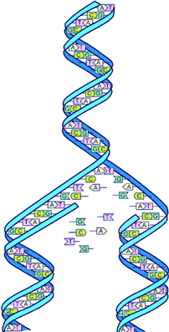
Biologicals in Pharmaceuticals
By 2016, 11 out of the top 20 pharma products will be biologics
By 2020, Biologics will enjoy 28% of global pharma sales
In last 5 yrs 60 biologic products has been approved globally
600 new biologic generics are in development stage
Ref. Deloitte, 2016 & Moklesur, 2104

Slide 12
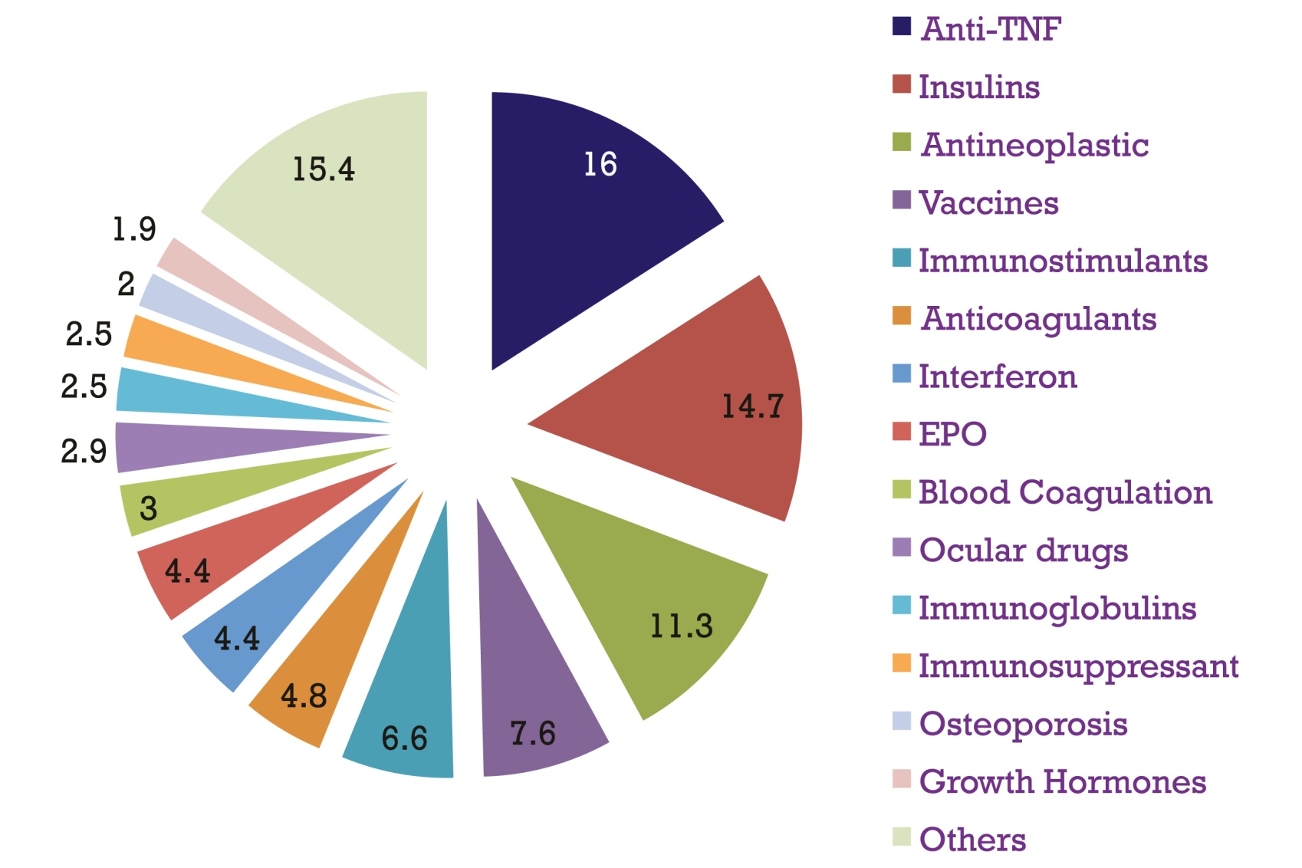
Market Segments (%) of Biologics
Ref. IMS MIDAS, Q2, 2014; Rx

Slide 13
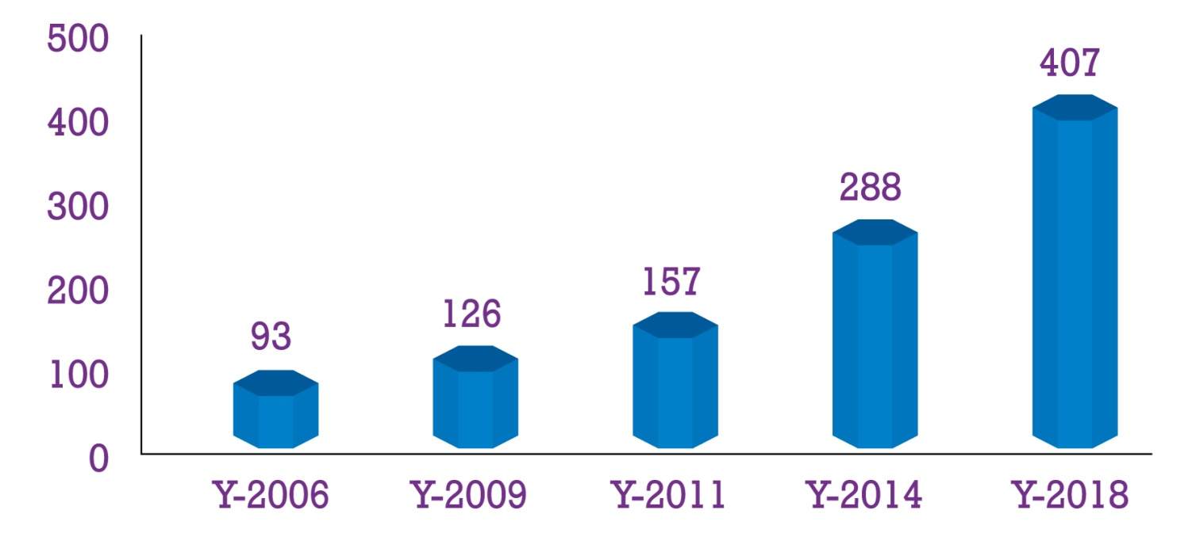
Market Trend of Biologics
In 2014 the total biologic product market was 288 bln USD
This market will continue to grow at >10% for next few yrs
In 2018 the revenue forecast for biological products is 407 bln USD
Ref. Industry Overview 2012 & Mokhlesur2014

Slide 14
Health Budget & Expenses

Slide 15
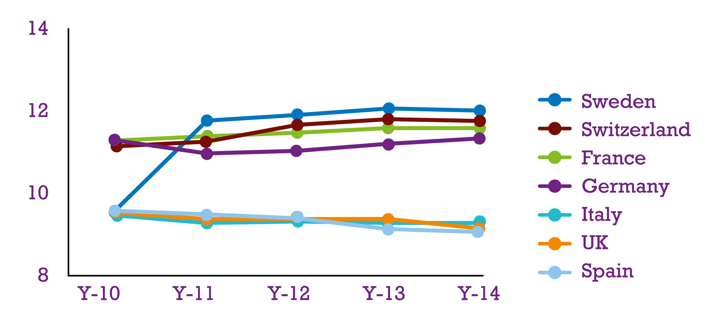
Health Expenditure as % of GDP in selected EU Countries
% of GDP
Ref. Data bank of The World Bank

Slide 16
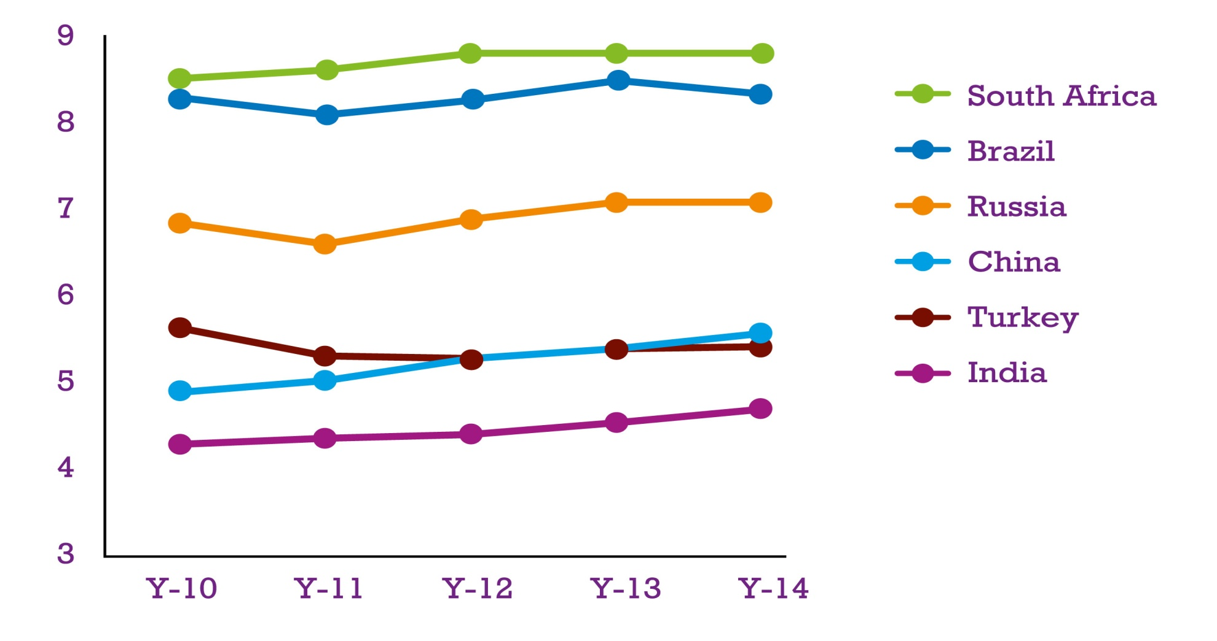
Health Expenditure as % of GDP in selected PE Countries
% of GDP
Ref. Data bank of The World Bank

Slide 17
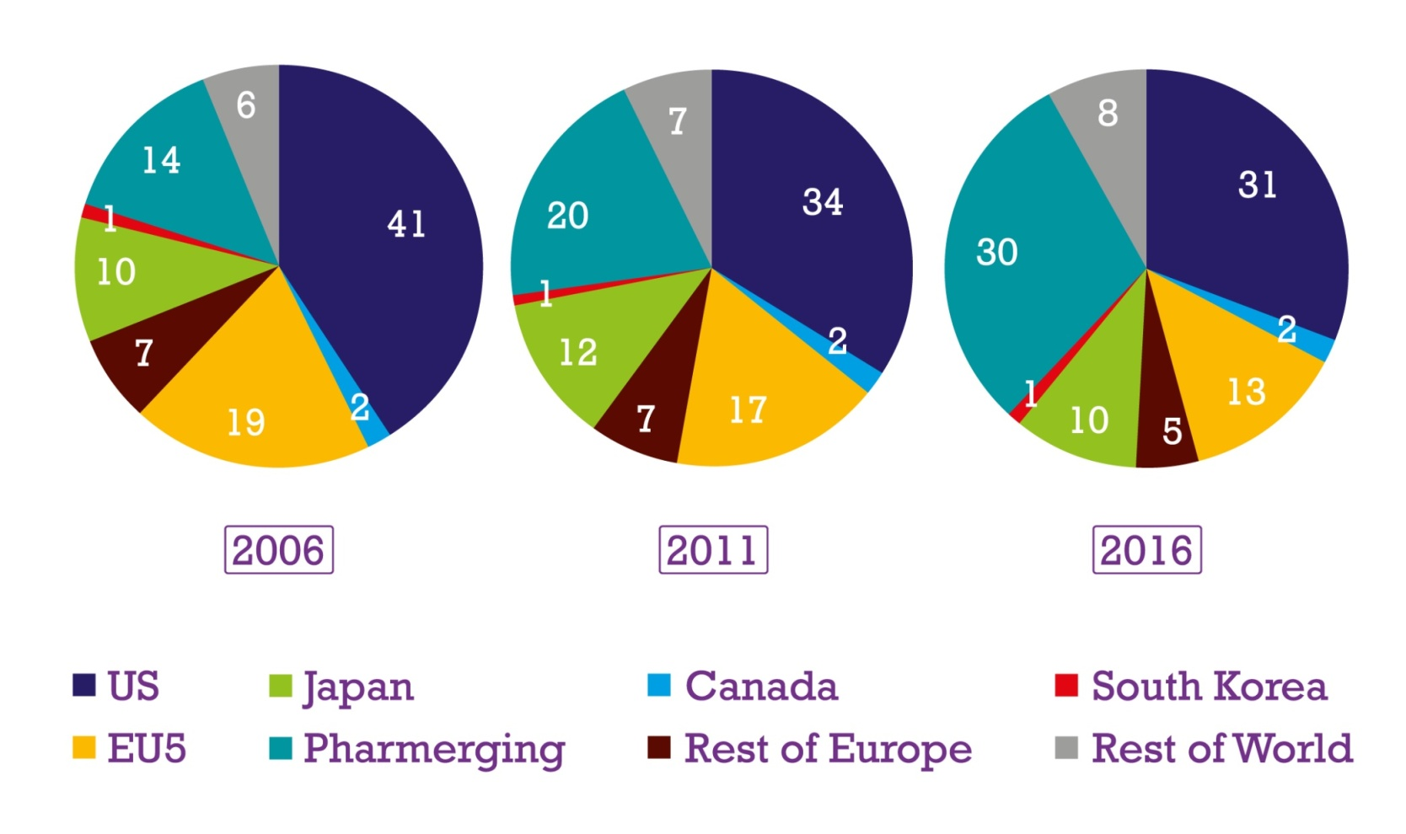
Region-wise Pharma Spending as % of Global Total
Pharmerging
EU5
USA
2006
2011
2016
Ref. IMS Health Market Prognosis, 2012

Slide 18
Expense by Developed & Developing Countries
Some developed countries are downsizing their health budget
Many emerging countries are making the healthcare as priority
Due to reduced heath budget some developed countries are becoming price sensitive
Due to increased health budget many people from emerging countries will get access to costly treatment if the price is reasonable for them

Slide 19
Biosimilars

Slide 20



Definition of Biosimilars
Biological Products highly similar to a US licensed reference
Standing minor difference in clinically inactive component
No difference in terms of safety, purity & Potency
Biological Medicinal products
Contains a version of authorized original medicine
Demonstrates similarity to the reference product in terms of
quality characteristics, biological activity, safety & efficacy
A biotherapeutic product
Similar to a licensed product in terms of quality, efficacy & safety

Slide 21
Scope for Biosimilars Due to Patent Expiration
Sl # | Brand | Active | Major Indication | Mkt in $ Bln
1 | Humira | Adalimumab | Rheumatoid Arthritis | 10.8
2 | Lantus | Insulin Glargine | Diabetes | 9.2
3 | Rituxan | Rituximab | Rheumatoid Arthritis | 8.6
4 | Enbrel | Etanercept | Rheumatoid Arthritis | 8.3
5 | Remicade | Infliximab | Crohn’s Disease | 7.9
6 | Avastin | Bevacizumab | Ovarian Cancer | 7.0
7 | Herceptin | Trastuzumab | Breast Cancer | 6.8
8 | Avonex | Interferon Beta-1A | Multiple Sclerosis | 5.5
9 | Copaxone | Glatiramer Acetate | Multiple Sclerosis | 4.6
10 | Neulasta | Pegfilgrastim | Neutropenia | 4.5
11 | Lucentis | Ranibizumab | Macular Degeneration | 4.5
12 | Levemir | Insulin Detemir | Diabetes | 2.5
13 | NovoMix 30 | Insulin Aspart | Diabetes | 1.8
14 | Xolair | Omalizumab | Allergic Asthma | 0.8
15 | Erbitux | Cetuximab | Colorectal Cancer | 0.25
Total |  |  |  | 83.05
Ref. IMS MIDAS, 06/2014, Rx bound, IMS Patent Focus & The Author

Slide 22
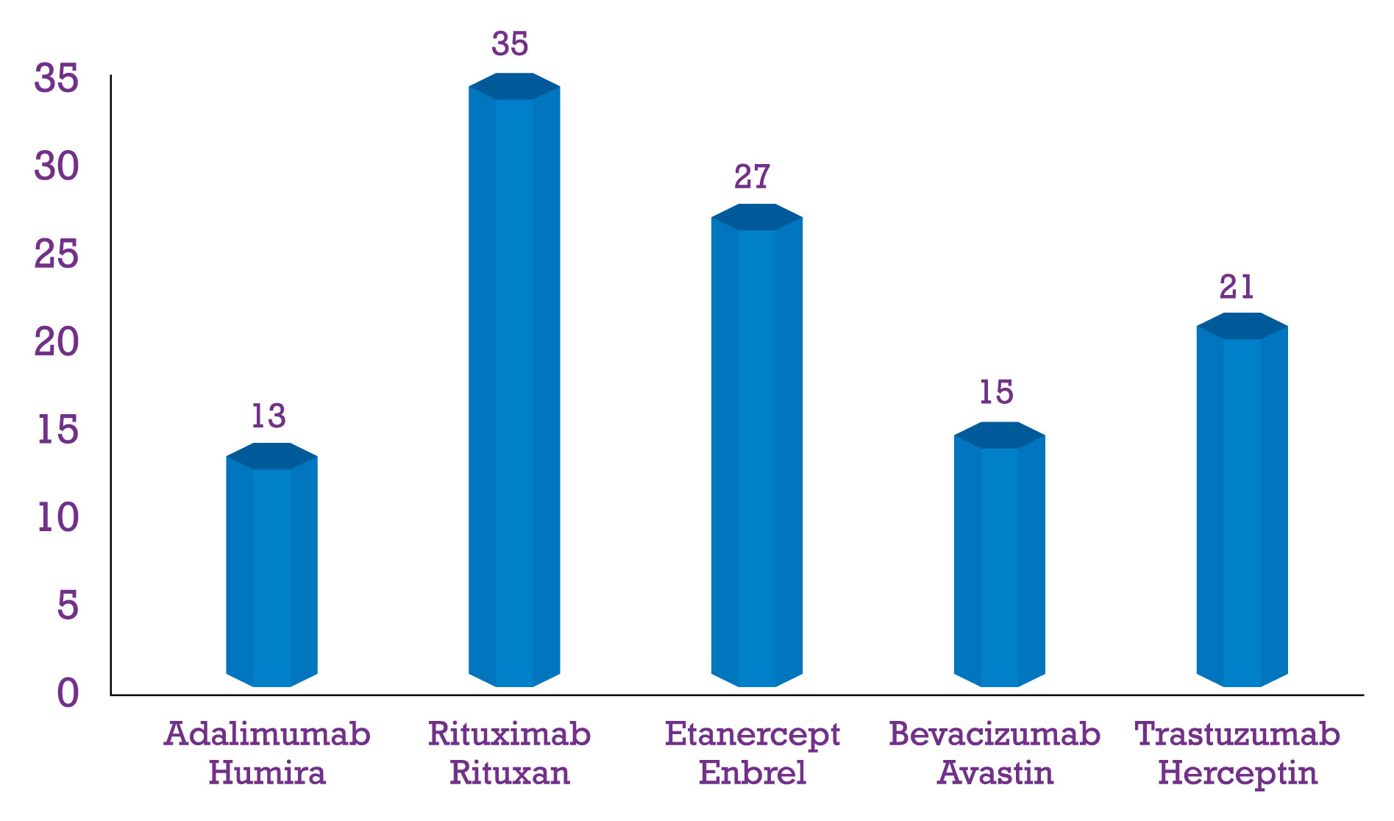
Biosimilars Under Development Against Top 05 Brands
Total = 111
Ref. The Potential for Biosimilars, IMS Health, March 2016

Slide 23
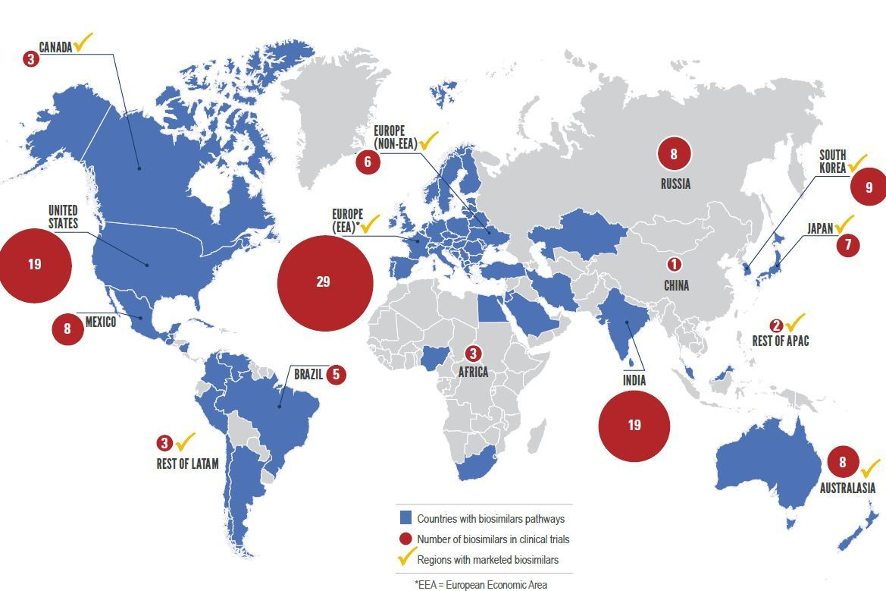
Region-wise Biosimilars Under Development

Slide 24
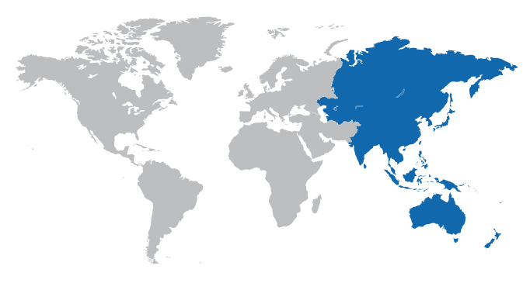
Strategic Locations for Biosimilars
Global biosimilars market is dominated by Europe, followed by Asia-Pacific, Rest of the World and North America. However, the Asia-Pacific is likely to witness the highest growth due to
Increase in health infrastructure
Relaxed regulatory requirements
Lower labor cost
Ref. Markets & Markets, 2016

Slide 25
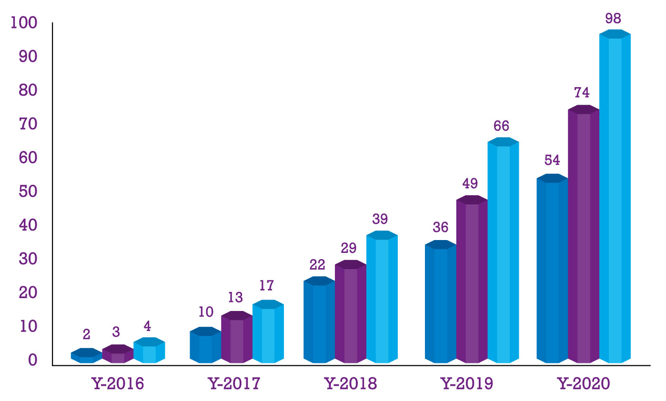
Reduction of Health Cost (bln USD) in EU5 & US due to Biosimilars
Consideration: 20%, 30% & 40% price reduction
of 8 most popular drugs
EU5 : UK, Germany, Italy, France, Spain
Ref. The Potential for Biosimilars, IMS Health, March 2016

Slide 26
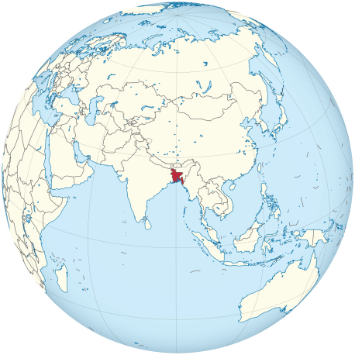
Bangladesh

Slide 27
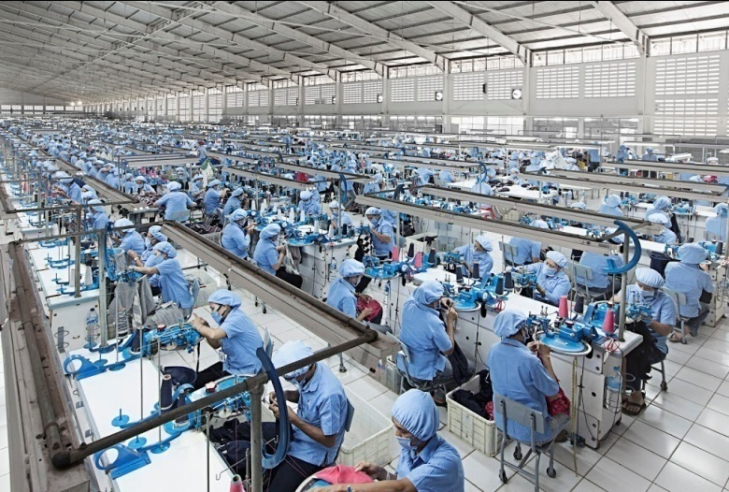
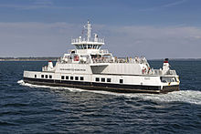
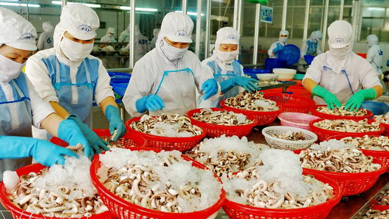
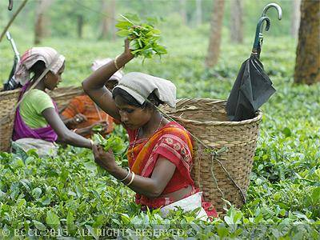
Readymade Garments
Ship Building
Shrimp
Tea

Slide 28
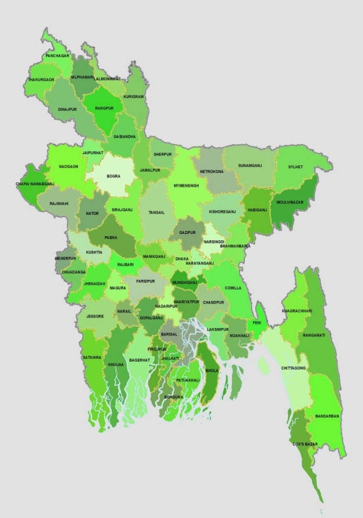
At a glance Bangladesh
Total Area : 147,570 km ² (94th )
Population : 162 mln (8th)
Density : 1,033/km² (12th)
GDP (PPP) : 572.44 bln USD (34th )
GDP (per capita) : 3,581 USD (144th )
GDP (nominal) : 205.32 bln USD (44th )
GDP (per capita) : 1466 USD (155th )
Recently the country has been uplifted as lower middle income country from lower income country (Ref. http://data.worldbank.org)
Ref. Bangladesh Bureau of Statistics, 2016 & Index Mundi

Slide 29
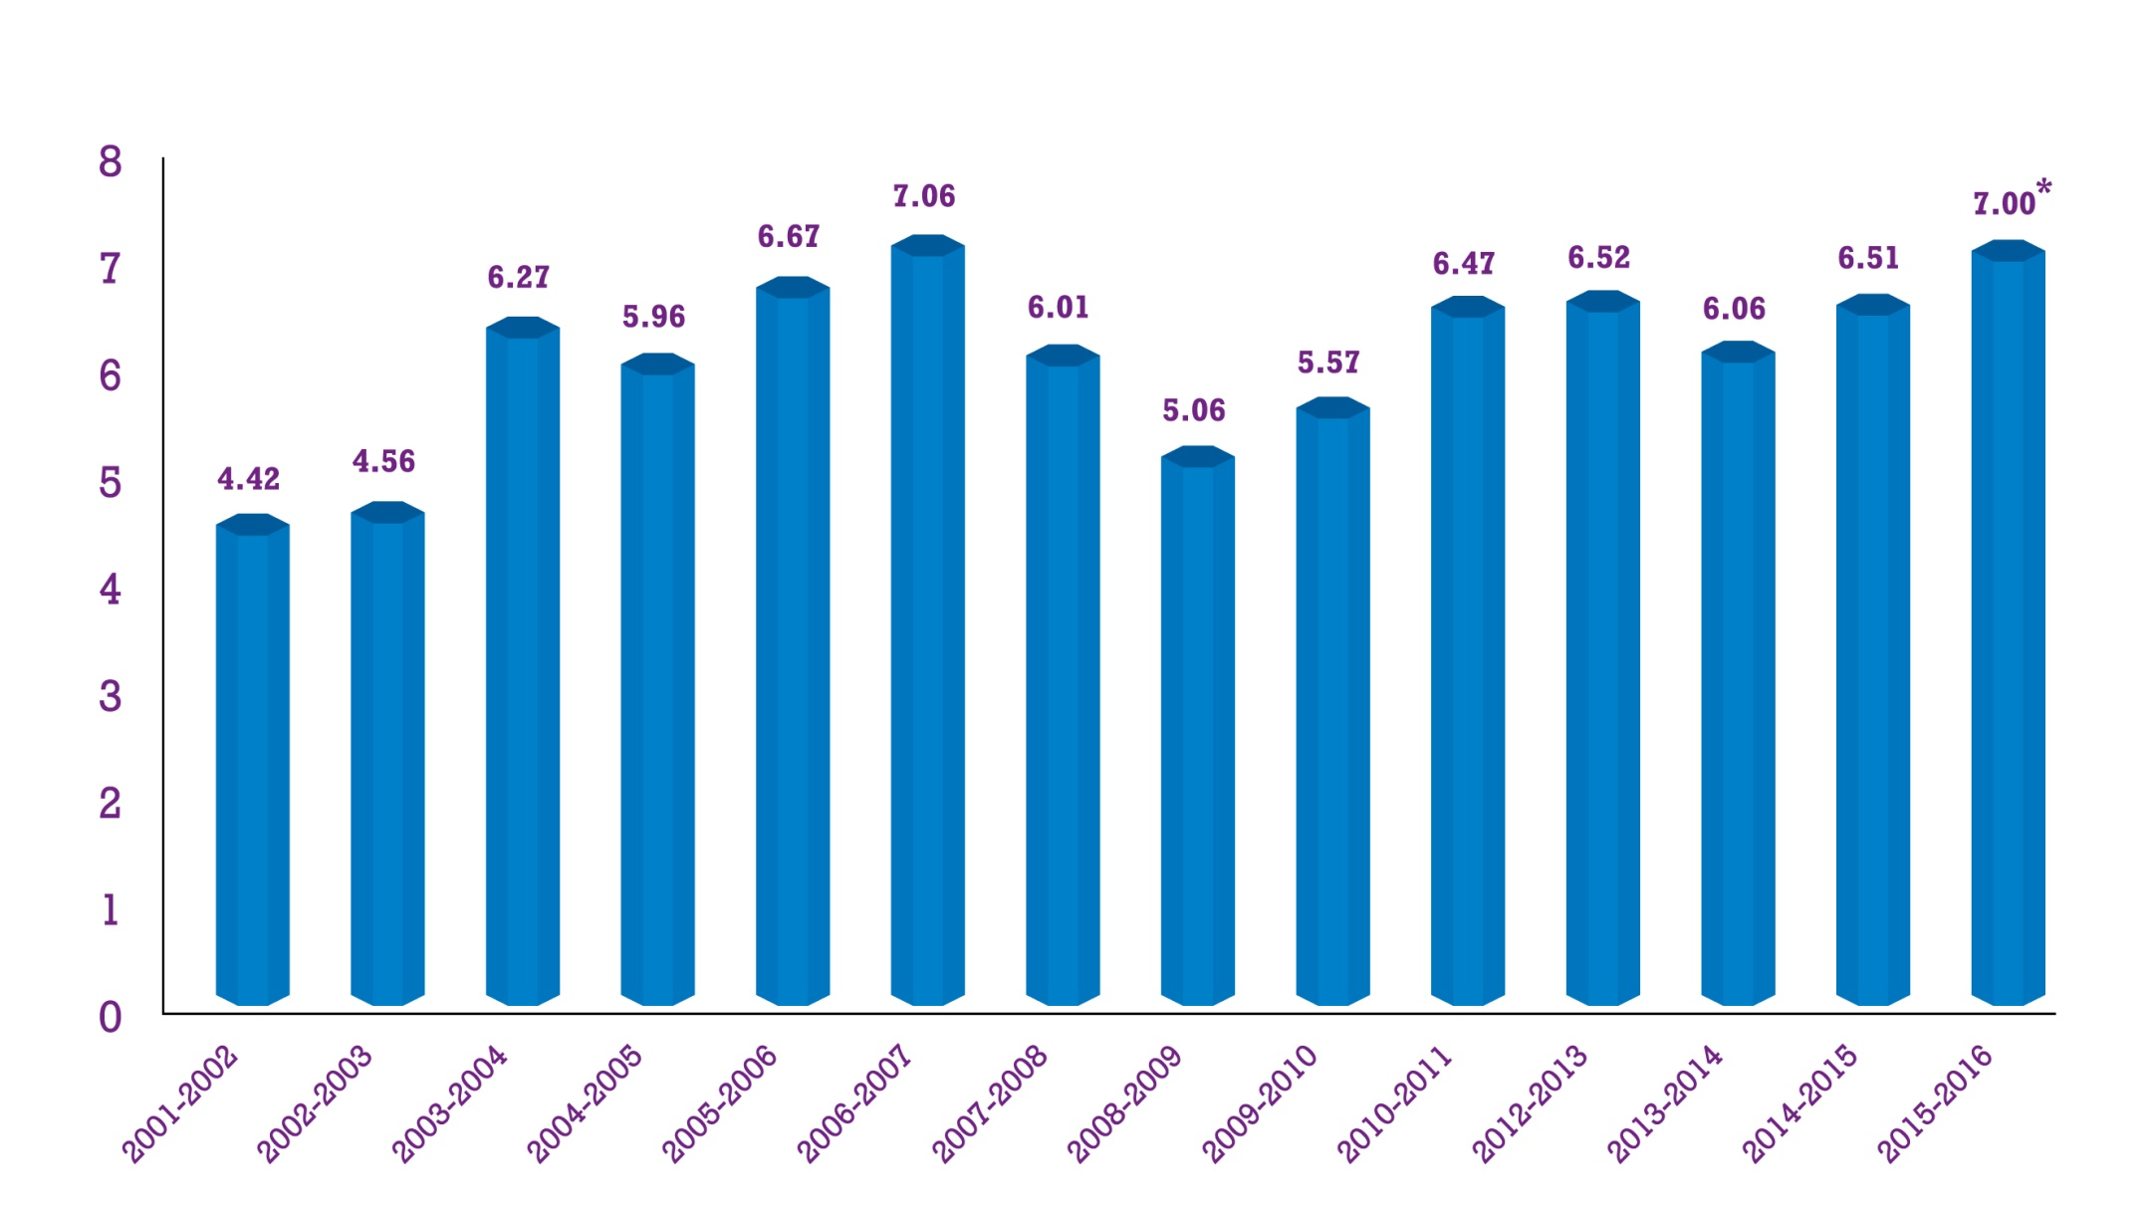
GDP Growth % of Bangladesh
7.2
Ref. Trading Economics (www.tradingeconomics.com/bangladesh/gdp-growth)

Slide 30
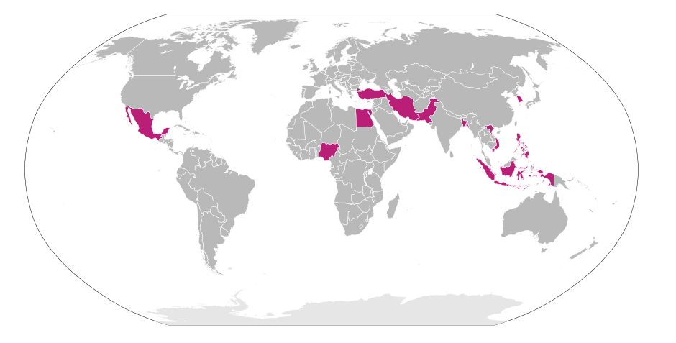
Economic Growth of Bangladesh
Bangladesh is classified among the Next Eleven emerging market economies in the world. According to IMF, Bangladesh's economy is the 2nd fastest growing economy of 2016.
Bangladesh has seen a major surge in export as the Bangladesh textile industry, the second largest in the world.
Ref. The Dhaka Tribune

Slide 31
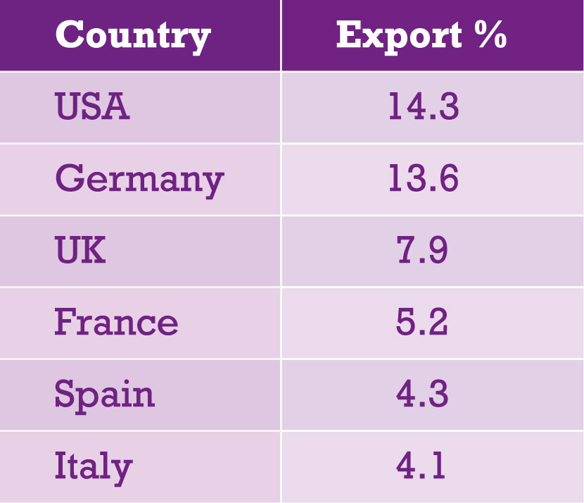
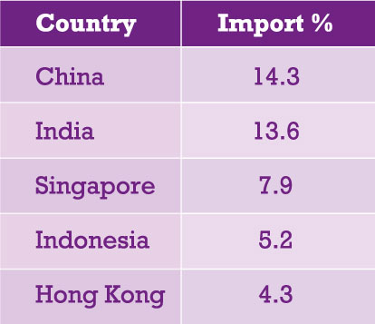
Export & Import Scenario of Bangladesh
Ref. The Dhaka Tribune

Slide 32
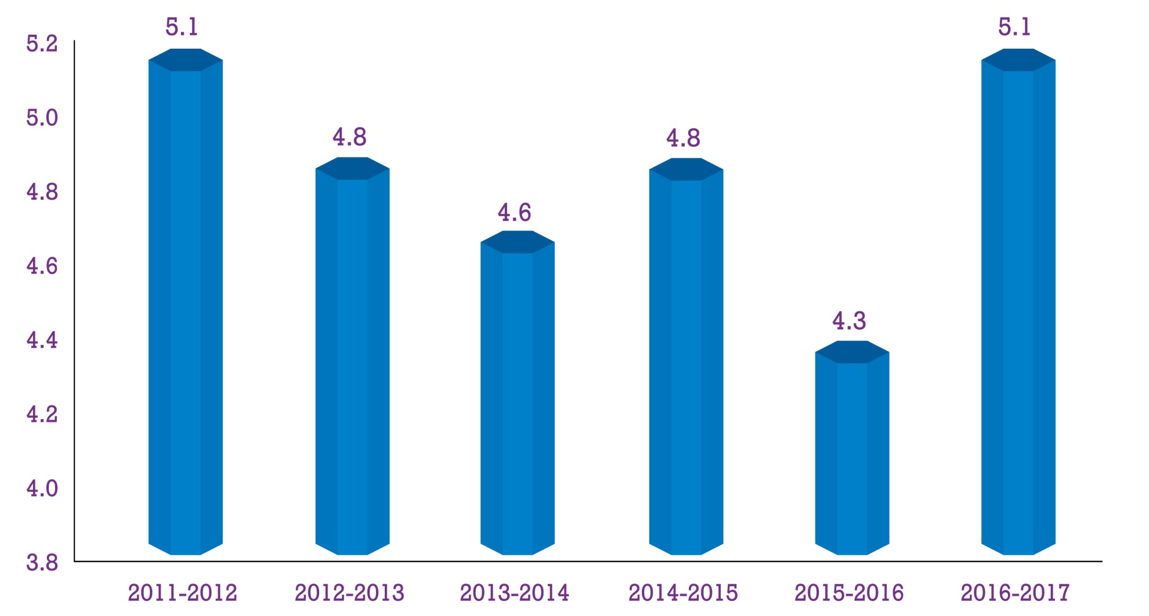
Healthcare Expenditure as % of GDP
Ref. Ministry of Finance, Bangladesh

Slide 33
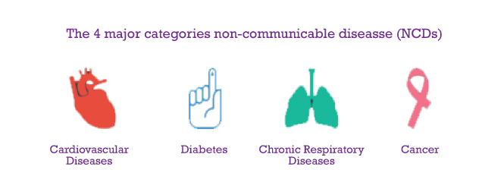
Prevalence of Non-Communicable Diseases (NCDs)
Bangladesh has been maintaining “0 polio status” (since 2006)
Prevalence of emerging of non-communicable diseases (NCDs)
More than half of hospital deaths were due to NCDs (2014)
Ref. The World Bank Report (www.who.int/countryfocus/cooperation_strategy/ccsbrief_bgd_en.pdf)

Slide 34
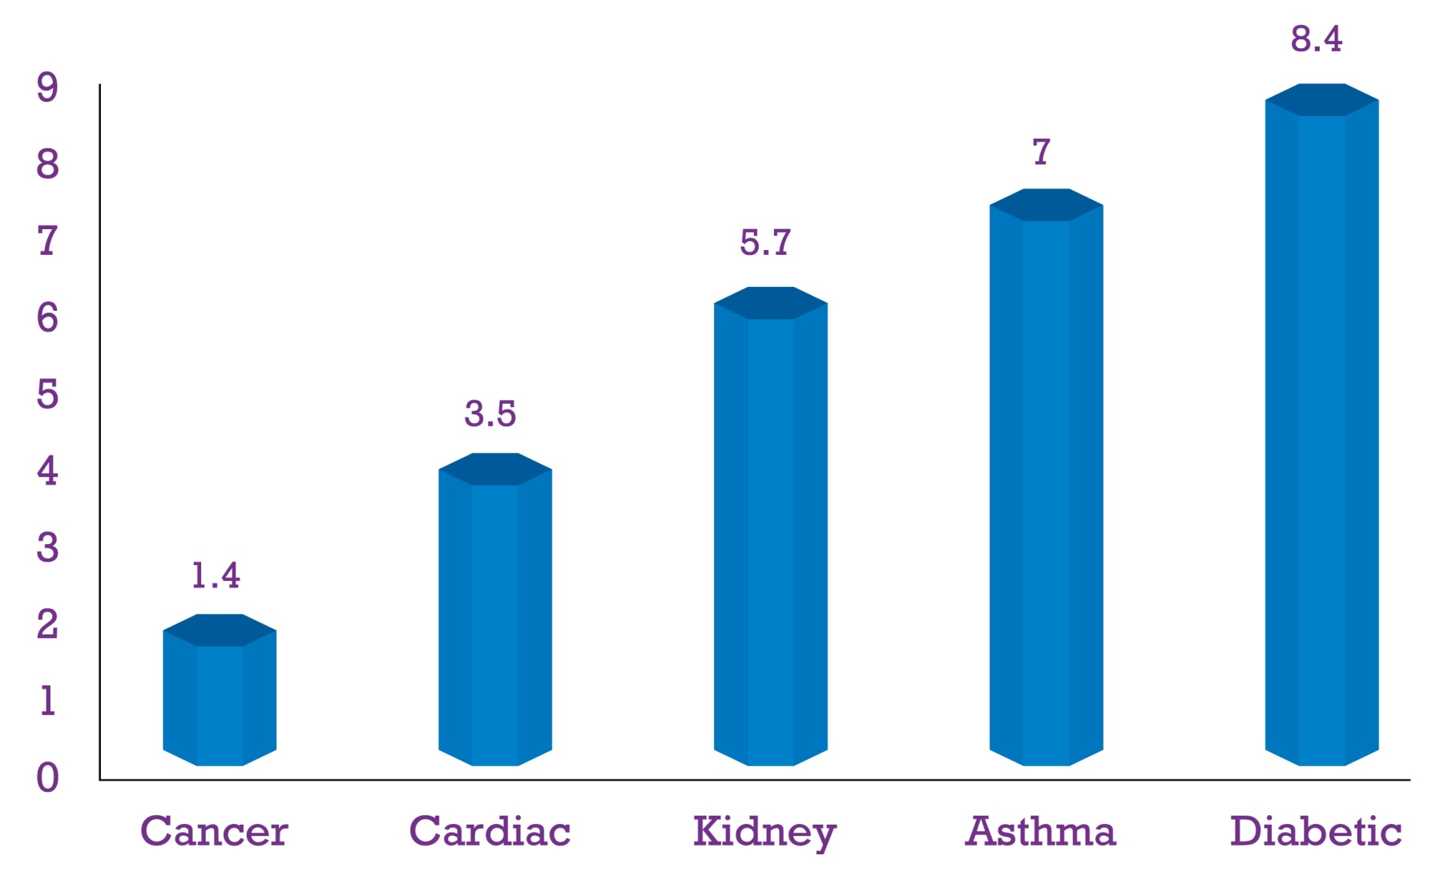
No. of Patients with Various NCDs in mln (Approx)
Ref. The Author (from multiple sources including official websites of different national health institutes of Bangladesh )

Slide 35
Influential Factors for Pharma Buying Process
Motivation & Recognition of need by the patients
Consultant Visit by the Patients
Available Information
Patients Attitude
Prescription by the Consultants
Quality of the product
Price
Promotion
Reputation of the company
Price
Dispensing by the Pharmacists
Commission
Availability
Purchase
Outcome
Ref: The Author (collected from Literature Review)

Slide 36
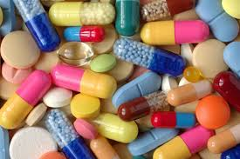
At a glance Pharma Market
Total Market : 1.4 bln USD (2 bln USD in 2018)
Company : 200 (95% local)
Avg. Growth : 12.8% (Last 5 yr)
Export : 72 mln USD (107 Countries)
Export Growth : 15.65% (Over last yr)
Import : <2% of local demand
Ref: LightCastle Analytics Wing in Industry Dynamics, 2015

Slide 37
Market Size of Biologics (mln USD)
Sl # | Active | Y-12 | Y-13 | Y-14 | Y-15 | Y-16
1 | Insulin | 14.8 | 18.1 | 18.2 | 21.4 | 27.6
2 | Interferon | 1.92 | 1.83 | 2.8 | 3.33 | 3.85
3 | MABs* | 1.83 | 1.62 | 2.82 | 3.33 | 3.95
4 | Erythropoietin | 0.01 | 0.02 | 0.37 | 0.86 | 1.17
5 | Filgrastim | 0.07 | 0.08 | 0.09 | 0.1 | 0.17
6 | Streptokinase | 0.06 | 0.07 | 0.14 | 0.08 | 0.15
7 | Others | 0.01 | 0.01 | 0.04 | 0.04 | 0.08
Total |  | 18.70 | 21.73 | 24.46 | 29.14 | 36.97
* MABs: Trastuzumab, Rituximab, Tocilizumab, Bevacizumab
Ref: IMS 1Q, 2016 & Internal Data

Slide 38
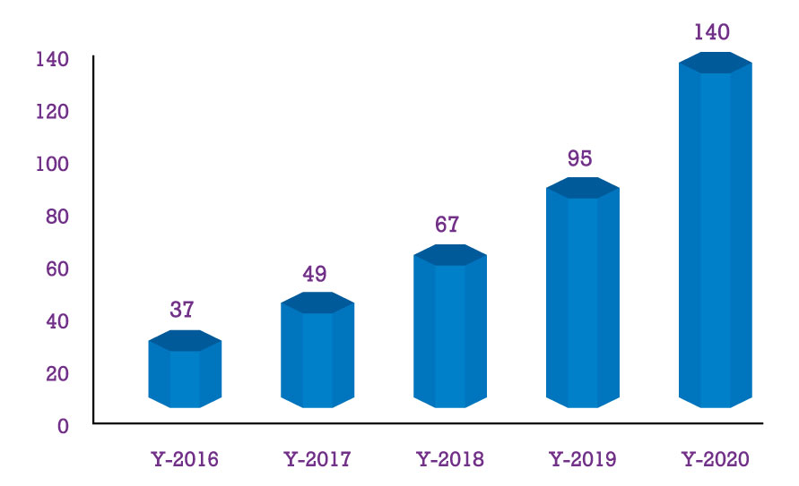
Market Trend (approx) of Biotech Products (mln USD)
Ref: The Author

Slide 39
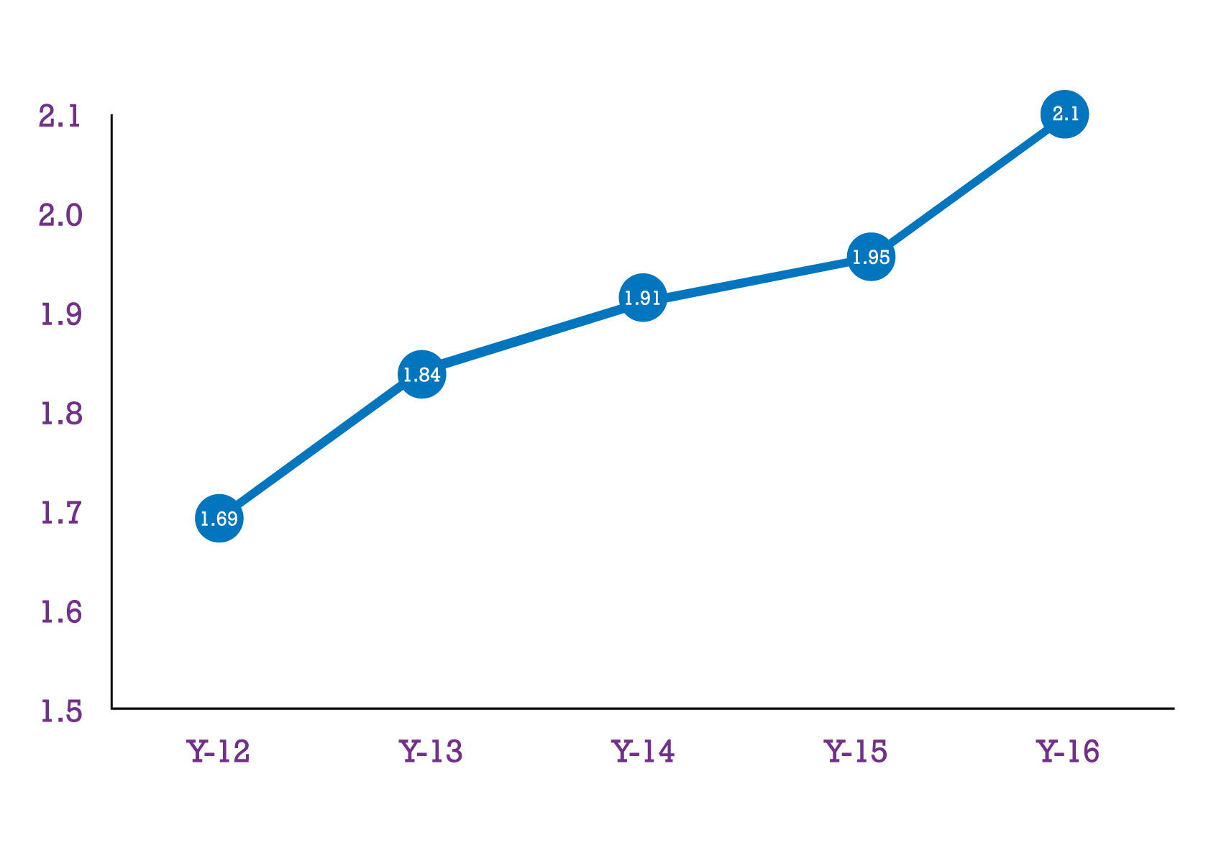
Market Share (%) of Biotech Products
Ref: IMS 1Q, 2016 & Internal Data

Slide 40
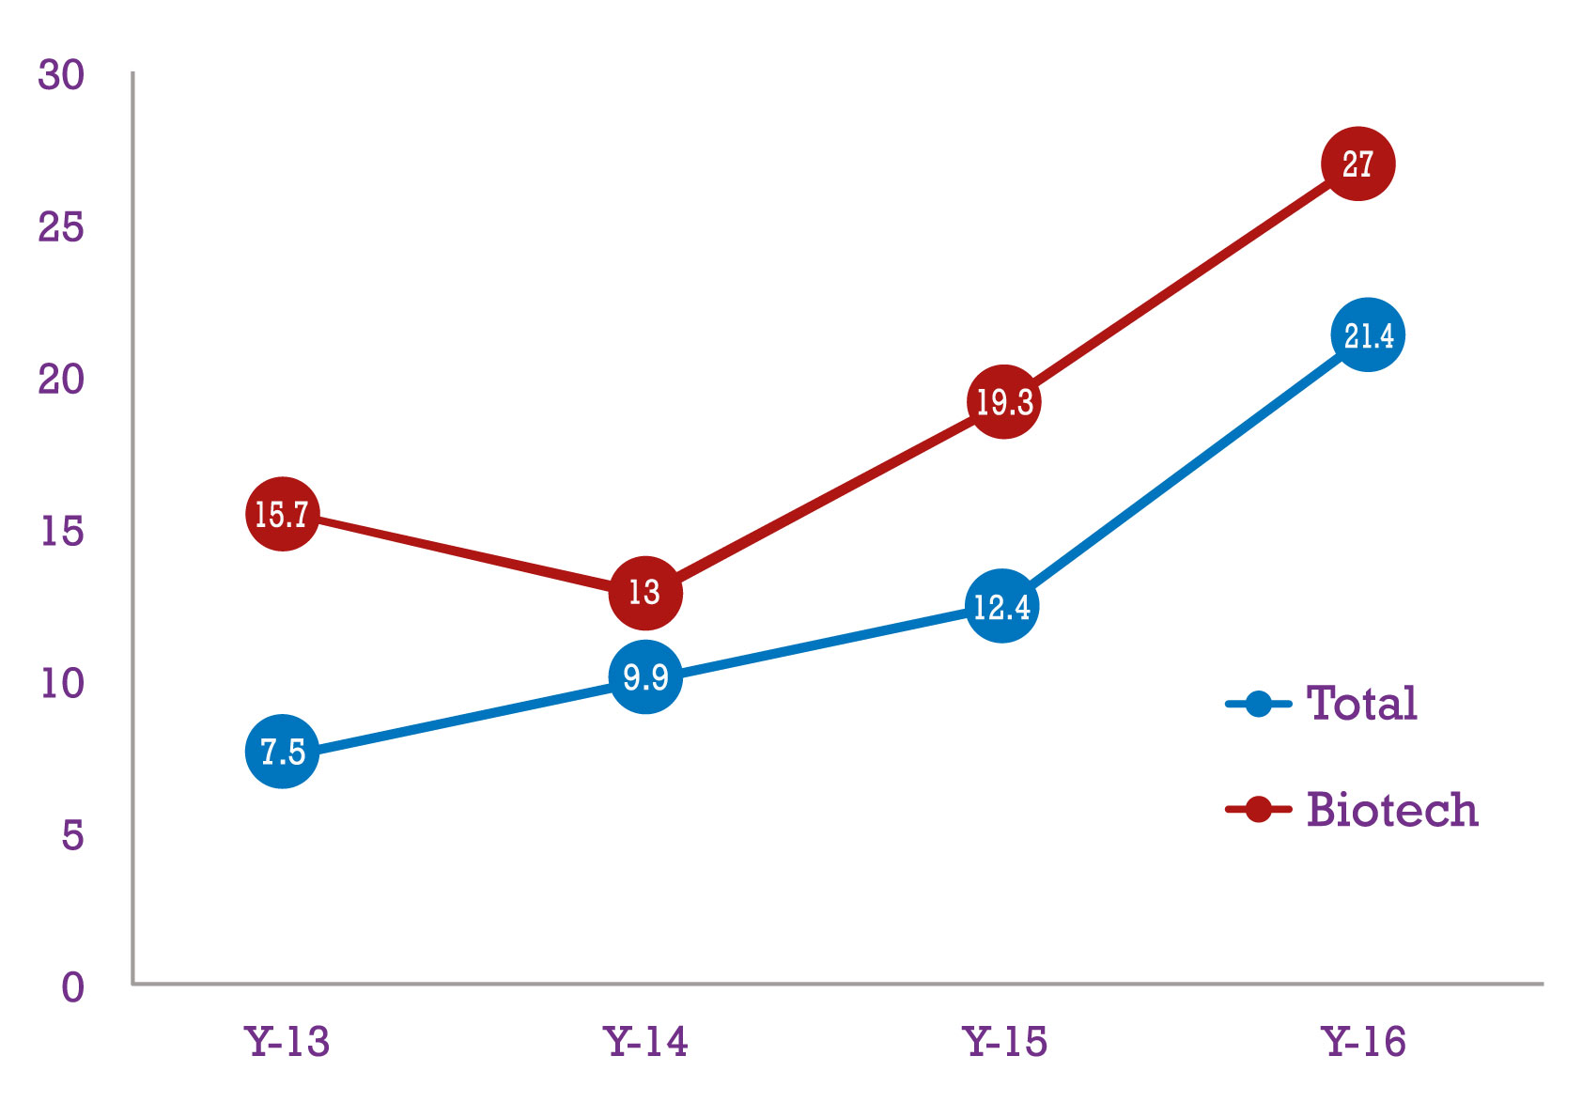
Growth % Biotech Products Vs Total Pharma Mkt
Ref: IMS 1Q, 2016 & Internal Data

Slide 41
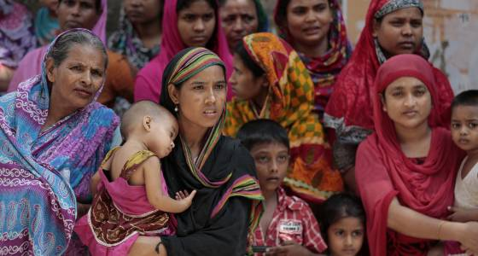
Why Bangladesh (Continued)
Huge number of population (Life Exp : 70.65 years)
Decreasing trend of poverty (1.8% annually)
Stable economic growth (Avg GDP Growth : 6-7%)
Increasing health awareness (Education & NGOs)

Slide 42

Why Bangladesh (Continued)
Prevalence of non-communicable diseases (Half of total)
Geographic location (02 Sea Ports & land connection)
Skilled Manpower (Producing Hormones, Vaccines)
High Productivity (Laborers, Managers & Entrepreneurs)

Slide 43
Why Bangladesh (Continued)
Sl | Cost Heads | Unit | Dhaka | Shanghai | New Delhi | Seoul
1 | Worker Wage | Person/Month | 50-100 | 200-250 | 150-180 | 890-1275
2 | Managerial Staff | Person/Month | 331 | 1000-1500 | 800-1200 | 1900-2000
3 | Industrial Land | Per Sqr m | 1000-1500 | 5000-5500 | 10000-10500
4 | Office Rent | Sqr. m/month | 10-12 | 60-65 | 30-35 | 34.5
5 | Electricity | Per KWh | 0.06-0.10 | 0.1 | 0.1 | 0.04
6 | Water for Business Use | Per Cu. M | 0.25-0.33 | 0.32 | 0.25 | 0.62-0.98
7 | Gas for Business Use | Per Cu. M | 0.085 |  | 0.52 | 0.29
8 | Personal Income Tax | Basic Rate | 10-25% | 5-45% | 10-30% | 40%
* Figures are in USD
Ref: Bangladesh Board of Investment (BOI), www.globalpropertyguide.com & The Shanghai daily

Slide 44
Why Bangladesh
Advantages of TRIPs (Exempt up to 2032)
Government patronization (1982 Drug Ordinance)
Investment friendly environment (Govt. Patronization)
Success history of pharma export (08 yrs Avg Gr 14%)
(Some companies are setting up plants in Saudi Arabia, UAE, Sri Lanka & in some African Countries. At present 3,600 Bangladeshi brands are already internationally registered and among them 100 are in regulated market) Ref. Mollick, 2015

Slide 45
National Drug Policies
1. A raw material which is locally manufactured will be given protection by disallowing it to be imported if sufficient quantity is available in the country.
2. No multinational company without their own factory will be allowed to market their products after manufacturing them in other factory in a toll basis.
3. No foreign brands may be imported in Bangladesh if the same or similar 03 products are available/manufactured in Bangladesh.

Slide 46

Mode of Entry
Joint Venture is the preferable option for Business Operation. Because-
Limited research activities by the local companies
Complying with the national drug policies
Scope to use local marketing expertise
Advantages of geographical location
Advantages of TRIPS
Risk minimization
Thank You

Slide 47
Let us meet again..
We welcome you to our future conferences of Conference Series LLC
through
6th International Conference and Exhibition on Biologics and Biosimilars
October 19-21, 2016 Houston, TX, USA
http://biosimilars-biologics.pharmaceuticalconferences.com/europe

