Slide 1
About Omics Group
OMICS Group International through its Open Access Initiative is committed to make genuine and reliable contributions to the scientific community. OMICS Group hosts over 400 leading-edge peer reviewed Open Access Journals and organize over 300 International Conferences annually all over the world. OMICS Publishing Group journals have over 3 million readers and the fame and success of the same can be attributed to the strong editorial board which contains over 30000 eminent personalities that ensure a rapid, quality and quick review process.

Slide 2
About Omics Group conferences
OMICS Group signed an agreement with more than 1000 International Societies to make healthcare information Open Access. OMICS Group Conferences make the perfect platform for global networking as it brings together renowned speakers and scientists across the globe to a most exciting and memorable scientific event filled with much enlightening interactive sessions, world class exhibitions and poster presentations
Omics group has organised 500 conferences, workshops and national symposium across the major cities including SanFrancisco,Omaha,Orlado,Rayleigh,SantaClara,Chicago,Philadelphia,Unitedkingdom,Baltimore,SanAntanio,Dubai,Hyderabad,Bangaluru and Mumbai.

Slide 3




Air Force Research Laboratory
Quantum well THz detection
With Landau Levels
9 September 2014
Integrity  Service  Excellence
Mayer A. Landau
Research Physicist
Space Vehicles Directorate
Air Force Research Laboratory
Notes:
Title Page:
Speaker: Mayer A. Landau
Section Chief, Advanced Space Power
Space Vehicles Directorate
Air Force Research Laboratory

Slide 4
Outline
Why THz?
Landau levels in a Quantum well detector
THz generation
Setup
Dispersion compensation
DISTRIBUTION STATEMENT A – Unclassified, unlimited Distribution
Notes:
Outline

Slide 5
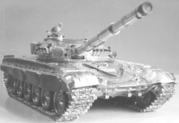
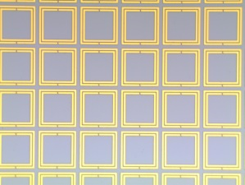
Why THz?
A bunch of gov’t organizations care about THz, like NASA and the ARMY. However, the Air Force does not currently care about THz.
Reason: Low power sources, expensive detectors limit applications and deployability and there is no defined need.
Great hobby frequency. Goldilocks frequency for the lab
– Most real world applications are in the RF or infrared bands.
For lab testing, RF requires large facilities.
In the other extreme, building infrared devices typically requires very small fabrication features.
-Typically, the physics at infrared is different than for RF. Eg. For metamaterials at RF frequencies, geometry matters.
For metamaterials at infrared frequencies, material matters. Low THz retains most of the features of RF, while higher THz is similar to IR. The transition is due to the carrier scattering frequency, which is typically in the THz.
- I work in the Space Directorate of the Air Force Research Lab. Many of the disadvantages of THz, such as absorption in the atmosphere, are not a problem in space.
- Possibly useful for material characterization, which is something we do.
DISTRIBUTION STATEMENT A – Unclassified, unlimited Distribution
Notes:
Outline

Slide 6
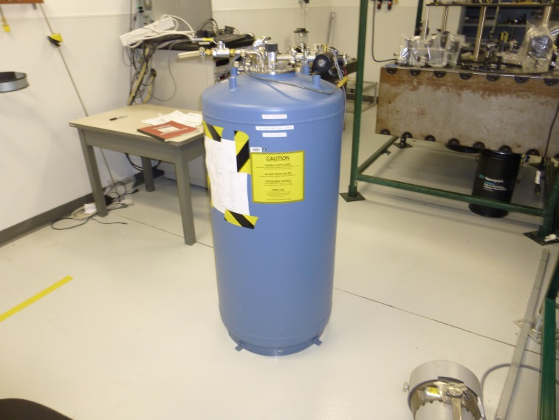
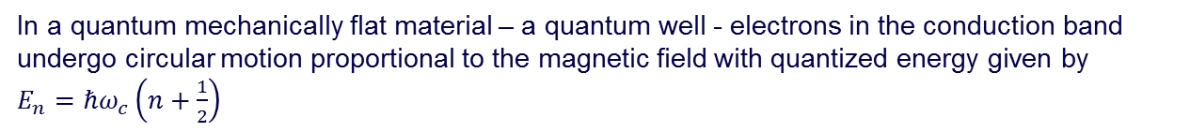
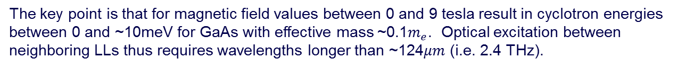
Landau Levels
In a quantum mechanically flat material – a quantum well - electrons in the conduction band undergo circular motion proportional to the magnetic field with quantized energy given by
$E_{n}=ℏω_{c}\left(n+\frac{1}{2}\right)$
Here $ω_{c}=\frac{eB}{m^{∗}}$ is the cyclotron frequency.
The key point is that for magnetic field values between 0 and 9 tesla result in cyclotron energies between 0 and ~10meV for GaAs with effective mass ~0.1$m_{e}$. Optical excitation between neighboring LLs thus requires wavelengths longer than ~124$μm$(i.e. 2.4 THz).
We have a 9 Tesla magnet in our lab.
DISTRIBUTION STATEMENT A – Unclassified, unlimited Distribution
Notes:
Outline

Slide 7
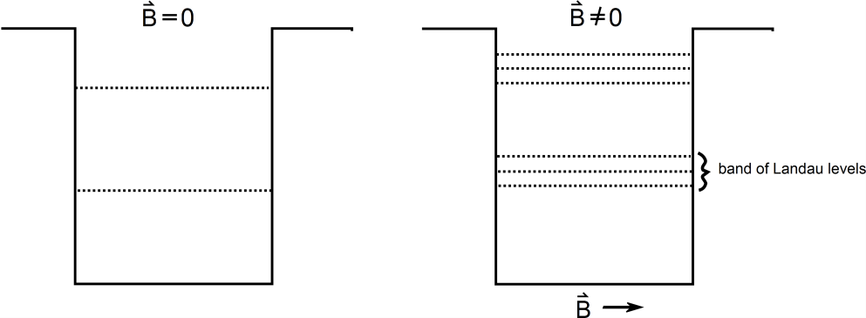
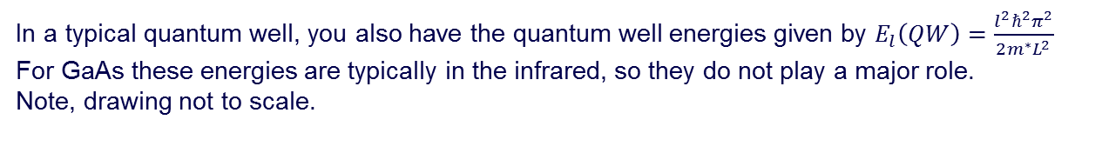
Landau Levels in Quantum Well
In a typical quantum well, you also have the quantum well energies given by $E_{l}\left(QW\right)=\frac{l^{2}ℏ^{2}π^{2}}{2m^{∗}L^{2}}$
For GaAs these energies are typically in the infrared, so they do not play a major role.
Note, drawing not to scale.
By adjusting the value of applied field to the quantum wells, the spacing between LLs can be continuously adjusted. Note that the higher LLs change energy by a larger amount than lower LLs, for a given change in magnetic field, therefore multiple tunneling alignments will occur as a function of applied magnetic field.
Problem is that a single quantum well type structure has a lot of dark current.
Often has issues with light incident from the growth direction.
DISTRIBUTION STATEMENT A – Unclassified, unlimited Distribution
Notes:
Outline

Slide 8
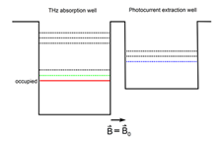
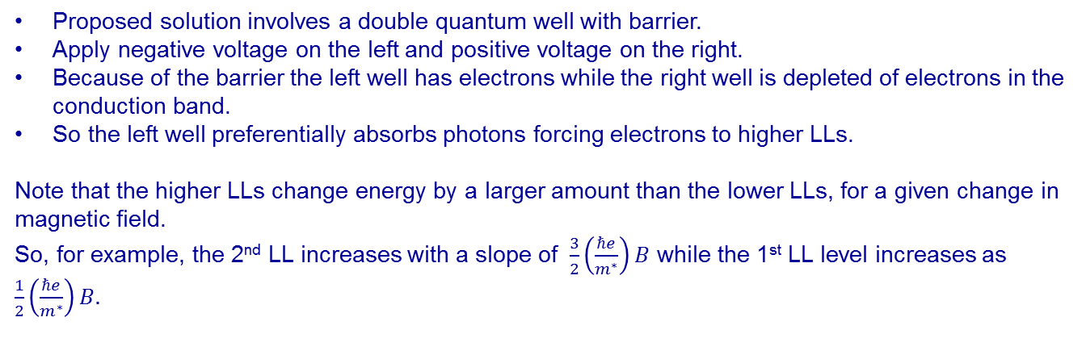
Proposed Solution
Electron Flow
Proposed solution involves a double quantum well with barrier.
Apply negative voltage on the left and positive voltage on the right.
Because of the barrier the left well has electrons while the right well is depleted of electrons in the conduction band.
So the left well preferentially absorbs photons forcing electrons to higher LLs.
Note that the higher LLs change energy by a larger amount than the lower LLs, for a given change in magnetic field.
So, for example, the 2nd LL increases with a slope of $\frac{3}{2}\left(\frac{ℏe}{m^{∗}}\right)B$ while the 1st LL level increases as $\frac{1}{2}\left(\frac{ℏe}{m^{∗}}\right)B.$
DISTRIBUTION STATEMENT A – Unclassified, unlimited Distribution
Notes:
Outline

Slide 9
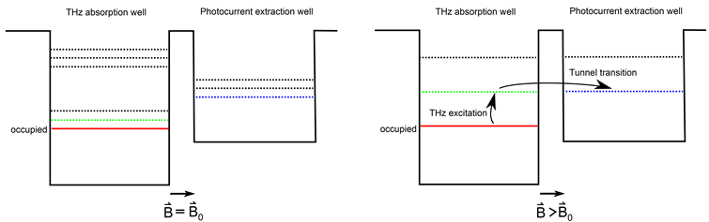
Proposed Solution
If you design the width and the height correctly, these two LL’s will eventually cross. Basically you try different combinations of GaAlAs/GaAs quantum wells (1.42-2.16 eV). These are grown at the University of New Mexico.
When two LLs align across the tunneling barrier, you get enhanced tunneling between the quantum wells.
Photocurrent results when carriers are injected from the left, to populate the lowest left LL, followed by THz radiation of the proper wavelength to excite the carriers to the next LL.
After tunnelling to the right well, the electron will be sensed as a photocurrent corresponding to a particular THz wavelength.
By tuning the magnetic field, the allowed tunnel transitions are tuned and thus also the wavelength of the THz photoresponse of the quantum well pair. This material architecture can thus enable the formation of a quasi-continuously tunable THz detector.
DISTRIBUTION STATEMENT A – Unclassified, unlimited Distribution
Notes:
Outline

Slide 10

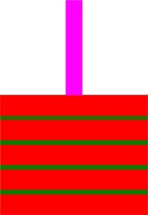
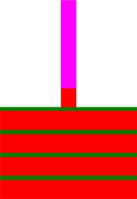



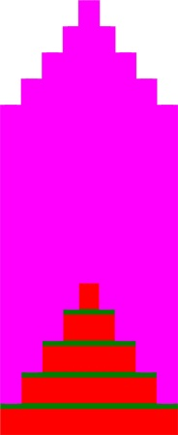


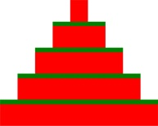
Quantum well development
Grow multiple layers to amplify signal.
Spin
Photoresist
Develop
Etch
MBE
Each green line represents the double quantum well structure.
Each red line represents the buffer layer
Repeat process several times
DISTRIBUTION STATEMENT A – Unclassified, unlimited Distribution
Notes:
Outline

Slide 11
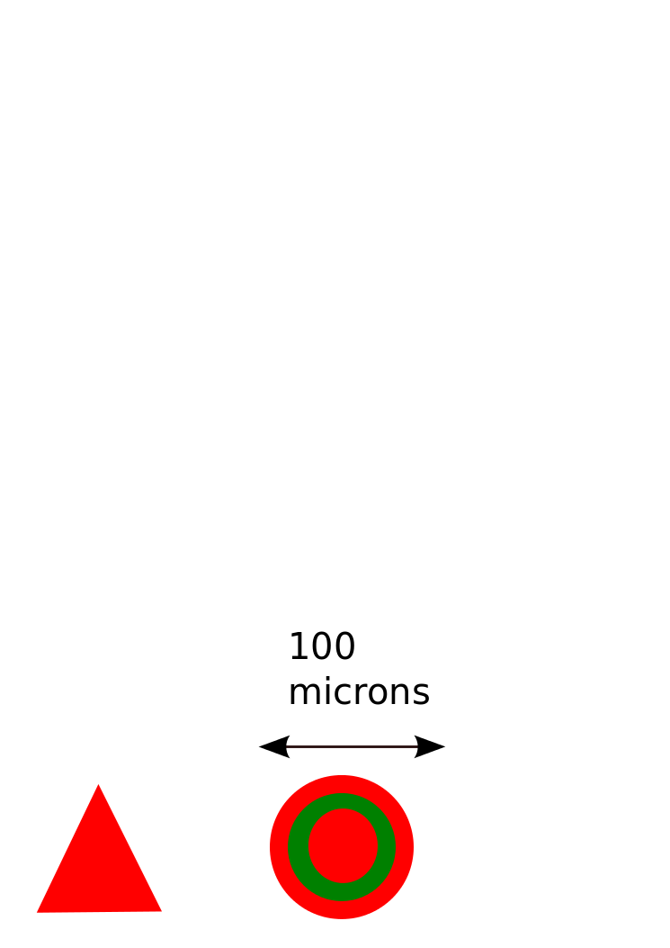
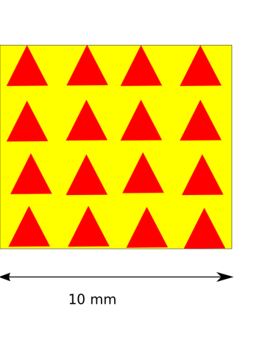

Array of Pyramids
Magnet sitting in liquid helium bath
$$=$$
You are limited by the size of the chamber 1”x3’
DISTRIBUTION STATEMENT A – Unclassified, unlimited Distribution
Notes:
Outline

Slide 12
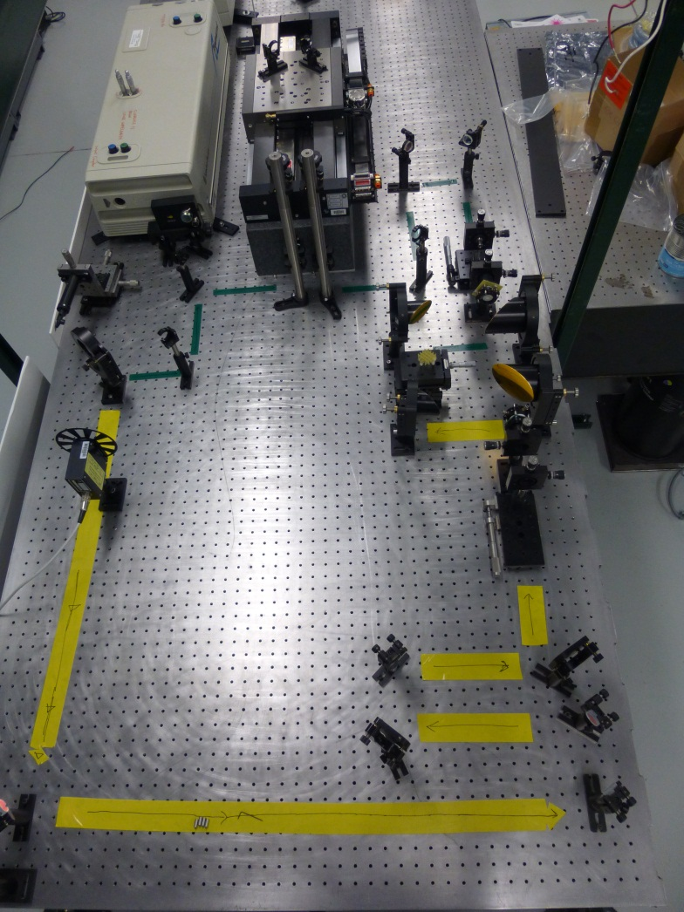
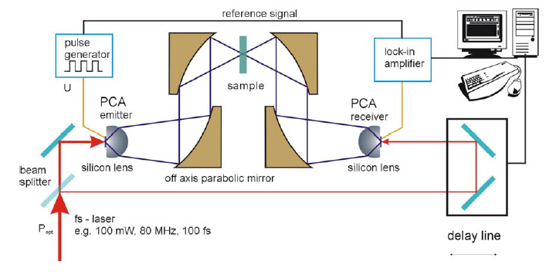
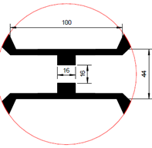
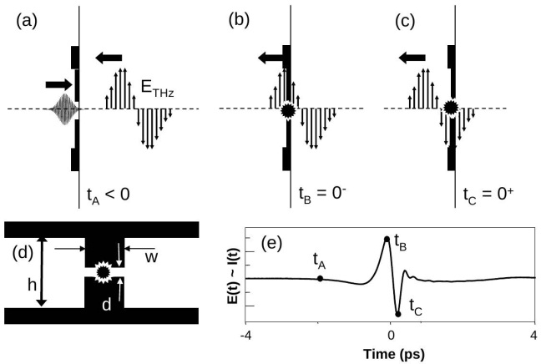
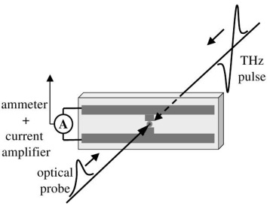
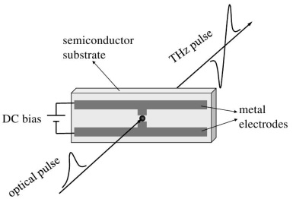
Teraheratz Photoconductive Probe Generation
Refractive index depends on wavelength.
Broadens pulse length.
DISTRIBUTION STATEMENT A – Unclassified, unlimited Distribution
Notes:
Outline

Slide 13
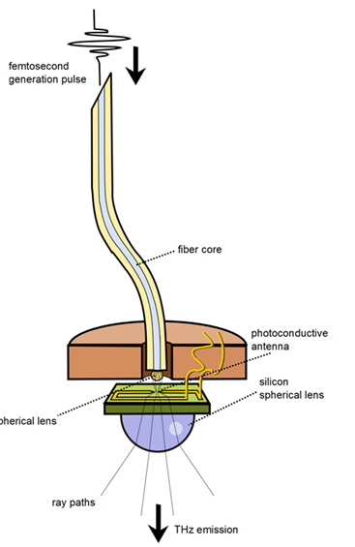
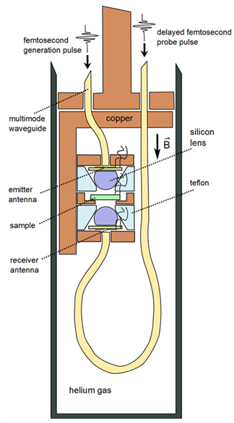
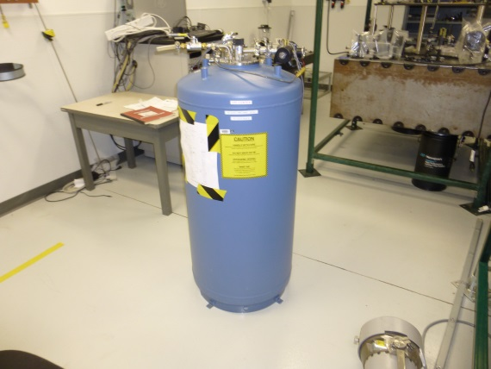
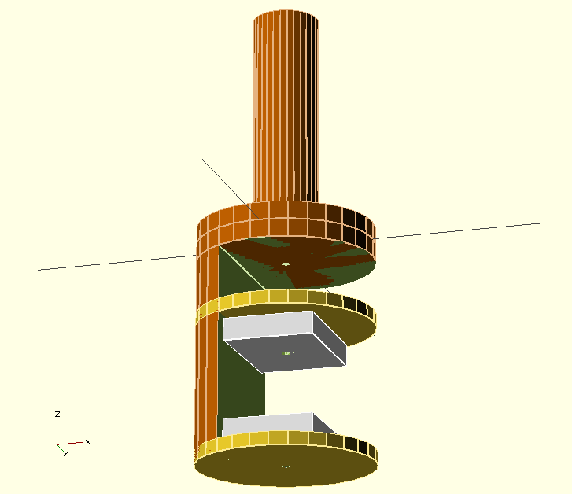
Need to get pulse Into Magnet
The way this is typically done, say at Sandia, is to build a special dewar with windows between the magnetic windings.
Would be better if we could use any dewar.
DISTRIBUTION STATEMENT A – Unclassified, unlimited Distribution
Notes:
Outline

Slide 14
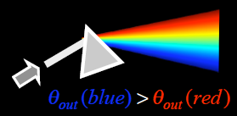
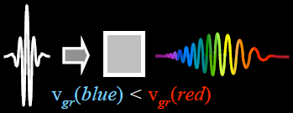
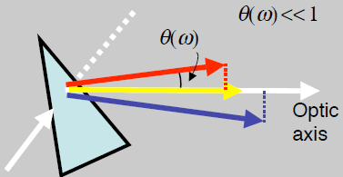
Pulse Dispersion
P
Refractive index depends on wavelength. Leads to group velocity dispersion. The different colors that make up the pulse separate because they travel at different velocities in the medium.
Positive dispersion
The effect is to broaden the pulse length.
Angular dispersion leads to negative group velocity delay type of dispersion .
Negative dispersion
So, in theory, you can recompress the pulse this way.
Problem, it is weakly negative.
Typical optical fiber introduces a lot of positive dispersion at 800 nm.
Down 5 feet of regular optical fiber, not enough negative.
Could use gratings, but gratings are very lossy.
DISTRIBUTION STATEMENT A – Unclassified, unlimited Distribution
Notes:
Outline

Slide 15
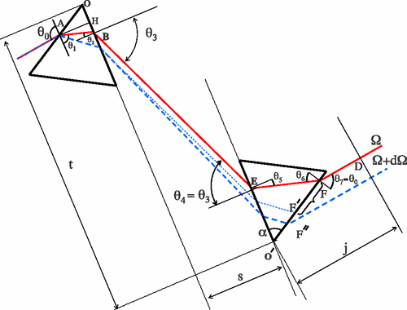
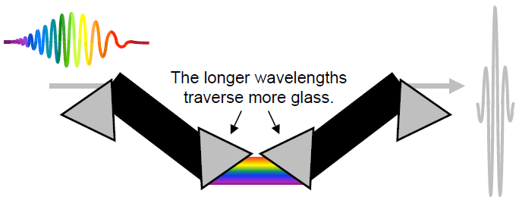
Recompressing the pulse 1
Typical silica fiber has positive GVD and negative group delay dispersion.
Problem. How to get rid of positive dispersion?
Use separated prisms.
Optical path length for red line (frequency Ω) is shorter then for blue line (frequency Ω+dΩ) . So negative dispersion.
Can use this method twice to compensate for dispersion already in pulse.
Problem. This method is difficult to align!
All prisms must have the same type of glass and the same amount of glass in the beam and their incidence angles must be identical.
DISTRIBUTION STATEMENT A – Unclassified, unlimited Distribution
Notes:
Outline

Slide 16
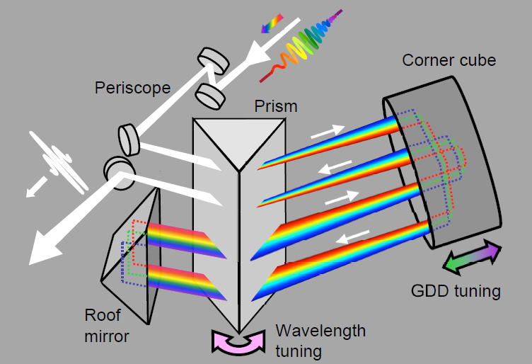
Recompressing the pulse
Better method due to Rick Trebino. What we are building.
In this setup, there is only one prism. By construction. The laser beam goes through the prims four times.
Since there is only one prism, by construction, the laser beam goes through the same amount of glass on each pass through.
∠ entry of 1st pass = ∠ exit of 4th pass
∠ exit of 1st pass = ∠ entry of 4th pass
∠ entry of 2nd pass = ∠ exit of 3rd pass
∠ exit of 2nd pass = ∠ entry of 3rd pass
DISTRIBUTION STATEMENT A – Unclassified, unlimited Distribution
Notes:
Outline

Slide 17
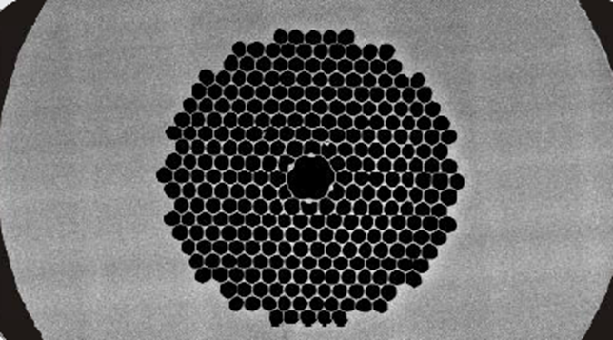
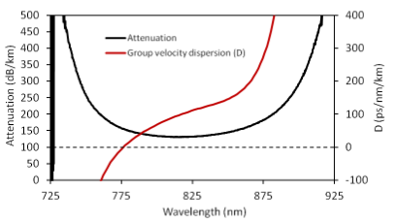

Recompressing the pulse 2
Typical optical fiber introduces a lot of positive dispersion at 800 nm. Typical silica fiber has positive GVD and negative group delay dispersion
$D_{λ}=−\frac{2πc}{λ}$GVD
One possible way around this problem is to use hollow core fiber.
This fiber can be designed for positive, negative, or zero dispersion for a given wavelength.
More design flexibility.
Added nice feature, extremely small bending radius.
Still have waveguide dispersion, but can have much less total dispersion then through regular fiber.
Or, can use negative GVD to cancel positive GVD of regular fiber.
DISTRIBUTION STATEMENT A – Unclassified, unlimited Distribution
Notes:
Outline

Slide 18
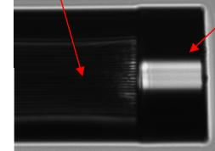
Recompressing the pulse
Pulse confined to air cavity at the center. Pulse propagates through air.
Since fiber is hollow, dirt and humidity enter, blocking fiber – need to cap fiber.
Problem, this will add positive GVD dispersion. Solution, Alphanov makes 20 micron thick caps.
Core of fiber
Laser light propagating through end cap.
End cap
Or, Alphanov can attach positive GVD multimode fiber to cancel negative GVD in hollow core fiber.
Lots of design possibilities.
DISTRIBUTION STATEMENT A – Unclassified, unlimited Distribution
Notes:
Outline

Slide 19
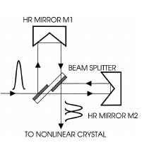
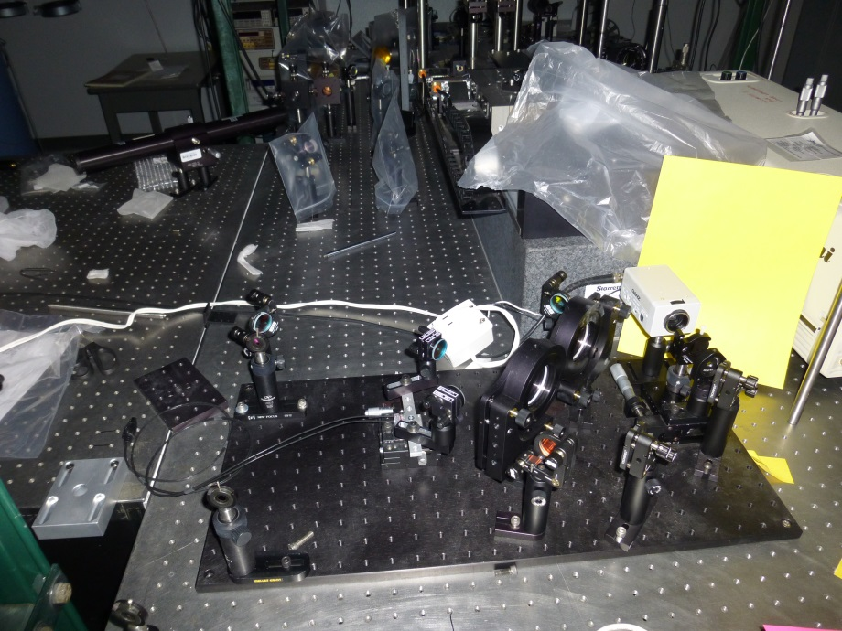
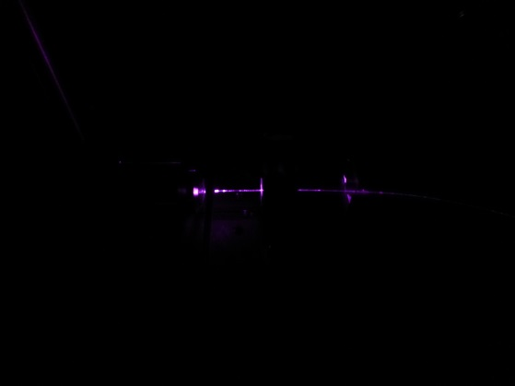
Measuring the pulse length
Home built balanced autocorrelator.
Problem. Not much output from hollow core fiber.
Extremely hard to measure pulse length with our setup.
Making improvements by using sensitive photodiodes instead of camera.
DISTRIBUTION STATEMENT A – Unclassified, unlimited Distribution
Notes:
Outline

Slide 20
Things To Do
Things to do.
Get working double quantum well stack and characterize it.
Get the dispersion correct on propagation through fiber
Send THz pulse into cryo-chamber
See if you can detect THz with the double well quantum stack.
DISTRIBUTION STATEMENT A – Unclassified, unlimited Distribution
Notes:
Outline

Slide 21
Let Us Meet Again
We welcome all to our future group conferences of Omics group international
Please visit:
www.omicsgroup.com
www.Conferenceseries.com
http://optics.conferenceseries.com/

