Slide 1

Laparoscopic bariatric surgery in Rural Australia: The Weight is Over
Presented by Dr May Tsai
MBBS, B Med Sci, PGCClinical Ultrasound, St Vincent’s Hospital Melbourne

Slide 2
Outline
Define obesity/Scope of health problem in Australia
Surgical treatment options
Pathophysiology
Objective
Methods
Results
Discussion
Conclusion
References

Slide 3

Definition of obesity
Notes:
Obesity is defined as abnormal or excessive fat accumulation that may impair health, and studies suggest that, without intervention, reversal of obesity is uncommon.
The most commonly used measure for classifying obesity is the body mass index (BMI), calculated as body weight in kilograms divided by height in metres squared (kg/m²). In adults a desirable BMI is between 18.5 to 25 and overweight is between 25 to 30. Obesity is defined as BMI over 30, while severe or morbid obesity is defined as BMI over 40. A BMI of 30 is equivalent to a weight of 97.5 kg in a person 1.8 m tall or a weight of 77 kg in a person 1.6 m tall. However, different populations have different associations between BMI, percentage of body fat, and health risks, and a desirable BMI is lower in some Asian populations (WHO 2004).

Slide 4
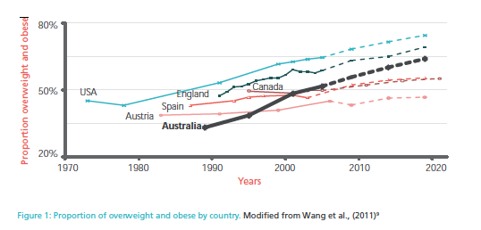
Australian statistics ^{[1]}

Slide 5

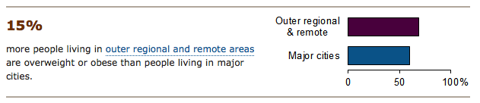

Australian statistics ^{[2]}
Notes:
Obesity is a global health problem and the prevalence of obesity is increasing in the Australian population.
The rates of overweight and obesity have increased dramatically in the last 30 years. The average Australian adult is now above a healthy weight. In the latest national survey, 63% of adults were above a healthy weight .
IN GENERAL, PEOPLE WHO LIVE OUTSIDE MAJOR CITIES ARE MORE LIKELY TO BE ABOVE A HEALTHY WEIGHT
Much of this difference is due to the higher concentration of people of a lower ses
Other possible explanations include more health risk behaviours (such as inadequate exercise and poor diet), more expensive fresh food (mainly in remote areas) and possibly less ready access to large supermarkets or grocery stores, which is associated with healthier eating. The 2010 Healthy
Food Access Basket Survey estimated the cost of a basket of healthy food in different parts
of Queensland reported a 26% higher cost in very remote areas compared with major cities.
bariatric surgery is increasingly used to address this issue. However, there is limited literature in the Australian rural context

Slide 6
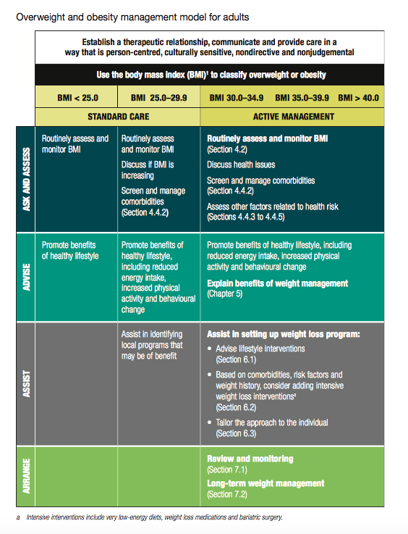
Current Australian Guidelines
ASK
ASSESS
ADVISE
ASSIST
ARRANGE
Key target in National Preventative Health Strategy ^{[3]}

Slide 7
Treatment options ^{[4]}
 | LIfestyle | Drug therapy | Surgical
Examples | Diet, exercise | Orlistat | LAGB, LSG
Weight loss | 5-10% | - 2.8kg compared to placebo | 12-39% of presurgical weight
Long term | 1/3 – 2/3 regain more weight | Regain weight when stopped | Improvement in obesity-related comorbidities Longer maintainence of weight loss
Notes:
Both lifestyle interventions and drug therapy usually result in modest weight loss of 5–10%: meta-analyses show a decrease of approximately 2.5 kg at 24 months for diet, exercise, and lifestyle5 and additional 2.8 kg compared with placebo for orlistat.6,7 A great challenge to obesity management is maintaining the weight loss. Over the long term, one-third to two-thirds of dieters subsequently regain more weight than they lost on their diets.8 While drug-treated patients are more likely to maintain weight losses, weight regain often occurs when medication is stopped.9
In contrast to these latter disappointing outcomes, bariatric surgery can be a very effective approach to weight loss. It is to date the most successful intervention for obesity. The weight loss range is 12% to 39% of presurgical body weight or 40–71% excess weight loss (EWL).10–12 Moreover, bariatric surgery results in long-term maintenance of weight loss, as well as improvement in all obesity-related comorbidities.13 In addition, bariatric surgery is the only approach to reversing type 2 diabetes mellitus, normalizing blood glucose even without significant weight loss.14
Bariatric Surgery: A Review of Procedures and Outcomes Katherine A. Elder, Bruce M. Wolfe
The increase in bariatric surgery procedures is due to numerous factors. First, the escalating rate of obesity has led to more individuals seeking treatment. The accumulating evidence identifying obesity-related mortality and comorbidities is a second factor that has led to increased numbers of patients seeking treatment through bariatric surgery. A third factor that has led to increased utilization of bariatric surgery for treatment of obesity is the lack of long-term effectiveness among nonsurgical treatments. Although behavioral and pharmacologic treatments of obesity can result in short-term weight loss of approximately 5%–10% body weight (with some of the most successful studies reporting weight loss as high as 18.8% at 12 months27), they have not been able to produce more than a modest weight loss for most patients, nor have these treatments demonstrated longer-term success.

Slide 8


Complications of Obesity ^{[1]}

Slide 9
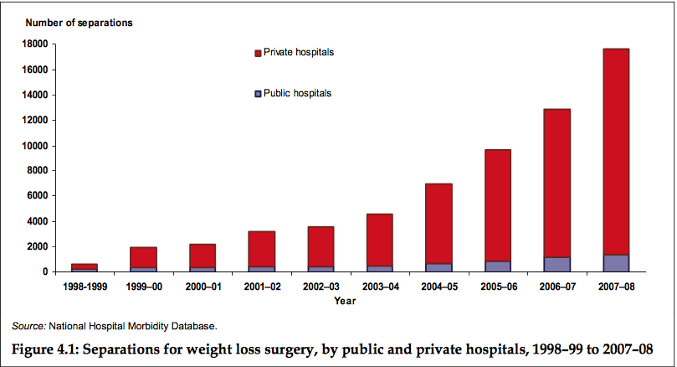
Bariatric surgery in Australia ^{[5]}

Slide 10
Surgical Treatment Options
3 main types - restrictive, malabsorptive, combined (restrictive and malabsorptive)
Restrictive
      Vertical banded gastroplasty -no longer routinely performed
      Laparoscopic adjustable gastric banding (LAGB)
      Laparoscopic sleeve gastrectomy (LSG)
Malabsorptive
      Jejunoileal bypass - no longer recommended
Combined (restrictive and malabsorptive)
      Biliopancreatic diversion with or without duodenal switch
      Roux-en-Y gastric bypass (RYGB)

Slide 11
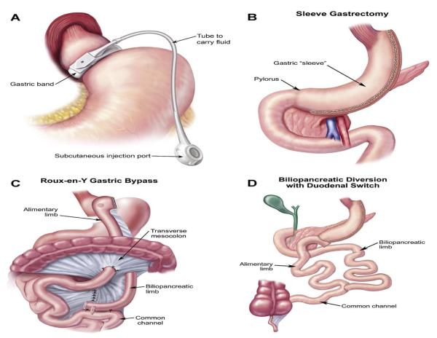
Surgical techniques ^{[6]}

Slide 12
Surgical techniques
3 main types - restrictive, malabsorptive, combined (restrictive and malabsorptive)
Restrictive
      Vertical banded gastroplasty -no longer routinely performed
      Laparoscopic adjustable gastric banding (LAGB)
      Laparoscopic sleeve gastrectomy (LSG)
Malabsorptive
      Jejunoileal bypass - no longer recommended
Combined (restrictive and malabsorptive)
      Biliopancreatic diversion with or without duodenal switch
      Roux-en-Y gastric bypass (RYGB)

Slide 13
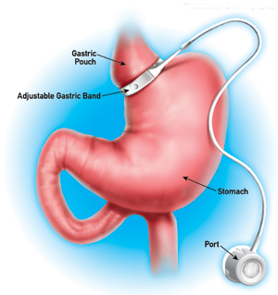
Surgical techniques
- Laparoscopic Adjustable Gastric Banding (LAGB)
2008-2010 most commonly performed bariatric procedure worldwide ^{[7]}
Restrictive
Directly impacts on
  Speed of eating
  Hunger
[8]

Slide 14
Laparoscopic Adjustable Gastric Banding
Advantages | Disadvantages
Minimally invasive | High reoperation rates secondary to complications
Fully reversible | Band Slippage/pouch dilatation Dysphagia with megaoesophagus
Adjustable procedure | Infection – band/port
Short hospital stay | Erosion
Low mortality rate | Failure to lose weight
[9]

Slide 15
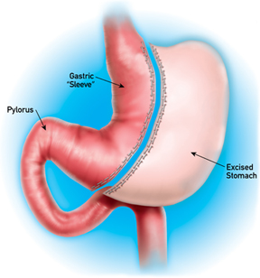
Surgical techniques
- Laparoscopic Sleeve Gastrectomy (LSG)
Increasing popularity over last 5 years. First used in staged approach for the super obese ^{[7]}
Restrictive – resecting greater curvature of the stomach
Directly impacts on
  Speed of eating
  Hunger
  Volume of food that can be eaten
  Endocrine changes
[8]

Slide 16
Laparoscopic Sleeve Gastrectomy
Advantages | Disadvantages
Technical efficiency | Irreversibility
Maintenance of physiological food passage - No dumping syndrome | GERD
No implantation of artificial device | Long term follow up limited
Excess weight loss 66% at 3 years
Low mortality rate
Low complication rate
Low re-intervention rate
Preservation of the pylorus
[9]
Notes:
Avoidance of foreign material
Maintenace of physiological food passage

Slide 17
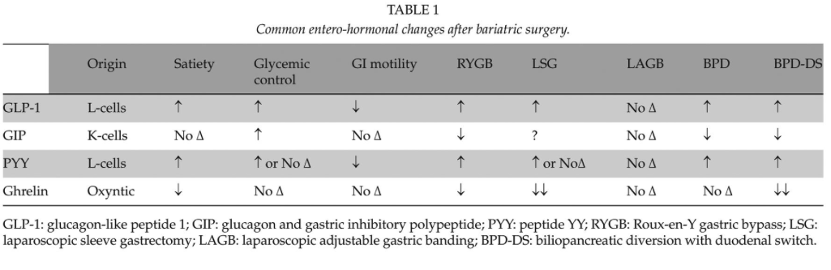
Pathophysiology
Metabolic and entero-hormonal changes post procedure ^{[7]}
Theories on different changes continue to evolve
[7]
Notes:
Obesity is an Endocrine disease
Even though both are restritctive procedures as a consequence of resection of the gastric fundus, the predominant area of human ghrelin production, ghrelin is significantly reduced after LSG but not after LAGB. This reduction remains stable at follow-up 6 months postoperatively, which may contribute to the superior weight loss when compared with LAGB.
ublished online before print September 30, 2014, doi: 10.1177/1457496914552344
Scandinavian Journal of Surgery March 2015 vol. 104 no. 1 18-23
Mechanisms Responsible for Excess Weight Loss after Bariatric Surgery
Bariatric Surgery: A Review of Procedures and Outcomes Katherine A. Elder, Bruce M. Wolfe

Slide 18
Laparoscopic Sleeve Gastrectomy Versus Laparoscopic Adjustable Gastric Banding – Perspective from Rural Australia
Y. M. Tsai¹, H. M. Tsai², J. Muir³, S. Clifforth⁴, W. Ooi⁵
¹ MBBS, St Vincent’s Hospital Melbourne
² BHlthSc MDent, Monash University
³ Director of Anaesthetics, Western District Health Service
⁴ FRACS, Hamilton Base Hospital
⁵ MBBS, Dept of General Surgery Austin Health

Slide 19


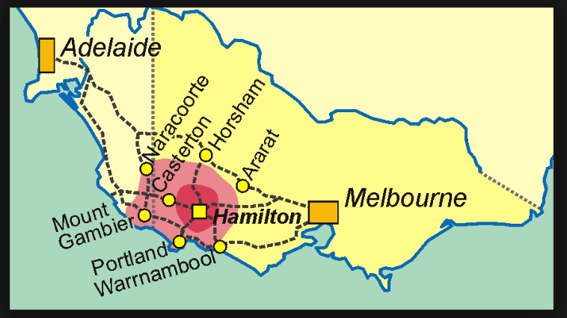
Where is Hamilton?

Slide 20
Objectives
Retrospective study from prospectively data collected on Lapbase
Compare outcomes of laparoscopic sleeve gastrectomy (LSG) and laparoscopic adjustable gastric banding (LAGB) performed by single surgeon in rural Australia.
Notes:
Our objective was to compare outcomes of laparoscopic sleeve gastrectomy (LSG) and laparoscopic adjustable gastric banding (LAGB) performed in rural Australia.

Slide 21
Methods
  Review of data 2007-2014 who underwent bariatric surgery by single surgeon at Hamilton Base Hospital was obtained.
  Pre-op weight, mean weight loss and complication rates were analysed. Statistical significance (p < 0.05)
  Local ethics guidelines were followed in the conduct of the review.
Notes:
Retrospective review of consecutive patients who underwent LAGB and LSG by a single surgeon at a rural hospital in Victoria, Australia were obtained from bariatric database. The main outcomes measured were major complications and weight loss over time, expressed as percentage of excess body weight loss (%EWL) and Body Mass Index loss (BML kg/m²).

Slide 22
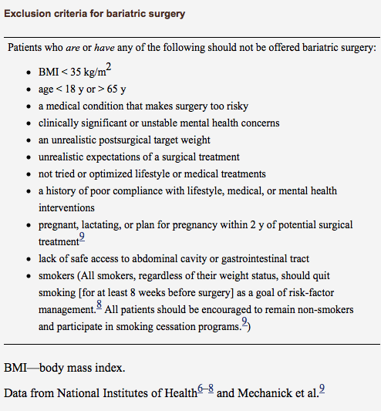
Selection criteria

Slide 23
Methods
  Exclusion criteria – previous bariatric surgery
  Outcomes measured – Weight loss expressed percentage of excess body weight loss (%EWL)
  Secondary outcomes – complication rates, length of stay

Slide 24
Perioperative management
Pre-operative review by surgeon, dietician, psychologist, anaesthetist and/or physician.
Follow up post op – surgeon and dietician. Dietician lead group discussion focusing on the dietary aspects of weight loss pre and post-op. Both groups received multivitamin tablet.
Deep vein thrombosis (DVT) prophylaxis 40 mg of enoxaparin sodium throughout inpatient stay, intermittent calf compression combined with TED stockings intra-op
Postop – HDU, early aggressive physiotherapy.
Pain relief – intercostal blocks (ropivacaine) intra-op, Patient controlled analgesia, regular panadol and endone PRN.

Slide 25
Results
2007 – 2012 101 (41.9%) patients underwent LAGB
2011 – 2014 140 (58.1%) patients underwent LSG
Notes:
140(58.1%) and 101 patients (41.9%) underwent LSG and LAGB respectively. No mortality was recorded.
LSG group had a higher pre-operative BMI (45.05 ±6.84kg/m²) compared to LAGB group being 43.15±6.73kg/m² (p<0.05).
2 (0.14%) returned to theatre for staple line leak. Total of 3 (2.1%) patients required post-op transfusion. Estimated mean intra-operative blood loss was 600mL.

Slide 26
Pre-op characteristics
Parameter | LAGB | LSG | P value
Number of patients | 101 | 140
Male, n (%) | 21 (21) | 24 (17) | NS
Age at surgery, mean ± SD | 50.6 ± 12.1 | 43.4 ±11.3 | P<0.001
Initial BMI, mean ± SD (range) [kg/m²] | 43.1 ±6.7 | 45.1± 6.8 | 0.03
Initial weight, mean ± SD (range) [kg] | 118.6 ± 22.0 | 125.2 ±23.0 | 0.028
Notes:
Initial BMI significantly higher – perhaps also reflect the trend of increasing obesity

Slide 27
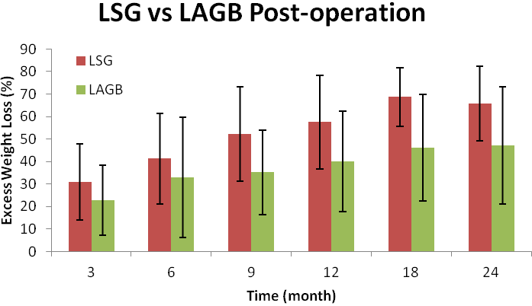
Average % EWL at follow up
*
*
*
*
*
* P<0.001
Notes:
In general we can say that LSG was more beneficial in the short term perspective of 1 year after surgery. Patients who underwent this procedure had significantly greater % excess weight loss at 6 and 12 months after surgery than the patients in the LAGB group. Even though this effect was still pres- ent at 24 months, the difference was not statistical- ly significant. We can say that based on our results, laparoscopic sleeve gastrectomy is more beneficial than laparoscopic adjustable gastric banding in the perspective of 2 years after the surgery under the condition that the patient is willing to accept the ir- reversibility of the procedure.

Slide 28
% EWL post operation
Time (months postop) | %EWL (SD) LAGB | %EWL (SD) LSG | P-value
3 | 22.8 (15.4) | 30.9 (16.9) | <0.001
6 | 32.9 (26.7) | 41.3 (20.1) | 0.001
9 | 35.19 (18.7) | 52.3 (21.0) | <0.001
12 | 40.0 (22.3) | 57.49 (20.9) | <0.001
18 | 46.2 (23.8) | 68.7 (13.0) | 0.003
24 | 47.2 (26.1) | 65.7 (16.5) | 0.172

Slide 29
Complication rates - LAGB
Complications | Number (%) N=101
Readjustment of band | 1 (1%)
Post-op Bleeding requiring PRBC transfusion | 1 (1%)
Pulmonary embolus | 1 (1%)
Death | 0
Average LOS (days) | 1.57
Notes:
Three patients (2%) returned to theatre due to staple line leak post LSG. Only 1(1%) patient in the LABG required return to theatre for readjustment of band. Post op blood transfusion rates were 2%(3patients) and 1%(1patient) in the LSG and LABG group respectively. 7 other patients (5%) undergoing LSG encountered post op complications (6patients atelectasis, 1patient atrial fibrillation) compared to 1 patient in LABG group with pulmonary embolus.
Overall complication rates in our series also compare favourably and importantly no complication had led to any mortality.
The singleleak (0.2%) that we experienced presented as a non-communicating abscess adjacent to the proximal staple line. The majority of reported leaks from the staple line occur proximally. It is unclear whether this is a pressure, technical or ischaemic phenomenon. Signiﬁcant controversy exists as to the best method of leak prevention. Musella et al.
16
have shown that over sewing the staple line itself does not
reduce staple line leaks but increases stenosis of the sleeve, whereas
Ser et al. have demonstrated a signiﬁcantly reduced leak rate (10%
versus 0%) when the staple line was reinforced

Slide 30
Complication rates - LSG
Complications | Number (%) N=140
Return to theatre - Staple line leak | 3 (2.1%)
Post-op Bleeding requiring PRBC transfusion | 3 (2.1%)
Post-op Atelectasis | 6 (4.2%)
Atrial fibrillation | 1 (0.7%)
Death | 0
Average LOS (days) | 2.2
Notes:
Three patients (2%) returned to theatre due to staple line leak post LSG. Only 1(1%) patient in the LABG required return to theatre for readjustment of band. Post op blood transfusion rates were 2%(3patients) and 1%(1patient) in the LSG and LABG group respectively. 7 other patients (5%) undergoing LSG encountered post op complications (6patients atelectasis, 1patient atrial fibrillation) compared to 1 patient in LABG group with pulmonary embolus.

Slide 31
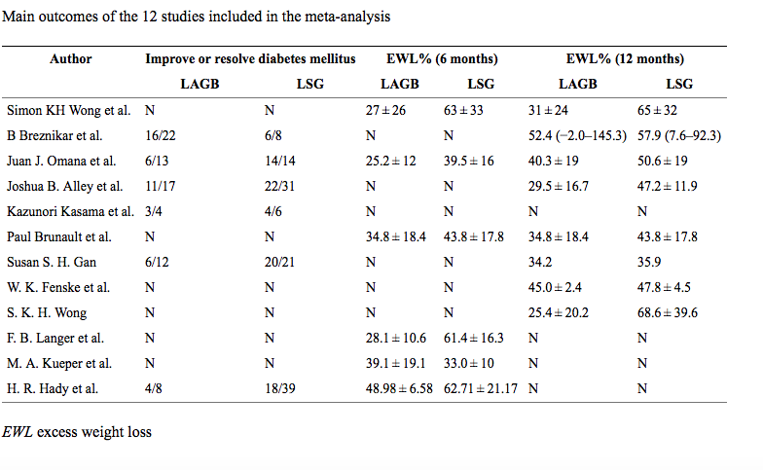
DISCUSSION
Wang et al (2013) ^{[10]}
  Meta-analysis of 12 studies involving 1004 patients
  Did not include complication rates
Mean % EWL (%) | 33.9 | 50.6 | 37.8 | 51.8
Notes:
inclusion criteria were as follows: (1) studies including randomized controlled trials and non-randomized studies that compared LAGB with LSG, (2) studies that provided information on at least one of the outcome measures, and (3) studies published in English. When a study reporting the same patient cohort was included in several publications, only the most recent or complete study was selected. The exclusion criteria were as follows: (1) case reports, (2) articles that were not full text or non-comparative studies, and (3) open operations, not by laparoscopic surgery.
%EWL for LAGB was 33.9 % after 6 months in six studies and 37.8 % after 12 months in four studies; for LSG, EWL was 50.6 % after 6 months and 51.8 % after 12 months in the same studies.
Obes Surg. 2013 Jul; 23(7): 980–986.
Published online 2013 Apr 20. doi: 10.1007/s11695-013-0893-3
PMCID: PMC3671102
Comparison Between Laparoscopic Sleeve Gastrectomy and Laparoscopic Adjustable Gastric Banding for Morbid Obesity: a Meta-analysis
Sen Wang, Ping Li, Xiao Fang Sun, Nian Yuan Ye, Ze Kuan Xu, and Daorong Wang

Slide 32
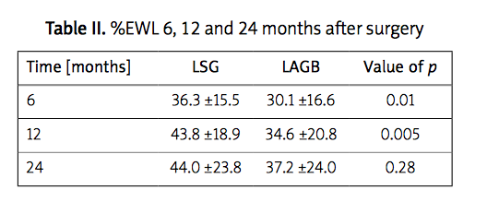
Lehmann et al.^{[11]}
Retrospective analysis of %EWL between LSG and LAGB
N=202 (LAGB 130, LSG 72)
Initial BMI 44.1±5.3 vs 45.2±5.4 kg/m²
Notes:
Comparison of percentage excess weight loss after laparoscopic sleeve gastrectomy and laparoscopic adjustable gastric banding study conducted in Europe (Poland)
On the other hand, the LSG procedure provides a more rapid excess weight loss, mainly in the initial 12 months, with a grad- ual extension of the gastric sleeve afterwards and the possibility to facilitate greater amounts of food, thus decreasing the potential to eliminate the ex- cess weight loss. At the same time it deregulates the hormonal axis responsible for the hunger-satiety sensation, causing a decrease in hunger and thus reducing the amounts of ingested food

Slide 33
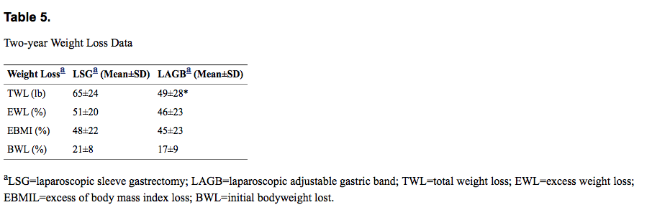
Varela ^{[12]}
Clinical trial; Prospective analysis of %EWL between LSG and LAGB (n=40, LAGB 20, LSG 20)
Initial BMI 45±5 vs 43±5 kg/m²
Hospital length of stay for LSG 2.4±0.9 vs LAGB 1.2±0.4
Overall morbidity LSG 20 % vs LAGB 10 % (included minor comorbidity eg Nausea/vomiting)
Notes:
Laparoscopic Sleeve Gastrectomy Versus Laparoscopic Adjustable Gastric Banding for the Treatment Severe Obesity in High Risk Patients
J. Esteban Varela, MD
Our data support findings of prospective randomized clinical trials by Himpens et al14 comparing gastric banding and sleeve gastrectomy, where weight loss was superior for the sleeve group however with a higher number of complications. Sleeve gastrectomy has also been shown to provide more than 50% of excess weight loss at 6 years.15 In our study, the total weight loss was greater after sleeve gastrectomy at 2 years. In addition, there was a general trend that favored laparoscopic sleeve gastrectomy in other weight loss parameters. No significant weight loss differences between the first and second year was observed. This may be likely to an increase in follow-up visit intervals during the second year. The majority of weight loss occurred within the first year and stabilized at year 2 with no additional weight loss. The weight loss of the sleeve gastrectomy and gastric banding groups are similar to those reported in other studies. These data suggest that close follow-up may also be essential for sleeve gastrectomy patients, to prevent weight regain or weight loss failure.
Although, laparoscopic gastric banding and sleeve gastrectomy are both considered restrictive operations, surgical techniques, postoperative care, and weight loss mechanistic pathways vary widely. In addition, sleeve gastrectomy is perceived as a more invasive procedure because at least two-thirds of the stomach is removed. Gastric banding produces adjustable restriction to food and appetite reduction by unclear mechanisms, while sleeve gastrectomy induces weight loss by ghrelin elimination, rapid gastric emptying, and other unknown hormonal mediated mechanisms with almost complete appetite suppression.11

Slide 34
Flint R.^{[13]}
Non-randomised, observational study comparing patients undergoing either LAGB or LSG by a single surgeon.
N=228 (LAGB 94, LSG 134)
Initial BMI 42.2±7.1 vs 50.2±9.0 kg/m²
Mean % EWL at 2 year 46.1±27.8% vs 72.1% ±20.9%
  Complication: Reoperation rate was significantly greater for LAGB than LSG (p<0.0001).
  LABG Group – gastric prolapse 19 patients (20%)
  LSG Group – 4 patients (3%) ; 1 for leakage, 2 for bleeding, 1 for check laparascopy, 2 patients (1%) gastroscopy for sleeve spasm
Notes:
New Zealand study
Similar study
94 patients, mean age 45.1 plus or minus 11.9 years, mean BMI 42.2 plus or minus 7.1 kg/m2) or a LSG (134 patients, mean age 44.8 plus or minus 9.11 years, mean BMI 50.2 plus or minus 9.0 kg/m2)
19 patients (20%) that required 29 reoperations following LAGB, most commonly for gastric prolapse (mean 22.8 plus or minus 13.8 months postop). In contrast, there were 4 patients (3%) that required reoperation following LSG (2 haemorrhage, 1 staple-line leak and 1 check laparoscopy) and 2 patients (1%) that required gastroscopy for sleeve spasm. Reoperation rate was significantly greater for LAGB than LSG (p<0.0001).

Slide 35
Strengths
Single surgeon, same bariatric team
Large cohort
First rural Australia cohort described
Notes:
The strengths of our study are that a single surgeon performed all the operations, always using the pars flaccida technique, and that a high rate of patient participation even at the 3-year follow-up visit was achieved, minimizing the potential bias. The 1-, 2-, and 3-year follow-up visits were attended by and of our patients, respectively.
Even though it was a retrospective analysis per- formed on relatively small groups, the populations were almost homogeneous in terms of initial BMI, age and gender distribution, like in case-matched studies. All patients were operated on by a small bariatric team. Therefore, these differences can be attributed to the type of operation and not selection bias.

Slide 36
Limitations
Retrospective data, not randomized
    Insufficient to provide long term (> 2years) weight loss comparisons
Database from public hospital may not be representative of private clinic
Comparison of resolution of comorbidity and improvement in quality of life not measured eg. BAROS analysis ^{[14]}
Notes:
Limitations of our study primarily relate to its retrospective nature
Exemplifying this is that we have not controlled the study during changes in technique thereby preventing direct comparison.
However, the large numbers and consistency of a single surgeon practice do make the results signiﬁcant.
First, this trial was not randomized. It proved difficult to randomize subjects to 2 very dissimilar surgical procedures at a medium volume bariatric program. Second, we analyzed short-term outcomes only, and follow-up was insufficient to provide long-term (> 2 years) weight loss comparisons. Lastly, the study did not provide enough power to allow comparisons of resolution of comorbidities.
Bariatric analysis and reporting outcome system - BAROS analyzes weight loss in an objective fashion, avoiding the use of this single criterion to define success or failure. Percentage of excess weight lost over time was selected because it is widely used in the literature and is accurate in the morbidly obese.
Despite the limitations of this study, the results may explain why LSG has gained preference over LAGB in recent years.

Slide 37
Conclusion
Dedicated unit can produce excellent results
LSG is more effective than LABG in achieving weight loss.
Multidisciplinary Team approach
Notes:
With a Dedicated unit, Bariatric surgery can be performed safely in rural Australia with comparable results to international standards.
Both methods show an acceptable percentage of excess weight loss with acceptable complication rates. During the first 2 years after surgery, the best results were obtained in women with lower BMI un- dergoing LSG surgery. Laparoscopic sleeve gastrecto- my provides greater %EWL after a shorter period of time, though the difference decreases in time.
LSG is more effective than LABG in achieving weight loss.
LSG can produce excellent results, with careful MDT assessment, specialist - surgical and anaesthetics, ICU back up and perioperative medical team support
Including surgeons, dietitians, nurses, psychologists and physicians) and includes planning for continuing follow-up
However, in order to prove the superiority of one method over another, further and more detailed studies need to be conducted.

Slide 38
Future Directions
Implication for research
  Stratification of weight loss according to obesity classification
  Operational impact vs Health care cost
  Mechanism of action of laparoscopic sleeve gastrectomy on metabolism
  Head -to-head randomised controlled trial (LSG vs LAGB vs LRYGB) with sufficiently long follow-up
Implication for practice
  Case selection
  Data collection

Slide 39

Thankyou

Slide 40
References
1. Obesity Australia - Obesity Australia: No time to weight Report. 2014 [cited 2015 7th November]; Available from: http://www.obesityaustralia.org/_literature.../No_Time_To_Weight_Report 18-19.
2. Australian Institute Health Welfare Overweight and obesity. 2015 [cited 2015 7th November]; Available from: http://www.aihw.gov.au/overweight-and-obesity/.
3. Australia Government Department of Health Clinical Practice Guidelines for the Management of Overweight and Obesity in Adults, Adolescents and Children in Australia. 2013 [cited 2015 7th November].
Elder, K.A. and B.M. Wolfe, Bariatric surgery: a review of procedures and outcomes. Gastroenterology, 2007. 132(6): p. 2253-71.
5. Welfare, A.I.H. Weight loss surgery in Australia. 2015 [cited 2015 7th November]; Available from: http://www.aihw.gov.au/publication-detail/?id=6442472385.
6. Lim, L.T.C.R.B., G.L. Blackburn, and D.B. Jones, Benchmarking Best Practices in Weight Loss Surgery. Current problems in surgery, 2010. 47(2): p. 79-174.

Slide 41
References
7. Lo Menzo, E., S. Szomstein, and R.J. Rosenthal, Changing trends in bariatric surgery. Scand J Surg, 2015. 104(1): p. 18-23.
8. Center, T.B., Adjustable Gastric band. http://www.stdavidsweightloss.com/our-procedures/gastric-band.aspx.
9. Silecchia, G., et al., Reoperation after laparoscopic adjustable gastric banding: analysis of a cohort of 500 patients with long-term follow-up. Surg Obes Relat Dis, 2008. 4(3): p. 430-6.
10. Wang, S., et al., Comparison Between Laparoscopic Sleeve Gastrectomy and Laparoscopic Adjustable Gastric Banding for Morbid Obesity: a Meta-analysis. Obesity Surgery, 2013. 23(7): p. 980-986.
11. Lehmann, A., et al., Comparison of percentage excess weight loss after laparoscopic sleeve gastrectomy and laparoscopic adjustable gastric banding. Videosurgery and other Miniinvasive Techniques, 2014. 9(3): p. 351-356.
12. Varela, J.E., Laparoscopic Sleeve Gastrectomy Versus Laparoscopic Adjustable Gastric Banding for the Treatment Severe Obesity in High Risk Patients. JSLS : Journal of the Society of Laparoendoscopic Surgeons, 2011. 15(4): p. 486-491.

Slide 42
References
13. Flint, R., A comparison of laparoscopic adjustable gastric band and laparoscopic sleeve gastrectomy: a single surgeon's experience. N Z Med J, 2015. 128(1408): p. 56-61.
14. Oria, H. and M. Moorehead, Bariatric Analysis and Reporting Outcome System (BAROS). Obesity Surgery, 1998. 8(5): p. 487-499.

Slide 43
Techniques - LSG
5 - port approach.
The gastrocolic ligament was divided with bipolar cautery
The greater curvature of the stomach and the fundus were mobilized.
36-French blunt Bougie was placed transorally and advanced to the pylorus.
Multiple applications through a 15mm port of a 60-mm Covidien Tri Staple black and purple loads and staple-line reinforcement which extended approximately 3cm from the pylorus toward the angle of His → gastric tube with approximately 40cc to 50cc of volume.
The stomach specimen was extracted through the right lower 15mm port.
Notes:
Laparoscopic Sleeve Gastrectomy
Laparoscopic sleeve gastrectomy was performed by a
4 or 5port approach. The gastrocolic ligament was divided
with bipolar cautery (LigaSure Vessel Sealing System, Valleylab,
Boulder, CO). The greater curvature of the stomach
and the fundus were mobilized. A 36-French blunt
bougie was placed transorally and advanced to the pylorus.
The sleeve gastrectomy was created by multiple applications through a 15mm port
of a 60-mm Covidien Tri Staple black and purple loads and staple-line reinforcement
(Seamguard, Bioabsorbable Staple Line Reinforcement,
W.L Gore and Associate Inc. Flagstaff, AZ), which extended
approximately 3cm from the pylorus toward
the angle of His, creating a gastric tube with approximately
40cc to 50cc of volume. The stomach
specimen was extracted through the right lower 15mm port.
Laparoscopic Adjustable Gastric Banding
Laparoscopic adjustable gastric banding was performed
with 4 abdominal ports. A retro-gastric window was created
bluntly by the standard “pars flaccida” technique. A HAGA heliogast band
was primed on the back table with approximately
3mL of saline solution and inserted into the abdomen,
placed below the gastroesophageal junction and buckled in place.
Three anterior nonabsorbable interrupted gastrogastric
stitches were placed to secure the band in place.
The band tubing was exited and connected to the EV3 port which was placed subcutaneously.

Slide 44
Techniques - LAGB
4 abdominal ports. A retro-gastric window was created bluntly by the standard “pars flaccida” technique.
A HAGA heliogast band was primed on the back table with approximately 3mL of saline solution
Inserted into the abdomen, placed below the gastroesophageal junction and buckled in place.
Three anterior nonabsorbable interrupted gastrogastric stitches were placed to secure the band in place.
The band tubing was exited and connected to the EV3 port which was placed subcutaneously.

Slide 45
Time (months postop) | %EWL (SD) LAGB | %EWL (SD) LSG | Number of pt/ total in LAGB (%) | Number of pt in LSG (%)
3 | 22.8 (15.4) | 30.9 (16.9) | 97/101 | 140/140
6 | 32.9 (26.7) | 41.3 (20.1) | 94/101 | 55/140
9 | 35.19 (18.7) | 52.3 (21.0) | 77/101 | 25/140
12 | 40.0 (22.3) | 57.49 (20.9) | 80/101 | 28/140
18 | 46.2 (23.8) | 68.7 (13.0) | 67/101 | 11/140
24 | 47.2 (26.1) | 65.7 (16.5) | 55/101 | 4/140

Slide 46
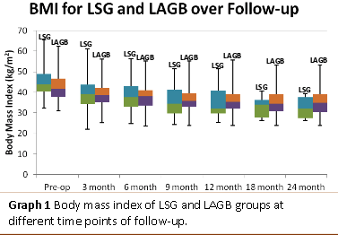
Average BMI over 24 months follow up

Slide 47
Discussion
American Society for Metabolic and Bariatric Surgery (2012)
  Position statement
  Weight loss: 55% excess weight loss at 3 years follow-up
  Complication: leakage (2.2%), bleeding (1.2%), stricture (0.63%)
  Mortality: 0.19%
Shi, Karmali, Sharma & Birch (2010)
  Systematic review
  Weight loss: 59.8% excess weight loss at 1 years follow-up
  64.7% excess weight loss at 2 years follow-up
  66.0% excess weight loss at 3 years follow-up
  Complication: leakage (1.17%), haemorrhage (3.57%)
  Mortality: 0.3%
Notes:
The main differences are the reversibility, the need for adjustments, the type of complications and the magnitude of their outcomes. The main advantage of LAGB surgery is that it is reversible and the band can be removed at any time. It can also be adjusted by injecting more fluid into the port to tighten it, thus providing more restriction if needed. The LSG procedure provides good restriction, and by eliminating the greater cur- vature and therefore the majority of ghrelin-produc- ing cells, it has an influence on the hunger-satiety axis, though one that is irreversible.
Short-term outcomes of both procedures were previously documented by other authors who deemed a loss of more than 50% of excess weight a success and loss of less than 25% a failure
http://onlinelibrary.wiley.com/doi/10.1002/14651858.CD003641.pub4/full
Comparisons of different surgical procedures: laparoscopic adjustable gastric banding versus laparoscopic isolated sleeve gastrectomy
One RCT (Himpens 2006) with an uncertain risk of bias across all domains compared laparoscopic adjustable gastric banding with laparoscopic isolated sleeve gastrectomy.
Primary outcomes
Measures of weight change, fat content or fat distribution
Himpens 2006 reported that the reduction in BMI was statistically significantly greater in participants in the laparoscopic isolated sleeve gastrectomy group than the laparoscopic adjustable gastric banding group three years after surgery (27.5 versus 18, P < 0.0004, Analysis 6.1). Weight loss (three years: 29.5 kg versus 17 kg, P < 0.0001, Analysis 6.2) and the proportion of excess weight loss at one year (57.7% versus 41.4%, P = 0.0004) and three years after surgery (66% versus 48%, P = 0.0025) ( Analysis 6.3) were also statistically significantly improved in laparoscopic isolated sleeve gastrectomy participants in comparison to the laparoscopic adjustable gastric banding participants. All of these data were presented by the trial authors as medians and ranges, so care should be taken when interpreting the results. The quality of the evidence was very low.
Health-related quality of life
Quality of life was not assessed by Himpens 2006.
Obesity-related comorbidities
At baseline, gastro-oesophageal reflux disease requiring drug therapy with proton pump inhibitors was a problem for 15% (6/40) of the laparoscopic adjustable gastric banding participants and 20% (8/40) of the participants in the laparoscopic isolated sleeve gastrectomy group. After one year, gastro-oesophageal reflux disease had resolved in 83% and 75% of these participants in the two groups respectively, and this remained the same at three years (statistical significance was not reported) ( Analysis 6.4). In those without gastro-oesophageal reflux disease at baseline, no statistically significant differences in rates of appearance of gastro-oesophageal reflux disease between the intervention groups were observed at one year (laparoscopic adjustable gastric banding 3/34 (8.8%), versus laparoscopic isolated sleeve gastrectomy 7/32 (21.8%), P = not significant (ns)) or three years [(laparoscopic adjustable gastric banding 7/34 (20.5%) versus laparoscopic isolated sleeve gastrectomy 1/32 (3.1%), P = ns).
Secondary outcomes
Adverse events, mortality and revision rates
No early postoperative complications were seen in the laparoscopic adjustable gastric banding group of the Himpens 2006 RCT. Two participants in the laparoscopic isolated sleeve gastrectomy group (5%) had an early post operative complication; both required revisional surgery and in one this was a total gastrectomy due to gastric ischaemia (Appendix 9). Late complications requiring surgery were observed in the laparoscopic adjustable gastric banding participants, with three pouch dilations (treated with band removal in two and conversion to Roux-en-Y gastric bypass in one); one gastric erosion (treated with Roux-en-Y gastric bypass) and three disconnections of the port (treated with reconnection). There were no late complications requiring surgery in the laparoscopic isolated sleeve gastrectomy group. Complications not requiring surgery that were observed at one and three years can be seen in Appendix 10. There appeared to be higher frequencies of complications in the laparoscopic adjustable gastric banding group than in the laparoscopic isolated sleeve gastrectomy group but this is based on observation of the data only, as no statistical analysis was undertaken.
In addition, two participants in each group had ‘insufficient weight loss’ noted as a complication in the Himpens 2006 study. The two participants in the laparoscopic adjustable gastric banding group were converted to Roux-en-Y gastric bypass and the two participants in the laparoscopic isolated sleeve gastrectomy group were converted to laparoscopic duodenal switch.

