Slide 1
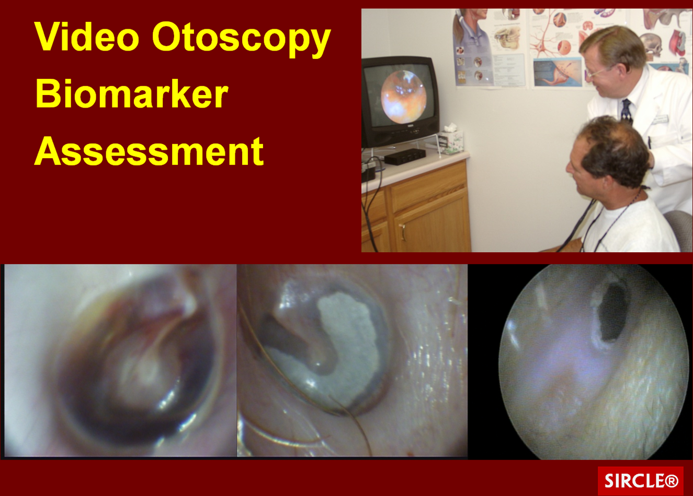
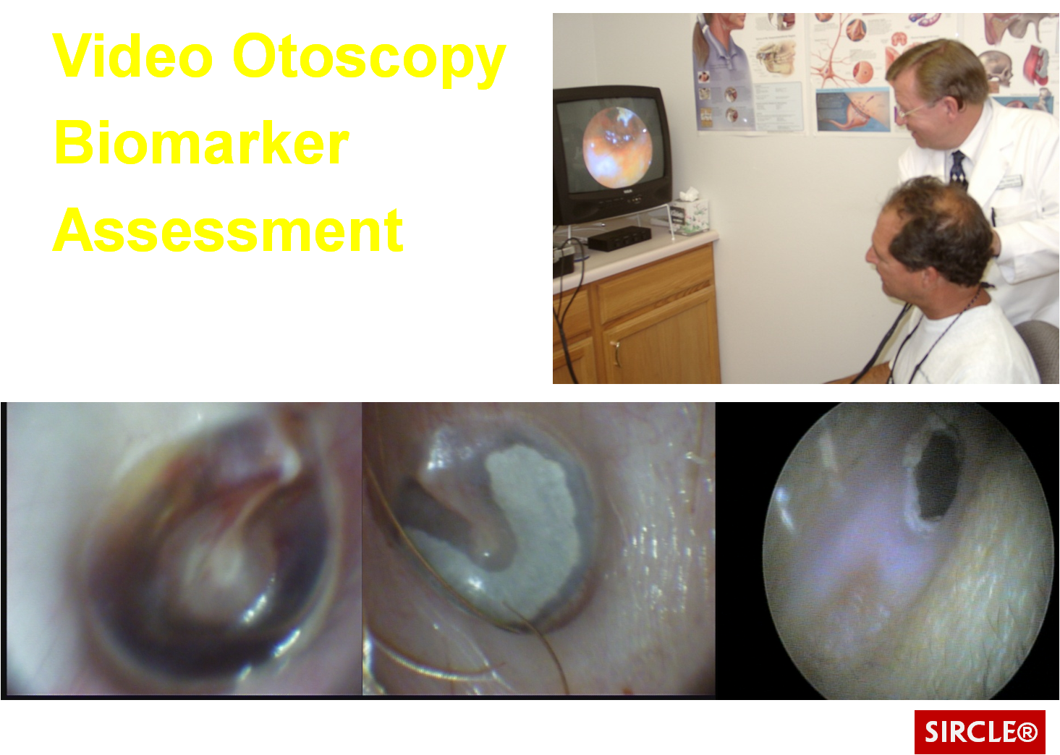
VIDEO OTOSCOPY
Neurophysiology & Hearing Aid Adaptation
Max Stanley Chartrand, Ph.D.
(Behavioral Medicine)
©2015 DigiCare® Behavioral Research

Slide 2

Taken from an actual court transcription…
Attorney: Doctor, before you did the autopsy, did you check for a pulse?
Witness: No.
Attorney: Did you check for blood pressure? Breathing?
Witness: No, no.
Attorney: So, then it is possible he was alive when you began the autopsy?
Witness: No.
Attorney: How can you be so sure, Doctor?
Witness: Because his brain was sitting on my desk in a jar.
Attorney: I see, but could have he still been alive, nevertheless?
Witness: Yes, I suppose he could have been alive…and practicing law.

Slide 3
Presenting Problem
There is a crucial need for clinicians, dispensers, and manufacturers to better understand the neurophysiological dynamics of the EAC and their interaction with hearing aid adaptation, especially in terms of:
-Absent or abnormal EAC keratin
-Neuroreflexes and mechanoreceptor hearing aid fitting artifacts
This lack of understanding has contributed to cases of failure to fit:
-Chronically high rates of returns-for-credit (RFCs) <20% in retail dispensing & mfg
-Chronically high rates of unnecessary factory remakes and repairs
-Repeated in-office shell modifications
These largely avoidable stressors have significantly hampered the industry’s ability to motivate and serve an already hesitant market of hearing impaired individuals to seek after and accept hearing correction
DigiCare®

Slide 4
Interneural relationships: The entire body can be affected in some way by what occurs in the EAC region and vise versa.

Slide 5
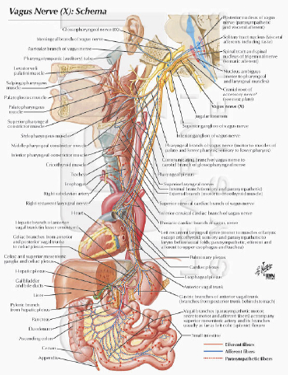
For example:
Hyperactivity in Arnold’s (Vagus) Reflex Can Evoke:
-Watering eyes
-Cough
-Gag effect
-Effortful phonation
-Chest tightness
-Hypertension
-Heart tension
(Pseudopericarditis)
-Nausea

Slide 6
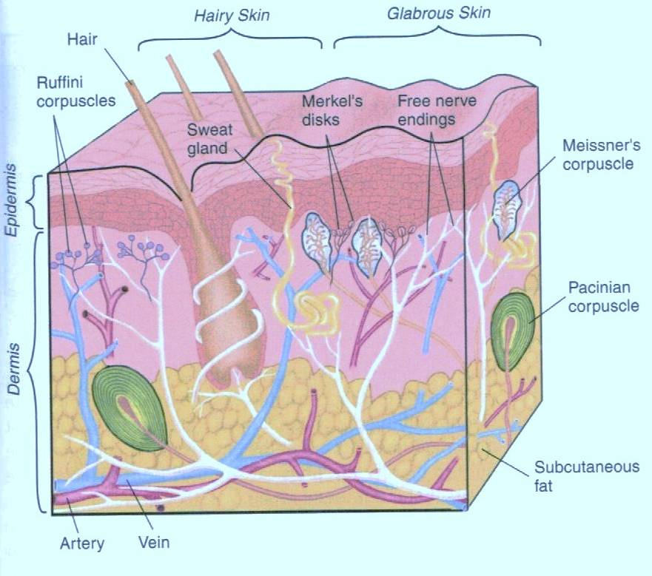
A Physiological Review of Human Skin

Slide 7

Corneum Stratum of the epidermis comprises 100% of the External Auditory Canal “epidermis”; there are no skin cells on the surface.
When EAC keratin is absent in the ear canal (via cotton swab trauma, low cellular pH, use of hydrogen peroxide, medication use, diabetes mellitus, etc.), EAC mechano- receptors are exposed, making them overly sensitive during hearing aid wear.

Slide 8
EAC Mechanoreceptors (You need to know them)
Hair follicles | Senses slight air movement, incites vascular activity at TM
Meissner’s Corpuscles | Senses light pressure near surface of epithelium, sends signal to tympanic plexus (Note: In complete reflex arc ceases firing upon cessation of movement)
Pacinian Corpuscles | Senses deep pressure in mid-level of tissue, sends signal to tympanic plexus region (Note: Excites cytokine and lymphocyte production)
Vagal stimulation (via Arnold’s Branch) | Evokes various reflexes, including gag, cough, cardiac constriction, nausea in stomach
Trigeminal (Efferent neurons) /Facial (Afferent neurons) | Controls vascularization & lymphatic activity (Note: Some aspects have no parasympathetic response)

Slide 9
Evidence & Remediation of
EAC Neuroreflex Hypersensitivity
Reflex Label Observation Fitting Artifact Remedy
Trigeminal (Red Reflex) | Hyper-vascularization re Otoscope Speculum Placement | Requires increased gain/output after 15-30 minutes | Utilize a wearing schedule to gradually increase wearing time; use MiraCell in EAC
Vagus/Arnold’s Branch (Cough Reflex) | Cough, gag reflex upon otoblock insertion | Complains of Non-acoustic occlusion, plugged sensation | Find most sensitive area & remove material, fit RIC, use MiraCell in EAC
Lymphatic (Tissue Swelling) | Painful sensitivity upon insertion of earmold in EAC—note missing keratin | HA becomes uncomfortable in short durations of wear, cannot acclimate | Improve keratin status with MiraCell before delivery, reduce pressure in EAC, fit RIC

Slide 10
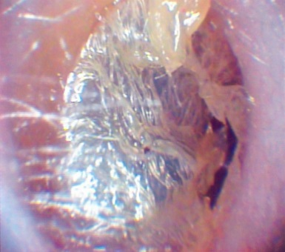
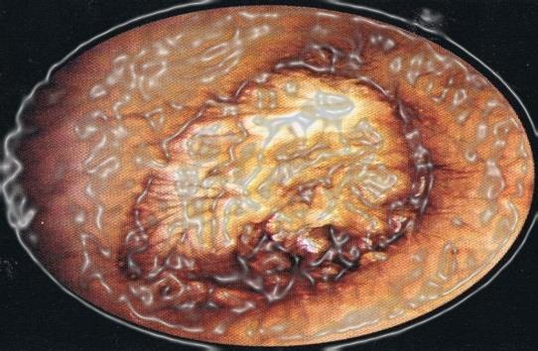
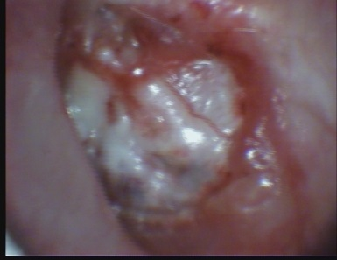
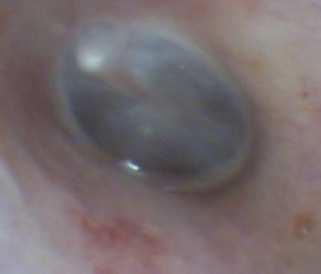
Keratosis Obturans: Progression over 1-5 years into “the ingrown toenail of the ear”
When cellular pH of the body falls below pH 7.1-7.2 (acidosis), external ear keratin can peel off at the rate of approx. 1mm per day. The example to the left is from a patient developing diabetes mellitus type 2 @ 6 months
At year 4-5, several keratoses have formed, trapping dead skin cells, bacteria, amoeba, fungus, yeasts, etc., debris, and cerumen. Often mistaken for impacted cerumen
Upon removal of just one of the keratoses, more keratoses are revealed, each with their separate layers of keratin wrapped around the organisms listed above
Upon removal of the final keratosis, a normal tympanic membrane is revealed
Latent diabetes II case

Slide 11
Potentially dangerous microorganisms common to the external meatus
Bacteria/Fungi Oto Culture Complications
DigiCare®

Slide 12
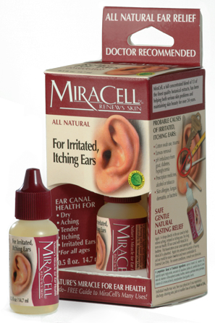
Introducing MiraCell’s ProEAR Solution
16 years of reports from the field show that MiraCell’s ProEar:
Encourages keratin growth
Soothes ears re adaptation of earmolds
Helps remove scar tissue, calcium plaque on eardrums
Softens hardened earwax for natural removal
Re-establishes pH flora of ear canal (6.50-7.35) Strengthen the ear’s immune system

Slide 13
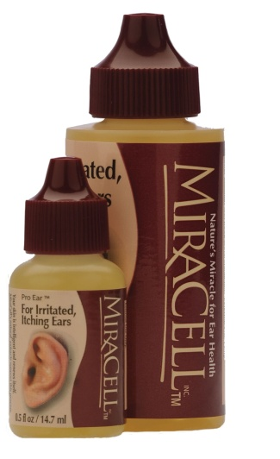
Standard Procedure for Using MiraCell’s ProEAR® Botanical Solution in the Ear...
Tilt the head sideways & pour a generous amount of ProEAR solution into the ear (enough to cover the ear drum, evoking a shiver).
Place wad of tissue at the entrance of the canal and leave for at least 10-15 minutes
Do the same to opposite ear
Repeat procedure daily for 2 weeks & once weekly thereafter.
(Demonstration)
DigiCare®

Slide 15
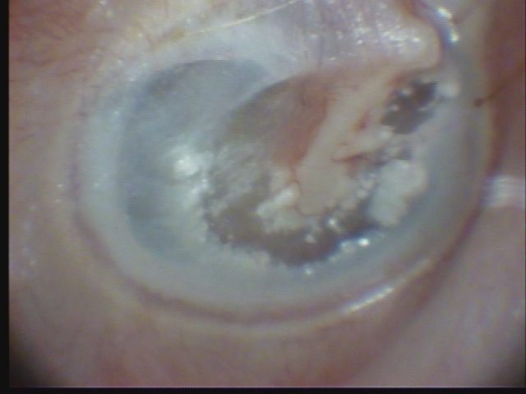
Male, 77 years of age
EAC Biomarkers:
Large, healed acoustic trauma/barotrauma perforation.
Past tympanoplasty was performed
Severe tympanosclerosis due to aging, chronic acidosis & childhood infections
3-4mm ring on annular ring indicates acute loss of bone mass—possibly over past 2 years
Ossicular chain intact (amazingly, there is no disarticulation; flaccid A)
Mixed hearing loss, hearing aid user.
Macrovascularization appears normal with subdued trigeminal (red) reflex
Microvascular constrictions (white areas in canal wall)
Tinnitus artifact: Vascular hissing, heartbeat, amplified 4KHz CV ringing.

Slide 16
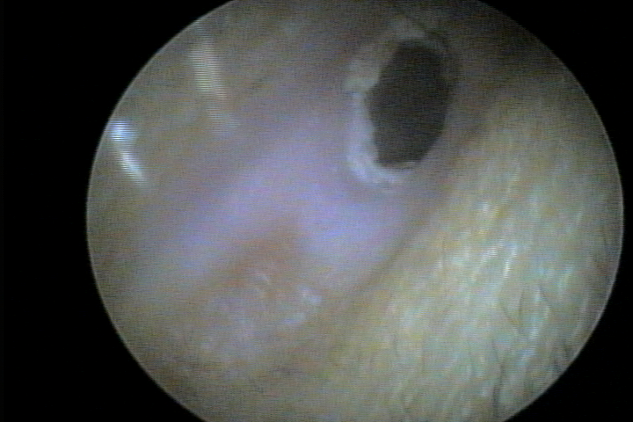
Male, 32 years of age
EAC Biomarkers:
Stenosis (Treacher-Collins syndrome)
Chronic dehydration, high caffeine intake, outdoor work w/o water access- High sodium in serum, complaints of developing kidney problems
Encrustment of keratin and debris caused by regular cotton swab use, noted large amount of epidermis cells deep inside EAC
Keratin differentiation is not evident until nearly halfway into the ear canal, so that desquamation migration does extend to hair follicle area, making self-hygiene difficult
Some yeasts growing at bottom of EAC due to acidosis/dehydration state and use of ear plugs at work (welder).

Slide 17
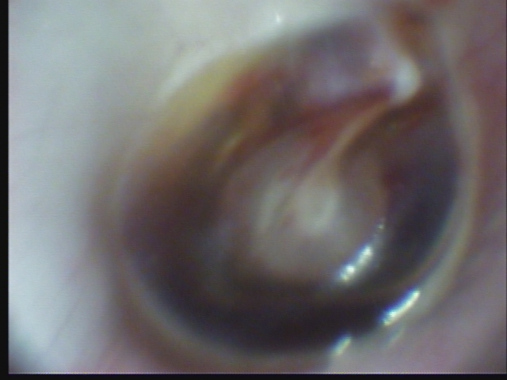
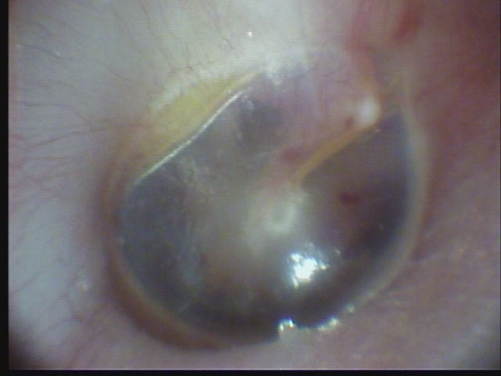
Female, 22 years of age
“Blue drum” as aftermath of acute OME w/ barotrauma (airplane descent)
Pure-tone thresholds exhibit PTA of 65dB at 250Hz rising to 35dB at 2KHz
Complaints of occlusion, hearing loss, generalized vertigo, tinnitus & disorientation
Normally, requires >3 months for recovery
In this case, recovery as shown in bottom photo required only 2 weeks using MiraCell®
At that time, thresholds were within about 10dB of normal, very little occlusion and none of the other complaints remained
Earlier tinnitus complaint (buzzing, heartbeat) gave way to silence by end of two weeks

Slide 18


Male, 72 years of age
EAC Biomarkers:
(Top photo) After patient had been to PCP for “impacted cerumen removal”. However, the keratosis obturans underlying the cerumen was still intact. Note read, “abnormal eardrum”. What appeared as an abnormal TM structure was instead 4-5 years’ keratin growth rolled into what Chartrand calls the “ingrown toenail of the ear”.
Tinnitus artifact: Contralateral, ipsilateral buzzing, roaring, amplified CV ringing.
(Bottom photo) Hearing professional softened keratosis obturans with MiraCell, and syringed with warm antiseptic water to remove the obturans, revealing a true TM. Audiometric scores went from flat configuration to a precipitous sensorineural loss. Own-voice occlusion and pulsating tinnitus ceased upon removal of obturans, leaving only the HF component at 4KHz.

Slide 19

Female, 68 years of age
EAC Biomarkers:
Case History shows no history of DMII
Differentiation: Lack of desquamation lines under peeled keratin indicates acute drop in cellular/serum pH about 6 months prior
Patient complained of not being able to walk without pain, moderate obesity, tinnitus in CV region (3-4KHz), audiometric notch in same region.
Upon referral to physician, blood glucose test and pH strip revealed slightly elevated blood sugar. Later, forced glucose test & physical exam revealed severe DMII with severe peripheral neuropathy secondary to DMII
Practitioners who see disturbed EAC keratin (not resulting from cotton swab trauma) are encouraged to refer for examination for possible DMII
Peeled keratin can be a sign of developing DMII

Slide 20
Study Hypotheses
H_{o} (null): Keratin status of the EAC has no positive relationship with successful adaptation to hearing aids.
H_{a} (alternative hypothesis): External ear keratin status is closely associated with success in physically adapting to hearing aids.
DigiCare®

Slide 21
Participants
Study Design
Bivariate correlational study
Data based on retrospective file review
45-day timeline of HA dispensing process
Observed best practice standards
98 hearing aid users (n = 98), 62 males, 36 females
Age range 29-95 years (mean age 70.29 years)
Randomly selected from 435 files
Hearing health/occupational therapy clinic in southern Colorado
DigiCare®

Slide 22
Keratin Status
Level 1 (Absent/peeling): 18.37%
Level 2 (Thin): 40.81%
Level 3 (Medium/Thick): 40.82%

Slide 23
Adaptation Experience
Level 1 (RFCs): 5.11%
Level 2 (Exchange): 6.12%
Level 3 (Remake): 11.22%
Level 4 (Modifications): 20.61%
Level 5 (No difficulty): 47.99%

Slide 24
Summary of Findings
Strong positive relationship between keratin status and physical adaptation to HA
Moderately negative relationship between keratin status and the rate of RFCs & remakes
No apparent relationship between age and keratin status
While the vast majority of instruments were custom models, males tended to require more BTEs, while females tended to choose BTEs
Males experienced considerably more RFCs and remakes than females
Males generally exhibited thicker (Level 5) keratin than females, though they also exhibited more detrimental aggressive personal ear care habits (i.e. missing keratin)
DigiCare®

Slide 25
Video Otoscopy Study
Practice Implications

Slide 26
Important Contributions Arising out of This Study
The need for more training in effective the use of video otoscopy in assessing keratin status and other biomarkers & predictors of hearing aid adaptation
A need for greater understanding of the neurophysiological behaviors of the EAC, including the neuroreflexes
Poor keratin status can be overcome during the dispensing process by using MiraCell with every HA patient
Confirmation of underlying disease, medication side-effects, and personal (and professional) ear care strategies that can contribute to HA adaptation problems
DigiCare®

Slide 27
Implications & Need for Future Research
The industry has invested heavily in non-intrusive technologies (open ear, implantable HA, etc.) that accommodate an ever-broadening market segment
Most hearing aid fittings may continue to involve EAC coupling due to acoustic, medical & financial considerations
Continued research in EAC neurophysiology by the industry needs to be conducted and integrated into assessment, dispensing & counseling protocols
Need for improved HA couplers, including less toxic (biochemically-active) materials
Inclusion of these constructs and principles in consumer satisfaction measurement tools
DigiCare®

Slide 28
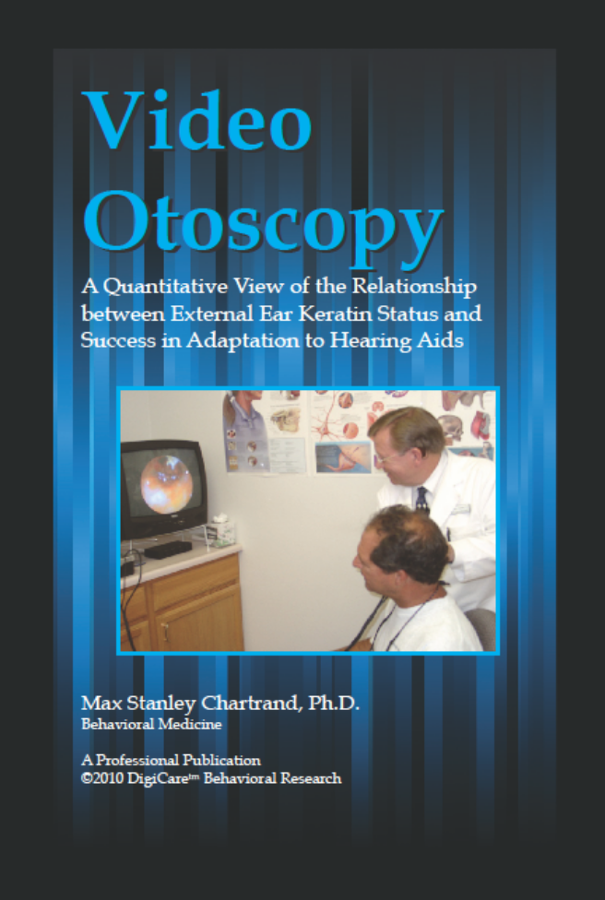

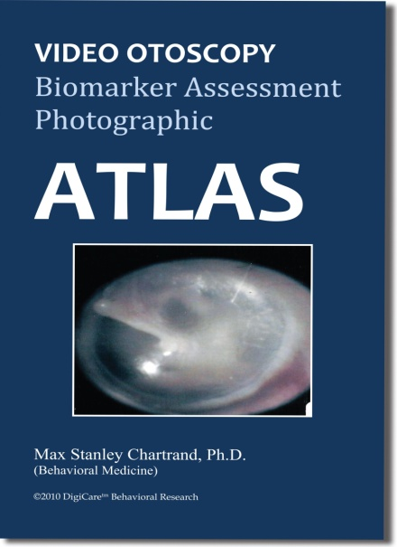
Use these one-of-a-kind tools to train staff, counsel patients, and sharpen your skills!
Available at this meeting at special convention price

Slide 30
Processed (Dead) vs Natural (Live) Foods
Microwave/Processed Foods vs Fresh/Slow-Cooked Foods
>Processed
Food Supply
Borrowed
Amino
Acids
Borrowed
Partial Enzymes
Slow Digestion/
Acid Formation
Synthetic Nutrients Only
<Organic
Food Supply
Amino
Acid
Chain
Natural Enzymes
Fast Digestion/High pH
Multiple
Bioavailable Nutrients
Since 1998 (U.S.)
Serotonin (Mood)
Melatonin (Sleep)
Dopamine (Motor)
Pre-1978 (U.S.)
Because of increasingly processed diet & polypharmacy, most older adults suffer chronic dehydration, pervasive chronic disease.
SIRCLE®

Slide 31
What are biomarkers?
The National Institutes of Health (NIH) defines biomarkers as:
“Characteristics that are objectively measured and evaluated as an indicator of normal biologic processes, pathogenic processes, or pharmacologic responses to a therapeutic intervention”

Slide 32
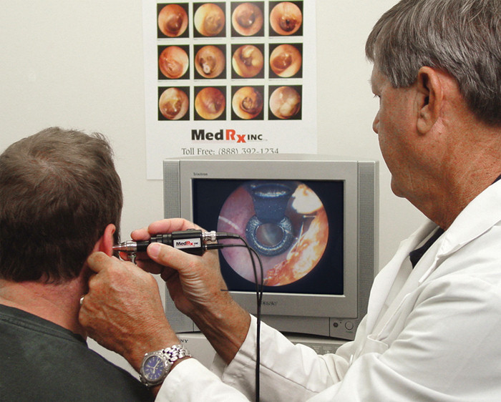
The FDA Red Flags are the Biomarkers that brought the dispensing profession into the larger community of health professions
Abbreviated list of Red Flags:
Pain in the ear
Significant cerumen
Rapidly progressive loss
Sudden unilateral loss
Deformity of the ear
Active drainage
Acute dizziness
Average air-bone gap at .5K, 1K, and 2KHz >15dB

