Slide 1
About Omics Group
OMICS Group International through its Open Access Initiative is committed to make genuine and reliable contributions to the scientific community. OMICS Group hosts over 400 leading-edge peer reviewed Open Access Journals and organize over 300 International Conferences annually all over the world. OMICS Publishing Group journals have over 3 million readers and the fame and success of the same can be attributed to the strong editorial board which contains over 30000 eminent personalities that ensure a rapid, quality and quick review process.

Slide 2
About Omics Group conferences
OMICS Group signed an agreement with more than 1000 International Societies to make healthcare information Open Access. OMICS Group Conferences make the perfect platform for global networking as it brings together renowned speakers and scientists across the globe to a most exciting and memorable scientific event filled with much enlightening interactive sessions, world class exhibitions and poster presentations
Omics group has organised 500 conferences, workshops and national symposium across the major cities including SanFrancisco,Omaha,Orlado,Rayleigh,SantaClara,Chicago,Philadelphia,Unitedkingdom,Baltimore,SanAntanio,Dubai,Hyderabad,Bangaluru and Mumbai.

Slide 3

p  n - Transverse Thermoelectrics:
A new class of Materials with
Possible Optoelectronic Applications
Matthew Grayson
m-grayson@northwestern.edu
EECS, Northwestern U.
Chuanle Zhou (post-doc), Boya Cui, Yang Tang (PhD)
Stefan Birner (NextNano / TU Munich)
Karen Heinselman
Phys. Rev. Lett. 110, 227701 (2013)

Slide 4
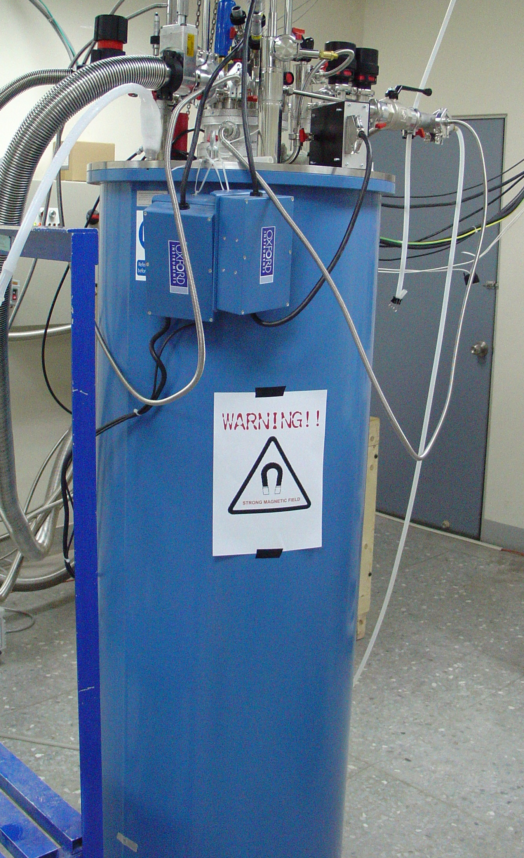
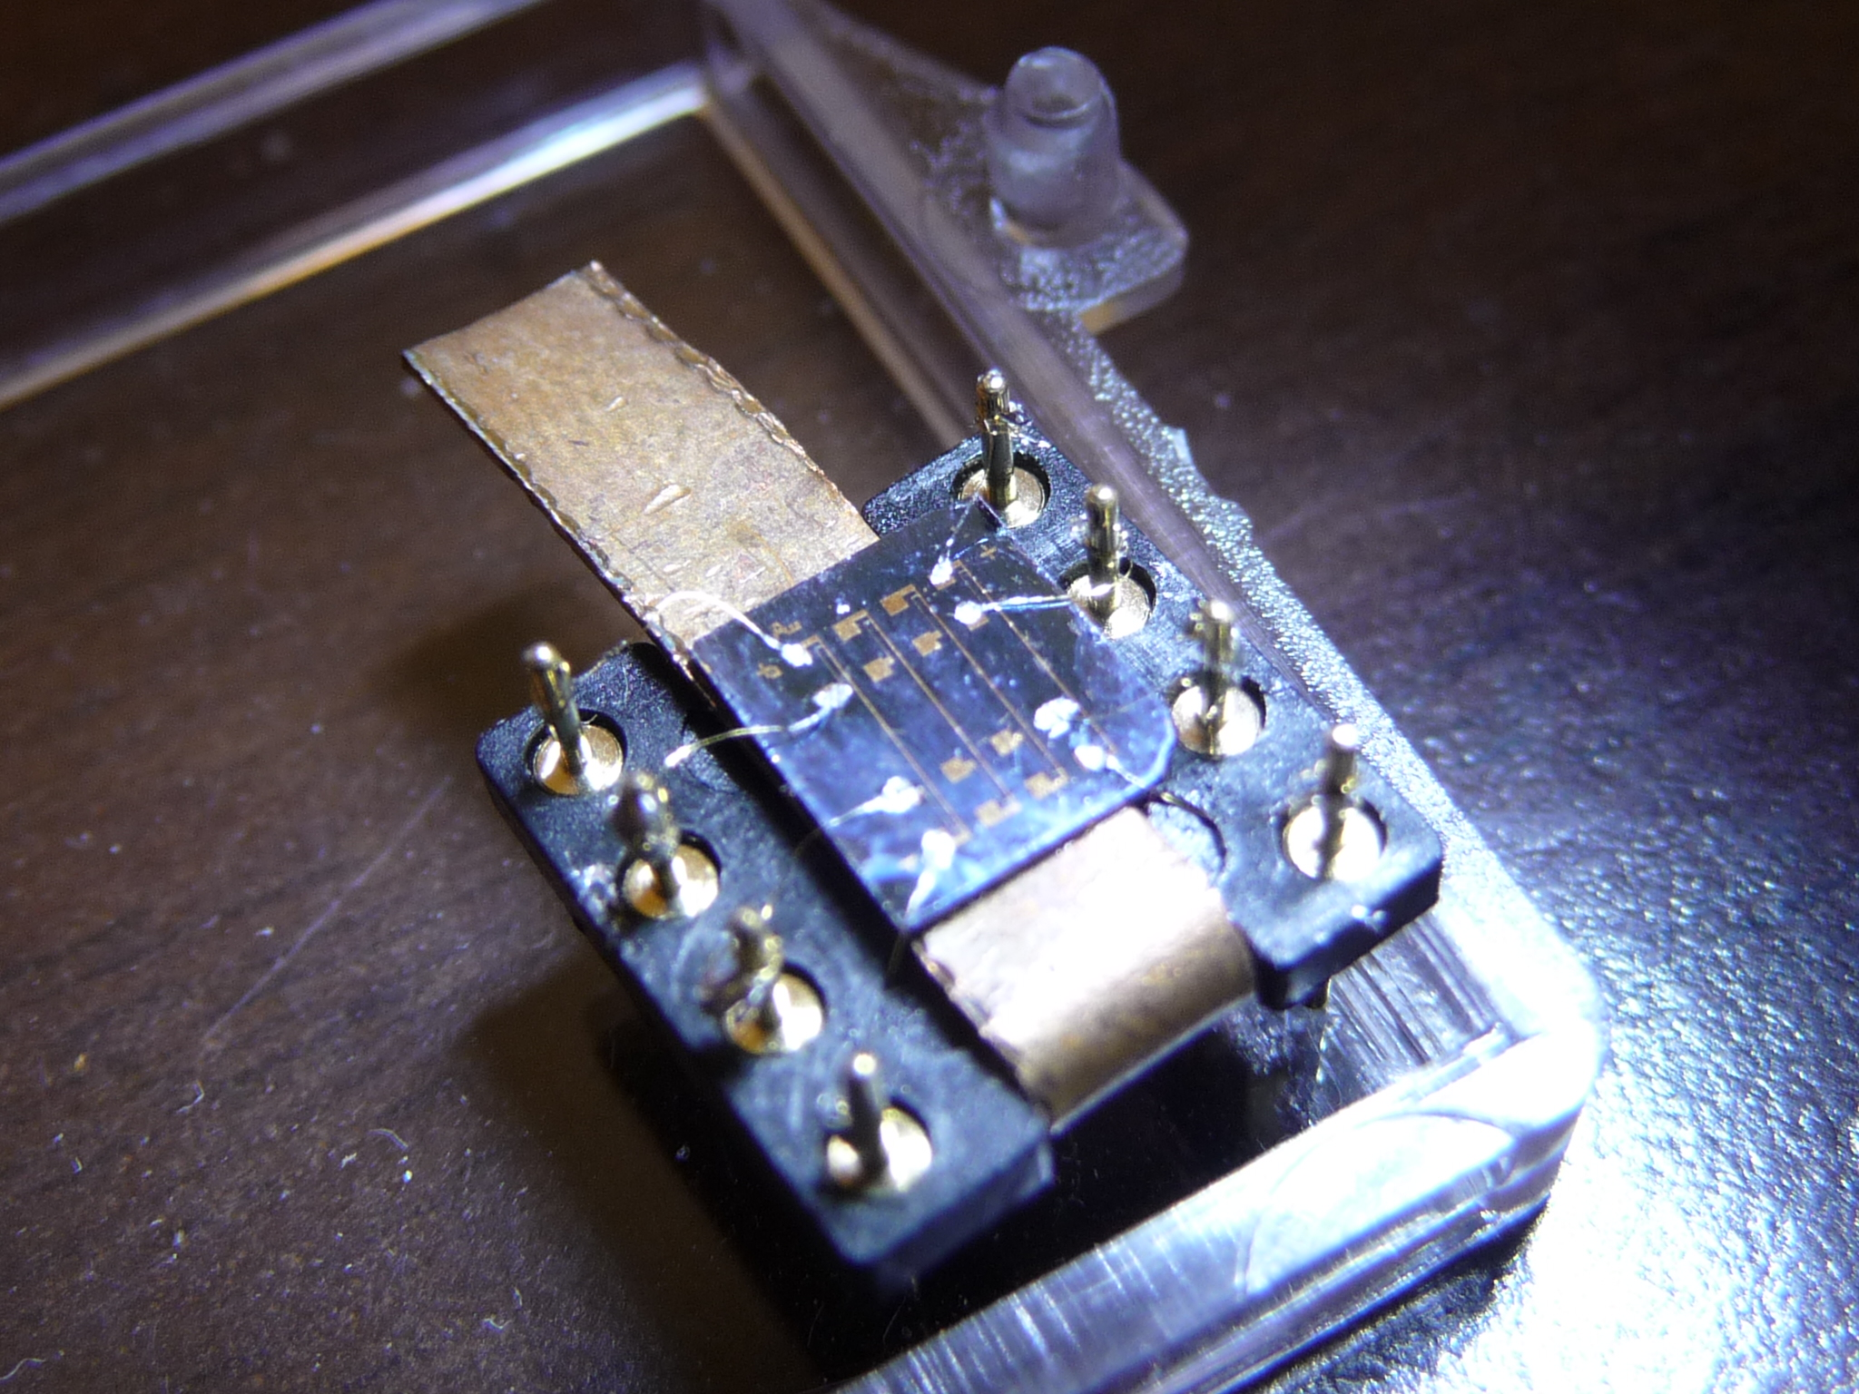
Motivation #1: for intrinsic on-chip cryocooling

Slide 5
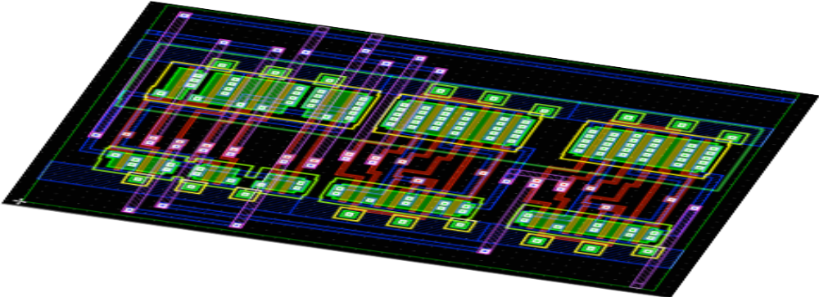
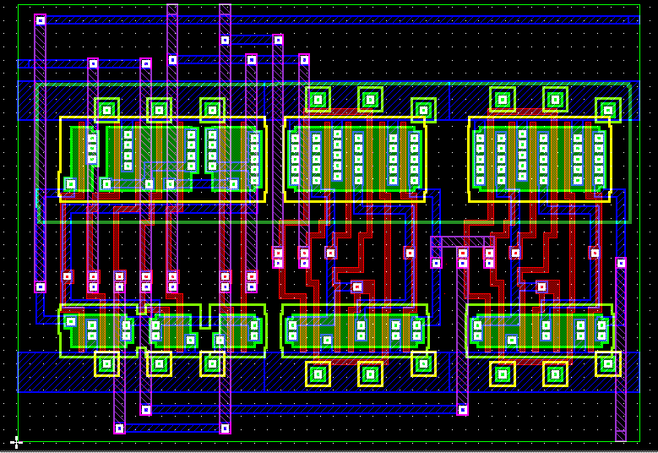
Motivation #2: integrated thermal management

Slide 6
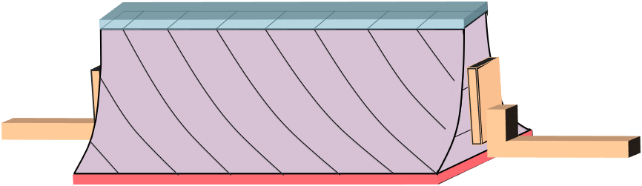
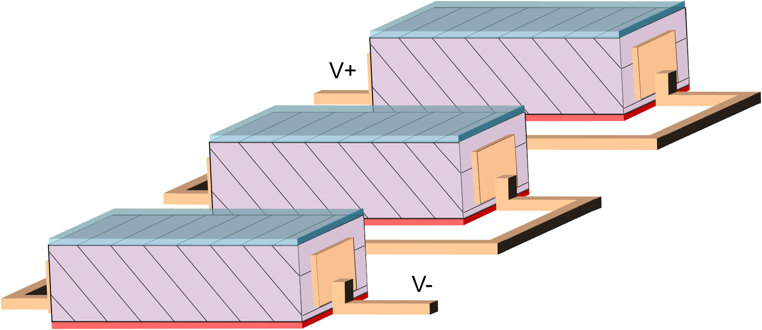
Motivation #3: overcome ZT limitations with geometric shaping

Slide 7
p x n Transverse Thermoelectrics:
Outline:
I. Transverse Thermoelectricity
Type II broken-gap superlattices

Slide 8
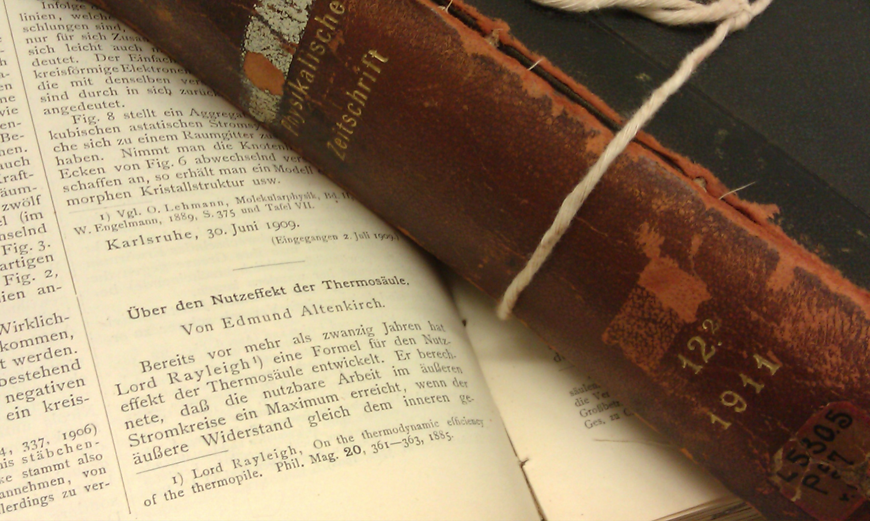
The Dawn of Thermoelectricity
Edmund Altenkirch, Phys.Zeits. 10, 560 (1909); 12, 920 (1911).
INTENSIVE PARAMETERS
Figure of Merit
S – Seebeck coefficent
ρ – Electrical resistivity
κ – Thermal conductivity
S²
ZT = T
ρ κ

Slide 9
Longitudinal thermoelectric figure of merit:

Slide 10
Longitudinal Thermoelectric:
T_{H}
T_{C}
T_{H}
e⁻
h⁺
Semi
Metal
Semi

Slide 11
Longitudinal Thermoelectric:
Double-leg
T_{H}
T_{C}
T_{H}
h⁺
h⁺
e⁻
h⁺
e⁻
e⁻
I

Slide 12
Transverse thermoelectric figure of merit:

Slide 13
Transverse Thermoelectric:
T_{H}
T_{C}
e⁻
h⁺
Semi
Metal

Slide 14
Transverse Thermoelectric:
Nernst-Ettingshausen effect
Single-leg
h⁺
h⁺
T_{H}
h⁺
T_{C}
B
e⁻
e⁻
e⁻
I
Symmetry broken by B-field
DISADVANTAGE: REQUIRES LARGE B-field (1.5 T)
K.F. Cuff, Appl. Phys. Lett. 2, 145 (1963); C.F. Kooi, J. Appl. Phys. 34, 1735 (1963)

Slide 15
Transverse Thermoelectric:
Stacked synthetic composites
Single-leg
semi-metal
h⁺
p-type semi
h⁺
e⁻
e⁻
e⁻
T_{H}
h⁺
T_{C}
h⁺
e⁻
I
Symmetry broken by structure
DISADVANTAGE: Thick (~mm) layers cannot be scaled down
Labor intensive fabrication
V.P. Babin, Sov. Phys. Semicond. 8, 478 (1974); Reitmaier, Appl. Phys. A 99, 717 (2010)

Slide 16
p x n Transverse Thermoelectrics
n
“n-type” in one direction….
p
h⁺
h⁺
h⁺
e⁻
e⁻
e⁻
e⁻
e⁻
e⁻
h⁺
h⁺
h⁺
e⁻
e⁻
e⁻
“p-type” orthogonal….
h⁺
h⁺
h⁺
Symmetry broken by band structure anisotropy

Slide 17
p x n Transverse Thermoelectrics
n
p
J
h⁺
h⁺
Q
h⁺
e⁻
e⁻
e⁻
e⁻
e⁻
e⁻
h⁺
h⁺
h⁺
e⁻
e⁻
e⁻
E
h⁺
h⁺
h⁺
Symmetry broken by band structure anisotropy

Slide 18
p x n Transverse Thermoelectrics
I
T_{C}
e⁻
e⁻
h⁺
Q
h⁺
e⁻
h⁺
n
T_{H}
p
Symmetry broken by band structure anisotropy
ADVANTAGE: Scalable to cm or μm
No external B-field

Slide 19
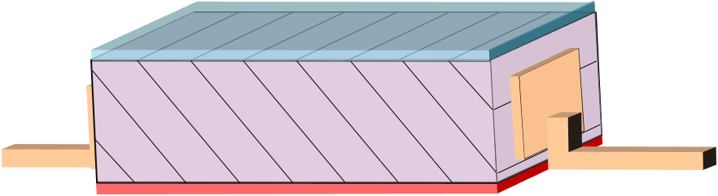
Transverse Seebeck voltage generator
^{p}
^{n}
^{+V}
^{E}
^{-V}
^{∇T}

Slide 20
Transverse Seebeck voltage generator
Meander structure:
Arbitrarily large Seebeck voltages V with small ΔT
^{p}
^{n}
^{E}
^{∇T}
H. J. Goldsmid, J. Elec. Mat.,40 5, 1254 (2010).

Slide 21
Transverse Peltier cooler
^{p}
^{n}
^{J}
^{Q}

Slide 22
Transverse Peltier cooler
Exponential Taper:
Arbitrarily large ΔT with finite current J
^{p}
^{n}
^{J}
^{Q}
C. F. Kooi et al., Appl. Phys. 34, 1735 (1963)

Slide 23
Annular Peltier cooler
Every angle of current takes heat away from center
^{n}
^{p}
^{J}
^{Q}

Slide 24
p x n Seebeck tensor
Seebeck Tensor
Electrical conductivity Tensor
Total Seebeck Tensor
n
p
b
y
0
a
θ
0
x
Notes:
Single band S is isotropic , sn<0, sp>0 (electron along, and the same for hole), e, h parallel conduct. weight with sigma tenor
Rotate to new basis gives off-diagal Seebeck (max at 45 degree)
S always isotropic, to make anisotropic is two parallel band so S weighted by conductivity Tensor
No Sba (to next page)
Intro ZT first ->s, sigma (motivate)
Two-band -> ansiotropic

Slide 25
Optimal transport coefficients
Optimal angle
Optimal transverse figure of merit
n
p
b
y
a
θ
x
Notes:
S^2 and denominator rho & k
New concept: angle need to be optimized, ZT(theta).
Zba

Slide 26
p x n Transverse Thermoelectrics:
Outline:
I. Transverse Thermoelectricity
Type II broken-gap superlattices

Slide 27
Transverse thermoelectric figure of merit:

Slide 28
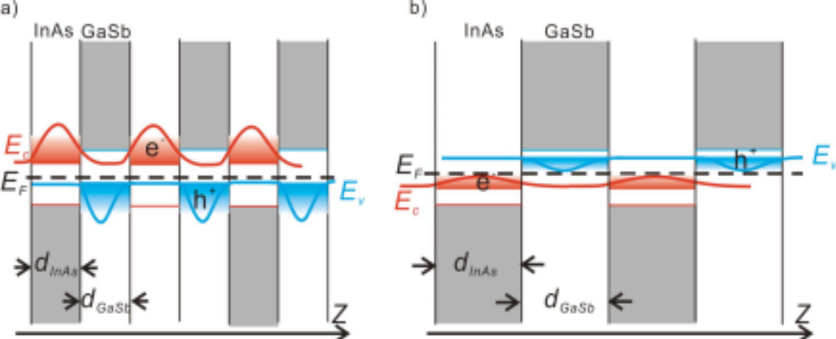
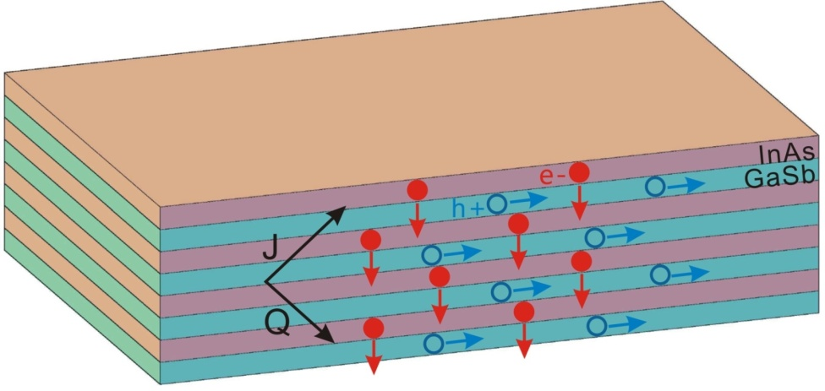
InAs/GaSb Type II superlattice
InAs/GaSb type II broken-gap superlattice (T2SL)
  Tunable bandgap
  Anisotropic electron-hole transport
  Fabrication challenge: strain, interface diffusion
Notes:
Only example

Slide 29
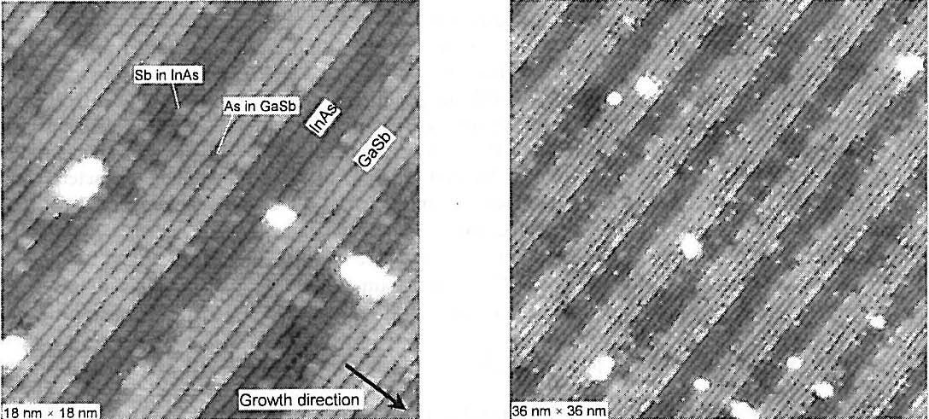
Interface Quality:
Minimal Sb segregation
Up to 15 um superlattice growth with smooth morphology
M. Razeghi, Binh-Minh Nguyen, et al.
Proc. SPIE 6206, 0277-786X/06 (2006)
Type II superlattice photodetectors for MWIR to VLWIR Focal Plane Arrays

Slide 30
Thermal Conductivity: Experiment

Slide 31
3ω Thermal Conductivity
Vertical thermal conductivity
  proportional to 3rd harmonic
  R + ΔR(T)
Type II
thin film
GaSb
substrate
+I +V -V -I
thin film
I ~ e^{iωt}
substrate
ΔT ~ P = I²R ~ e^{i2ωt}
ΔR ~ (dR/dT)T ~ e^{i2ωt}
ΔV = IΔR ~ e^{i3ωt}
2 mm
  D. G. Cahill, Rev. Sci. Instrum. 61(2) 802, (1990).
  D. G. Cahill, Phys. Rev. B 50, 6077 (1994).
  Chuanle Zhou, MG, et al. J. Elect. Mat. (2012)
Notes:
*** SHOW A DIAGRAM OF THE RELEVANT PHYSICS WITH THAT ENERGY SCALE (QHE = Landau level energies, quantum wire = subband energies, Coulomb blockade dot energies (already shown ☺)
Quantized energy level, low temperature=> thermal energy smaller than level distance
Eg: 2D(QHE): GaAs/AlGaAs at 1.2K
1D(QW): large wire transverse dimensions, fermi wavelengths are large and thus they have low energy separations. can only be resolved at cryogenic temperature (few kelvins)
0D(coulomb blockade)single electron transistor:thermal energy k_{B}T must be below the charging energy E_{C} =e^2/C, C~1fF, T<1K

Slide 32
3ω Thermal Conductivity
Vertical thermal conductivity
  proportional to 3rd harmonic
  λ ~ d
  R + ΔR(T)
Type II
thin film
GaSb
substrate
κ_{film}
+I +V -V -I
κ_{subs}
ΔV = IΔR ~ e^{i3ωt}
  D. G. Cahill, Rev. Sci. Instrum. 61(2) 802, (1990).
  D. G. Cahill, Phys. Rev. B 50, 6077 (1994).
  Chuanle Zhou, MG, et al. J. Elect. Mat. (2012)
Notes:
*** SHOW A DIAGRAM OF THE RELEVANT PHYSICS WITH THAT ENERGY SCALE (QHE = Landau level energies, quantum wire = subband energies, Coulomb blockade dot energies (already shown ☺)
Quantized energy level, low temperature=> thermal energy smaller than level distance
Eg: 2D(QHE): GaAs/AlGaAs at 1.2K
1D(QW): large wire transverse dimensions, fermi wavelengths are large and thus they have low energy separations. can only be resolved at cryogenic temperature (few kelvins)
0D(coulomb blockade)single electron transistor:thermal energy k_{B}T must be below the charging energy E_{C} =e^2/C, C~1fF, T<1K

Slide 33
Type II Superlattice Thermal Conductivity
Thermal conductivity suppressed up to 2 orders of magnitude from
GaSb bulk value
+
  Chuanle Zhou, MG, et al unpublished

Slide 34
Power Factor: Theory

Slide 35
InAs/GaSb Type II superlattice
InAs/GaSb type II broken-gap superlattice (T2SL)
  Tunable bandgap
  Anisotropic electron-hole transport
  Fabrication challenge: strain, interface diffusion
Notes:
Only example

Slide 36
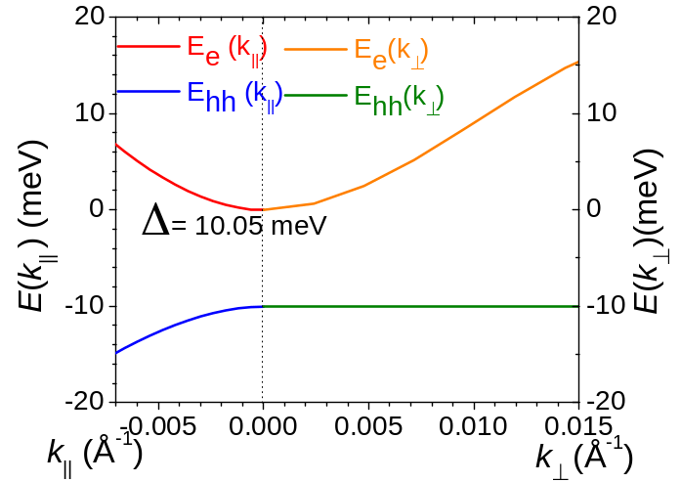
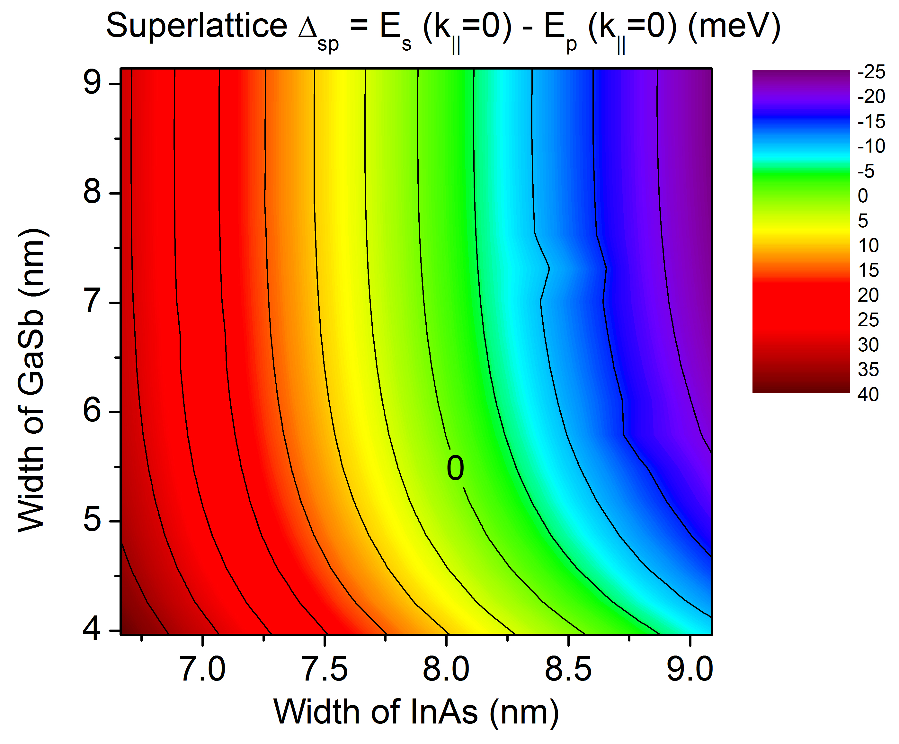
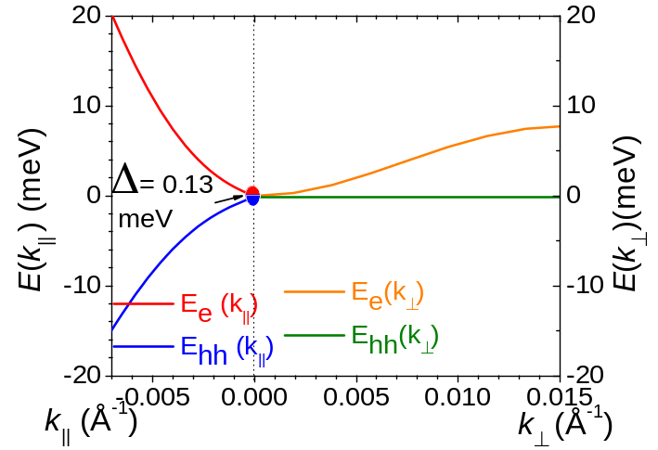
Type II Superlattice
NextNANO³: Full-band envelope-function
simulation InAs/GaSb
superlattice dispersion
Positive gap:
Semiconductor
5.4nm GaSb/7.5nm InAs
(21ML GaSb/22ML InAs)
8.53nm GaSb/7.87nm InAs
(28ML GaSb/26ML InAs)
Zero gap

Slide 37
Deduce Conductivity & Seebeck Tensor
From band structure =>
For n-conductivity & Seebeck:
anisotropic 3D dispersion
For p-conductivity & Seebeck:
2D dispersion
(Power-law scattering, , where s = 0 observed for T2SL at 300 K)
Optimize transverse power factor S²σ => deduce optimal chemical potential μ
  Chuanle Zhou, MG, submitted to PRL

Slide 38
InAs/GaSb Type II superlattice
Optimal T2SL
  d_{GaSb} = 3.96 nm, d_{InAs} = 7.88 nm
  E_{g} = 28.3 meV, μ = 2.43 meV
  θ⊥ = 32°
  κ = 4 W/m∙K (measured¹)
  Z ⊥ T = 0.025 at T = 300 K
n
p
b
y
a
θ
x
¹ C. Zhou et al., J. Elec. Mat. (2012)
Notes:
Single plot optimize ZT,
Cite k paper
Include T~E^s

Slide 39
Differential Transport Equations
Transverse Thermoelectrics
Longitudinal thermoelectrics
Ettingshausen effect
39
Notes:
To determine temperature distribution

Slide 40
Thermal distribution
Different from longitudinal and Ettingshausen cooling
ΔT = 4 K (ZT = 0.026)
T_{H} = 300 K, b = 10 μm
ΔT=14 K (ZT = 0.1)
ΔT=56 K (ZT = 0.5)
Notes:
Rec; diff eq; arb
Why .026; 0.1 0.5

Slide 41
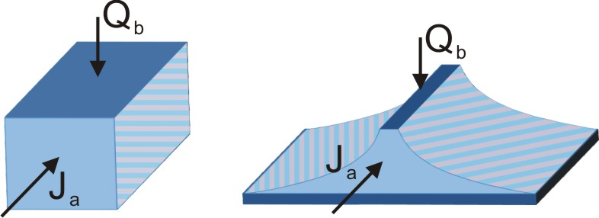

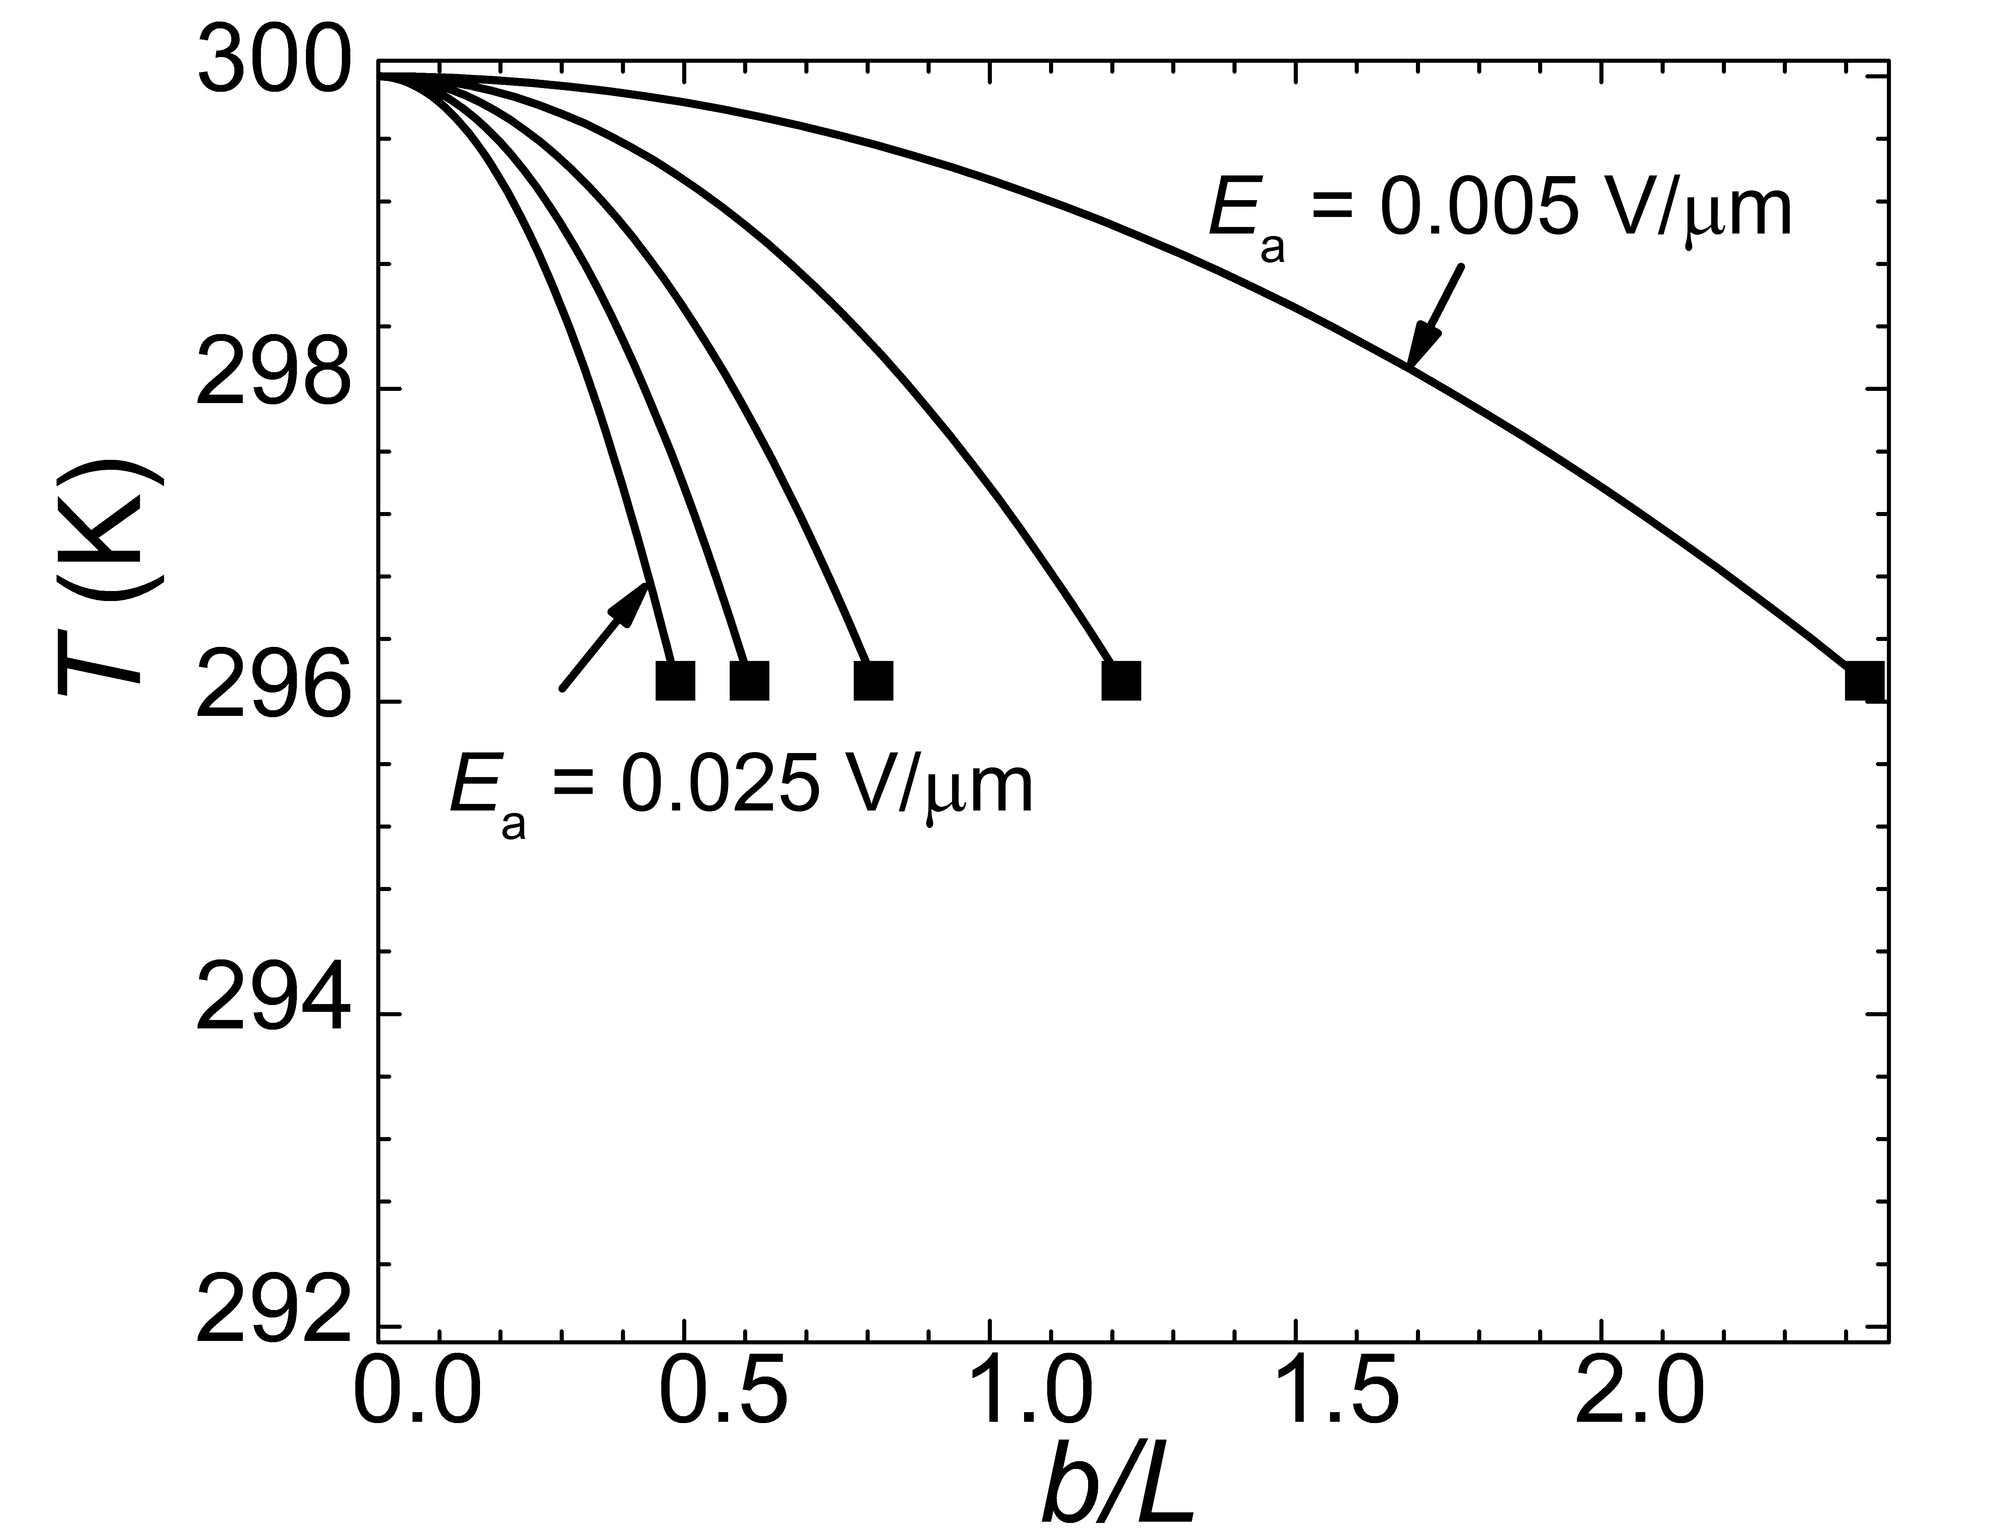
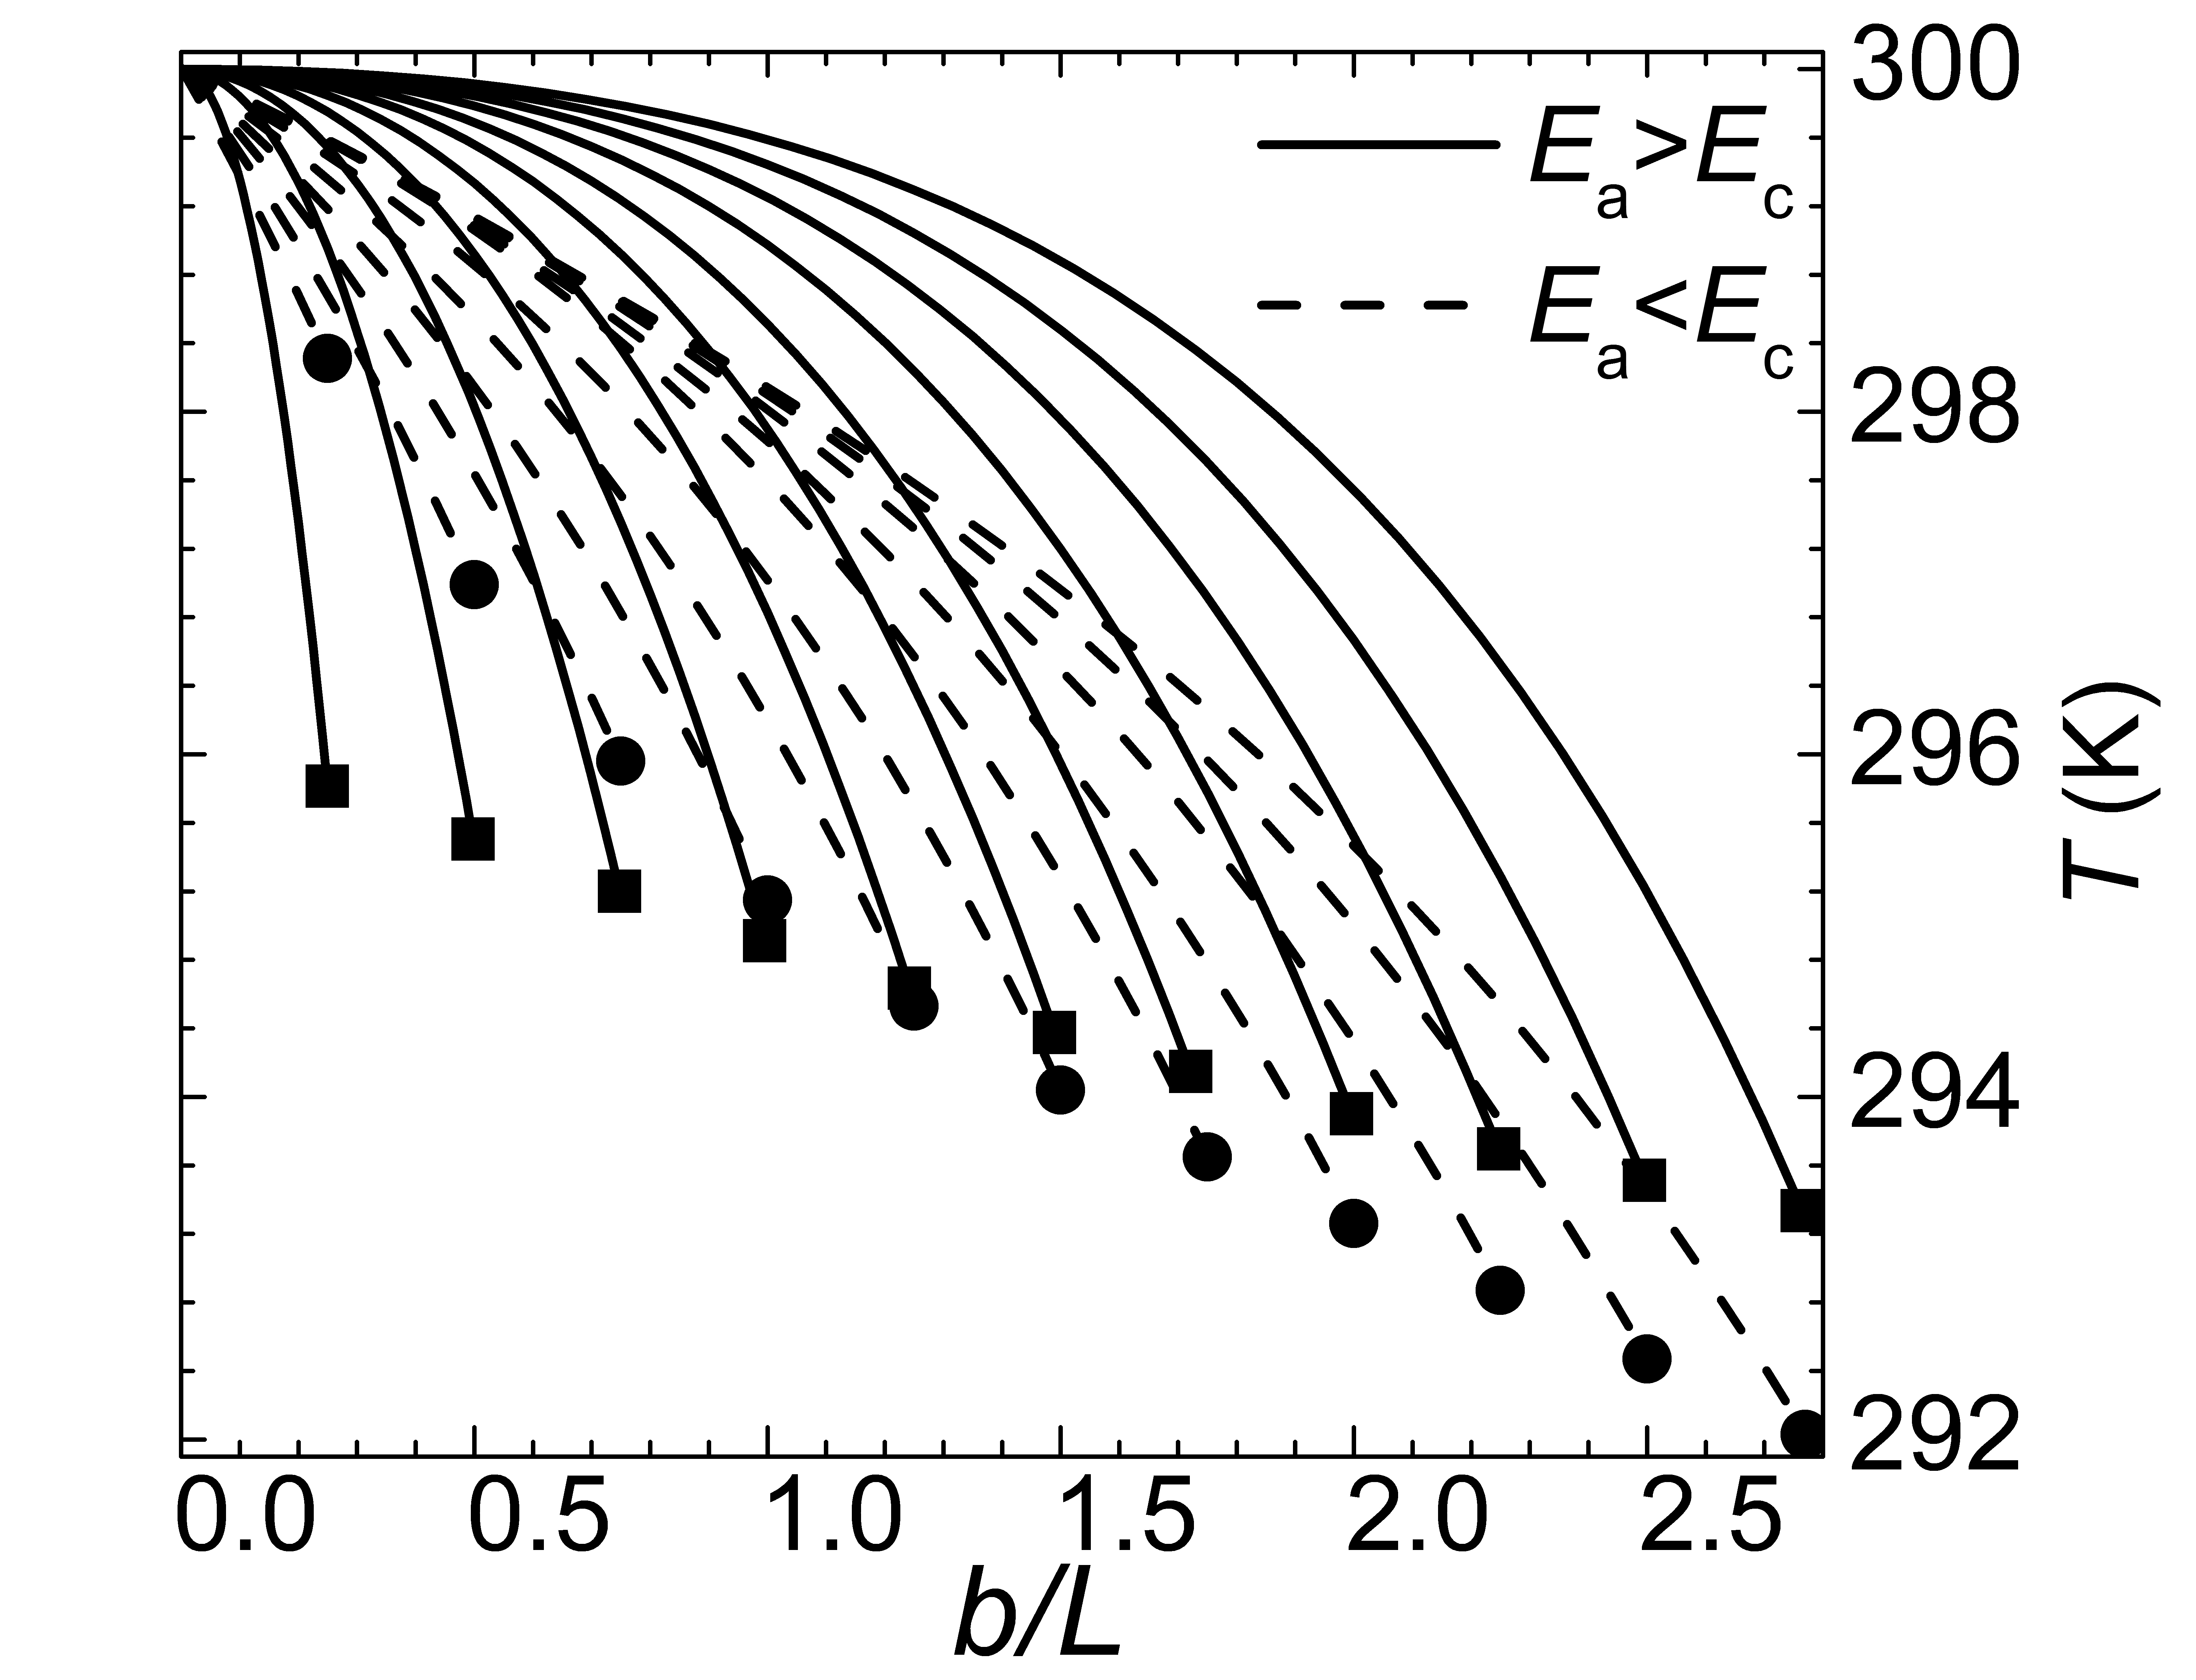
Exponentially tapering
A competitive ΔT = 8 K (b/L=2.77)
Notes:
b/L for rectangular?
One plot rec/exp

Slide 42
p × n Type material
Bulk materials (monoclinic)^{1,2}: CsBi₄Te₆, ReGe_{x}Si_{1.75−x}
p-type in a-direction and n-type in c-direction
  age:
    Bulk material, geometric shaping
    Low Z⊥T at low temperature
¹Gu, Zhang, PRB 71, 113201 (2005)
²Chyung, Mahanti, Kanatzidis,
MRS Proc 793 (2004)
42
¹J-J Gu, et al.,Mat. Res. Soc. Symp. Proc. 753, BB6.10.1 (2003) ²D.-Y. Chung, Mat. Res. Soc. Symp. Proc. 793 S6.1.1 (2004)
Notes:
Bulk material one page, ZT vs T, good but not best for low temperature, identify a solution, need to look to new materials
People didn’t notice transverse TE then. I found ReSi These material give direction to look for material
Alloy substation need to be explored to work for low temperature
Assume ZT=1 at RT, ZT=0.5 at low temperatures(sw in peroidic table)
What material: small Eg(~kT), at various T
Anisotropic conductivities, from SL/none cubic crystal

Slide 43
p x n Transverse Thermoelectrics:
Outline:
I. Transverse Thermoelectricity
Type II broken-gap superlattices

Slide 44
Let Us Meet Again
We welcome all to our future group conferences of Omics group international
Please visit:
www.omicsgroup.com
www.Conferenceseries.com
http://optics.conferenceseries.com/

