Slide 1
Evaluation of the Mucosal Retention Properties and Toxicological Profiles of a Mucoadhesive Polymer Gel
Matt Martin, PharmD

Slide 2
Matt Martin, PharmD
B.S. in Chemistry. 2002. Morehead State University.
Doctor of Pharmacy. 2006. University of Kentucky College of Pharmacy.
Practiced 8 years in a compounding pharmacy preparing sterile and non-sterile medications
Consultant Pharmacist at Professional Compounding Centers of America

Slide 3
Oral Mucosa
Targeted to:
  Bypass first pass metabolism
  Avoid gastrointestinal degradation
  Achieve a more rapid onset of action

Slide 4
Buccal Mucosa
Non-keratinized epithelial cells of the inner cheeks
  Highly vascularized
  Low enzymatic activity
  Fairly immobile

Slide 5
Challenges for Buccal Delivery
Low residence time
  Continuous secretion of saliva causing swallowing
  Food intake
  Movement of the tongue
Mucoadhesive polymers adhere to mucosal lining of the cheeks and increase residence time

Slide 6
MucoloxTM
Water
Isomalt
Pullulan
Glycerin
Poloxamer 407
Tamarindus Indica Seed Polysaccharide
Sodium Hyaluronate
Zea Mays (Corn) Starch
Simethicone
Carbomer
Sodium Benzoate
Potassium Sorbate
Disodium EDTA
MucoLoxTM , also referred to as Mucoadhesive Polymer Gel, is a proprietary gel designed to improve mucoadhesion and prolong retention of medications at application sites within the oral mucosa.

Slide 7
Evaluation of Mucosal Retention
Compare the retention of MucoLox™ to that of a mucoadhesive commercial reference product.
EpiOral Model (MatTek Corporation)
  EpiOral (ORL-200): human derived, non-keratinized oral epithelial cells

Slide 8
Methodology
MucoLoxTM and the reference product were labeled with sodium fluorescein
100 uL sample of each product applied to the apical layer of the EpiOral tissues
Incubated at intervals of 5, 10, 30, 40 min, 1, 2, and 5 hr

Slide 9
Methodology
Samples rinsed 3 times in Dulbecco’s Phosphate-Buffered Saline
Loss of NaFl only from the sample validated by collection of supernatant
Images acquired by Olympus FV1000 confocal microscope

Slide 10
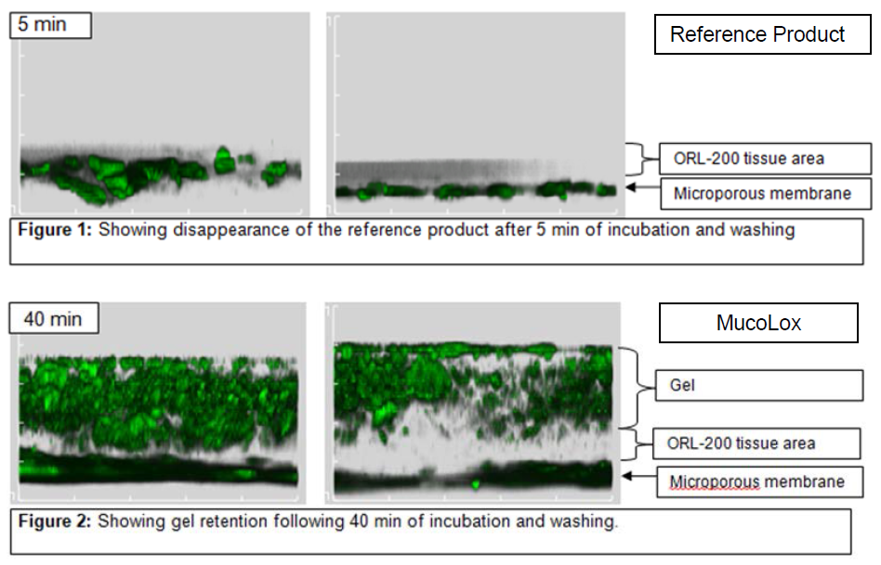

Slide 11
Safety & Toxicologicological Profile
Oral Human Mucosa evaluated with the EpiOral Model
Tissue exposed to distilled water (negative control)
40 uL of MucoloxTM diluted to 50% and 1% Triton X-100 applied to the samples
Incubated at 37º C for intervals of 1, 4.5, and 20 hr

Slide 12
Human Oral Mucosa Evaluation
Samples rinsed twice with phosphate buffer saline
300 μL of MTT solution (3-[4,5-dimethylthiazol-2yl]-2,5-diphenyltetrazolium bromide) applied and incubated for 3 hours
Succinate dehydrogenase enzymes within the mitochondria of viable cells have the ability to reduce soluble yellow tetrazonium salt of MTT to an insoluble purple formazan derivative

Slide 13
Human Oral Mucosa Evaluation
Samples immersed in 2mL of extraction solution, sealed in plastic bag, stored at room temperature overnight
200 μL aliquot of each extract was evaluated using a Molecular Device SpectraMax® M5 Microplate Reader
This device quantifies the absorbance potential of the samples at 570 nm, a wavelength absorbed by reduced MTT

Slide 14
Human Oral Mucosa
The greater the percent absorbancy, the greater the amount of MTT reduced by succinate dehydrogenase within the extract, and the higher the percent cell viability within the tissue
Mean percent cell viabilities were calculated

Slide 15
Human Oral Mucosa
For tissues treated with MucoLoxTM 50%, mean percent viabilities were 97%, 98%, and 85% following 1, 4.5, and 20 hr of exposure, respectively.
For tissues treated with Triton X-100 1%, mean percent viabilities were 117%, 30%, and 6% following 1, 4.5, and 20 hr of exposure, respectively.

Slide 16
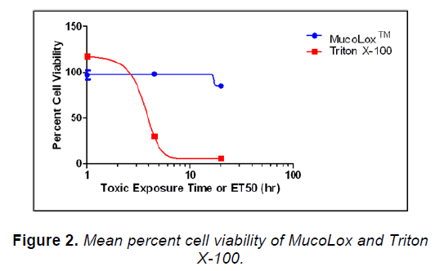
Human Oral Mucosa

Slide 17
Human Nasal Mucosa
EpiAirway- normal human-derived tracheal/bronchial epithelial cells, cultured and differentiated to resemble the pseudostratified epithelium of the nasal mucosa
MucoloxTM 100%, 10%, and 1% diluted with sterile water applied to tissues vs sterile water as the negative control.

Slide 18
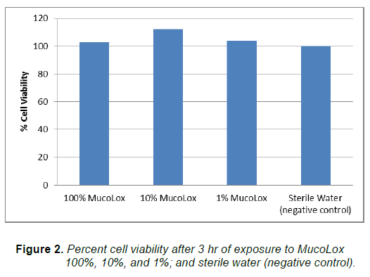
Human Nasal Mucosa

Slide 19
Human Vaginal Tissue
EpiVaginal™
Multilayered tissue produced from human-derived vaginal-ectocervical epithelial cells (Figure 1).
  Composed of basal layer and multiple non-cornified layers
  Highly differentiated to resemble the growth and morphological characteristics of the human vaginal mucosa

Slide 20
Human Vaginal Tissue
MucoloxTM 100% compared to Triton X-100 1% (positive control)
Percent cell viabilities for the tissue treated with MucoLoxTM were 87%, 78%, and 79% following exposure at 1, 4.5, and 20 hr, respectively
Triton X-100 percent cell viabilities were 97% and 26% at 45 min and 2 hr of exposure, respectively

Slide 21
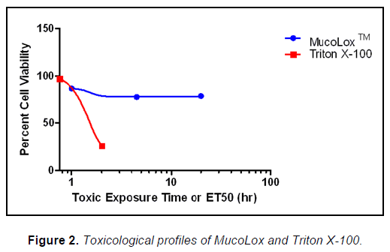
Human Vaginal Tissue

Slide 22
Questions?
Please send correspondence to: PCCAScience@pccarx.com

Slide 23
References
Assessment of the Mucoadhesive Properties of MucoLox™ Using a 3D Model of the Human Oral Mucosa
Evaluation of the Safety and Toxicological Profile of MucoLox™: Human Oral Mucosa, Nasal Mucosa and Vaginal Mucosa (Part 1/3)
Evaluation of the Safety and Toxicological Profile of MucoLox™: Human Oral Mucosa, Nasal Mucosa and Vaginal Mucosa (Part 2/3)
Evaluation of the Safety and Toxicological Profile of MucoLox™: Human Oral Mucosa, Nasal Mucosa and Vaginal Mucosa (Part 3/3)

Slide 24
References
An in vitro model for the rapid screening of potential components and formulations for nasal drug delivery 2015, MatTek Corporation, viewed 23 January 2015, http://www.mattek.com/epiAirway/applications/drug-delivery.
Ayehunie, S., Cannon, C., Gimondo, J., Hayden, P., Kandárová, H. & Klausner, M. 2007, ‘Human vaginal-ectocervical tissue model for testing the irritation potential of vaginal-care products’, Toxicology Letters, vol. 172, pp. S73.
Drug delivery 2015, MatTek Corporation, viewed 14 January 2015, http://www.mattek.com/epioral/applications/drug-delivery.
EpiVaginal Tissue Model 2015, MatTek Corporation, viewed 14 January 2015, http://www.mattek.com/epioral/applications/drug-delivery.
Giannola, L.I., Caro, V.D., Giandalia, G., Siragusa, M.G., Campisi, G. & Wolff, A. 2008, ‘Current status in buccal drug delivery’, Pharmaceutical Technology Europe, vol. 20, no. 5, pp. 32-36, 38-39.
Hao, J. & Heng, P. 2003, ‘Buccal delivery systems’, Drug Development and Industrial Pharmacy, vol. 29, no. 8, pp. 821-832.
MucoLox 2014, PCCA, viewed 13 January 2015, http://www.pccarx.com/pcca-products/pcca-exclusives/bases/mucolox.
Repka, M., Chen, L. & Chan, R. 2011, ‘Buccal drug delivery’, in Rathbone, M. (ed), Controlled Release in Oral Drug Delivery, Springer US, New York, pp. 329-340.
Salamat, N., Chittchang, M. & Johnston, T. 2005, ‘The use of mucoadhesive polymers in buccal drug delivery’, Advanced Drug Delivery Reviews, vol. 57, pp. 1666-1691.
Wang, H., Cheng, H., Wang, F., Wei, D. & Wang, X. 2010, ‘An improved 3-(4,5-dimethylthiazol-2-yl)-2,5-diphenyl tetrazolium bromide reduction assay for evaluating the viability of Escherichia coli cells’, Journal of Microbiological Methods, vol. 82, pp. 330-333.

