Slide 1
Maintrac®
Therapy control and long-term surveillance by circulating, epithelial tumor cell (CETCs)
www.dmb-diagnostics.de

Slide 2
Questions we can answer:
Real-time cancer monitoring even years after diagnosis, surgery and therapy meaningful?
5 or 10 years Tamoxifen? How to recognize when maintenance therapy does not work?
Success control in the adjuvant situation? If the therapy does not work, which way shall I go?

Slide 3
Status quo in oncolgy
Today‘s Standard
Doctor‘s Needs
Quantitative, real time monitoring
Therapy based on chemosensitivity of actual tumor (CETCs)
Monitoring of tumor activity by cell count
Better guidance of endocrine therapy
Imaging diagnostics of solid tumors = already too big and too late
Surgery if possible
Treatment decision based only on tumor size, nodal status and organ localization
Longtime surveillance based on imaging techniques and general condition = too late for the patient
Serum markers still used but too unspecific

Slide 4


Major Enemy in Oncology Diagnostics and Treatment
Inhomogeneity
Biopsy, paraffin tissue, ctDNA:
Are you brave enough to judge now how the whole picture looks like?
?=

Slide 5

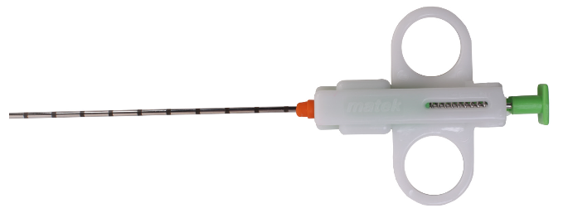
Inhomogeneity in Reality Even Worth
Good Luck!
I’m sure, you will find the “right” answer!

Slide 6
Methodology we try to get as close to homogeneity as possible

Slide 7
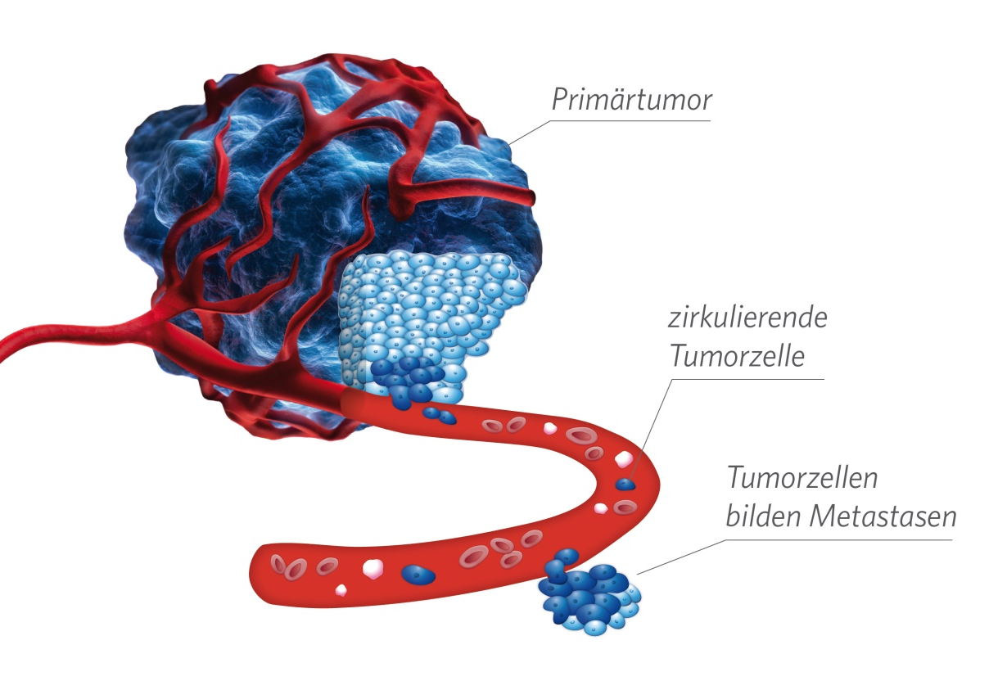
Metastasis Formation Through Circulating Tumorzellen
Carcinoma are of epithelial Origin
Carcinoma seed epithelial cells into the blood
⇒ CETCs
(circulating epithelial
tumor cells)

Slide 8
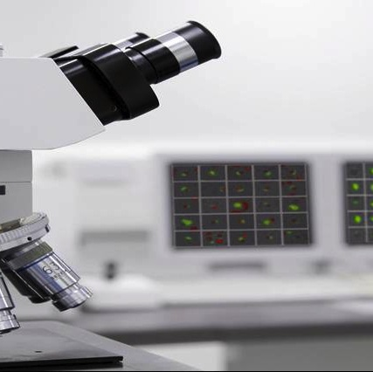
Testing
Microscope based
semi-automated image evaluation
Detection of
ANY solid tumor
NOT for lymphoma
or leukaemia

Slide 9
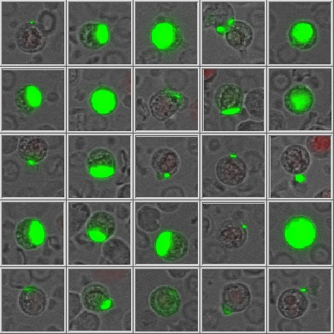
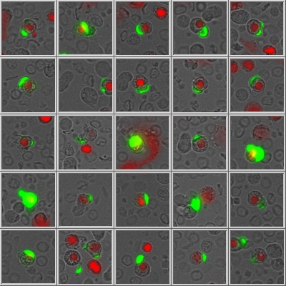
Cell gallery of a patient
red stained nucleus
= dead cell

Slide 10
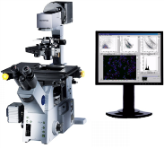
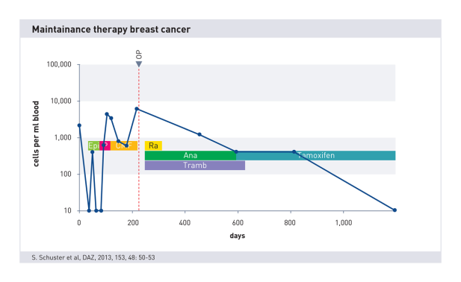
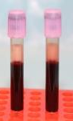
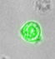
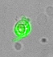
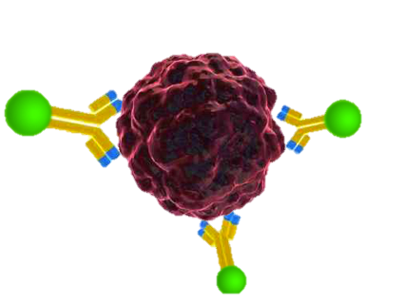

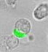
Quantitative, Vital Cell Number Determination
1
4
Blood sample
Trend of cell number
Maintrac® Mikroscope
NO! Selektion
NO! Extraction
Staining with fluorescent antibodies
2
3
Quantitative determination of vital cells
Success control:
    Antihormon therapy
Longtime surveillance
EpCAM antibody
Microscopic identification of vital cells

Slide 11
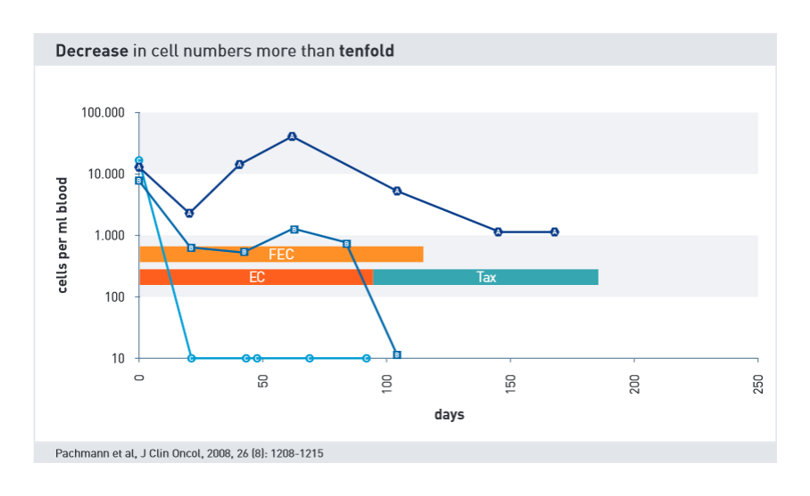
Decreasing Cell Numbers =
Good Prognosis

Slide 12
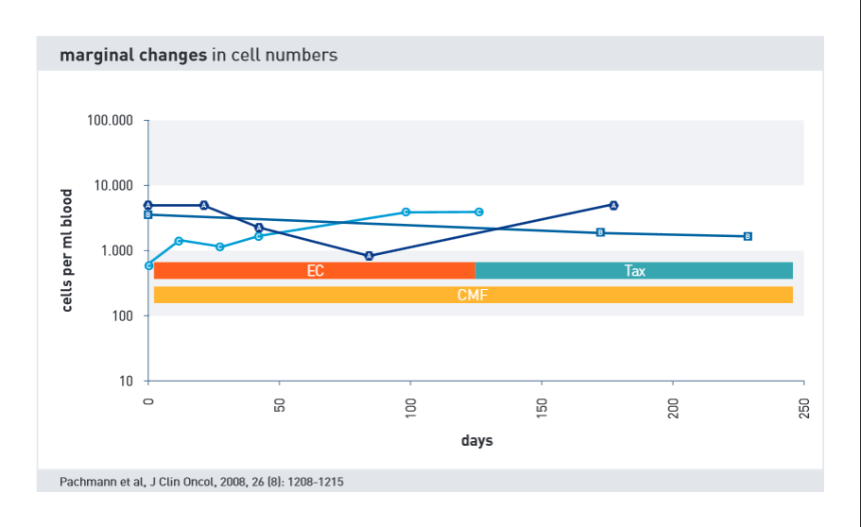
No Change =
Still Quite Good Prognosis

Slide 13
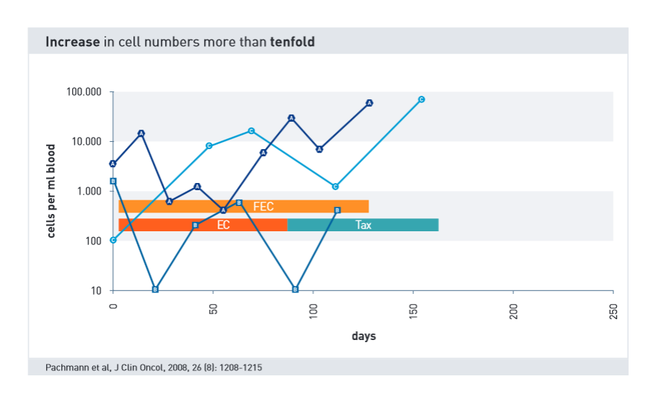
Increasing Cell Number =
Bad Prognosis

Slide 14
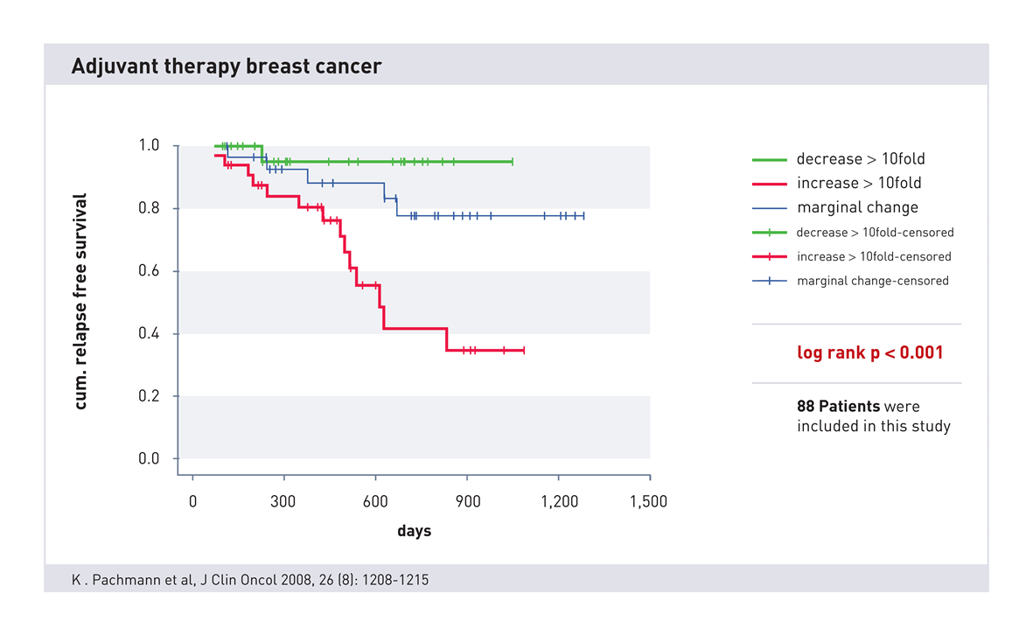
Success Control of Chemotherapy
Increasing
cell numbers correlate highly significant with
a poor prognosis

Slide 15
THERAPY CONTROL USING CIRCULATING TUMOR CELLS
Surveillance (end of anti-hormone therapy)
or how long to give Tamoxifen

Slide 16
Initial Situation
Maintenance (German Guideline):
  Monthly self examination of breast through patient
  1.-3. years every 3 month doctor
  4.-5. year half year doctor
  After 5. year yearly doctor
  Yearly mammography
  Early diagnosis potential curable situation
  X-ray of lung, skeletal-scintigraphy, liver ultra sound or tumour marker-diagnostics for patients without symptoms no advantage

Slide 17
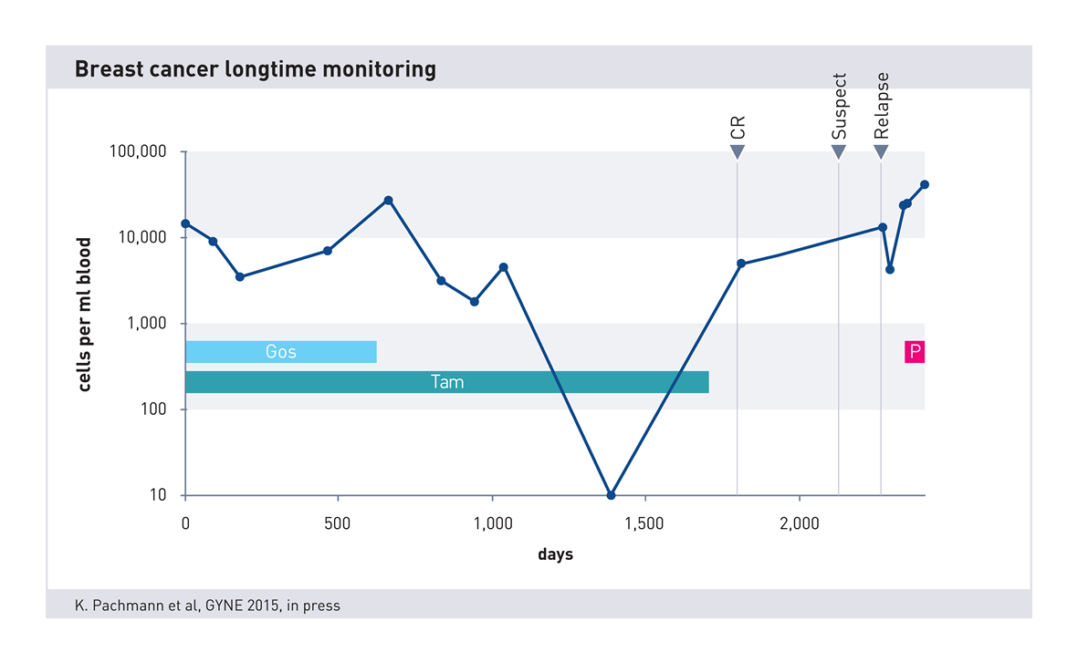
Longtime surveillance

Slide 18
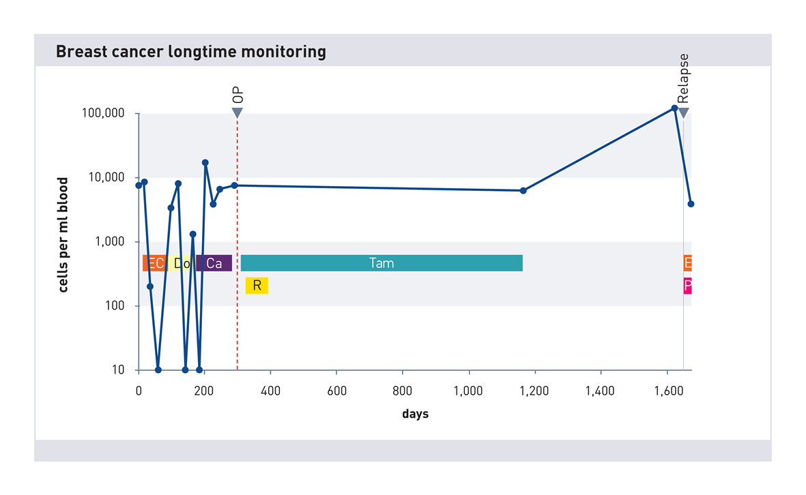
Longtime surveillance

Slide 19
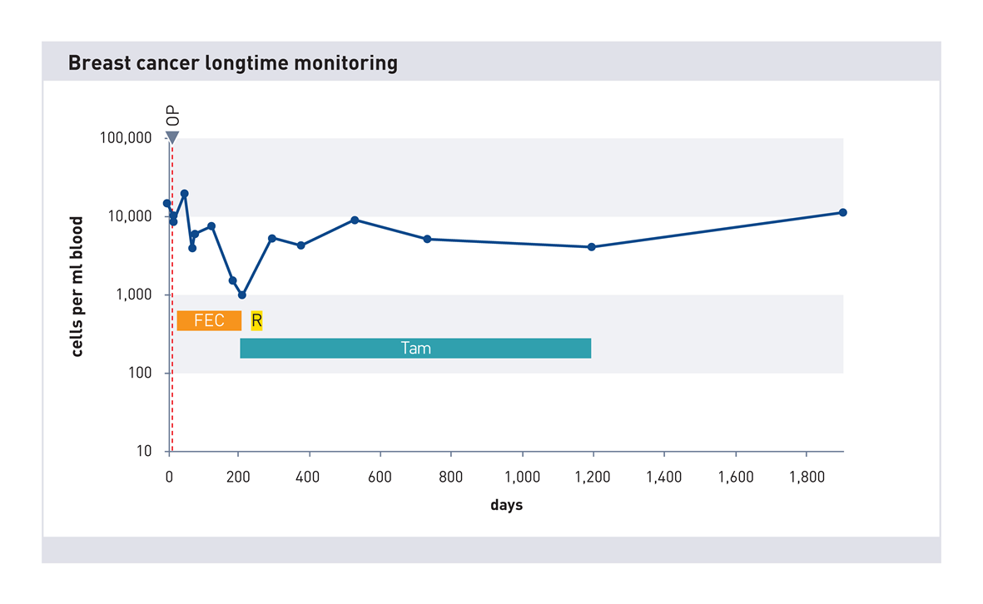
Longtime surveillance

Slide 20
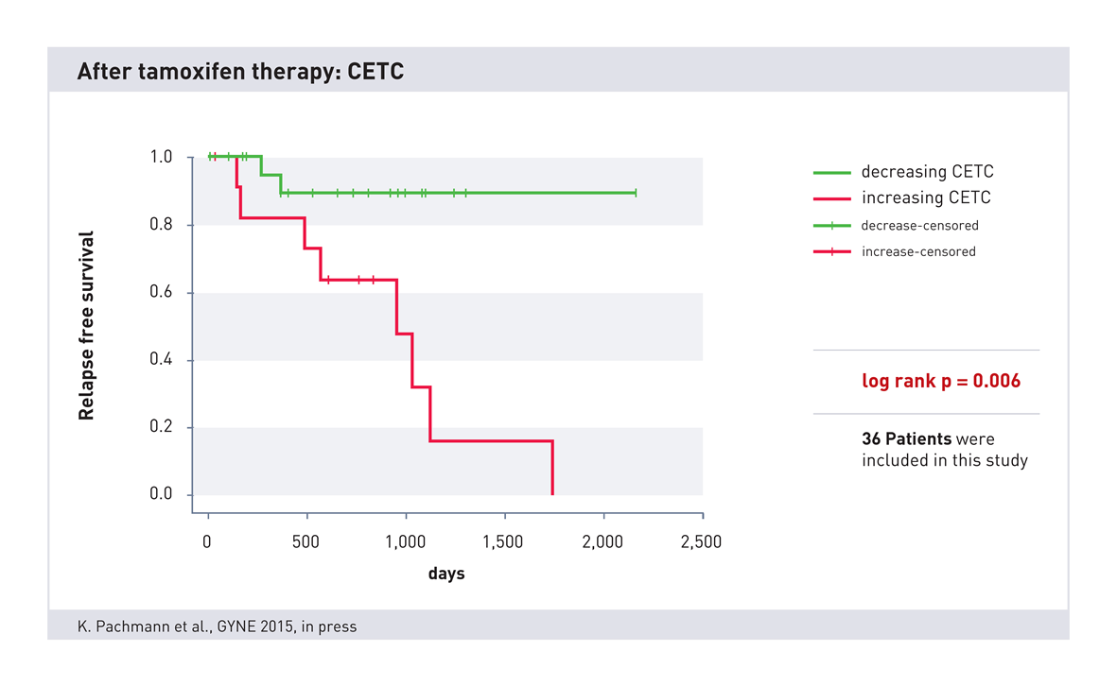
Tamoxifen: 5 or 10 years?

Slide 21
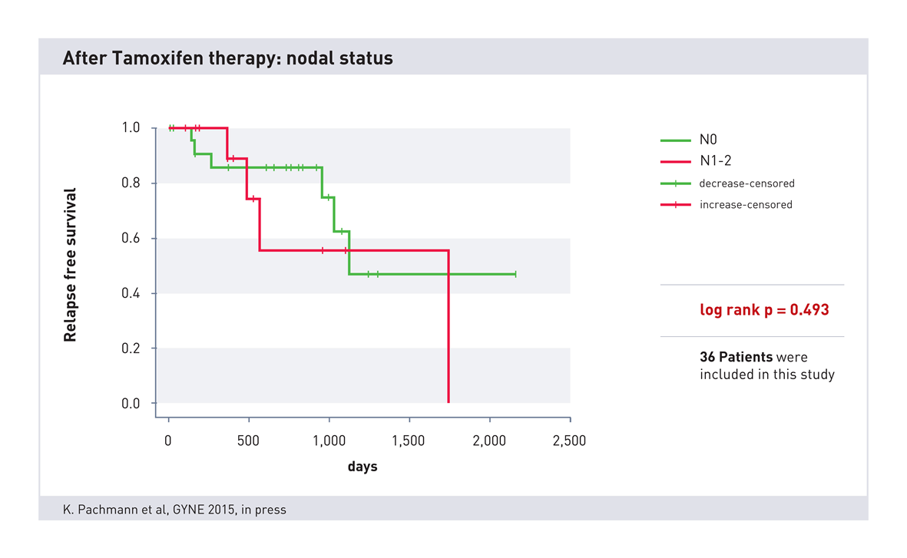
Nach Tamoxifen Therapie: Nodalstatus

Slide 22
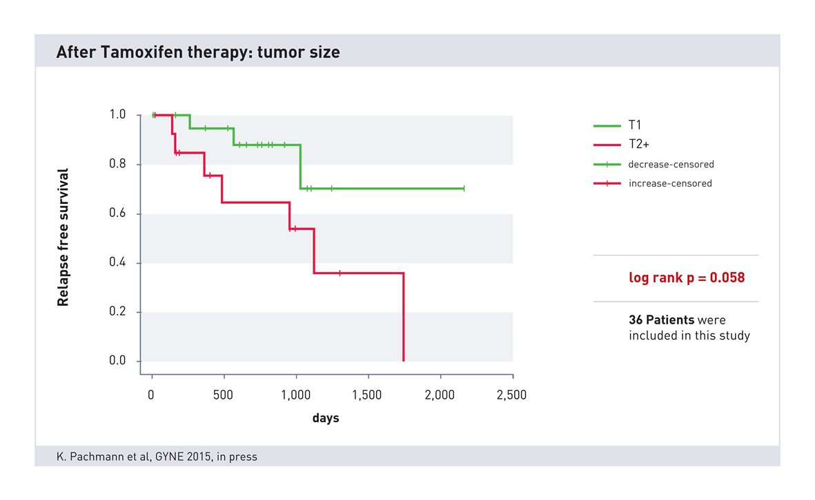
Nach Tamoxifen Therapie: Tumorgröße

Slide 23
End of therapy
During therapy and 4-6 weeks after end of therapy a measurement
Increase of cell number
Decrease/stable cell numbers
Go ahead with therapy
Restart therapy
After 3 month cell number determination
After 3-6 month cell number determination
If cell number increases,
restart anti-hormon therapy
Every 3-6 month cell number control

Slide 24
Ende der Therapie
Während der Therapie und 4-6 Wochen nach Abschluss der Therapie eine Messung
Anstieg der Zellzahl
Absinken/ Gleichbleiben der Zellzahl
Therapie fortführen
Erneute Aufnahme der Therapie
Nach 3 Monaten Zellzahl bestimmen
Nach 3-6 Monaten Zellzahl bestimmen
Falls die Zellzahlen ansteigen,
erneut mit antihormoneller Therapie beginnen
Alle 3-6 Monate Zellzahl überprüfen
????????????????

Slide 25
Antihormonelle Therapie und zirkulierende Tumorzellen

Slide 26
General Principals of Adjuvanten, Endocine Therapy AGO ++ (02/2015)
Standard Therapy duration 5 years
Therapy duration up to 10 years after individuel risk benefit evaluation especially in case of higher risk (i.e. N+)
Duration, choice & sequence of AI or Tam depending on menopause status and side effects
Change to different endocrine therapy (Tam or AI) is better than to stopp
AI as first Therapy especially for post menopausal pat. with high risk and lobular carcinoma
Up to date no evidence for AI > 5 years

Slide 27
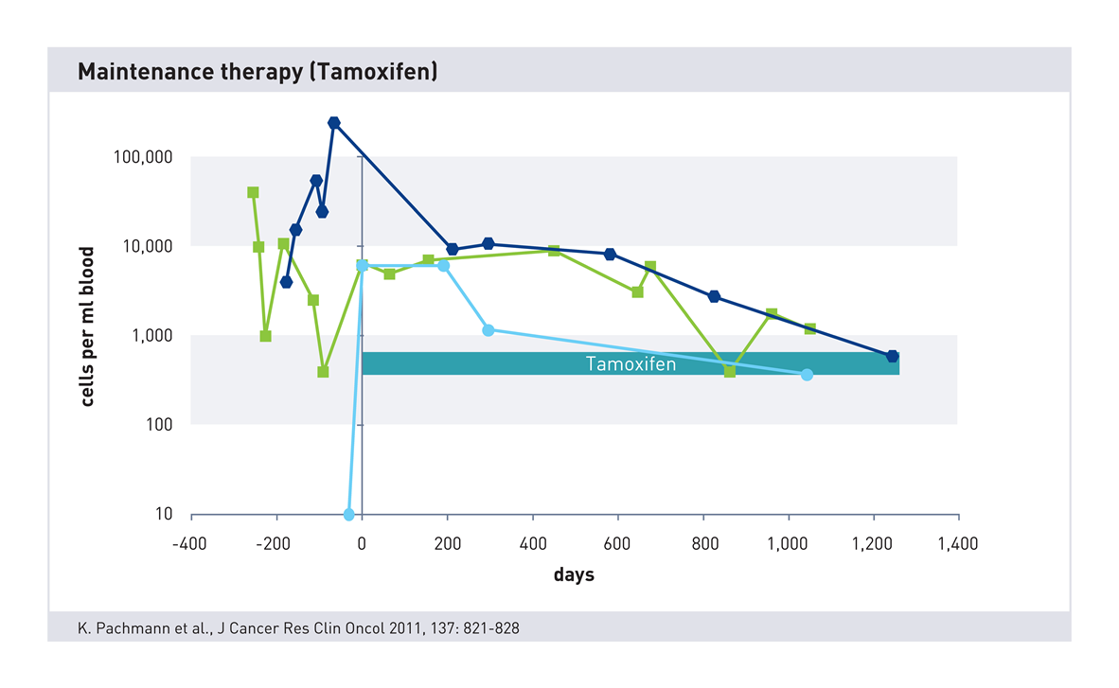
Maintenance Therapy under Tamoxifen

Slide 28
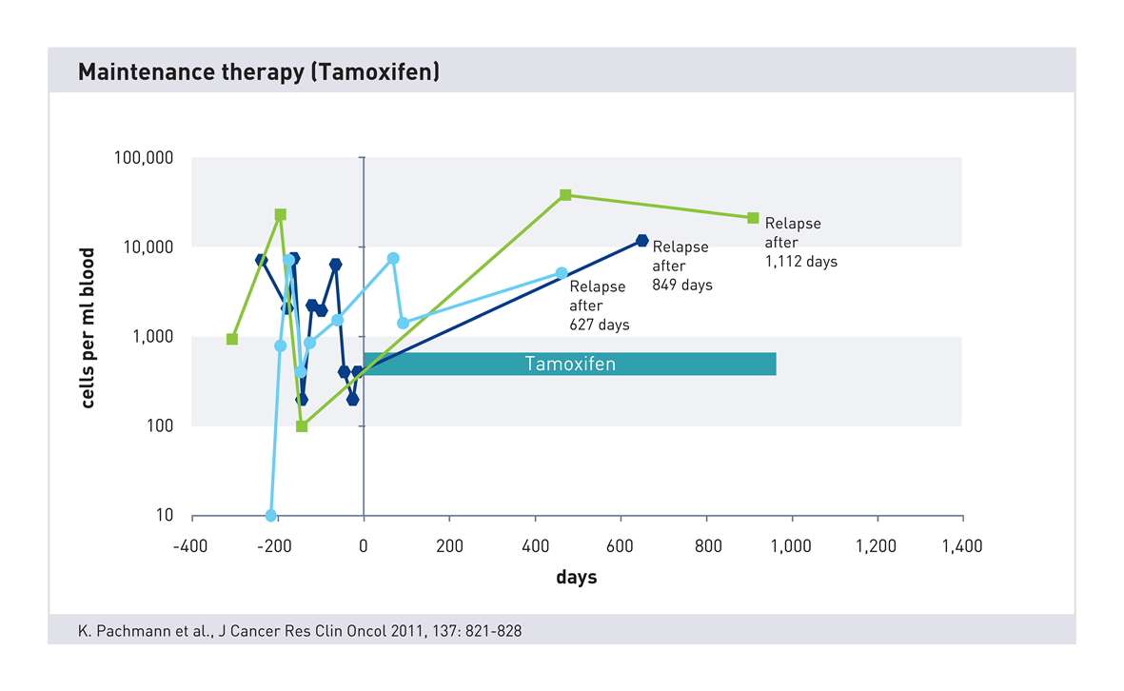
Maintenance Therapy
under Tamoxifen
Continious increase
during Tamoxifen therapy
often leads
to relapse

Slide 29
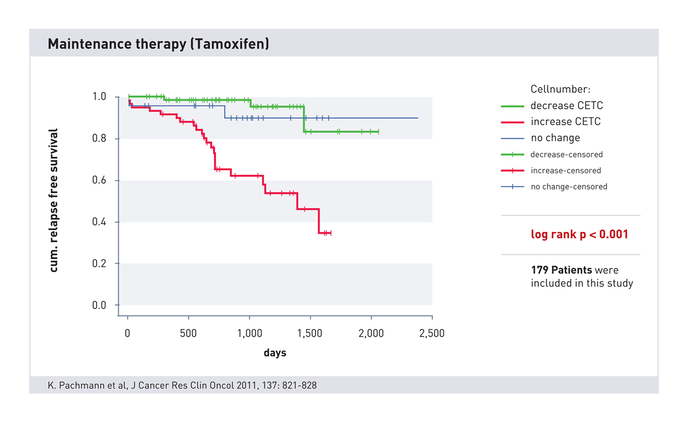
Outcome clinical trial
Notes:
No Change:
Keine Änderung während der Therapie = schlafende Zellen = Anstieg nach der Therapie

Slide 30
Chemosensitivity

Slide 31
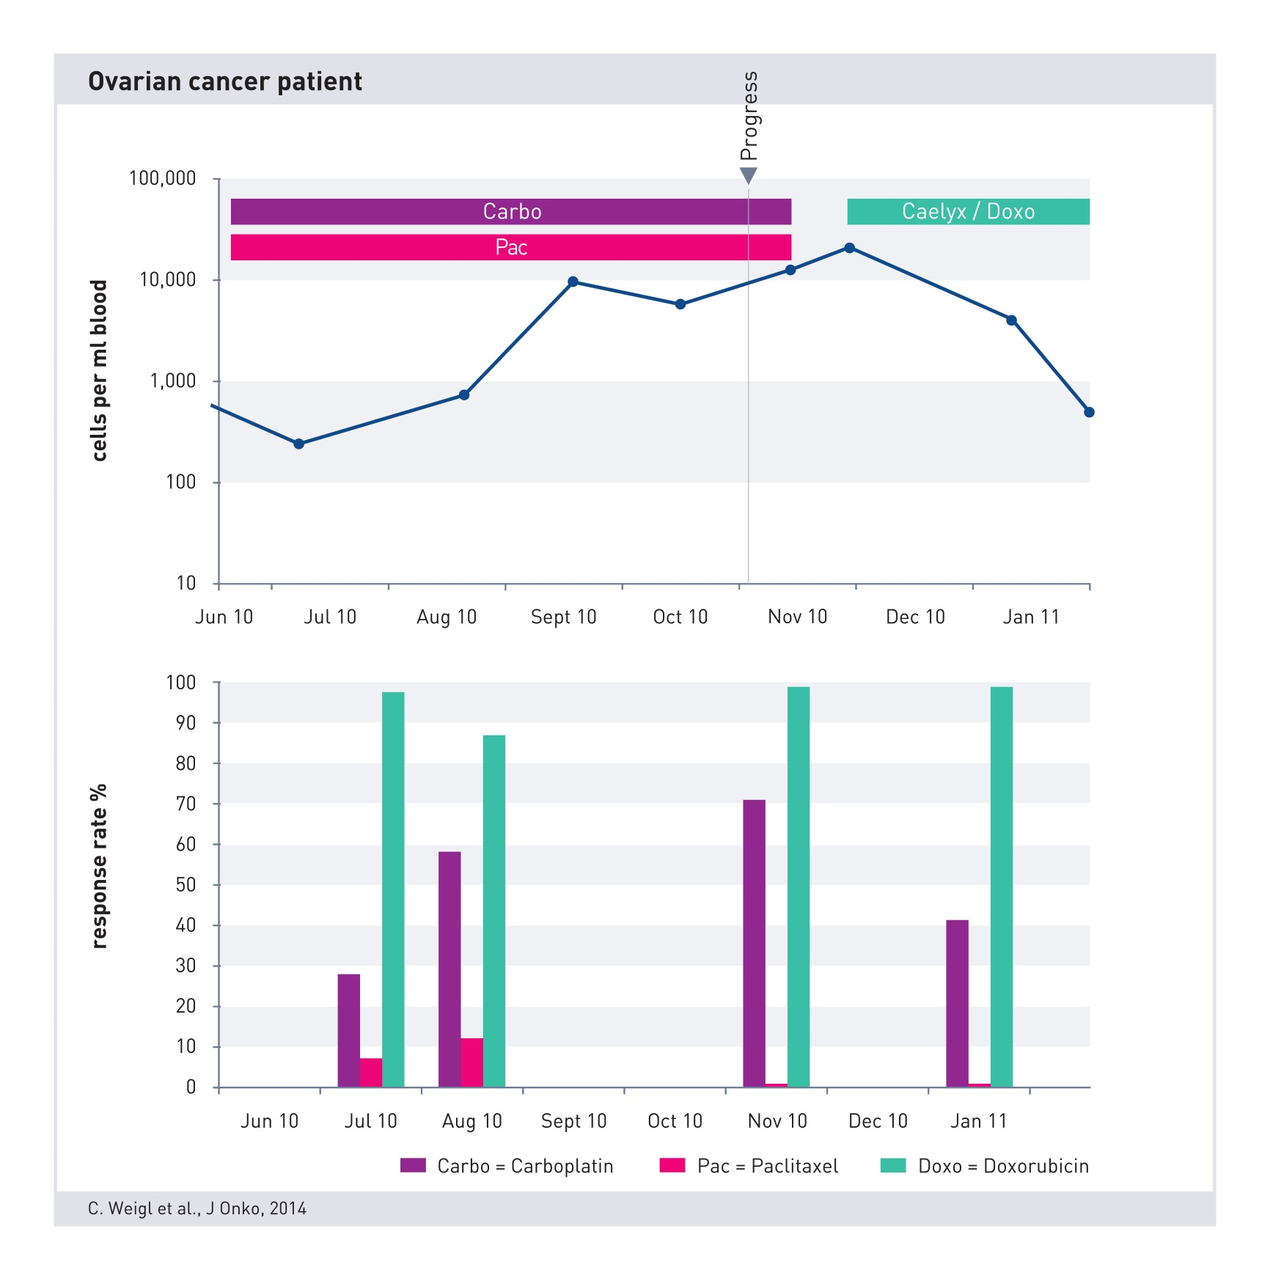
Ovarialkarzinom Patientin

Slide 32
Characterisation of CETC

Slide 33



Marker
Estrogen receptor
Androgen receptor
Progesteron receptor
PSA/PSMA
FISH EGFR
…

Slide 34
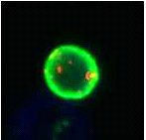
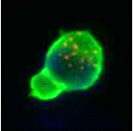
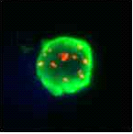
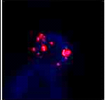
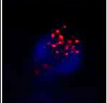
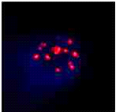
FISH test: HER2/neu
EpCAM positive cells with amplified signal of the Her2/neu genes

Slide 35
Other Diagnostic Methods

Slide 36
CETC/CTC
Maintrac®
Other CTC methods
Quantitative:
  no fixation!
  no isolation!
  no enrichment!
Living cells
High reproducibility
Therapy control (monitoring)
96 Well based → High throughput
Already used in clinical/all day routine (>100.000 tests)
>650 patients in clinical trials
Almost all methods use selection, fixation, isolation
→ loss of > 90% of CTCs
Measurement of dead cells
Not suitable for repeated measurement (no monitoring!)
No treatment control
All are still scientific methods
Most have no or insufficient clinical data

Slide 37
Maintrac® vs cfDNA/ctDNA
Maintrac®
cfDNA
Maintrac® measures the present tumor state
Quantitative measurement and monitoring
EpCam positive, epithelial cells are measured, covering almost all tumor cells
cfDNA measures only the past of the tumor (dead cells).
origin of DNA is unclear, no reference to actual present tumor cells
Difficult measurement technique
Only targeted genes are detected, missing of other yet unknown tumor mutations

Slide 38
Summary

Slide 39
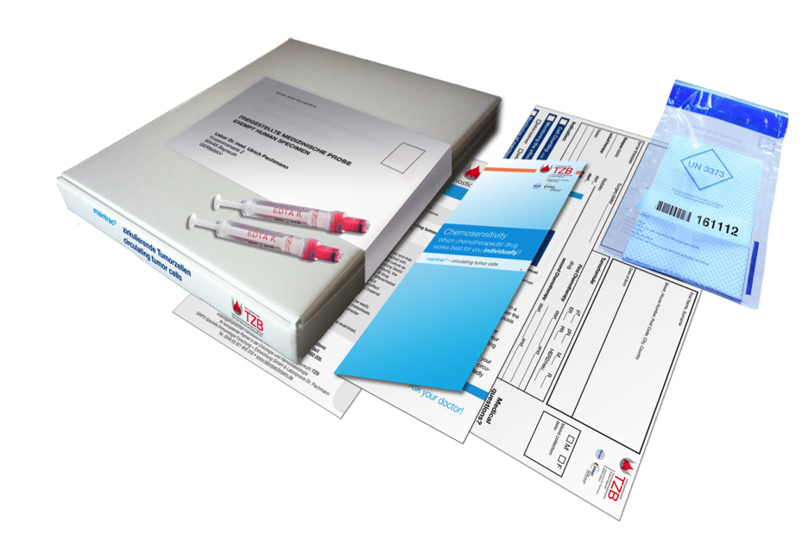
Blood Sample Transportation

Slide 40
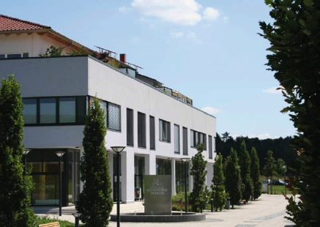
Courier Shipment
Within 72 h
At room temperature
To our laboratory in Bayreuth, Germany
Medical result usually 4-5 days after sample arrival

Slide 41
Discussion
Epithelial cells are not necessarily tumor cells!
  Yes, but healthy epithelial cells are after a surgery/inflamation only for a short time in the blood stream; cancer cells remain however very long (up to 10 years)
  Increase by factor 5 or more is important, not from 900 to 1500!
Clinical data?
  >100.000 worldwide maintrac mesurements
  650 patients in clinical studies published (80 % Breast cancer)
  Fluctuations observed when patient do not comply with maintenance therapy → restart of therapy very favorable
  Testing of blood samples has no clinical or therpeutic relevance?
  → Change or ongoing medication is not relevant?

Slide 42
maintrac®
CETC als Erfolgsparameter, prognostischer und prädiktiver Marker für personalisierte Therapieentscheidungen
Quantitative Erfassung der CETC
Höchste Sensitivität auch bei Patienten mit Primärtumor
Verlaufs- und Erfolgskontrolle während der Tumortherapie
Charakterisierung therapierelevanter Tumoreigenschaften
Identifikation der wirksamsten Therapien
Langzeitüberwachung auch 10 Jahre nach einer Krebsdiagnose
Echtzeitkontrolle durch eine Blutprobe von 15ml

Slide 43
Thank you for your attention www.dmb-diagnostics.de

Slide 45
Arbeitsgemeinschaft
Transfusionsmedizinisches Zentrum Bayreuth TZB
SIMFO Spezielle Immunologie Forschung + Entwicklung GmbH
& Labor Dr. Pachmann
Dr. rer. nat. Stefan Schuster
sschuster@simfo.de
Kurpromenade 2
95448 Bayreuth
Germany
www.maintrac.de

Slide 46
Increasing cell numbers
What can we do?

Slide 47


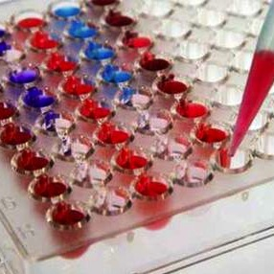
Chemo-sensitivity
Comparing deathrate
of circulating tumor cells
under different medications
in a blood sample

Slide 48
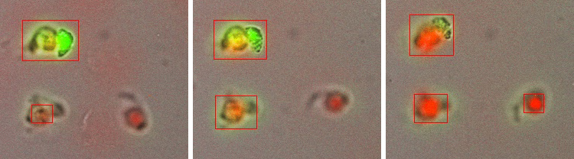
The mortality rate of the CETCs is measured over the time in the presence of medication

Slide 49
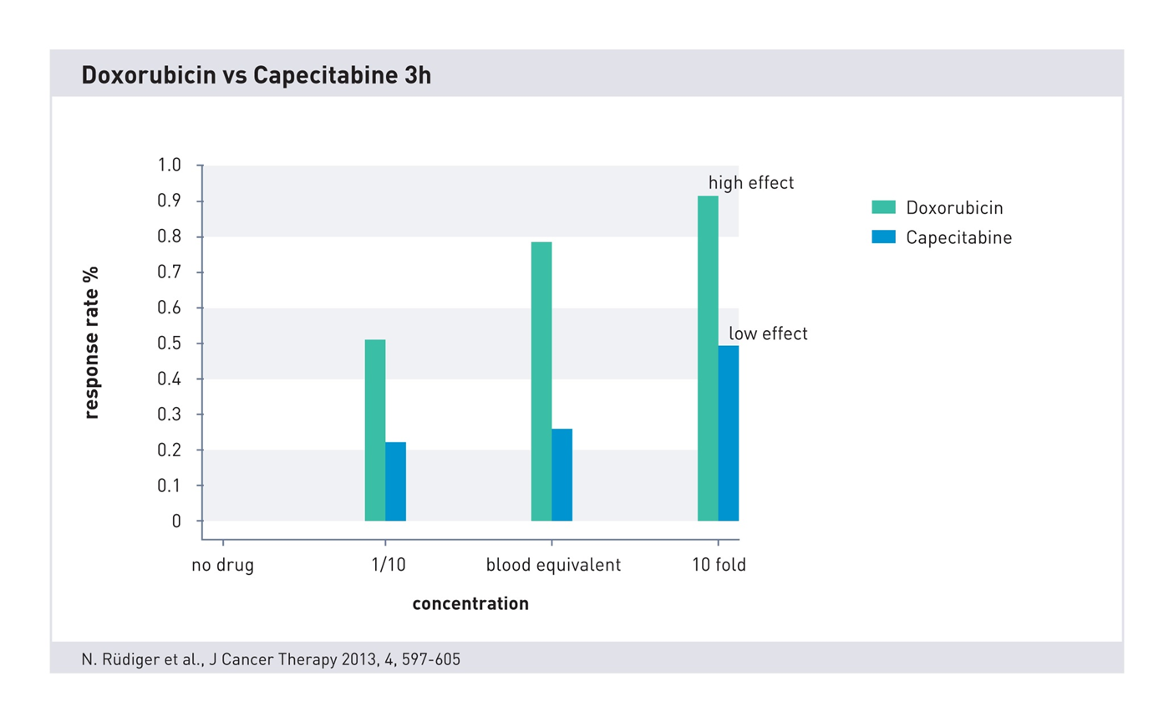
Notes:
49
49
Absterberate gegenüber einer Probe ohne Medikamentenzusatz zu drei verschiedenen Zeitpunkten mit drei verschiedenen Konzentrationen

Slide 50
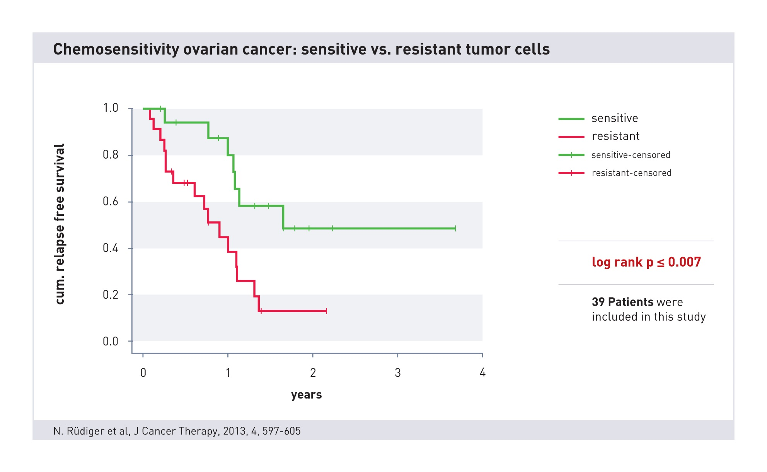
Impact of Chemosensitivity testing
Notes:
50
Patientinnen mit chemosensitiven Zellen haben unter der Leitlinientherapie ein signifikant besseres Überleben als Patientinnen mit chemoresistenten Zellen, für sie müssten andere Medikamente gewählt werden

Slide 51
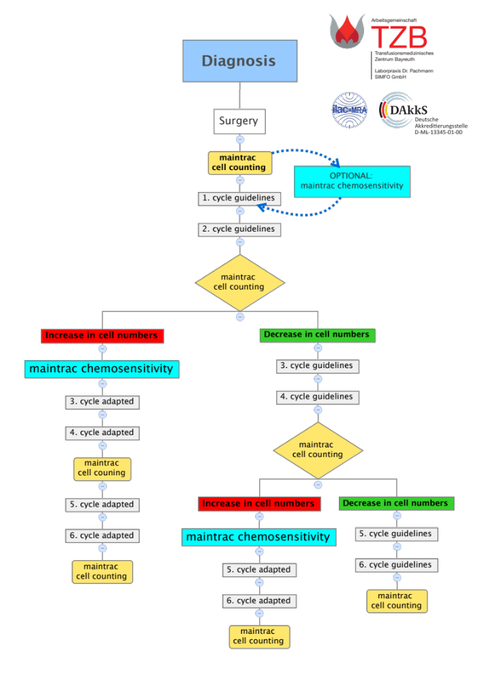
If cell numbers are increasing, it is
advisable to perform chemosensitivity to
determine the drug with the best efficiency.

Slide 52
Conclusion
CETCs can be identified and characterized
Maintrac is quantitative
Chemosensitivity can be measured
CETC measurement adds a big value to nowadays cancer therapy and is therefore already used in over 30 countries in daily routine!

Slide 53
Arbeitsgemeinschaft
Transfusionsmedizinisches Zentrum Bayreuth TZB
SIMFO Spezielle Immunologie Forschung + Entwicklung GmbH
& Labor Dr. Pachmann
Kurpromenade 2
95448 Bayreuth
Germany
www.maintrac.com
www.dmb-diagnostics.de

Slide 54
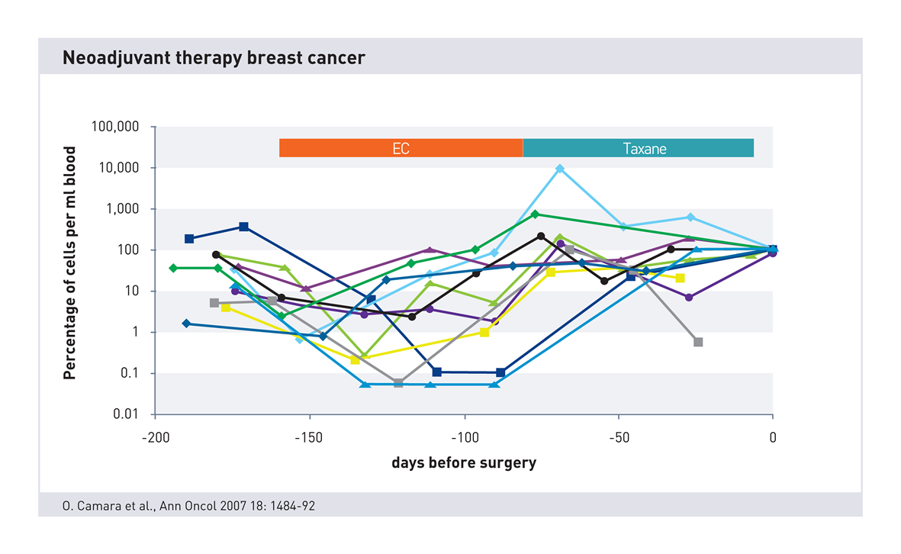
Neoadjuvant treatment
At the end of neoadjuvant therapy
all patients experience increasing numbers of vital CECTs !

Slide 55
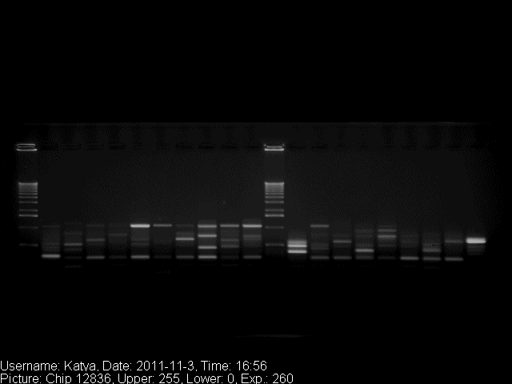
Genetic Heterogeneity of CETCs
Notes:
Heterogenität der genetischen Mutationen von EGFR bei einem Patienten mit Bronchial Karzinom. EGFR Mutationen kommen v.a. Exon 18-21 vor

Slide 56
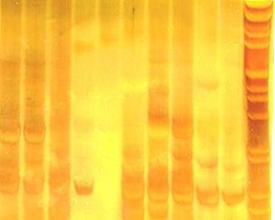
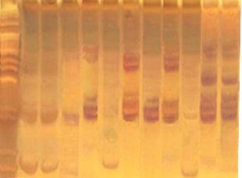

Changes of gene expression in CETCs
Pre surgery
Post surgery
NANOG
EpCam (420 Bp)
Her2/Neu (376 Bp)
Vimentin (327 Bp)
Gremlin (264 Bp)
RPL 13 A (229 Bp)
NANOG:
Important transcription factor, involved in the control of self renvewal of stem cells.
Overexpression allows human embryonic stem cells retention of the pluripotency.
Gremlin 1 (grem 1):
Antagonist of BMPs (Bone morphogenetic proteins ) in the TGF beta signaling pathway.
Probably BMP antagonists are important for the survival of tumor stroma and proliferation of certain cancers
RPL 13 A
Part of the 60s subunit of the ribosome.
Extraribosomale extraribosomale tasks: Part of GAIT complex (gamma interferon-activated inhibitor of translation), which influences the inflammation process
Pizon M. et al, Ecancermedicalscience. 2013 Aug 23;7:343

Slide 57
Evaluation

Slide 58
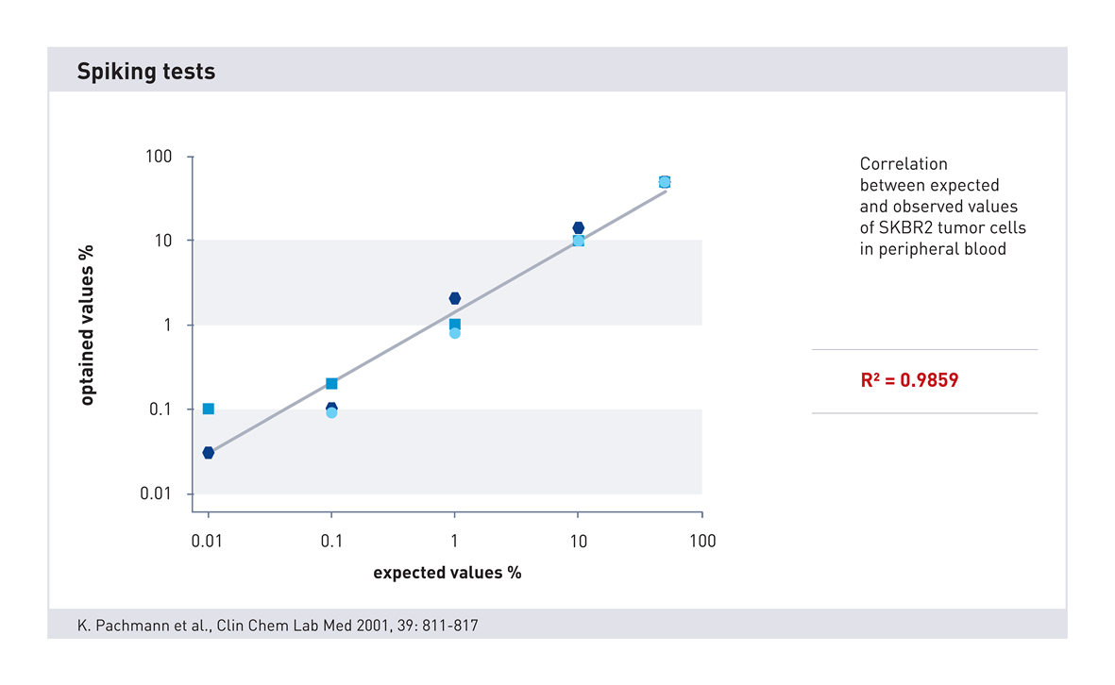
Spiking Tests

Slide 59
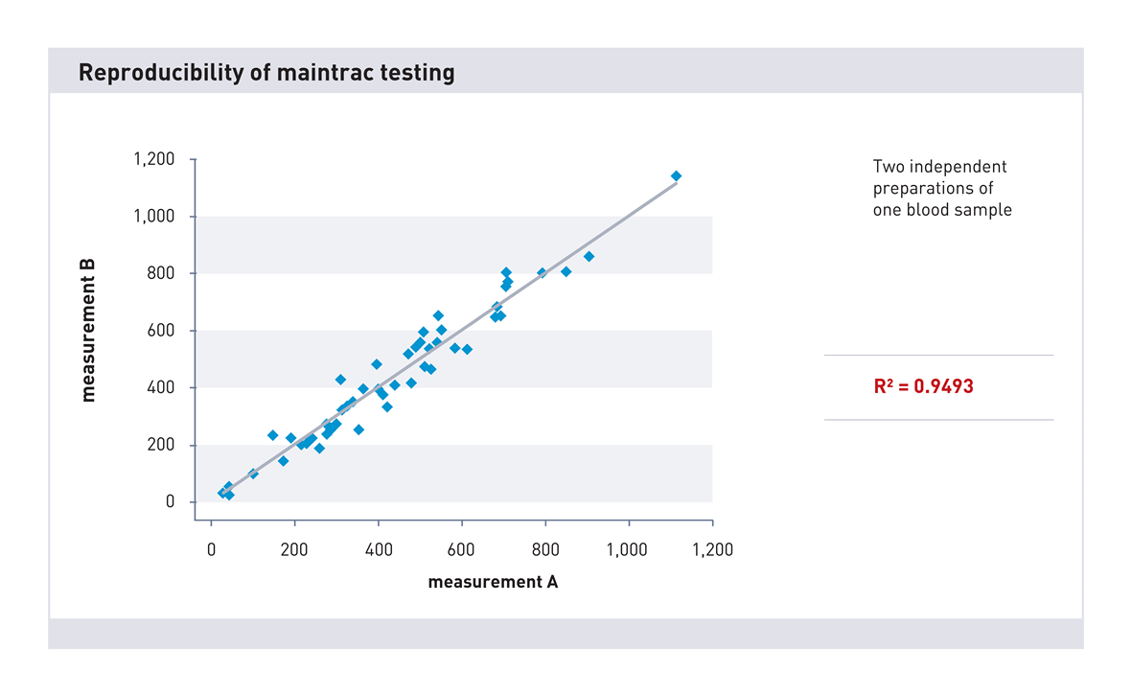
Reproducibility of maintrac testing
Notes:
Zwei unabhängige Zellpräparationen aus demselben Blut

Slide 60
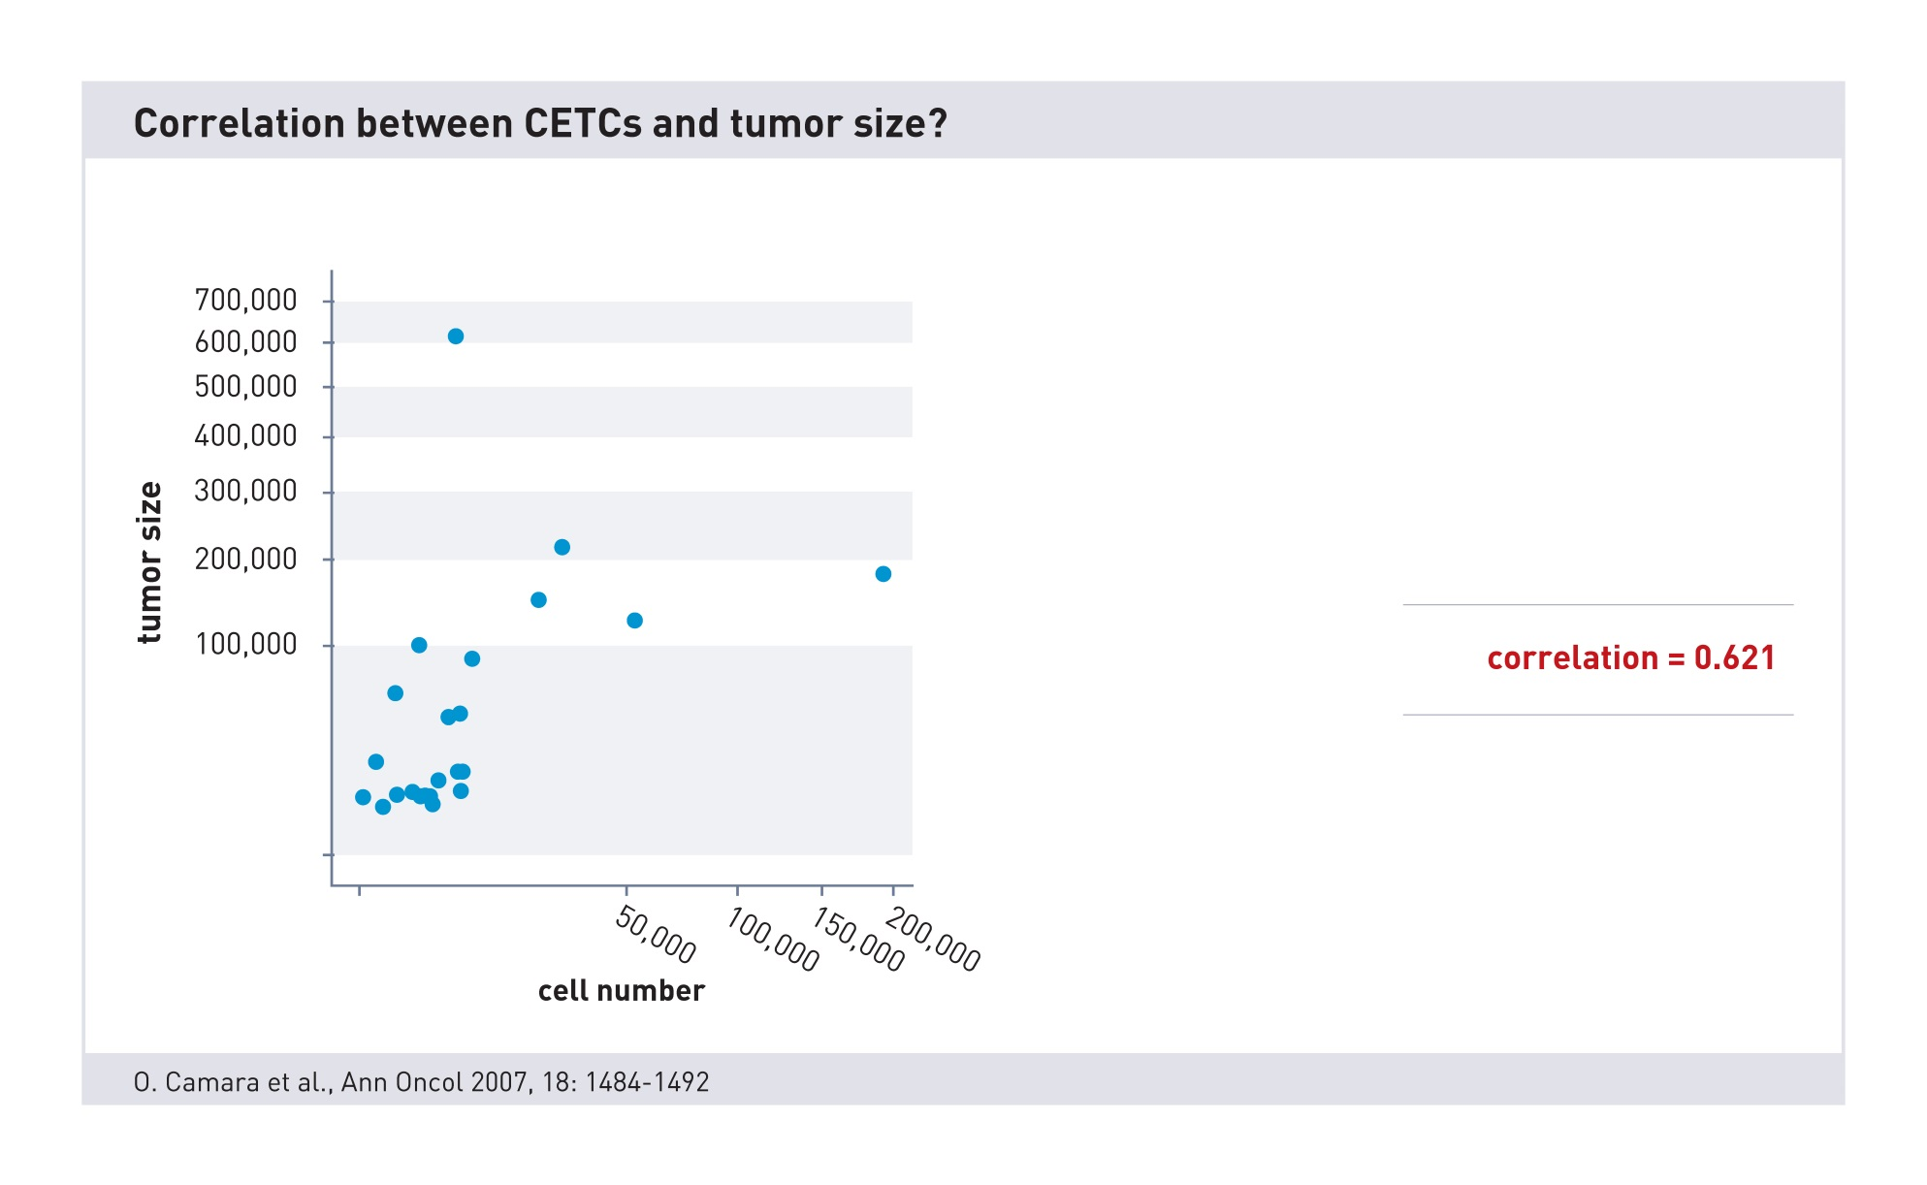
CETCs and tumor size

Slide 61
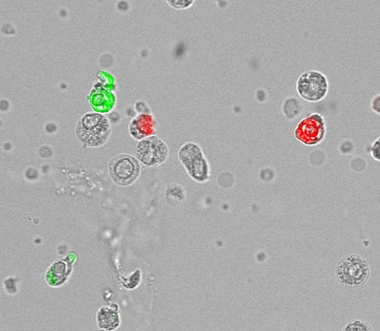
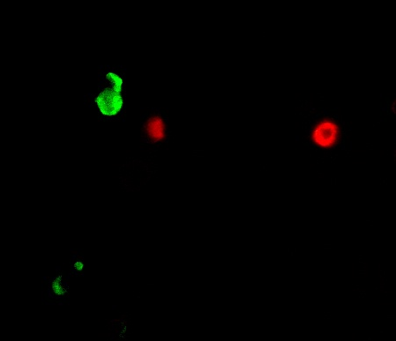
EpCAM + CD45
EpCAM + CD45

Slide 62
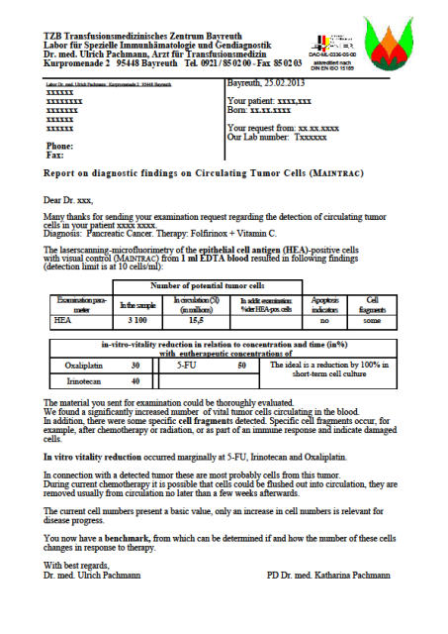
Sample Letter

Slide 63
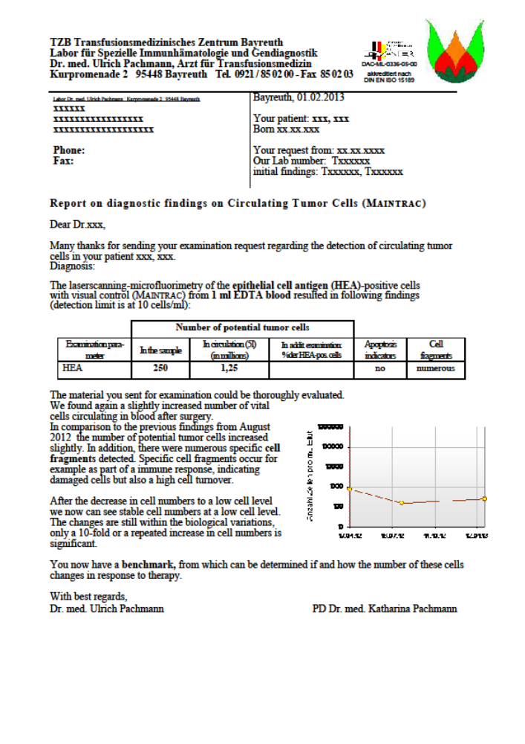
Sample Letter

