Slide 1

Effect of Passivation on Suppression or
Utilization of Atomic Migration Phenomena
in Metallic Thin-film Materials
M. Saka
Tohoku University
Sendai, Japan
Saka-01

Slide 2
SKIN
Environment
Human Body
Fig. 1
Saka-02

Slide 3
Passivation
(Natural oxide film, Artificial)
Metallic material
Atoms
(ia)
(ib)
Depletion
Accumulation
Accumulation of
Atoms Hillock
Depletion of
Atoms Void
(iib)
e⁻
Electron Flow e⁻
Back Flow
(iia)
(iiib)
e⁻
(a) EM without Passivation
(No Back Flow)
(b) EM with Passivation
Fig. 2
Saka-03

Slide 4
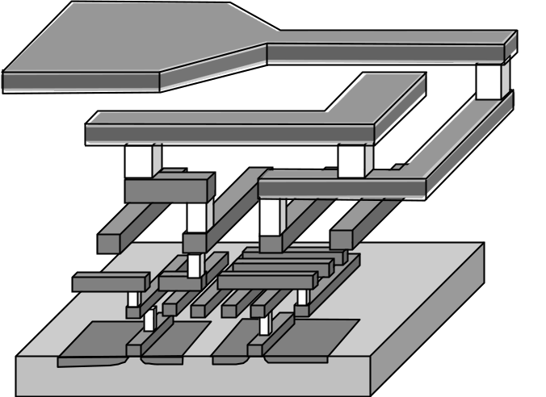
Pad
. . . .
Via
Third layer
Multi-level interconnections
Second layer
First layer
Gate
Fig. 3
H. Abé, K. Sasagawa & M. Saka, Int. J. Fracture, (2006)
Saka-04

Slide 5
CONTENTS
(Atomic Migration in Metallic Thin-film Materials in Relation
with PASSIVATION)
■ Electromigration(EM) in Straight Thin-film Line
■ EM in Corner Part Composed of Dissimilar Metals
without Passivation
with Passivation
without Passivation
with Passivation
■ Fabrication of Micro Materials Based on EM with
Passivation
■ Fabrication of Micro and Nano Materials Based on
Stress Migration(SM) with Passivation
Saka-05

Slide 6
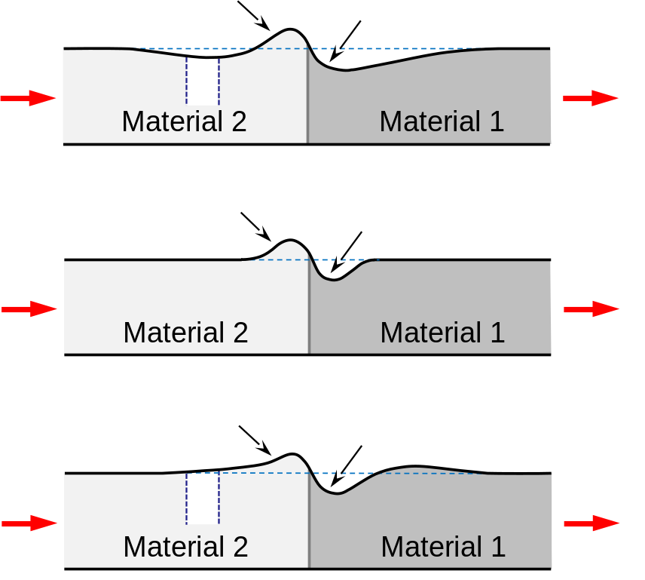
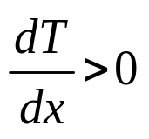
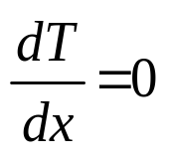
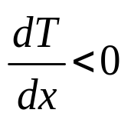
■EM in Straight Thin-film Line
(without Passivation)
Hillock
Void
(a)
e⁻
e⁻
x
Hillock
Void
(b)
e⁻
e⁻
Hillock
Void
(c)
e⁻
e⁻
T : absolute temperature
Fig. 4
M. Aoyama & M. Saka, Microsyst. Technol., (2015)
Saka-06

Slide 7

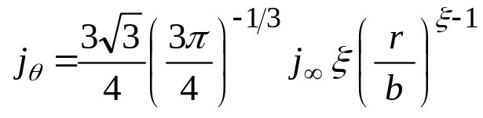

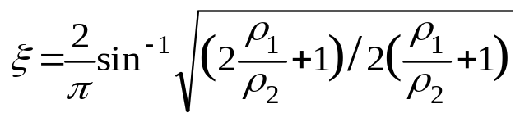
■EM in Corner Part Composed of Dissimilar Metals
(without Passivation)
j∞
Material 2
b
r
ρ₂
θ
Material 1
ρ₁
Fig. 6
b
j∞
Circumferential component of current density vector at θ = π/2
Area size of j_{θ} concentration
(3)
(4)
Volume of accumulation and depletion of atoms at θ = π/2
M. Saka & X. Zhao, Int. J. Heat and Mass Transfer, (2012);
Y. Kimura, X. Zhao & M. Saka, Proc. APCF/SIF-2014, (2014)
Saka-09

Slide 8
(with Passivation)
Material 2
b
ρ₂
θ₂
j∞
θ₁
Electrically insulated
r
θ
ρ₁
b
Material 1
j∞
Fig. 7
M. Saka, Y. Kimura & X. Zhao, (2016)
Saka-10

Slide 9
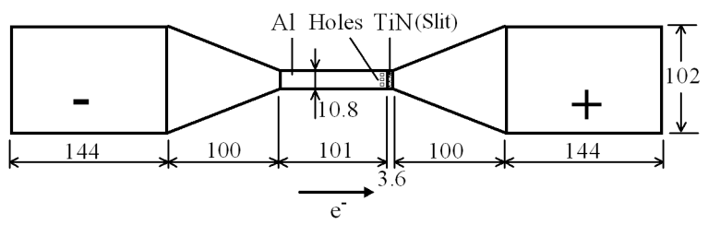
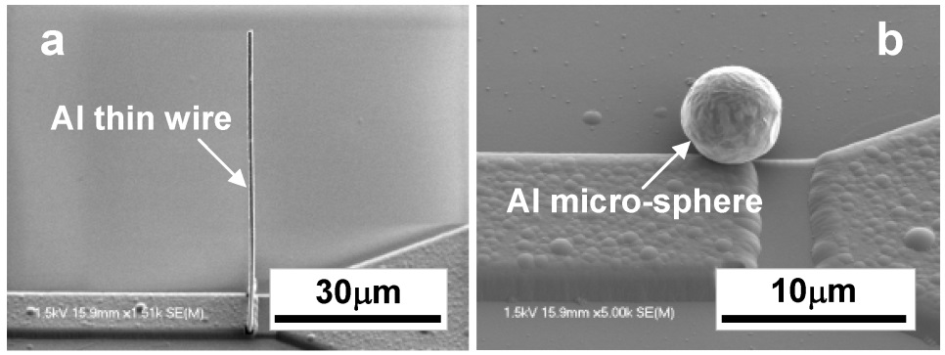
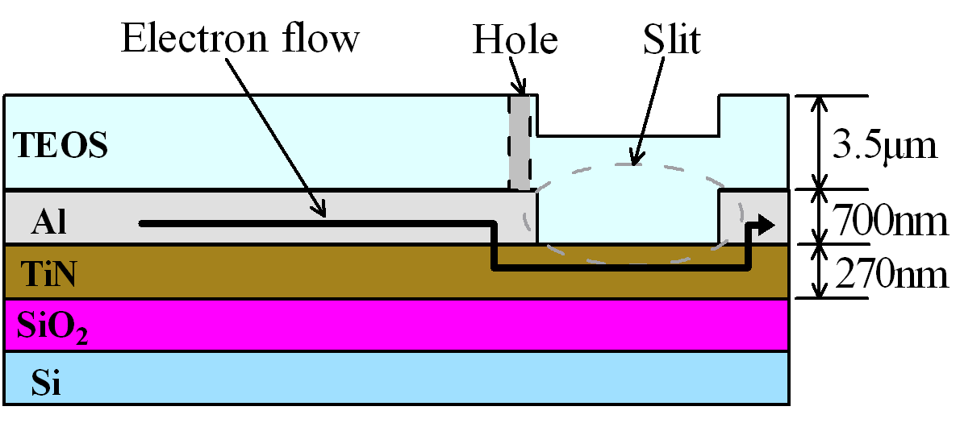
■Fabrication of Micro Materials Based on EM with
Passivation
(a)
(b)
: μm
PASSIVATION
Fig. 12
Fig. 13
M. Saka, H. Tohmyoh, M. Muraoka, Y. Ju & K. Sasagawa, Mater. Sci. Forum, (2009)
Saka-17

Slide 10
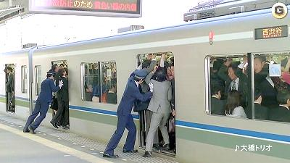

■Fabrication of Micro and Nano Materials Based on
SM with Passivation
σ : compressive hydrostatic stress
gradσ : driving force of SM
(from Google Web)
Fig. 14
M. Saka ed., Metallic Micro and Nano Materials, (2011)
Saka-18

Slide 11
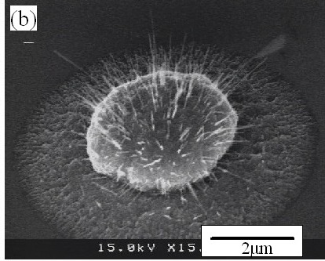
Passivation(Artificial or
Oxide Film) on Surface
of Metallic Material
Atoms are discharged
through Weak Spots
Hillock, Wire
Weak spot
Cu₂O
Cu NW
Thermal-compressive hydrostatic
stress
Hillock
Hole
Hillock
Hillock
Ta
Ta
Ta
Cu
Cu
Cu
Ta
Ta
Ta
SiO2
SiO2
SiO2
Si
Si
Si
Fig. 15
Fig. 16
M. Saka, H. Tohmyoh, M. Muraoka, Y. Ju & K. Sasagawa,
Mater. Sci. Forum, (2009)
Saka-19

Slide 12
●Ag thin wires
(1～2μm diameter, ～680μm length)
[ Thick Brittle TiN (600nm) Passivation ]
●Ag micro-particles
[ Thin TiN (2nm) Passivation ]
Atomic discharge
Crack
TiN (600 nm)
Ag (300 nm)
Ti (300 nm)
Cu foil (80 μm)
Tensile (+)
Compressive (-)
Tensile (+)
N
M
Grain boundary
Ag atom
Fig. 17
Y. Lu, Y. Li & M. Saka, Mater. Lett., (2016)
Saka-20

Slide 13

CONCLUSIONS
Suppression or Utilization of Atomic Migration (EM, SM)
in Relation with PASSIVATION
Fig. 13(a)
Fig. 16
This work was supported by JSPS KAKENHI Grant-in-Aid for Scientific Research (B) No.26289001.
Saka-21

