Slide 1

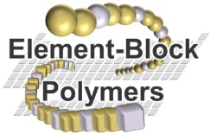

4th International Conference on Nanotek & Expo
December 01-03, 2014, San Francisco, USA
Construction, Functionalization, and Organization of Dendrimer with Conjugated Backbones
Masatoshi Kozaki*, Shuichi Suzuki, Keiji Okada
Graduate School of Science, Osaka City University, Osaka 558-8585 Japan
E-mail: kozaki@sci.osaka-cu.ac.jp

Slide 2
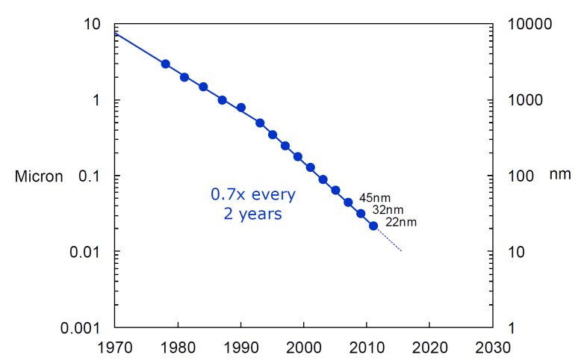
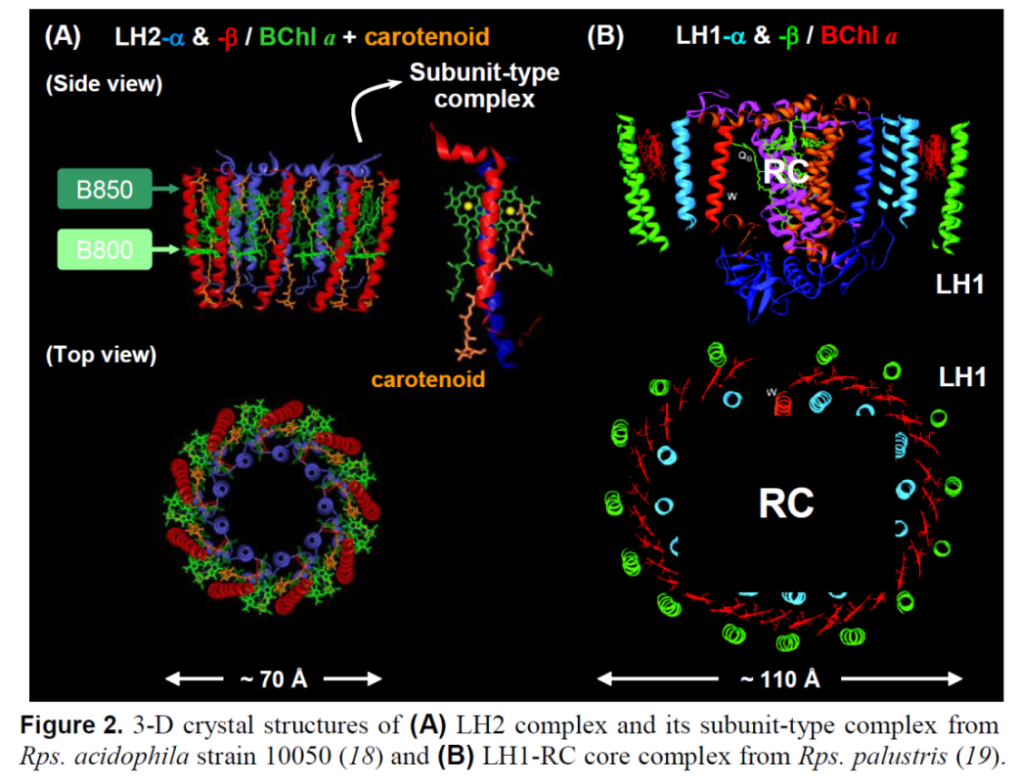
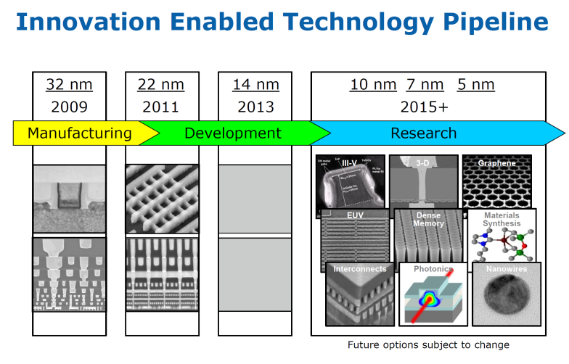
Top-down and Bottom-up Approach to
Nano-scale Architectures
Moore’s Low
7.0 nm
11.0 nm
Bottom-up
Top-down

Slide 3
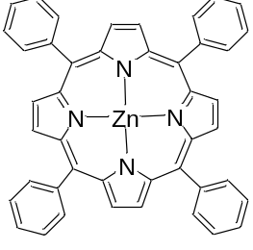
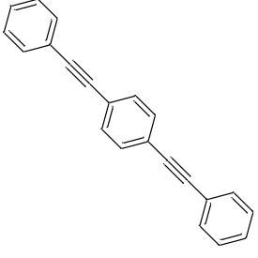
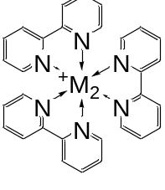
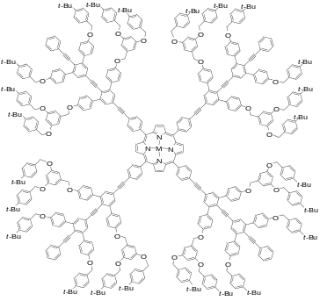
The Concept of the Stepwise Approach to
Nano-scale Architectures
Step 1 Precise Arrangement of Functional Units
Step 2
Integration of Dendrimers
Molecular Devices and Machines
Functional Units
Dendrimers

Slide 4
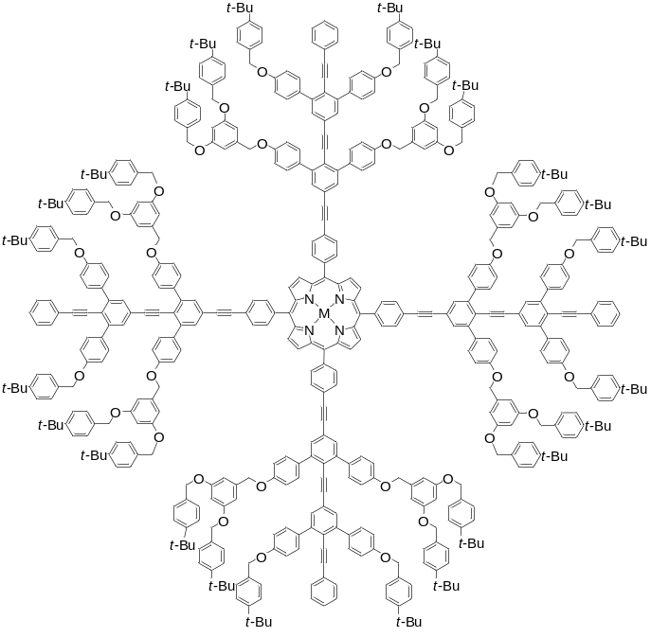
Introduction of Dendrimers with Rigid Backbones
1) A dendrimer has rigid conjugated backbones within the flexible dendritic structure.
2) The rigid backbone serves as a scaffold for the construction of a well-designed assembly as well as a mediator in both the electron and energy transfer processes
3) The rigid backbones are useful for the construction of well-organized nano-scale assembly of dendrimers.

Slide 5
How to make the Dendrimer
(Convergent Approach)
Kozaki, M.; Okada, K. Org. Lett. 2004, 6, 485-488.

Slide 6
Synthesis of a Conjugated Chain with Branched Side Chains

Slide 7
Functionalized Dendrons and Core units

Slide 8
Preparation of Dendrimer with Light-Harvesting Ability
dendrimer-16 (C₄₆₀H₃₃₂N₄O₃₂Zn: 6486)

Slide 9
Advantage of the Dendrimer with Conjugated Chains
(1) Jiang, D.-L.; Aida, T. J. Am. Chem. Soc. 1998, 120, 10895-10901.

Slide 10
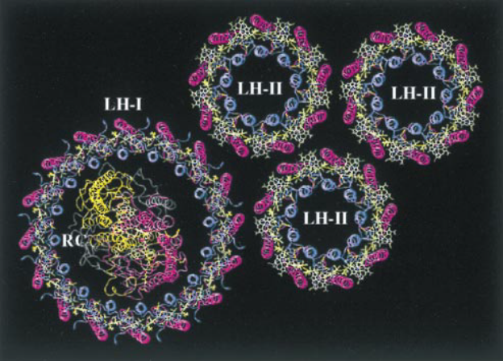
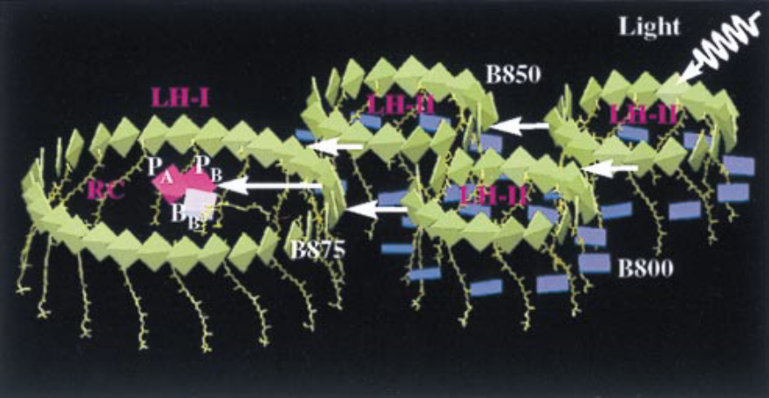
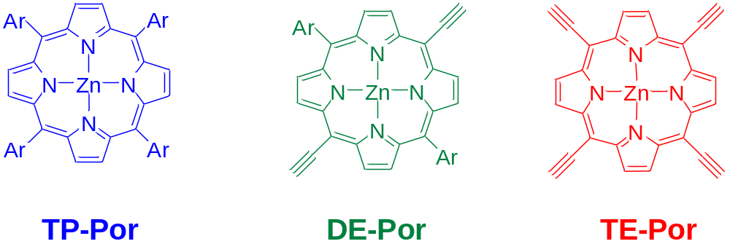
How to Make the Visible Light Harvester
(Biomimetic Strategy)
B800
B800
B875
B850
B875
B850
Figure 2. (a) Arrangement of pigment.protein complexes in the modeled bacterial PSU of Rb. sphaeroides. (b) Excitation transfer in the bacterial photosynthetic unit. LH-II contains two types of BChls, commonly referred to as B800 (dark blue) and B850 (green), which absorb at 800 nm and 850 nm, respectively. BChls in LH-I absorb at 875 nm and are labeled B875 (green). (Hu,X.; Damjanović, A.; Ritz, T.; Schulten, K. Proc. Natl. Acad. Sci. USA 1998, 95, 5935-5941.)

Slide 11
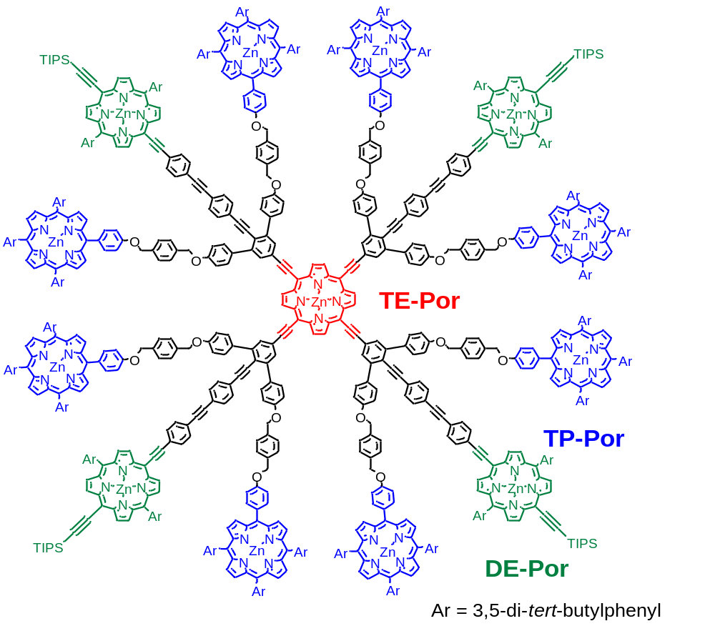
Strategic Arrangement of Porphyrins using the Dendritic Architecture
dendrimer-17 (C₁₀₁₆H₁₀₂₈N₅₂O₁₆Si₄Zn₁₃: 15186)
Uetomo, A.; Kozaki, M.; Suzuki, S.; Yamanaka, K.; Ito, O.; Okada, K. J. Am. Chem. Soc. 2011, 133, 13276-13279.

Slide 12
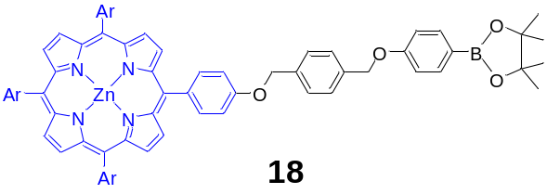
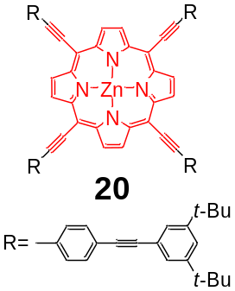
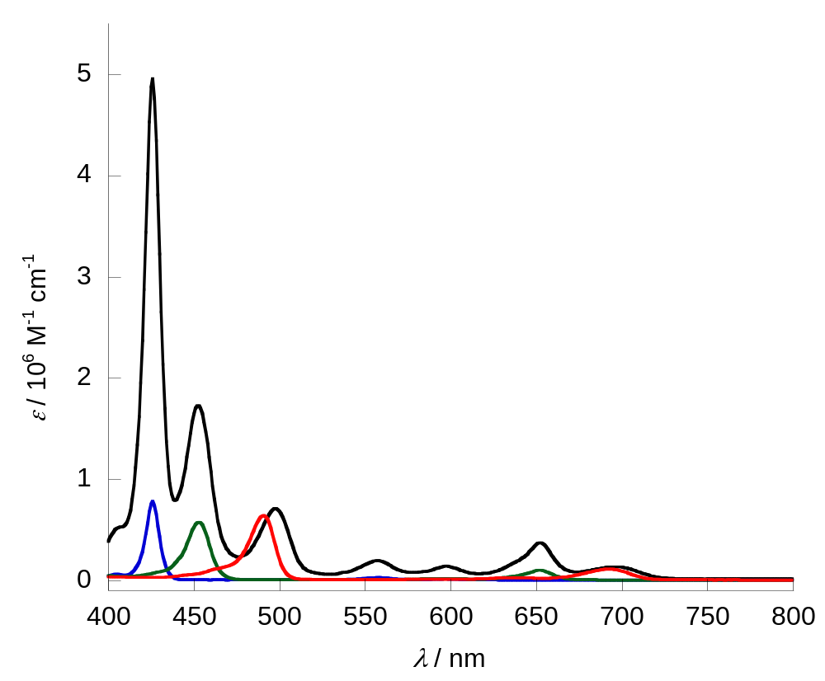
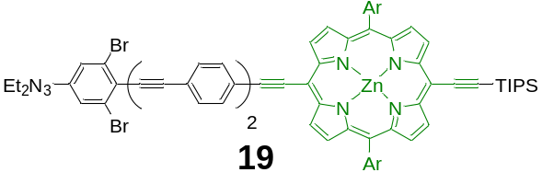
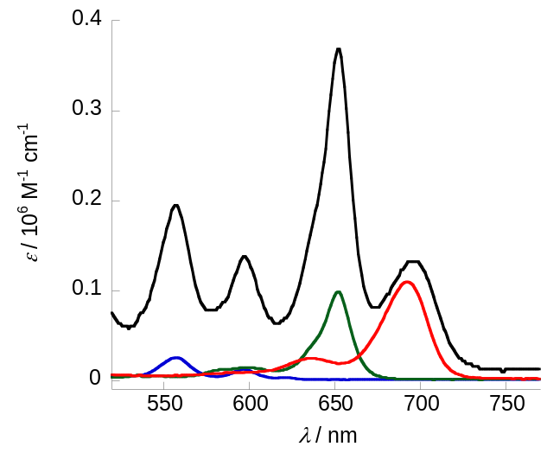
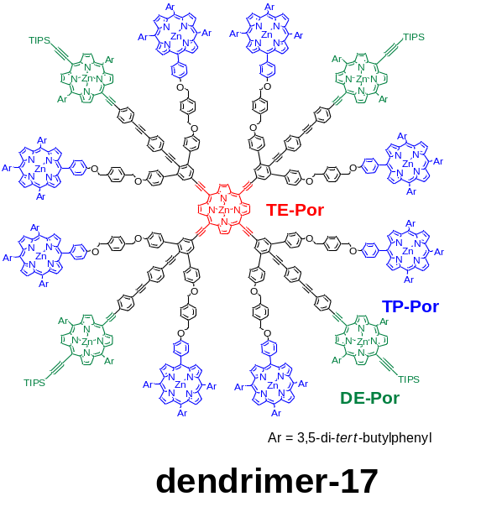
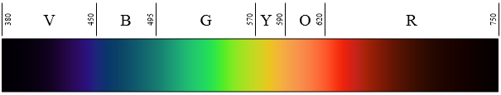
strong absorptions throughout the visible region ε > 56,000 M⁻¹ cm⁻¹
Figure 3. Absorption spectra of dendrimer-17 (black), 18 (blue), 19 (green), and 20 (red) measured in THF. The inset shows expanded absorption spectra in the Q-band region.

Slide 13
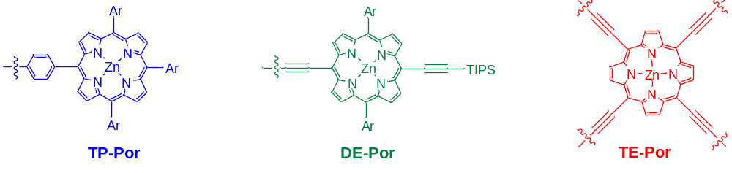
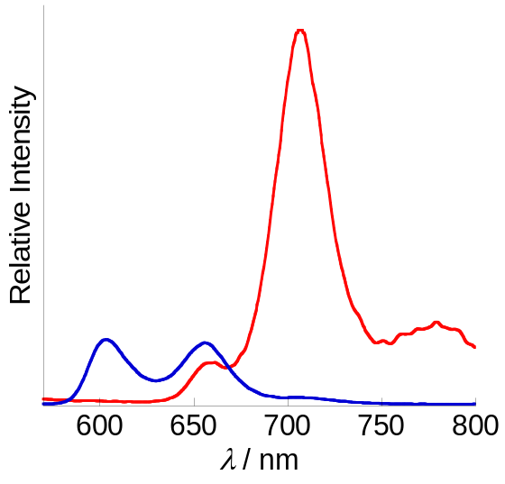
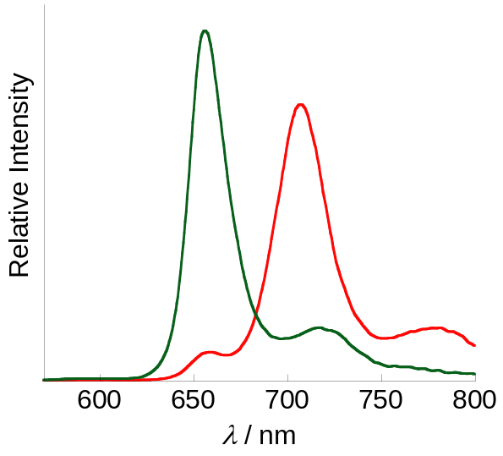
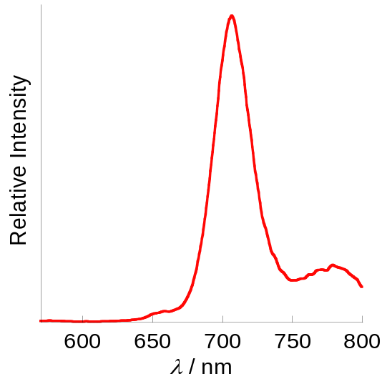
Φ_{EN} = 91%
Φ_{EN} = 94%
Excited on TP-Por
19
Excited on
DE-Por
Excited on
TE-Por
18
Figure 4. Steady-state fluorescence spectra of (a) dendrimer-3 (red) and 11 (blue) (λ_{ex} = 426 nm), (b) dendrimer-3 (red) and 12 (green) (λ_{ex} = 453 nm), and (c) dendrimer-3 (λ_{ex} = 498 nm) measured in THF. Fluorescence intensities are measured after normalizing the absorbance at excitation wavelength.

Slide 14
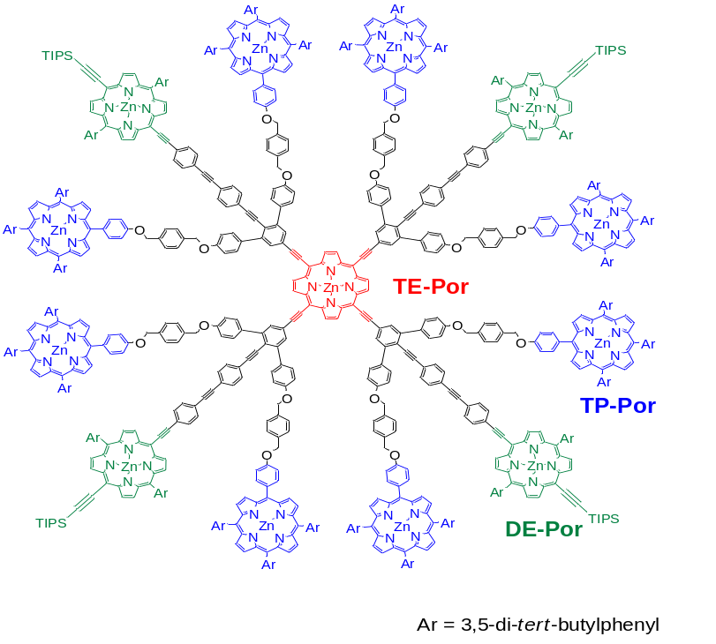
Effective Light Harvesting Antenna
TP-Por**
0
98% quantum efficiency
96% total quantum efficiency
TP-Por* 2.07 eV
45%
51%
k_{EN2} = 5.0 ×10⁹ s⁻¹
k_{EN1} = 5.7 ×10⁹ s⁻¹
DE-Por* 1.91 eV
TE-Por*
1.77 eV
k_{EN3} =
3.0 ×10¹⁰ s⁻¹
k_{d}(TP-Por*) = 5.3 ×10⁸ s⁻¹
k_{d}(TP-Por*) = 6.7 ×10⁸ s⁻¹
k_{d}(TP-Por*) = 4.0 ×10⁸ s⁻¹
Fast energy transfer through conjugated chains
dendrimer-17
Figure 9. Energy diagram and relaxation process from an excited states of TP-Por in dendrimer-17. * and ** denote the first and the second excited states, respectively.

Slide 15
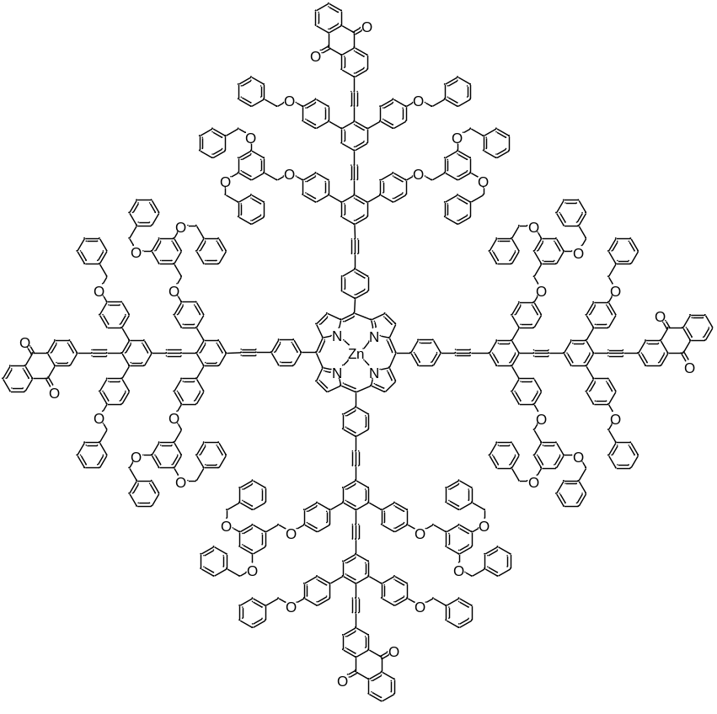
Dendrimer with both Light-Harvesting and Charge-separating Properties
dendrimer-21
Notes:
次にUVですが、それぞれの化合物でポルフィリン部に特徴的なソーレー帯、Ｑバンドの吸収が観測され、その他に、短波長領域にポリベンジルエーテル鎖、共役鎖、アントラキノンの吸収が観測されました。ここで、アントラキノンを有するデンドリマーにおいてのみ吸収の広がりが見られました。これは、このデンドリマーにおいてポルフィリン核とアントラキノン間になんらかの相互作用があるためと推測しています。

Slide 16
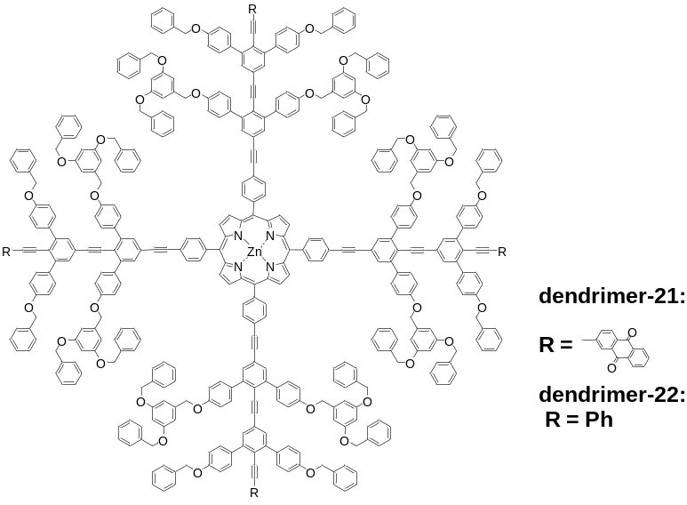
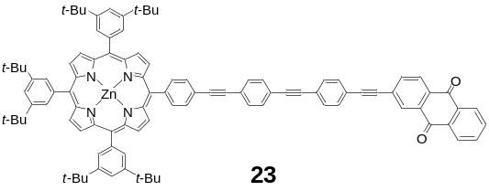
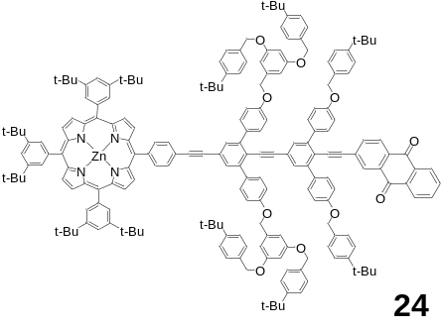
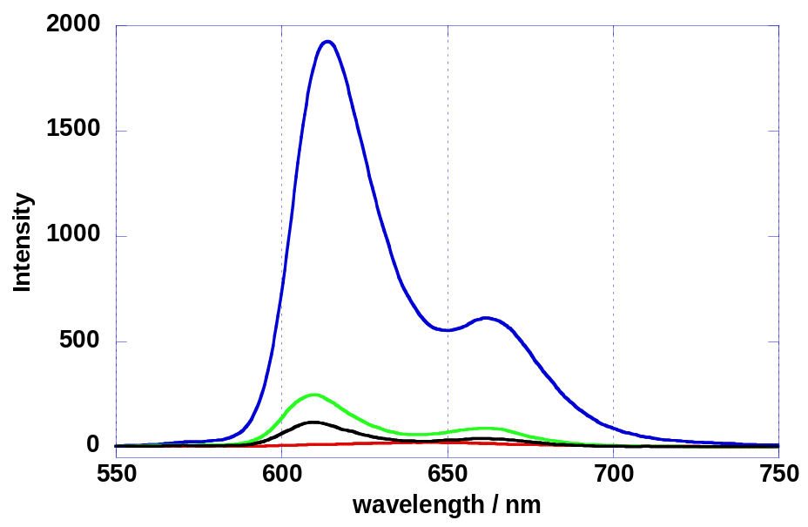
Charge-Separating Properties of the Dendrimer
dendrimer-16
dendrimer-23
14
15
Figure 10. Fluorescence spectra of dendrimer-1 and -2, 14, and 15 in DMF.

Slide 17
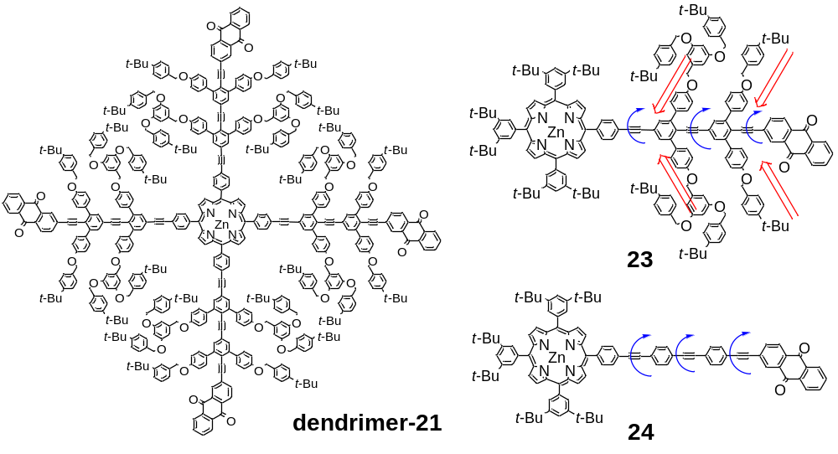
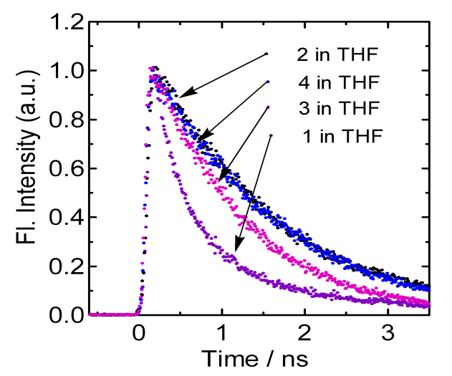
k_{CS} X 10⁻⁹/ s⁻¹
Figure 11. Charge-separation rate constants (k_{CS}) from the the excited singlet state of ZnP to AQ.
dendrimer-2
15
14
dendrimer-1
Table 2. Charge-separation rate constants (k_{CS}) from the the excited singlet state of ZnP to AQ.
Compds. | k_{CS} / s⁻¹ ª
 | 1,4-dioxane | THF | benzonitrile | DMF
 | 0.782 × 10⁹ (35%) | 2.50 × 10⁹ (63%) | 5.74 × 10⁹ (88%) | 8.63 × 10⁹ (92%)
 | 0.238 × 10⁹ (65%) | 0.208 × 10⁹ (37%) | 1.19 × 10⁹ (12%) | 1.70 × 10⁹ (8%)
14 | - | 0.284 × 10⁹ | 1.55 × 10⁹ | 2.08 × 10⁹
15 | - | - | 0.486 × 10⁹ | 0.691 × 10⁹
ª Fluorescence lifetimes of dendrimer-1 were used as a standard ((t_{f} )_{ref} ).
dendrimer-1
dendrimer-1
Figure 12. (a) Fluorescence decays of dendrimer-1 and -2, 14, and 15 in DMF at around 610 nm-670 nm range.
Kozaki, M.; Akita, K.; Okada, K. Org. Lett. 2007, 9, 1509-1512. Kozaki, M.; Akita, K.; Okada, K.; Islam, D.-M. S.; Ito, O. Bull. Chem. Soc. Jpn. 2010, 83(10), 1223-1237.

Slide 18
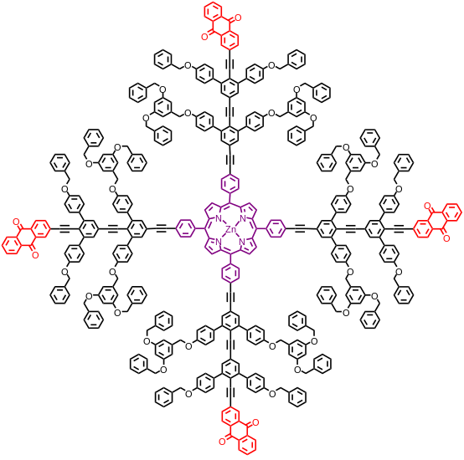
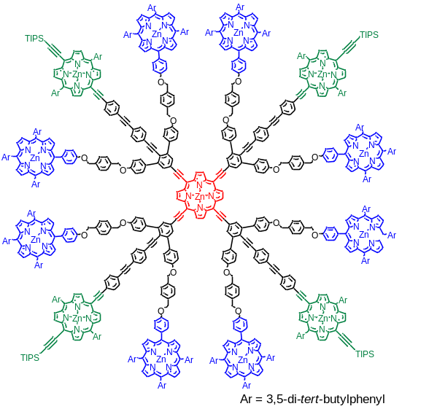
Dendrimers with Conjugated Backbones
Charge-separating System
Light-harvesting Antenna
Org. Lett. 2007, 9, 1509-1512.
Bul. Chem. Soc. Jpn. 2010, 83, 1223-1237.
J. Am. Chem. Soc. 2011, 133, 13276-13279.
Establishment of the Synthetic Methodology for the Construction of a Nanoscale Array of Denderimers
Precise arrangement of Dendrimers Creation of advanced functions that are not realized with low molecular weight materials

Slide 19
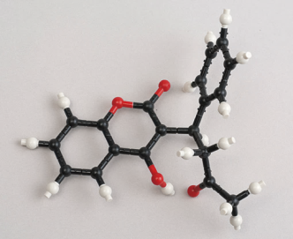
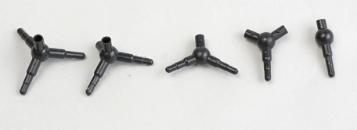
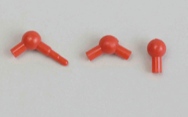

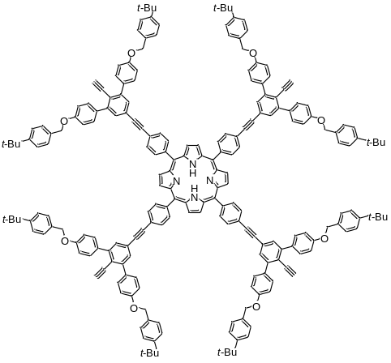
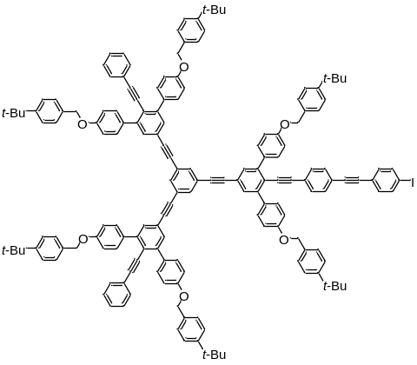
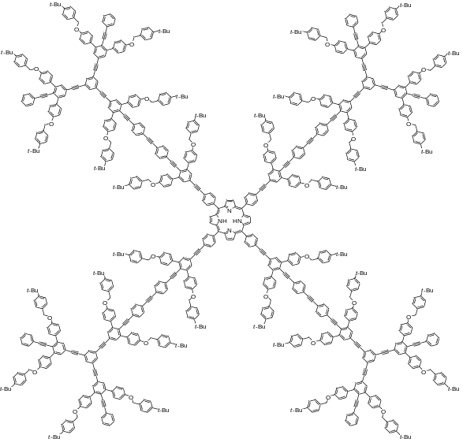
Methodology for the Construction of Nanoscale Architectures
A₄-type Dendrimer
AB₂-type Dendrimer
Advantages of the Assembling Method
The well-defined arrangement of connecting sites and rigidity of conjugated backbones ensure the accurate formation of pre-designed architectures.
A well-designed and highly organized array of functional units can be prepared using the conjugated backbones as a scaffold. Moreover the interaction among these units is adjustable by structural modification of backbones.

Slide 20
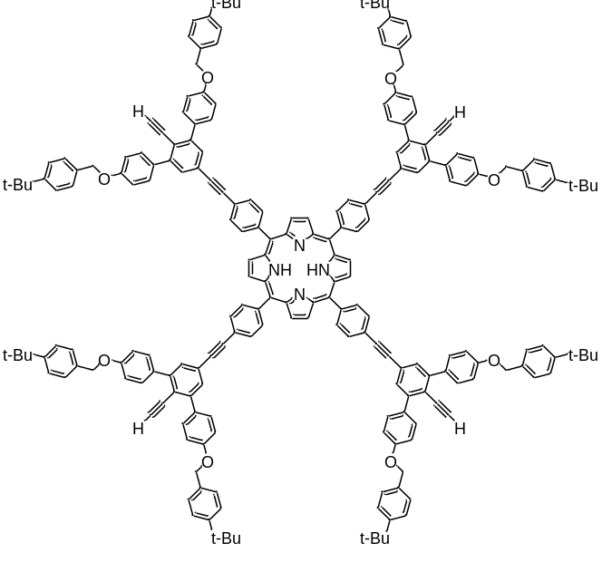
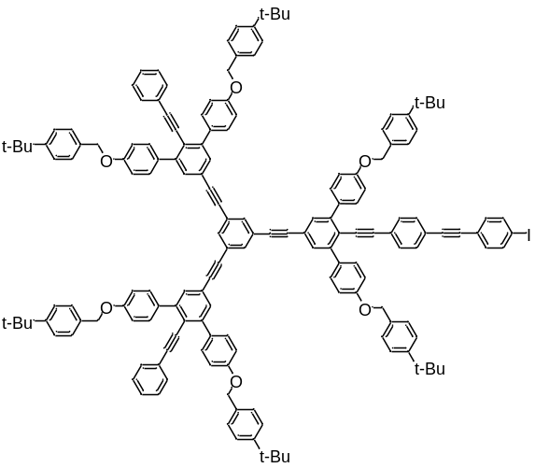
Dendrimers with Necked and Buried Couplers
AB₂-type Dendrimer with
Necked Coupler
A₄-type Dendrimer with
Buried Coupler

Slide 21
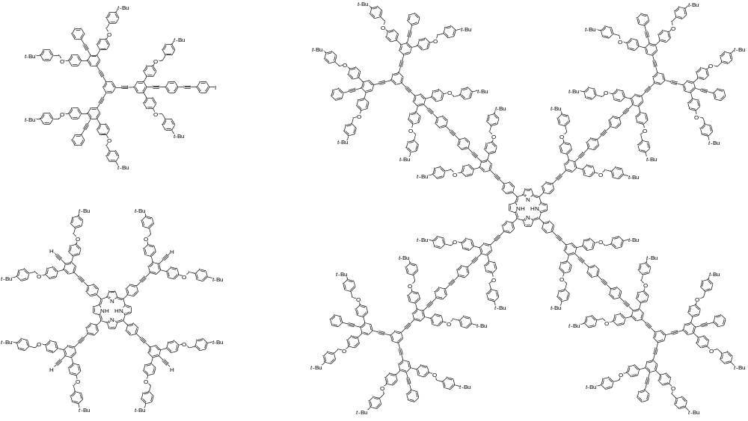
Integration of Dendrimers
Necked Coupler
Pd₂(dba)₃•CHCl₃ AsPh₃THF/NEt₃
40 ºC, 72 h
AB₂-type dendrimer 7
52%
11 nm
Buried Coupler
A₄-type Dendrimer 11
Assembly 12 (C₈₇₆H₇₅₀N₄O₃₂: 11,846)

Slide 22
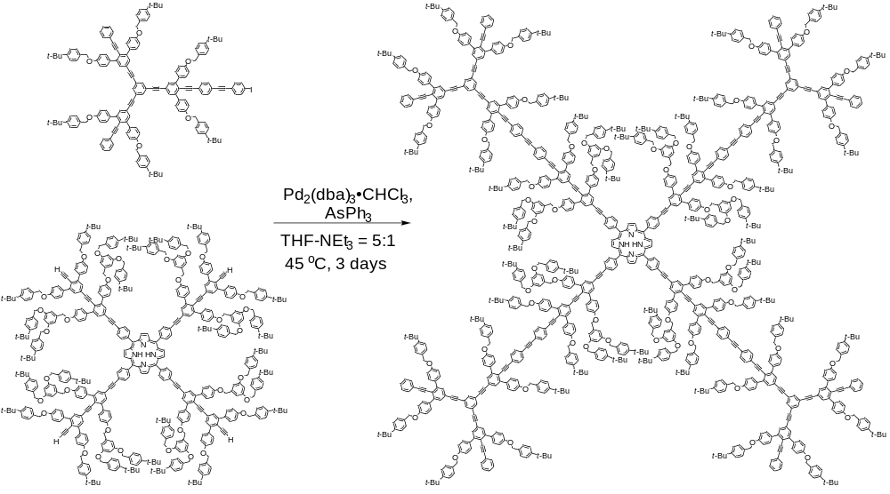
Synthesis of Porphyrin Dendrimers
AB₂-type Dendrimer 7
17%
13.5 nm
A₄-type Dendrimer 15
Assembly 16 (C₁₁₈₈H₁₀₇₀N₄O_{56:} 16,299)

Slide 23
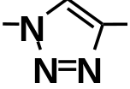
Iterative Convergent / Divergent Strategy
Click Reaction (CuAAC reaction)
+
Cu(I)
Simple procedure and clean conversion
azide
ethynyl
triazole
Iterative Convergent / Divergent Strategy
D1
Azidation
Deprotection
D1A
D1E
Click Reaction
D2

Slide 24

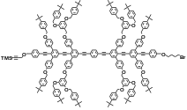


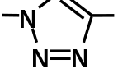


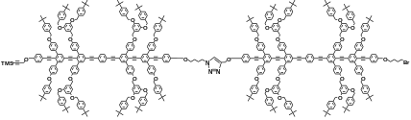
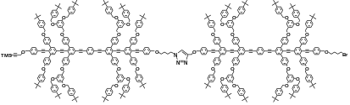
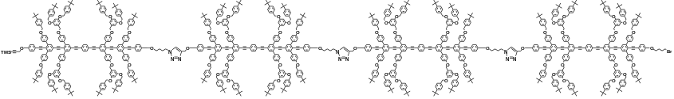
Iterative Convergent / Divergent Synthesis
D1 (MW 3,936)
Azidation
76%
91%
Deprotection
D1E
D1A
76%
Click Reaction
Click Reaction
（CuI, i-Pr₂NEt / THF)
D2 (MW 7,762)
Deprotection
(K₂CO₃, 18-crown-6
MeOH / CH₂Cl₂)
Azidation
94%
92%
Deprotection
Azidation
(NaN₃, DMF)
D2A
59%
D2E
Click Reaction
D4 (MW15,414)

Slide 25

Iterative Convergent / Divergent Synthesis
D4 (MW15,414)
Azidation
94%
79%
Deprotection
D4A
93%
D4E
Click Reaction
48 nm
D8 (MW 30,718)

Slide 26
Conclusion
Dendrimers containing rigid conjugated backbones were prepared by a convergent method where the attachment of dendritic branches and the extension of phenylene-ethynylene units were alternatively manipulated on the structure of AB₂ substituted diphenylacetylene in a combination with Suzuki-Miyaura and Sonogashira cross-coupling reactions.
These dendrimer structures were applied for the construction of several light-harvesting antennas and charge-separating systems. The conjugated network inside the dendritic structure was shown to play an important role as a mediator in both the photoinduced energy- and electron-transfer processes.
We present a novel methodology for the stepwise construction of shape-persistent assemblies using the dendrimers with conjugated backbones as the key modular building blocks. These examples demonstrate advantage of the dendrimer with conjugated backbones for the construction of nanoscale molecular devices such as artificial photosynthetic systems.
Acknowledgment
This work was partially supported by Grants (No.23350022 and 22350066) from JSPS. We thank for Otsuka Electronics for measurements of fluorescence quantum yields.

Slide 27



610 nm
(λ_{ex} = 426 nm)
660 nm
(λ_{ex} = 454 nm)
Figure 5. Fluorescence decays of 6 (red), 4 (gray), 9 (blue), and 13 (green) at 610 with λ_{ex} = 426 nm in THF.
Figure 6. Fluorescence decays of 6 (red), 7 (gray), and 14 (green) at 660 with λ_{ex} = 454 nm in THF.

Slide 28


710 nm
(λ_{ex} = 427 nm)
Figure 8. Fluorescence decay curve at 710 nm of 6 excited at 427 nm in THF (dots). The red solid line was obtained by the simulation. The shape decay (blue) is lamp profile.
Figure 7. Energy diagram and relaxation process from an excited states of TP-Por in the antenna 1. * and ** denote the first and the second excited states, respectively
Table 1. Photophysical data of 1, 4, 8, and 9 in THF.
compd | λ_{ex}/nm | λ_{detect}/nm | k_{EN}/s⁻¹ | energy-transfer step | calcd k_{EN} / s⁻¹ ª
6 | 427 | 610 | 1.2 × 10¹⁰ | EN1+EN2 | -
9 | 427 | 610 | 5.7 × 10⁹ | EN1 | 2.57 × 10¹⁰
13 | 427 | 610 | 5.0 × 10⁹ | EN2 | 1.81 × 10⁹
6 | 456 | 660 | 3.0 × 10¹⁰ | EN3 | 9.89 × 10⁹
14 | 456 | 660 | 3.0 × 10¹⁰ | EN3 | 9.89 × 10⁹
ª Energy transfer rates were evaluated using the Förster equation.

Slide 29




Light Harvesting Properties of the Dendrimer
Highly efficient (~100%) intramolecular singlet energy transfer
Conjugated Chains
(a)
Branching Chains
Branching Chains
Φ_{f}＝0.05
scattering
Porphyrin
(Soret band)
(b)
Conjugated Chains
Φ_{f}＝0.05
scattering
dendrimer-16
Zn-TPP
(c)
Porphyrin
Φ_{f}＝0.05
Figure 1. UV-vis spectra of dendrimer-16 and Zn-TPP in THF. (upper right) Steady-state fluorescence spectra of dendrimer-16 in THF. (lower right) (a) 286 nm excitation (The intense peak at 572 nm is the scattering of excitation light). (b) 372 nm excitation (The weak peak at 415 nm is the scattering of excitation light). (c) 433 nm excitation.
Kozaki, M.; Akita, K.; Okada, K. Org. Lett. 2007, 9, 1509-1512.

Slide 30

Major and Minor Products
17 %
32 %
C₁₁₈₈H₁₀₇₀N₄O₅₆ MW 16,299
C₁₀₃₀H₉₃₄N₄O₅₀MW 14,172

Slide 31

Synthesis of Dendrimers

Slide 32

Synthesis of Porphyrin Dendrimers

Slide 33

Synthesis of Porphyrin Dendrimers
A₄-type Dendrimer with
Buried Coupler

Slide 34
Summary
C₁₁₈₈H₁₀₇₀N₄O₅₆ MW 16,299
C₁₀₃₀H₉₃₄N₄O₅₀MW 14,172
Advantage of Dendrimers in the formation of a nano-scale architecture
・ Bonding between the ends of conjugated chain results in the formation of nano-scale architecture with well-defined shape and pai-conjugated network.
Problems in the Assembling Process of Dendrimers
・ Low Encounter-probability inhibits an intramolecular reaction. As the results, formation of the product from intramolecular side reaction was increased.
・ Separation and purification is problematic. Strong tendency of aggregation impede the GPC-separation.
巨大分子の合成特有の問題点
（１）低分子量の化合物の反応では、マイナーな副反応や副生成物が主となる場合がある。
（２）低分子量の反応では容易に分離できる副生生物の分離が困難な場合が多い。

Slide 35





Separation by GPC
%Int.
100
16,299 M⁺
75
CHCl₃ : CS₂
1:0
9:1
1:1
50
25
16: MW 16299
0
10,000 12,000 14,000 16,000 20,000 22,000
m / z
Figure 2. MALDI-TOF MS spectrum of 16
%Int.
100
14,170
75
9.0 15.0 21.0 27.0
Retention time / min
50
Figure 1. GPC chart of the mixture of assembly 16 and 17
25
0
10,000 12,000 14,000 16,000 20,000 22,000
m / z
Figure 3. MALDI-TOF MS spectrum of 17

Slide 36



VT NMR in CDCl₂CDCl₂
16
17
130 ºC
130 ºC
95 ºC
95 ºC
60 ºC
60 ºC
25 ºC
25 ºC
9.0 8.0 7.0 6.0 5.0
9.0 8.0 7.0 6.0 5.0
δ / ppm
δ / ppm
Figure 4. ¹H NMR spectra of 16 (left) and 17 (right) in CDCl₂CDCl₂ at various temperature

Slide 37





Efficient intramolecular singlet energy transfer
Branching Chains (299 nm)
Φ_{f}＝0.073
（67％）
assembly-3
Normalized Intensity
Scattering peak
Conjugated Chains (364 nm)
6
5
4
3
2
1
0
Φ_{f}＝0.078
（72％）
Normalized Intensity
Porphyrin (427 nm)
Φ_{f}＝0.11
X 10
Normalized Intensity
wavelength / nm
Figure 9. UV-vis spectra of assembly-3 in THF. (left) Steady-state fluorescence spectra of asesembly-3 in THF. (right) (a) 286 nm excitation (The intense peak at 598 nm is the scattering of excitation light). (b) 372 nm excitation. (c) 433 nm excitation.

Slide 38

Synthesis of Dendrimers
Flexible linker
D1

Slide 39



UV-vis Spectra (in CH₂Cl₂)
Aggregated
Non aggregated
Figure 5. UV-vis spectra of D1, D2, D4, and D8 in CH₂Cl₂.
 | λ _{max} / nm
D1 | 407
D2 | 396, 423
D4 | 397, 426
D8 | 397, 427
Schanze, K. S. et al.
J. Phys. Chem. Lett. 2013, 4, 1410-1414.

Slide 40


Concentration Dependence (in CHCl₂CHCl₂)
2.72×10⁶ M
D1
5.43×10⁷ M
5.36×10⁶ M
2.72×10⁷ M
1.07×10⁶ M
5.36×10⁷ M
Figure 6. UV-vis spectra of D2 in CHCl₂CHCl₂.
Figure 7. UV-vis spectra of D1 in CHCl₂CHCl₂.

Slide 41


Temperature Dependence
(D2 in CHCl₂CHCl₂)
D1 at 90 ºC
D2 at 90 ºC
Figure 8. UV-vis spectra of D2 in CHCl₂CHCl₂.
Figure 9. UV-vis spectra of D1 and D2 in CHCl₂CHCl₂.

Slide 42


Fluorescence Spectra in CH₂Cl₂
λ_{ex} = 395 nm (conjugated chains)
Schanze, K. S. et al.
J. Phys. Chem. Lett. 2013, 4, 1410-1414.
Figure 6. Fluorescence spectra of D1, D2, D4, and D8 in CHCl₂CHCl₂.

Slide 43










Higher Order Structure of Octamer
heating
cooling
Folded form
Extended form

