Slide 1


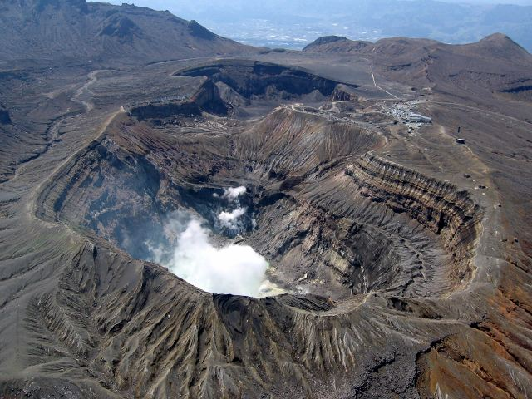
Study of structural-chemistry
of sodium 4-phenylbutyrate
on its binding to serum albumin
Masaki Otagiri, Keishi Yamasaki
Faculty of Pharmaceutical Sciences, Sojo University,
Kumamoto, Japan

Slide 2
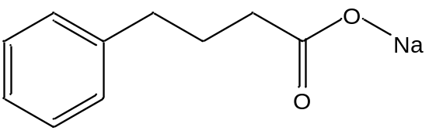
Background
Sodium 4-phenylbuthyrate (PB) is a phenyl-substituted
fatty acid derivatives.
PB is used for the treatment of urea cycle disorders
by its ammonium scavenging activity.
Sodium 4-phenylbuthyrate (PB)
PB has also another pharmacological activities such as an inhibitor
of endoplasmic reticulum stress and histone deacetylases.
PB is expected for clinical use in treating a wide variety of diseases.
However, the binding of PB to plasma protein is not fully understanding.
Protein binding fraction of PB
Means ± S.D.
(n=3)
**
**
**; P < 0.01
We investigate the binding of PB to serum albumin in details.
Free fraction (%)
Binding mode : structural-binding relationship,
thermodynamic analysis
Binding site : fluorescent probe, binding to mutant.
X-ray crystallographic analysis
(4％)
(0.1%)
(1.5％)
Enokida, T. et al., J. Pharm. Sci. (2016)

Slide 3
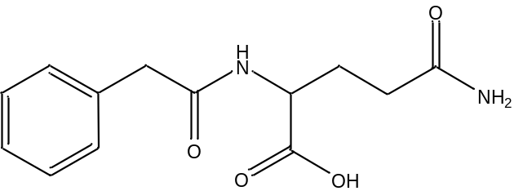
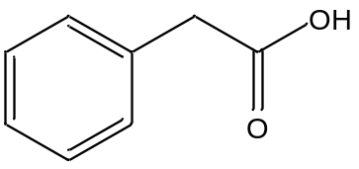
Binding parameters of PB and its metabolites for HSA
PB
Metabolites
Parameters
PA
PG
K(×10⁵ M⁻¹)
13.7±2.12
0.53±0.35
− #
n
0.87±0.03
1.11±0.35
− #
PG: phenyl acetyl glutamine
PA: phenyl acetate
#; The affinity to HSA is too low to determine the binding parameters.
Means ± S.D. (n=3)
PB strongly binds to HSA, but its metabolites do show low binding to HSA

Slide 4
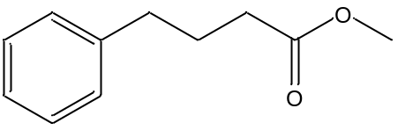
Effect of the number of methylene units in PB and its structurally
related compounds on their association constants for binding to HSA
PC
m
PH
PV
m
compounds
Association constant (K)
(×10⁵ M⁻¹)
PB
1
2
3
4
5
6
PA
PP
PB
PV
PC
PH
M-PB
PP
CH₃
PA
M-PB
Number of methylene (m)
Means ± S.D. (n=3)
Several driving forces such as hydrophobic and electrostatic interactions might be involved for the binding of PB to HSA

Slide 5
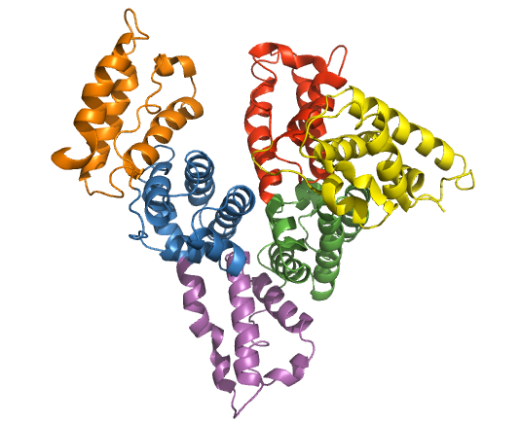
Crystal structure of rHSA including typical ligands
HSA contains three structurally similar domains, I–III, which can be further divided into subdomains A and B.
Major drug binding sites, site I and site II are located in subdomains IIA and IIIA of HSA, respectively.
IB
IIIB
IA
Site II
Dansylsarcosine
Ibuprofen
Diazepam
IIIA
Site I
IIA
Warfarin
Furosemide
Indomethacin
IIB

Slide 6
Approach for topology analysis of binding site on HSA
Albumin
Spectrometry
Genetics
Organic
Chemistry
Docking
Simulation

Slide 7
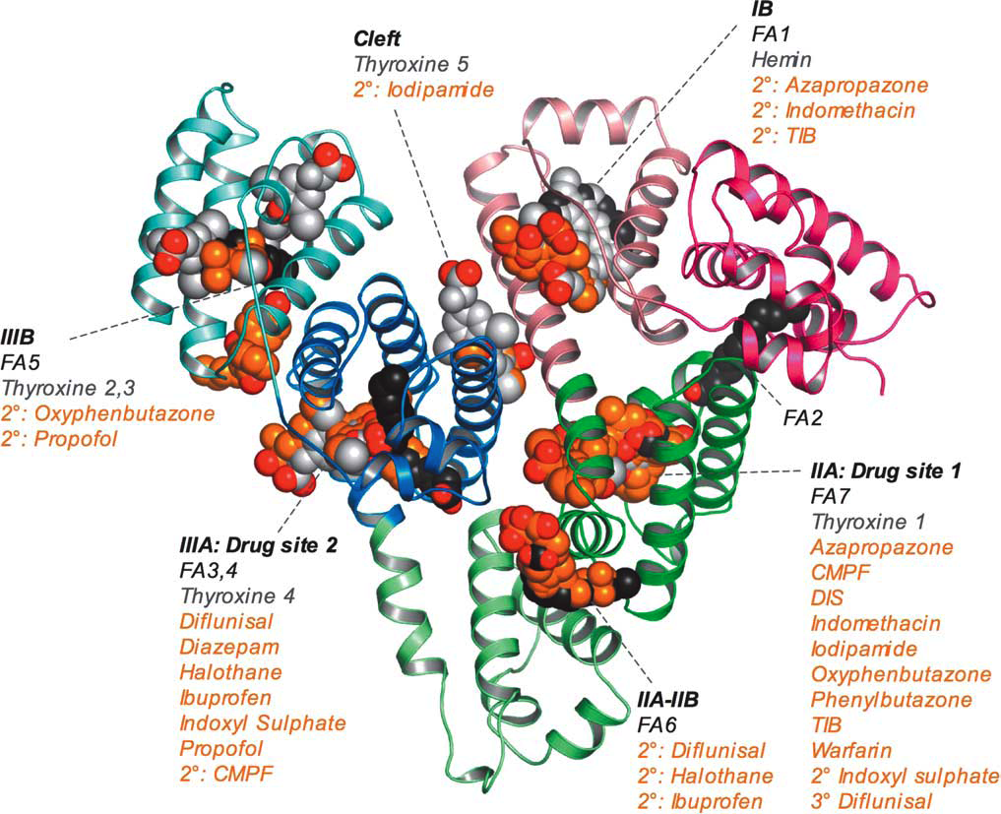
Mapping of ligand binding site on HSA
Cys34
Site I
Site II
Biochem. Biophys. Acta (1996, 1999), Biochem. J. (2000, 2001), J. Mol. Biol. (2005, 2006)
Notes:
7

Slide 8
Identification of PB binding site and amino acid residues
involved in the PB-HSA interaction
Effect of PB on the fluorescence intensity
of site specific ligand-HSA systems
Binding of PB to wild-type and mutant HSAs
**
Warfarin (Site I)
**
Free fraction (%)
Fluorescence intensity as % of initial intensity
Dansylsarcosine (Site II)
[PB]/[HSA]
Means ± S.D. (n=3)
**; P < 0.01
PB was suggested to interact with Tyr411 and Arg410 residues in site II

Slide 9
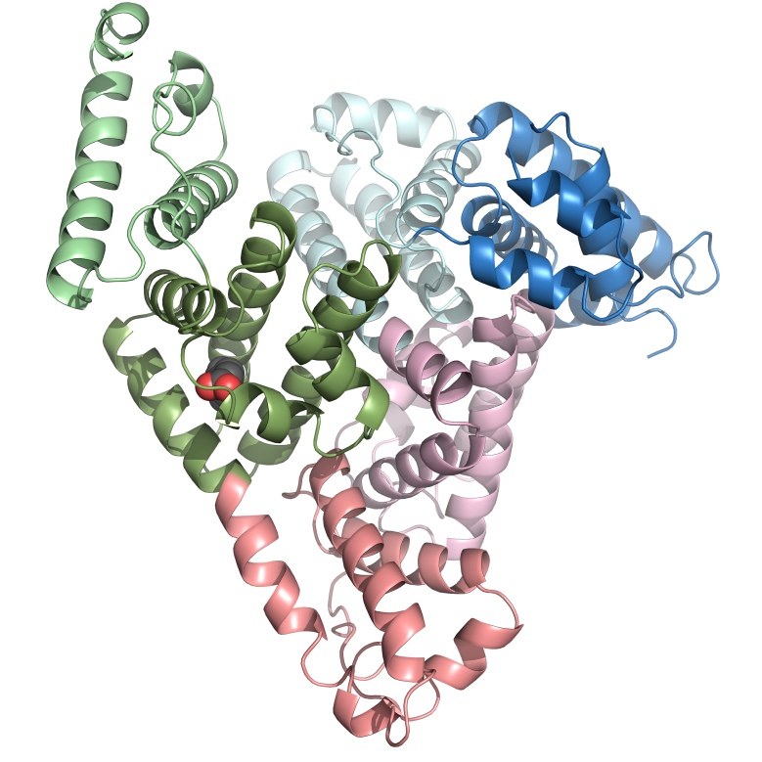
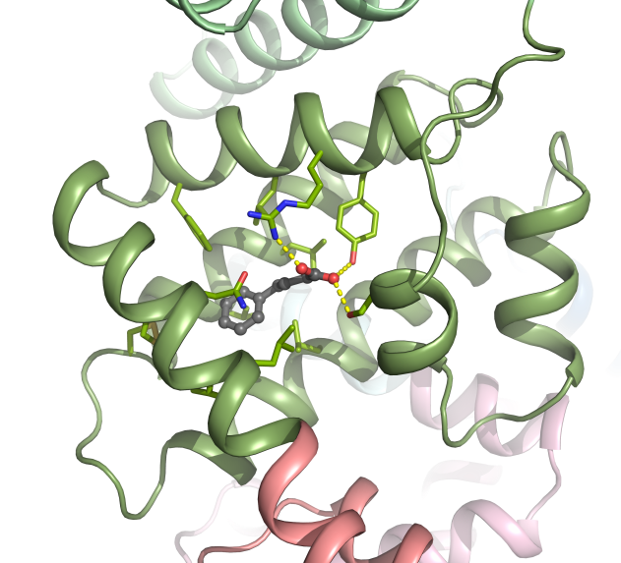
X-ray crystal structure analysis of PB-HSA complex
PB binding at drug siteⅡ
IB
IIIB
IA
Arg410
Leu407
Tyr411
Phe403
IIIA
IIA
Asn391
Ser489
PB
Leu387
IIB
PB was concluded to interact with Tyr411 and Arg410 residues in site II

Slide 10
Effects of endogenous substances on the binding of PB to HSA
In diseased states such as renal and hepatic diseases, the binding of PB to HSA can be altered.
One of altered binding mechanism can be explained on the basis of the displacement by accumulated endogenous substances.
Octanoic acid
Indoxyl sulfate
Bilirubin
**
**
**
Free fraction (%)
Ligands concentration (μM)
Indoxyl sulfate concentration (μM)
Bilirubin concentration (μM)
The above results suggest that the accumulated endogenous substances
affect binding of PB to HSA in renal diseased
Means ± S.D. (n=3)
**; P < 0.01, *; P < 0.05

Slide 11
Binding of PB to mammalian serum albumin
Despite the high sequence of identities and similarities among
mammalian albumins, the binding properties of PB have been found to be
different among albumin species.
Such species differences in protein binding can result in a change in
pharmacokinetics and pharmacodynamics among species.
Binding parameters of PB to mammalian serum albumin
Species | n₁ | K₁(×10⁵ M⁻¹) |  | n₂ | K₂(×10³ M⁻¹)
Human | 1.00±0.04 | 13.9±0.7 |  | 4.49±0.83 | 8.15±2.35
Bovine | 1.02±0.03 | 12.8±1.7 |  | 5.74±0.58 | 6.45±1.07
Rabbit | 1.26±0.05 | 4.11±0.72 |  | 5.38±0.58 | 8.33±1.59
Rat | 1.16±0.05 | 8.94±2.15 |  | 6.18±0.25 | 6.93±0.29
Means ± S.D. (n=3)
K₁: Human ≒ Bovine >> Rat > Rabbit

Slide 12
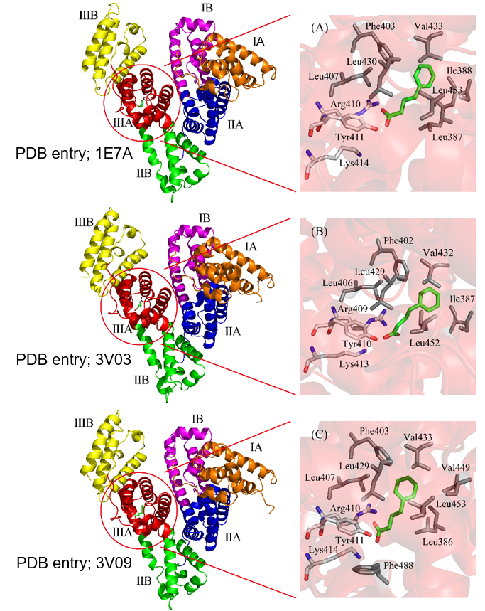
Molecular docking of PB at the site in subdomain IIIA of albumins
PB (green)
Human
Species differences in the affinity are attributed to differences in the structural feature of the PB binding sites on albumins (e.g. charge distribution, hydrophobicity, shape, and size of the pocket).
Bovine
Rabbit

Slide 13
Docking energy for binding to albumins.
m
Number of methylene (m)
●： human
○： bovine
▲： rabbit
Docking energy
(U_Dock by ASEDock)
PH
PA
PP
PC
PB
PV
The above findings may be reflected in the difference in acceptable molecular size from the data for the dependence of the alkyl chain length on the association constant and docking energy

Slide 14
Summary
PB was found to strongly bind to HSA (K=1.4 x 10⁶ M⁻¹), but affinities of its metabolites were weaker than that of PB.
Several forces including hydrophobic and electrostatic interaction were suggested to play important role on the binding of PB and its derivatives to HSA.
PB was concluded to bind to site II in subdomain IIIA of HSA, and particularly, Arg410, Tyr411 and Ser489 were involved in PB-site II interaction through hydrogen bonding.
Endogenous substances (e.g. free fatty acids and indoxyl sulfate) which are increased in diseased states caused to decrease the PB binding.
Species differences for PB binding can be explained by structure features of PB binding site such as charge distribution, hydrophobicity, shape, and size of the pocket.
Such a detailed analysis of PB-albumin interaction provide valuable information in terms of our understanding of the pharmacokinetics and the pharmacological effects of PB. Furthermore, the findings presented herein will also be useful when PB are clinically applied for the treatment of a variety of diseases.

Slide 15

Acknowledgement
Sojo University
Dr. A. Kawai
Dr. T. Enokida
Prof. S. Miyamoto
Dr. Y. Okamoto
Kumamoto University
Prof. T. Maruyama
Thank you for your kind attention
Kumamoto Castle

Slide 17
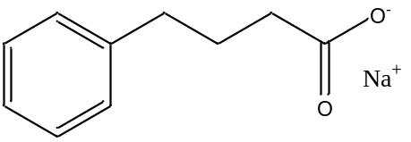
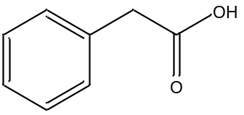
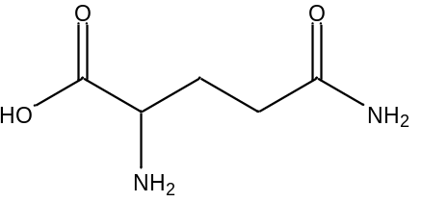
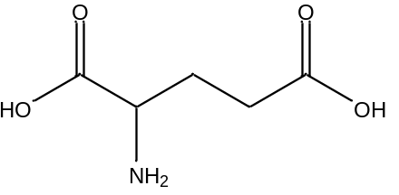
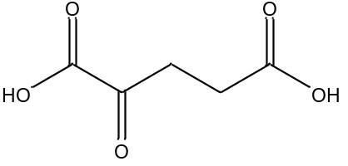
4-phenylbuthyrate (PB)
  Urea cycle disorders
Hyperammonemia
Β oxidant
PB
Phenyl acetate (PA)
glutamate
NH₃
Phenyl acetyl glutamine （PG)
NH₃
Eliminate into urine
Glutamic acid
Improve ammonia disorder
α-ketoglutarate

Slide 18
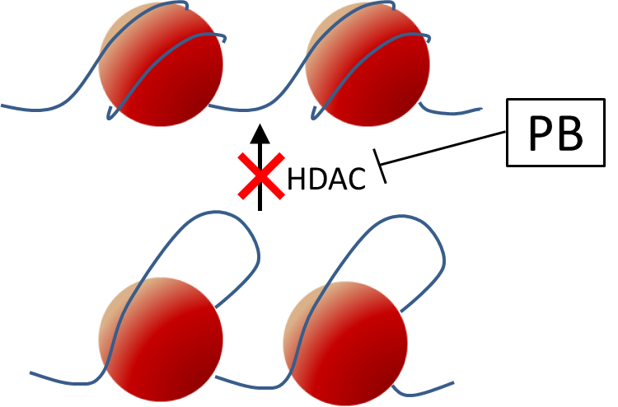
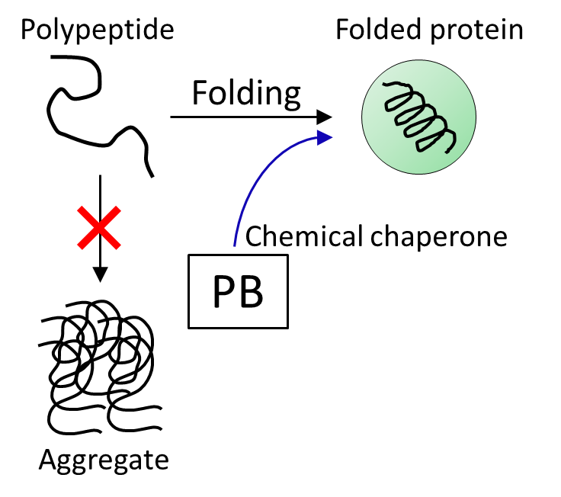
Urea cycle disorders
PB
Inhibition of Histone deacetylase（HDACs）
Suppression of miss folding as a molecular chaperone
Ryu H et al. J Neurochem 2005;93:1087-1098
Qi X et al. Mol Pharmacol 2004;66:899-908

Slide 19
Binding Parameters of PB to Mammalian Serum Albumins (案２)
Species | n₁ | K₁(×10⁵ M⁻¹) |  | n₂ | K₂(×10³ M⁻¹)
Human | 1.00±0.04 | 13.9±0.7 |  | 4.49±0.83 | 8.15±2.35
Bovine | 1.02±0.03 | 12.8±1.7 |  | 5.74±0.58 | 6.45±1.07
Rabbit | 1.26±0.05 | 4.11±0.72 |  | 5.38±0.58 | 8.33±1.59
Rat | 1.16±0.05 | 8.94±2.15 |  | 6.18±0.25 | 6.93±0.29
Means ± S.D. (n=3)
PB binding properties was different among albumin species.
K₁: Human≒Bovine>>Rat>Rabbit

