Slide 1
About OMICS Group
OMICS Group International is an amalgamation of Open Access publications and worldwide international science conferences and events. Established in the year 2007 with the sole aim of making the information on Sciences and technology ‘Open Access’, OMICS Group publishes 400 online open access scholarly journals in all aspects of Science, Engineering, Management and Technology journals. OMICS Group has been instrumental in taking the knowledge on Science & technology to the doorsteps of ordinary men and women. Research Scholars, Students, Libraries, Educational Institutions, Research centers and the industry are main stakeholders that benefitted greatly from this knowledge dissemination. OMICS Group also organizes 300 International conferences annually across the globe, where knowledge transfer takes place through debates, round table discussions, poster presentations, workshops, symposia and exhibitions.

Slide 2
About OMICS Group Conferences
OMICS Group International is a pioneer and leading science event organizer, which publishes around 400 open access journals and conducts over 300 Medical, Clinical, Engineering, Life Sciences, Phrama scientific conferences all over the globe annually with the support of more than 1000 scientific associations and 30,000 editorial board members and 3.5 million followers to its credit.
OMICS Group has organized 500 conferences, workshops and national symposiums across the major cities including San Francisco, Las Vegas, San Antonio, Omaha, Orlando, Raleigh, Santa Clara, Chicago, Philadelphia, Baltimore, United Kingdom, Valencia, Dubai, Beijing, Hyderabad, Bengaluru and Mumbai.

Slide 3

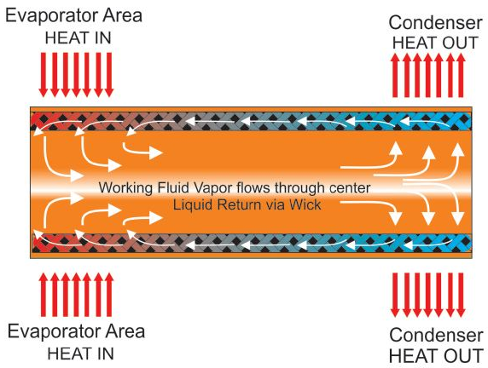
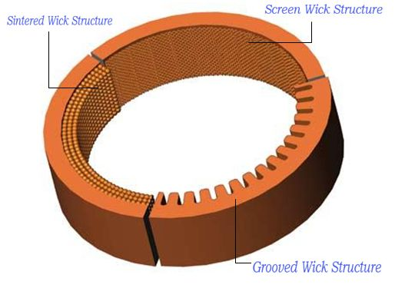
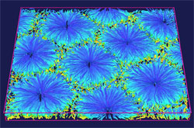
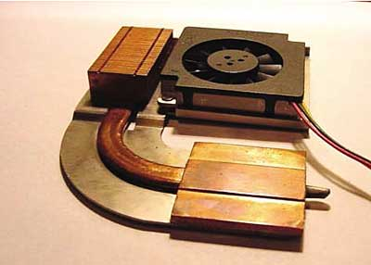
A Review On Nanofluid Heat Pipe
Maryam Shafahi
Mechanical Engineering Department
California State Polytechnic University, Pomona

Slide 4
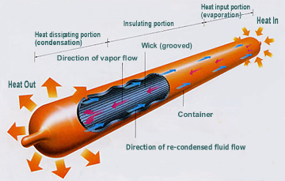
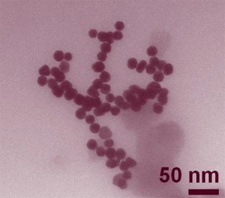
Layout
What is a heat pipe?
What is Nanofluid?
Why nanofluid heat pipe?
Heat pipe characteristics
Heat pipe limitations
Wick design
Working fluid
Thermophysical properties of nanofluids
Thermal conductivity
Viscosity and density

Slide 5
Layout
Electronics
Thermal syphon with nanofluid
Cylindrical Nanofluid Heat Pipe
Flat-SHaped Nanofluid Heat Pipe
Conclusion
References
Questions

Slide 6
What Is A Heat Pipe?
Heat pipes are high capacity heat transfer devices that use evaporation, insulation and condensation as means to remove heat .
This device uses a wick, as a porous media, to pump the condensed liquid working fluid to evaporation section.

Slide 7
What is Nanofluid?
Nanofluid- “is a nanoparticle of solid metallic or nonmetallic materials dispersed in base fluids such as water, ethylene glycol and glycerol.”
Typically made of chemically stable metals, metal oxides or carbon in various forms
Base fluid usually water and organic fluids
Range between 1-100nm

Slide 8
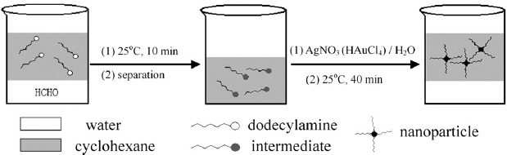
Why nanofluid heat pipe?
The use of nanofluid enhances heat transfer in the heat pipe due to its improved thermo-physical properties, such as a higher thermal conductivity.

Slide 9


Heat Pipe Applications
They are mainly used in cooling and thermal management in electronics, aerospace, and telecommunications.
Recent studies have shown that heat pipes can be used in military avionics. The LED monitors in the cockpit use very small components with very high energy and need to dissipate the heat generated very quickly.

Slide 10
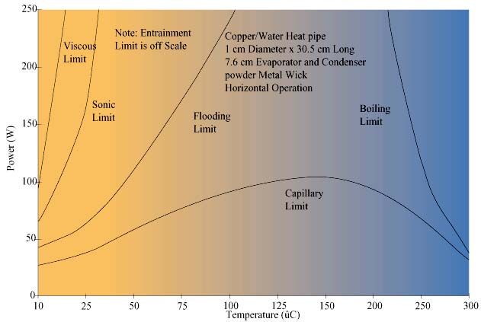
Characteristics of Heat Pipe
Heat pipe limitation
Capillary limit
Sonic Limit
Entrainment limit
Viscous limit
Boiling limit
Flooding limit
Maximum Heat flux

Slide 11
Wick type
The wick is in charge of the capillary action in the pipe, which traditionally is in forms of screens, wire meshes, sintered metal powders and woven fiberglass or grooves [13].
According to Graham Rice, within an adiabatic uniform space of the heat pipe the wick structure would achieve a more stable boiling process, which provides a more uniform condensation and capillary action [7].

Slide 12
Working Fluid
Each heat pipe is used for a specific heat flux at a specific temperature range; therefore the working fluid is chosen based on the characteristics that will allow the heat pipe to work within the desired temperature range [15,16]
It is also important to point out that the working fluid should be compatible with the pipe itself and the wick around it .

Slide 13
Nanofluid Characteristics
Advantages
  enhancement of thermal conductivity
  Maintains Newtonian behavior of fluid
  Small Concentration
Disadvantages
  Agglomeration could cause clogging of channels
  Instability
  Increased viscosity and density
  High cost

Slide 14
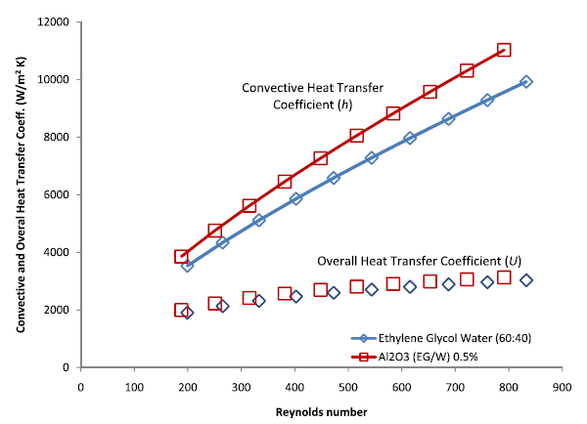
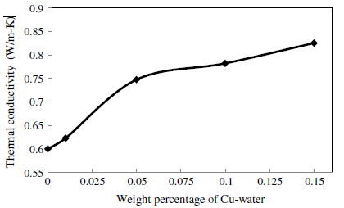
Thermal conductivity and convection coefficient enhancement

Slide 15

Viscosity and Density

Slide 16

Electronics
More compact and smaller electrical components, more challenge are faced to dissipate heat.
Researchers show the use of nanofluid to be more of an ideal base fluid increasing thermal conductivity and the overall heat transfer of a liquid coolant. In a study by Shokouhmand et al. on the performance analysis of microchannel heat sinks, nanofluid containing Cu nanoparticles was used for a silicon microchannel heat sink. Compared with the pure water, experimentation showed that nanofluid could enhance the performance of the heat sink by increasing both the thermal conductivity of the coolant and the nanoparticle thermal dispersion effect.

Slide 17
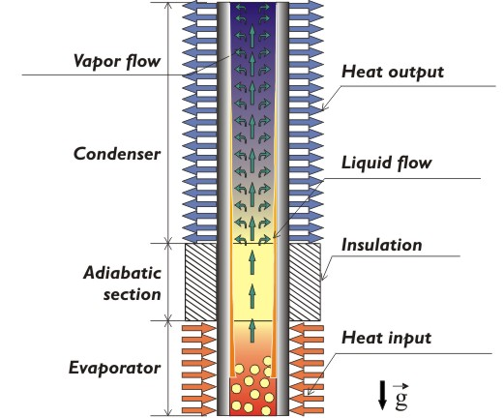
Thermal syphon with nanofluid
Another heat pipe model was done by Asmaie et al. with a closed two-phase thermo syphon, using CFD modeling. Because the system lacked a capillary and wicking structure, the model was mounted vertically to allow gravity to return the condensed fluid back to the evaporator section. Their study showed that the maximum heat fluxes of the thermosyphon had a remarkable increase upon substituting of the nanofluid with water as the working fluid. Under the same conditions, the maximum heat flux of nanofluid was about 46 % higher than water.

Slide 18
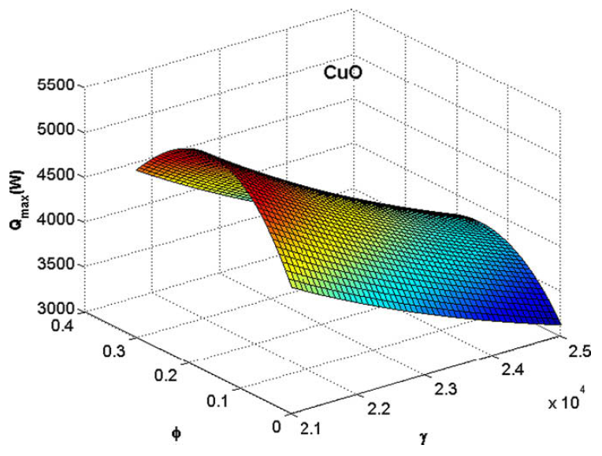
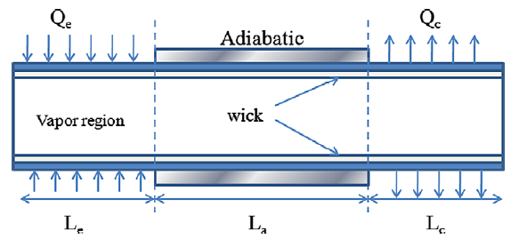
Cylindrical Nanofluid Heat Pipe
Cylindrical model assumes steady state, incompressible, and Newtonian fluid, and ignores radiative and gravitational effects. Overall, study shows improvement in thermal performance [22].

Slide 19
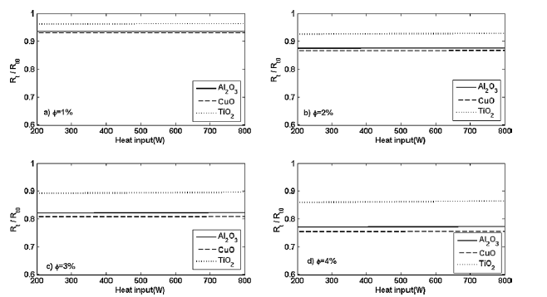
Cylindrical Heat Pipe Thermal Resistance Reduction

Slide 20
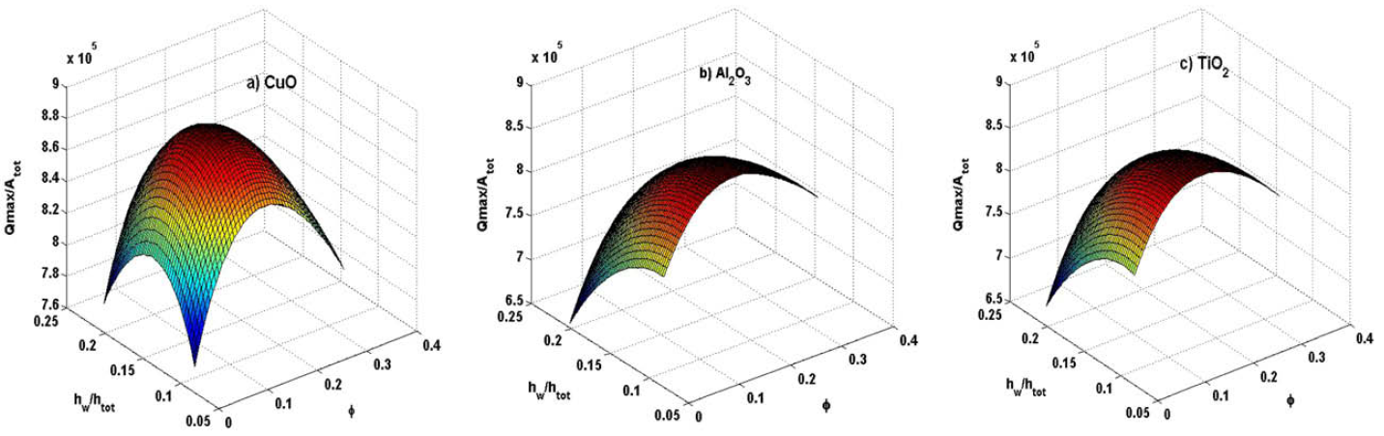
Flat Shaped Nanofluid Heat Pipe

Slide 21
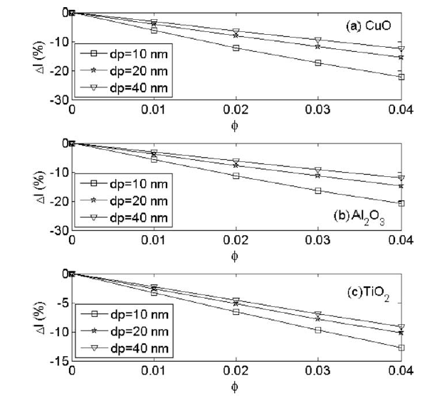
Flat Shaped Heat Pipe Size Reduction

Slide 22



Conclusion
Thermal conductivity
Pressure drop
Thermal resistance
Maximum heat flux
Heat pipe size

Slide 23
References
M. Shafahi, V. Bianco, K. Vafai, O. Manca. An Investigation of the Thermal Performance of Cylindrical Heat Pipes Using Nanofluids. International Journal of Heat and Mass Transfer, vol. 53, pp 376-383, 2009. http://www.medgadget.com/2011/10/nanoparticle-measurement-breakthrough-could-lead-to-super-accurate-pregnancy-tests.html
M. Shafahi, V. Bianco, K. Vafai, O. Manca. Thermal Performance of Flat-Shaped Heat Pipes Using Nanofluids. International Journal of Heat and Mass Transfer, vol. 53, pp 1438-1445, 2010.
N. Zhu and K. Vafai. Analytical modeling of the startup characteristics of asymmetrical flat-shaped and disk-shaped heat pipes. International Jounral of Heat Mass Transfer, vol. 71, no. 17, pp. 2619-2637, 1998.
] L. Asmaie, M. Haghshenasfard, et al. Thermal Performance Analysis of Nanofluids in a Thermosyphon Heat Pipe Using CFD Modeling. Heat Mass Transfer, vol. 49, pp. 667-678, 2013.
M.C.S. Reddy, V.V. Rao. Experimental Investigation of Heat Transfer Coefficient and Friction Factor of Ethylene Glycol Water Based TiO2 Nanofluid in Double Pipe Heat Exchanger With and Without Helical Coil Inserts. International Communications in Heat and Mass Transfer, vol. 50, pp.68-76, 2014.
[Wael I.A. Aly. Numerical Study on Turbulent Heat Transfer and Pressure Drop of Nanofluid in Coiled Tube-in-Tube Heat Exchangers. Energy Conversion and Management, vol. 79, pp. 304-316, 2014.
H. Shokouhmand, M. Ghazvini, J. Shabanian. Performance Analysis of Using Nanofluids in Microchannel Heat Sink in different Flow Regimes and its simulation using Artificial Neural Network. Proc. of the World Congress on Engineering, vol. 3, 2008.
W.N. Septiadi, N. Putra, M. Juarsa, I.P.A Putra, R. Sahmura. Characteristics of Screen Mesh Wick Heat Pipe with Nanofluid as Passive Cooling System. Atom Indonesia, vol. 39, no. 1, pp. 24-31, 2013.
L.G. Asirvatham, R. Nimmagadda, S. Wongwises. Heat transfer performance of screen mesh wick heat pipes using silver-water nanofluid. International Journal of Heat and Mass Transfer, vol. 60, pp. 201-209, 2013.
[54] K.H. Do, S.P. Jang. Effect of nanofluids on the thermal performance of a flat micro heat pipe with a rectangular grooved wick. International Journal of Heat and Mass Transfer, vol. 53, pp. 2183-2192, 2010.
R. Saleh, N. Putra, S.P. Prakoso, W.N. Septiadi. Experimental investigation of thermal conductivity and heat pipe thermal performance of ZnO nanofluids. International Journal of Thermal Sciences, vol. 63, pp. 125-132, 2013.
http://www.lepten.ufsc.br/english/research/tucal/presentation.html

Slide 24

Questions?

Slide 25
Let Us Meet Again
We welcome you all to our future conferences of OMICS Group International
Please Visit:
www.omicsgroup.com
www.conferenceseries.com
http://mechanical-aerospace.conferenceseries.com/

