Slide 1


Mary McGowan
Community Liaison Manager
Children’s Cancer Centre
The Royal Children’s Hospital Melbourne

Slide 2
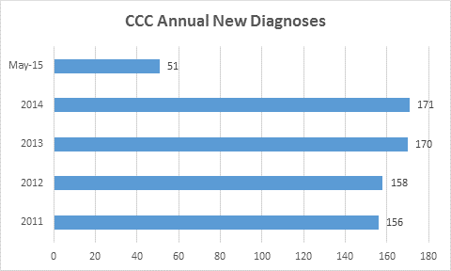

Slide 3
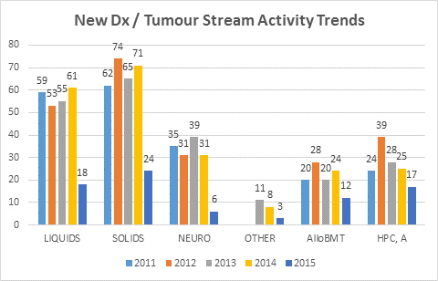

Slide 4
Paediatric Brain Tumours
Choroid
3%
Oligo
5%
Other
14%
Cranio
6%
Germ Cell
7%
Astrocytoma,
Low grade
30%
Ependy
8%
Medullo
8%
BSG
9%
Astro, HG
10%
Paediatric Brain Tumours leading cause of mortality in children and adolescents

Slide 5
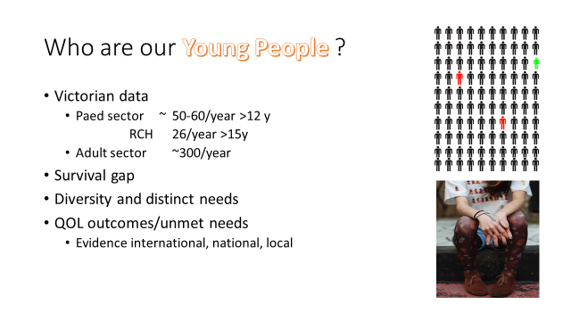

Slide 6
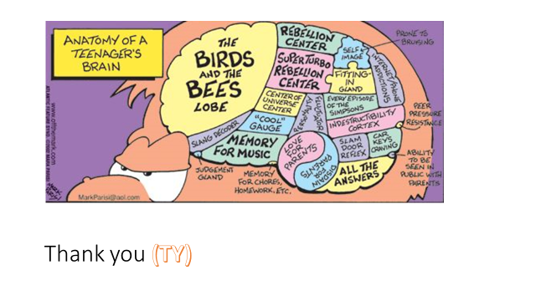

Slide 7
220 new cases per year in Victoria
5 year survival for under 15 years
CANCER TYPE 1970 –79 2006-10
Leukemia 39% 92%
Lymphoma 58% 93%
Bone 45% 79%
Brain 35% 50%
OVERALL 49% 82%

Slide 8
Rarely a Medical Emergency
ALWAYS an
EMOTIONAL and a
FINANCIAL Emergency

Slide 9
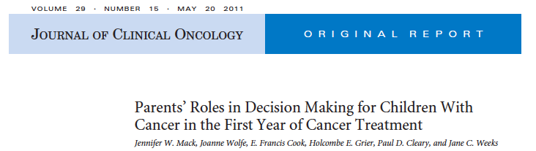

Slide 10
Response categories in the parent survey were
“I prefer to make the decisions about treatment with little or no input from my child’s oncologist”;
“I prefer to make the decisions after considering my child’s oncologist’s opinion”;
“I prefer that my child’s oncologist and I make the decisions together”;
“I prefer that my child’s oncologist make the decisions after considering my opinion”;
“I prefer that my child’s oncologist make the decisions with little or no input from me.”

Slide 11
two thirds 66% (127 of 192) desired a collaborative decision-making process with the physician,
26% (50 of 192) preferred to retain primary responsibility for decision making ,
8% (15 of 192) wished to delegate decision-making responsibility to the physician
++Quality of information and communication

Slide 12
All children wanted to be involved in the process
Half did not understand that it was research
Half did not recall they were involved in the decision making
86% did not understand the doctor

Slide 13
Different Ways
Developing parents education
Engaging parents and family in quality improvement
Improving co decision making

Slide 14
Different Ways
Implementing co decision making
  Understanding parents preferred choice
  Role of quality of communication and information

Slide 15
Still a lot to do together

Slide 16


Slide 17
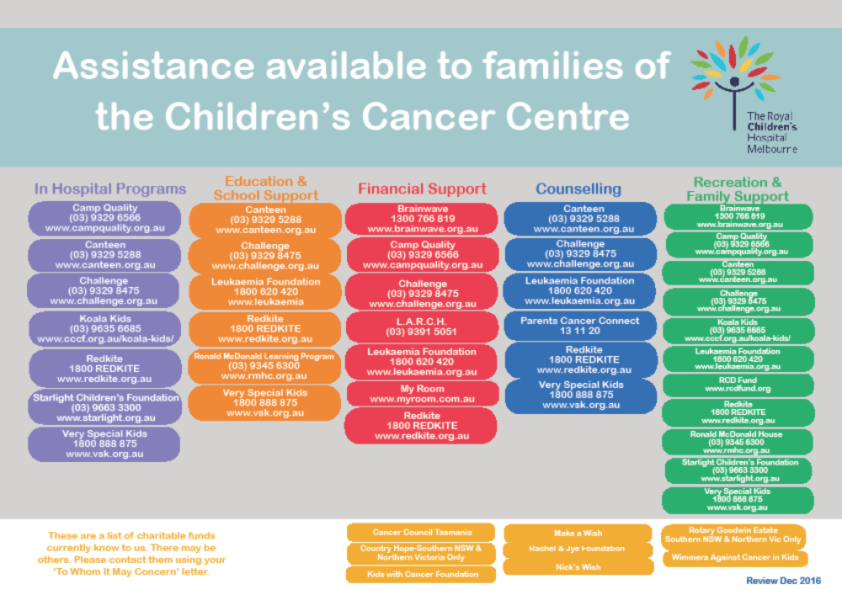

Slide 18
No 2 Standard of the Australian
Health Accreditation Services
Consumer Engagement
To improve overall outcomes for our families

Slide 19
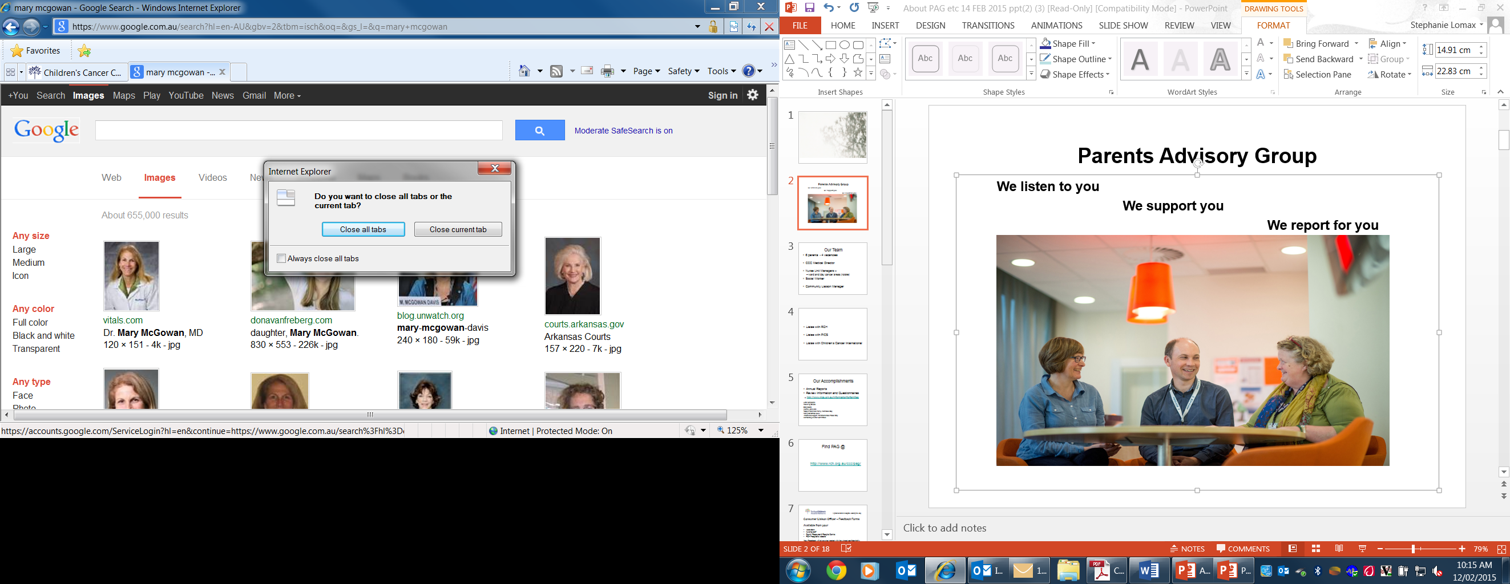
Parents Advisory Group
We listen to you
We support you
We report for you

Slide 20
Prior to Starting
Necessary support infrastructure
Strategic plan
Workshop / Forum
Criteria
Recruitment
Orientation
Retention and Recognition
Regular Support
Debrief
Present at Staff Quality Meeting quarterly

Slide 21
Our team
9 parents - 1 vacancy
CCC Medical Director
Nurse Unit Managers
  Ward and Day Cancer areas (rotate)
Social Worker
Community Liaison Manager

Slide 22
Our role
Liaise with RCH
Liaise with PICS
Liaise with Children’s Cancer International

Slide 23
Our accomplishments
Annual Reports
  Review Information & Questionnaires (i.e. http://www.pics.org.au/Informationforfamilies)
Letter campaigns
Parent Tip Sheets
Story Board
Monthly ward visits
Parent & Family Information Day!
Family Christmas Movie
Initiated and support International Gold Ribbon Day
Membership on other committees

Slide 24
Find PAG @
http://www.rch.org.au/ccc/pag/

Slide 25


Community Liaison
Victorian Paediatric Oncology Consumer Registry
        There are many ways in which children and families can provide feedback an advice. These include:
        • Participate in a phone interview
        • Complete a survey
        • Join a group discussion with other parents /patients
        • Join a short-term working group with a specific focus
        • Participate as a member of the Victorian PICS Consumer and Community Advisory Committee
In addition, we would like the opportunity to provide you with information that may be of interest to you from time to time.
Feedback forms available from your
  Ward clerk
  Nursing staff
  Family Resources & Respite Centre
  RCH website or your treating hospital
http://www.rch.org.au/quality/consumer_liaison/
Your feedback will always be treated with confidentiality.
You will not be discriminated against because you have spoken out and expressed your concerns.
A great children's hospital, leading the way

Slide 26

Victorian Paediatric Oncology Consumer Registry
http://www.pics.org.au/

Slide 27
Chocolates
BOOST
TWIRL
TIME OUT
BREAKAWAY
AFTER EIGHT
TAKE 5
PICNIC
DOUBLE DELIGHT

Slide 28


Slide 29
https://www.youtube.com/watch?v=mHjzZyBdiGo
If for, some reason, it doesn't work, just Google Little Stars Marmaduke

