Slide 1

Schmidtea mediterranea:
A new animal model for neurodevelopmental toxicology studies?
Mary M. Staehle
Rowan University Henry M. Rowan College of Engineering
Biomedical and Chemical Engineering
staehle@rowan.edu

Slide 2
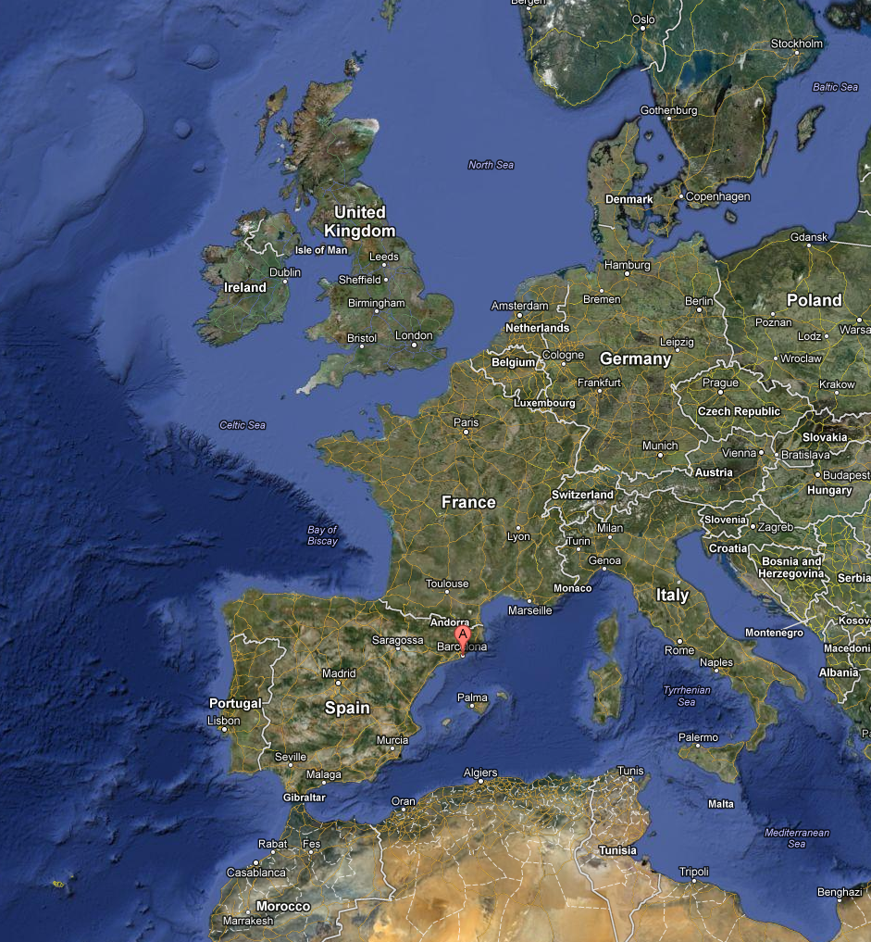
Schmidtea mediterranea Planaria (Smed)
Planaria are small, freshwater flatworms
Schmidtea mediterranea were originally collected in 1998 from the Parc de Montjuïc in Barcelona (Sanchez Alvarado and Newmark)
Smed are small (2-6mm), asexual worms

Slide 3
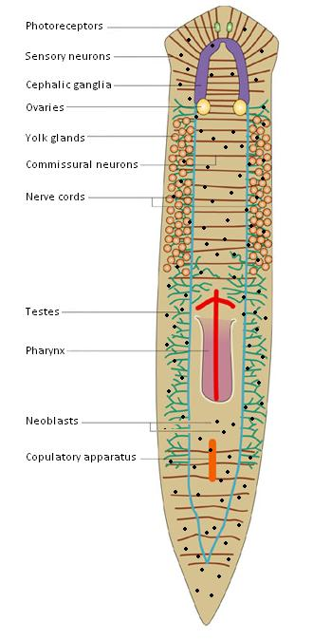
Schmidtea mediterrania Planaria (Smed)
Planaria are flatworms widely considered to be the simplest organism alive with a CNS¹
The CNS consists of a bi-lobed cephalic ganglia, which serves as the planarian brain, and two ventral nerve cords²
Planarian body consists of a collection of pluripotent neoblasts³
¹ Umesono Y, Watanabe K, Agata K. “A planarian orthopedia homolog is specifically expressed in the branch region of both the mature and regenerating brain.” Development, Growth, and Differentiation 39:723-727. (1997)
² Cebria F, et al. “Dissecting planarian central nervous system regeneration by the expression of neural-specific genes.” Development, Growth, and Differentiation 44:135-146. (2002)
³ Newmark PA, Alvarado AS . “Not your father’s planarian: A classic model enters the era of functional genomics.” Nature 3:210-219. (2002)

Slide 4
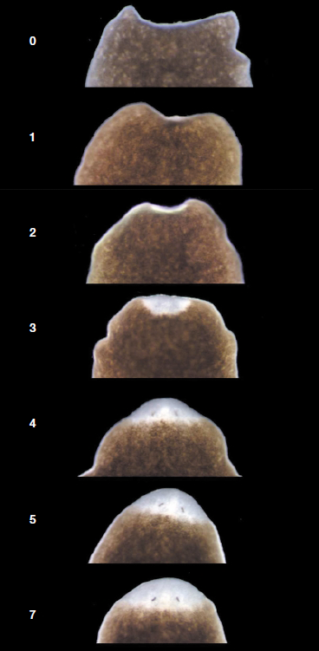
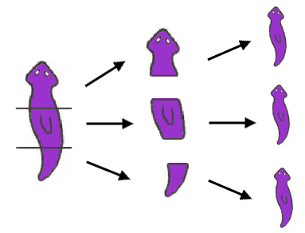
Planaria: Masters of Regeneration
Planaria are commonly studied for their ability to regenerate
(from as little as 1/279th)
The genome is sequenced
Previous behavioral teratology experiments have shown adverse effects and withdrawal-like symptoms
  Cocaine^{1,2}
  Marijuana substitutes³
  Opioid-dopamines⁴
¹Palladini et al. “A pharmacological study of cocaine activity in planaria.” Comparative Biochemistry and Physiology 115C:41-45. (1996)
² Raffa RB, Valdez JM. “Cocaine withdrawal in Planaria.” European Journal of Pharmacology 430:143-145. (2001)
³Rawls SM, Gomez T, Raffa RB. “An NMDA antagonist (LY 235959) attenuates abstinence-induced withdrawal of planarians following acute exposure to a cannabinoid agonist (WIN 52212-2).” Pharmacology Biochemistry and Behavior 86: 499-504. (2008)
⁴Passarelli et al. “Opiod-dopamine interaction in planaria: a behavioral study. Comparative Biochemistry and Physiology 124:51-55. (1999)

Slide 5
We hypothesize that head-regenerating planaria are a viable model for investigating the direct effects of Toxin Exposure during neurodevelopment.

Slide 6
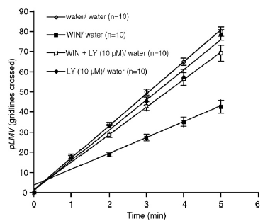
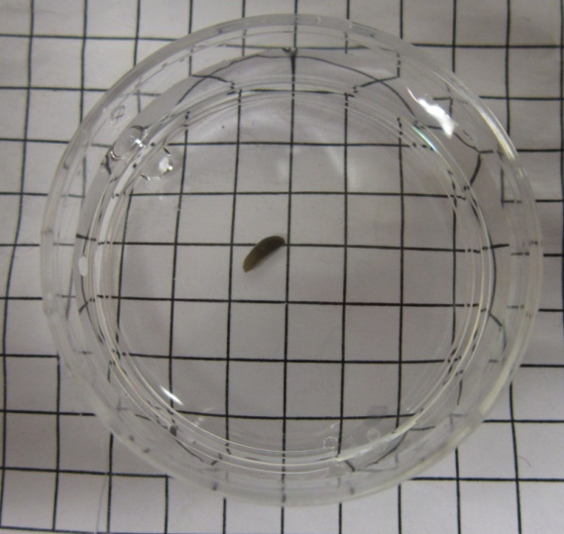
Assessment Methods: pLMV
Planarian Locomotive Velocity (pLMV)
Rawls SM, Gomez T, Raffa RB. “An NMDA antagonist (LY 235959) attenuates abstinence-induced withdrawal of planarians following acute exposure to a cannabinoid agonist (WIN 52212-2).” Pharmacology Biochemistry and Behavior 86: 499-504. (2008)
Lowe, J.R. et al. Neurotoxicology and Teratology, 48 (2015) 28-32.

Slide 7
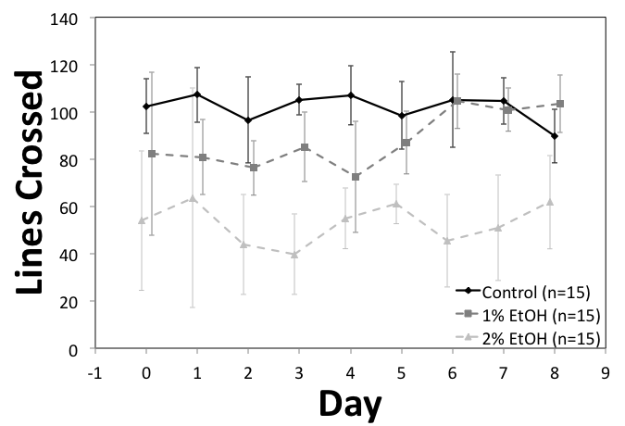
Assessment Methods: pLMV and Ethanol in Planaria
Lowe, J.R. et al. Neurotoxicology and Teratology, 48 (2015) 28-32.

Slide 8
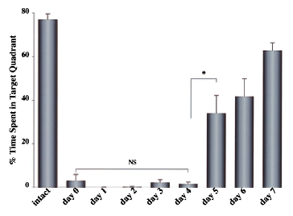
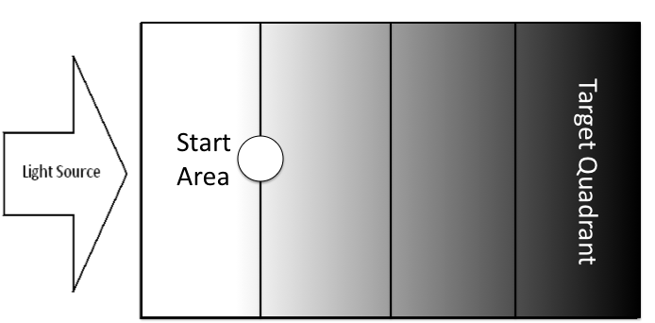
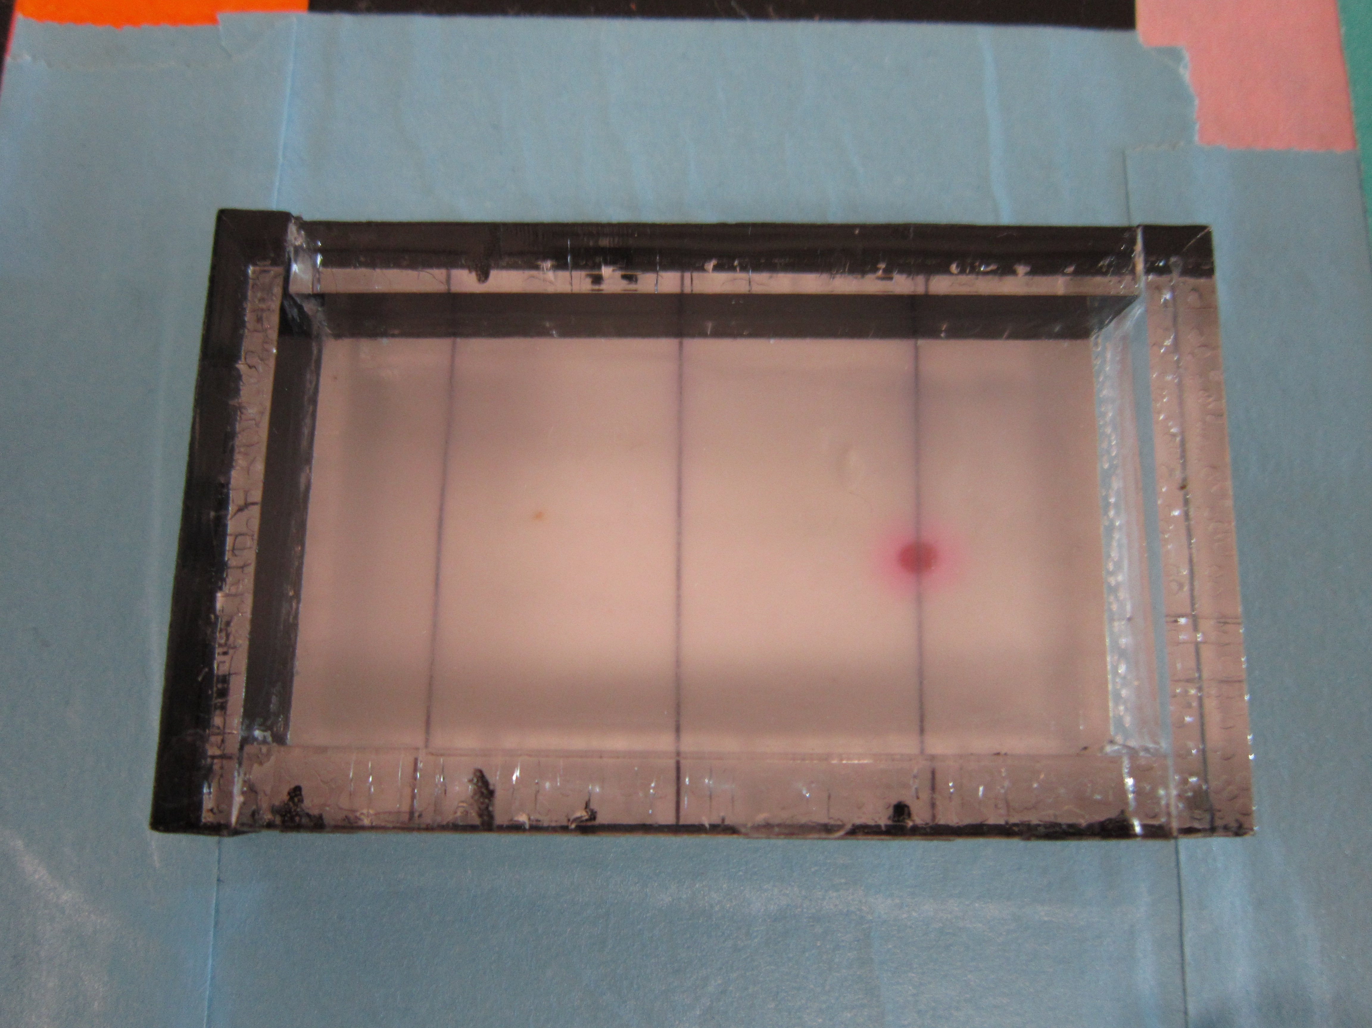
Assessment Methods: pLA
Planarian Light Avoidance (pLA)
Inoue T, et al. “Morphological and functional recovery of the planarian photosensing system during head regeneration.” Zoological Science 21:275-283. (2004)
Lowe, J.R. et al. Neurotoxicology and Teratology, 48 (2015) 28-32.

Slide 9
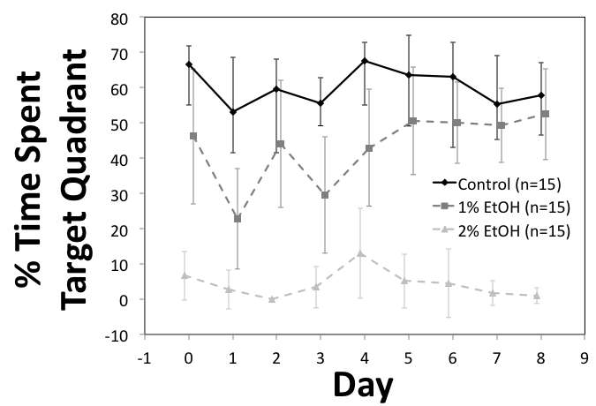
Assessment Methods:
pLA and Ethanol in Planaria
Lowe, J.R. et al. Neurotoxicology and Teratology, 48 (2015) 28-32.

Slide 10
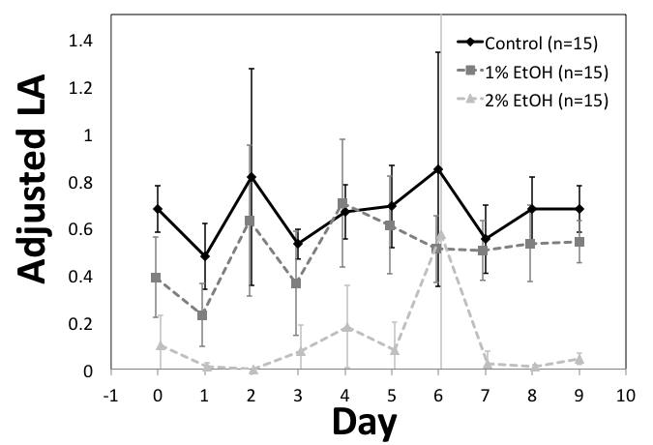
Assessment Methods:
Cognitive Function Score
Cognitive Function Score
Lowe, J.R. et al. Neurotoxicology and Teratology, 48 (2015) 28-32.

Slide 11
Assessing Effects of Toxin Exposure
High doses of ethanol (2%) inhibit cognitive function in planaria*
Lower doses of ethanol (1%) do not alter cognitive function in planaria
  Acute exposure does slightly attenuate cognitive function – perhaps a response to de-ciliation^{1,2}
Lowe, J.R. et al. Neurotoxicology and Teratology, 48 (2015) 28-32.

Slide 12
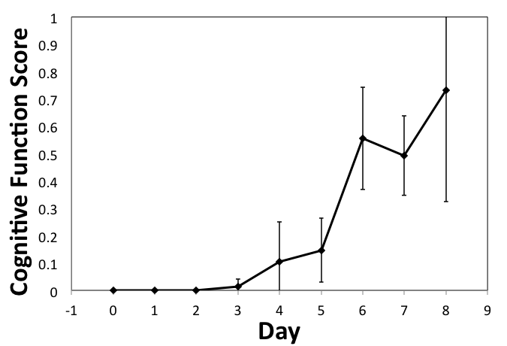
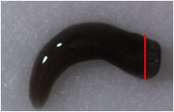
Does Alcohol Affect Planarian Regeneration?
Lowe, J.R. et al. Neurotoxicology and Teratology, 48 (2015) 28-32.

Slide 13
Does Alcohol Affect Planarian Regeneration?
Lowe, J.R. et al. Neurotoxicology and Teratology, 48 (2015) 28-32.
Notes:
This is slightly behind the results in Inuoe, but there are a number of factors that may influence that…

Slide 14
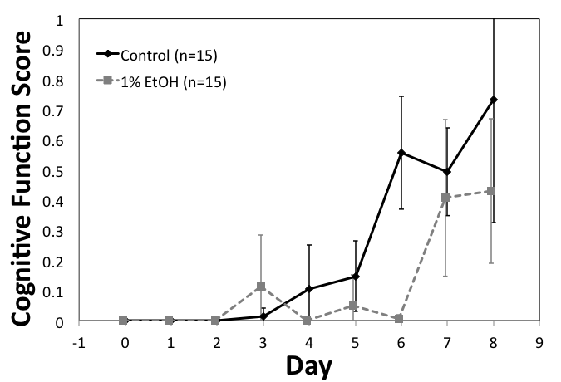
Does Alcohol Affect Planarian Regeneration?
Lowe, J.R. et al. Neurotoxicology and Teratology, 48 (2015) 28-32.
Notes:
.35 / 1.08

Slide 15
Does Alcohol Affect Planarian Regeneration?
Lowe, J.R. et al. Neurotoxicology and Teratology, 48 (2015) 28-32.

Slide 16
Neurodevelopmental Effects of Ethanol Exposure
Alcohol affects intact planaria in a dose-dependent manner
Exposure to 1% ethanol delays the reacquisition of cognitive function in head regenerating planaria, suggesting that alcohol retards neurodevelopmental processes in planaria
Lowe, J.R. et al. Neurotoxicology and Teratology, 48 (2015) 28-32.

Slide 17

Bisphenol A (BPA)
Commonly used in plastics and epoxy resins
Estrogenic molecule
  Endocrine disruptor
Present in 93% of human population
Placental transfer of BPA
Can We Do Better?
http://upload.wikimedia.org/wikipedia/commons/thumb/6/61/Bisphenol-A-Skeletal.svg/240px-Bisphenol-A-Skeletal.svg.png

Slide 18
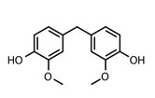
Bis-Guaiacol F (BGF)
BPA alternative
Green engineering
  Made from waste from paper/pulp industry
Tests for human safety are still needed
Kaleigh H. Reno, Joseph F. Stanzione, III, Joshua M. Sadler, John J. La Scala, and Richard P. Wool, “Bisphenol Alternatives Derived from Renewable Substituted Phenolics.” U.S. Provisional Pat. Appl., filed May 27, 2014.
Notes:
From Lignin – second most abundant renewable resource

Slide 19
Lethality Test Results

Slide 20
Bgf was less lethal to the Smed on a dose-dependent scale

Slide 21
Bpa represses cognitive function
2 ppm
2 ppm
Intact Smed
Regenerating Smed

Slide 23
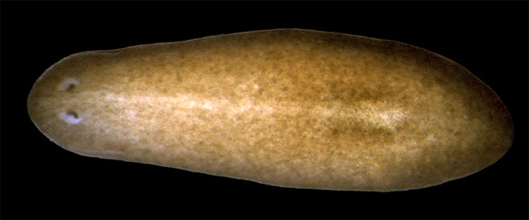
Conclusions
BGF worms withstand higher concentrations for longer periods of time than BPA worms
Planaria are a novel animal model for studying the direct effects of toxins on:
  Neurodevelopment
  In vivo Stem Cell (Neoblast) Differentiation
  Potential for high-throughput experiments
“Coal mine canary”?
http://blogs.discovermagazine.com/notrocketscience/2011/05/12/an-entire-flatworm-regenerated-from-a-single-adult-cell/#.VJCsoyvF_To

Slide 24
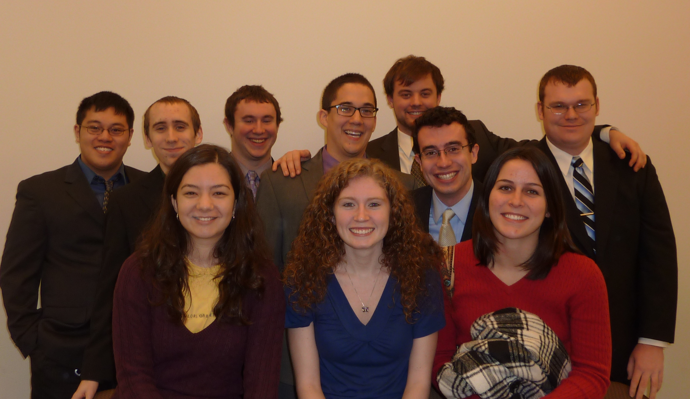
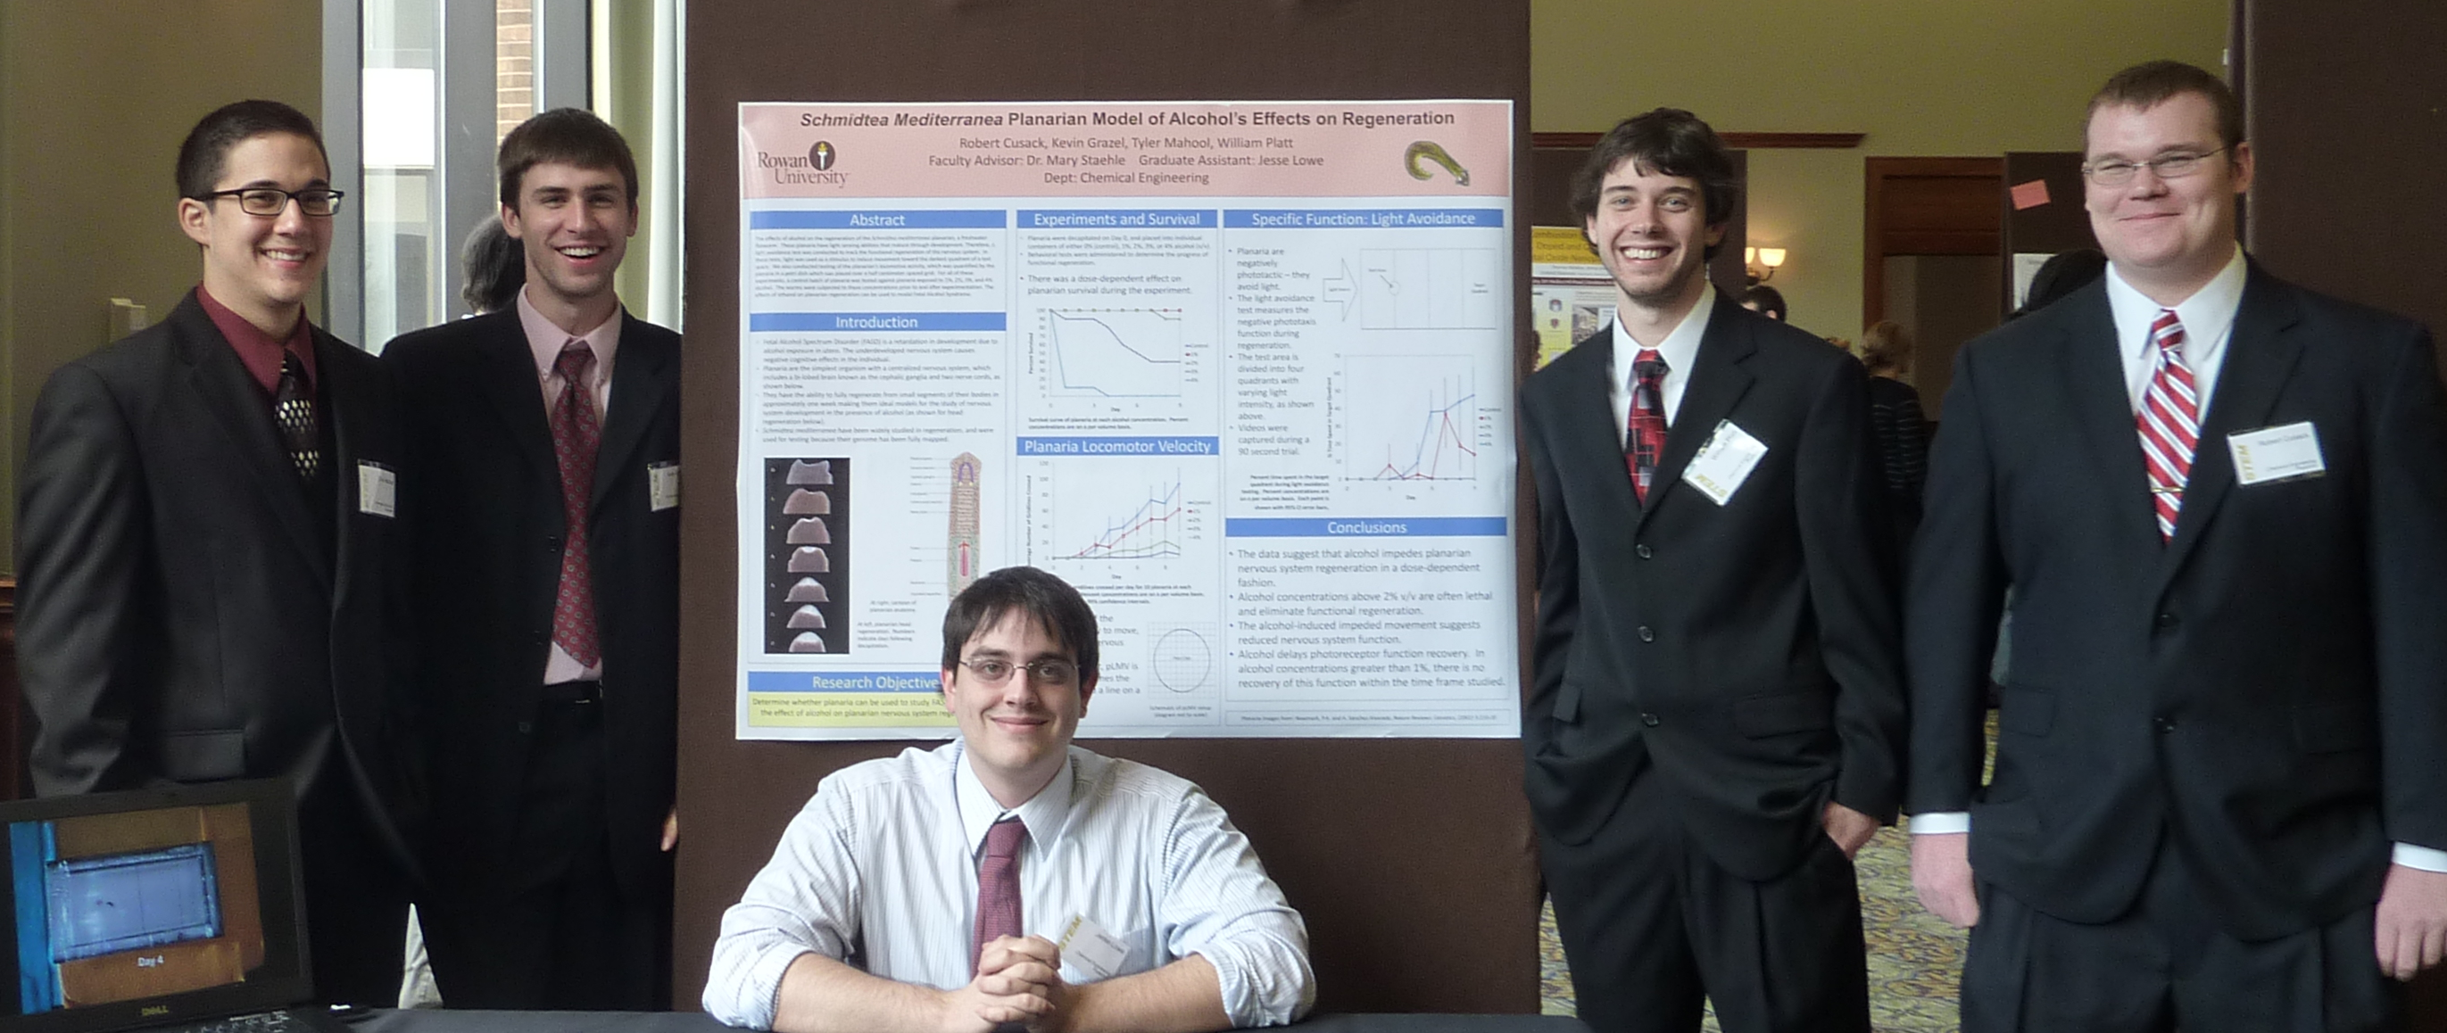
Acknowledgements
Dr. Joseph Stanzione III
Dr. Kevin Dahm
Jesse R. Lowe
Tyler D. Mahool
Undergraduate Students

Slide 25
Schmidtea mediterranea:
A new animal model for neurodevelopmental toxicology studies?
Mary M. Staehle
Rowan University Henry M. Rowan College of Engineering
Biomedical and Chemical Engineering
staehle@rowan.edu

Slide 26
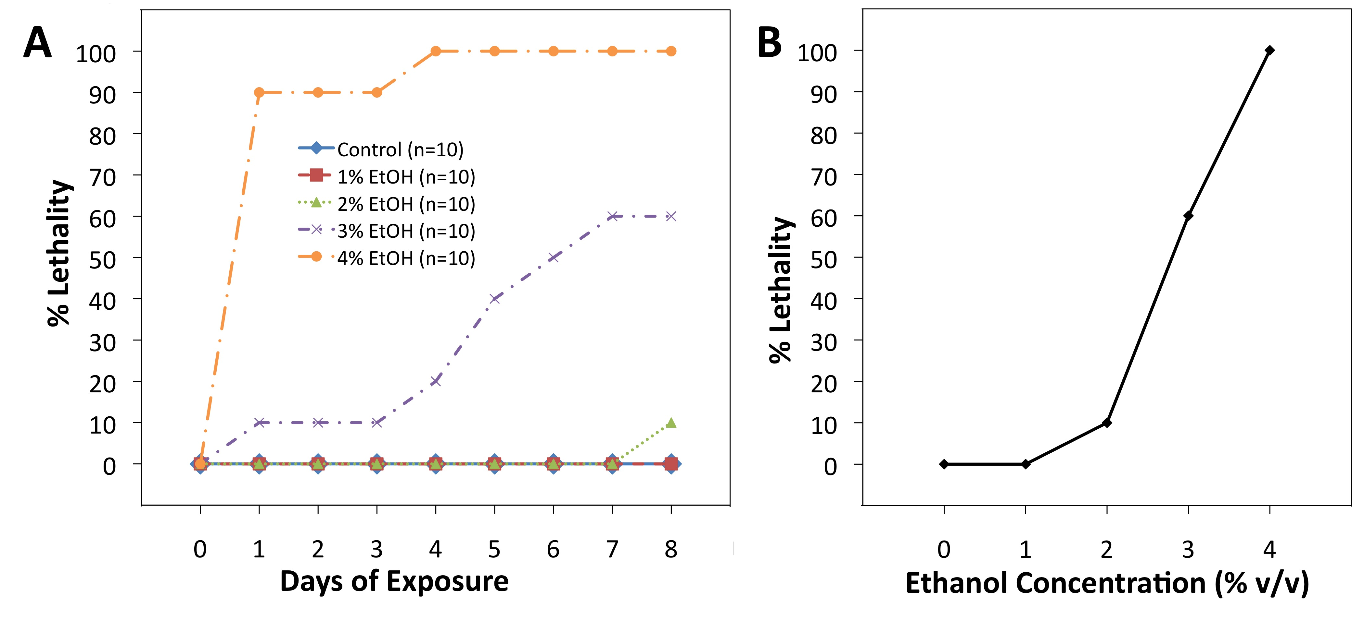
Alcohol Exposure Affects Planarian Viability in a Dose-Dependent Manner
Lowe, J.R. et al. Neurotoxicology and Teratology, 48 (2015) 28-32.

