Slide 1

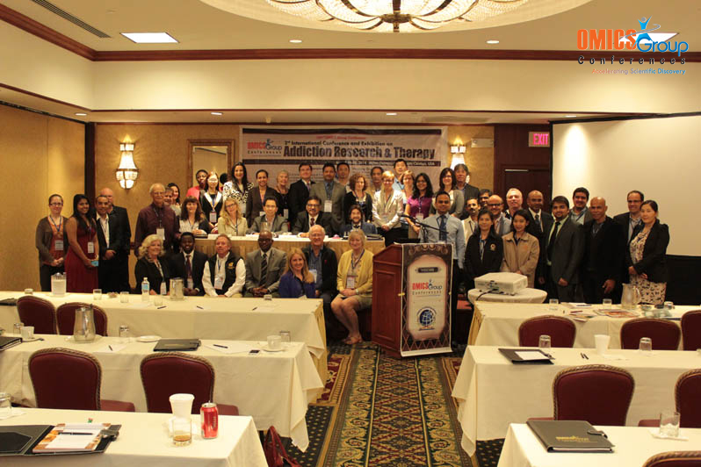
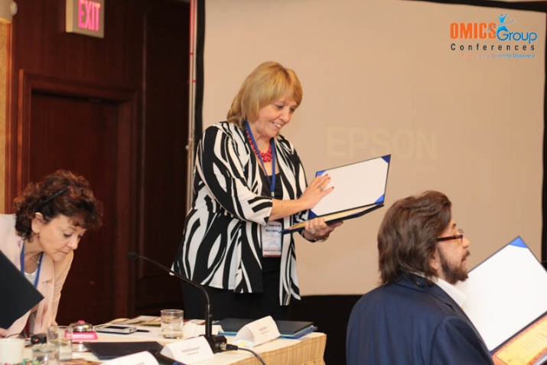
Addiction Therapy-2014
Chicago, USA
August 4 - 6, 2014
Mary Hauser

Slide 2
Comprehensive Analysis of Reported Drugs (CARD)™
Mary P. Hauser, MA

Slide 3
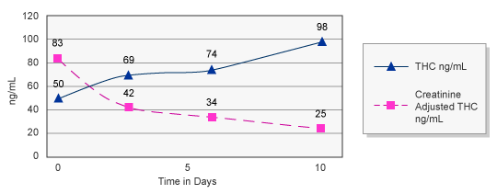
History
Since 1997 Dominion has provided clinics with state-of-the-art drug testing, support, education and training
Dominion was unique in offering Creatinine-Adjusted levels allowing the clinic to monitor the elimination of a drug over time
Sample Creatinine-Adjusted THC Levels

Slide 4
How CARD™ Was Born
By 2004, Dominion began getting requests from clinics to provide summary data about their practice
Dominion accommodated this by providing clinic-specific data summaries
Most of the clinics that Dominion works with use drug testing results to demonstrate their clinic’s effectiveness
More and more clinics began requesting that medication compliance be added to their summary reports

Slide 5
CARD™ Development
In 2009, Dominion began the development of a summary that would capture various results
By working with clinics the following categories of data summaries were developed:
  An overall summary of testing results – how many patients tested positive for illicit drugs in the quarter?
  How many were prescribed treatment-related drugs in the quarter?
  How many were taking the drug?
  What illicit drugs were being used?
  Were the patients being honest about their drug use?
The Challenge: Capture the information and report it back to the clinic

Slide 6
CARD™ Prototype
During 2009, a combined effort from Dominion’s Addiction Services Department, Information Systems Department, Clinical Services Department, and Laboratory worked together to generate a reporting structure
In late 2009, the prototype for Comprehensive Analysis of Reported Drugs (CARD)™ was ready for BETA testing

Slide 7
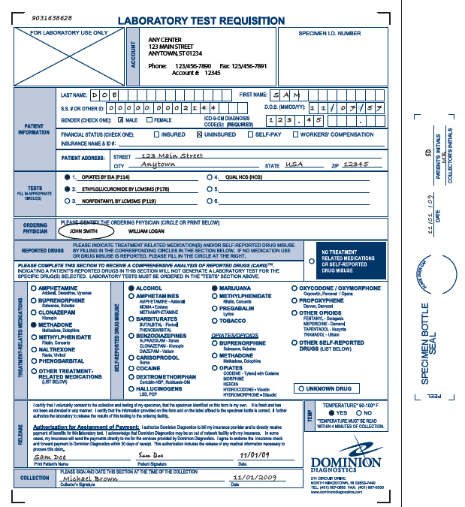
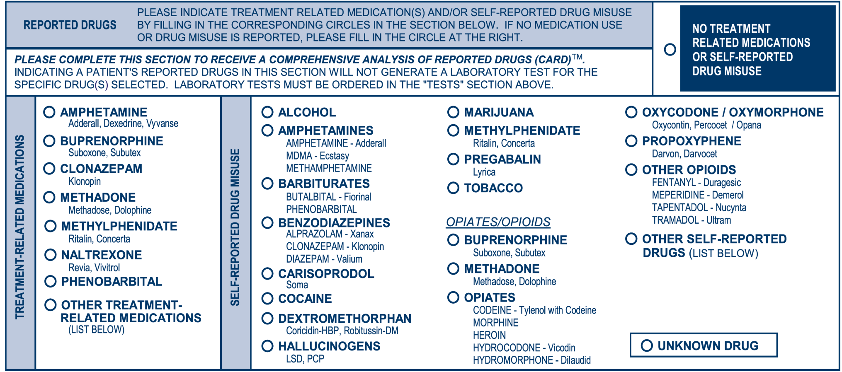
CARD™ Launch
In 2010, the launch of CARD™ began
The Clinic would report on the requisition
  If the patient was prescribed any treatment related medication
  If they were not prescribed any medications and the patient reported no drug use

Slide 8
Prescribed Treatment-Related Medications
If the patient was prescribed treatment related medication(s), the Clinic would report this on the requisition and indicate what medication was prescribed

Slide 9
Self-Reported Drug Misuse
The patient was asked to fill out the self-reported drug misuse section and report any drug taken in the last 72 hours or since their last drug test if the test was taken within the last 72 hours

Slide 10
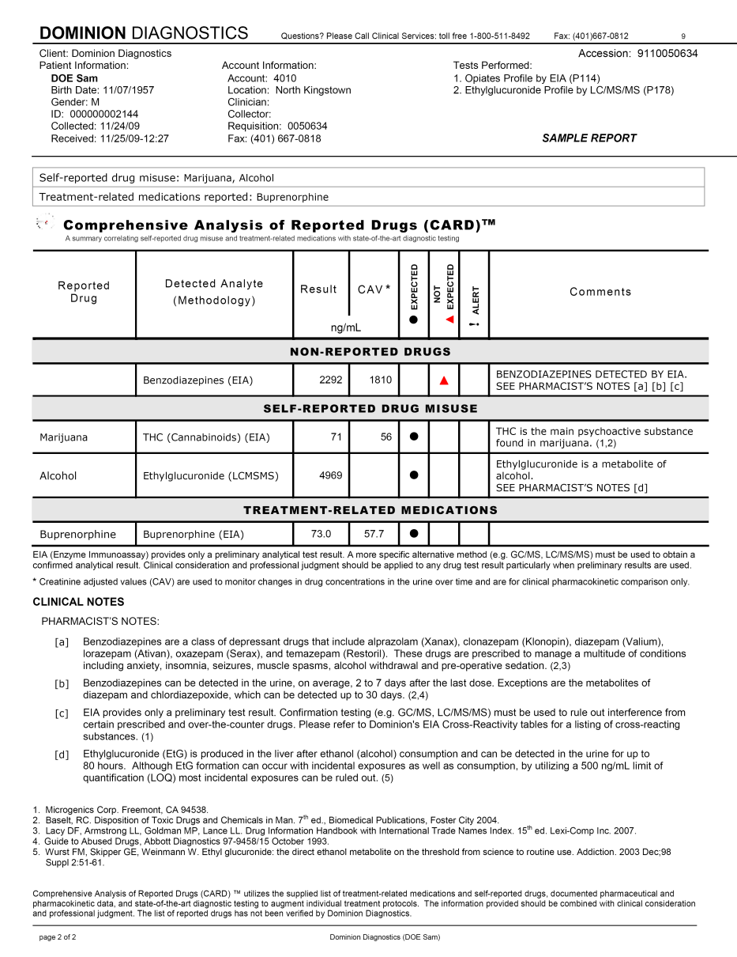
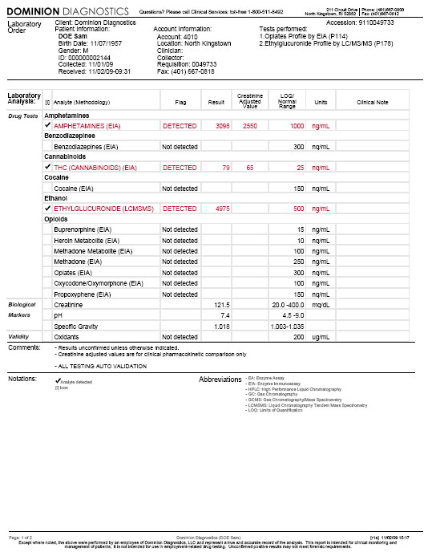
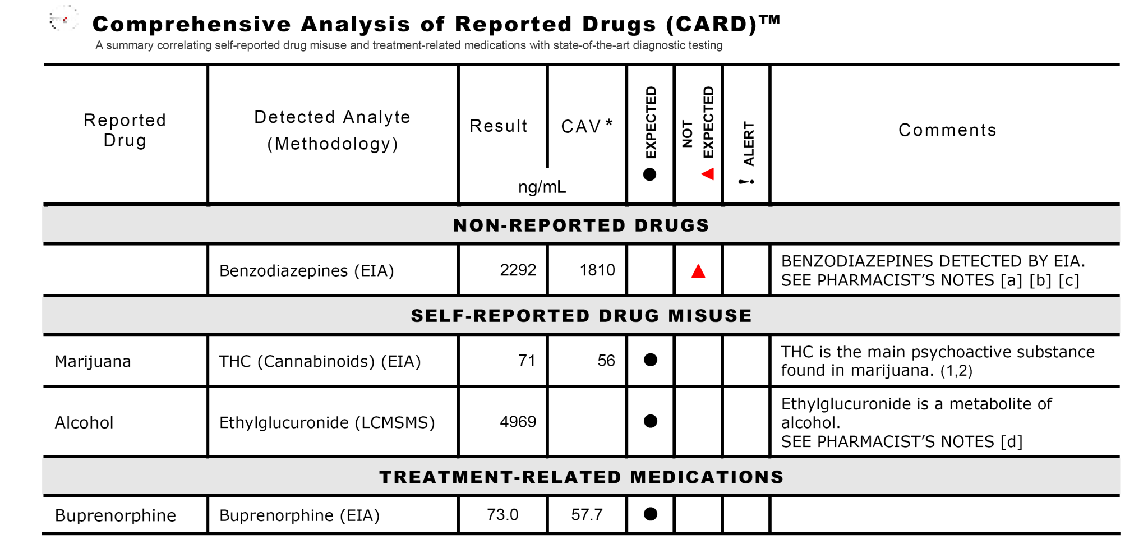
Laboratory Analysis Results + CARD™
The Clinic would receive their standard laboratory analysis report as well as a second page, the CARD™ Report, that would “alert” the Clinic to any results that were unexpected based on the medications and misuse reported

Slide 11
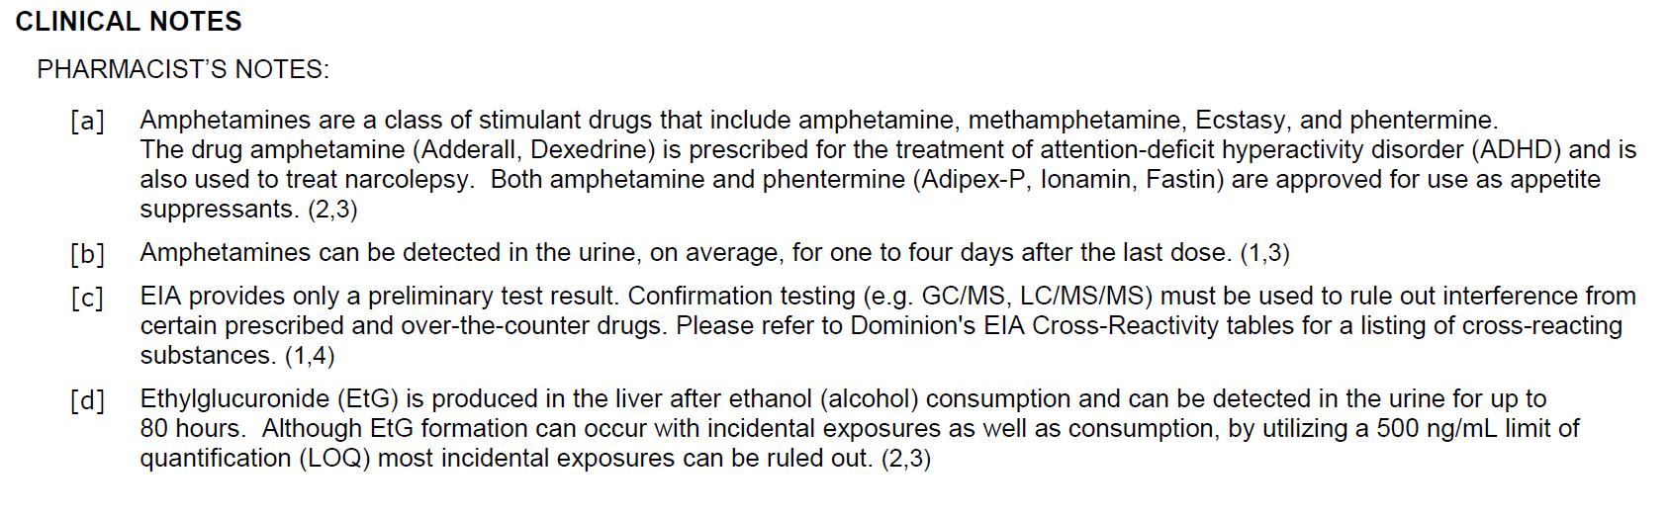
CARD™ References
CARD™ would provide Pharmacist’s Notes supported by scientifically validated and published references to assist the Clinic with interpretation of clinical comments and results

Slide 12
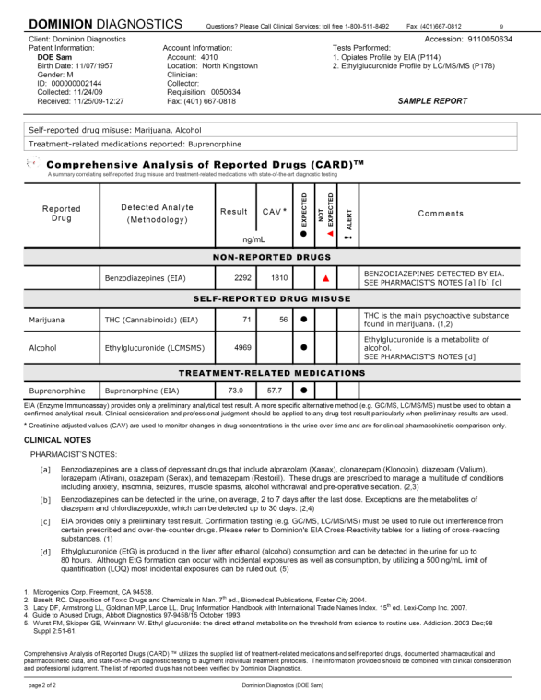
Unexpected Results
The Clinic would be able to use the CARD™ Report as a quick reference for unexpected results

Slide 13
CARD™ Summary Reports
The Clinic would also receive a summary quarterly and annually that would show the following:
  Overall Summary of the Clinic
  Summary of NO treatment related medication prescribed and NO self reported use
  Adherence to Treatment Related Medication
  Self-Reported Misuse for Both Detected and Non-Detected
  Self-Reported Drug Misuse When Adherent to Medication both detected and non-detected
  A Summary as to why a CARD™ Analysis could not be completed

Slide 14
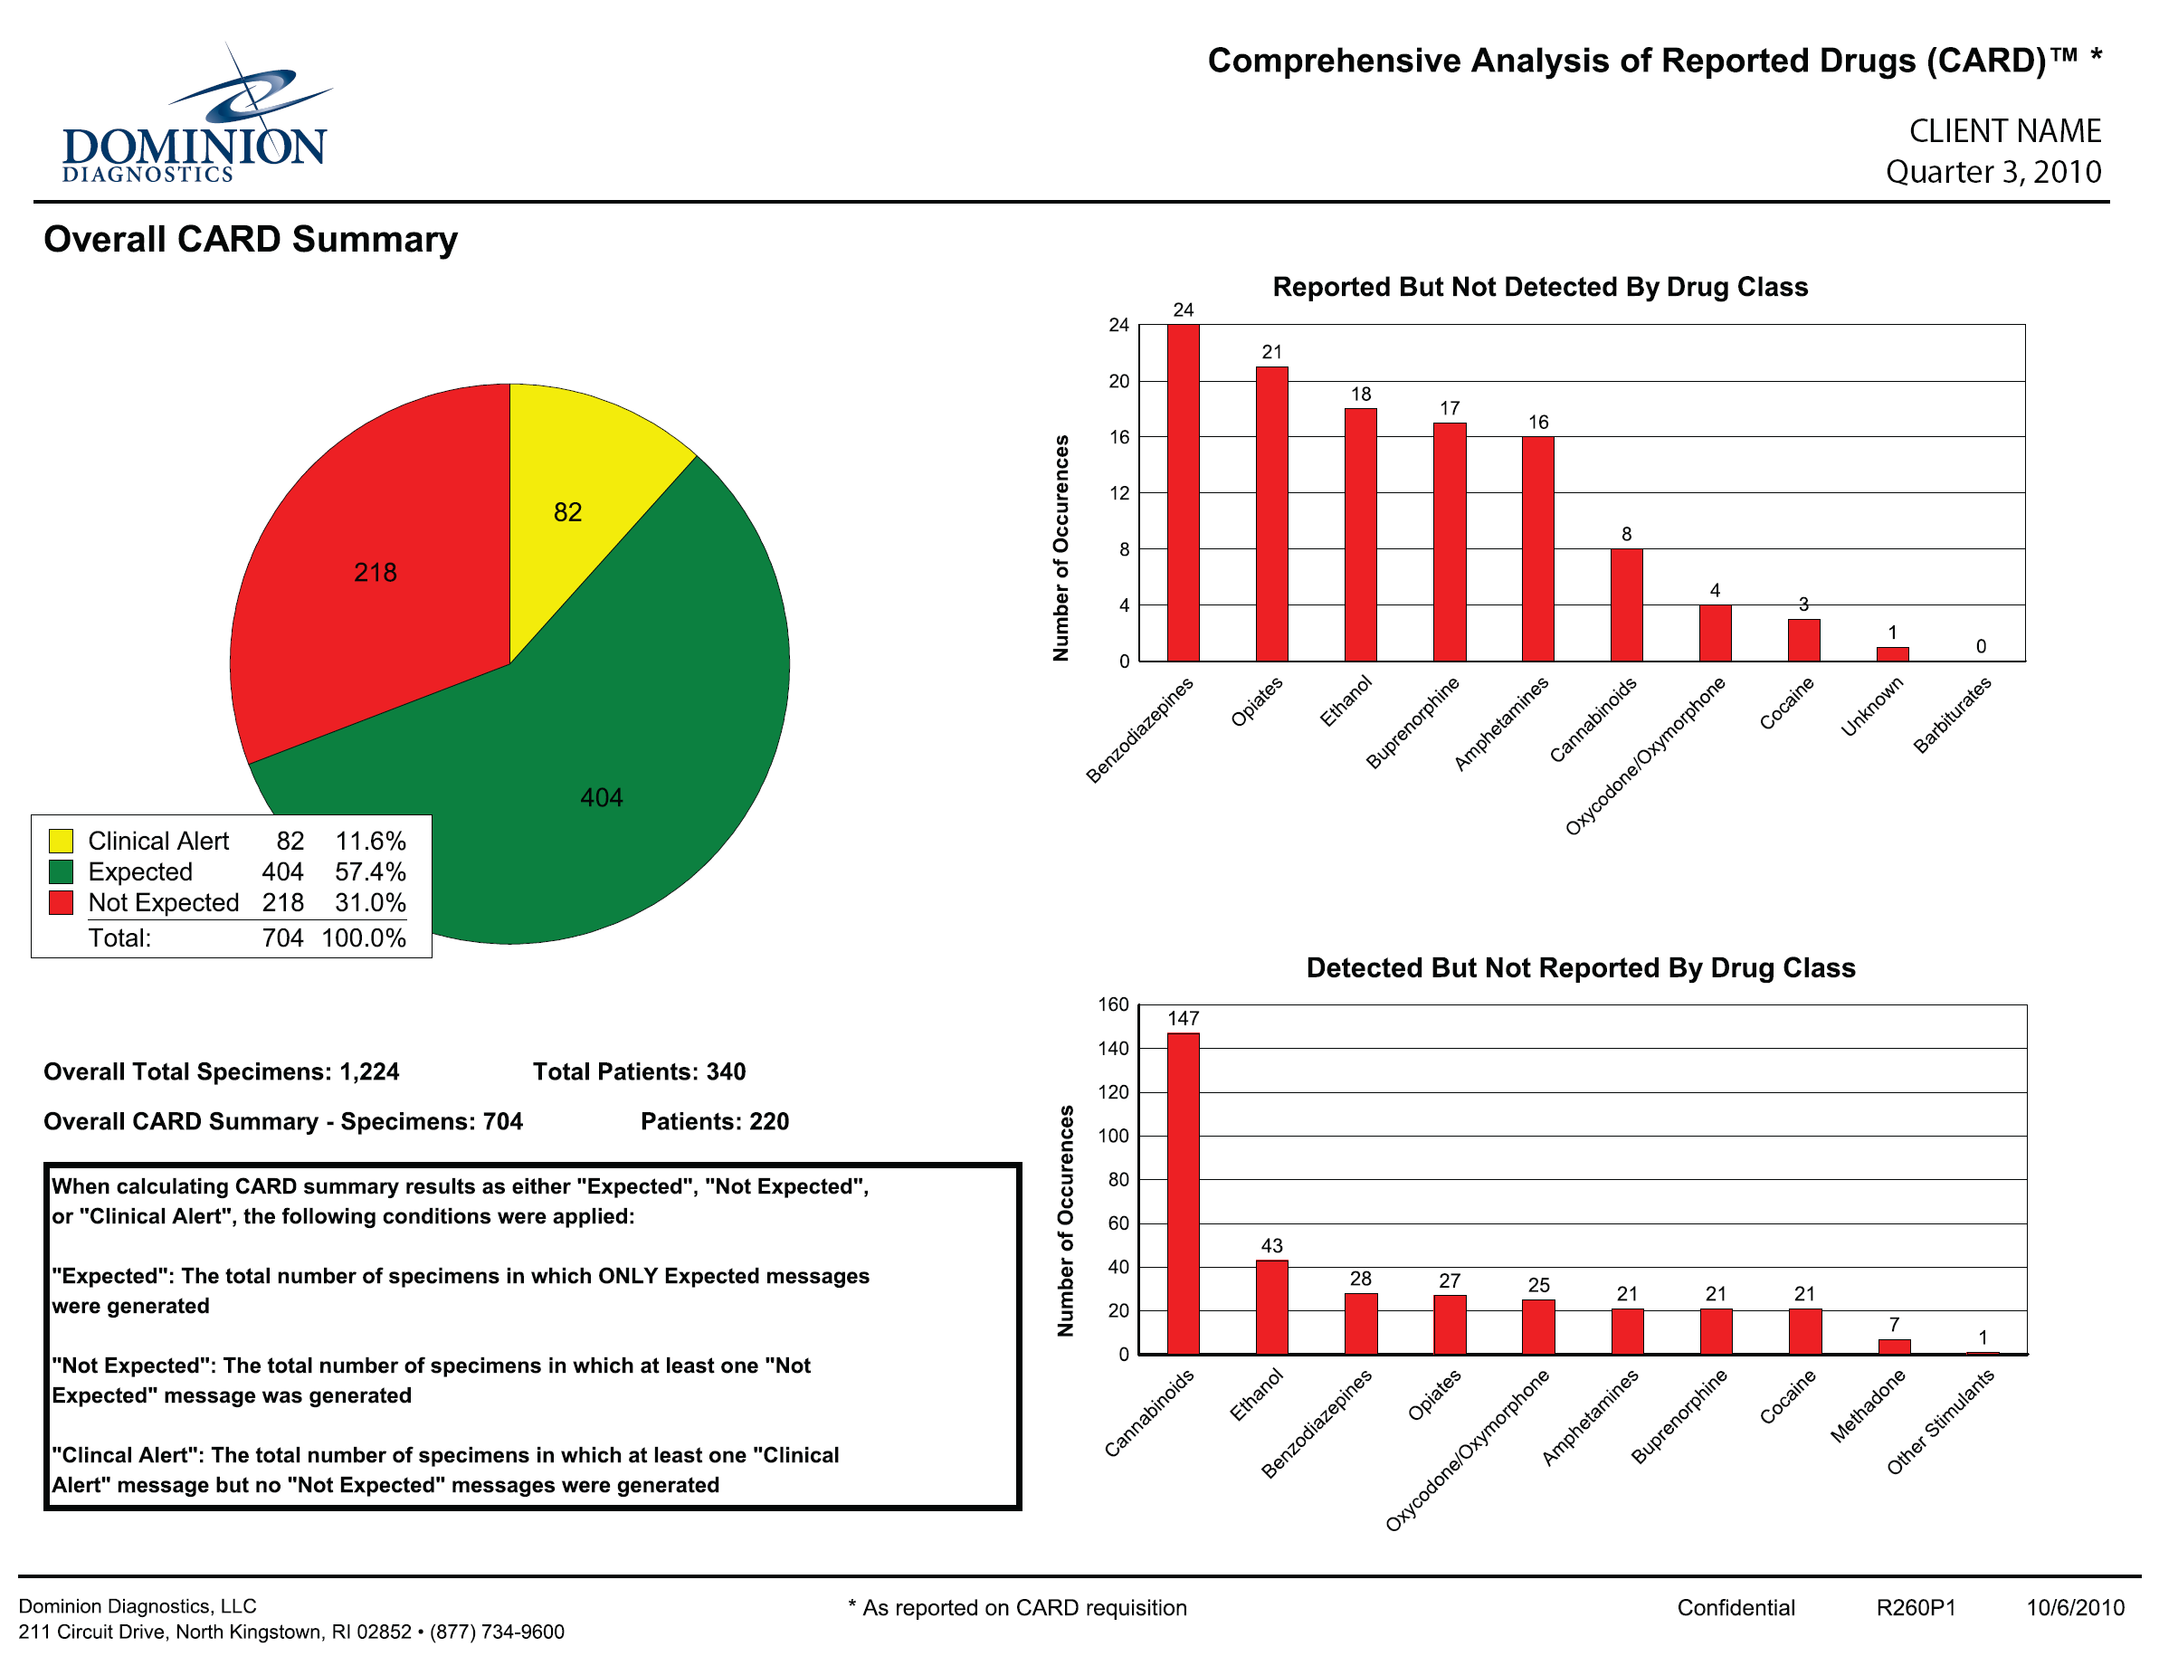

Slide 15
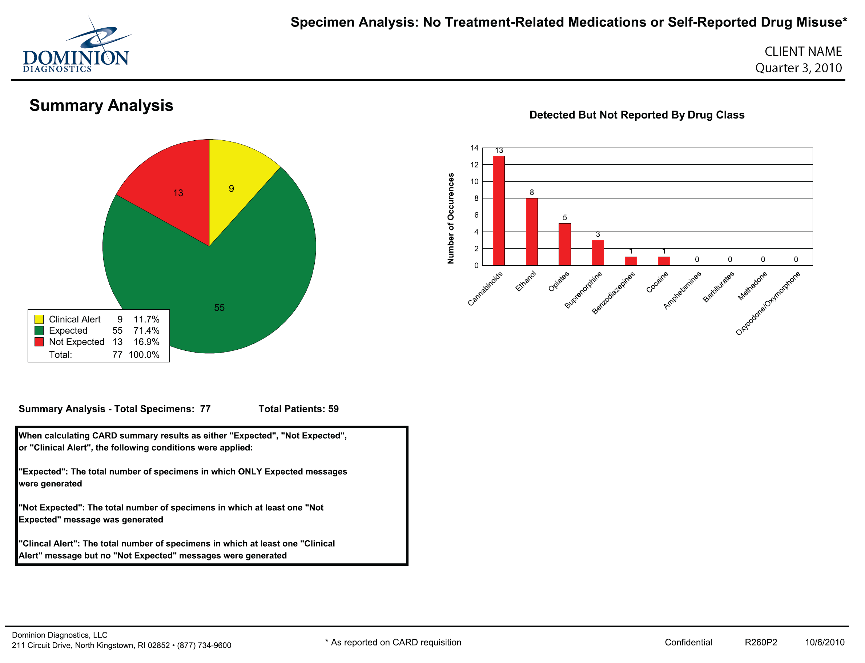

Slide 16
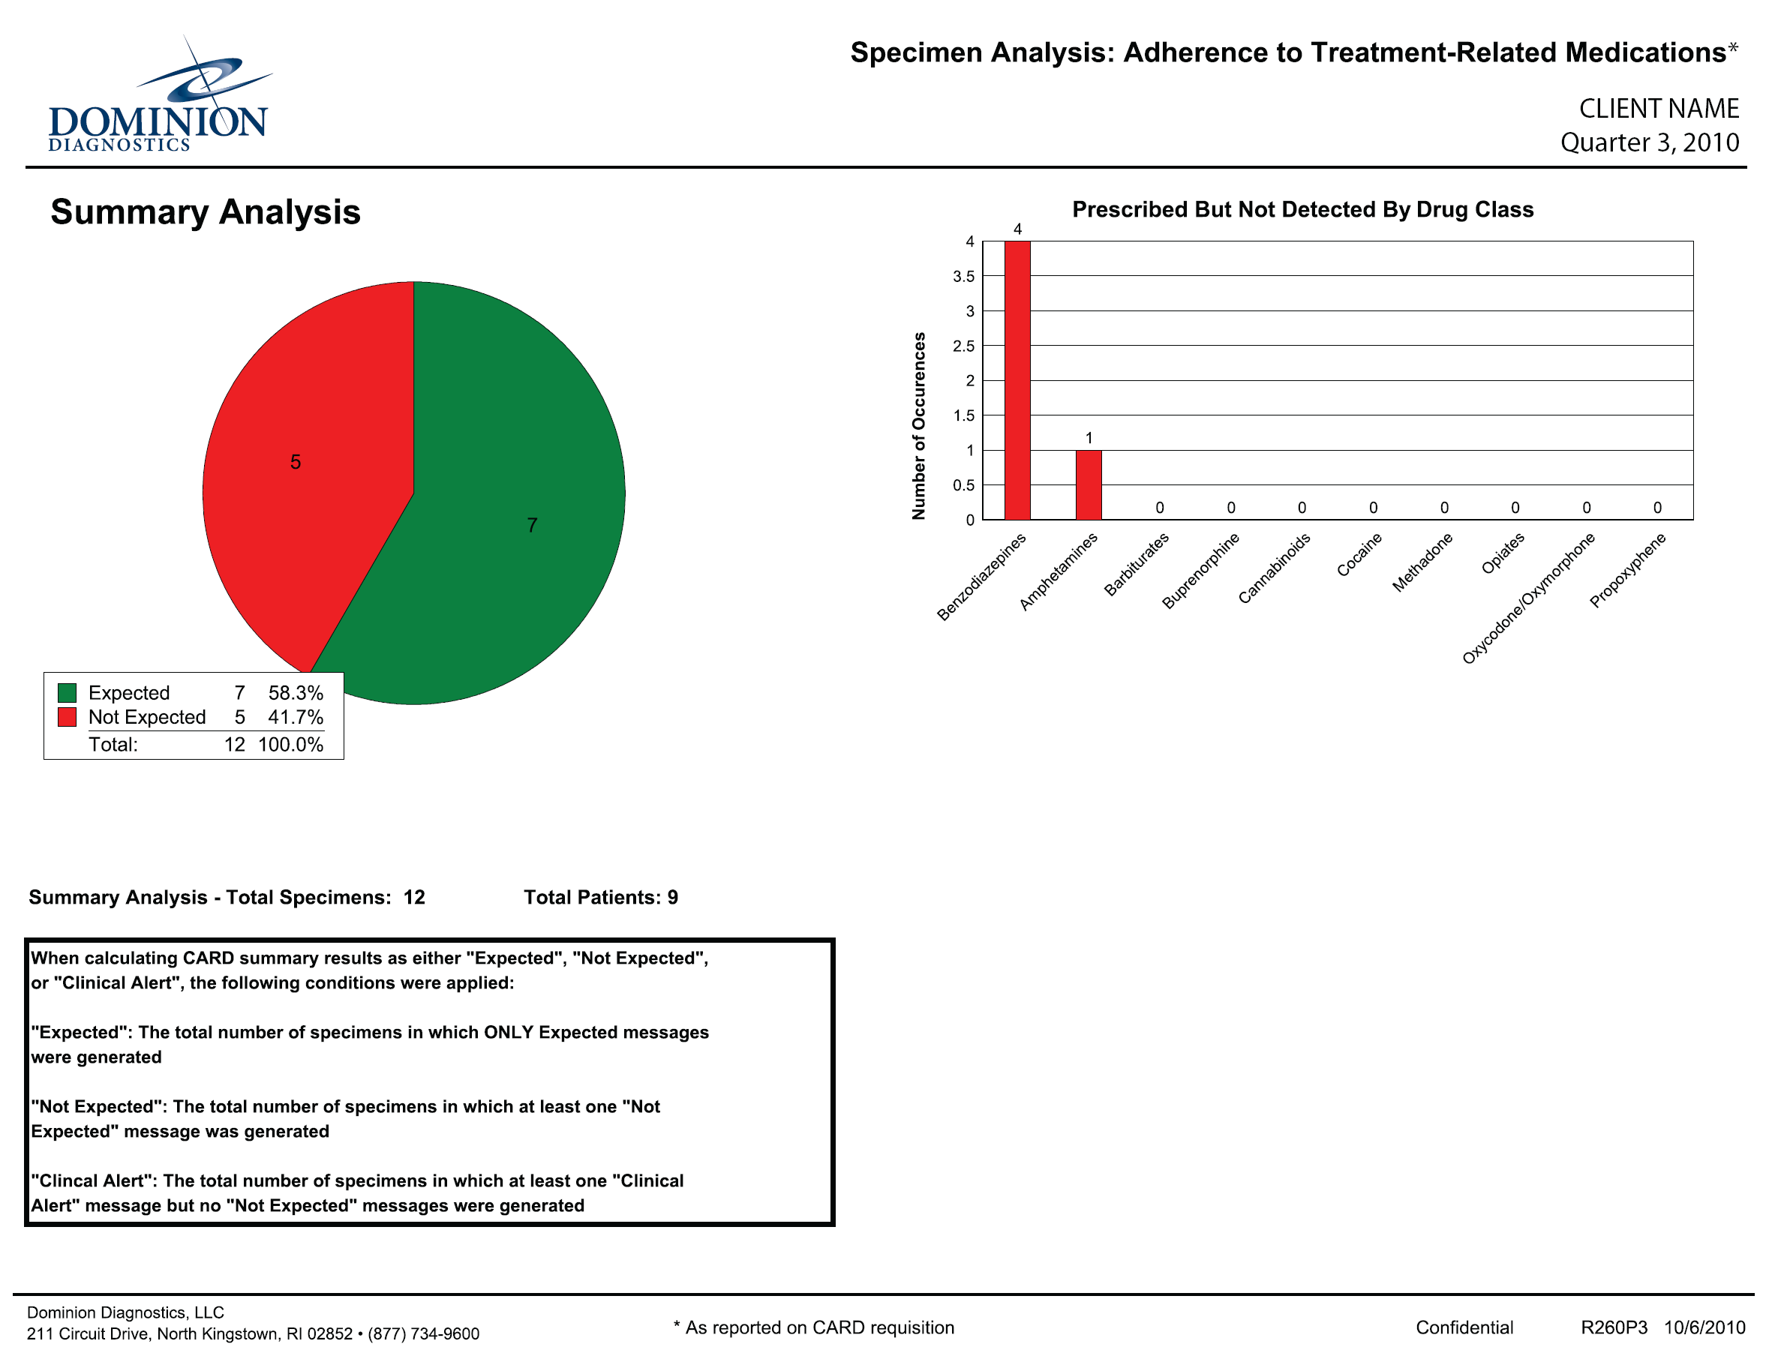

Slide 17
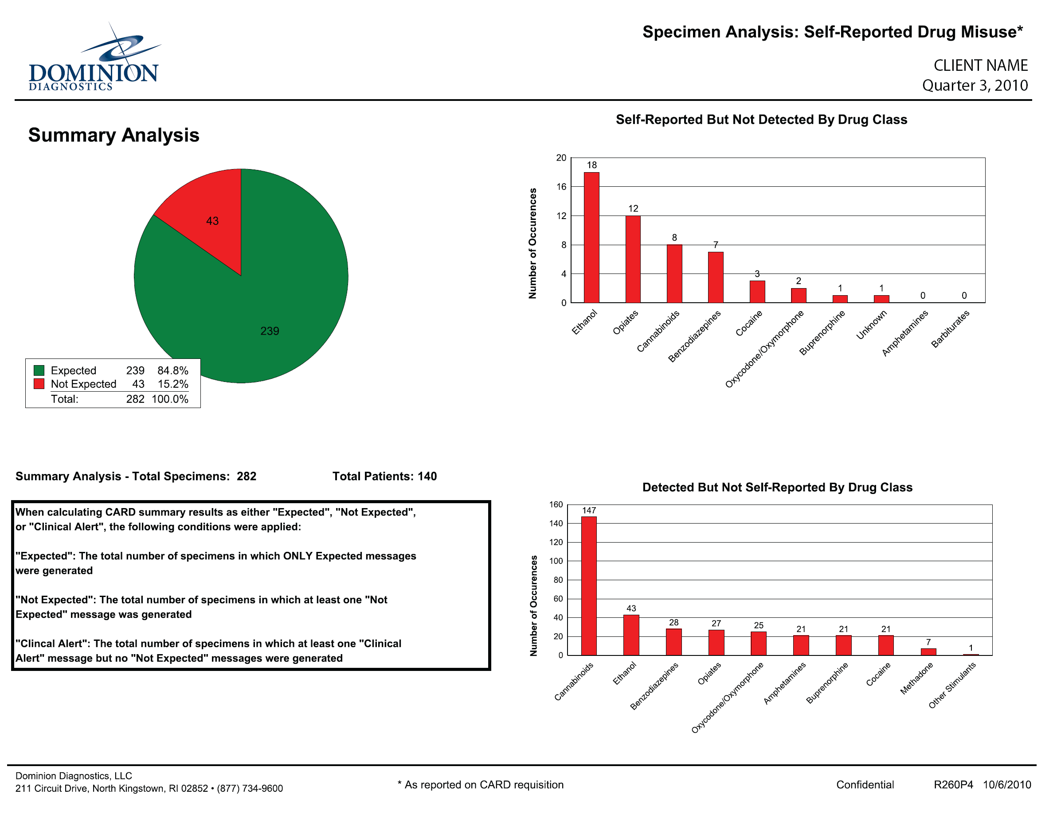

Slide 18
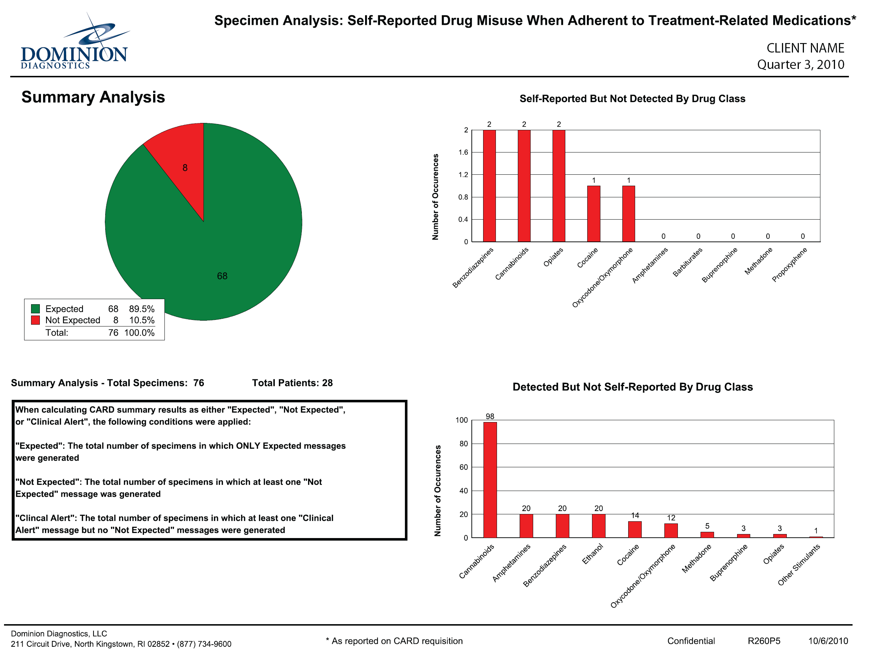

Slide 19
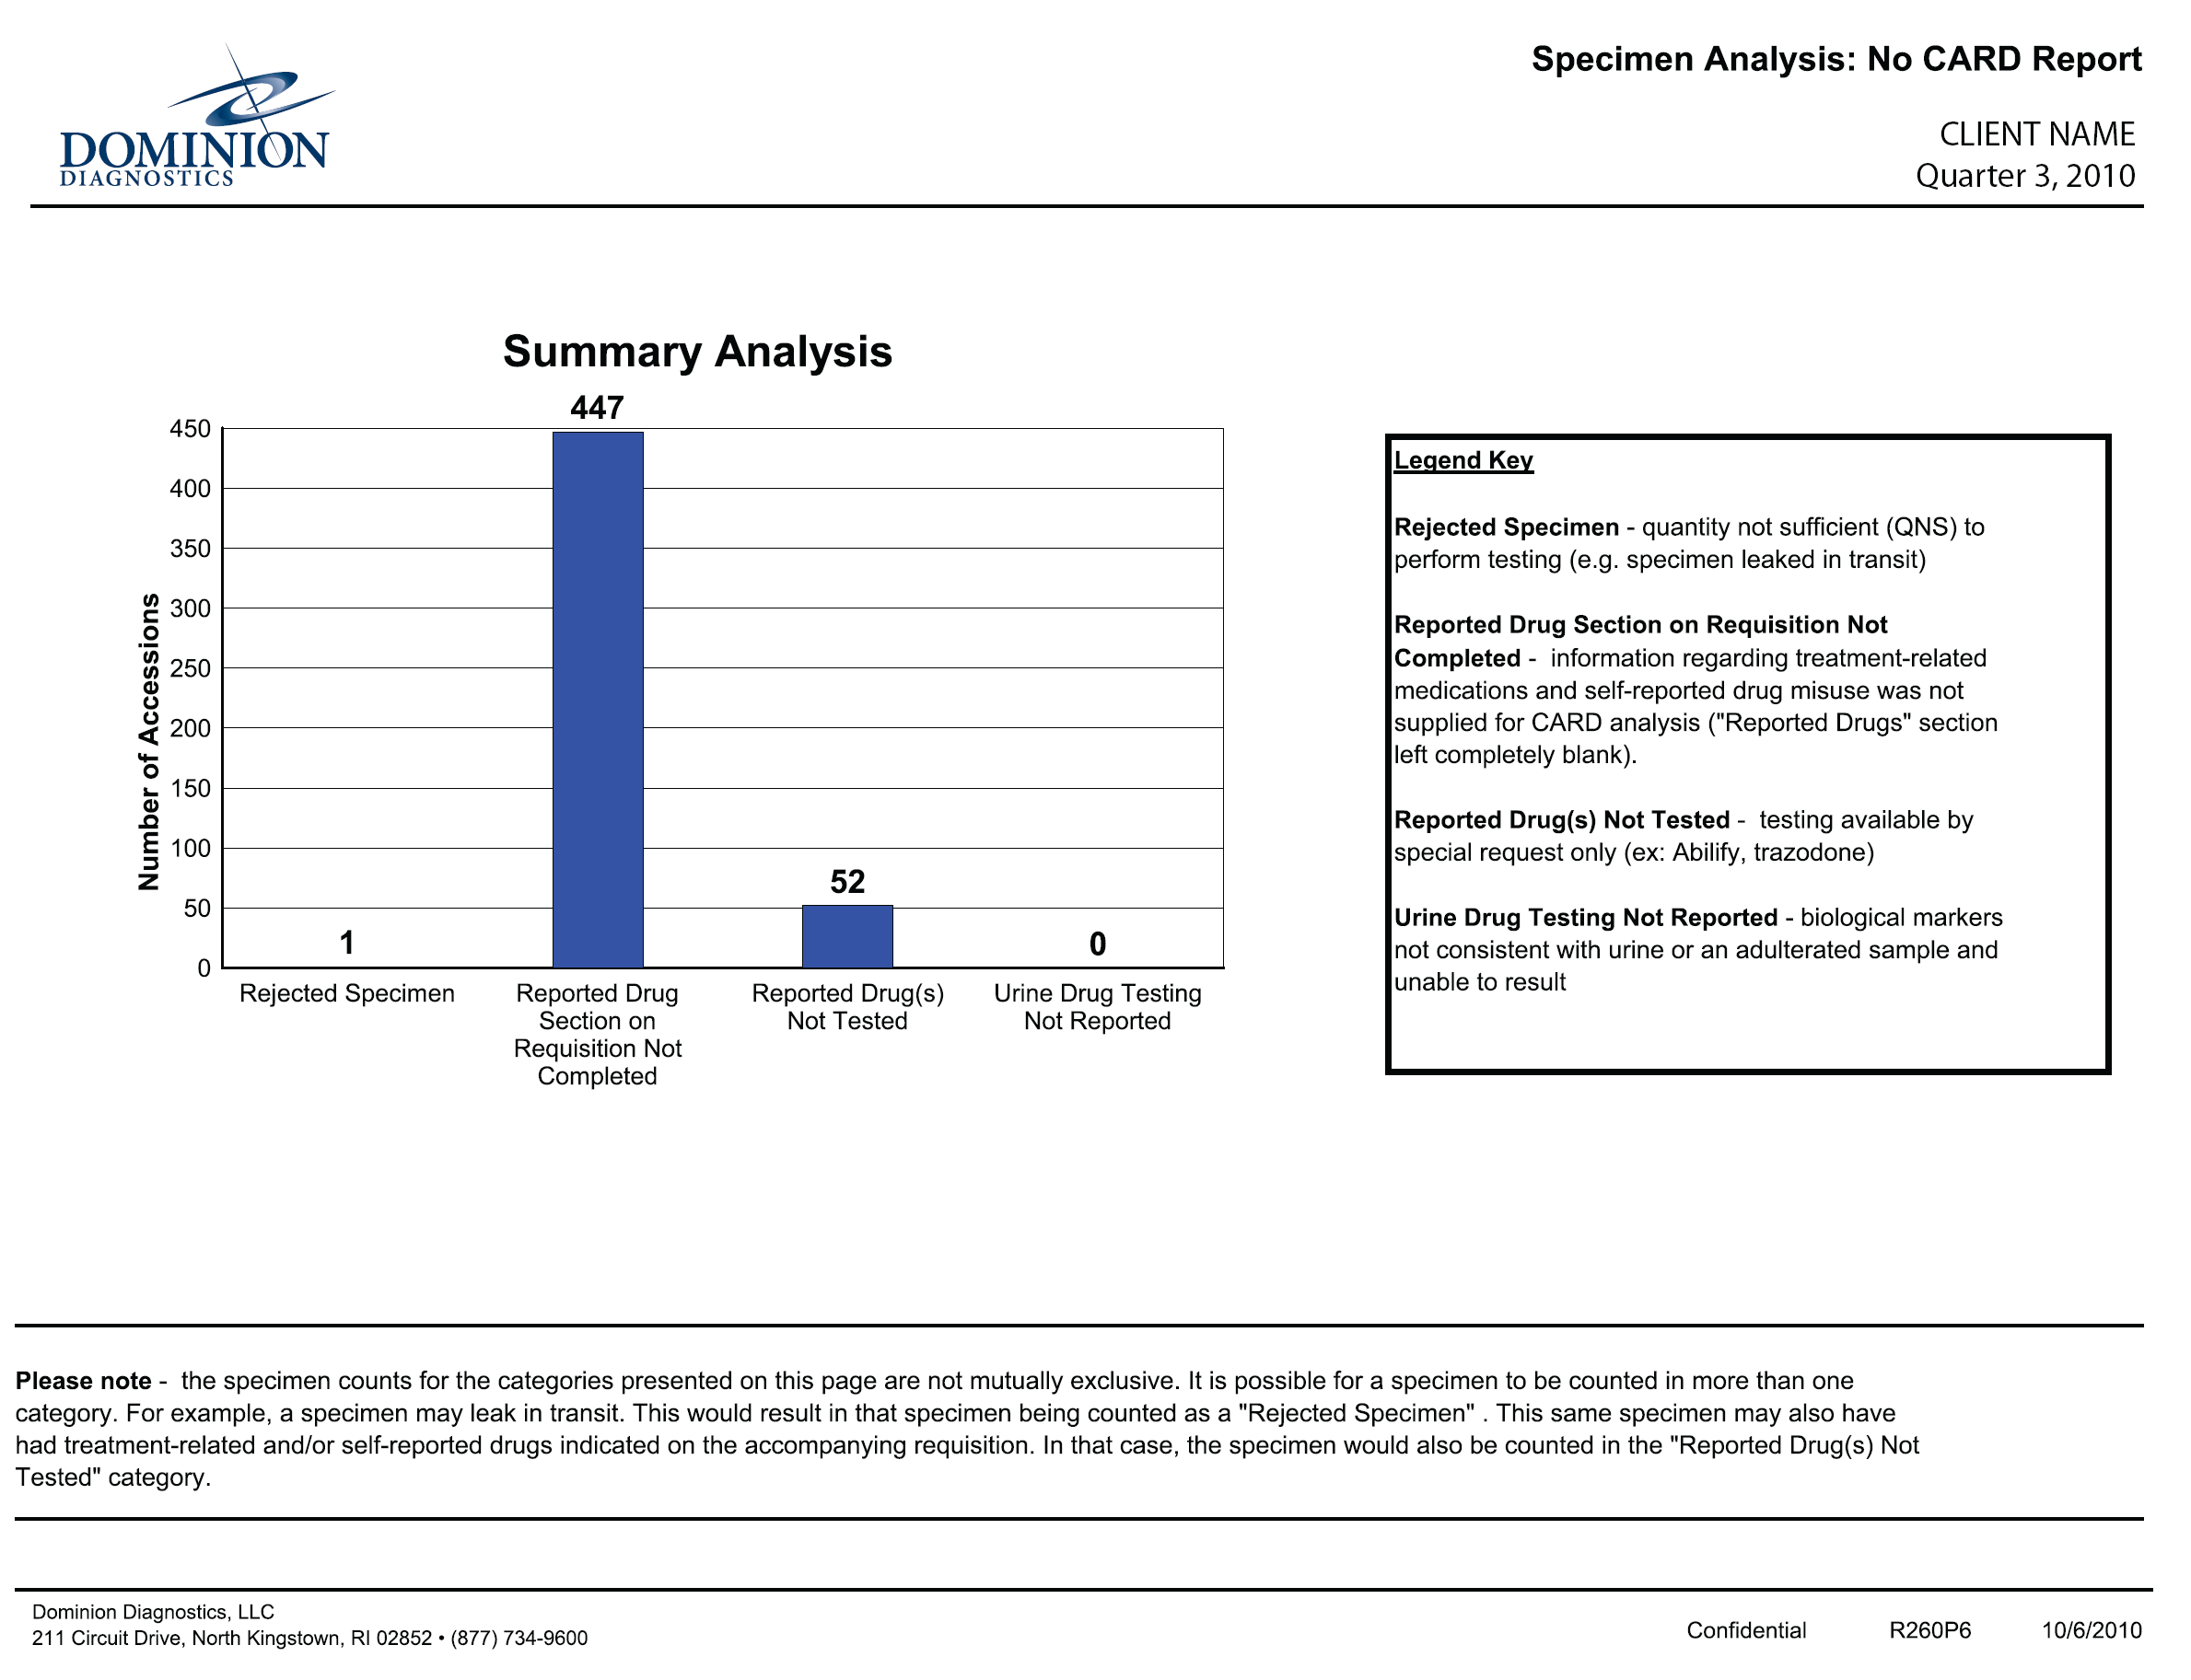

Slide 20
Data Sorted by Levels of Care
Clinics requested that Data be sorted by level of care
Dominion sorts the data by Medical Detox, Amb Detox, Opiate Tx, IP, PHP, IOP, OP, RES thus dividing the data by level of care

Slide 21
CARD™ Data Review
Dominion’s Addiction Services Advisory Board began review of the data summaries in 2011
In 2012, Dr. Ken Blum began a statistical analysis of the data
Measurement of patient compliance to treatment-related medications was of particular interest to the field

Slide 22

Meet the eminent gathering once again at
Addiction Therapy-2015
Florida, USA
August 3 - 5, 2015
Addiction Therapy – 2015 Website:
addictiontherapy.conferenceseries.com

