Slide 1
OXIDATIVE DNA DAMAGE IS ELEVATED IN RENAL PATIENTS UNDERGOING HAEMODIALYSIS
Mary Hannon-Fletcher
4th International Conference on Geriatrics and Gerontological Nursing
October 03-04, 2016 London, United Kingdom

Slide 2
Background
End stage renal disease (ESRD) is associated with an increase in oxidative stress, cardiovascular disease and cancer
The main treatment for ESRD, haemodialysis (HD)
HD itself induces repetitive bouts of oxidative stress through membrane biocompatibility and endotoxin challenge
Resulting in increased levels of reactive oxygen species
Leading to increased levels of oxidative DNA damage and thus genomic instability
May impact on the elevated levels of cancer reported in HD patients

Slide 3
Diet and HD Patients
Malnutrition is prevalent in 40-50%
Very restricted diets resulting in regulation of certain nutrients such as:
  sodium, potassium, phosphate, protein & fluids
Reduction or exclusion of certain foods increases the risk of inadequate intakes
Under-nutrition exacerbates oxidative stress
Together with the increased losses of essential minerals and water-soluble vitamins via HD
Many studies have reported HD patients deficient in several important vitamins

Slide 4
Participants
Ethical permission was obtained from ORECNI and Governance was obtained from theWestern Health and Social Services Trust (WHSCT)
Thirty eight patients receiving HD in the WHSCT, and 8 age and gender matched control volunteers were recruited
Volunteers gave informed consent and non-fasting morning blood samples were collected
Blood samples were protected form light and kept at 4OC until assayed the same day

Slide 5
Modified Comet Assay
DNA Damage was measured using the Modified Comet assay
This assay uses oxidative specific DNA damage measured using bacterial enzymes:
Endonuclease III (Endo III, recognise pyrimidine-pyrimidine breaks)
Formamidepyrimidine DNA glycosilase (FPG, recognise purine-purine breaks
Measurement used was % tail DNA damage

Slide 6
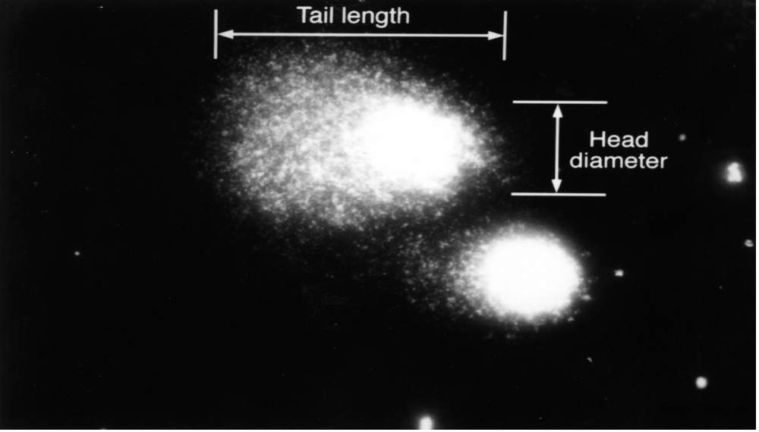
Assessment of DNA Damage
The Comet assay is a Single Cell Microelectrophoretic method for the quantitative measurement of DNA damage and alkali labile sites. Damaged cells have the appearance of a comet with a tail owing to extension of the DNA towards the anode
(McKelvey Martin et al., Mut Res 288 (1993) 47-63).

Slide 7
Results

Slide 8
Table 1: Baseline Characteristics of Participants
 | Age (years) | BMI (kg/m²)
HD | 64.10 ± 4.75 | 26.03 ± 7.15
Control | 60.38 ± 4.73 | 24.50 ± 3.05
HD: haemodialysis; BMI: body mass index.
Data is presented as mean ± standard deviation

Slide 9
Figure 1 – Total DNA damage in HD patients and control group
Values are presented as mean ± Standard deviation.
*** = p>0.001

Slide 10
Table 2: FPG and Endo III specific DNA damage
Values are presented as mean ± Standard deviation.
* = p=0.03**p=0.002.

Slide 11
To Summarize
The HD patients had significantly elevated levels of all types of DNA damage than the control group:
  Alkaline DNA damage (19.46 ± 8.35 vs 3.86 ± 0.99 % tail DNA, p<0.05)
  FPG (5.81 ± 6.63 vs 1.23 ± 0.39 % tail DNA, p<0.0)
  Endo III (6.04 ± 6.11 vs 1.98 ± 0.85% tail DNA, p<0.01)
We observed a positive correlation between the duration on dialysis (months) and levels of Endo III specific damage (p=0.041).

Slide 12
To Conclude
The main finding of this study was that individuals receiving HD have increased alkaline DNA damage and oxidative specific DNA damage
The duration of HD is positively correlated with Endo III specific DNA disruption
This damage may contribute to the increased cancer risk observed in this patient group

Slide 13
Acknowledgements
Supported by grants from
  WHCST
  Amgen / Irish Nephrological Society Research Award
Thanks to the research group:
Dr Peter Garrett
Ms Twyla Moffitt

