Slide 1
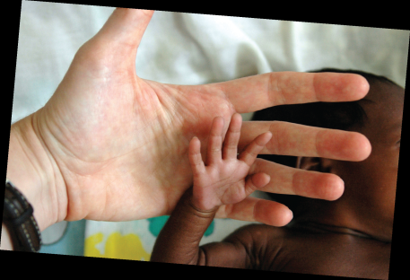
Topical Nystatin for the Prevention of Catheter-Associated Candidiasis in ELBW Infants
Mary Beth Bodin, DNP, CRNP, NNP-BC

Slide 2
Disclosures
I have no financial affiliations with any entities discussed in this presentation.
A full report of this study will be published in Advances in Neonatal Care in an upcoming issue (June, 2015).

Slide 3

Co-investigators
Guillermo Godoy, MD; Neonatologist for DCH Health System, Tuscaloosa, AL
J.B. Philips, III, MD; Neonatologist for University of Alabama at Birmingham, Birmingham, AL

Slide 4
Background
Catheter-associated Candida bloodstream infections are associated with high morbidity and mortality.
Several prophylactic regimens have been developed including oral administration of non-absorbable antifungals and intravenous infusions.
No published reports prior to this study were found that employed a topical regimen.
Stoll BJ, Hansen N, Fanaroff AA, et al. Late-onset sepsis in very low birth weight neonates: The experience of the NICHD neonatal research network. Pediatrics 2002; 110:285-291.
Benjamin DK, Poole C, Steinbach WJ, Rowen JL, Walsh TJ. Neonatal candidemia and end-organ damage: A critical appraisal of the literature using meta-analytic techniques. Pediatrics 2003; 112:634-640.

Slide 5
Purpose
The purpose of this study was to evaluate the effectiveness of topical Nystatin cream in preventing catheter-associated Candida sepsis.

Slide 6
Research Design
A retrospective descriptive design
Incidence of Candida sepsis in Extremely Low Birth Weight Infants (ELBW, <1000 grams at birth)
Topical Nystatin cream for Candida bloodstream infection prophylaxis
January 1, 2000 and December 31, 2010

Slide 7
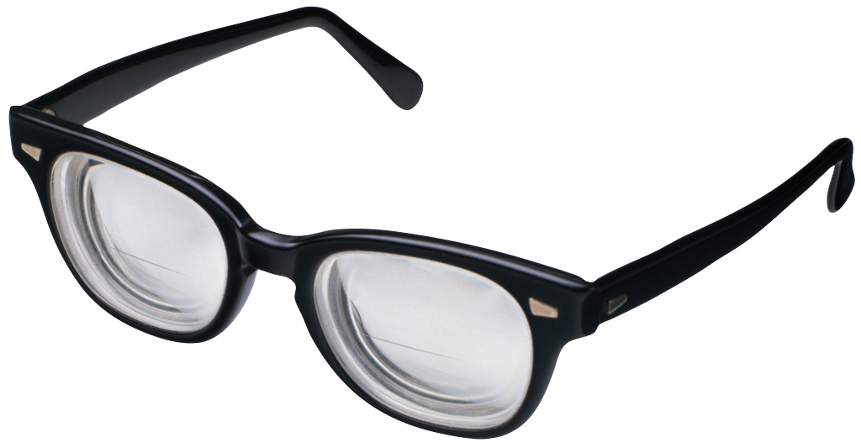
Methods
The electronic medical records of all infants less than 1,000 grams admitted to the study NICU were reviewed to establish the incidence of Candida sepsis.

Slide 8
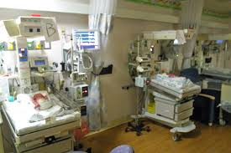
Results
464 ELBW infants were admitted to the NICU during the study period. Three infants (0.65%) developed Candida sepsis.

Slide 9
Demographics and Variables for infants developing Candida sepsis
Infant (n=3) | Estimated Gestational age & weight | Gender | Age at Diagnosis | Organism | Length of Stay | Outcome
1 | 25 weeks 808 grams | Female | 28 6/7 weeks | Candida parapsilos | 6 months and 6 days | Discharged to home
2 | 22 4/7 weeks 525 grams | Male | 27 1/7 weeks | Candida lusitaniae | 8 months and 14 days | Transfer for G-tube
3 | 22 3/7 weeks 480 grams | Female | 23 3/7 weeks | Candida albicans | 3 weeks and 4 days | Expired

Slide 10
Risk Factors
Risk factors for all three infants included:
extreme prematurity
resuscitation including endotracheal intubation
invasive central lines
prophylactic antibiotics on admission.
*Infant 3 had the additional risk factor of prenatal maternal Candida infection (vaginal)
Saiman L, Ludington E, Pfaller M, et al. Risk factors for candidemia in neonatal intensive care unit patients. Pediatr Infect Dis J 2000; 19:319-324.

Slide 11
Strengths & Limitations
Using historical clinical data to examine the possible effects of using a Nystatin cream protocol to reduce Candida colonization was a strength.
The major limitation was the lack of information related to the incidence of Candida bloodstream infection in the study NICU prior to implementation of the Nystatin protocol.

Slide 12
Conclusions
These data demonstrate that a topical Nystatin cream protocol is associated with a very low rate of Candida sepsis in ELBW infants with central catheters. Use of this protocol may contribute to a decrease in the morbidity and mortality associated with catheter-associated Candida infections in ELBW infants.

Slide 13

Future Research
Before generalizations can be made as to the safety and efficacy as compared to enteral and parenteral prophylactic treatments and in other institutions, large multi-centered randomized controlled trials are required.
The authors of the study suggest further investigation of the safety of this protocol in the ELBW population.

Slide 14
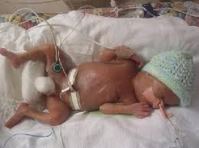
Topical Nystatin Protocol
For all infants with a central venous or arterial access catheter, apply a thin layer of Nystatin Cream (100,000 USP units per gram) to the axilla, groin, neck, and behind the ears once a day until the access device is removed.

Slide 15
References
Stoll BJ, Hansen N, Fanaroff AA, et al. Late-onset sepsis in very low birth weight neonates: The experience of the NICHD neonatal research network. Pediatrics 2002; 110:285-291.
Kaufman D, Boyle R, Hazen KC, Patrie JT, Robinson M, Donowitz LG. Fluconazole prophylaxis against fungal colonization and infection in preterm infants. N Engl J Med 2001; 345:1660-6.
Benjamin DK, Poole C, Steinbach WJ, Rowen JL, Walsh TJ. Neonatal candidemia and end-organ damage: A critical appraisal of the literature using meta-analytic techniques. Pediatrics 2003; 112:634-640.
Saiman L, Ludington E, Pfaller M, et al. Risk factors for candidemia in neonatal intensive care unit patients. Pediatr Infect Dis J 2000; 19:319-324.
Austin N, Darlow BA, McGuire W. Prophylactic oral/topical non-Absorbed antifungal agents to prevent invasive fungal infection in very low birth weight infants. Cochrane Database of Systematic Reviews 2013: CD003478.

Slide 16
References
Austin N, McGuire, W. Prophylactic systemic antfungal agents to prevent mortality and morbidity in very low birth weight infants. Cochrane Database of Systematic Reviews 2013: CD003850.
Benjamin DK, Hudak ML, Duara S, et al. Effect of fluconazole prophylaxis on candidiasis and mortality in premature infants. A randomized clinical trial. JAMA. 2014; 311:1742-1749.
Mersal A, Alzahrani I, Azzouri M, et al. Oral Nystatin Versus Intravenous Fluconazole as Neonatal Antifungal Prophylaxis: Non-inferiority Trial. Journal of Clinical Neonatology, 2013; 2: 88-92.
Burwell LA, Kaufman D, Blakely J, Stoll BJ, Fridkin, SK. Antifungal prophylaxis to prevent neonatal candidiasis: A survey of perinatal physician practices. Pediatrics, 2006; 118: e1019-e1026.
Chicella MF, Woodruff ED, Desai MM. A review of Candida prophylaxis in the neonatal intensive care population. J Pediatr Pharmacol Ther, 2012; 16:237-245.

Slide 17
References
Kaufman, DA. Fungal Infections in Preterm Infants. Medscape: diseases & Procedures. Obtained from http://emedicine.medscape.com/article/980487-overview
Qualitest Pharmaceuticals (2009), Nystatin Cream, drug monograph. Obtained from: http://www.drugs.com/pro/nystatin-cream.html.
Lund C, Kuller J, Lane A, Lott, J W, Raines DA. Neonatal skin care: The scientific basis for practice. Neonatal Network, 1999; 18:15-26.
Visscher MO. Update on the use of topical agents in neonates. Newborn & Infant Nursing Reviews, 2009; 9:31-47.
Sarvikivi E, Lyytikaimen O, Soll, DR, et al. Emergence of fluconazole resistance in a Candida parapsilosis strain that caused infections in a neonatal intensive care unit. J Clin Microbiol, 2005; 43:2729-2735.
Nystatin/ Pricing. Epocrates: an athenahealth company. Epocrates for iPad 2014.

Slide 18
Contact Information
Mary Beth Bodin, DNP, CRNP, NNP-BC
sbodin2006@comcast.net
205-657-2985 (cell)
Dr. Guillermo Godoy, MD, Neonatologist
guillermo461@comcast.net

Slide 19

Questions??

