Slide 1
The role of climate model data and long-term data archives in climate change research
World Conference on Climate Change
October 24-26, 2016 Valencia, Spain

Slide 2
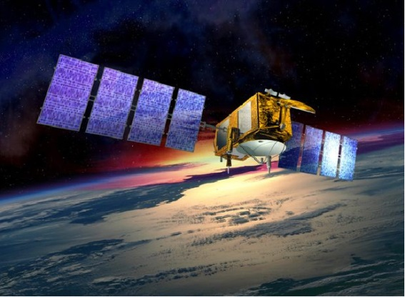
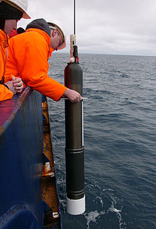
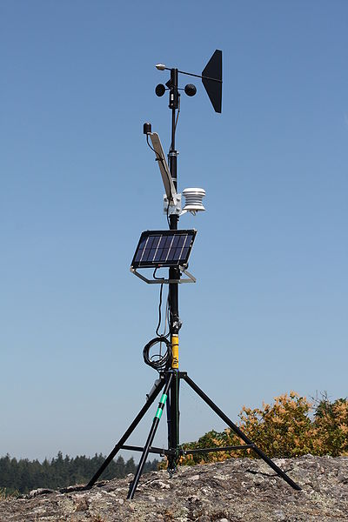
Observations and Models (1)
Characteristics of Observations
Diverse: different instruments measuring different parameters
Discrete: certain spatial-temporal coverage
Continuously extended
No future information
Observation Data Management
  Big Data: many different parameters and data formats
Products for different research purposes, esp. satellite data
→ new versions: reprocessing with improved algorithms
Description on measurement conditions and provenance required

Slide 3

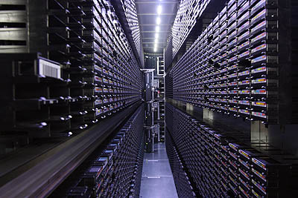
Observations and Models (2)
Characteristics of Climate Model
Relatively homogeneous, with standardized formats and naming conventions, e.g. CF
Static (Once created and many times analyzed)
4D data for many parameters as mean values for grid cells over a time interval
Future projections and scientific questions
Model Data Management
  High Volume Data: PBytes of homogeneous data created
  New data versions are rare
  → for post-processed datasets
  Data access of data subsets
  Detailed description of data subsets required
→ Reanalysis Models for observation data assimilation

Slide 4
IPCC Data Distribution Centre (DDC)

Slide 5






IPCC DDC and TGICA
IPCC DDC (Data Distribution Centre) – ipcc-data.org
jointly managed by:
British Atmospheric Data Centre (BADC):
Climatologies
World Data Center Climate (WDCC) at DKRZ:
Reference Data Archive for climate model output
Center for International Earth Science Information Network (CIESIN) at Columbia University:
social-economic data archive
→ Certified ICSU World Data System (WDS) members
IPCC TGICA
(Task Group on Data and Scenario Support for Impact and Climate Analysis)
Oversees IPCC DDCs
Enables research and sharing of information across the IPCC Working Groups
→ Mandate and structure of TGICA are currently under review by the IPCC
Notes:
FAR: NCAR comparable role to ETH Zurich in AR5

Slide 6
History of IPCC DDC
1995: IPCC SAR climate model data long-term archived
1998: IPCC DDC formally established
2008: parts of FAR data added to DDC
2013/14: IPCC DDC AR5 data long-term archival
2016: IPCC Task Force built for transformation of the organization of IPCC data and information to serve the needs of the IPCC during and beyond AR6.
2020/21: IPCC DDC AR6 long-term archival
Notes:
FAR: NCAR comparable role to ETH Zurich in AR5

Slide 7
IPCC DDC Reference Data Archive
The IPCC DDC provides data on the long-term for an interdisciplinary user community
in support of the IPCC Authors.
Long-term:
archival with second data copy in an established data center
Interdisciplinary Use:
add information to the data for a creator-independent usage
IPCC Author Support:
provide a reliable, up-to-date and easily-accessible CMIP6 data pool

Slide 8


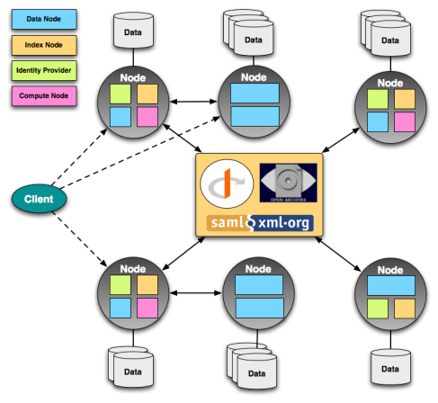
IPCC DDC Services for AR6
Data Creator
IPCC Author
IPCC DDC User
IPCC DDC AR6 Services
Earth System Grid Federation (ESGF)
CMIP Data Pool at DKRZ
IPCC DDC Reference Data Archive at DKRZ
CMIP6
(subset)
AR6
Replication
Long-Term Archival
CMIP5
AR5
CORDEX
AR4
Derived Products
AR3
Analysis Input
AR2

Slide 9
Data Management

Slide 10

CMIP Data Pool
Replicate to build CMIP Data Pool
Challenges:
Implementation:
Timely automated update of evolving data
Provide easy and script-based access to data
User support
Coordination nationally and internationally
Synda tool used based on ESGF Search API
User accounts on Linux machine provided
Request tracker
Task group built

Slide 11

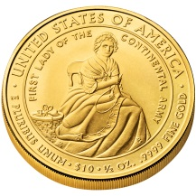

Principles of Long-Term Archival (1)
Gather what you can…
…as long as it is available.
Metadata challenges:
Implementation:
Ancillary metadata is
diverse in respect to:
Granularity,
Format,
Access,
Stability.
Registration of ancillary metadata URL in relation to the data by metadata
providers.
refer-
ences
citation
ESMVal
errata

Slide 12



Principals of Long-Term Archival (2)
Automate what you can…
…for a timely archival.
Automated access, interpretation and mapping of
metadata sorts the different pieces of metadata in the
hierarchical structure of the LTA metadata schema.
citation
refer-
ences
Mapping
errata
ESMVal

Slide 13




Principals of Long-Term Archival (3)
Check everything at least twice…
…before archival.
The automated process is interrupted at several stages in order to ensure metadata consistency.
After archival such a quality assurance is unfeasible.
refer-
ences
citation
ESMVal
errata

Slide 14
Data Usage

Slide 15
IPCC DDC Users
Climate researchers like IPCC WG I Authors:
familiar with data formats and tools to analyze the data
skills to interpret and use data without additional services
Climate impact researchers like IPCC WG III Authors:
need information on data formats and analysis tools
need more information on how to use the data
additional at technical services requested like derived climate parameters, data regridding
Policy advisors:
need assistance on data formats, tools and data interpretation
Personnel as well as technical services required, ideally a climate service center with trained personnel

Slide 16
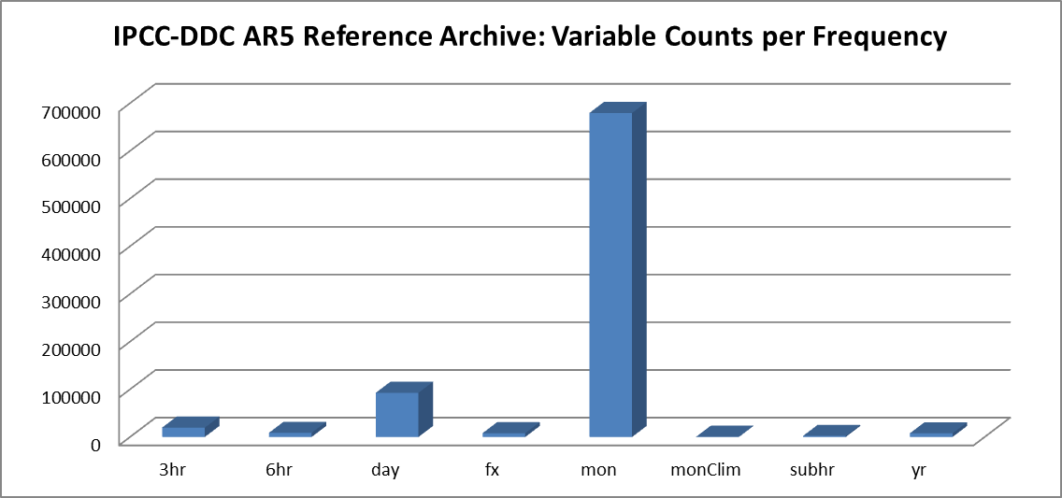
IPCC DDC: AR5 Reference Archive
The DDC Reference Archive / The IPCC WG1 Archive
Experiments: | 101 / 78 | different experiments / scenarios
Variables: | 605 / 123 | different variables (628 requested variables)
Size: | 1.6 PByte / 100 TByte | (all AR data: 1.7 PByte)
Models: | 60 / 58 | participating models
Institutes: | 27 / 24 | participating institutes
Simulations: | 1145 / 952 | provided simulations
Variables: | 818795 / 93247 | provided variables

Slide 17
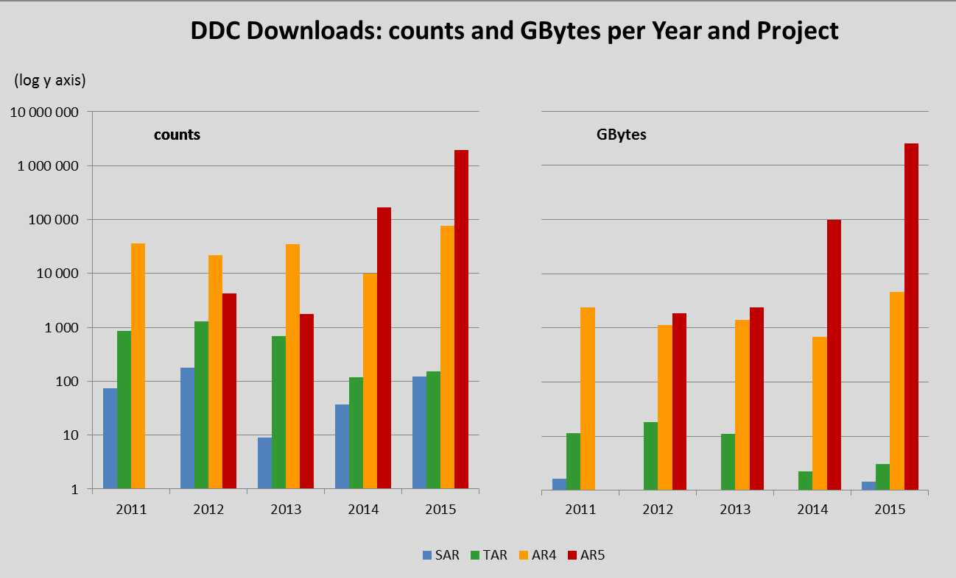
IPCC-DDC: Usage (1)
Reference Archive for Climate Model Output Data
1 PByte
1 TByte

Slide 18
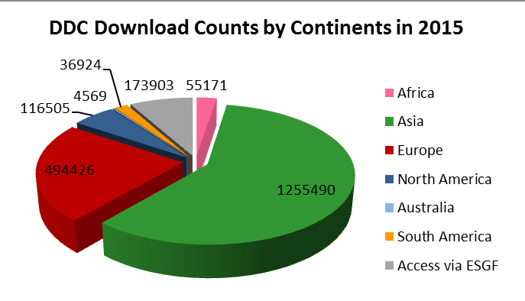
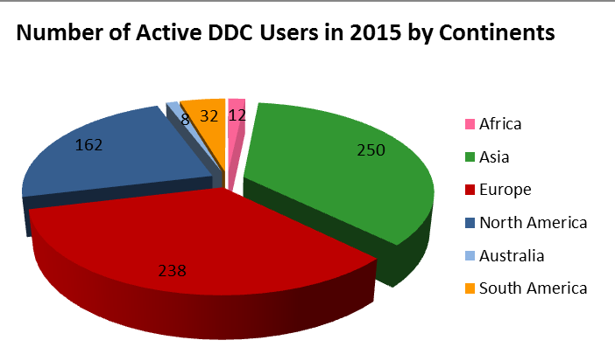
IPCC-DDC Usage (3)
Reference Archive for Climate Model Output Data
702 Active DDC Users in 2015:
42% located in developing and economy-in-transition countries (Africa, Asia, South America)
15 users requested regional data on storage media
Download Counts per Continent in 2015:
69 % of downloads from users in developing and economy-in-transition countries (59 % Asia)
average download count per user = 2 800
Asian and African users were the most active with average download numbers
per user of 5 000 and 4 600.

Slide 19
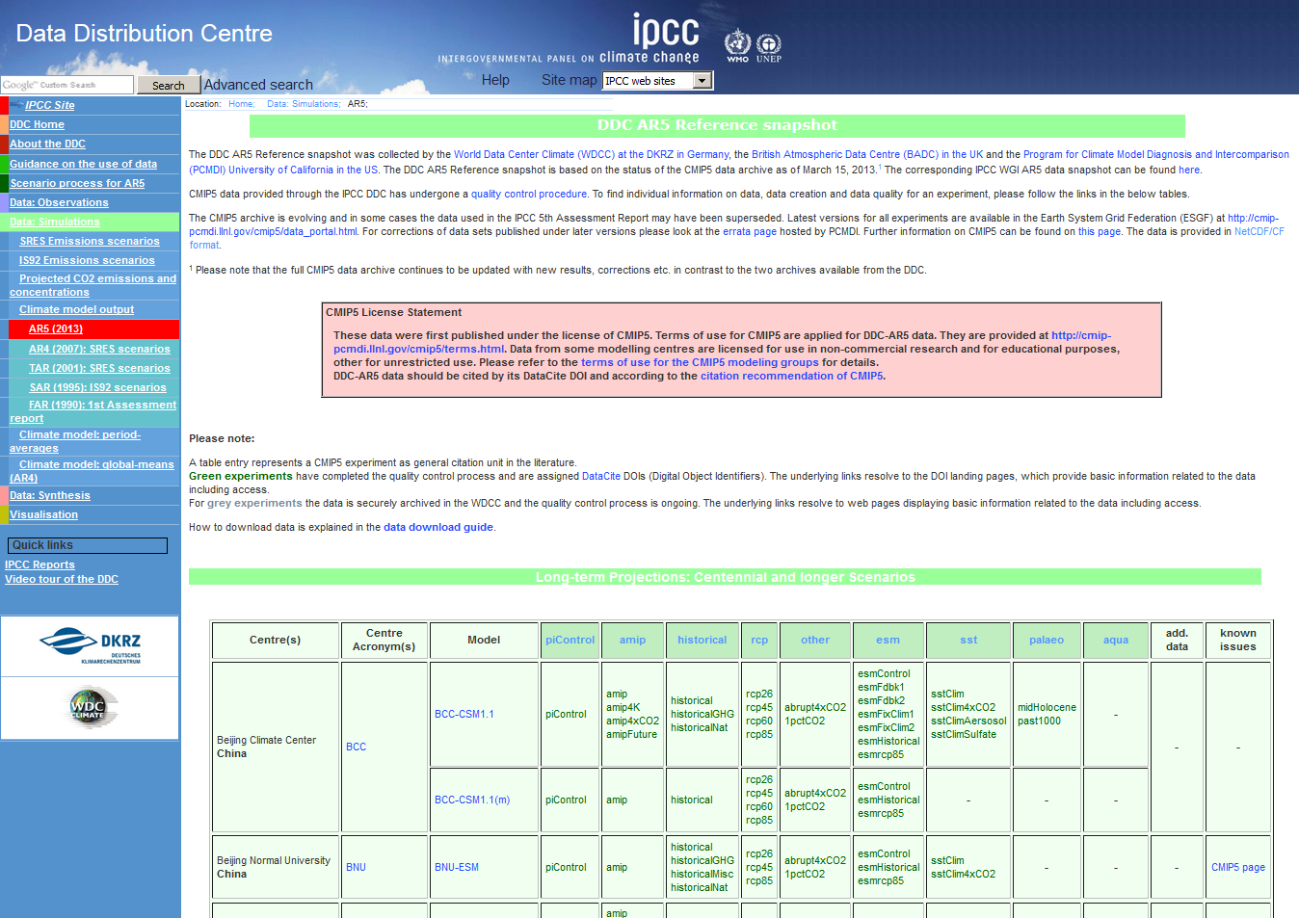
IPCC DDC: http://ipcc-data.org
DDC at DKRZ: http://ipcc.wdc-climate.de
M. Stockhause, F. Toussaint, M. Lautenschlager (2015): CMIP6 Data Citation and LTA. WIP white paper. Zenodo. doi:10.5281/zenodo.35178.

Slide 20
Observations and Models in Climate (3)
Use of Observations for Models
Model verification
Regional climate model forcing
→ Models applied for data assimilation, e.g. using 4D-Var technique
Reanalysis Data provide gridded data, e.g. from ECMWF or NCEP/NCAR
Obs4MIPs: make observational products more accessible for climate model intercomparison
Use of Models for Observations
  Find knowledge gaps to trigger observations, e.g. in the deep sea
  Plan measurements and campaigns, e.g.
  explore expected value ranges for measurement parameters
Use model for measurement set up and planning
Many others…

Slide 21
IPCC AR6: Timeframe
Updated timeframe for IPCC AR6 from 16th September 2016 (http://ipcc.ch/activities/pdf/ar6_schedule.pdf):
05/2017: AR6 Scoping Meeting
09/2017: IPCC approval of AR6 outline
02/2018: Decision on selection of authors
05/2019: WG I AR6 first-order draft expert review
03/2020: WG I AR6 second-order draft expert review
04/2021: WG I AR6 IPCC acceptance/adoption/approval at IPCC-53

Slide 22
Experiences from AR5
CMIP5 data infrastructure was under development during data distribution:
    Missing version management
    → intransparent data changes
    Complicated authentication/authorization solution
    → data access barrier
    Script-based access under development and not matching user requirements
ETH Zurich set up and managed a data repository to support the work of the IPCC WG1 authors
IPCC DDC long-term archived two data collections for AR5
No communication between IPCC WGs and IPCC DDC/TGICA

